Slide 1


Electronic Synthetic Aperture Radar Imager
Team E#11/M#27 - Milestone #3
System Level Design

Slide 2
Agenda
Team & Project Overview
Electrical System
FPGA Programming
Antenna Design
Antenna Structural Design
Power Supply and Signal Processing
Detailed Schedule
Detailed Budget
Detailed Risk Assessment

Slide 3
Project Overview
Project Manager – Jasmine Vanderhorst
Industrial Engineering

Slide 4
Team Overview
Industrial Engineers
  Jasmine Vanderhorst
  Benjamin Mock
Responsibilities
  Project Management
  Scheduling
  Budget & Purchasing
  Risk Assessment
Electrical Engineers
  Matthew Cammuse
  Joshua Cushion
  Patrick Delallana
  Julia Kim
Responsibilities
  Radio Frequency
  Signal Processing
  Programming
  Antenna Design
Mechanical Engineers
  Malcolm Harmon
  Mark Poindexter
Responsibilities
  Component Box Design
  Component Layout Design
  Antenna Structure

Slide 5
Project Goal
Objective: To create a radar system with 20 stationary antennas using commercial-off-the-shelf (COTS) components. 4 antennas will transmit high frequency signals and 16 antennas will receive the signals reflected from the target.
Desired Outcome: Detect a metal object from at least 20 feet away and have pixels illuminate on a screen indicating a metal object is present at a certain area in the scene extent.

Slide 6
Electrical System
Radio Frequency Components Engineer: Joshua Cushion
Electrical Engineering

Slide 7
Radio Frequency Analysis
Electrical System
  Transmit Signal Chain
  Receive Signal Chain
  IQ Demodulator
  Level Shift Circuit
  Radar Range Equation

Slide 8
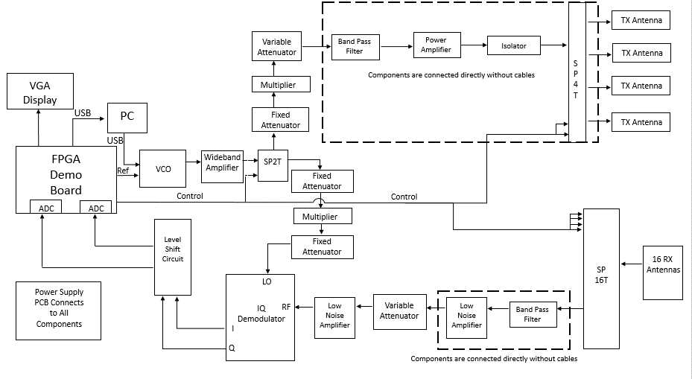
Electrical System

Slide 9
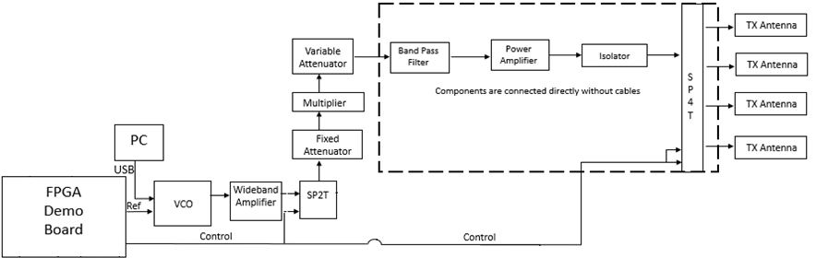
Transmit Signal Chain

Slide 10
Transmit Signal Chain
Role:
Generate radio frequency sinusoidal waveform
  Target operating frequency: 10 GHz (X Band)
  Maximum Power: 10W/m² (FCC Regulations)
Key Components:
Voltage Controlled Oscillator
Power Amplifier
Frequency Multiplier
Signal Attenuators
SPDT Switch
SP4T Switch
Transmit Antennas

Slide 11
Transmit Signal Chain - Data
Transmit Path Chain
Component | Input Power (dBm) | Input Power (mW) | Gain (dB) | Output Power (dBm) | Output Power (mW) | P1db Compression (dBm)
VCO | 0 | 1.00 | 0 | -4 | 0.40 | -
Cable | -4 | 0.40 | -0.2 | -4.2 | 0.38 | -
Wideband Amplifier | -4.2 | 0.38 | 26 | 21.8 | 151.36 | 24
Cable | 21.8 | 151.36 | -0.2 | 21.6 | 144.54 | -
SPDT Switch | 21.6 | 144.54 | -2 | 19.6 | 91.20 | 27
Cable | 19.6 | 91.20 | -0.2 | 19.4 | 87.10 | -
Fixed Attenuator | 19.4 | 87.10 | -10 | 9.4 | 8.71 | -
Cable | 9.4 | 8.71 | -0.2 | 9.2 | 8.32 | -
X2 Frequency Multiplier | 9.2 | 8.32 | 0 | 14 | 25.12 | -
Cable | 14 | 25.12 | -0.2 | 13.8 | 23.99 | -
Variable Attenuator | 13.8 | 23.99 | -15.5 | -1.7 | 0.68 | 37
Cable | -1.7 | 0.68 | -0.2 | -1.9 | 0.65 | -
Band Pass Filter | -1.9 | 0.65 | -3 | -4.9 | 0.32 | -
Cable | -4.9 | 0.32 | -0.2 | -5.1 | 0.31 | -
Power Amplifier | -5.1 | 0.31 | 32 | 26.9 | 489.78 | 30
Isolator | 26.9 | 489.78 | -0.2 | 26.7 | 467.74 | -
SP4T Switch | 26.7 | 467.74 | -2 | 24.7 | 295.12 | 37
Cable | 24.7 | 295.12 | -0.2 | 24.5 | 281.84 | -

Slide 12
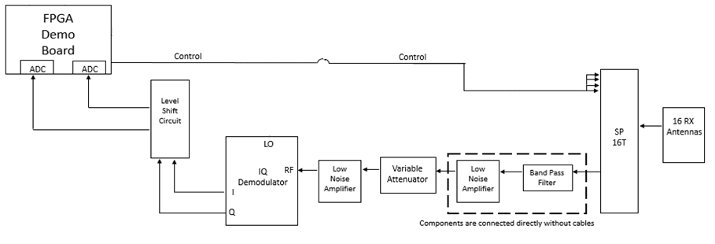
Receive Signal Chain

Slide 13
Receive Signal Chain
Role:
Receive the reflected radio frequency signal scatterings from target
Convert the phase and amplitude of the received RF signals into digital voltages
Key Components:
Receive Antennas
SP16T Switch
Signal Attenuator
Low Noise Amplifier
IQ Demodulator
Level Shift Circuit
Analog to Digital Converters

Slide 14
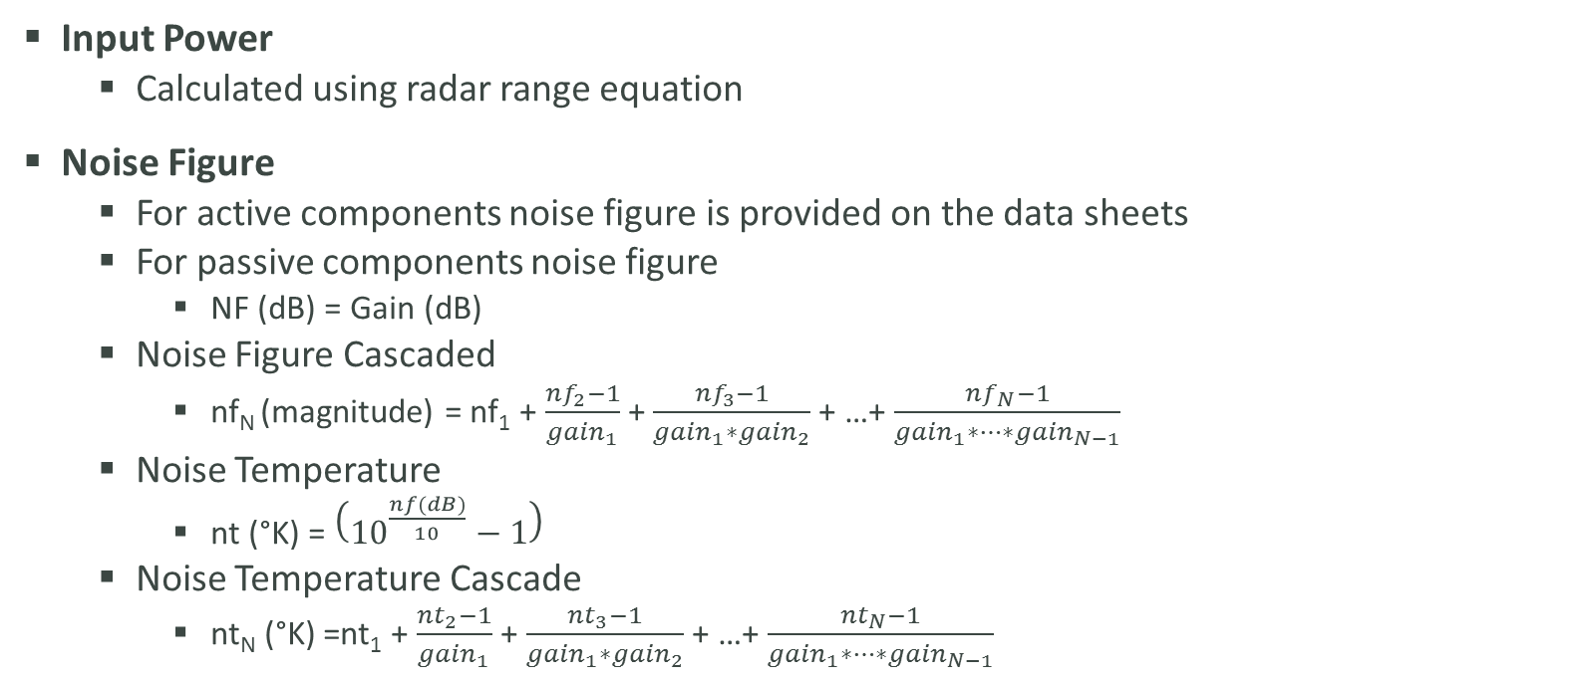
Receive Signal Chain –
Calculation Equations
Input Power
  Calculated using radar range equation
Noise Figure
  For active components noise figure is provided on the data sheets
  For passive components noise figure
    NF (dB) = Gain (dB)
  Noise Figure Cascaded
    nf_{N} (magnitude) = nf₁ + $\frac{{nf}_{2}−1}{{gain}_{1}}$ + $\frac{{nf}_{3}−1}{{gain}_{1}∗{gain}_{2}}$ + …+ $\frac{{nf}_{N}−1}{{gain}_{1}∗…∗{gain}_{N−1}}$
  Noise Temperature
    nt (°K) = $\left({10}^{\frac{nf(dB)}{10}}−1\right)$
  Noise Temperature Cascade
    nt_{N} (°K) =nt₁ + $\frac{{nt}_{2}−1}{{gain}_{1}}$ + $\frac{{nt}_{3}−1}{{gain}_{1}∗{gain}_{2}}$ + …+ $\frac{{nt}_{N}−1}{{gain}_{1}∗…∗{gain}_{N−1}}$

Slide 15
Receive Signal Chain - Data
 | Cable | SP16T | Cable | Band Pass Filter | Cable
Pin (dBM) | -46.29482719 | -46.4948 | -51.1948 | -51.3948 | -54.3948
Pin (mW) | 2.34702E-05 | 2.24E-05 | 7.59E-06 | 7.25E-06 | 3.64E-06
Gain (dB) | -0.2 | -4.7 | -0.2 | -3 | -0.2
Gain | 0.954992586 | 0.338844 | 0.954993 | 0.501187 | 0.954993
Pout (dBM) | -46.49482719 | -51.1948 | -51.3948 | -54.3948 | -54.5948
Pout (mW) | 2.24139E-05 | 7.59E-06 | 7.25E-06 | 3.64E-06 | 3.47E-06
NF (dB) | 0.2 | 4.7 | 0.2 | 3 | 0.2
NF | 1.047128548 | 2.951209 | 1.047129 | 1.995262 | 1.047129
NF (cascaded) | 1.047128548 | 3.090295 | 3.235937 | 6.456542 | 6.76083
Noise Temp (K) | 13.66727893 | 565.8507 | 13.66728 | 288.6261 | 13.66728
Noise Temp cascade (K) | 79.07179131 | 300.7824 | 320.9303 | 992.4848 | 1085.565
 | Low Noise Amplifier | Cable | Variable Attenuator | Low Noise Amplifier | Cable | RF-IQ Demodulator
Pin (dBM) | -54.5948 | -16.5948 | -16.7948 | -25.7948 | 12.20517 | 12.00517
Pin (mW) | 3.47E-06 | 0.021904 | 0.020918 | 0.002633 | 16.61565 | 15.86782
Gain (dB) | 38 | -0.2 | -9 | 38 | -0.2 | -7
Gain | 6309.573 | 0.954993 | 0.125893 | 6309.573 | 0.954993 | 0.199526
Pout (dBM) | -16.5948 | -16.7948 | -25.7948 | 12.20517 | 12.00517 | 5.005173
Pout (mW) | 0.021904 | 0.020918 | 0.002633 | 16.61565 | 15.86782 | 3.166046
NF (dB) | 2.2 | 0.2 | 9 | 2.2 | 0.2 | 7
NF | 1.659587 | 1.047129 | 7.943282 | 1.659587 | 1.047129 | 5.011872
NF (cascaded) | 11.22018 | 11.22024 | 11.22803 | 11.22984 | 11.22845 | 11.2642
Noise Temp (K) | 191.2802 | 13.66728 | 2013.552 | 191.2802 | 13.66728 | 1163.443
Noise Temp cascade (K) | 3550.754 | 3550.798 | 3557.694 | 3559.304 | 3558.066 | 3589.879

Slide 16
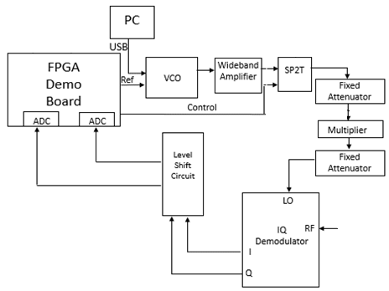
IQ Demodulator

Slide 17
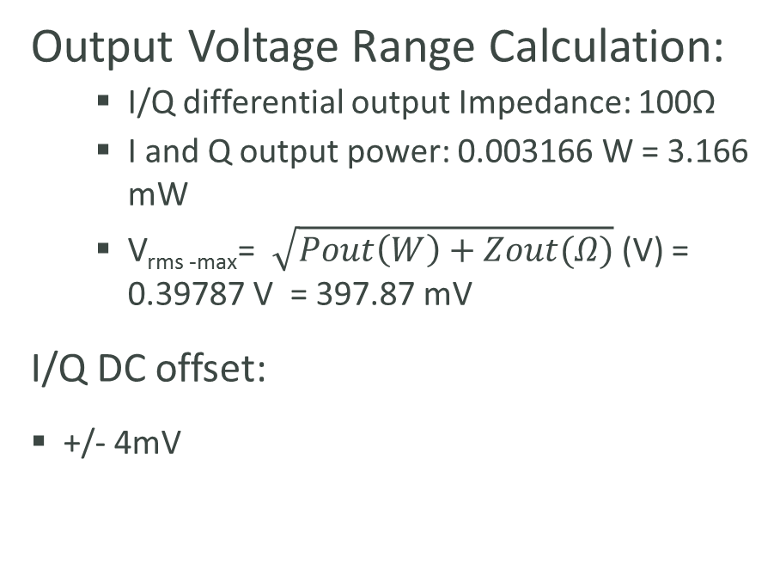
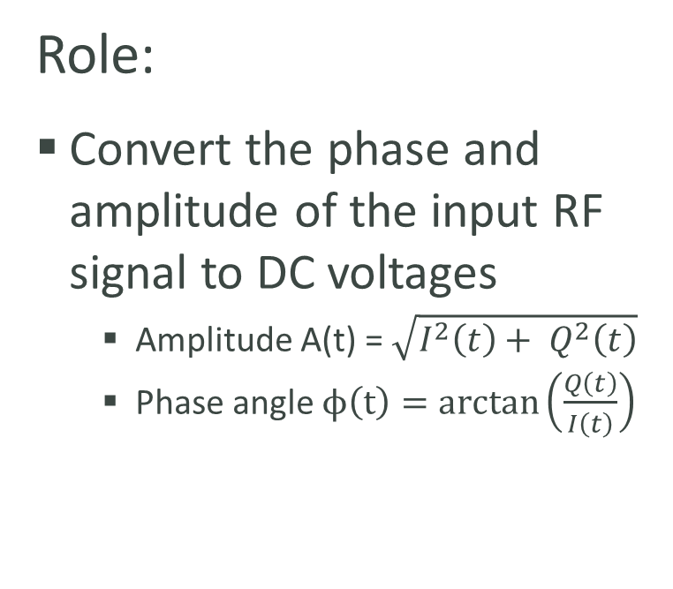
IQ Demodulator
Role:
Convert the phase and amplitude of the input RF signal to DC voltages
  Amplitude A(t) = $\sqrt{I^{2}\left(t\right)+ Q^{2}\left(t\right)}$
  Phase angle $ϕ\left(t\right)=arctan\left(\frac{Q\left(t\right)}{I\left(t\right)}\right)$
Output Voltage Range Calculation:
  I/Q differential output Impedance: 100Ω
  I and Q output power: 0.003166 W = 3.166 mW
  V_{rms -max}= $\sqrt{Pout\left(W\right)+Zout(Ω)}$(V) = 0.39787 V = 397.87 mV
I/Q DC offset:
+/- 4mV

Slide 18
IQ Demodulator
Components | Input Power (dBm) | Input Power (mW) | Gain (dB) | Output Power (dBm) | Output Power (mW) | P1db Compression (dBm)
VCO | 0 | 1.00 | 0 | -4 | 0.40 | -
Cable | -4 | 0.40 | -0.2 | -4.2 | 0.38 | -
Wideband Amplifier | -4.2 | 0.38 | 26 | 21.8 | 151.36 | 24
Cable | 21.8 | 151.36 | -0.2 | 21.6 | 144.54 | -
SPDT | 21.6 | 144.54 | -2 | 19.6 | 91.20 | 27
Cable | 19.6 | 91.20 | -0.2 | 19.4 | 87.10 | -
Fixed Attenuator | 19.4 | 87.10 | -10 | 9.4 | 8.71 | -
Cable | 9.4 | 8.71 | -0.2 | 9.2 | 8.32 | -
X2 Frequency Multiplier | 6 | 3.98 | 0 | 14 | 25.12 | -
Cable | 14 | 25.12 | -0.2 | 13.8 | 23.99 | -
Fixed Attenuator | 13.8 | 23.99 | -7 | 6.8 | 4.79 | 37
Cable | 6.8 | 4.79 | -0.2 | 6.6 | 4.57 | -
LO IQ Demodulator | 6.6 | 4.57 | - | - | - | -

Slide 19
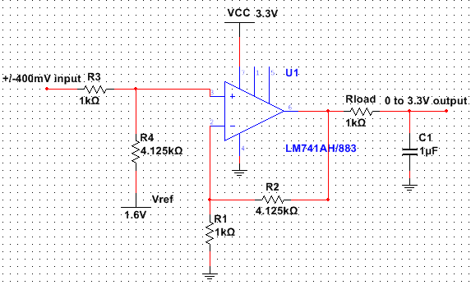
Level Shift Circuit
Captured using NI Muiltisim v12

Slide 20
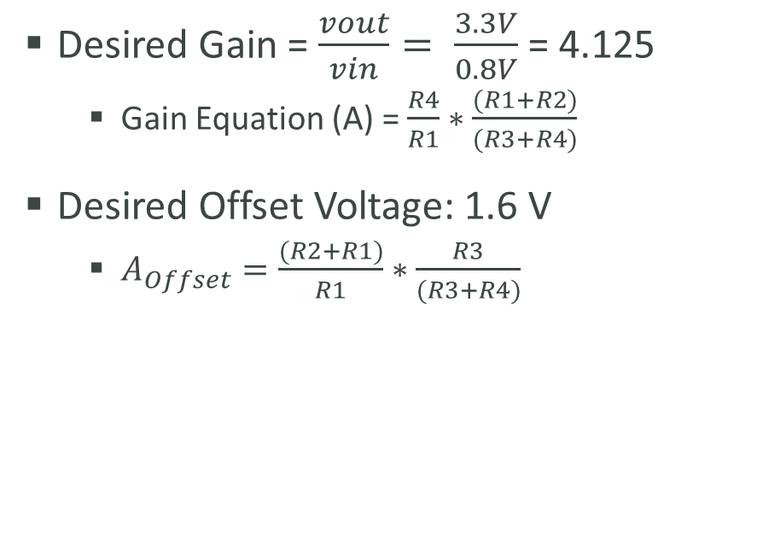
Level Shift Circuit
Role:
Allows the A/D converter to account for negative output voltages from IQ demodulator
Shift the input voltage range from +/-400 mV to 0-3.3 V
  Amplifies the input voltages
  Centers the output voltage at 1.6V
Need one for both I and Q outputs
Desired Gain = $\frac{vout}{vin}= \frac{3.3V}{0.8V}$ = 4.125
  Gain Equation (A) = $\frac{R4}{R1}∗\frac{(R1+R2)}{(R3+R4)}$
Desired Offset Voltage: 1.6 V
  $A_{Offset}=\frac{(R2+R1)}{R1}∗\frac{R3}{(R3+R4)}$

Slide 21
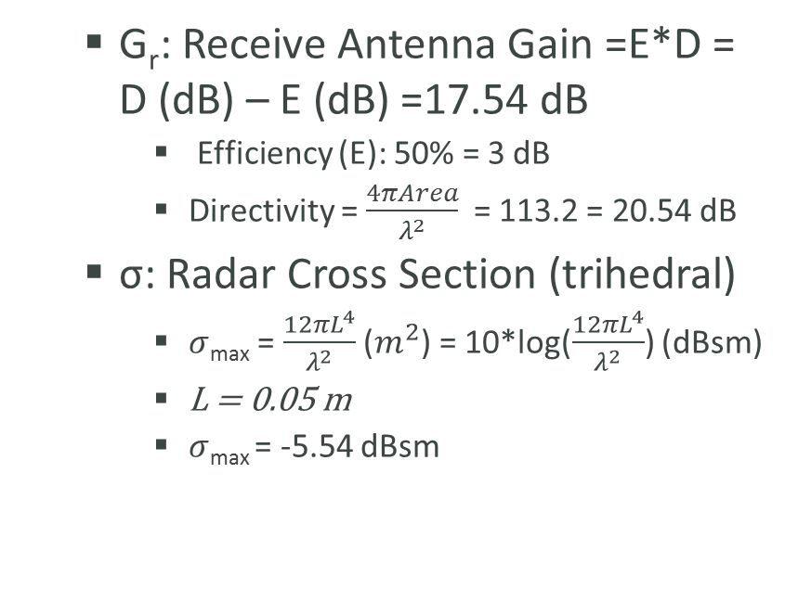
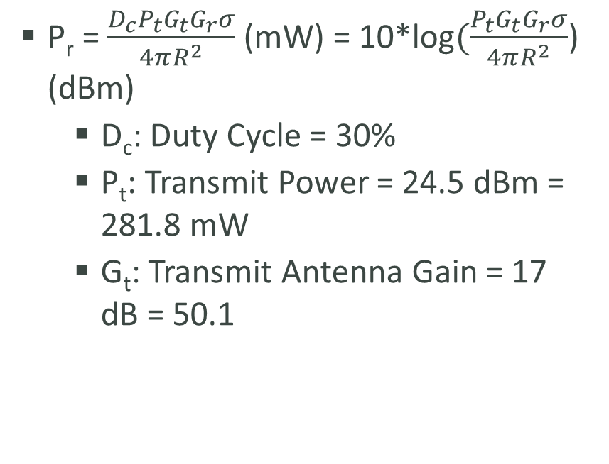
Radar Range Equation –
Received Power
P_{r} = $\frac{D_{c}P_{t}G_{t}G_{r}σ}{4πR^{2}}$ (mW) = 10*log$(\frac{P_{t}G_{t}G_{r}σ}{4πR^{2}}$) (dBm)
  D_{c}: Duty Cycle = 30%
  P_{t}: Transmit Power = 24.5 dBm = 281.8 mW
  G_{t}: Transmit Antenna Gain = 17 dB = 50.1
  G_{r}: Receive Antenna Gain =E*D = D (dB) – E (dB) =17.54 dB
    Efficiency (E): 50% = 3 dB
    Directivity = $\frac{4πArea}{λ^{2}}$ = 113.2 = 20.54 dB
  σ: Radar Cross Section (trihedral)
    $σ$_{max} = $\frac{12πL^{4}}{λ^{2}}$ ($m^{2}$) = 10*log($\frac{12πL^{4}}{λ^{2}}$) (dBsm)
    L = 0.05 m
    $σ$_{max} = -5.54 dBsm

Slide 22
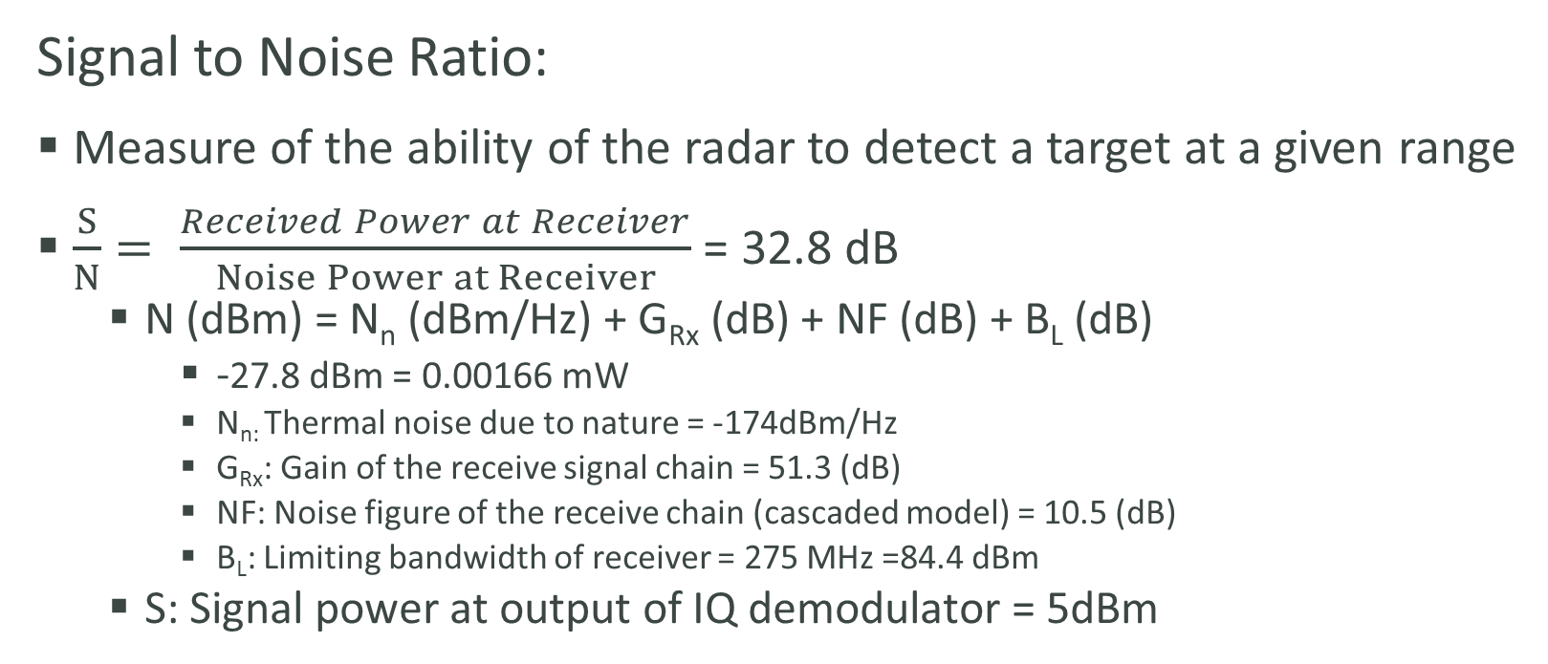
Radar Range Equation
Signal to Noise Ratio:
Measure of the ability of the radar to detect a target at a given range
$\frac{S}{N}= \frac{Received Power at Receiver}{Noise Power at Receiver}$ = 32.8 dB
  N (dBm) = N_{n} (dBm/Hz) + G_{Rx} (dB) + NF (dB) + B­­_{L} (dB)
    -27.8 dBm = 0.00166 mW
    N_{n:} Thermal noise due to nature = -174dBm/Hz
    G_{Rx}: Gain of the receive signal chain = 51.3 (dB)
    NF: Noise figure of the receive chain (cascaded model) = 10.5 (dB)
    B_{L}: Limiting bandwidth of receiver = 275 MHz =84.4 dBm
  S: Signal power at output of IQ demodulator = 5dBm

Slide 23
FPGA Programming
Lead Programmer: Patrick de la Llana
Electrical & Computer Engineering

Slide 24
What will be covered?
Quick Summary of which components have contact with FPGA board
Timing Diagram
Coding Sequence

Slide 25
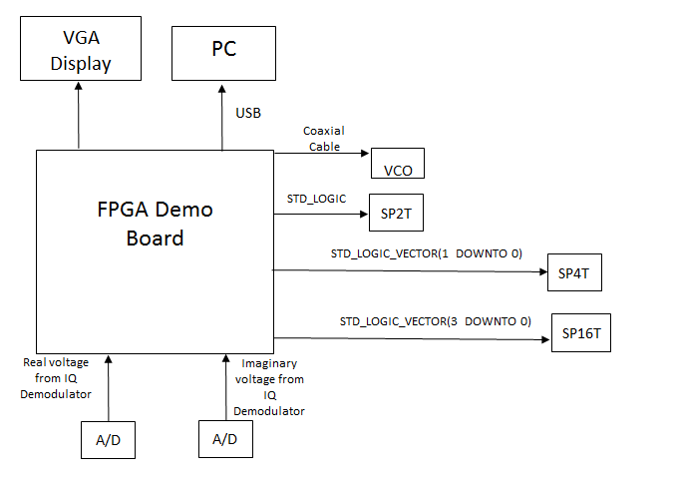
Hardware Design

Slide 26
RF Controlling Signals in
Timing Diagram
Signals used:
  Clk
    100MHz. 10 ns rising edge to rising edge.
    Allows for fast switching time.
  Pulse
    70 ns. 20 ns on and 50 ns off.
    40 ns for signal. 10 ns for delay, switching, and settling.
  SPDT
    Logic 1 is transmit mode.
    Logic 0 is receive mode.
  SP4T
    20 ns on.
  SP16T
    Inherent small delay of 0.25 ns per receiver.

Slide 27
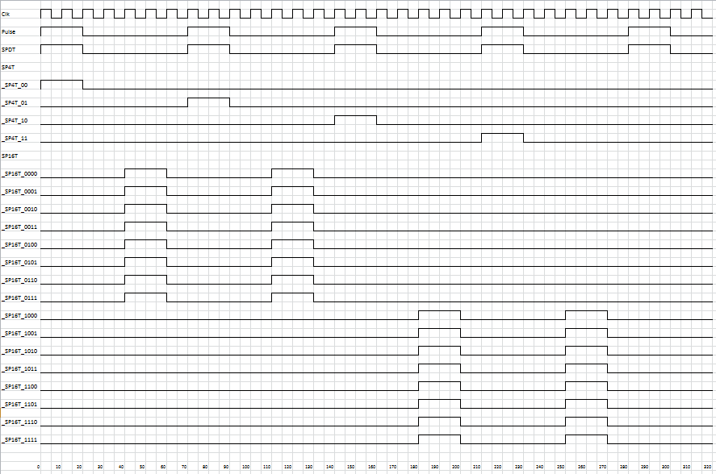
Timing Diagram

Slide 28
Pins For Signals in Timing Diagram
Signal | PIN
Clock | V10
Pulse | V16
SPDT | U15
SP4T | V15
SP16T | M11

Slide 29
Coding Sequence Explanation
1) Code will be written to generate pulses for SPDT,SP4T, SP16T switches.
  Purpose: Control timing.
1a)Code will be written to push button on board that will send out the pulse.
  Purpose: Check functionality of code
USE | Switch/Button | PIN
Manually control pulse | BTNL | C4

Slide 30
Coding Sequence Explanation
2) Code will be written to convert Analog voltage to Digital voltage. This will be done by taking voltages from shift level circuit and storing in a 12 bit word.
  Purpose: Gathering of Data from IQ Demodulator.
3) Voltage is displayed on 7 segment display.
  Purpose: To verify the operation for the Analog to Digital Conversion

Slide 31
Pins for 7 segment display
USE | Switch/Button | PIN
Display Analog Digital Voltage | 7 segment display | CA
Display Analog Digital Voltage | 7 segment display | CB
Display Analog Digital Voltage | 7 segment display | CC
Display Analog Digital Voltage | 7 segment display | CD
Display Analog Digital Voltage | 7 segment display | CE
Display Analog Digital Voltage | 7 segment display | CF
Display Analog Digital Voltage | 7 segment display | CG
Display Analog Digital Voltage | 7 segment display | DP
Display Analog Digital Voltage | 7 segment display | AN3
Display Analog Digital Voltage | 7 segment display | AN2
Display Analog Digital Voltage | 7 segment display | AN1
Display Analog Digital Voltage | 7 segment display | AN0

Slide 32
Coding Sequence Explanation
4) Storing of data that is the result of the Analog to Digital Conversion on the FPGA.
  Purpose: Allows for data to be worked on for signal processing of information.
4a)Intermediary step to have code written for signal processing of data in VHDL.
  Purpose: This step would only be done if using software for signal processing is not possible.

Slide 33
Coding Sequence Explanation
5)Code will be written that receives signal processing from PC and outputs it to VGA display.
  Slider switches : Generate digital word that is proportional to what pixels get activated.
  Purpose: Show the functionality of the PC in regards to how the signal processing results come out.
  FPGA connected to PC via USB port

Slide 34
Pins for Slider Switches
USE | Switch/Button | PIN
Generate digital word for VGA | SW0 | T10
Generate digital word for VGA | SW1 | T9
Generate digital word for VGA | SW2 | V9
Generate digital word for VGA | SW3 | M8
Generate digital word for VGA | SW4 | N8
Generate digital word for VGA | SW5 | U8
Generate digital word for VGA | SW6 | V8
Generate digital word for VGA | SW7 | T5

Slide 35
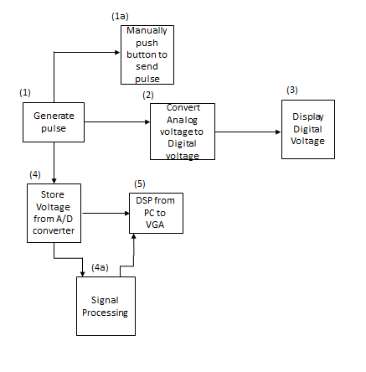
Coding Sequence

Slide 36
Antenna Design
Antenna Engineer: Matt Cammuse
Electrical Engineering

Slide 37
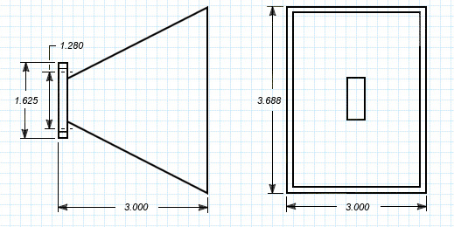
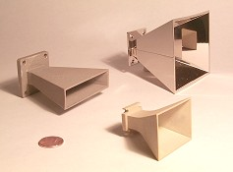
Antenna Hardware - Antennas
MA86551 X- Band Horn Antennas
Horn Antenna Specifications Data Sheet
Center Frequency | 10.525 GHz
Frequency Range | 8 – 12.4 GHz
Nominal Gain | 17 dBi
H-Plane (Azimuth) Beamwidth | 25°
E-Plane (Elevation) Beamwidth | 25°
Scene Extent | 9’ x 9’
RF Connection | UG-39/U
Price | $20.00 per antenna
MA86551 Horn Antenna Dimensions
Length | 3 in.
Width | 3 in.
Height | 3.688 in.
Waveguide Entry | 1.280 in.
Flange Size | 1.625 in.

Slide 38
Antenna Hardware – Iso-Adapter
WR90 Waveguide Iso-Adapter
WR90 Waveguide Isolator X-Band Data Sheet
Frequency Range | 8.2 – 12.4 GHz
RF Connection | WR90
Price | $79.95 per Iso-Adapter
Prevents unwanted transmission leakage through transmit antennas
Coaxial input and output
TestParts.com

Slide 39
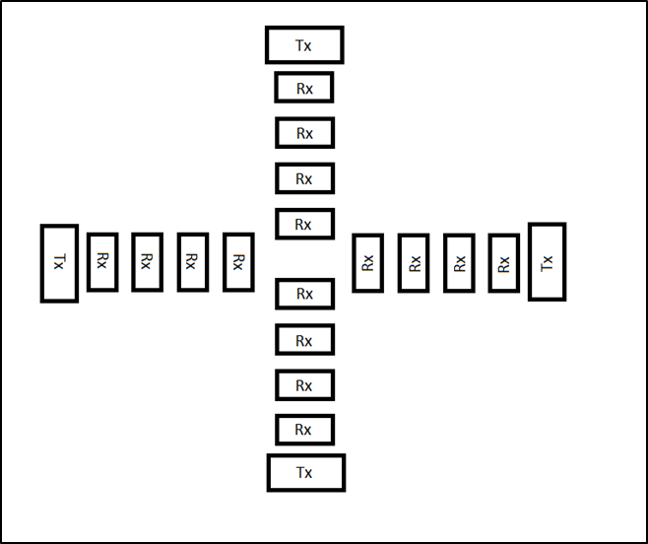
Antenna Design Principle
T-shaped design
2 Linear antenna arrays
  Azimuth = horizontal array
  Elevation = vertical array
2-D image
  Each antenna covers one dimension
Propagation pattern covers scene extent of 30’’ x 30’’

Slide 40
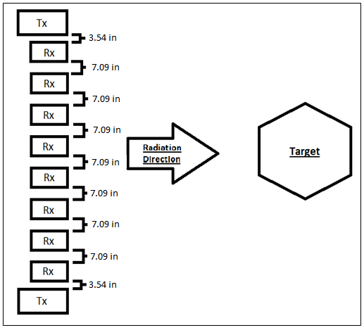
Antenna Spacing
Distances between antennas
Transmit – Receive
  3λ = 3.54 in.
Receive – Receive
  6λ = 7.09 in.

Slide 41
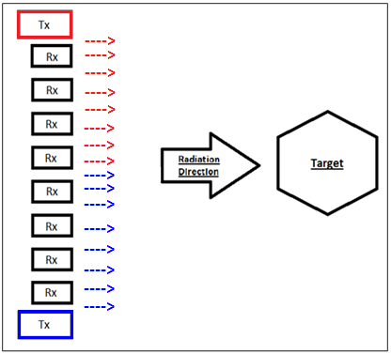
Phase Centers
16 Phase centers per antenna array
  8 per transmit antenna
  Creates 16 columns of scene extent
32 total phase centers
Maximum absorbance point of a reflected signal
Located between one transmit and one receive horn antenna
3λ spacing

Slide 42
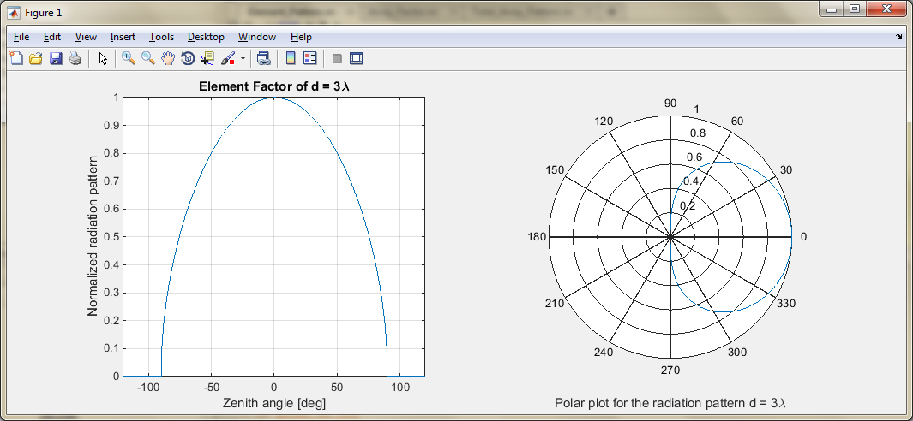
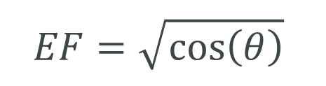
Linear Antenna Array Radiation Patterns
Element Factor
$$EF=\sqrt{\cos\left(θ\right)}$$
Element Factor Variables
Description | Variable | Value
Zenith Angle Range | θ | 0-240°

Slide 43
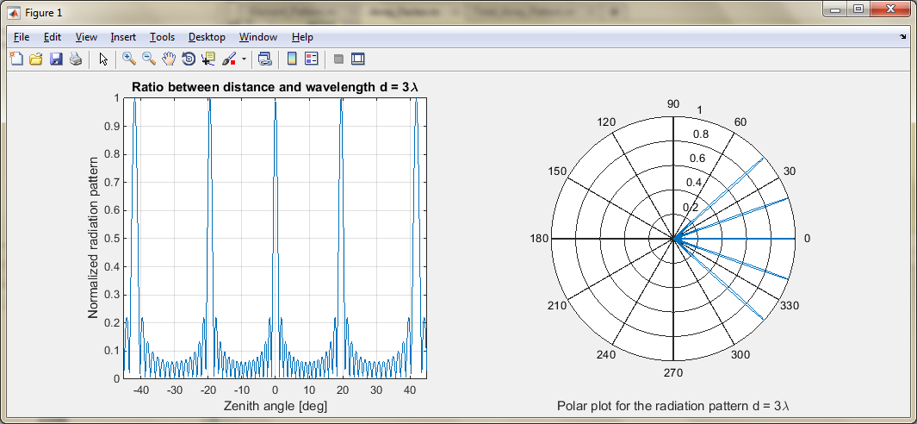
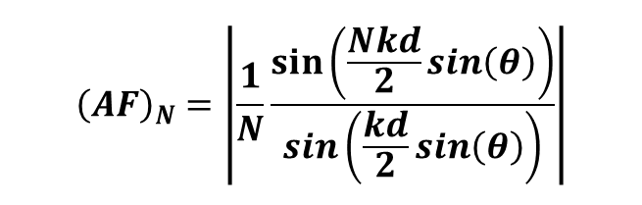
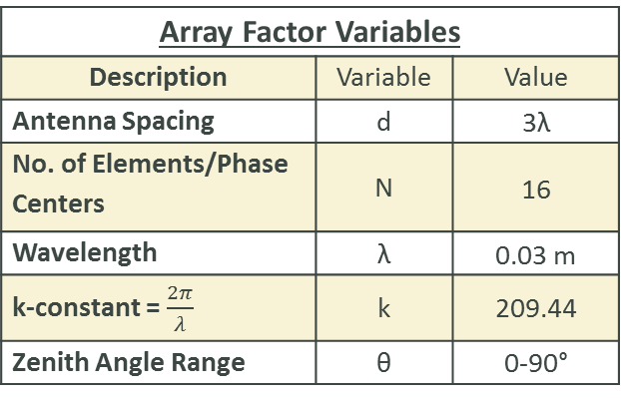
Linear Antenna Array Radiation Patterns
Array Factor
$${\left(AF\right)}_{N}=\left|\frac{1}{N}\frac{sin\left(\frac{Nkd}{2}\sin\left(θ\right)\right)}{\sin\left(\frac{kd}{2}\sin\left(θ\right)\right)}\right|$$
Array Factor Variables
Description | Variable | Value
Antenna Spacing | d | 3λ
No. of Elements/Phase Centers | N | 16
Wavelength | λ | 0.03 m
k-constant = $\frac{2π}{λ}$ | k | 209.44
Zenith Angle Range | θ | 0-90°

Slide 44
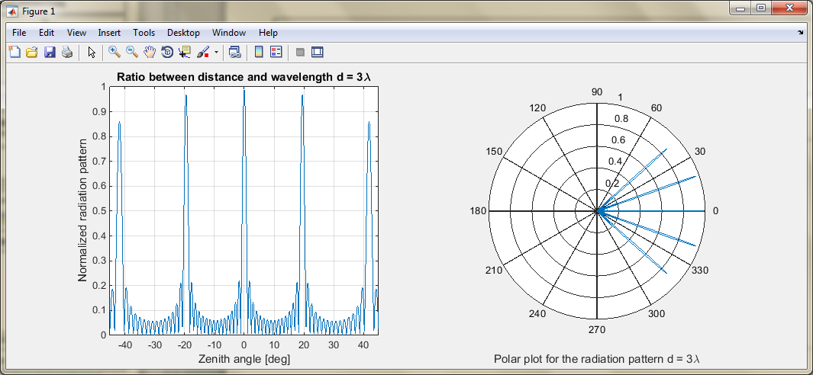
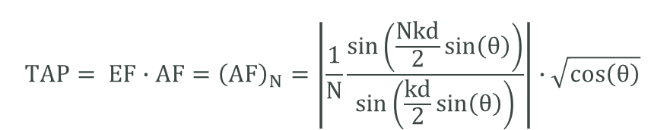
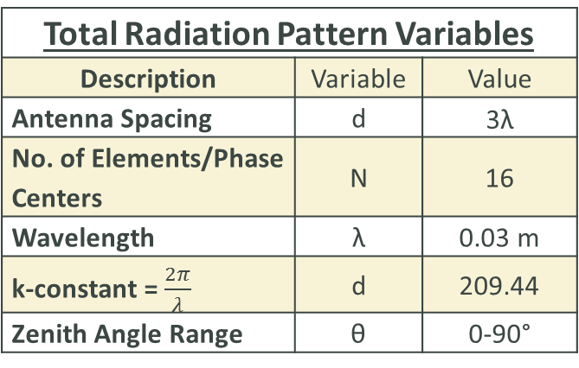
Linear Antenna Array Radiation Patterns
Total Radiation Pattern
$$TAP= EF∙AF={\left(AF\right)}_{N}=\left|\frac{1}{N}\frac{sin\left(\frac{Nkd}{2}\sin\left(θ\right)\right)}{\sin\left(\frac{kd}{2}\sin\left(θ\right)\right)}\right|∙\sqrt{\cos\left(θ\right)}$$
Total Radiation Pattern Variables
Description | Variable | Value
Antenna Spacing | d | 3λ
No. of Elements/Phase Centers | N | 16
Wavelength | λ | 0.03 m
k-constant = $\frac{2π}{λ}$ | d | 209.44
Zenith Angle Range | θ | 0-90°

Slide 45
Antenna Structural Design
Antenna Structure Engineers:
Mark Poindexter & Malcolm Harmon
Mechanical Engineering

Slide 46
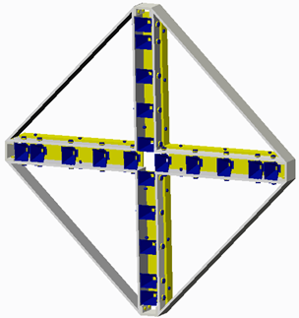
Antenna Structure
4 Quadrant Panels - Aluminum
4 Quadrant Dividers - Aluminum
16 - ½ inch x 1 inch Hex Cap Screws -
Stainless Steel
4 Back Plate Horn Covers - Aluminum
24 - ½ inch x 2 inch Hex Bolts and Nuts -
Stainless Steel
20 Horn Antennas
40 - 1 inch x 3 inch Custom bolts - Stainless Steel
80 - 1 inch Nuts for Custom Bolts - Stainless Steel
Mark Poindexter

Slide 47
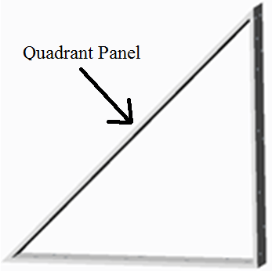
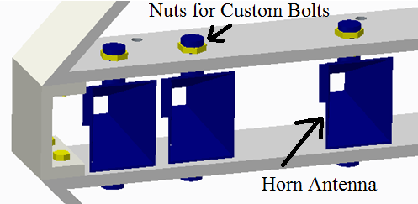
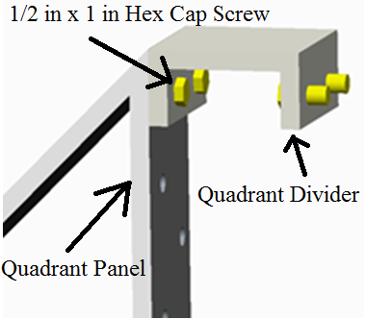
Antenna Structure Continued
Mark Poindexter

Slide 48
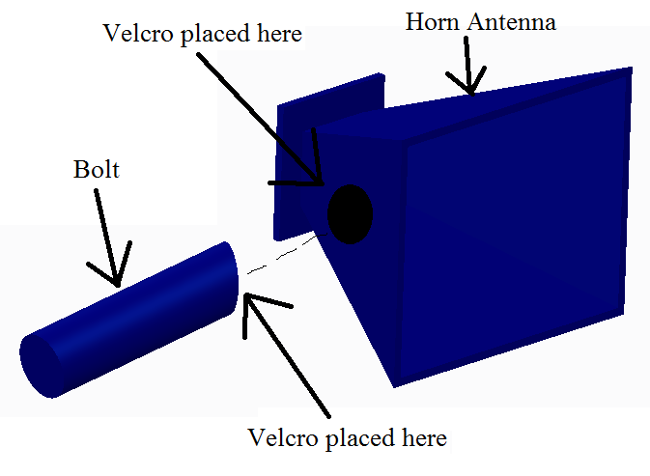
Antenna Structure Continued
Industrial Velcro
2 in x 2 in holds 175 lbs
1 in Diameter Circle holds
35 lbs
Maximum Horn Weight using Velcro is 70 lbs.
Mark Poindexter

Slide 49
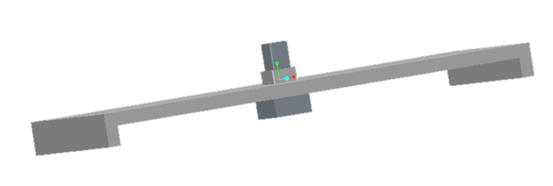
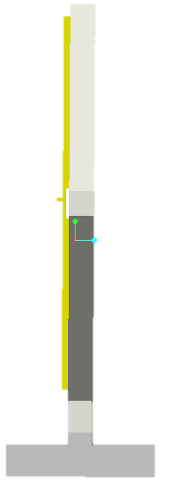

Antenna Structure Stand
Supports the weight of the Antenna Structure
Three legged stand to provide more support
Male component that increases rigidity
5 in.
72 in
24 in.
64 in.
Malcolm Harmon

Slide 50
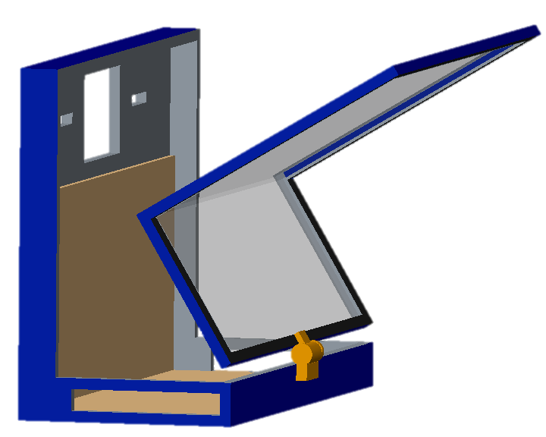
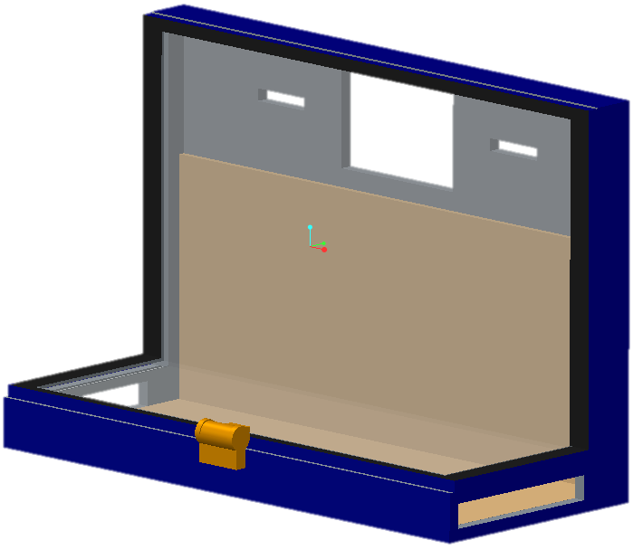
Electrical Component Box
Plexiglas Used for Lid
2-in-1 Lid
Wood Interior for easy Component Attachment
Various Slots to Provide Flow for Cables
22 in.
9.75 in.
8.75 in
Malcolm Harmon

Slide 51
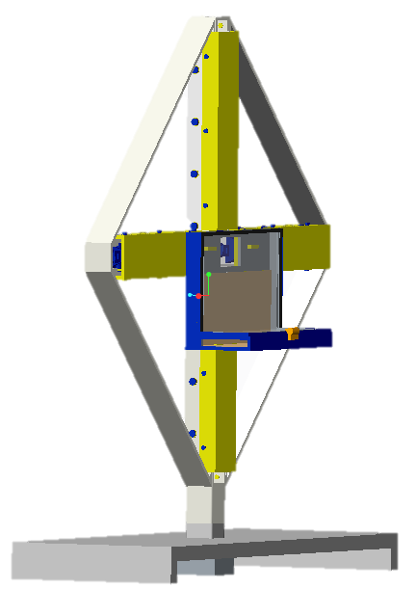
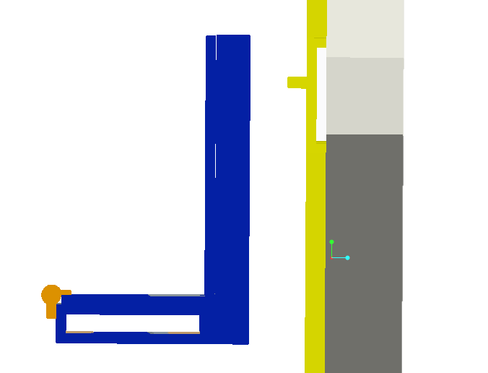

Antenna Structure
SIDE VIEW – COMPONENT BOX ATTACHTMENT
Slot for Component Box
Removable
Sturdy Support
SIDE VIEW – STUCTURE STAND ATTACHMENT
Pin and Slot Joint
Rectangular fit for rigidity
Removable
Malcolm Harmon

Slide 52
Power Supply and Signal Processing
Signal Processing Engineer – Julia Kim
Electrical Engineering

Slide 53
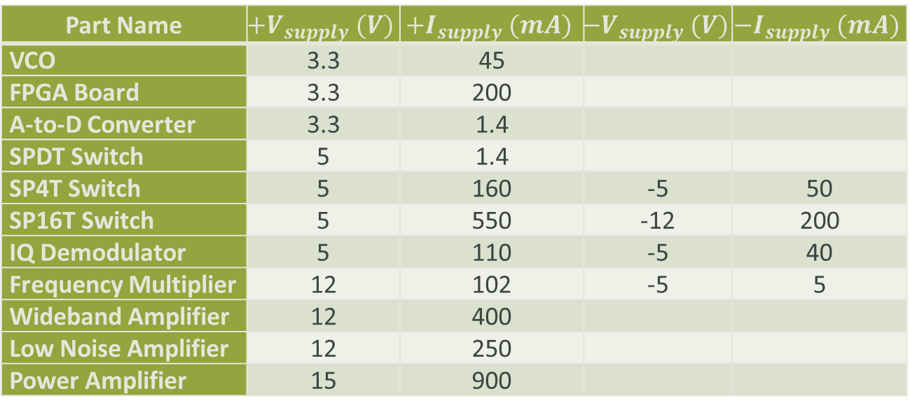
Power Supply
Part Name | $${+V}_{supply} (V)$$ | $${+I}_{supply} (mA)$$ | $${−V}_{supply} (V)$$ | $${−I}_{supply} (mA)$$
VCO | 3.3 | 45
FPGA Board | 3.3 | 200
A-to-D Converter | 3.3 | 1.4
SPDT Switch | 5 | 1.4
SP4T Switch | 5 | 160 | -5 | 50
SP16T Switch | 5 | 550 | -12 | 200
IQ Demodulator | 5 | 110 | -5 | 40
Frequency Multiplier | 12 | 102 | -5 | 5
Wideband Amplifier | 12 | 400
Low Noise Amplifier | 12 | 250
Power Amplifier | 15 | 900
Power supply can be shared by placing the input voltage in parallel
For components that have positive and negative voltages, a power supply with differential output
Input Voltage and Current for each Component

Slide 54
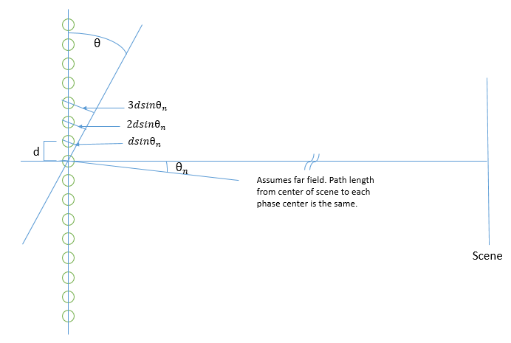
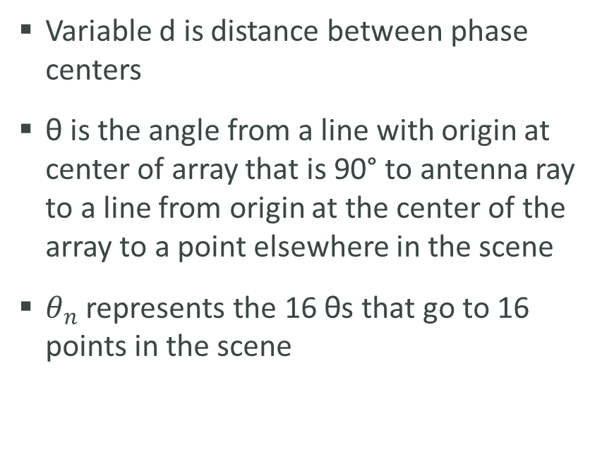
Signal Processing
Variable d is distance between phase centers
θ is the angle from a line with origin at center of array that is 90° to antenna ray to a line from origin at the center of the array to a point elsewhere in the scene
$θ_{n}$ represents the 16 θs that go to 16 points in the scene
Sixteen Phase Centers from each Tx/Rx Pair to Scene

Slide 55
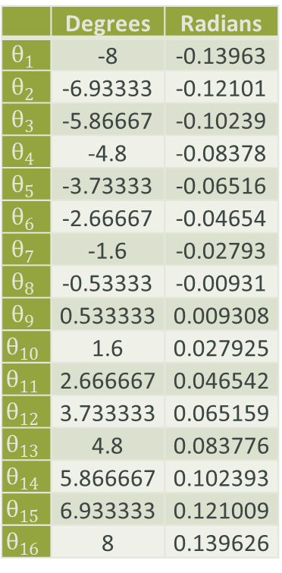
Fourier Transform Example –
16 Phase Centers
 | Degrees | Radians
$$θ_{1}$$ | -8 | -0.13963
$$θ_{2}$$ | -6.93333 | -0.12101
$$θ_{3}$$ | -5.86667 | -0.10239
$$θ_{4}$$ | -4.8 | -0.08378
$$θ_{5}$$ | -3.73333 | -0.06516
$$θ_{6}$$ | -2.66667 | -0.04654
$$θ_{7}$$ | -1.6 | -0.02793
$$θ_{8}$$ | -0.53333 | -0.00931
$$θ_{9}$$ | 0.533333 | 0.009308
$$θ_{10}$$ | 1.6 | 0.027925
$$θ_{11}$$ | 2.666667 | 0.046542
$$θ_{12}$$ | 3.733333 | 0.065159
$$θ_{13}$$ | 4.8 | 0.083776
$$θ_{14}$$ | 5.866667 | 0.102393
$$θ_{15}$$ | 6.933333 | 0.121009
$$θ_{16}$$ | 8 | 0.139626
 | 1*d*sin(θn) | 2*d*sin(θn) | 3*d*sin(θn) | 4*d*sin(θn) | … | 16*d*sin(θn)
f(θ1) | -2.623351149 | -5.246702299 | -7.870053448 | -10.4934046 | … | -41.97361839
f(θ2) | -2.27541248 | -4.550824961 | -6.826237441 | -9.101649922 | … | -36.40659969
f(θ3) | -1.926685206 | -3.853370412 | -5.780055619 | -7.706740825 | … | -30.8269633
f(θ4) | -1.577290187 | -3.154580375 | -4.731870562 | -6.309160749 | … | -25.236643
f(θ5) | -1.227348516 | -2.454697032 | -3.682045548 | -4.909394064 | … | -19.63757626
f(θ6) | -0.876981474 | -1.753962948 | -2.630944422 | -3.507925896 | … | -14.03170358
f(θ7) | -0.526310491 | -1.052620981 | -1.578931472 | -2.105241962 | … | -8.420967849
f(θ8) | -0.1754571 | -0.3509142 | -0.5263713 | -0.7018284 | … | -2.8073136
f(θ9) | 0.1754571 | 0.3509142 | 0.5263713 | 0.7018284 | … | 2.8073136
f(θ10) | 0.526310491 | 1.052620981 | 1.578931472 | 2.105241962 | … | 8.420967849
f(θ11) | 0.876981474 | 1.753962948 | 2.630944422 | 3.507925896 | … | 14.03170358
f(θ12) | 1.227348516 | 2.454697032 | 3.682045548 | 4.909394064 | … | 19.63757626
f(θ13) | 1.577290187 | 3.154580375 | 4.731870562 | 6.309160749 | … | 25.236643
f(θ14) | 1.926685206 | 3.853370412 | 5.780055619 | 7.706740825 | … | 30.8269633
f(θ15) | 2.27541248 | 4.550824961 | 6.826237441 | 9.101649922 | … | 36.40659969
f(θ16) | 2.623351149 | 5.246702299 | 7.870053448 | 10.4934046 | … | 41.97361839
Values for Sixteen Angles
Basis Functions for the Sixteen Angles

Slide 56
Fourier Transform Example –
16 Phase Centers

Slide 57
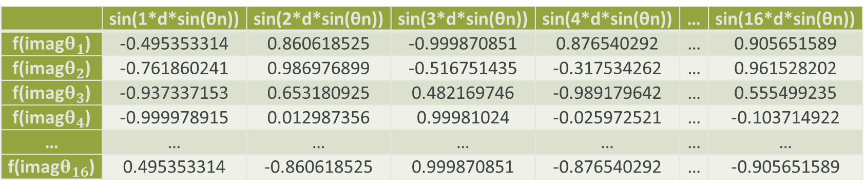
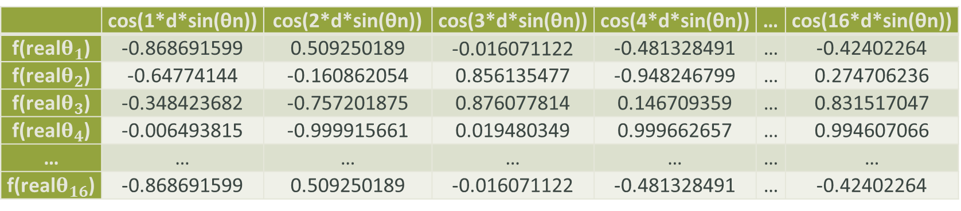
Fourier Transform Example
 | cos(1*d*sin(θn)) | cos(2*d*sin(θn)) | cos(3*d*sin(θn)) | cos(4*d*sin(θn)) | … | cos(16*d*sin(θn))
f(real$θ_{1}$) | -0.868691599 | 0.509250189 | -0.016071122 | -0.481328491 | … | -0.42402264
f(real$θ_{2}$) | -0.64774144 | -0.160862054 | 0.856135477 | -0.948246799 | … | 0.274706236
f(real$θ_{3}$) | -0.348423682 | -0.757201875 | 0.876077814 | 0.146709359 | … | 0.831517047
f(real$θ_{4}$) | -0.006493815 | -0.999915661 | 0.019480349 | 0.999662657 | … | 0.994607066
… | … | … | … | … | … | …
f(real$θ_{16}$) | -0.868691599 | 0.509250189 | -0.016071122 | -0.481328491 | … | -0.42402264
Real Part of Basis Functions
 | sin(1*d*sin(θn)) | sin(2*d*sin(θn)) | sin(3*d*sin(θn)) | sin(4*d*sin(θn)) | … | sin(16*d*sin(θn))
f(imag$θ_{1}$) | -0.495353314 | 0.860618525 | -0.999870851 | 0.876540292 | … | 0.905651589
f(imag$θ_{2}$) | -0.761860241 | 0.986976899 | -0.516751435 | -0.317534262 | … | 0.961528202
f(imag$θ_{3}$) | -0.937337153 | 0.653180925 | 0.482169746 | -0.989179642 | … | 0.555499235
f(imag$θ_{4}$) | -0.999978915 | 0.012987356 | 0.99981024 | -0.025972521 | … | -0.103714922
… | … | … | … | … | … | …
f(imag$θ_{16}$) | 0.495353314 | -0.860618525 | 0.999870851 | -0.876540292 | … | -0.905651589
Imaginary Part of Basis Functions

Slide 58
Signal Processing Example
Real Part of Basis Functions
Imaginary Part of Basis Functions

Slide 59
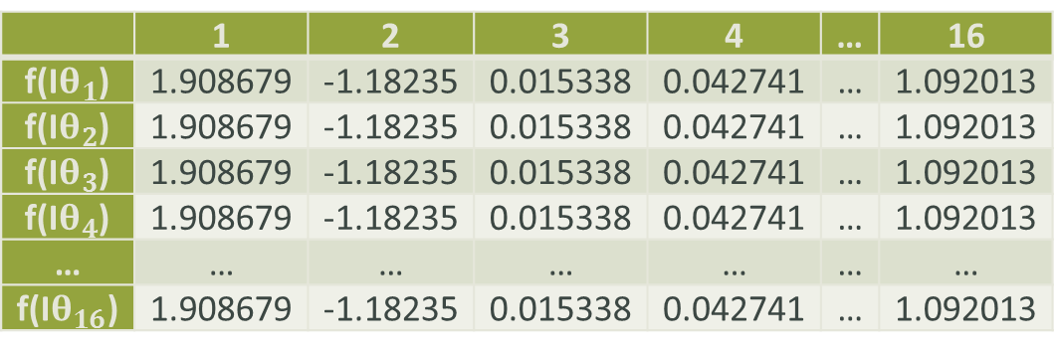


Fourier Transform Example –
IQ Demodulator
 | 1 | 2 | 3 | 4 | … | 16
f(I$θ_{1}$) | 1.908679 | -1.18235 | 0.015338 | 0.042741 | … | 1.092013
f(I$θ_{2}$) | 1.908679 | -1.18235 | 0.015338 | 0.042741 | … | 1.092013
f(I$θ_{3}$) | 1.908679 | -1.18235 | 0.015338 | 0.042741 | … | 1.092013
f(I$θ_{4}$) | 1.908679 | -1.18235 | 0.015338 | 0.042741 | … | 1.092013
… | … | … | … | … | … | …
f(I$θ_{16}$) | 1.908679 | -1.18235 | 0.015338 | 0.042741 | … | 1.092013
“I” data with Energy from $θ_{4}$, $θ_{6}, θ_{8}$, $θ_{11}$, and $θ_{14}$
$$f\left(Iθ_{n,1}\right)=\left(\cos\left(1∗d\sin\left(θ_{4}\right)\right)\right)+\left(\cos\left(1∗d\sin\left(θ_{6}\right)\right)\right)+\left(\cos\left(1∗d\sin\left(θ_{8}\right)\right)\right)+\left(1∗cos\left(d\sin\left(θ_{11}\right)\right)\right)+\left(\cos\left(1∗d\sin\left(θ_{14}\right)\right)\right)$$
$$f\left({Iθ}_{n,1}\right)=\left(−0.006493815\right)+\left(0.639474733\right)+\left(0.984646851\right)+\left(0.639474733\right)+\left(−0.348423682\right)$$
$$f({Iθ}_{n,1})= 1.908679$$

Slide 60
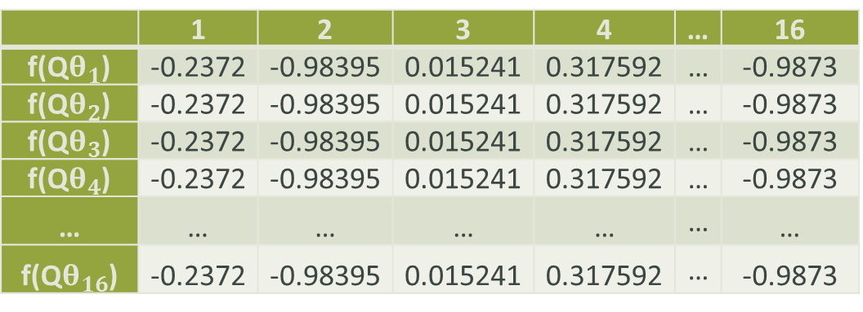


Fourier Transform Example –
IQ Demodulator
 | 1 | 2 | 3 | 4 | … | 16
f(Q$θ_{1}$) | -0.2372 | -0.98395 | 0.015241 | 0.317592 | … | -0.9873
f(Q$θ_{2}$) | -0.2372 | -0.98395 | 0.015241 | 0.317592 | … | -0.9873
f(Q$θ_{3}$) | -0.2372 | -0.98395 | 0.015241 | 0.317592 | … | -0.9873
f(Q$θ_{4}$) | -0.2372 | -0.98395 | 0.015241 | 0.317592 | … | -0.9873
… | … | … | … | … | … | …
f(Q$θ_{16}$) | -0.2372 | -0.98395 | 0.015241 | 0.317592 | … | -0.9873
“Q” data with Energy from $θ_{4}$, $θ_{6}, θ_{8}$, $θ_{11}$, and $θ_{14}$
$$f({Qθ}_{n,1})=\left(\sin\left(1∗d\sin\left(θ_{4}\right)\right)\right)+\left(\sin\left(1∗d\sin\left(θ_{6}\right)\right)\right)+\left(\sin\left(1∗d\sin\left(θ_{8}\right)\right)\right)+\left(\sin\left(1∗d\sin\left(θ_{11}\right)\right)\right)+\left(\sin\left(1∗d\sin\left(θ_{14}\right)\right)\right)$$
$$f\left({Qθ}_{n,1}\right)=\left(−0.999978915\right)+\left(−0.768812113\right)+\left(−0.174558238\right)+\left(0.768812113\right)+\left(0.937337153\right)$$
$$f({Qθ}_{n,1})=−0.2372$$

Slide 61
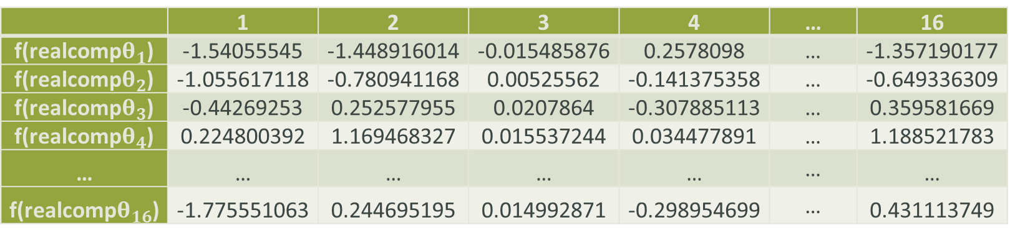
Fourier Transform Example
 | 1 | 2 | 3 | 4 | … | 16
f(realcomp$θ_{1}$) | -1.54055545 | -1.448916014 | -0.015485876 | 0.2578098 | … | -1.357190177
f(realcomp$θ_{2}$) | -1.055617118 | -0.780941168 | 0.00525562 | -0.141375358 | … | -0.649336309
f(realcomp$θ_{3}$) | -0.44269253 | 0.252577955 | 0.0207864 | -0.307885113 | … | 0.359581669
f(realcomp$θ_{4}$) | 0.224800392 | 1.169468327 | 0.015537244 | 0.034477891 | … | 1.188521783
… | … | … | … | … | … | …
f(realcomp$θ_{16}$) | -1.775551063 | 0.244695195 | 0.014992871 | -0.298954699 | … | 0.431113749
Real Part after Complex Multiply
$$f\left(realcompθ_{1,1}\right)=\left(R_{1,θ1}×I_{1d}\right)+\left(I_{1,θ1}×Q_{1d}\right)$$
$$f\left(realcompθ_{1,1}\right)=\left[f\left({realθ}_{1,1}\right)×f\left({Iθ}_{1,1}\right)\right]+[f\left({imagθ}_{1,1}\right)×f\left({Qθ}_{1,1}\right)]$$
$$f\left(realcompθ_{1,1}\right)=\left[\left(−0.868691599\right)\left(1.908679\right)\right]+\left[\left(−0.495353314\right)\left(−0.2372\right)\right]=−1.54055545$$

Slide 62
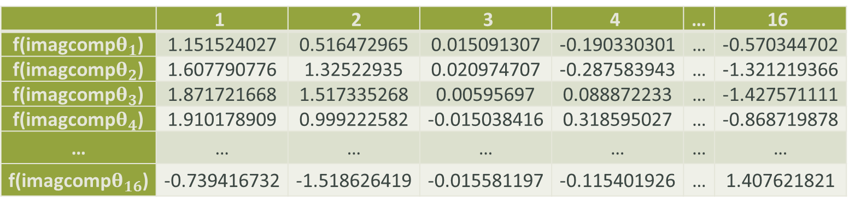
Fourier Transform Example
 | 1 | 2 | 3 | 4 | … | 16
f(imagcomp$θ_{1}$) | 1.151524027 | 0.516472965 | 0.015091307 | -0.190330301 | … | -0.570344702
f(imagcomp$θ_{2}$) | 1.607790776 | 1.32522935 | 0.020974707 | -0.287583943 | … | -1.321219366
f(imagcomp$θ_{3}$) | 1.871721668 | 1.517335268 | 0.00595697 | 0.088872233 | … | -1.427571111
f(imagcomp$θ_{4}$) | 1.910178909 | 0.999222582 | -0.015038416 | 0.318595027 | … | -0.868719878
… | … | … | … | … | … | …
f(imagcomp$θ_{16}$) | -0.739416732 | -1.518626419 | -0.015581197 | -0.115401926 | … | 1.407621821
Imaginary Part after Complex Multiply
$$f\left(imagcompθ_{1,1}\right)=\left({−I}_{1,θ1}×I_{1d}\right)+(R_{1,θ1}×Q_{1d})$$
$$f\left(imagcompθ_{1,1}\right)=\left[(−f\left({imagθ}_{1,1}\right))×f\left({Iθ}_{1,1}\right)\right]+[f\left(realθ_{1,1}\right)×f\left({Qθ}_{1,1}\right)]$$
$$f\left(imagcompθ_{1,1}\right)=\left[(−\left(−0.495353314\right))\left(1.908679\right)\right]+\left[\left(−0.868691599\right)\left(−0.2372\right)\right]=1.151524027$$

Slide 63
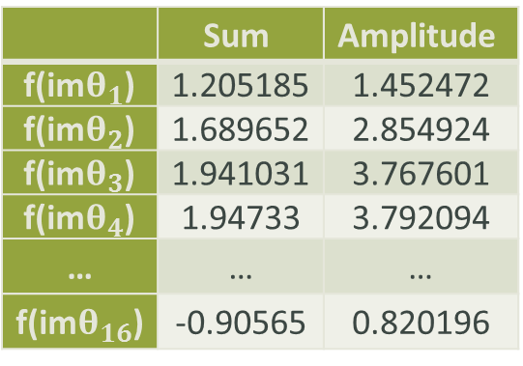

Fourier Transform Example
 | Sum | Amplitude
f(re$θ_{1}$) | -3.33835 | 11.14456
f(re$θ_{2}$) | -3.88689 | 15.10794
f(re$θ_{3}$) | -4.55195 | 20.72023
f(re$θ_{4}$) | 12.7253 | 161.9332
… | … | …
f(re$θ_{16}$) | -3.12353 | 9.756424
 | Sum | Amplitude
f(im$θ_{1}$) | 1.205185 | 1.452472
f(im$θ_{2}$) | 1.689652 | 2.854924
f(im$θ_{3}$) | 1.941031 | 3.767601
f(im$θ_{4}$) | 1.94733 | 3.792094
… | … | …
f(im$θ_{16}$) | -0.90565 | 0.820196
Amplitude for the Real Part of
the Sixteen Functions
Amplitude for the Imaginary Part of
the Sixteen Functions
$A_{n}=20×log⁡[{\left({real}_{θn}+{imag}_{θn}\right)}^{1/2}]$ is used to then calculate the amplitude for each angle.

Slide 64
Fourier Transform Example
Amplitude | Theta
11.00268101 | -8
12.54375538 | -6.9333
13.88950329 | -5.8667
22.19388739 | -4.8
15.74410412 | -3.7333
21.29348537 | -2.6667
16.63108983 | -1.6
20.83898545 | -0.5333
16.71801857 | 0.53333
16.47464885 | 1.6
21.50486346 | 2.66667
15.3578126 | 3.73333
14.4351896 | 4.8
22.87509704 | 5.86667
11.7719943 | 6.93333
10.24346885 | 8
Amplitude vs Angle Graph
Corresponding Amplitudes for each Angle

Slide 65

Complete
Detailed Schedule
Project Manager: Jasmine Vanderhorst
Industrial Engineer

Slide 66
Schedule - Critical Tasks
Component Ordering Delayed
  Vendors Still Pending Approval
  Additional parts need to be considered
  Sponsor wants to do a final review session before any parts are ordered from both the mechanical and electrical disciplines
Securing Testing and Storage Facility
  Still considering viable options for testing
  Secure storage space (based on size) once all parts and equipment finalized
Determine Next 2 milestones timelines and schedule at least 2 more visits to Tallahassee for Pete, per his request.

Slide 67
Pending Scheduled Items
Cabling Design
Interface Control Document
Mechanical Stress & Strain Analysis
System Calibration Calculations
Component Layout Integrated Design

Slide 68
Complete Detailed Budget
Co-Lead Engineer & Treasurer –
Benjamin Mock
Industrial Engineer

Slide 69
Budget Assessment
Component | Manufacturer /Distributer | Quantity | Total Cost ($)
VCO | Hittite | 2 | 700
Frequency Multiplier | Hittite | 2 | 90
SPDT Swith | Hittite | 1 | 70
 | Subtotal |  | 860

Slide 70
Budget Assessment
Component | Manufacturer /Distributer | Quantity | Total Cost ($)
Power Amplifier | Fairview Microwave | 1 | 2500
Low Noise Amplifier | Fairview Microwave | 2 | 3100
Variable Attenuator | Fairview Microwave | 3 | 2000
Fixed Attenuator | Fairview Microwave | 12 | 600
 | Subtotal |  | 8200

Slide 71
Budget Assessment
Component | Manufacturer /Distributer | Quantity | Total Cost ($)
SP4T Switch | RF Lambda | 1 | 1500
Isolator | RF Lambda | 1 | 150
 | Subtotal |  | 1650
A-D Converter | Digilent | 2 | 90
FPGA | Digilent | 1 | 190
 | Subtotal |  | 280

Slide 72
Budget Assessment
Component | Manufacturer /Distributer | Quantity | Total Cost($)
Aluminum Frame | Bettinger Welding | 1 | 1000
Absorbing Foam | dB Engineering | 4 Rolls | 4000
Field Strength Meter | Digi-Field | 1 | 250

Slide 73
Budget Assessment
Component | Manufacturer /Distributer | Quantity | Total Cost ($)
Wideband Amplifier | Mini-Circuits | 1 | 900
Antenna Horns | Advanced Receiver | 25 | 500
SP16T Switch | Universal Microwave | 1 | 100
IQ Demodulator | Polyphase Microwave | 1 | 1300
Band Pass Filter | Marki Microwave | 2 | 1600

Slide 74
Detailed Risk Assessment
Co-Lead Engineer & Treasurer –
Benjamin Mock
Industrial Engineer

Slide 75
Structural Risks
Quadrant Stress Increased by Antenna Horns
Description | The weight of the 5 horns will have increasing deflection in the quadrant’s arms, horns could lose alignment.
Probability | Very Low, with aluminum yield strength of 275 MPa.
Consequence | Weight might cause progressive bending in the material of the quadrant.
Strategy | Determine the yield strength of the material to ensure its capability within the system.

Slide 76
Structural Risks
Unaligned Structure Stand can Increase Redirect Signal
Description | The stand that supports the structure must provide stability so the precise alignment can be achieved.
Probability | Moderate, Bettinger has ensured quality fabrication of the joint piece.
Consequence | Misalignment can account for inability to process signal as appropriately intended.
Strategy | Assess all errors before fabrication, have square O-rings ready if necessary to adjust alignment after fabrication.

Slide 77
Electrical System Risks
Component Failure
Description | If the maximum value for a component’s input or output voltage is exceeded the component may fail
Probability | Low, the design process accounted for component tolerance and power was calculated for the system.
Consequence | High, if components become stressed then the RADAR will fail to operate successfully.
Strategy | Maximum thresholds were taken into consideration when designing the system.

Slide 78
Electrical System Risks
Software Development Risk
Description | Software may be inadequate relative to the scope of the project, including the FPGA pulse generation, control timing, and signal processing.
Probability | Moderate, FPGA does not come with image processing software.
Consequence | High, if pulse generation and timing are not properly made then the RADAR will not display the appropriate image.
Strategy | Test equipment can be used instead of signal processing software.

Slide 79
Electrical System Risks
Interface Outside of Scene Extent
Description | Antenna propagates weaker grating lobes in addition to the main lobes. These lobes will need to be absorbed to prevent invalid detection of metal.
Probability | Moderate, the beamwidth for the horns is fairly large.
Consequence | High, the displayed image will not accurately what is in the scene extent if the grating lobes are not absorbed.
Strategy | RF Absorbing Materials will be placed around the testing facility to ensure that only the scene extent is reflecting signals.

Slide 80
Electrical System Risks
Phase Center Amount
Description | Each array contains 16 phase centers, 32 total for the RADAR.
Probability | Low, spacing will need to be precise for appropriate use.
Consequence | Severe, non-properly aligned antenna will not properly generate the 16 phase centers.
Strategy | Utilizing a laser to ensure that the antennas are aligned correctly.

Slide 81
Electrical System Risks
Signal Processing
Description | The data from the I-Channel and the Q-Channel may not be collected from the IQ demodulator.
Probability | Low, the FPGA will be programmed to receive such information.
Consequence | Minor, the alternate will be to generate this data via programming.
Strategy | Voltmeter can be attached to the channels of the demodulator to generate this data manually.

Slide 82
Schedule Risks
Schedule Risks
Description | Facilities procurement is still undetermined.
Probability | Low, CAPS has responded with potential availability. Will know by early next week. Physics Department still pending.
Consequence | High, without appropriate testing facilities the scope can not be measured.
Strategy | Continue persistent contact with all facilities to ensure that the location is secure and available.

Slide 83
Budget Risks
Purchase Order Risk
Description | Orders must exceed $100 for use of purchase orders.
Probability | Low, for components less than $100 the team must supply the fund to purchase the item. Majority of components far exceed this threshold.
Consequence | Moderate, depends on funds available to Project Manager.
Strategy | Team will pool money if necessary to purchase components. Orders will be placed to ensure that purchase orders can be placed wherever possible.

Slide 84
Questions & Comments
THANK YOU

