Slide 1


Electronic Synthetic Aperture Radar Imager
Team E#11/M#27 - Milestone #2
Project Proposal and Statement of Work

Slide 2
Agenda
Project Overview
Team Qualifications
System Breakdown
  Electrical System
    Power Supply & Distribution
    FPGA Programming
  Antenna Design
  Mechanical Design
Detailed Schedule
Detailed Budget
Detailed Risk Assessment

Slide 3
Project Overview
Signal Processing Engineer – Julia Kim
Electrical Engineering

Slide 4
Problem Statement
Problem: To create a physical schematic of a radar system with SAR theory using commercial-off-the-shelf (COTS) components.
Theoretically, an SAR Imager requires a mobile transmission and receiving antenna to capture a greater range and/or clearer image of what is being targeted.

Slide 5
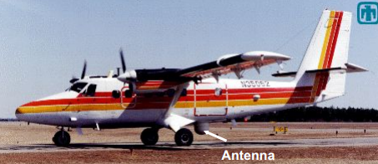
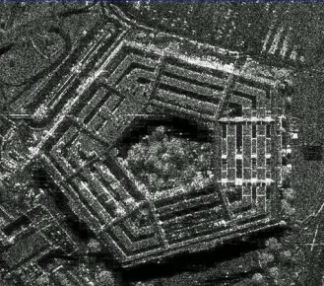
SAR Imager
SAR carried by the Sandia Twin Otter aircraft.
Data is collected at ranges of 2 – 15 km.

Slide 6
Problem Statement
Solution: Team will use multiple stationary antennas that transmit and receive signals.
  ECE will design a stationary schematic of a radar system with 20 antennas.
  ME will design the physical structure for the antennas and the associated horns that go with them.
  IE will manage human factors, risk analysis, project schedule, and overall budget.

Slide 7
Intended Use and Users
Intended Use: Theoretical implementation and testing.
  Primary use: Check for the transmission and receiving of pulse by the antennas.
Intended Users: Student members of the team.
  As a research project, it is intended to be an operating physical schematic of the project.

Slide 8
Team Qualifications
Project Manager: Jasmine Vanderhorst
Industrial Engineer

Slide 9
Team Qualifications
Project Manager (PM) – Jasmine Vanderhorst (IE)
  Courses: Eng. Management, Business Ethics, Industrial Tools
  Experience: 4 Internships – program & project management
Asst. (PM) & Antenna Engineer – Matthew Cammuse (EE)
  Courses: Electromagnetic Fields I & II, Digital Comm., Digital Logic, Microprocessors, Circuits I & II
  Experience: NSWCDD Internship - Electromagnetic and Radio Frequency Department

Slide 10
Team Qualifications (cont’d.)
Asst PM & Antenna Structure – Malcolm Harmon (ME)
  Courses: Mechanics & Materials, 3 year Certification in AutoCAD
  Experience: 3-Dimensional Software Experience, Building Manager
Lead Engineer & Programmer – Patrick De la Llana (ECE)
  Courses: Digital Logic, Data Structures, Control Systems, Digital Communications, and Microprocessors
  Experience: CAPS (Center for Advanced Power Systems) research

Slide 11
Team Qualifications (cont’d.)
Co-Lead Industrial Engineer & Treasurer– Benjamin Mock (IE)
  Courses: Manuf. Process, Engineering Materials, Engineering Management, Human Factors, and Ergonomics
  Experience: Treasurer of 2 organizations, Southeast District Parliamentarian for 1 organization, time management, risk forecasting, and technical writing.
Co-Lead Electrical & RF Engineer – Joshua Cushion (EE)
  Courses: Electronics I & II Labs, Power Electronics
  Experience: 3 Internships – Digital & Analog Circuit Design & Analysis

Slide 12
Team Qualifications (cont’d.)
Signal Processing Engineer & Document Control – Julia Kim (EE)
  Courses: Power Electronics, Fundamentals of Power Systems, and Power Systems I, Signals & Systems
  Experience: Lab work in Advanced Circuits and Electronics
Co-Lead Mechanical Engineer & Antenna Structure – Mark Poindexter (ME)
  Courses: ME Tools & Lab, Mechanical Systems I & II, and Dynamic Systems II
  Experience: designing with Pro E Software, work with small & large machines and automotive repairs

Slide 13
System Breakdown
RF Engineer: Joshua Cushion
Electrical Engineering

Slide 14
Project Subsystems
Electrical System
  Radio Frequency Circuit Components
  Power Supply Printed Circuit Board (PCB)
  Field Programmable Gate Array (FPGA) Board
Antenna Design
Mechanical Structure

Slide 15
Electrical System
RF Engineer: Joshua Cushion
Electrical Engineering

Slide 16
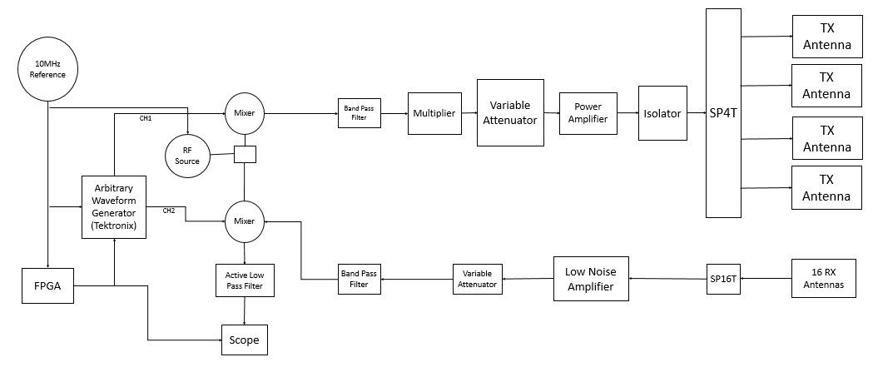
Block Diagram – Simple Model
Simple Model
Joshua Cushion

Slide 17
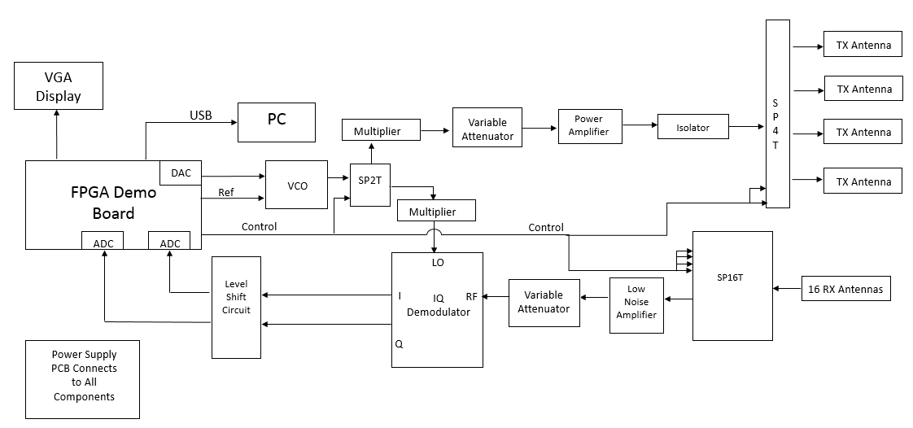
Block Diagram – Advanced Model
Advanced Model
Joshua Cushion

Slide 18
Concept Generation – Electrical System
Advanced Model
Simple Model
Advantages :
  Does not include test equipment
  Image processing is done while system is running
Disadvantages:
  Heavy dependence on the FPGA
    More FPGA programming tasks
  High risk of timing issues
Advantages :
  Very little dependence on the FPGA
    Less FPGA programming tasks
  More reliable switching time for switches
Disadvantages:
  Requires test equipment
    Oscilloscope
    Waveform generator
  Image processing is done after a complete cycle

Slide 19
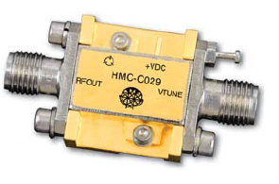
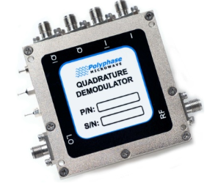
Major Circuit Components
Voltage Controlled Oscillator (VCO)
  Creates the high frequency transmit signal
  Specifications:
    Operating frequency: 5 – 10 GHz
    Output power: +20 dBm
    Input Voltage: 8 - 15 V
IQ Demodulator
  Represents the phase and amplitude
  of the RF input as a output voltage
  Specifications
    LO/RF frequency: 6 – 10 GHz
    DC offset: (-8) – (+8) mV
    Input voltage: ±5 V
VCO: HMC-C029
IQ Demodulator:AD60100B

Slide 20
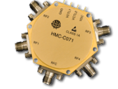
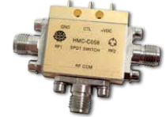
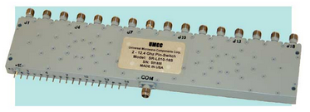
Major Circuit Components
Switches
  Single Pole Double Throw (SPDT)
  Single Pole Four Throw (SP4T)
  Single Pole 16 Throw (SP16T)
Specifications
  Operating frequency
  Switching times
  Output power
  Supply Voltage
SP4T: HMC-C071
SPDT: HMC-C058
SP16T: SWL01016S

Slide 21
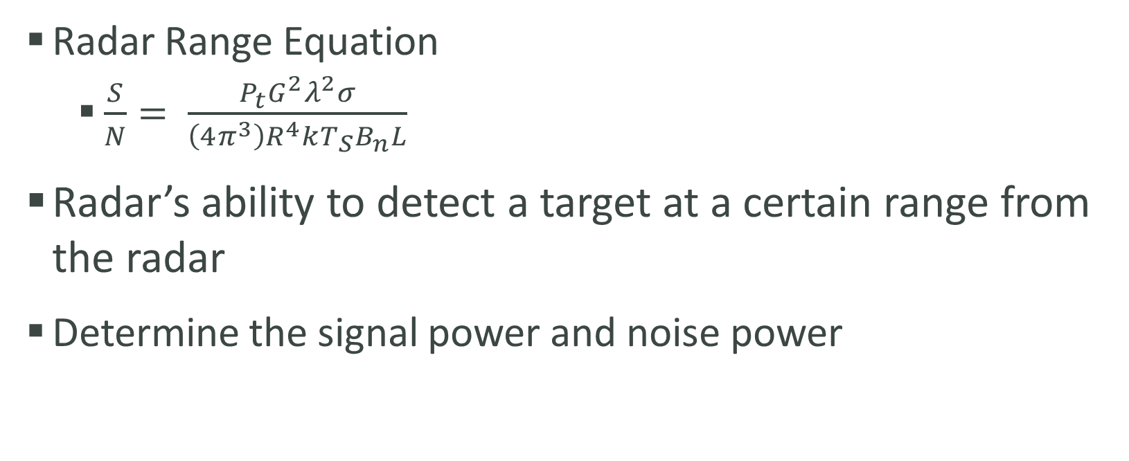
Major Task: Radar Range Equation Parameters
Radar Range Equation
  $\frac{S}{N}= \frac{P_{t}G^{2}λ^{2}σ}{\left(4π^{3}\right)R^{4}kT_{S}B_{n}L}$
Radar’s ability to detect a target at a certain range from the radar
Determine the signal power and noise power

Slide 22
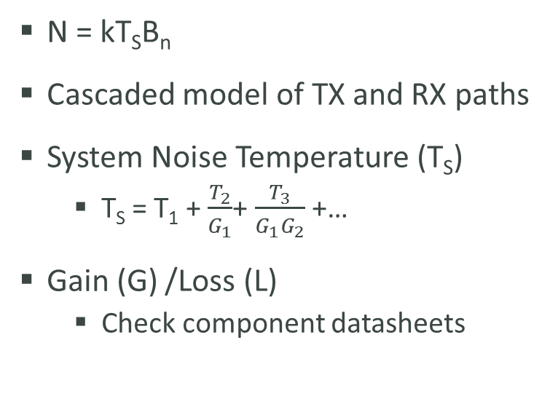
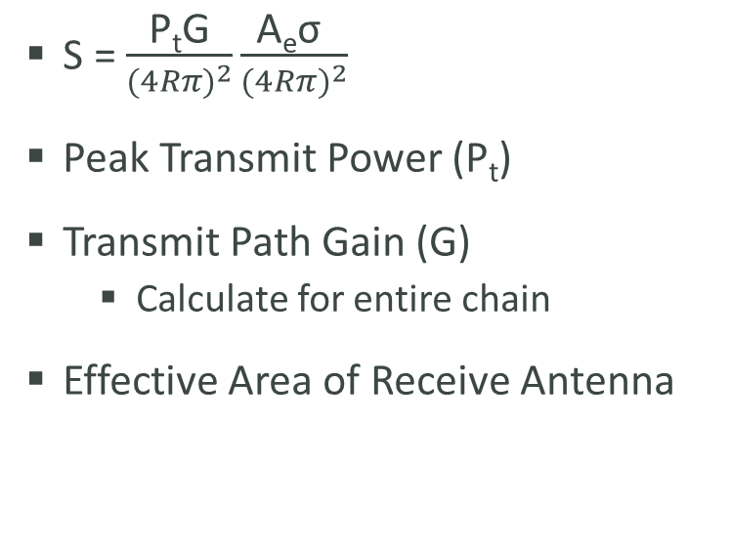
Signal to Noise Ratio
Signal Power
Noise Power
S = $\frac{\text{P}\text{t}\text{G}}{(4{Rπ)}^{2}}\frac{\text{A}\text{e}\text{σ} }{(4R{π)}^{2}}$
Peak Transmit Power (P_{t})
Transmit Path Gain (G)
  Calculate for entire chain
Effective Area of Receive Antenna
N = kT_{S}B_{n}
Cascaded model of TX and RX paths
System Noise Temperature (T_{S})
  T_{S} = T₁ + $\frac{T_{2}}{G_{1}}$+ $\frac{T_{3}}{G_{1}G_{2}}$ +…
Gain (G) /Loss (L)
  Check component datasheets

Slide 23
Power Supply and Distribution
Signal Processing Engineer – Julia Kim
Electrical Engineering

Slide 24
Concept Generation
Goal: To efficiently supply and distribute power to the components in the electrical system
One main power supply input
Options:
  Solder less bread board with Through-Hole Technology (THT) components
  Design a printed circuit board (PCB) with soldered components

Slide 25
Proposed Design
Printed Circuit Board (PCB)
Requirements
  Accept input from a main power supply
  13 output connections, one for each component
  Supply the required input voltage and current for each component
  Operate within the specified temperature range for each component

Slide 26
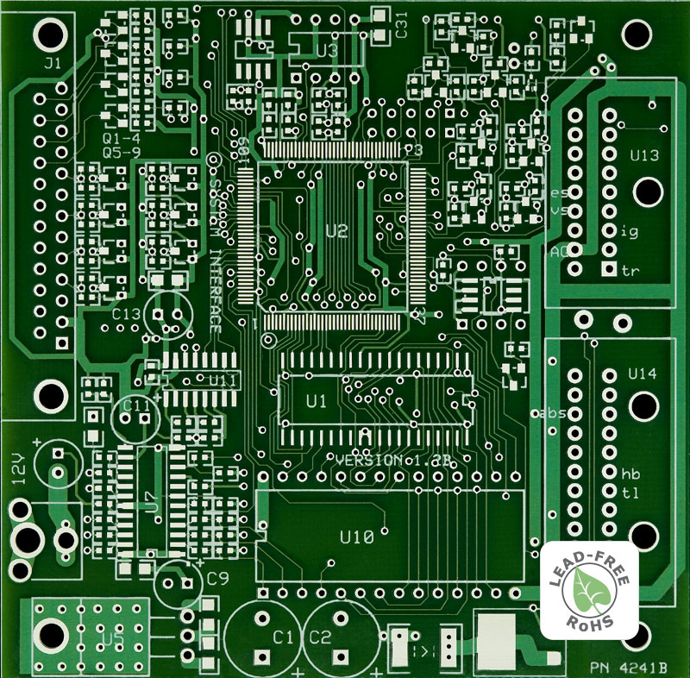
Statement of Work
Tasks:
  Gather info for each component:
    Max, min, typical
      Input voltage
      Input current
      Input power
      Operating temperatures

Slide 27
FPGA Programming
Lead Programmer: Patrick de la Llana
Electrical & Computer Engineering

Slide 28
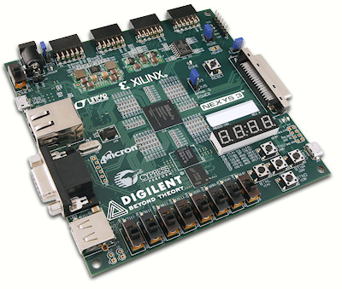
Concept Generation & Selection: FPGA
Digilent Nexys 3
  Newer version of Nexys 2
Specifications:
  USB port
  8-bit VGA Display
  100MHz clock
  Pmod capability

Slide 29
FPGA: Needs & Wants
100 MHz clock
  Switching edge needs to be 10ns
Pmod Capability
  For the purpose of plug in A/D and D/A converters.
USB port
  Desired for simplicity.
VGA port
  VGA display of image.

Slide 30
Tasks of FPGA
Generate Signal
Control Timing
  SPDT - Transmit and Receive Modes
  SP4T – Transmit Antennas.
  SP16T – Receive Antennas
Store Data
  Voltages and phases from the IQ demodulator into data.
Image processing
  16 point Fast Fourier transform
  End result a 1-Dimensional display of pixels divided into 16 columns.

Slide 31
Major Goals
Create Timing Diagram
  Sequential mapping of signals to match timing.
Interface Control Document (ICD) Chart
  Make sure all interfaces are compatible
    (voltage, cable type, etc.).
Test code when component arrives.
Research more into FPGA and LabVIEW compatibility.

Slide 32
Antenna Design
Antenna Engineer: Matt Cammuse
Electrical Engineering

Slide 33
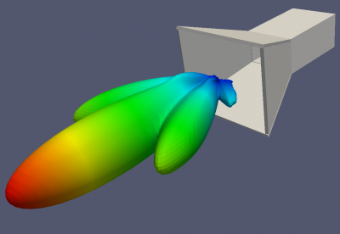
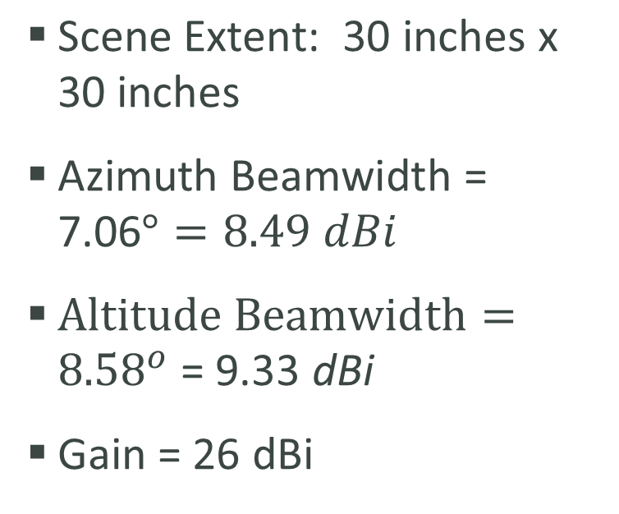
Antenna Instruments & Conditions
Instruments
Conditions
Horn Antenna
  X-Band: 10 GHz
Waveguide-to-Coaxial adapter
$\text{Scene} \text{Extent}\text{: 30 }\text{inches} \text{x}\text{ 30 }\text{inches}$
$\text{Azimuth} \text{Beamwidth}\text{ = 7.06}°=8.49 dBi$
$Altitude Beamwidth={8.58}^{o}\text{ = 9.33 }\text{dBi}$
Gain = 26 dBi

Slide 34
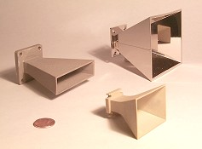
Preferred Horn Antenna
Company: Advanced Receiver
Antenna Type: X-Band Horns
Model No: MA86551
Center Frequency: 10.525 GHz
Frequency Range: 8-12.4 GHz
Nominal Gain: 17 dBi
H-Plane (Azimuth) beamwidth: 25°
E-Plane (Altitude) beamwidth: 25°
RF Connection: Mates with UG-39/U
Price: $20.00
Quantity: 20
Total Cost: $400.00
Azimuth Range = 106 in. [8.8 ft.]
Altitude Range = 106 in. [8.8 ft.]
Scene Extent ≈ 9 feet x 9 feet

Slide 35

Alternative Horn Antennas
    Advanced Technical Materials: High Band – Model No. 90-443-6
    Advanced Technical Materials: High Band – Model No. 75-443-6
Price per horn: $465.50
Frequency Range: 8.20-12.4 GHz
Gain: 24 dBi
H-Plane (Azimuth) beamwidth: 10.6°
E-Plane (Altitude) beamwidth: 8.8°
Height: 7 in.
Width: 10 in.
Length: 20.2 in
Price per horn: $522.50
Frequency Range: 10-15 GHz
Gain: 24 dBi
H-Plane (Azimuth) beamwidth: 10.5°
E-Plane (Altitude) beamwidth: 8.9°
Height: 5.73 in.
Width: 8.07 in.
Length: 17 in.

Slide 36
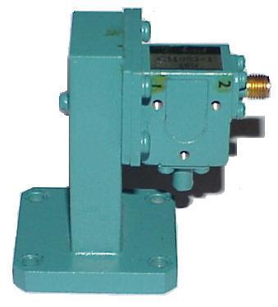
Waveguide-to-Coaxial Adapter
    WR90 Waveguide Isolator X-Band 8.2 to 12.4 GHz
    Flann 16094-NF | WR90 to N-Female Waveguide Adapter X-Band
Frequency Range: 8.2-12.4 GHz
Price: $79.95
Configured with Isolator
  Reduces leakage
Frequency Range: 8.2-12.4 GHz
Square Non-Choke Flange
Price: $129.95
    Omega Laboratories Model 108 - WR90 to N-Female Waveguide Adapter
Frequency Range: 8-12.4 GHz
Square Non-Choke Flange
Price: $129.95

Slide 37
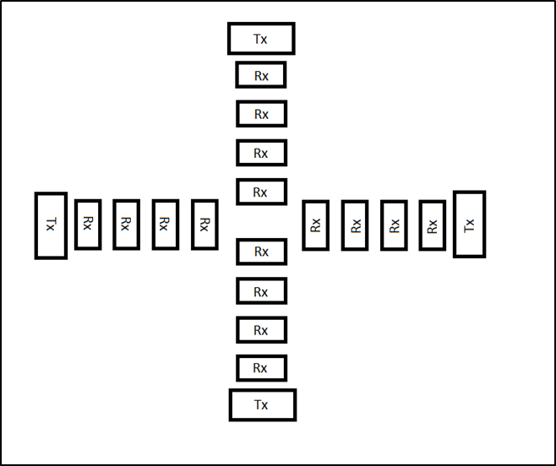
Overall Structure
Linear Antenna Apertures (2)
  Transmit – 4
  Receive – 16
T-shape design
  Apertures crossing
Vertical Aperture → Altitude
Horizontal Aperture → Azimuth
32 Phase Centers

Slide 38
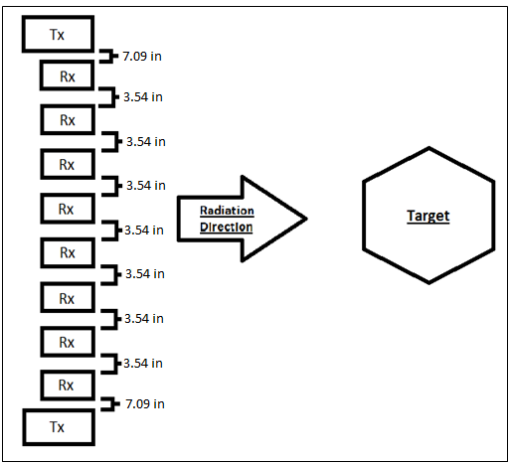
Antenna Design - Aperture
Transmits Antennas (Tx) – 2
  Location: Ends of array
Receive Antennas (Rx) – 8
  Location: Between transmit antennas
16 Phase Centers
  Midpoint between Tx and Rx
Antenna Spacing
  Transmit-to-Receive Spacing = 7.09 in
  Receive-to-Transmit Spacing = 3.54 in
  Prevents grating lobes
  Array Factor

Slide 39
Major Tasks
Calculate required Beamwidth and Gain
Find capable instruments
  Horn antennas
  Waveguide-to-coaxial
Determine spacing between antennas

Slide 40
Mechanical Design
Antenna Structure Engineers:
Mark Poindexter & Malcolm Harmon
Mechanical Engineering

Slide 41
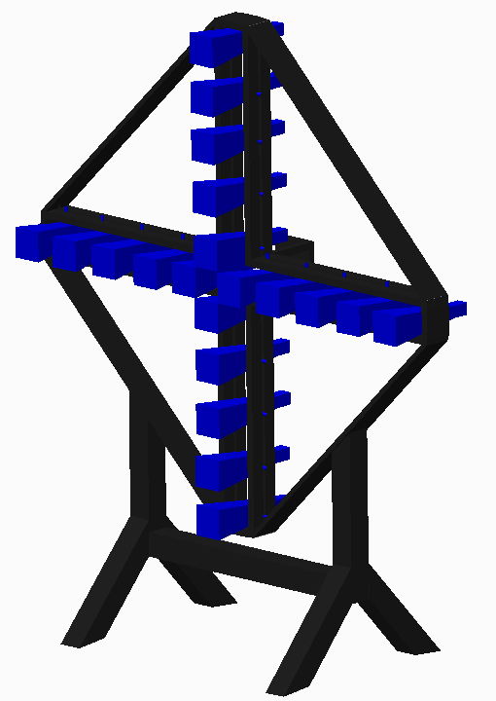
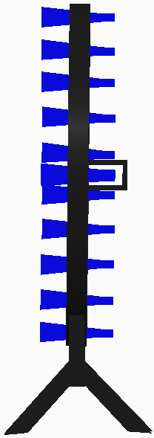
Structure – Design 1
Horn Alignment
  T Configuration
Horn Placement
  Adjustability
Electrical Components
  Detachable Box
Material
  Aluminum Based Metal
Stand
  Saw Horse

Slide 42
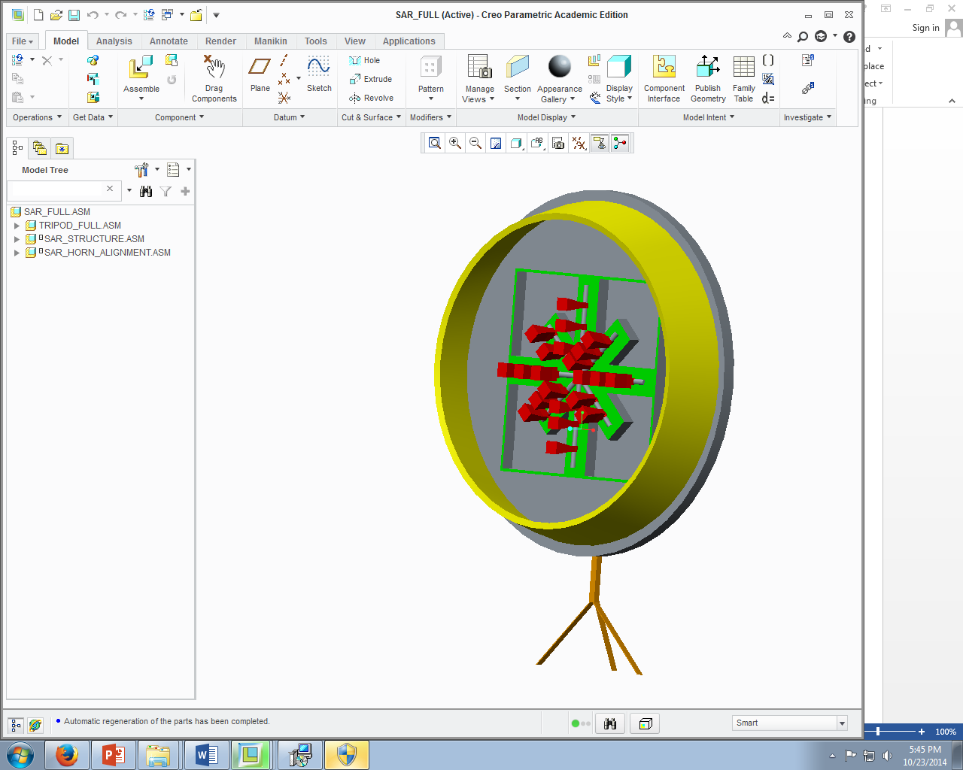
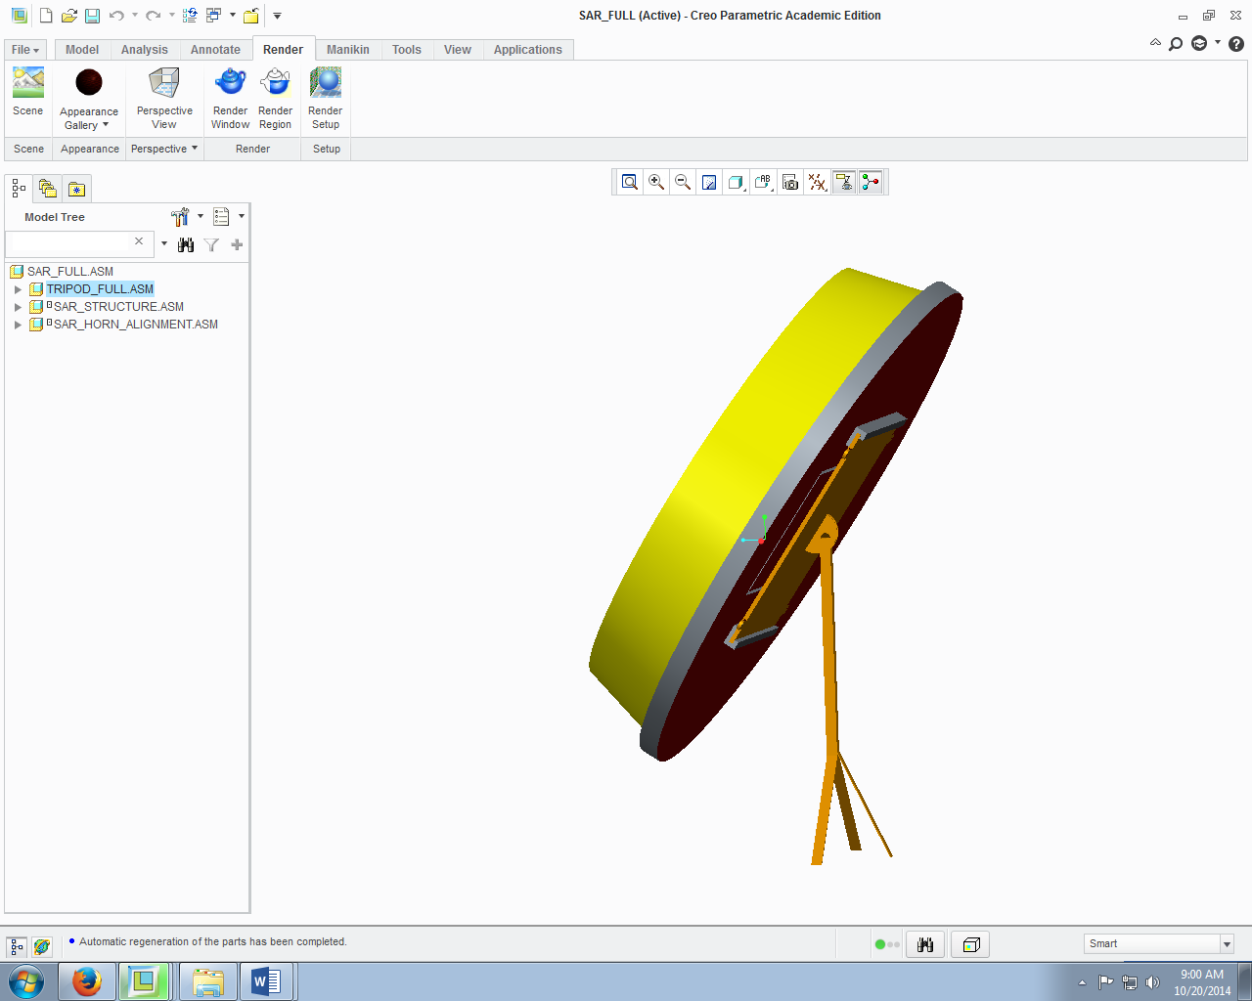
Structure – Design 2
Horn Alignment
  Cylindrical Web Configuration
Horn Placement
  Adjustability
Electrical Components
  Detachable Horn Cover
Material
  Galvanized Steel Based Metal
Stand
  Tripod

Slide 43
Comparison
Scale: 1 - 5 (Constructability) | Design 1 | Design 2
Phase Centers | 5 | 3
Horn Adjustability | 4 | 4
Horn Coverage | 2 | 4
Electrical Components | 4 | 3
Structure Mounting | 3 | 3

Slide 44
Material Selection
Scale 1-4 | Weight | Overall Strength | Machinability | Cost | Total
Aluminum | 3 | 2 | 1 | 2 | 8
Galvanized Steel | 4 | 1 | 2 | 1 | 8
ABS | 1 | 3 | 3 | 4 | 11
PLA | 2 | 4 | 4 | 3 | 13

Slide 45
Synthetic Aperture Radar –
Final Design
Choosing the Features
Parts Retained
Design 1 | Design 2
Horn Placement Component Box | Horn Shield Back Plate Cover
Blended Parts
Final Design
Wall Mount Design Stand
New Features
Final Design
ABS Plastic

Slide 46
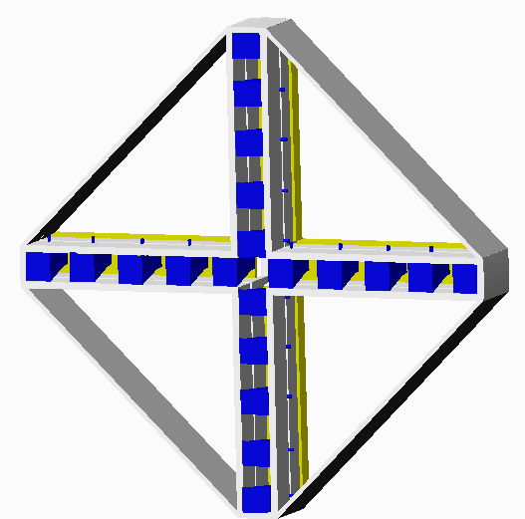
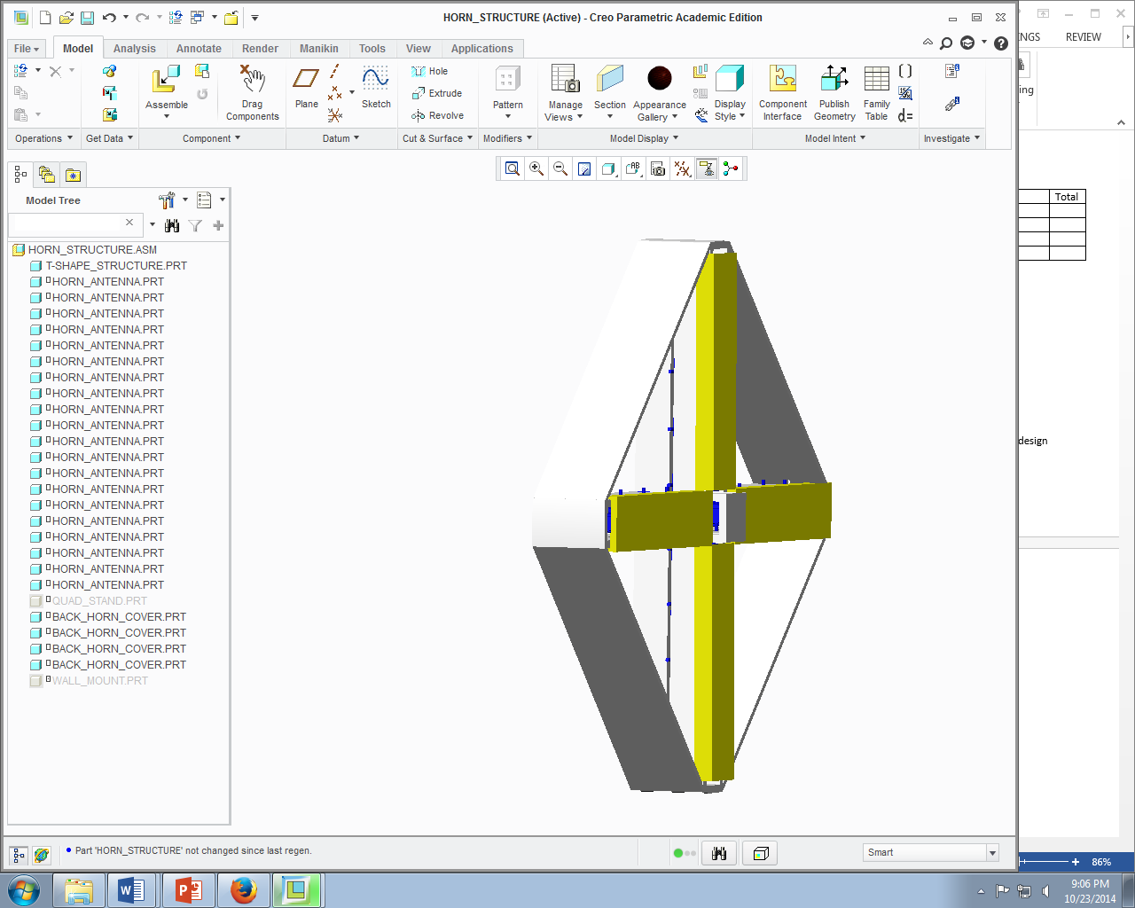
Retain Parts
Horn Placement Component Box | Horn Shield Back Plate Cover

Slide 47
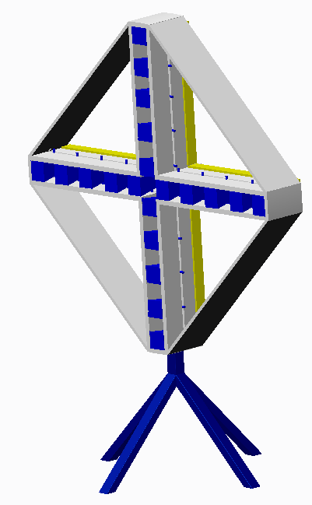
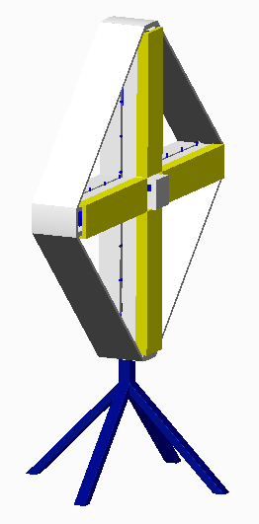
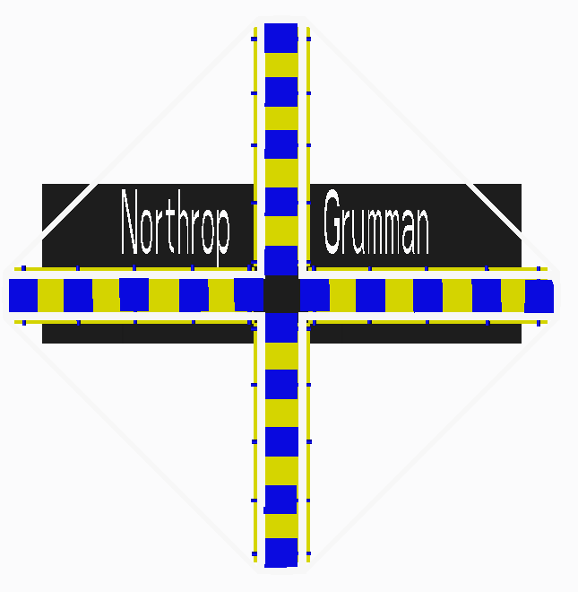
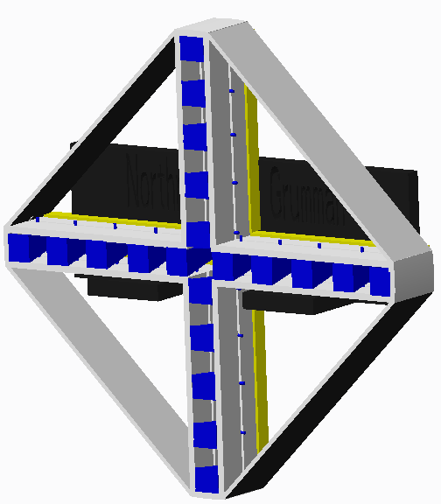
Parts Blended
Wall Mount | Quad Stand

Slide 48

Complete
Detailed Schedule
Project Manager: Jasmine Vanderhorst
Industrial Engineer

Slide 49
Project Main Tasks
Frequency Justification
Antenna Design
FPGA Programming ­
Trade-Off analysis
Simulation: Timing
Radar Range Equation
Transmit Path
Receive Path
Cabling Design
Conceptual Mechanical Design
Finalize Mechanical Design
Power Budget
Testing
Generate Interface Control Document
System Calibration
Generate Final Performance Characteristics

Slide 50
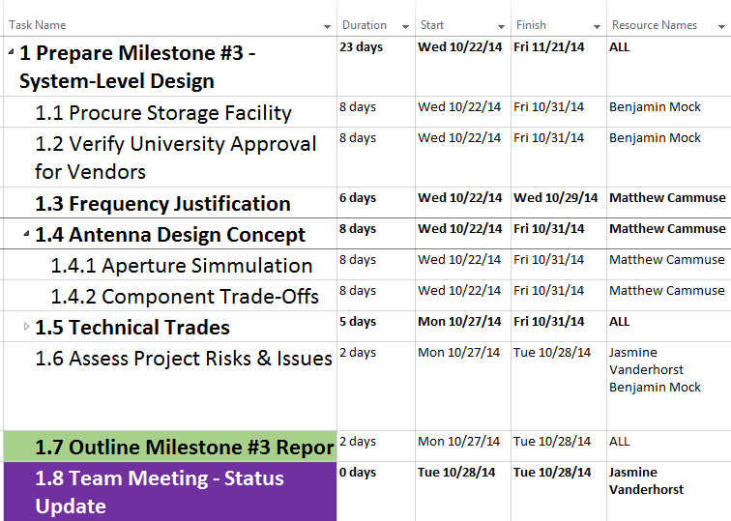
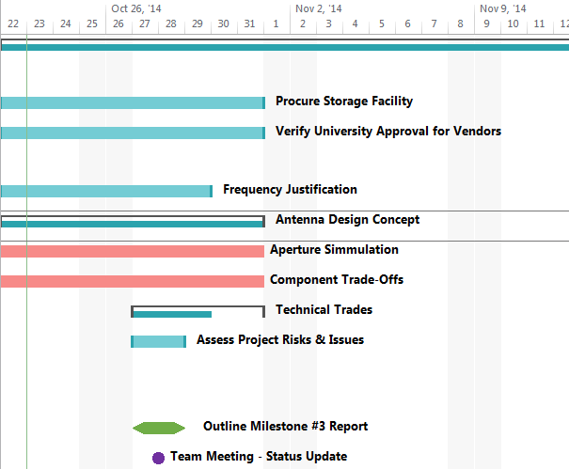
Critical Path – Antenna Design

Slide 51
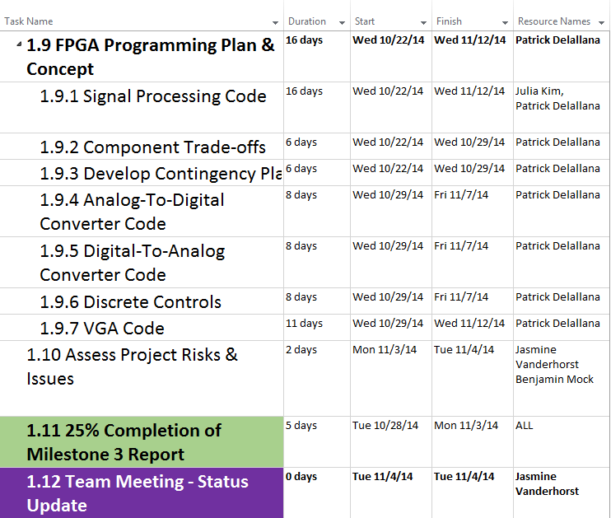
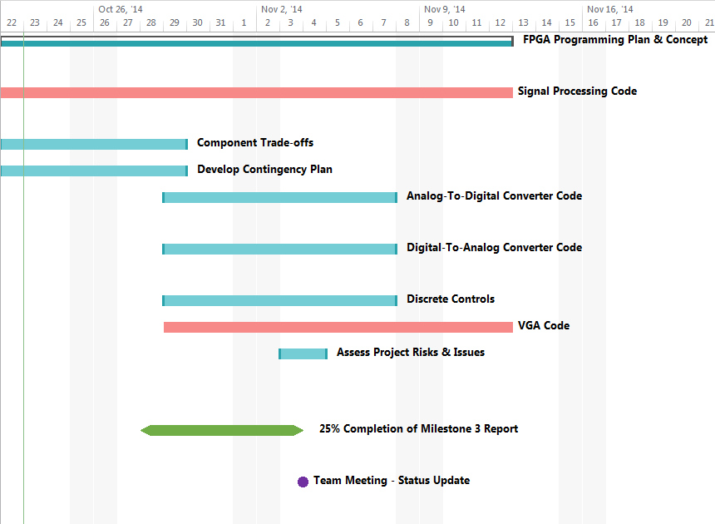
Critical Path – FPGA Programming

Slide 52
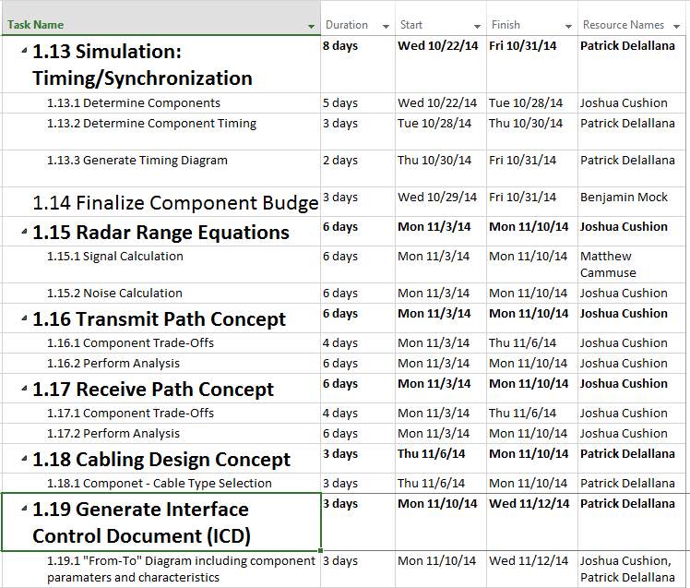
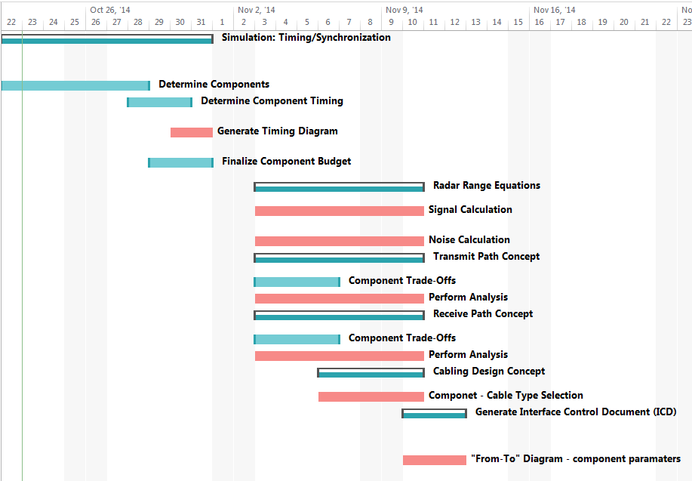
Critical Path – Analysis

Slide 53
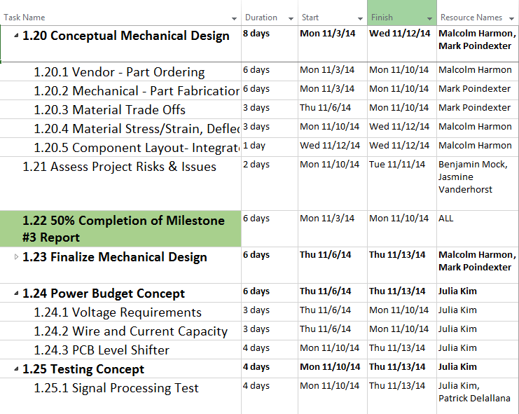
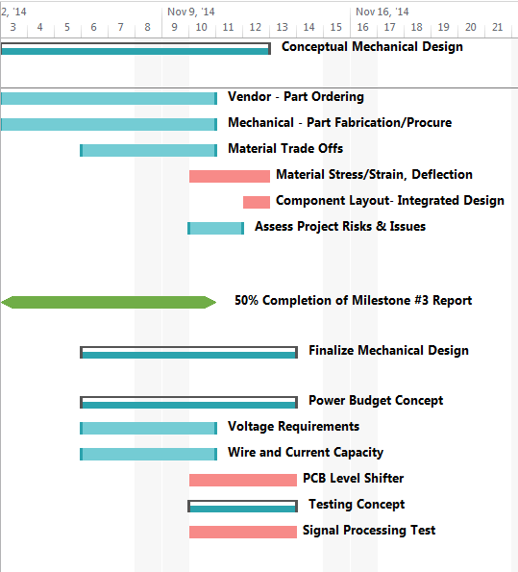
Critical Path – Mechanical & Power

Slide 54
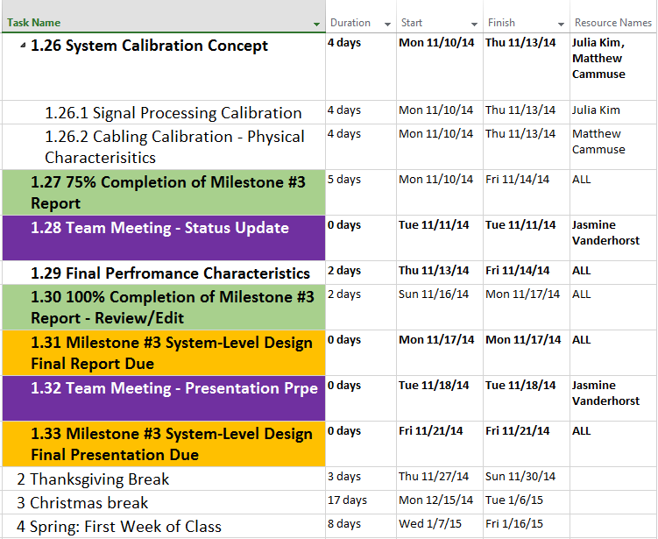
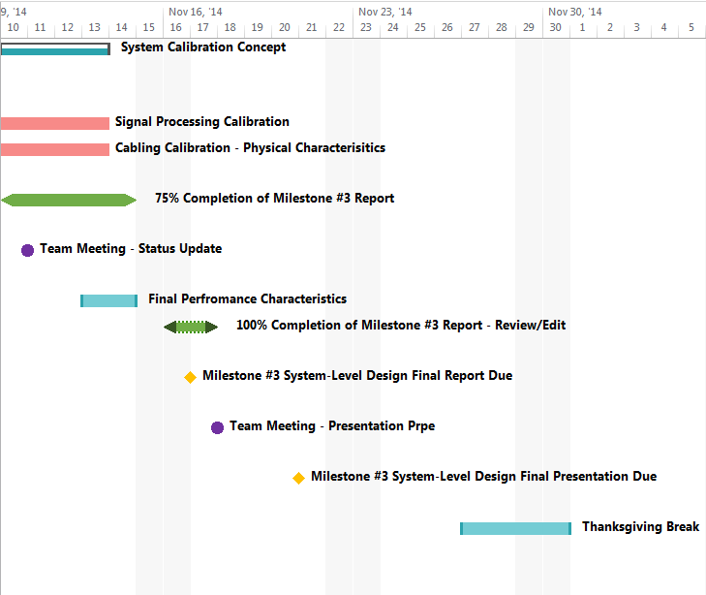
Critical Path – Calibration

Slide 55
Complete Detailed Budget
Co-Lead Engineer & Treasurer –
Benjamin Mock
Industrial Engineer

Slide 56
Major Component Cost - 1
Component | Distributor | Quantity | Unit Cost | Total Cost
FPGA | Digilent | 1 | $140.00 | $140.00
Antenna Horns | Advanced Receiver | 20 | $20.00 | $400.00
VCO | Hittite | 1 | $1,100.95 | $1,100.95
Power Amplifier | Fairview Microwave | 1 | $2,420.27 | $2,420.27

Slide 57
Major Component Cost - 2
Component | Distributor | Quantity | Unit Cost | Total Cost
Low Noise Amplifier | Fairview Microwave | 1 | $1,512.67 | $1,512.67
D/A Conv. | Digilent | 1 | $28.99 | $28.99
A/D Conv. | Digilent | 1 | $37.00 | $37.00
Freq. Mult. | Mini-Circuit | 1 | $41.95 | $41.95

Slide 58
Major Component Cost - 3
Component | Distributor | Quantity | Unit Cost | Total Cost
SPDT | Hittite | 1 | $69.95 | $69.95
SP4T | UMCC | 1 | $79.95 | $79.95
SP16T | UMCC | 1 | $25.95 | $25.95
Var. Atten. | Narda | 2 | $6.00 | $12.00

Slide 59
Major Component Cost - 5
Component | Distributor | Quantity | Unit Cost | Total Cost
IQ Demodul. | Polyphase Microwave | 1 | $1,512.67 | $1,512.67

Slide 60
Major Component Cost - 6
Component Subtotal |  | $9,043.96
Overhead | 20.00% | $1,808.79
Total Expense |  | $10,852.75
 | (Risk Mitigation Maximum) | $19,896.71

Slide 61
Project Expenses
Primary Tentative Expenses
Secondary Tentative Expenses
  RADAR Absorbing Foam & Support
  Cabling
  Mechanical Structure Fabrication
  Trihedral Reflectors
  Storage Apparatus
  Assembly Tooling
  3-D Printing Order
  Overhead
  Mannequin

Slide 62
Personnel Expenses - 1
Baseline Assumptions
  Hourly Rate $30.00
  Hours/Week 12hrs
  Total Weeks 30 (2 semesters)
  Total Hours 360hrs
  Fringe Benefits 29.00%

Slide 63
Project Expense - 2
Projected Expense
  Cost per Engineer
    $10,800.00
  Fringe per Engineer
    $3,132.00
  Total Cost for Team
    $111,456.00

Slide 64
Detailed Risk Assessment
Co-Lead Engineer & Treasurer –
Benjamin Mock
Industrial Engineer

Slide 65
Major Project Risks
Procurement Difficulties
Signal Processing Code
  Dependence on Critical Path
Budget Limitations

Slide 66
Minor Project Risks
Component Failure
Extraneous noise conflicts with signal processing
  Vibration & Heat Generation
Facility Availability
Non Integrated Circuit components require soldering which may negatively affect component quality

Slide 67
Questions & Comments
THANK YOU

