Slide 1


Electronic Synthetic Aperture Radar Imager
Team E#11/M#27 - FAMU Foundation NGES Project Presentation

Slide 2
The Engineering Program
NGES Enterprise Student Project
Jasmine Vanderhorst – Industrial Engineer
Benjamin Mock – Industrial Engineer

Slide 3
FAMU-FSU College of Engineering
Department | Anticipated graduating students in undergrad degree programs in Spring 2015
Chemical & Biomedical | 63
Civil & Environmental | 46
Electrical & Computer | 81
Industrial | 28
Mechanical | 117

Slide 4
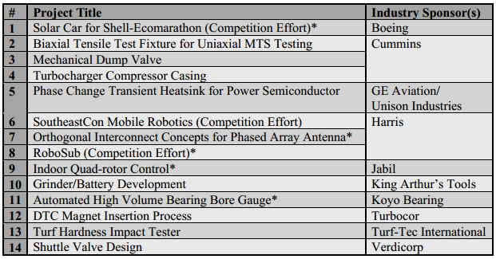
Impact of Senior Design
Notes:
Industry
Real-world challenges & opportunity to engage with professional engineers
Boeing, Cummins, Harris, Lockheed, and GE
SoutheastCon Mobile Robotics Competition
1st place in engineering design

Slide 5
Benefits of the NGES Program
Exposure To Industry Experts
  Pete Stenger
Professionalism
  Team Accountability
  Cooperative Learning
  Highly Detailed Work
  Design Integrity
  Timeliness
Experiences Gained
  EH&S Safety Training
  Radio Frequency Engineering
  DFMA Process Engineering
  Critical Decision Making
  Mechanical Design, Analysis, & Fabrication Process

Slide 6
Introductions
The Team Overview
Jasmine Vanderhorst

Slide 7
The Team Structure
Engineer | Jasmine Vanderhorst | Benjamin Mock | Joshua Cushion | Matthew Cammuse | Patrick Delallana | Julia Kim | Malcolm Harmon | Mark Poindexter
Field of Study | Industrial Engineering | Industrial Engineering | Electrical Engineering | Electrical Engineering | Electrical Engineering | Electrical Engineering | Mechanical Engineering | Mechanical Engineering
Tasks | -Project Management -Team Web Master -Reliability Engineering -Presentations | -Lead IE & Treasurer -Procurement -Safety & Testing -Reliability Engineering | -Lead EE & Radio Frequency Engineer -Power Supply Design -Electrical System Design | -Assistant Project Manager & Co-Lead EE -Antenna Array Design -Testing Strategy | -Co-Lead EE -FPGA Programming -VGA and A-to-D Conversion Coding -System Timing | -Co-Lead EE & Recording Secretary -Signal Processing -Image Calibration | -Assistant Project Manager -Vendor Relations -Antenna Frame Design -Material Analysis | -Co-Lead ME -Component Box Design -Cabling Design & Setup -Vendor Relations

Slide 8
Stakeholders
Northrop Grumman
  Corporate Sponsor: Pete Stenger
FAMU Administration
  University Advancement: Kacy Lowe
Electrical and Computer Engineering
  Lead Coordinator: Dr. Michael Frank
  Main Advisor: Dr. Simon Foo
  Co-Main Advisor: Dr. Shonda Bernadin
  Extra Reviewers: Dr. Bruce Harvey and Dr. Rajendra Arora

Slide 9
Stakeholders
Mechanical Engineering
  External Coordinators: Dr. Nikhil Gupta and Dr. Scott Helzer
  External Technical Advisor: Dr. Emmanuel Collins
  Teaching Assistants: Ricardo Aleman and Samuel Botero
Industrial Engineering
  External Coordinator: Dr. Okenwa Okoli
  Teaching Assistants: Emily Hammel and Margaret Scheiner

Slide 10
Project Overview
Radar Imager Project Scope
Matthew Cammuse – Electrical Engineer

Slide 11
Project Mission
Objective: Develop a “static, multi-antenna Synthetic Aperture RADAR (SAR) imager”
  In brief: Giant metal detector
Why?: Security
Prevention of guns, knifes or dangerous objects from entering public facilities:
  Schools
  Airports
  Office Buildings

Slide 12
Imaging Radar Operational Concept
40 x 40 inch scene
Pulsed Transmit/Receive
Imaging Radar
Static parts
COTS components
Digital beam forming
16 - 2.5 inch
1-D Cells in
Azimuth and
Elevation
PC Display
20 foot range to scene center
5 x 5 feet
Beams are formed
Digitally with Fourier
Transform, 16 in Azimuth
And 16 in Elevation
20nS wide RF
Pulse @ 10 GHz
16 - Azimuth
16 - Elevation
VGA Connection
X-Band Horn
Antenna Array

Slide 13
Electronic Radar Imager
Performance Characteristics
Requirement | Units | Value | Comments
Frequency | GHz | 10.0 +/- 0.1 GHz | Single frequency operation. BW supports 1/PW
Range to scene to be imaged | feet | 20 | 20 foot radius from center of antenna aperture
Scene extent | inches | 40 x 40 | The area to be imaged
Cross range resolution | inches | 2.5 | 1-D in Azimuth and Elevation
Down range resolution | inches | N/A | A future enhancement to performance
TX Pulse Width (PW) | nS | 20
Transmit Power | W | 0.2
Antenna aperture size | feet | 5 x 5 | Waveguide horns in cross configuration
Pulse Repetition Interval | nS | 100
Receiver Noise Figure | dB | 3 | Does not include front end losses
Image Time | mS | 0.5 | Time to collect 1 set of image data

Slide 14
Electrical System
Major Electrical Components & Designs
Joshua Cushion – Electrical Engineer

Slide 15
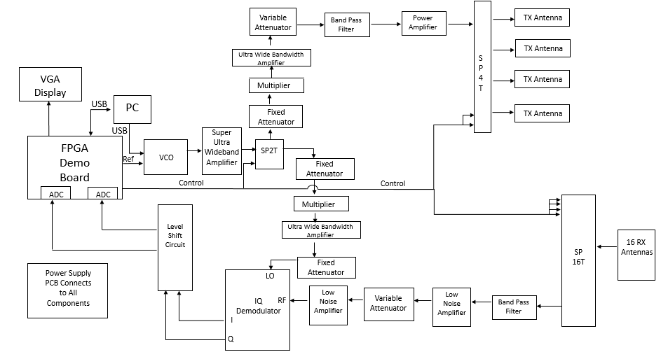
Electrical System Overview

Slide 16
Transmit Signal Chain
SPDT Switch
Frequency Multiplier
SP4T Switch
4 Antennas
Key Components
VCO
Band Pass Filter
Roles:
Generate radio frequency (RF) signal
  Target operating frequency: 10 GHz (X Band)
Transmit the RF signal
  Range: 20 feet
  Maximum transmit power: 10 W/m² (929 mW/ft²)
  ~ FCC Regulations

Slide 17
Receive Signal Chain
Low Noise Amplifiers
IQ Demodulator
Level Shift Circuit
Analog to Digital Converters
FPGA
Key Components
SP16T Switch
Band Pass Filter
16 Antennas
Roles:
Receive the reflected RF signal scatterings from target
IQ Demodulator
  Interpret the phase and amplitude of the received RF signals
  Convert phase and amplitude to DC voltages

Slide 18
Power Supply
FPGA
IQ Demodulator
Amplifiers
Power Supply
VCO
Frequency Multiplier
Switches
Dual Level Shift Circuit
Roles:
Generate the power for components
Maintain constant supply of voltage and current without overheating
Deliver the power to the components

Slide 19
Programming
FPGA, VGA Display, and Discrete Codes
Patrick Delallana – Electrical & Computer Engineer

Slide 20
Programmable Component
System will be controlled via FPGA.
FPGA will be coded in VHDL
Two modes
  Transmit
  Receive
Timing will be controlled via switches
  SPDT
  SP4T
  SP16T

Slide 21
Tasks of FPGA
Generate Signals
Control Timing
  SPDT - Transmit and Receive Modes
  SP4T – Transmit Antennas.
  SP16T – Receive Antennas
Store Data
  Voltages and phases from the demodulator into data.
Image processing
  End result a 1-Dimensional display of pixels divided into 16 columns.

Slide 22
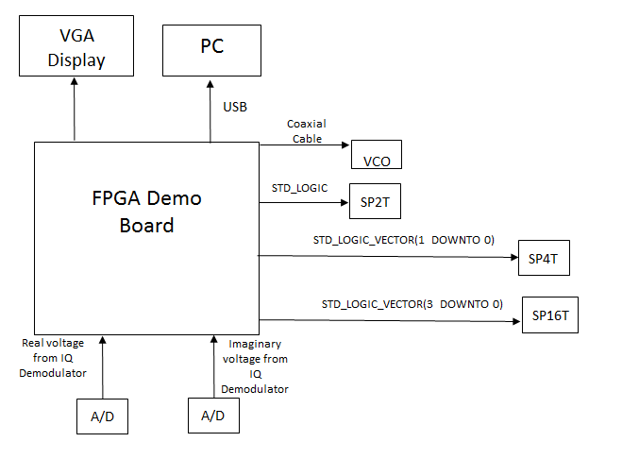
Hardware Design

Slide 23
Coding Subtasks
Discrete timing control
  Timing of switches
Analog to Digital Conversion Code
  Voltages from IQ Demodulator and store in 12 bit word
VGA Code
  Display line of pixels that corresponds to detected metal

Slide 24
Functionality Mitigation Strategies
For Discrete Timing
  Use push button to send pulse
Analog to Digital Conversion Code
  Display voltages on 7 segment display
VGA code
  Use switches to control where VGA is lit.

Slide 25
Signal Overview
Signal Processing
Julia Kim – Electrical Engineer

Slide 26
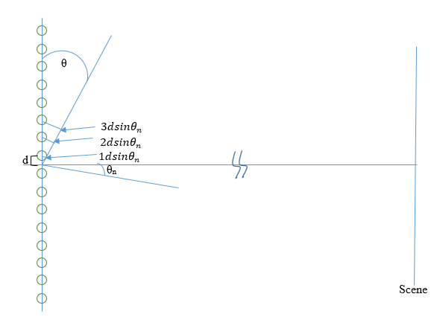
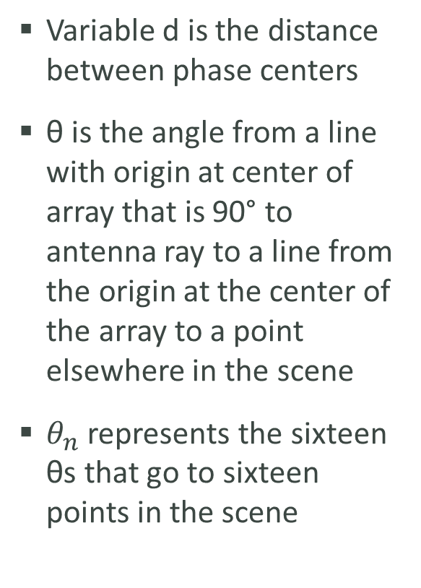
Signal Processing
Variable d is the distance between phase centers
θ is the angle from a line with origin at center of array that is 90° to antenna ray to a line from the origin at the center of the array to a point elsewhere in the scene
$θ_{n}$ represents the sixteen θs that go to sixteen points in the scene

Slide 27
Signal Processing
For image formation, the sum of the energy from some of the scatterers is taken and they are decomposed by multiplying them by the basis functions.
The basis function represents the energy that will come in from a different angle, so if it is multiplied by the total energy, it decomposes it into just that part.

Slide 28
Signal Processing
Fourier transform is used to decompose the waveform into the amounts of energy that come in from different angles.
Basically a 1-D image that tells the user where the energy is coming in from different angles in the scene

Slide 29
Mechanical Components
Antenna Mechanical Models
Malcolm Harmon – Mechanical Engineer
Mark Poindexter – Mechanical Engineer

Slide 30
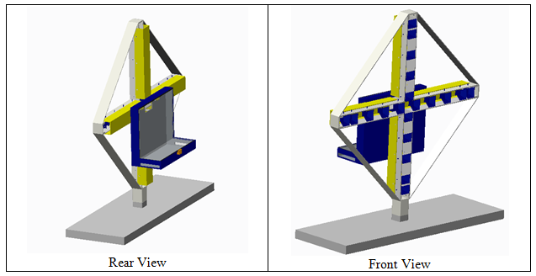
Antenna Structure Design
Includes stand and component box which stands 6 ft. high
5.3 ft. wide excluding stand, 6 ft. wide including stand

Slide 31
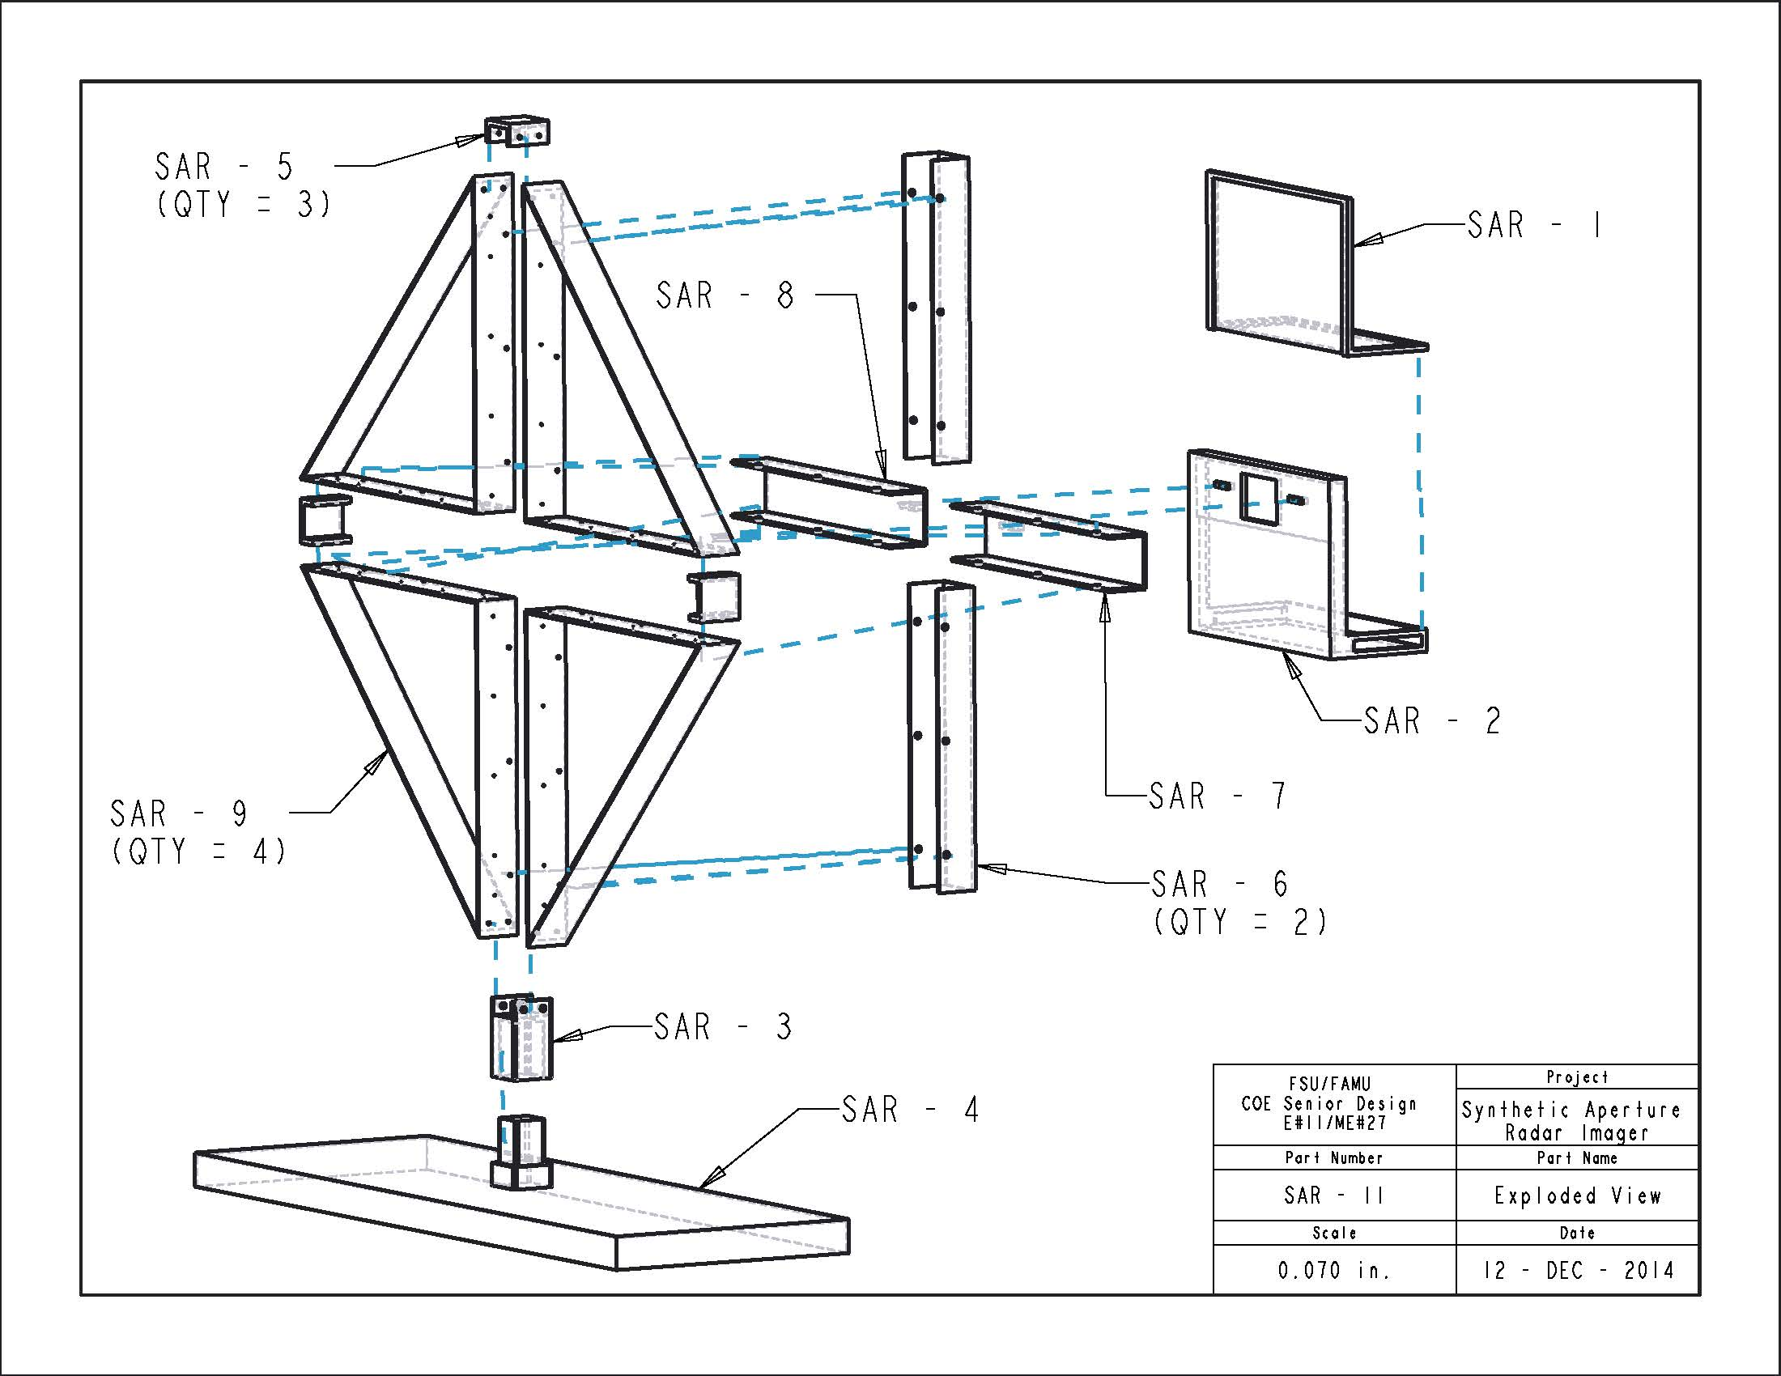
Antenna Structure Design
Exploded view separated by components
Part # | Part Name
SAR - 1 | Comp. Box Lid
SAR - 2 | Comp. Box
SAR - 3 | Channel To Stand
SAR - 4 | Stand
SAR - 5 | Channel Connector
SAR - 6 | Vertical Horn Cover
SAR - 7 | Left Horn Cover
SAR - 8 | Right Horn Cover
SAR - 9 | Quadrant Panel

Slide 32
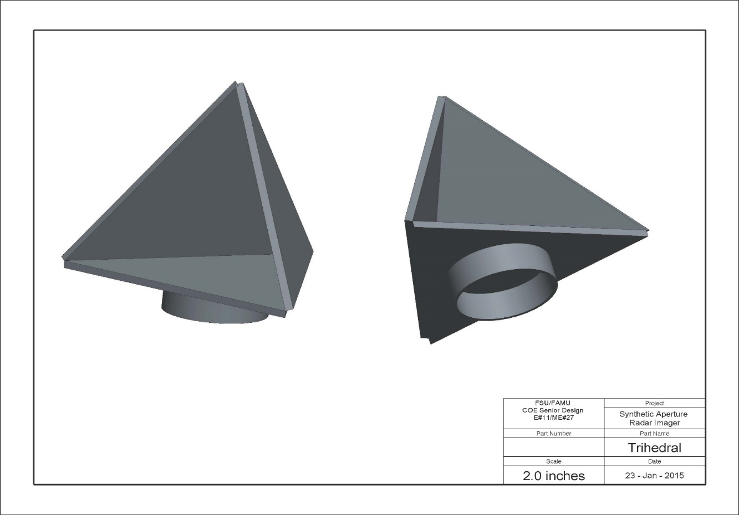
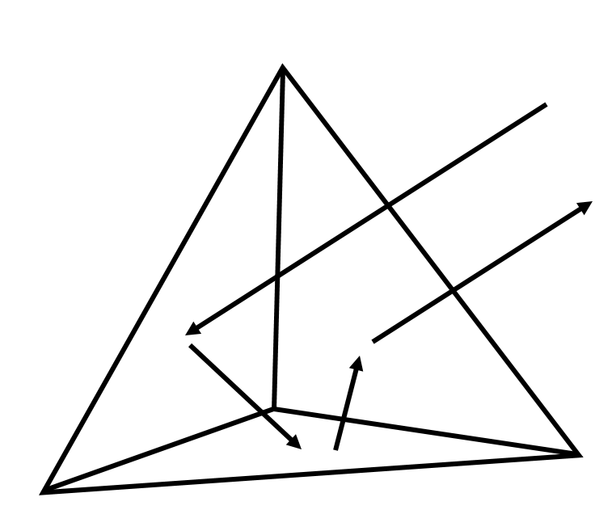
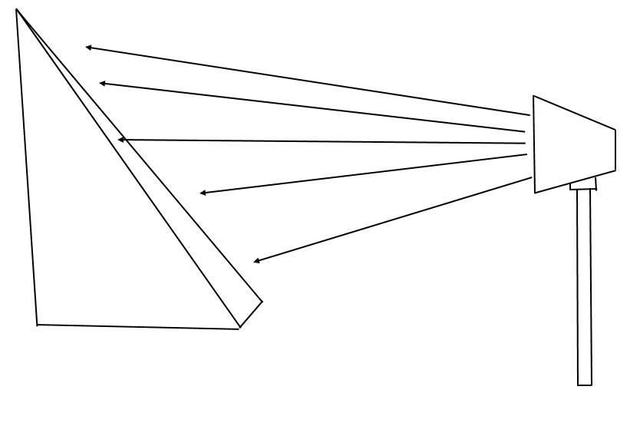
Trihedral
Triangular planes are joined together to form a triangular pocket to receive and reflect waves

Slide 33
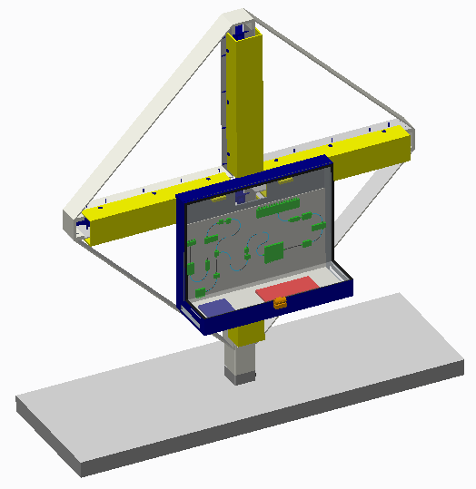
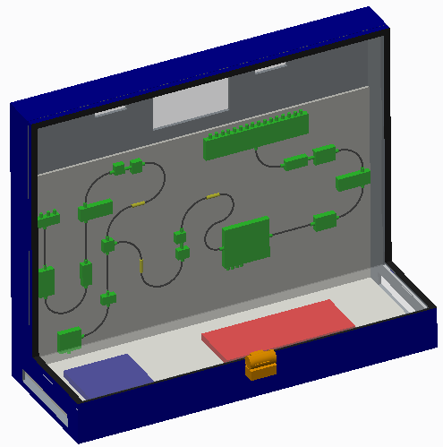
Component Box

Slide 34
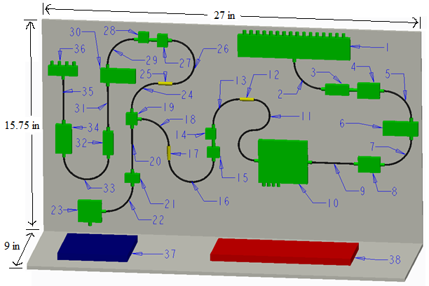
L-Shaped
Component
Sheet
1 - SP16T Switch 14 - Ultra Wide Band Amplifier 27 - Multiplier
2 - 3 Inch 90 Degree Bend Cable 15 - Multiplier 28 - Ultra Wide Band Amplifier
3 - Band Pass Filter 16 - 5 Inch 180 Degree Bend Cable 29 - 3 Inch 90 Degree Bend Cable
4 - Low Noise Amplifier 17 - Fixed Attenuator 30 - Variable Attenuator
5 - 3 Inch 90 Degree Bend Cable 18 - 3 Inch 90 Degree Bend Cable 31 - 3 Inch Cable
6 - Variable Attenuator 19 - SP2T Switch 32 - Band Pass Filter
7 - 3 Inch 90 Degree Bend Cable 20 - 3 Inch Cable 33 - 5 Inch 180 Degree Bend Cable
8 - Low Noise Amplifier 21 – Super Ultra Wide Band Amplifier 34 - Power Amplifier
9 - 3 Inch Cable 22 - 3 Inch 90 Degree Bend Cable 35 - 3 Inch Cable
10 - IQ Demodulator 23 - VCO 36 - SP4T Switch
11 - 7 Inch S Bend Cable 24 - 3 Inch 90 Degree Bend Cable 37 - FPGA
12 - Fixed Attenuator 25 - Fixed Attenuator 38 – Power Supply/Level Shift Circuit
13 - 3 Inch 90 Degree Bend Cable 26 - 5 Inch 180 Degree Bend Cable

Slide 35

Mechanical Summary
Accomplished Tasks
  Structure Design
  Stress Analysis
Current Tasks
  Fabrication shop
  Heat Analysis
  Component Securement

Slide 36
Project Schedule
Major Milestones & Goals
Jasmine Vanderhorst – Industrial Engineer

Slide 37
Schedule Update
Completed
Near Completion
Obtain Storage and Testing Facility
  Center for Advanced Power Systems (CAPS)
Level Shift Circuit Design
Programming Descriptions
Transmit, Receive, Demodulator LO Chain Design
Antenna Aperture Design
Welding and Assembly (February 12-27, 2015)
Anechoic Foam Expense Assessment (February 13, 2014)
Contingency Plans

Slide 38
Ongoing & Upcoming Activities
Component Ordering & Shipping
Signal Processing & Image Calibration
Data Storing Software for FPGA to PCU
Power Supply Design
Software & Hardware Demonstration (February 23-27)
DC Wire Harness Design
Hardware & Software Integration

Slide 39
Project Budget
Cost Breakdown
Benjamin Mock – Industrial Engineer

Slide 40
Budget

Slide 41
Large Budget Items
SPDT Switch
SP16T Switch
Mechanical Frame
Waveguide Adapters
Anechoic Absorbers
Price Reduction Strategy
  Compare Quote Estimates
  Compare Stock/Lead Times
  Analyze with team

Slide 42
Project Summary
Overall Project Assessment

Slide 43
Complete Electrical System
Goals:
Generate the RF signal (10 GHz)
Transmit the RF signal (20 feet)
Receive the reflected RF signal scatterings
Interpret the phase and amplitude of received RF signals
Generate and deliver power to operate the components

Slide 44
Major Challenges
Antenna Design
  Spacing & Accuracy
Anechoic Foam Chamber
  Design Layout, Quantity, and Expenses
Power Supply Design
  Concept Complexity
Signal Processing & Image Calibration
  Concept Complexity
Mechanical Components
  Horn Holding Apparatus

Slide 45
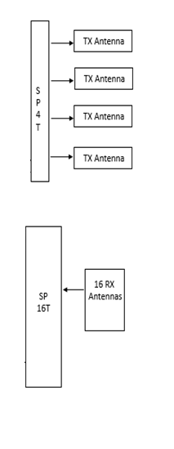
Contingency Plan
Testing Equipment:
Signal Generator
Spectrum Analyzer
Signal Generator
  RX Components:
  SP16T
  Variable Attenuator
  Low Noise Amplifier
  Band Pass Filter
  TX Components:
  SP4T
  Isolator
Spectrum Analyzer

Slide 46
Going Forward
Sub-Assembly & Testing
  CAPS
Midterm Hardware & Software Review
  Demonstration of Transmit and Demodulator LO Chain
  Demonstration of FPGA Coding and Discrete Controls
Connecting all major subassemblies and componentry
Hardware and Software Integration
System Integration Testing & Troubleshooting
Fault Tree Analysis- System Reliability
Capture Lessons Learned

Slide 47
Thank You!
Questions & Comments

