Slide 1


Electronic Synthetic Aperture Radar Imager
Team E#11/M#27 – Milestone #7
Spring 2015 – Final Senior Design Presentation

Slide 2
Team Agenda
Team Roles & Responsibilities
Project Overview
Electrical System
Power Supply Design
Programming Overview
Signal Processing
Mechanical Analysis
Project Management
Conclusion
Closing Questions

Slide 3
The Team Structure
Engineer | Jasmine Vanderhorst | Benjamin Mock | Joshua Cushion | Matthew Cammuse | Patrick De la llana | Julia Kim | Malcolm Harmon | Mark Poindexter
Field of Study | Industrial Engineering | Industrial Engineering | Electrical Engineering | Electrical Engineering | Electrical Engineering | Electrical Engineering | Mechanical Engineering | Mechanical Engineering
Tasks | Project Management Team Web Master Technical Writing & Formatting Presentations & Posters | Lead IE & Treasurer Procurement Budget Allocation Safety Analysis Risk Analysis | Lead EE & Radio Frequency Engineer Electrical System Design Testing Strategy & Application | Assistant Project Manager & Co-Lead EE Antenna Array Design Power System Wiring | Co-Lead EE FPGA Programming Timing, Switches, and A-to-D Conversion Coding System Timing | Co-Lead EE & Recording Secretary Signal Processing Image Calibration | Assistant Project Manager Vendor Relations Antenna Frame Design Material Analysis User Manual | Co-Lead ME Vendor Relations Component Box Design Cabling Design Heat Transfer Analysis User Manual

Slide 4
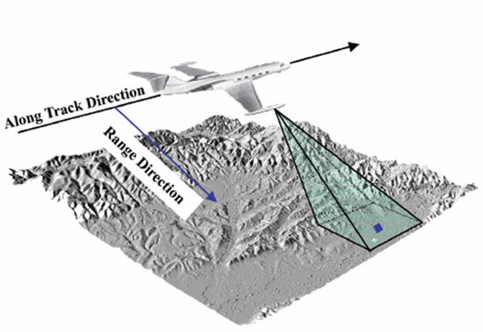
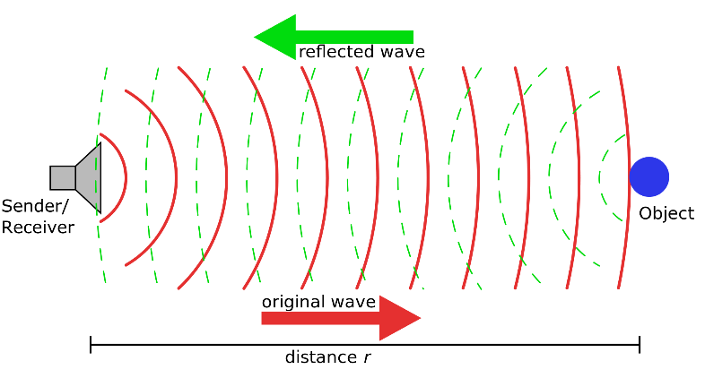
Project Introduction & Goals
SAR Introduction
Project Goal
What is an SAR?
Synthetic Aperture Radar: Typically, a single rotating antenna is attached to an aircraft flying over a target zone capturing several high resolution images to create a single image map.
Why is an SAR needed?
Typical Use: Environmental Monitoring, Earth-Resource Mapping, and Military Applications
What is the project goal?
To develop a “static, multi-antenna Synthetic Aperture RADAR (SAR) imager”
Project Theory: 20 stationary antennas, creating a single low resolution image for the purpose of detecting metal objects and weapons
How will this type of RADAR be used?
Typical Use: Government Buildings, Schools, Airports, & various other homeland security applications

Slide 5
Project Overview
Radar Imager Project Scope
Matthew Cammuse – Electrical Engineer

Slide 6
Performance Characteristics
Requirement | Units | Value | Comments
Frequency | GHz | 10.0 +/- 0.1 GHz | Single frequency operation. BW supports 1/PW
Range to scene to be imaged | feet | 20 | 20 foot radius from center of antenna aperture
Scene extent | inches | 40 x 40 | The area to be imaged
Cross range resolution | inches | 2.5 | 1-D in Azimuth and Elevation
Down range resolution | inches | N/A | A future enhancement to performance
Tx Pulse Width (PW) | nS | 20
Transmit Power | W | 0.2
Antenna aperture size | feet | 5 x 5 | Waveguide horns in cross configuration
Pulse Repetition Interval | nS | 100
Receiver Noise Figure | dB | 3 | Does not include front end losses
Image Time | mS | 0.5 | Time to collect 1 set of image data

Slide 7
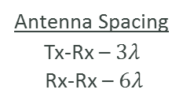
Imaging Radar Operational Concept
40 x 40 inch scene
Pulsed Transmit/Receive
Imaging Radar
Static parts
COTS components
Digital beam forming
16 - 2.5 inch
1-D Cells in
Azimuth and
Elevation
PC Display
X-Band Horn (17 dBi)
Antenna Array
20 [ft] range to scene center
5 x 5 feet
Beams are formed
Digitally with Fourier
Transform, 16 in Azimuth
And 16 in Elevation
20nS wide RF
Pulse @ 10 GHz
16 - Azimuth
16 - Elevation
Antenna Spacing
Tx-Rx – $3λ$
Rx-Rx – $6λ$
VGA Connection

Slide 8
Electrical System
Major Electrical Components & Designs
Matthew Cammuse – Electrical Engineer
Joshua Cushion – Electrical Engineer

Slide 9
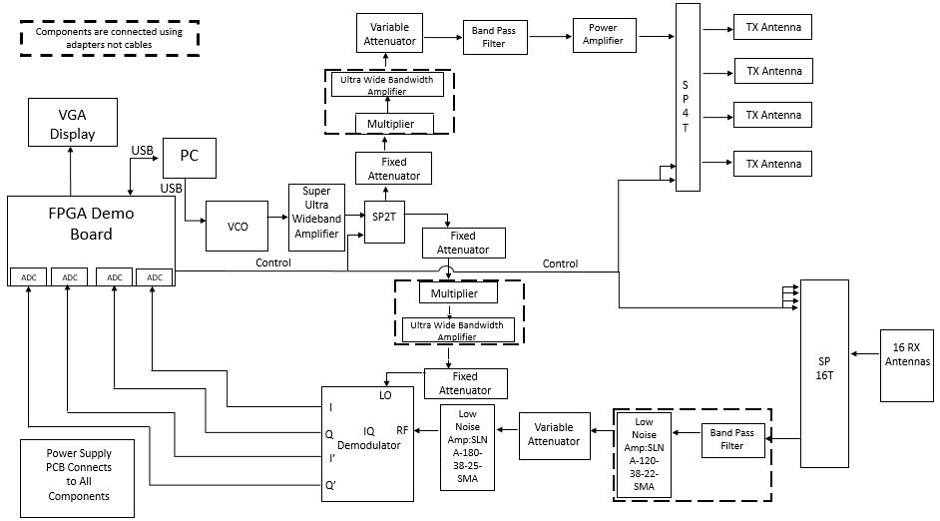
Electrical System Overview

Slide 10
Transmit Signal Chain Role
Role:
Generate radio frequency sinusoidal waveform
  Target operating frequency: 10 GHz (X Band)
  Maximum Power: 10 W/m² = 1 mW/cm² (FCC Regulations)
  Power in 10322 cm² (40 in²) Scene Extent = 0.008 mW/cm²
Key Components:
Voltage Controlled Oscillator
Power Amplifier
Frequency Multiplier
Signal Attenuators
SPDT Switch
SP4T Switch
Transmit Antennas

Slide 11
Transmit Signal Chain – Power
Component | Input Power |  | Output Power |  | Frequency
 | [dBm] | [mW] | [dBm] | [mW] | [GHz]
Voltage Controlled Oscillator (VCO) | 0.000 | 1 | -4.000 | 0.398 | 5
Super Ultra Wideband Amplifier | -4.196 | 0.381 | 21.804 | 151.501 | 5
Single Pole Double Throw (SPDT) Switch | 21.530 | 142.233 | 19.530 | 89.743 | 5
Fixed Attenuator | 19.413 | 87.347 | 9.413 | 8.735 | 5
Frequency Multiplier | 9.413 | 8.735 | -3.088 | 0.491 | 10
Ultra Wide Bandwidth Amplifier | -3.088 | 0.491 | 8.913 | 7.785 | 10
Variable Attenuator | 8.795 | 7.577 | -3.205 | 0.478 | 10
Band Pass Filter | -3.323 | 0.465 | -6.323 | 0.233 | 10
Power Amplifier | -6.518 | 0.223 | 25.482 | 353.319 | 10
Single Pole Four Throw (SP4T) Switch | 25.482 | 353.319 | 22.482 | 177.079 | 10

Slide 12
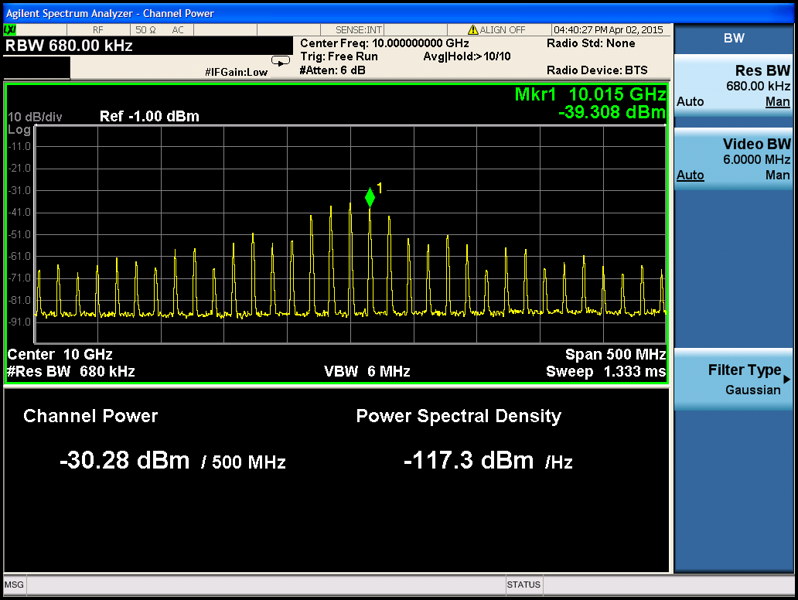
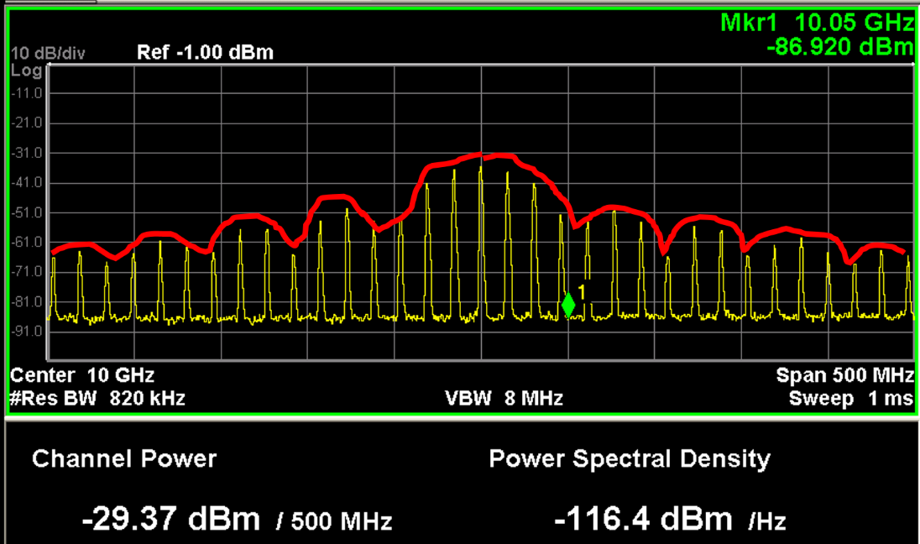
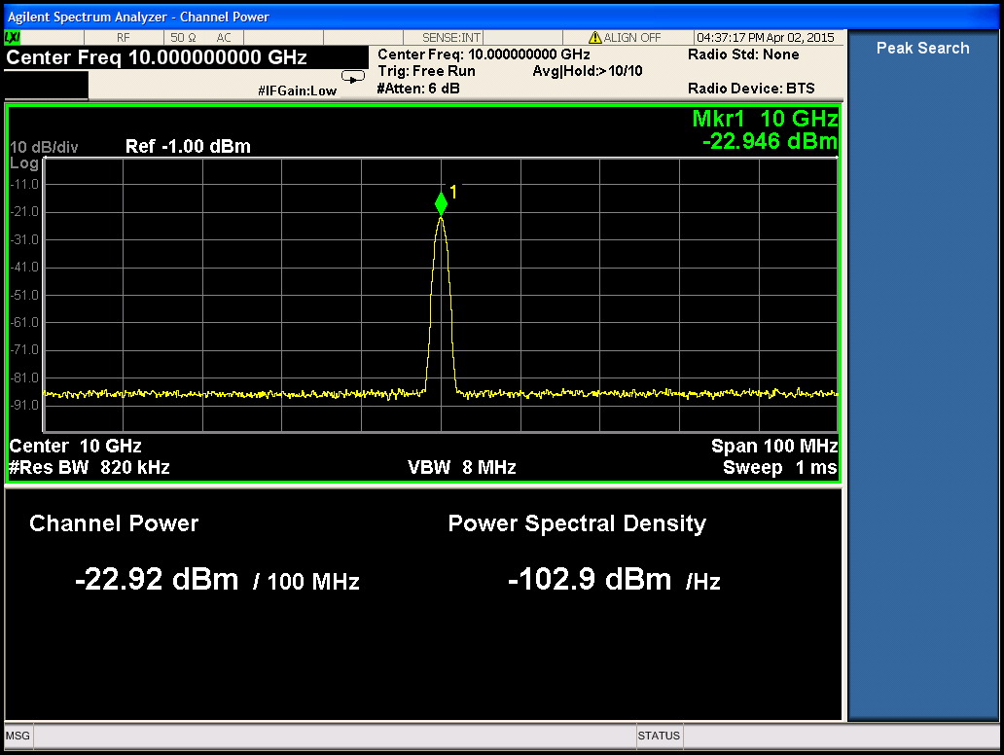
Transmit Signal Chain – Test Strategies
Measure and verify each at the output of SP4T switch:
Peak Signal Power
  42dB (attenuation) – 22.92 dBm = 21.804 dBm
Average Signal Power
  Attenuation – measured power/span – 10*log (duty cycle)
    17.749 dBm and 16.839 dBm
Pulse Width = 20nS
  Null Frequency = 50 MHz
  1/null frequency
Period (T) = 65nS
  Frequency = 15.38 GHz
  1/T

Slide 13
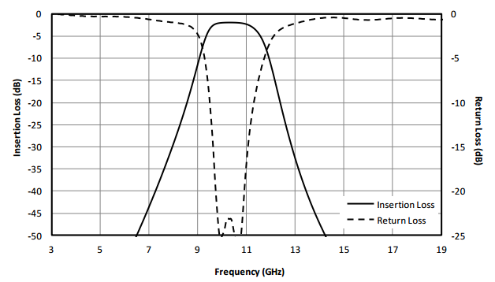
Design Changes – Transmit Signal Chain
VCO:
Role:
  Generate a signal of -4dBm and 5 GHz
Problem:
  Max frequency of signal: 4.631 GHz
  Once multiplied by 2 (9.262 GHz), does not meet minimum passband of BPF (9.75 GHz)
Alternative:
  Used an RF signal generator
  Output signal:
    Power: -4dBm
    Frequency: 5 GHz
Band Pass Filter Performance

Slide 14
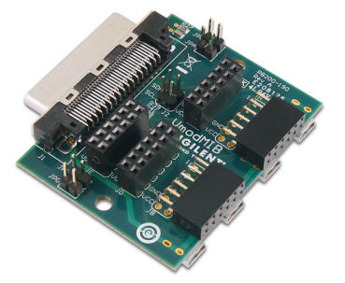
Design Changes – Transmit Signal Chain
FPGA to SPDT Switch:
Role:
  Generate a 20nS pulse with period of 60nS for SPDT switch
Problem:
  PMOD connectors provide low fidelity 20nS pulse
  VHDCI connector provides the correct signal
    Pins too small to solder to
Alternative:
  Use an signal generator until VHDCI breakout board is delivered
VHDCI Breakout Board

Slide 15
Receive Signal Chain Role
Role:
Receive the reflected radio frequency signal scatterings from target
Convert the received RF signals into digital voltages
Key Components:
Receive Antennas
SP16T Switch
Signal Attenuator
Low Noise Amplifier
IQ Demodulator
Four Analog to Digital Converters

Slide 16
Receive Signal Chain – Power
Component | Input Power |  | Output Power |  | Frequency
 | [dBm] | [mW] | [dBm] | [mW] | [GHz]
Single Pole Sixteen Throw (SP16T) Switch | -53.251 | 4.731E-06 | -57.951 | 1.603E-06 | 10
Band Pass Filter | -58.068 | 1.560E-06 | -61.068 | 7.820E-07 | 10
Low Noise Amplifier (LNA-SLNA-120-38-22-SMA) | -61.068 | 7.820E-07 | -23.068 | 4.934E-03 | 10
Variable Attenuator (SA4077) | -23.342 | 4.632E-03 | -37.342 | 1.844E-04 | 10
Low Noise Amplifier (LNA-SLNA-180-38-25-SMA) | -37.460 | 1.795E-04 | 0.540 | 1.132 | 10
Radio Frequency (RF) IQ Demodulator | 0.070 | 1.016E+00 | -6.930 | 0.203 | 10

Slide 17
Receive Signal Chain – Test Strategies
Measure power and frequency of signal input into RF channel of IQ demodulator
Measure the output voltage from the I and Q channels of IQ demodulator as the corner reflector moves within the scene extent

Slide 18
Design Changes – Receive Signal Chain
Level Shift Circuit:
Role:
  Shift the voltage range from IQ demodulator from ±100mV to 0 - 200mV
  Allows the 2 ADCs to sample negative I and Q voltages once shifted
Alternative:
  Sampled I, I’, Q, Q’ channels from IQ demodulator
  Used 4 ADCs and updated software to only sample the positive I and Q voltages
LO
ADC
I
FPGA Demo Board
Level Shift Circuit
IQ Demodulator
I’
ADC
Q
Q’
RF
Before
LO
ADC
I
FPGA Demo Board
IQ Demodulator
ADC
I’
ADC
Q
ADC
Q’
RF
After

Slide 19
IQ Demodulator (LO) Chain – Power
Component | Input Power |  | Output Power |  | Frequency
 | [dBm] | [mW] | [dBm] | [mW] | [GHz]
Voltage Controlled Oscillator (VCO) | 0.000 | 1.000 | -4.000 | 0.398 | 5
Super Ultra Wideband Amplifier | -4.196 | 0.381 | 21.804 | 151.501 | 5
Single Pole Double Throw (SPDT) Switch | 21.530 | 142.233 | 19.530 | 89.743 | 5
Fixed Attenuator | 19.413 | 87.347 | 9.413 | 8.735 | 5
Frequency Multiplier | 9.217 | 8.350 | -3.283 | 0.470 | 10
Ultra Wide Bandwidth Amplifier | -3.283 | 0.470 | 8.717 | 7.442 | 10
Fixed Attenuator | 8.599 | 7.243 | 5.599 | 3.630 | 10
LO (IQ Demodulator) | 5.129 | 3.258 | - | - | 10

Slide 20
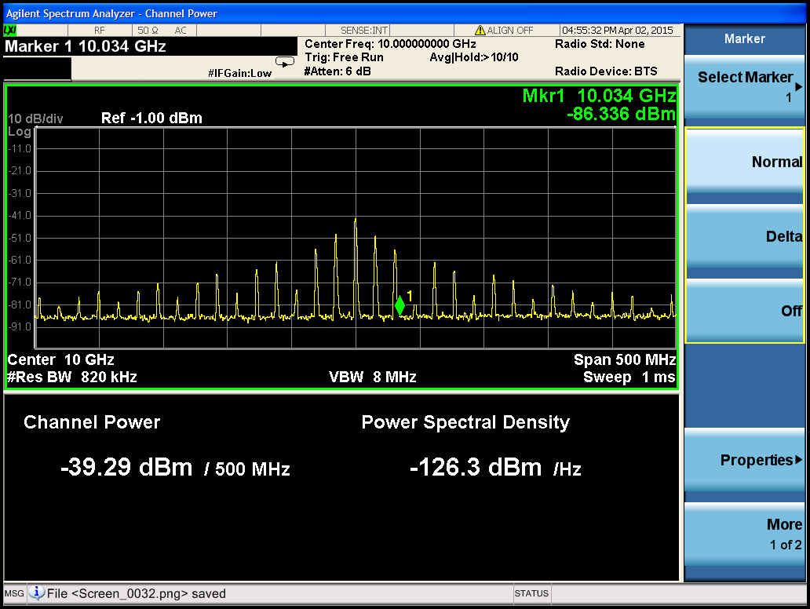
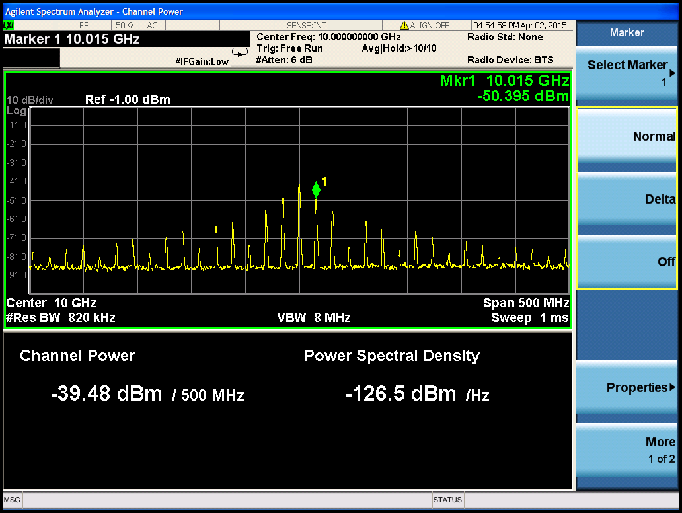
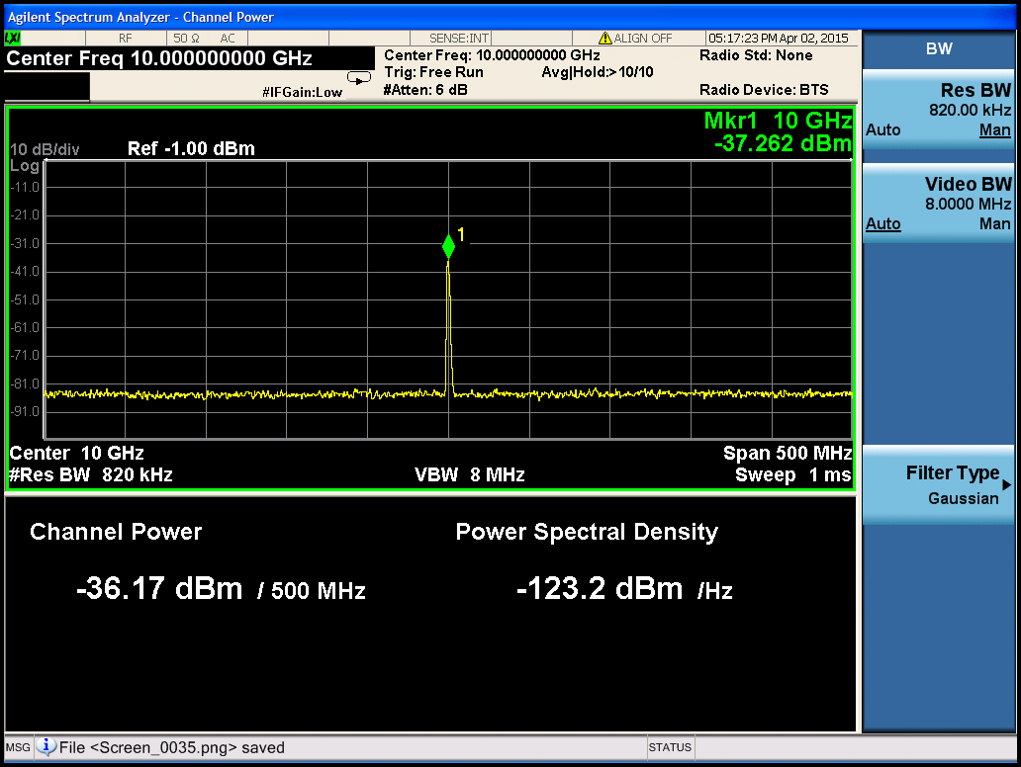
IQ Demodulator LO Signal Chain-Test Strategies
Measure and verify each at the input of LO channel:
Peak Signal Power
  42dB (attenuation) – 37.262 dBm = 4.738 dBm
Average Signal Power
  Attenuation – measured power/span – 10*log (duty cycle)
    4.629 dBm and 4.819 dBm
Period (T) = 65nS
  Frequency = 15.38 GHz
  1/T
Pulse Width = 40nS
  Null Frequency = 50 MHz
  1/null frequency

Slide 21
Power Supply
Power Overview
Matthew Cammuse– Electrical Engineer

Slide 22
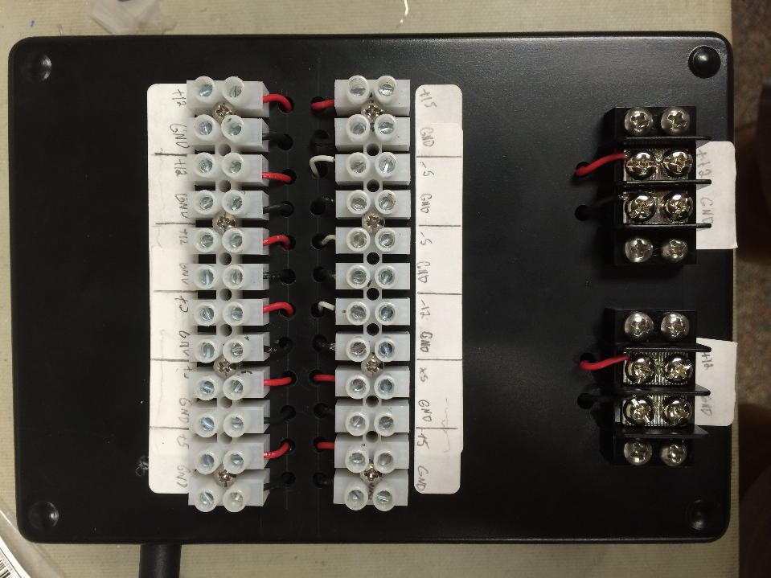
Black Box Power Supply
QTY | Part Name | V+(V) | I+ (mA) | V-(V) | I-(mA)
1 | VCO | 5 | 45 | - | -
1 | SPDT Switch | 5 | 1.4 | - | -
1 | SP4T Switch | 5 | 160 | -5 | 50
1 | SP16T Switch | 5 | 550(max) | -12 | 200(max)
1 | IQ Demodulator | 5 | 110 | -5 | -
1 | Super Ultra Wideband Amplifier | 12 | 400(max) | - | -
2 | Ultra Wide Bandwidth Amplifier | 12 | 62(typ) 68(max) | - | -
1 | Low Noise Amplifier SLNA-120-38-22-SMA | 12 | 250 | - | -
1 | Low Noise Amplifier SLNA-180-38-25-SMA | 12 | 250(min) 280(typ) 320(max) | - | -
1 | Power Amplifier | 15 | 900(typ) 1100(max) | - | -
1 | FPGA Board | USB Powered
Black Box Power Supply
19 [V] Input
ON-OFF Switch

Slide 23
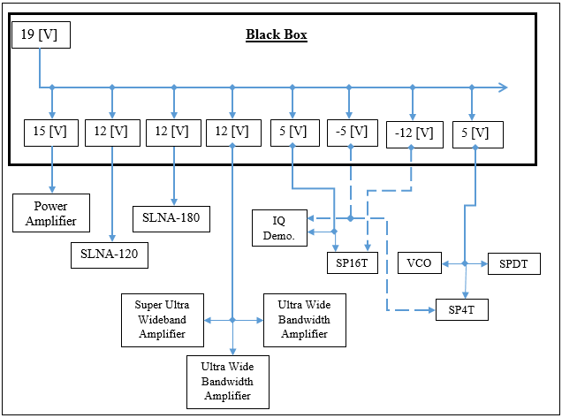
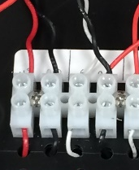
Power Supply Block Diagram
Electrical Wiring
Positive Voltage – Red wire
Negative Voltage – White wire
Ground – Black
Twisted Pairings
Regulators

Slide 24
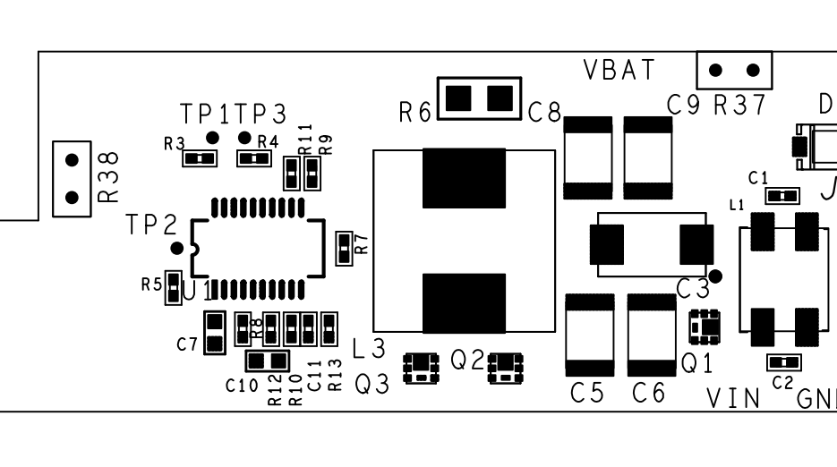
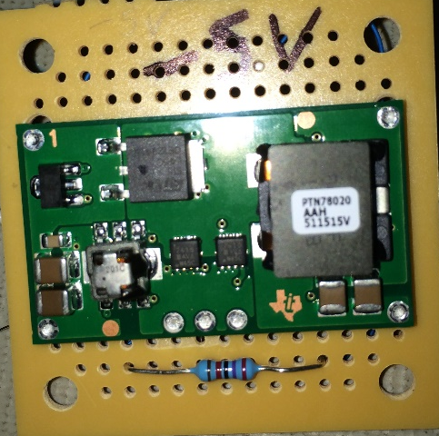
Voltage Regulators
Positive Voltage (+V)
Negative Voltage (-V)
Linear Technology: LTC4008 Battery Charger
Output voltage based on R7 and R12 resistors
Pi filter
Digikey: DC-DC Converter
Output voltage based on controlled resistor
Voltage [V] | Resistor | [Ω]
+5 | R7 | 154k
 | R12 | 47.5k
+12 | R7 | 100k
 | R12 | 11.0k
+15 | R7 | 130k
 | R12 | 11.0k
Voltage [V] | (R_{SET}) [Ω]
-5 | 2k
-12 | 28.8k

Slide 25
Programming Overview
Major Coding Sequences
Patrick Delallana – Electrical & Computer Engineer

Slide 26
Software Design Summary
Tasks
  Splitting up of programming tasks into major priorities
Purpose
  Purpose and description of each task
Testing
  Methods that were used to test the software for each task
Results
  System demonstration results for each task
Status
  Status with regards to completion of project

Slide 27
Task 1: System Timing
Description
  Controls the SPDT, SP4T, and SP16T switch
  Outputs pulse that transmits to the target
Explanation
  20 nS pulse to transmit to target
  SPDT same timing as pulse, logic 1 on, logic 0 off
  SP4T has logic 0 being on, logic 1 being off
  SP16T has logic 0 being on, logic 1 being off

Slide 28
Task 1: System Timing
Testing
  Code was tested using an oscilloscope to check for correct outputs.
  Switches on FPGA were used to change the different combinations for transmit receive.
Results
  System timing code was able to control the switches for the system. The demonstration for this code was successful.
Status
  This code is complete, and needs no further work.

Slide 29
Task 2: Analog to Digital Conversion Code
Purpose
  Converts analog voltage ranging from 0 to 3.3 volts into digital binary combination that is stored onto the FPGA.
  Converts four signals I, Ibar, Q, Qbar from IQ demodulator.
  Result is a 12 bit binary combination.
Explanation
  Two states were used, idle and read.
  When idle, a signal was output showing A/D was not reading
  When read, a signal was output showing A/D was reading and a counter was used to check how many bits were being used and how many were left.

Slide 30
Task 2: Analog to Digital Conversion Code
Testing
  DC power supply was used as test for input voltage
  7 segment display was used to read voltages in hex.
  Pushbuttons were used to display different voltages from IQ demodulator.
Results
  Analog to Digital Conversion code was able to convert and display the different voltages from the IQ demodulator in the system demonstration.
Status
  This code is complete, and needs no further work.

Slide 31
Task 3: VGA Code
Description
  Perform the basis functions for angles, and break down into real and imaginary parts
  Gives amplitude and phase corresponding to each angle
  Parse the display into columns of 16, with each column representing an angle
  Performs the fast Fourier transform of the incoming energy
Explanation
  HSYNC (horizontal) and VSYNC (vertical ) counters to label where pixels light up
  Lookup table for sine and cosine values of different angles

Slide 32
Task 3: VGA Code
Testing
  Code was tested by checking to see if varying input voltage from DC power supply would light up the VGA display depending on amplitude.
  Code was checked in CAPS to see if signal reflected off corner reflector would light up VGA display
Results
  Input signal from the IQ demodulator was able to light up the VGA display depending on amplitude of signal. This would only let you know something is reflecting, not where it is.

Slide 33
Task 3: VGA Code - Steps
Completed Steps
  Pixel illumination
  Lookup table
Steps that need to be taken to ensure completion
  Parse the lighting up of pixels into 16 columns
  Write basis functions in VHDL
  Complex multiplication of results of basis functions in VHDL

Slide 34
Signal Overview
Signal Processing
Julia Kim – Electrical Engineer

Slide 35
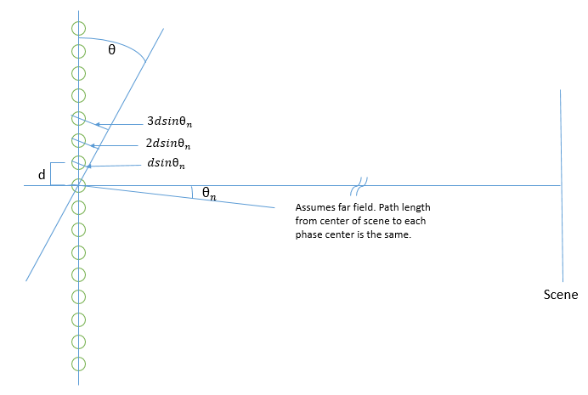
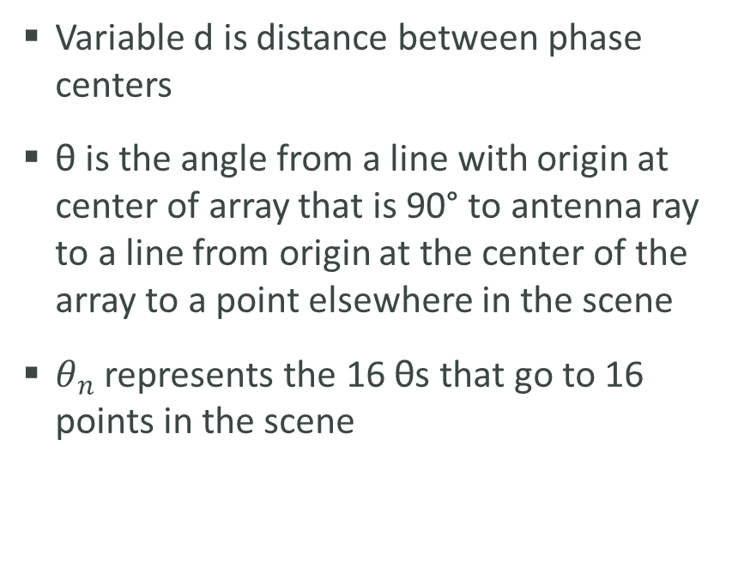
Signal Processing
Variable d is distance between phase centers
θ is the angle from a line with origin at center of array that is 90° to antenna ray to a line from origin at the center of the array to a point elsewhere in the scene
$θ_{n}$ represents the 16 θs that go to 16 points in the scene
Sixteen Phase Centers from each Tx/Rx Pair to Scene

Slide 36
Signal Processing – Basis Functions
For image formation, the sum of the energy from some of the scatterers is taken and they are decomposed by multiplying them by the basis functions.
The basis function represents the energy that will come in from a different angle, so if it is multiplied by the total energy, it decomposes it into just that part.

Slide 37
Signal Processing End Goal
Fourier transform is used to decompose the waveform into the amounts of energy that come in from different angles.
Basically a 1-D image that tells the user where the energy is coming in from different angles in the scene

Slide 38
Mechanical Overview
Mark Poindexter – Mechanical Engineer
Malcolm Harmon – Mechanical Engineer

Slide 39
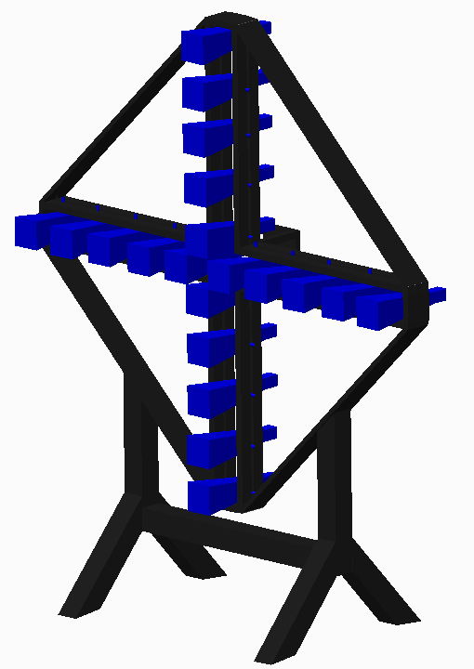
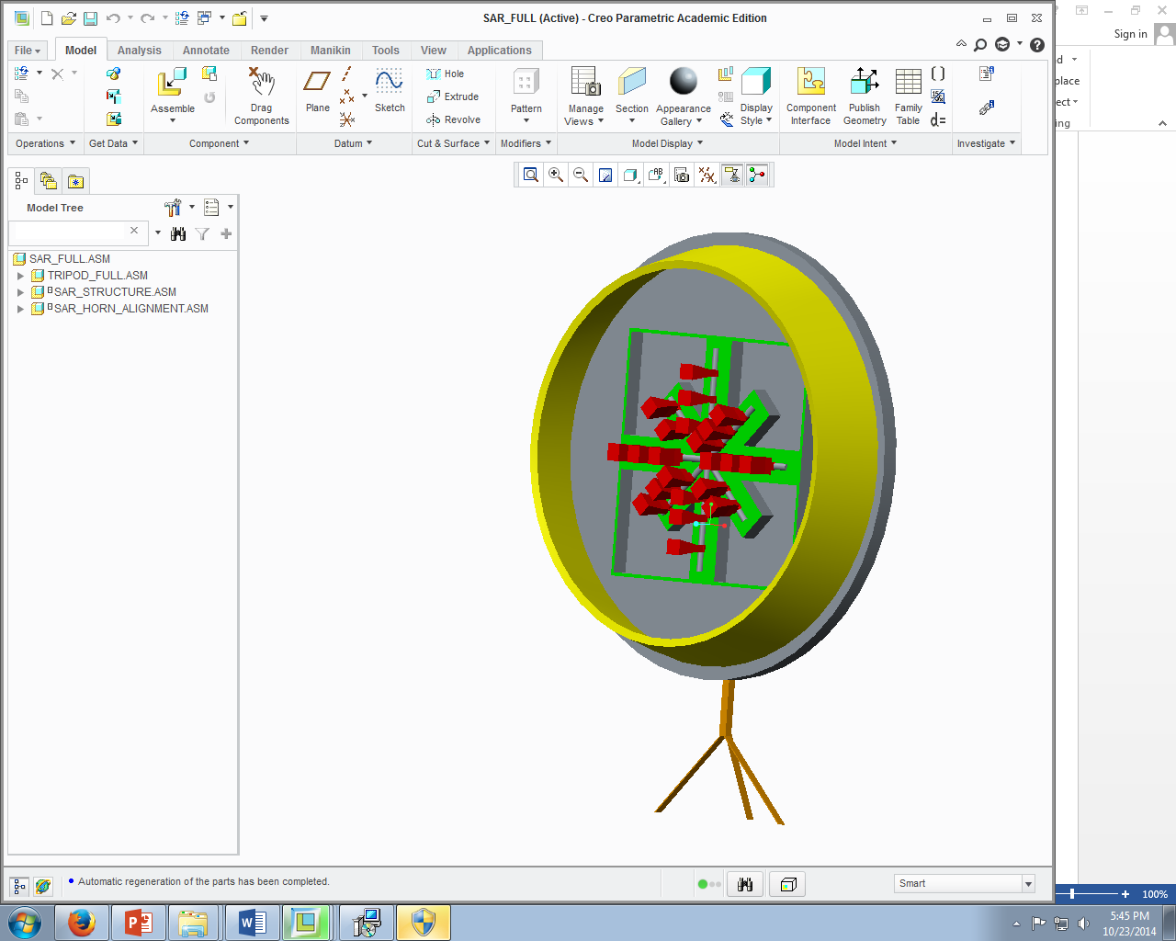
Prior Design
Analysis
Scale: 1(Low) – 5 (High) (Constructability) | Design 1 | Design 2
Electrical Components | 4 | 3
Structure Mounting | 3 | 3
Scale: 1(Low) – 5(High) (Horn Alignment)
Phase Centers | 5 | 3
Horn Adjustability | 4 | 4

Slide 40
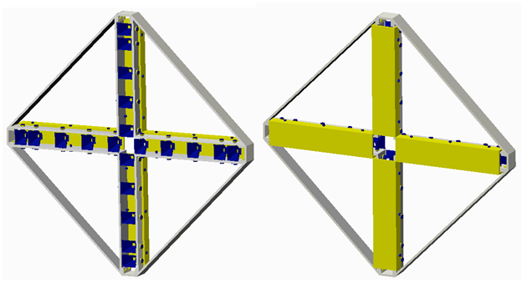
Restructured Body Design
Horn Placement Component Box | Horn Shield Back Plate Cover

Slide 41
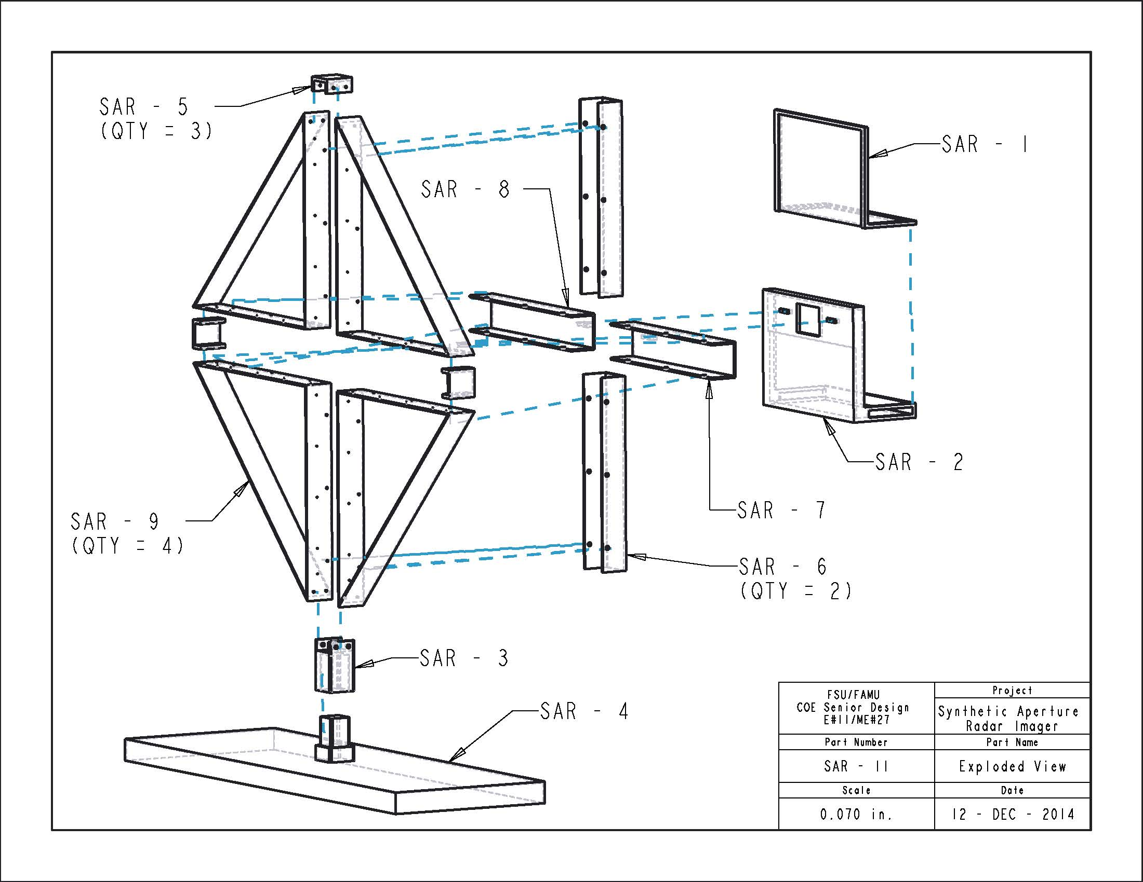
Antenna Structure Design
Component Box
Part # | Part Name
SAR - 1 | Comp. Box Lid
SAR - 2 | Comp. Box
SAR - 3 | Channel To Stand
SAR - 4 | Stand
SAR - 5 | Channel Connector
SAR - 6 | Vertical Horn Cover
SAR - 7 | Left Horn Cover
SAR - 8 | Right Horn Cover
SAR - 9 | Quadrant Panel

Slide 42
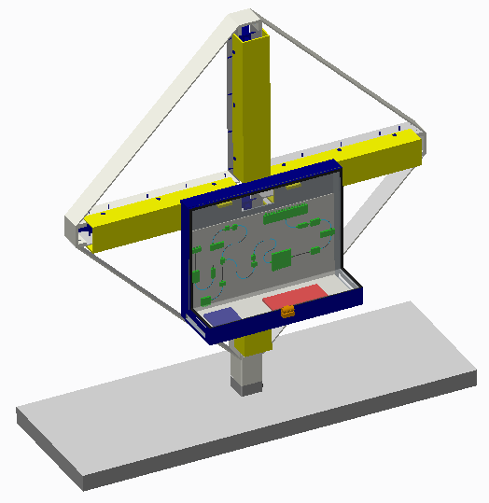
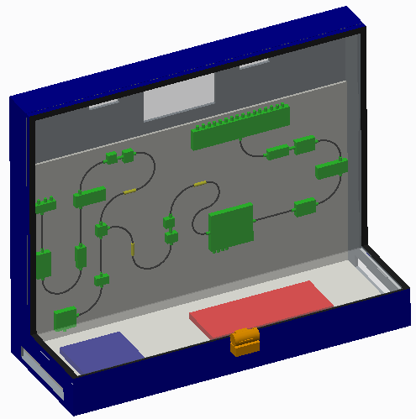
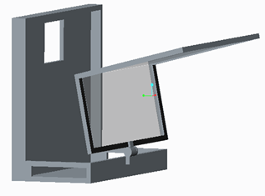
Component Box
Rotated Lid for easy access to Components
Manually mounted on structure for most convenient placement

Slide 43
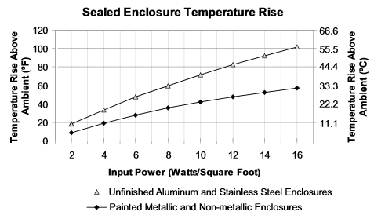

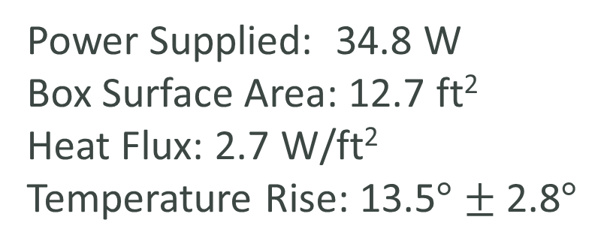
Heat Analysis – Component Box
Power Supplied: 34.8 W
Box Surface Area: 12.7 ft²
Heat Flux: 2.7 W/ft²
Temperature Rise: 13.5$°$ $±$ 2.8$°$

Slide 44
Antenna Structure Design
Horn Covers
Part # | Part Name
SAR - 1 | Comp. Box Lid
SAR - 2 | Comp. Box
SAR - 3 | Channel To Stand
SAR - 4 | Stand
SAR - 5 | Channel Connector
SAR - 6 | Vertical Horn Cover
SAR - 7 | Left Horn Cover
SAR - 8 | Right Horn Cover
SAR - 9 | Quadrant Panel

Slide 45
Antenna Structure Design
Structure Frame and Stand
Part # | Part Name
SAR - 1 | Comp. Box Lid
SAR - 2 | Comp. Box
SAR - 3 | Channel To Stand
SAR - 4 | Stand
SAR - 5 | Channel Connector
SAR - 6 | Vertical Horn Cover
SAR - 7 | Left Horn Cover
SAR - 8 | Right Horn Cover
SAR - 9 | Quadrant Panel

Slide 46
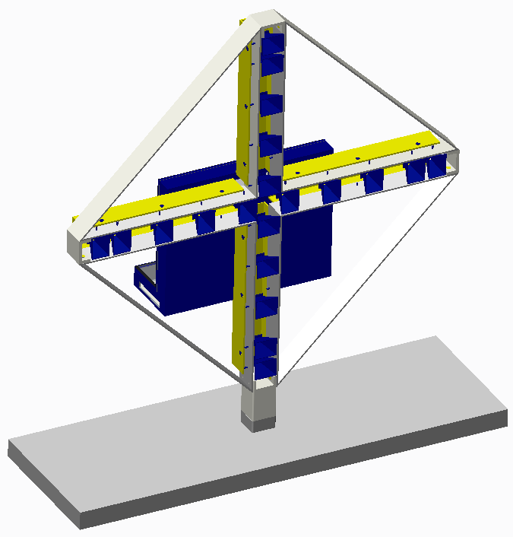
Final Antenna Structure

Slide 47
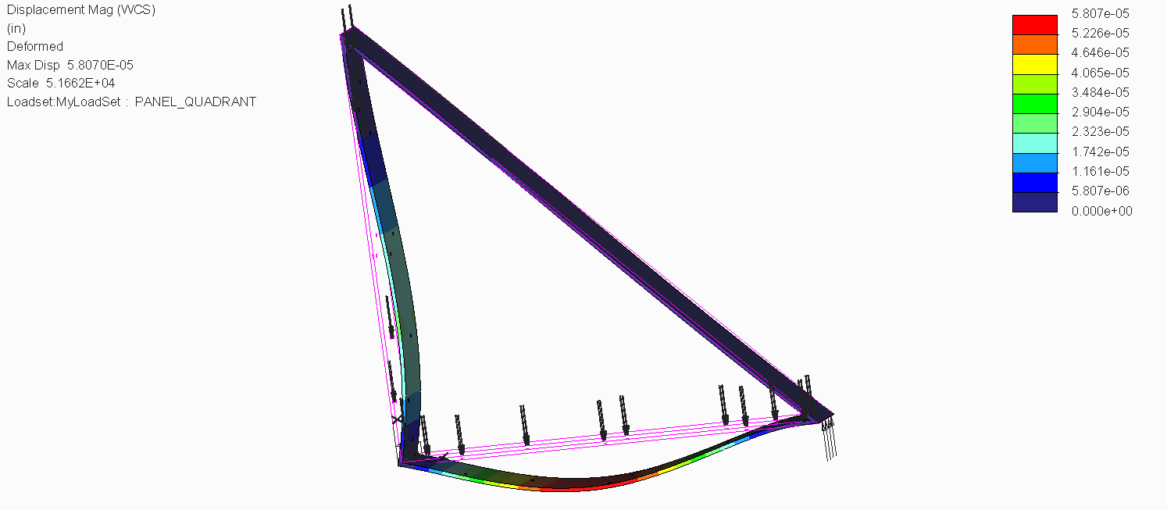
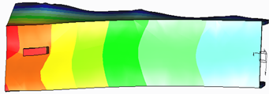
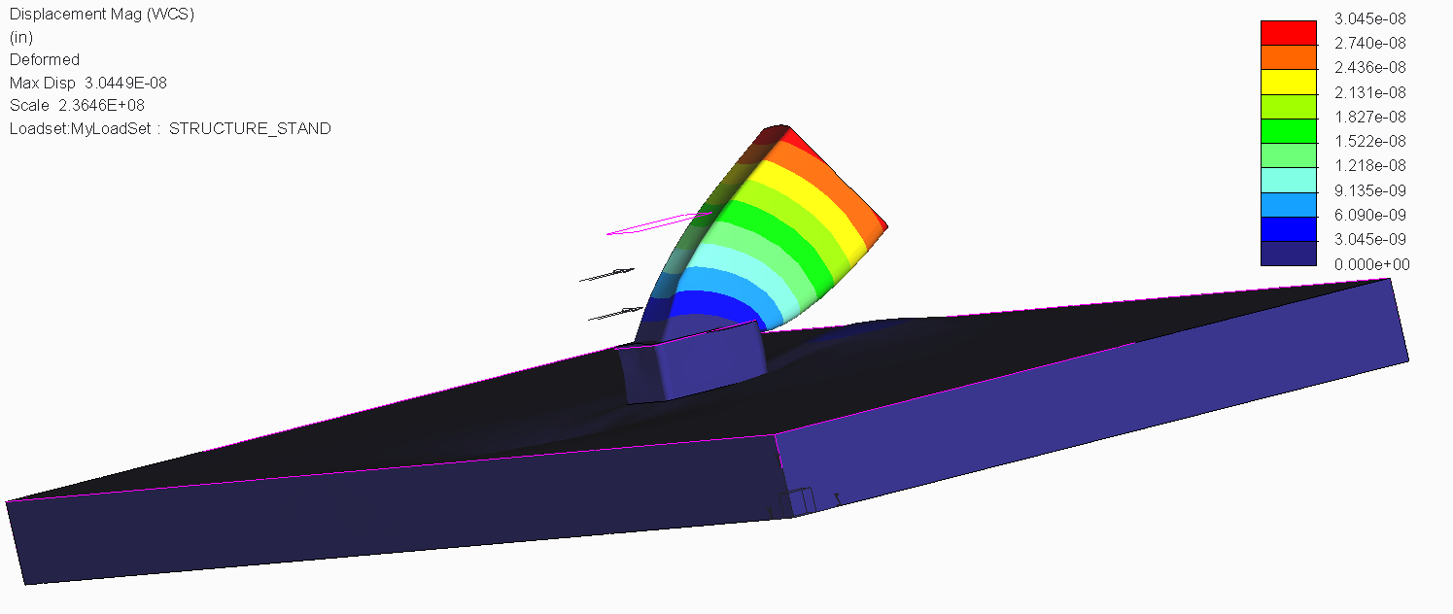
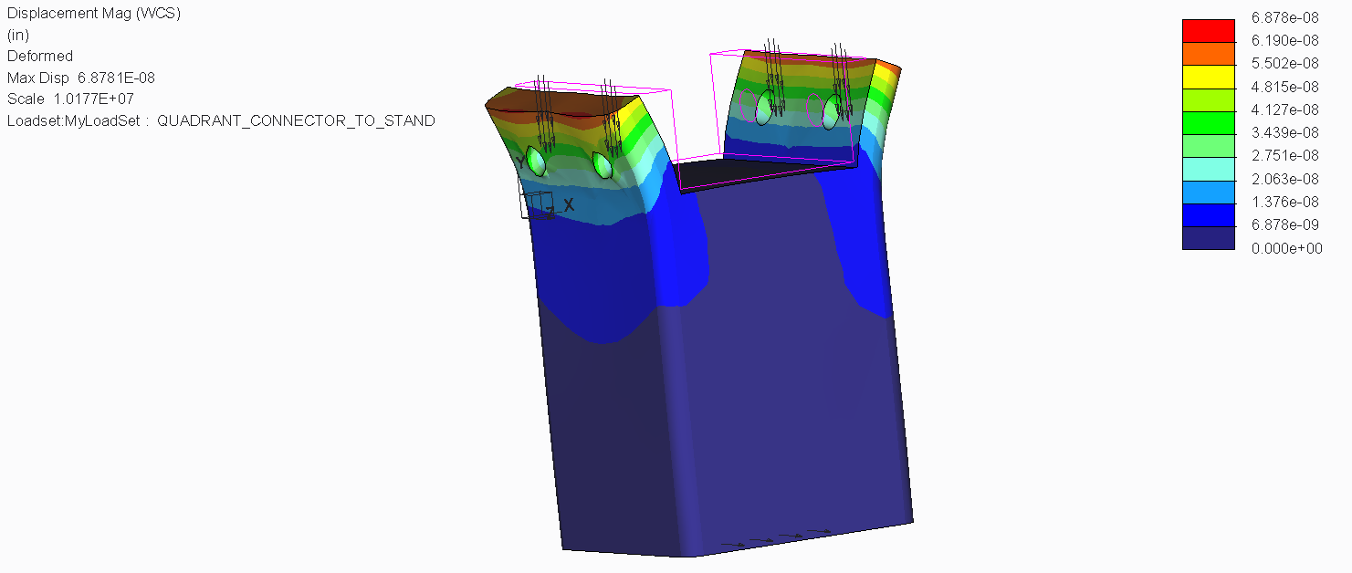
Stress Analysis - Antenna Structure
DRAMATIZED MAX DISPLACEMENT IN INCHES
Horn Covers
Max Dis.
9.0x10⁻⁷ in
Quadrant Panel
Max Displacement
1.1x10⁻⁶ in
Stand to Structure Connector
Max Displacement 8.1x10⁻⁷ in
Stand
Max Displacement
5.5x10⁻⁵ in

Slide 48
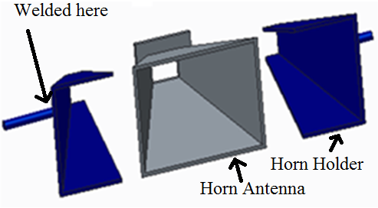
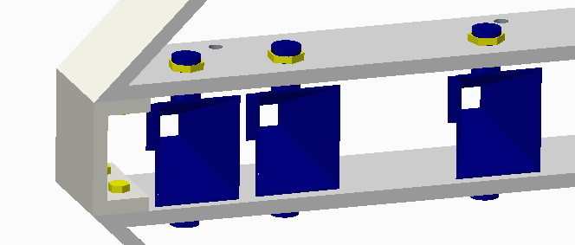
Horn Holders
Nut threaded rods to compress horn holders
Rotate about threaded rods axis for alignment
Threaded rod welded to horn holders

Slide 49
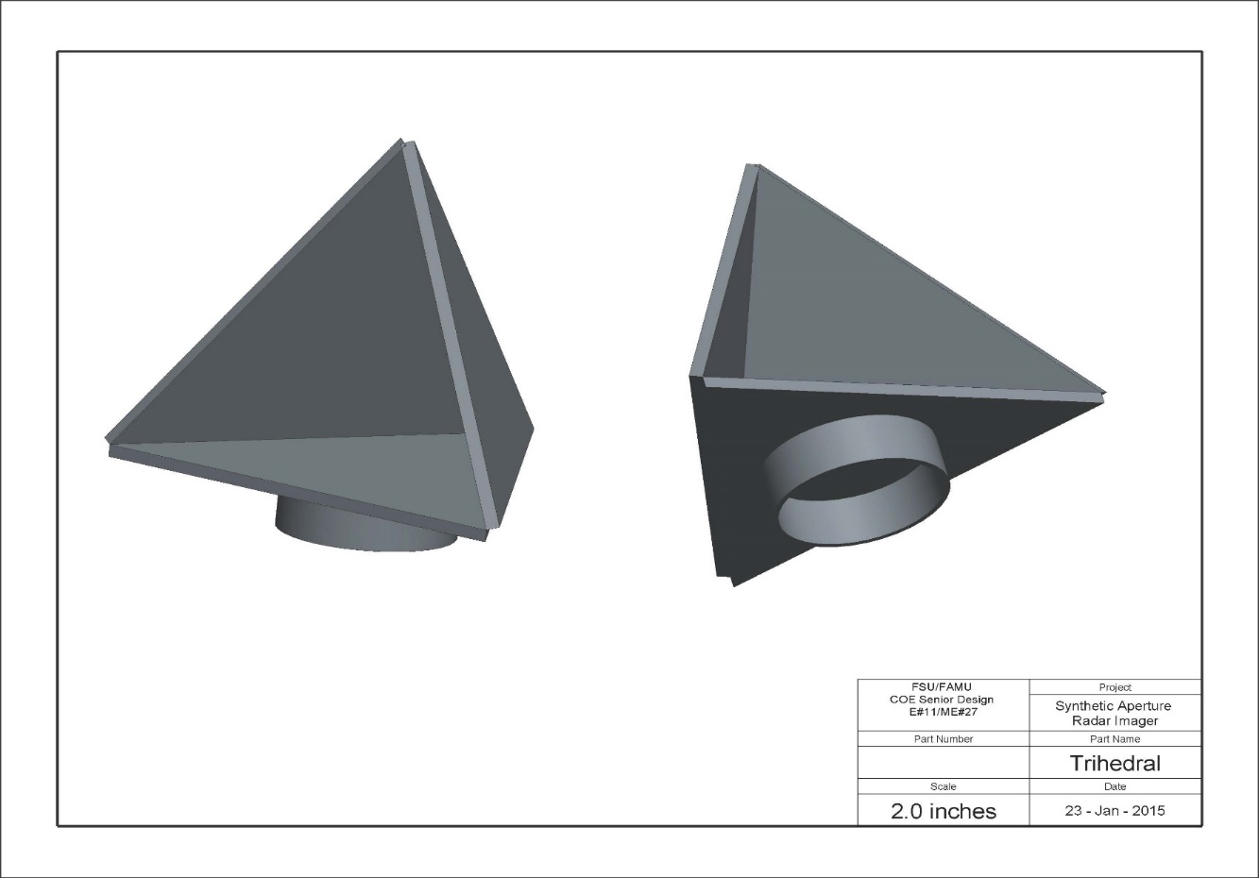
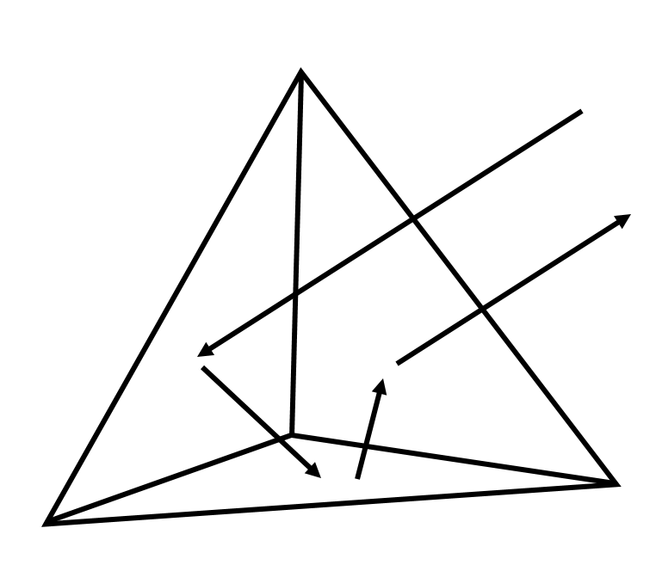
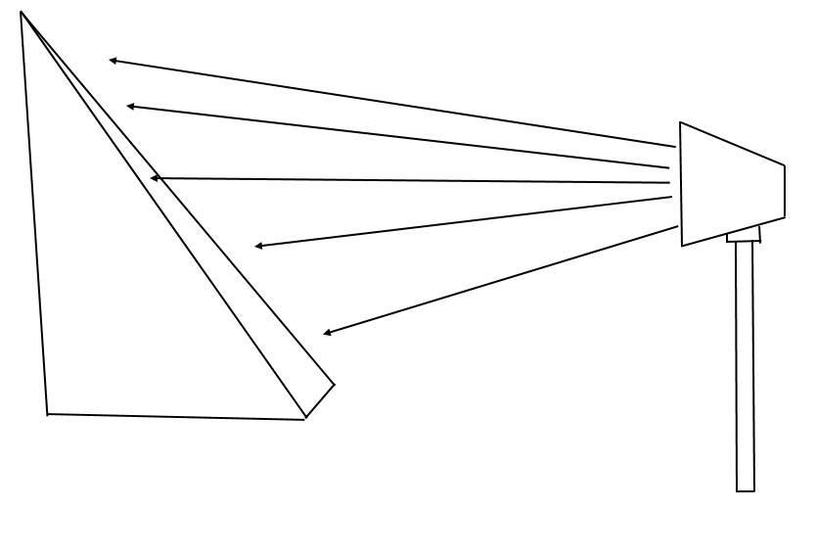
Trihedral
Triangular planes are joined together to form a triangular pocket to receive and reflect waves

Slide 50
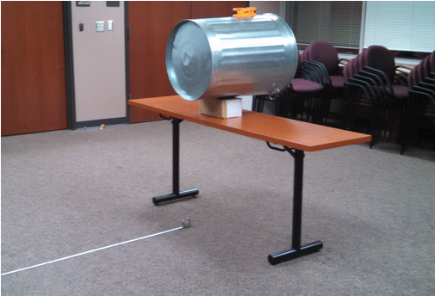
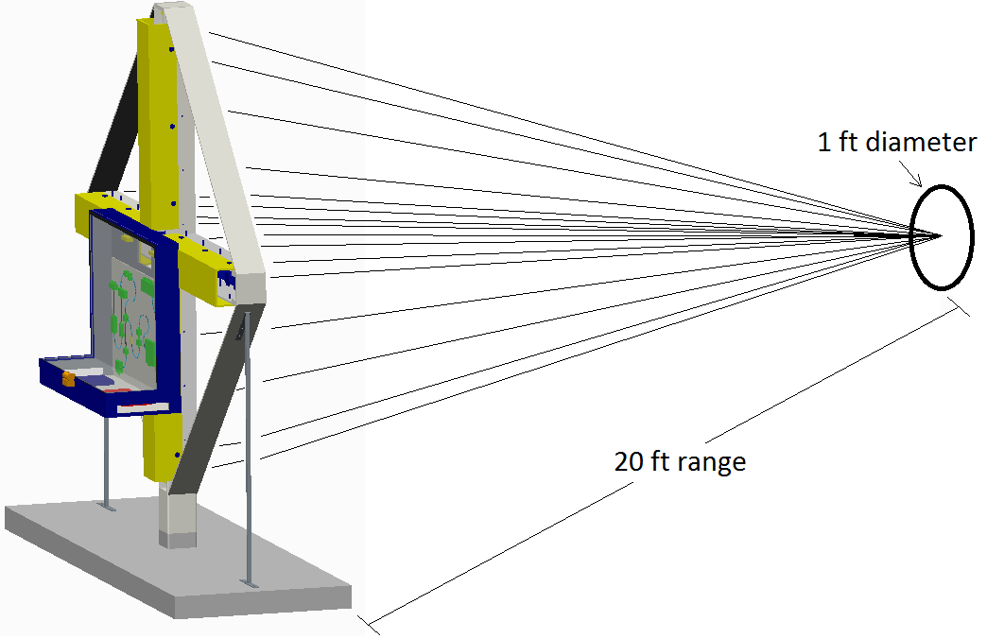
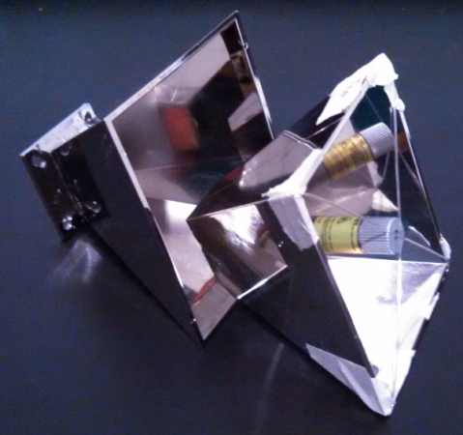
Results – Horn Alignment

Slide 51
Project Management
Budget Assessment, Bill of Materials, Schedule
Benjamin Mock – Industrial Engineer
Jasmine Vanderhorst – Industrial Engineer

Slide 52
Resource Allocation
Initial Projection
Final Evaluation
Northrop Grumman sponsored up to $50,000
Projected $38,000 expense
Left a $12,000 buffer

Slide 53
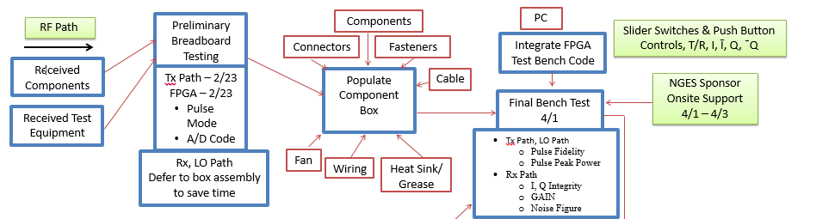
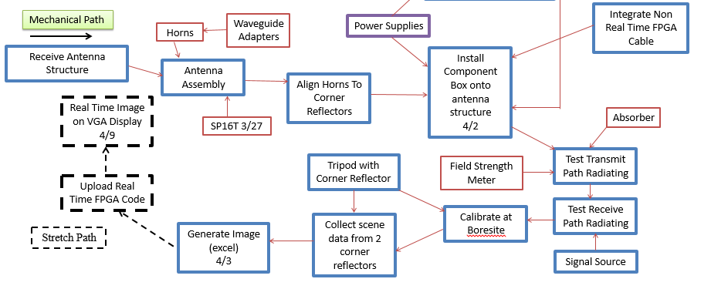
Project Flow – Parallel Schedule

Slide 54
Project Schedule
Fall 2014
Spring 2015 – Post Midterm Hardware Demonstration
Designed RF Electrical System
Antenna Design & Analysis
Mechanical Structure Design & Analysis
Performed Component Analysis
Procurement Process Initiated
Signal Power Levels & Pulse Quality Testing & Verification
  Transmit Chain 3/23
  LO IQ Demodulator 3/23
  Receive 3/27
Test Timing Switches
  SPDT & SP4T – 3/25
  SP16T – delivered 3/27; tested 3/29
A-to-D Converter Test – 3/27

Slide 55
Project Schedule
Spring 2015
Major Milestones
IQ Demodulator output correct voltages for I & Q channels – 3/31
Verify FPGA Code performs A/D Conversion of I, I’, Q, and Q’ – 4/1
Single Antenna detects a returned pulse from Transmit Chain – 4/2
  NG Sponsor Visit – 4/1 – 4/3
  Assemble Mechanical Structure – 4/1
  Correctly Transmit RF Pulse at 20 foot distance – 4/2
  Integrate Electrical System – 4/3
    4 Transmit, 16 Receive, Assembled Component Box, Power Supply
  Test & Calibrate SAR System – 4/3
  Successfully Demonstrate Full System Setup – 4/9

Slide 56
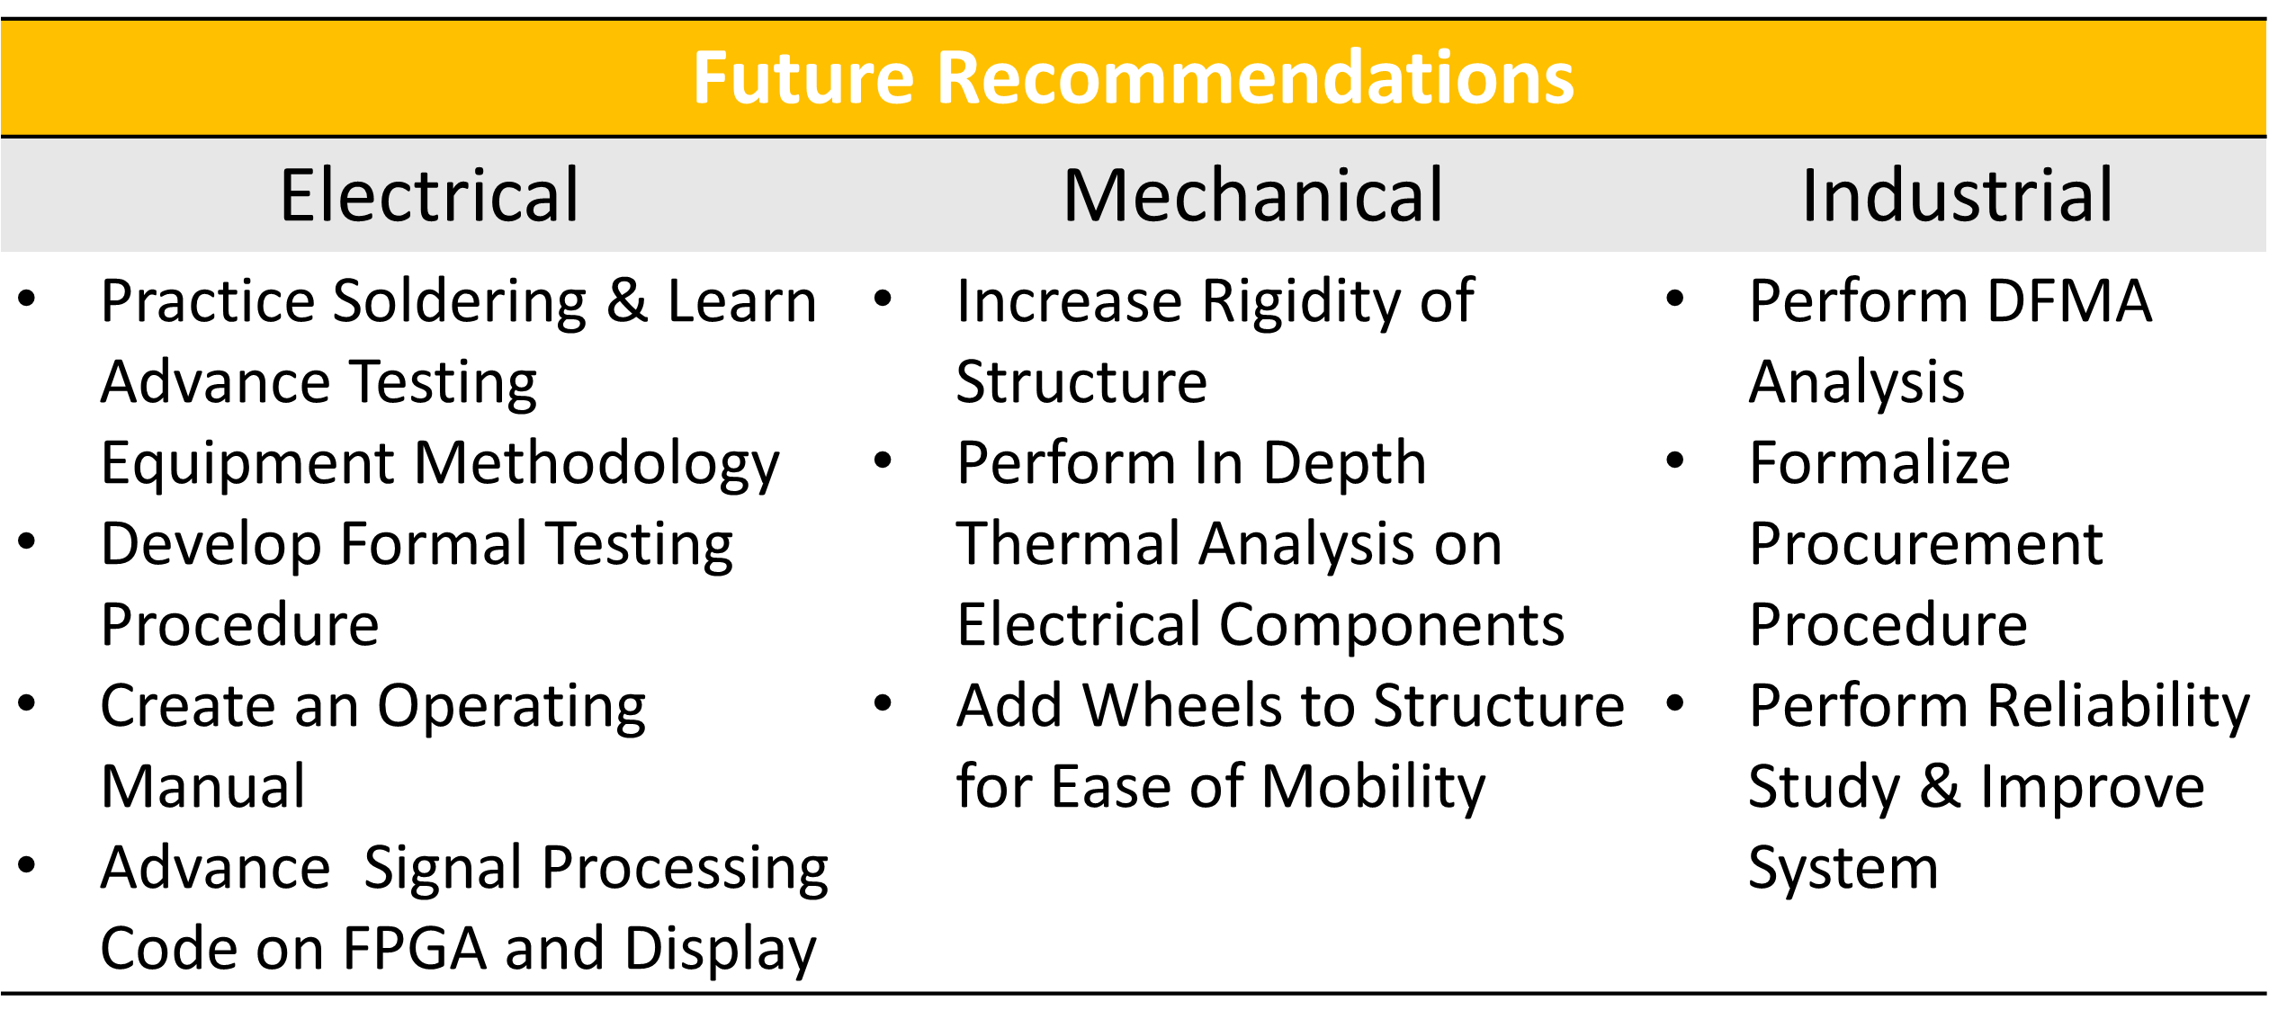
Future Recommendations

Slide 57
Project Conclusion
Completion Status and Conclusion
Jasmine Vanderhorst – Industrial Engineer

Slide 58
Project Completion Status
Electrical Component Design
  Percent Complete: 100%
Signal Processing Calculations
  Percent Complete: 100%
Programming
  Percent Complete: 75%
  Needed: VHDL Code for Signal Processing Functions
Structural Design
  Percent Complete: 100%

Slide 59
Conclusion
Transmit/receive path was achieved
  Measured results from testing were close to theoretical results
Pulses were coded and implemented effectively for transmit and receive
  Output voltages from IQ demodulator were obtained successfully and displayed
Efficient power supply box was designed and set up
Theoretical calculations for signal processing were realized
Structure for antennas and component box were manufactured
  Heat and stress analyses were realized for structure

Slide 60
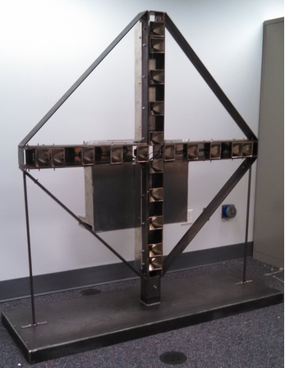
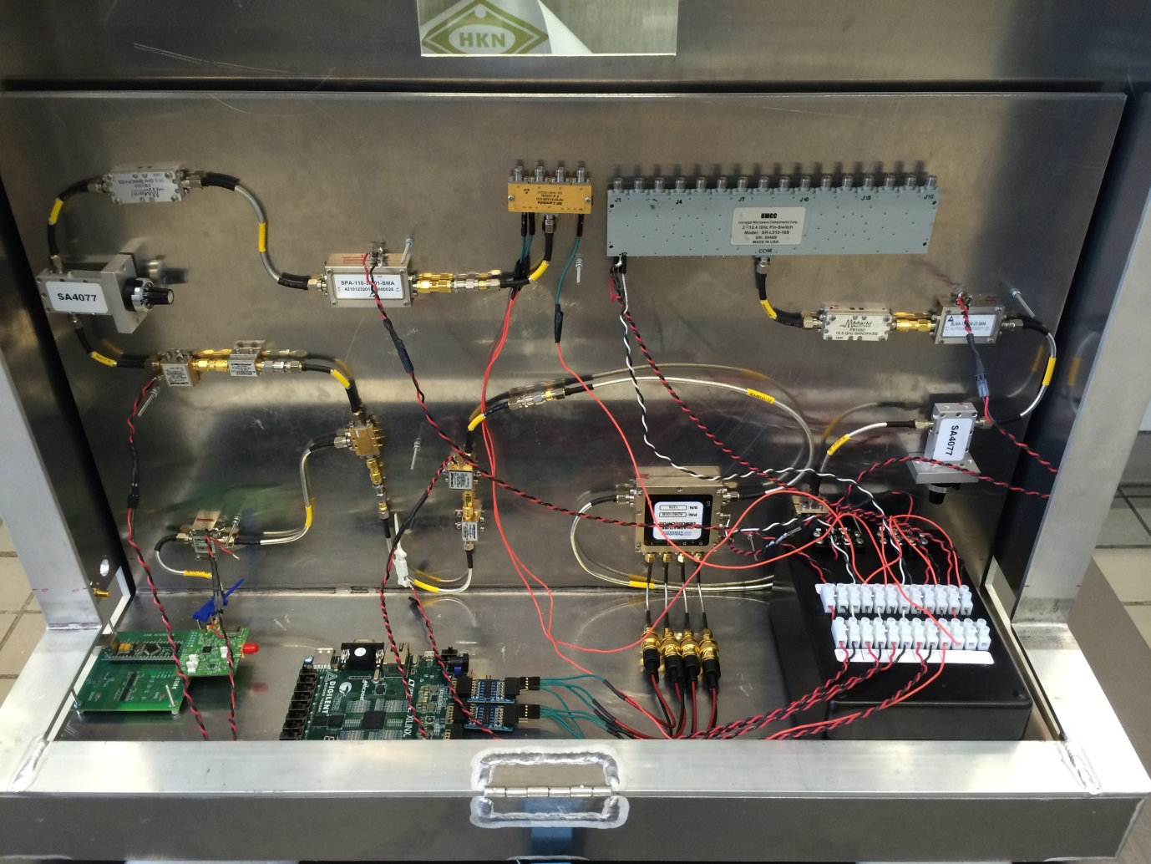
Final Product

Slide 61
Thank You!
Questions & Comments

