Slide 1


Electronic Synthetic Aperture Radar Imager
Team E#11/M#27 - Milestone #4
Detailed Design & Testing Strategy

Slide 2
Team Agenda
Brief Introductions
Project Overview
Power Supply Design
Electrical System
Programming
Signal Processing & Image Calibration
Mechanical Analysis
Project Schedule
Project Assessment
Closing

Slide 3
The Team Structure
Engineer | Jasmine Vanderhorst | Benjamin Mock | Joshua Cushion | Matthew Cammuse | Patrick Delallana | Julia Kim | Malcolm Harmon | Mark Poindexter
Field of Study | Industrial Engineering | Industrial Engineering | Electrical Engineering | Electrical Engineering | Electrical Engineering | Electrical Engineering | Mechanical Engineering | Mechanical Engineering
Tasks | -Project Management -Team Web Master -Reliability Engineering -Presentations | -Lead IE & Treasurer -Procurement -Safety & Testing -Reliability Engineering | -Lead EE & Radio Frequency Engineer -Power Supply Design -Electrical System Design | -Assistant Project Manager & Co-Lead EE -Antenna Array Design -Testing Strategy | -Co-Lead EE -FPGA Programming -VGA and A-to-D Conversion Coding -System Timing | -Co-Lead EE & Recording Secretary -Signal Processing -Image Calibration | -Assistant Project Manager -Vendor Relations -Antenna Frame Design -Material Analysis | -Co-Lead ME -Component Box Design -Cabling Design & Setup -Vendor Relations

Slide 4
Project Overview
Radar Imager Project Scope
Matthew Cammuse – Electrical Engineer

Slide 5
Project Mission
Objective: Develop a “static, multi-antenna Synthetic Aperture RADAR (SAR) imager”
  In brief: Giant metal detector
Why?: Security
Prevention of guns, knifes or dangerous objects from entering public facilities:
  Schools
  Airports
  Office Buildings

Slide 6
Imaging Radar Operational Concept
40 x 40 inch scene
Pulsed Transmit/Receive
Imaging Radar
Static parts
COTS components
Digital beam forming
16 - 2.5 inch
1-D Cells in
Azimuth and
Elevation
PC Display
20 foot range to scene center
5 x 5 feet
Beams are formed
Digitally with Fourier
Transform, 16 in Azimuth
And 16 in Elevation
20nS wide RF
Pulse @ 10 GHz
16 - Azimuth
16 - Elevation
VGA Connection
X-Band Horn
Antenna Array

Slide 7
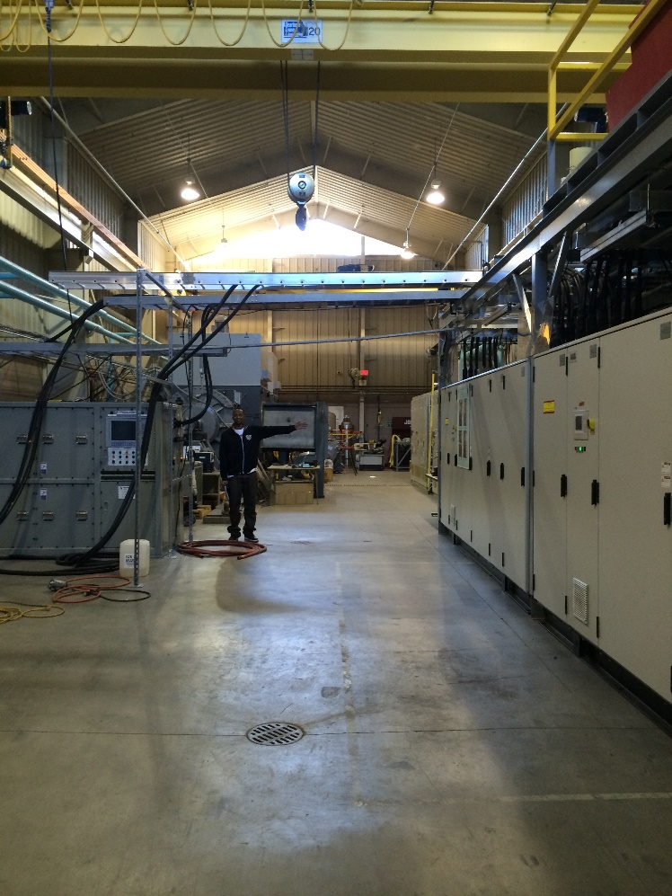
Test Site Location: CAPS
Pros | Cons
Large Room | 5 MW Dynamometer Room
Near engineering school | Scheduling
Easy Storage | Limited Hours
Available test benches | Various reflection objects
No cost | Anechoic rf absorbing foam layout
 | Return signal distortion
Desire:
Faraday Cage – FSU Physics Department
Chances: Slim

Slide 8
Final Radiation Plan
(CAPS Adapted)
Original Goal:
  20 [ns] transmitting
  20 [ns] receiving
Solution:
  Extend time between each transmitting signals
    20 [ns] transmitting, 20 [ns] receiving, 20-40 [ns] rest
  Prevents absorption of delayed return signals
  Less distortion and noise
Problem:
  Test Site
  Lack of full anechoic chamber
  Delay return signals
  Expect distortions and noise
20 [ns]
+20 [ns]
Tx
Rx
20 [ns]
Trihedral
+20 [ns]
Random Objects

Slide 9
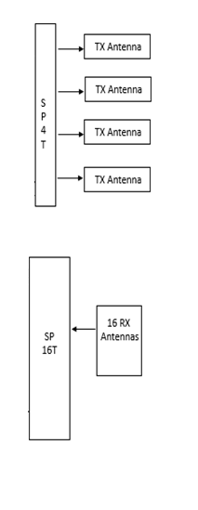
Contingency Plan
Rental Test Equipment
  Signal Generator
  Spectrum Analyzer
Reverse Development
Simplify the amount of antennas and components
Goal:
  Transmit and receive signals
Signal Generator
Spectrum Analyzer

Slide 10
Electrical System
Major Electrical Components & Designs
Matthew Cammuse – Electrical Engineer
Joshua Cushion – Electrical Engineer

Slide 11
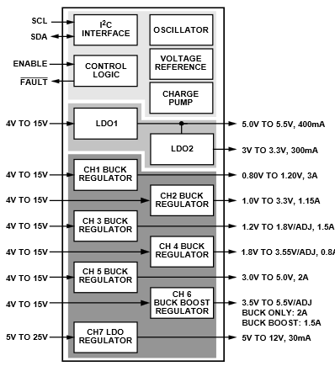
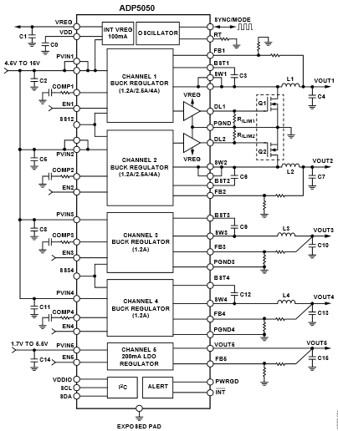
Power Supply Design
Current Design:
Standard Power supplies
Voltage Regulators
  9 Voltage Outputs
  5 Voltage Output
9 Output
5 Output

Slide 12
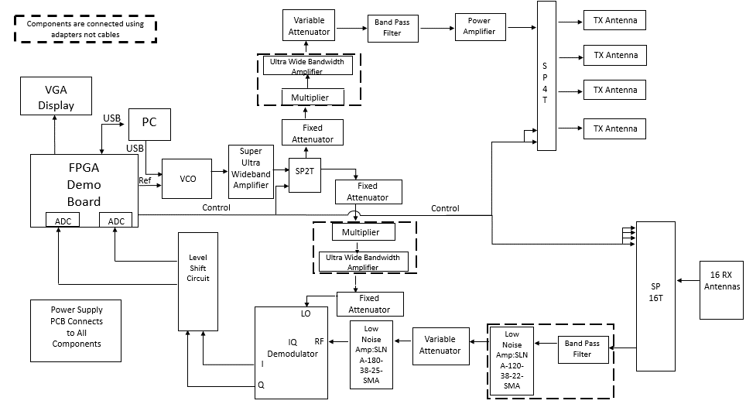
Electrical System

Slide 13
Transmit Signal Chain-Test Strategies
Verify output reference signal from FPGA:
  10 MHz < Frequency < 200 MHz
  1V_{pk-pk} < Voltage < 3.3V_{pk-pk}
Verify the period of the pulses from the FPGA to the switches:
  SPDT – 20 ns
Measure signal strength and frequency of output from the components in the chain
SPDT Switch
Frequency Multiplier
SP4T Switch
4 Antennas
Key Components
VCO
Band Pass Filter

Slide 14
Transmit Signal Chain
Component | Input Power |  | Output Power
 | [dBm] | [mW] | [dBm] | [mW]
Voltage Controlled Oscillator (VCO) | 0 | 1 | -4 | 0.398
Super Ultra Wideband Amplifier | -4.12 | 0.387 | 21.88 | 154.2
Single Pole Double Throw (SPDT) Switch | 21.76 | 150.0 | 19.76 | 94.62
Fixed Attenuator | 19.64 | 92.05 | 9.64 | 9.204
Frequency Multiplier | 9.44 | 8.79 | -3.06 | 0.494
Ultra Wide Bandwidth Amplifier | -3.06 | 0.494 | 8.94 | 7.834
Variable Attenuator | 8.82 | 7.621 | -4.08 | 0.382
Band Pass Filter | -4.3 | 0.372 | -7.3 | 0.186
Power Amplifier | -7.5 | 0.178 | 22.5 | 177.83
Single Pole Four Throw (SP4T) Switch | 22.38 | 172.98 | 20.38 | 109.14

Slide 15
Receive Signal Chain-Test Strategies
Low Noise Amplifiers
Dual Level Shift Circuit
Analog to Digital Converters
FPGA
Key Components
SP16T Switch
Band Pass Filter
16 Antennas
IQ Demodulator
Measure signal strength and frequency of output from the components in the chain
Measure the output voltage from the I and Q channels of IQ demodulator
Measure the output voltage channels of the dual level shift circuit

Slide 16
Receive Signal Chain
Component | Input Power |  | Output Power
 | [dBm] | [mW] | [dBm] | [mW]
Single Pole Sixteen Throw (SP16T) Switch | -53.24 | 4.742E-06 | -57.94 | 1.609E-06
Band Pass Filter | -58.09 | 1.552E-06 | -61.09 | 7.790E-07
Low Noise Amplifier (LNA-SLNA-120-38-22-SMA) | -61.09 | 7.780E-07 | -23.09 | 4.915E-03
Variable Attenuator (SA4077) | -23.21 | 4.775E-03 | -27.21 | 1.903E-03
Low Noise Amplifier (LNA-SLNA-180-38-25-SMA) | -27.33 | 1.849E-03 | 10.68 | 1.168E+01
Radio Frequency (RF) IQ Demodulator | 10.56 | 11.38 | 3.555 | 2.267E+00

Slide 17
IQ Demodulator (LO) Chain
Component | Input Power |  | Output Power
 | [dBm] | [mW] | [dBm] | [mW]
Voltage Controlled Oscillator (VCO) | 0 | 1 | -4 | 0.398
Super Ultra Wideband Amplifier | -4.12 | 0.387 | 21.88 | 154.2
Single Pole Double Throw (SPDT) Switch | 21.76 | 150.0 | 19.76 | 94.62
Fixed Attenuator | 19.64 | 92.05 | 9.64 | 9.204
Frequency Multiplier | 9.44 | 8.79 | -3.06 | 0.494
Ultra Wide Bandwidth Amplifier | -3.06 | 0.494 | 8.94 | 7.834
Fixed Attenuator | 8.82 | 7.621 | 5.82 | 3.819
LO (IQ Demodulator) | 5.55 | 3.589 | - | -

Slide 18
Dual Level Shift Circuit
Input voltage: ± 340mVdc
  Increments: 0.005mVdc
Output voltage: 0 to 3.3Vdc
Vin(V) | -0.340 | -0.335 | -0.330 | -0.325 | … | -0.005 | 0.000 | 0.005 | 0.010 | … | 0.085 | 0.325 | 0.330 | 0.335 | 0.340
Vout(V) | 0.000 | 0.024 | 0.049 | 0.073 | … | 1.626 | 1.650 | 1.674 | 1.699 | … | 2.063 | 3.227 | 3.251 | 3.276 | 3.300

Slide 19
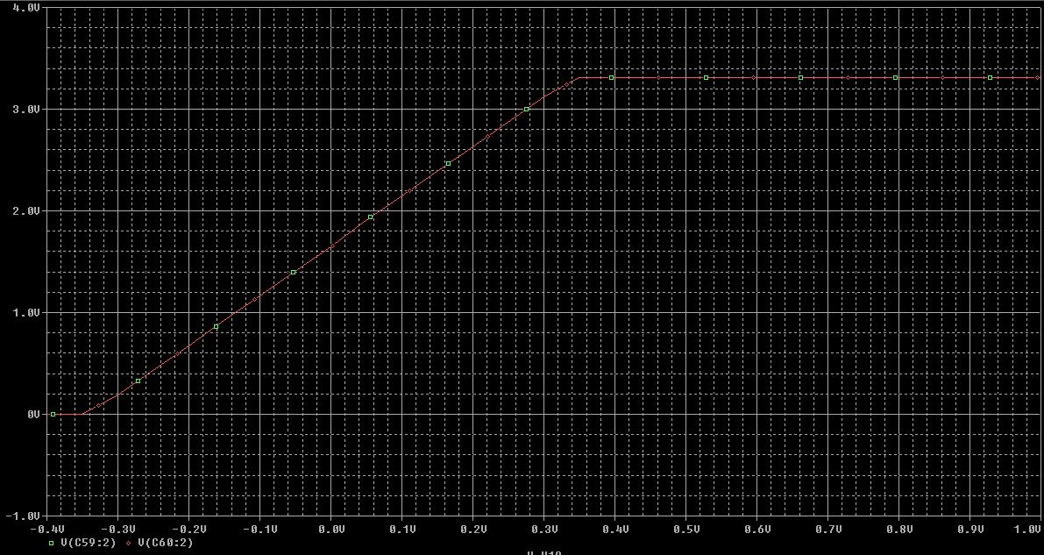
Dual Level Shift Circuit
Maximum Output 3.3Vdc

Slide 20
Risks & Contingency Plan
Failed Parts
Alternative
VCO
FPGA – pulses for switches
Dual Level Shift Circuit
Analog to Digital converters
High frequency signal generator
  Input signal into frequency multipliers
Use signal generator
Use oscilloscope to measure the outputs form the IQ demodulator
Manually hard code the output voltages from IQ Demodulator into DSP software

Slide 21
Programming
Timing Controls, Switches, A-to-D, Binary to BCD, & Mitigation
Patrick Delallana – Electrical & Computer Engineer

Slide 22
Summaries
What will be covered:
Separate Coding Tasks
  Code written for subtasks
Logic & explanation behind code written
Mitigation Strategies

Slide 23
Discrete Timing Control
Sets up the timing for the switches of the system.
Several ways to do this.
  Combinational with clock dividers
  Inherent counter

Slide 24
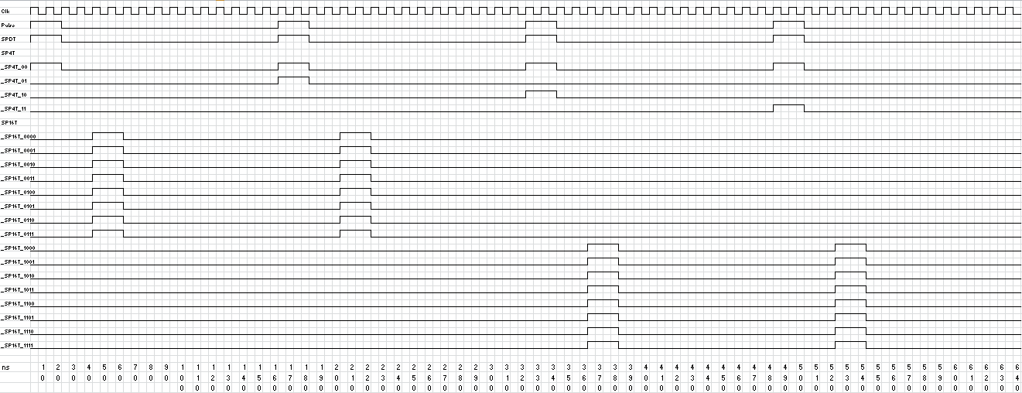
Timing Diagram

Slide 25
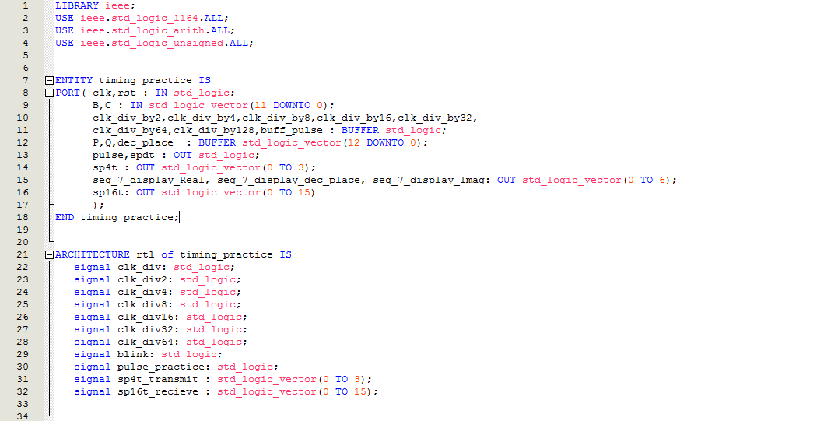
Discrete Timing Control

Slide 26
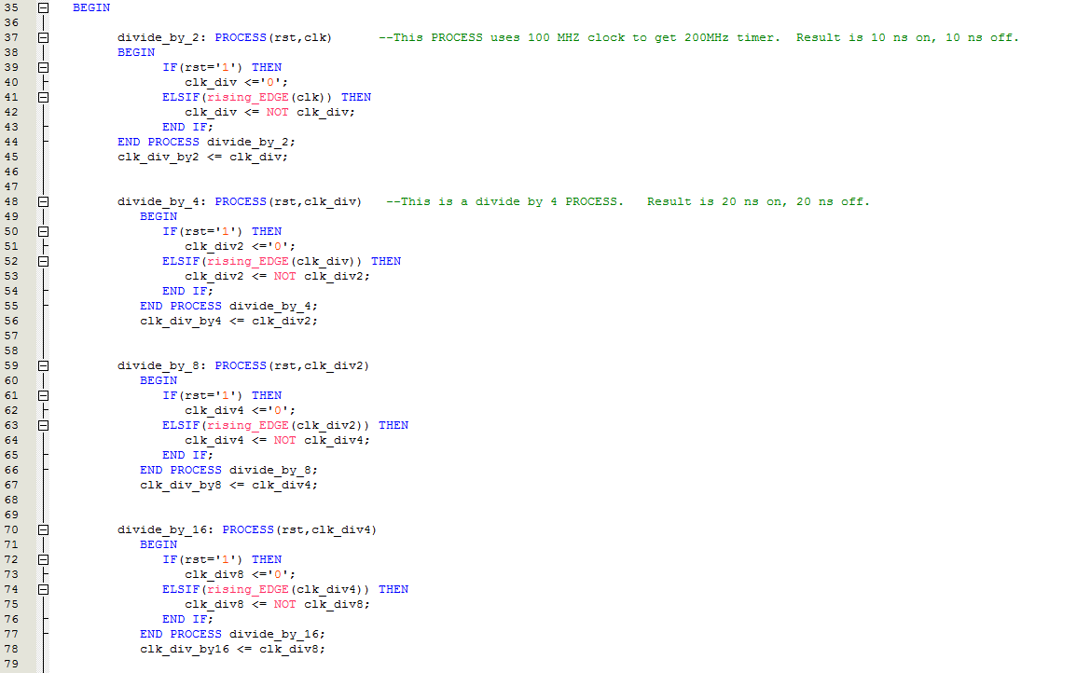
Code for Discrete Timing Control

Slide 27
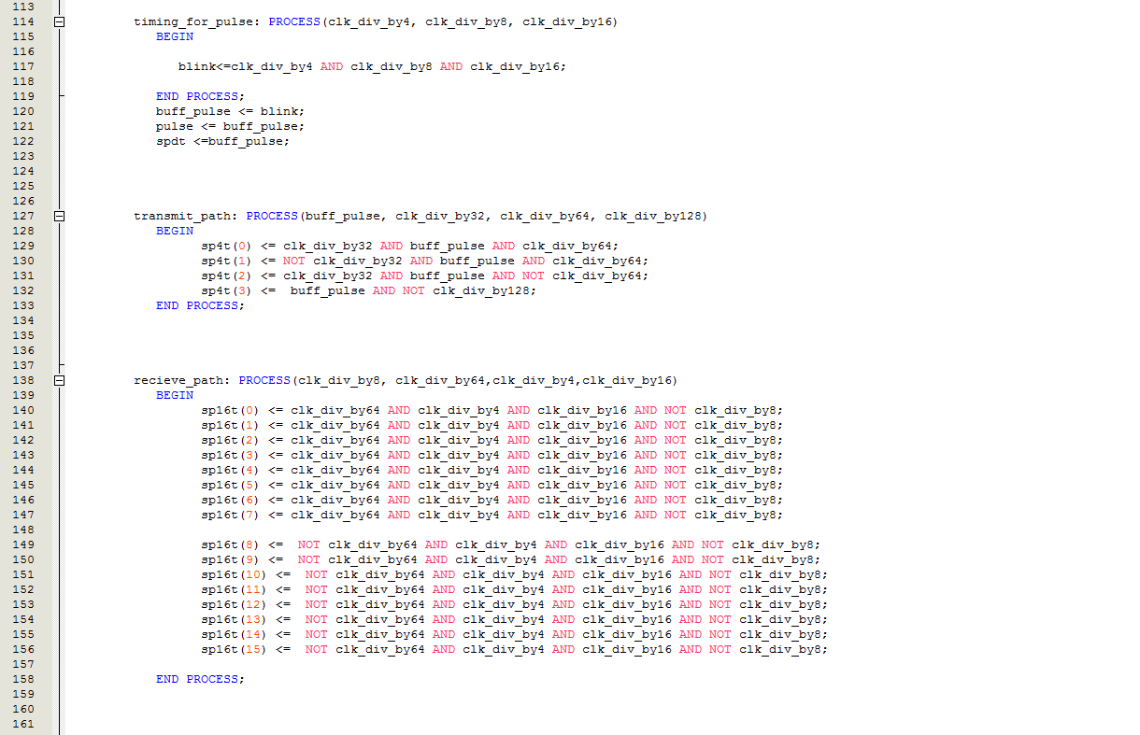
Combinational Logic for Switches

Slide 28
Mitigation Strategy
Use button to output pulse.
Could be one switch for each transmit/receive path.
Off time for transmitting and receiving mode may be increased, depending on results from testing.

Slide 29
Analog to Digital Conversion
A/D converter takes in analog voltage, outputs Digital combination of analog voltage
  12 bit output
  Range is 0 to 3.3 V.
Goal here is to store data from the IQ demodulator, and check via 7 segment display.

Slide 30
Binary to BCD Conversion
Shift and add 3 algorithm was used.
  Shift Binary number left one bit
  If n shifts have taken place, the binary coded decimal number not in the binary column anymore and the algorithm is finished. If this has not happened, go to step 3.
  If the binary values in any of the binary coded decimal columns is 5 or greater, the value in that column must be added by 3.
  Go back to step 1

Slide 31
Shift & Add 3 Algorithm
Binary Coded Decimal Columns
Operation | Thousands | Hundreds | Tens | Units | Binary
B |  |  |  |  | 1111 1111 1111
HEX |  |  |  |  | 1111 1111 1111
Start |  |  |  |  | 1111 1111 1111
Shift 1 |  |  |  | 1 | 1111 1111 111
Shift 2 |  |  |  | 11 | 1111 1111 11
Shift 3 |  |  |  | 111 | 1111 1111 1
Add 3 |  |  |  | 1010 | 1111 1111 1
Shift 4 |  |  | 1 | 0101 | 1111 1111
Add 3 |  |  | 1 | 1000 | 1111 1111
Shift 5 |  |  | 11 | 0001 | 1111 111
Shift 6 |  |  | 110 | 0011 | 1111 11
Add 3 |  |  | 1001 | 0011 | 1111 11
Shift 7 |  | 1 | 0010 | 0111 | 1111 1
Add 3 |  | 1 | 0010 | 1010 | 1111 1
Shift 8 |  | 10 | 0101 | 0101 | 1111
Add 3 |  | 10 | 1000 | 1000 | 1111
Shift 9 |  | 101 | 0001 | 0001 | 111
Add 3 |  | 1000 | 0001 | 0001 | 111
Shift 10 | 1 | 0000 | 0010 | 0011 | 11
Shift 11 | 10 | 0000 | 0100 | 0111 | 1
Add 3 | 10 | 0000 | 0100 | 1010 | 1
Shift 12 | 100 | 0000 | 1001 | 0101
BCD | 4 | 0 | 9 | 5
P | 15 12 | 11 8 | 7 4 | 3 0
z | 27 24 | 23 20 | 19 16 | 15 12 | 11 0
Vectors | Thousands = P[14:12]=z[26:24] | Hundreds= P[11:12]=z[26:24] | Tens= P[7:4]=z[19:16] | Units= P[3:0]=z[15:12]

Slide 32
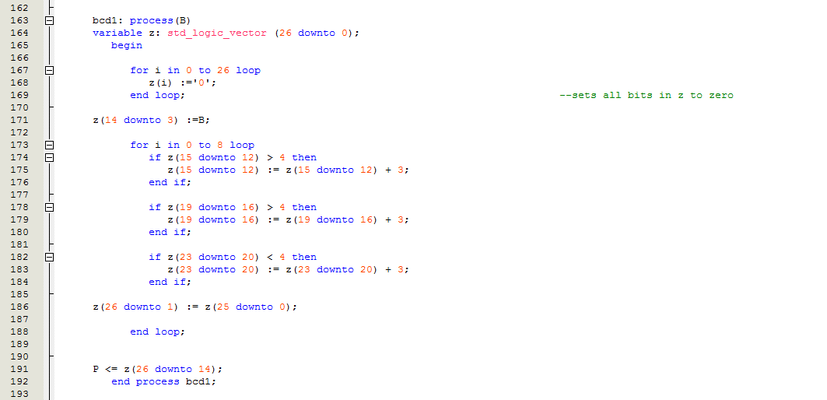
Logic For Binary to BCD Conversion

Slide 33
Next Milestone
Verify correct pulse output from pin on FPGA using oscilloscope and probe.
To check A/D code via 7 segment display. Input to A/D converter would just be DC power supply.
Possibly check output to VGA display via switches

Slide 34
Signal Overview
Signal Processing
Julia Kim – Electrical Engineer

Slide 35
Signal Processing –
Basis Functions
For image formation, the sum of the energy from some of the scatterers is taken and they are decomposed by multiplying them by the basis functions.
The basis function represents the energy that will come in from a different angle, so if it is multiplied by the total energy, it decomposes it into just that part.

Slide 36
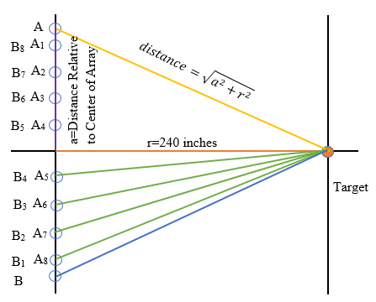
Boresite Calibration
A is the first transmit horn
  A1 through A8 are the receive horns
Range=20 feet=240 inches
1λ=1.18 inches at 10 GHz

Slide 37
Boresite Calibration
BORESITE CALIBRATION
 | f = Distance Relative to Center of Array (λ) | a = Distance Relative to Center of Array (inches) | Distance to Range from Each Antenna (θ=0°) (inches) | Sum of Tx and Rx Path of Each Antenna (inches)
A | 24 | 28.34645669 | 241.67
A1 | 21 | 24.80314961 | 241.28 | 482.95
A2 | 15 | 17.71653543 | 240.65 | 482.32
A3 | 9 | 10.62992126 | 240.24 | 481.90
A4 | 3 | 3.543307087 | 240.03 | 481.69
A5 | 3 | 3.543307087 | 240.03 | 481.69
A6 | 9 | 10.62992126 | 240.24 | 481.90
A7 | 15 | 17.71653543 | 240.65 | 482.32
A8 | 21 | 24.80314961 | 241.28 | 482.95
Calibration at boresite done in order to determine what the calibration factor would be when the target is at the center of the array of horns.

Slide 38
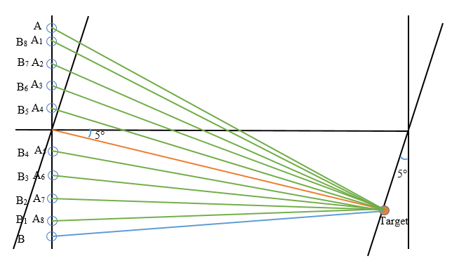
Calculation of Error at Maximum Angle
If the target is shifted and rotated at an angle θ, then the distance to each of the phase centers increases by d*sin(θ)
It looks at how the phase line comes in at different angles and causes different phase slopes from phase center to phase center

Slide 39
Phase Centers for Transmit Antenna
 | e = Far Field Phase Centers (lambda) | d = Far Field Phase Centers (inches) | 2*d*sin(θ) (inches)
A1 | 22.5 | 26.57480315 | -4.17
A2 | 19.5 | 23.03149606 | -3.61
A3 | 16.5 | 19.48818898 | -3.06
A4 | 13.5 | 15.94488189 | -2.50
A5 | 10.5 | 12.4015748 | -1.95
A6 | 7.5 | 8.858267717 | -1.39
A7 | 4.5 | 5.31496063 | -0.83
A8 | 1.5 | 1.771653543 | -0.28
Far field phase centers are calculated by taking the average of the transmit antenna and the receive antenna being calculated
d*sin(θ) was multiplied by two since it’s two-way as with the transmit and receive, it goes out and back

Slide 40
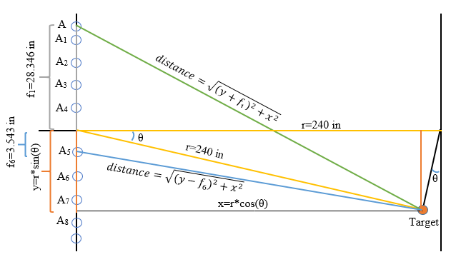
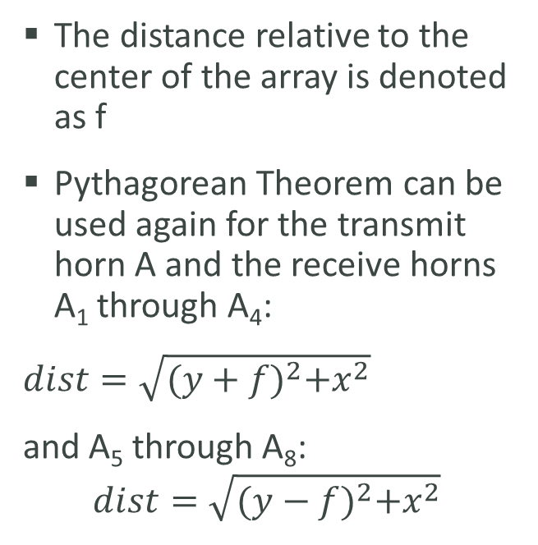
Geometry of Antennas with Target Rotated Off at 5°
The distance relative to the center of the array is denoted as f
Pythagorean Theorem can be used again for the transmit horn A and the receive horns A₁ through A₄:
$dist=\sqrt{{(y+f)}^{2}+x^{2}}$
and A₅ through A₈:
$$dist=\sqrt{{(y−f)}^{2}+x^{2}}$$

Slide 41
Calculation of Error at 5°
 | Distance to Point on Radius of Range (inches) | Sum of Tx and Rx Path to Each Antenna (inches) | Resultant (inches) | Error (deg)
A | 243.87
A1 | 243.21 | 487.07 | -4.13 | -13.218
A2 | 242.04 | 485.90 | -3.58 | -10.088
A3 | 241.07 | 484.93 | -3.03 | -8.4158
A4 | 240.30 | 484.17 | -2.48 | -7.7861
A5 | 239.75 | 483.61 | -1.92 | -7.7678
A6 | 239.40 | 483.27 | -1.36 | -7.9209
A7 | 239.26 | 483.13 | -0.81 | -7.8023
A8 | 239.33 | 483.20 | -0.26 | -6.9714
Path length for Tx antenna A is added to the respective ones for Rx antennas A₁ through A₈
The sums of the path lengths with the target off five degrees were subtracted from the sums of the path lengths at boresite
Results of the resultant in inches are subtracted from the results of the 2*d*sin(θ) calculated

Slide 42
Calculation of Error at 5°
This ends up being the phase error that occurs

Slide 43
Signal Processing & Image Calibration
Error (degrees) | I_{error} = cos(error) | Q_{error} =sin(error) | I_{combined} | Q_{combined}
-13.2183 | 0.97351 | -0.2287 | -0.9993 | 0.03782
-10.0876 | 0.98454 | -0.1752 | 0.9781 | 0.20815
-8.41575 | 0.98923 | -0.1464 | -0.9082 | -0.4184
-7.78614 | 0.99078 | -0.1355 | 0.80472 | 0.59366
… | … | … | … | …
1.53471 | 0.99964 | 0.02678 | 0.8211 | -0.5708
1.38164 | 0.99971 | 0.02411 | -0.9142 | 0.40526
1.50024 | 0.99966 | 0.02618 | 0.97539 | -0.2205
2.33108 | 0.99917 | 0.04067 | -0.9999 | 0.01495
The I data would be the sum of the real part of the basis functions for those angles, which would be the sum of each of the sixteen points of f(realθ₄), f(realθ₈), f(realθ₁₃), and the value of I_{combined,1}
Q data would be the sum of the imaginary part of the basis functions for those angles and the value of Q_{combined,1}

Slide 44
Signal Processing
Fourier transform is used to decompose the waveform into the amounts of energy that come in from different angles.
Basically a 1-D image that tells the user where the energy is coming in from different angles in the scene

Slide 45
Mechanical Components
Mark Poindexter – Mechanical Engineer
Malcolm Harmon – Mechanical Engineer

Slide 46
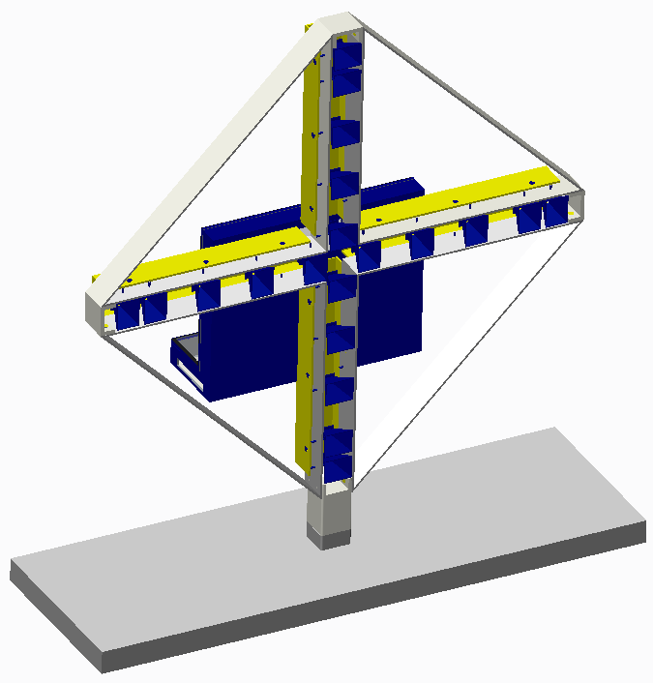
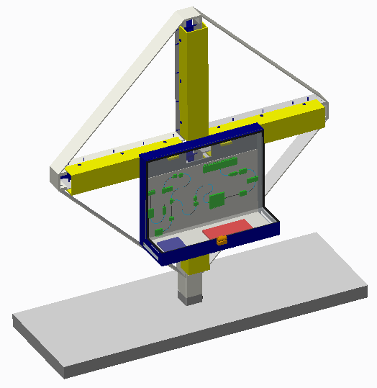
Antenna Structure Recap

Slide 47
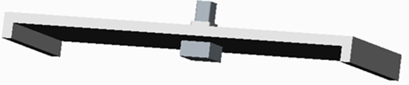
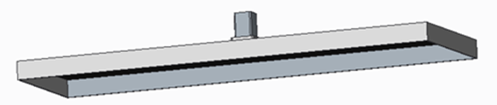
Design Change - Stand
Before
3 inch
THICK
Aluminum
24 in
Now
3/16 inch
THICK
Steel
72 in

Slide 48
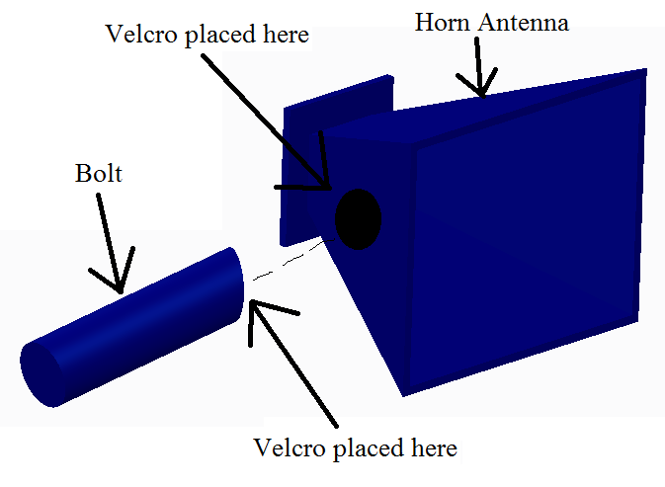
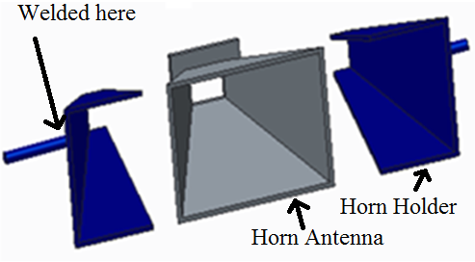
Design Change - Horn Holders
Before
Now

Slide 49
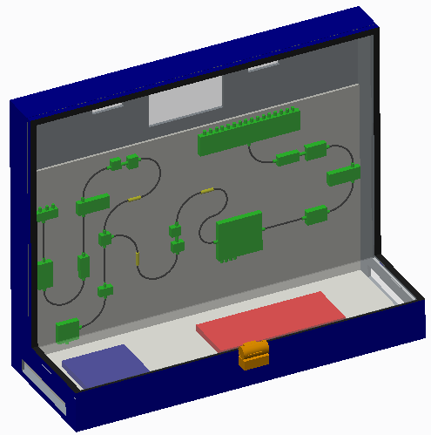
Design Change - Component Box
28 in
Before
16 inch TALL
24 inch WIDE
Bottom extends
10 inch OUT
Now
22.5 inch TALL
28 inch WIDE
Bottom extends
10.25 inch OUT
22.5 in
10.25 in

Slide 50
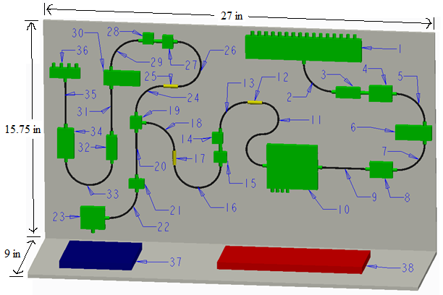
L-Shaped
Component
Sheet
1 - SP16T Switch 14 - Ultra Wide Band Amplifier 27 - Multiplier
2 - 3 Inch 90 Degree Bend Cable 15 - Multiplier 28 - Ultra Wide Band Amplifier
3 - Band Pass Filter 16 - 5 Inch 180 Degree Bend Cable 29 - 3 Inch 90 Degree Bend Cable
4 - Low Noise Amplifier 17 - Fixed Attenuator 30 - Variable Attenuator
5 - 3 Inch 90 Degree Bend Cable 18 - 3 Inch 90 Degree Bend Cable 31 - 3 Inch Cable
6 - Variable Attenuator 19 - SP2T Switch 32 - Band Pass Filter
7 - 3 Inch 90 Degree Bend Cable 20 - 3 Inch Cable 33 - 5 Inch 180 Degree Bend Cable
8 - Low Noise Amplifier 21 – Super Ultra Wide Band Amplifier 34 - Power Amplifier
9 - 3 Inch Cable 22 - 3 Inch 90 Degree Bend Cable 35 - 3 Inch Cable
10 - IQ Demodulator 23 - VCO 36 - SP4T Switch
11 - 7 Inch S Bend Cable 24 - 3 Inch 90 Degree Bend Cable 37 - FPGA
12 - Fixed Attenuator 25 - Fixed Attenuator 38 – Power Supply/Level Shift Circuit
13 - 3 Inch 90 Degree Bend Cable 26 - 5 Inch 180 Degree Bend Cable

Slide 51
Heat Transfer from Electrical Components
Components | Area (ft²) | Voltage (V) | Current (A) | Dissipated Power (W) | Heat Transfer (W/ft²)
VCO | 0.174 | 3.300 | 0.045 | 0.149 | 0.855
FPGA | 0.278 | 3.300 | 0.200 | 0.660 | 2.376
SPDT | 0.005 | 5.000 | 0.001 | 0.007 | 1.400
SP4T | 0.010 | 5.000 | 0.160 | 0.800 | 78.367
SP16T | 0.089 | 5.000 | 0.550 | 2.750 | 30.938
IQ DEMOD | 0.075 | 5.000 | 0.110 | 0.550 | 7.300
SUPER ULTRA WBA | 0.005 | 12.000 | 0.400 | 4.800 | 897.662
ULTRA WBA | 0.005 | 12.000 | 0.400 | 4.800 | 1031.642
LOW NOISE AMP | 0.012 | 12.000 | 0.320 | 3.840 | 321.488
POWER AMP | 0.017 | 15.000 | 1.100 | 16.500 | 981.818
TOTAL | X | X | X | 34.856 | 3353.846

Slide 52
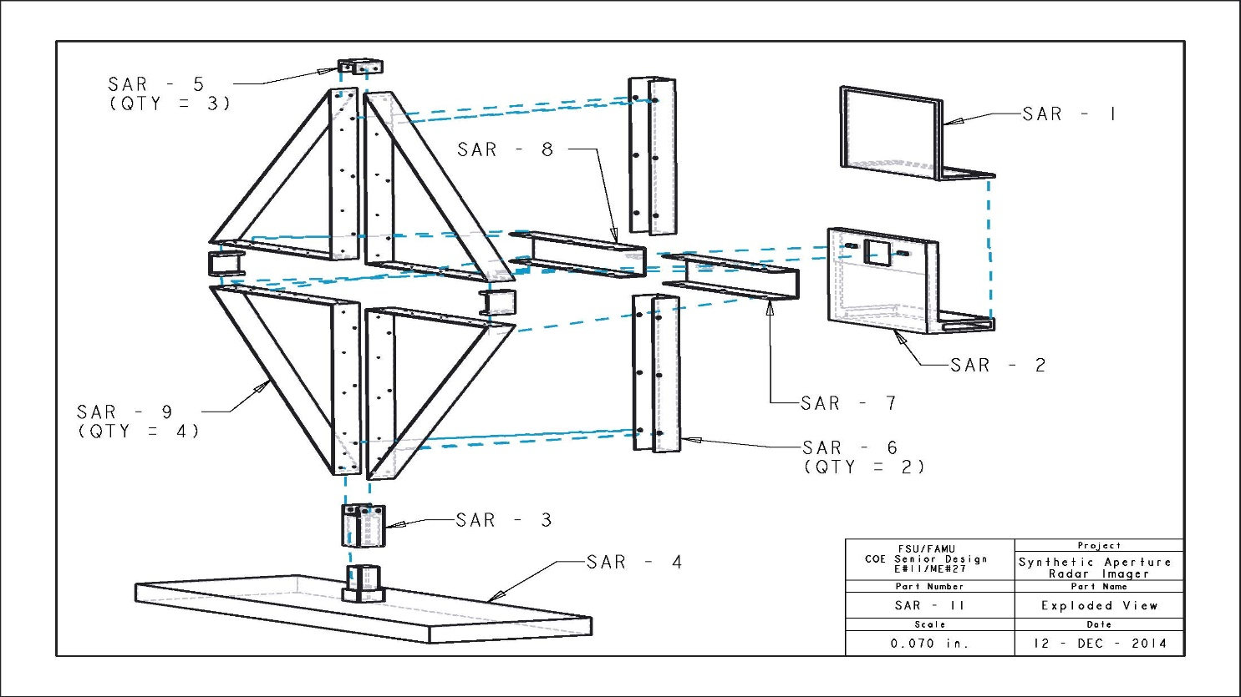
Antenna Structure – Stress Analysis
Exploded view separated by components
Includes stand and component box which stands 6 ft. high
Aluminum Structure
5.3 ft. wide excluding stand, 6 ft. wide including stand
Component | Weight | units
Component Box | 33.3 | lb
Quadrant Panel | 9.9 | lb
Quadrant Connector | 1.3 | lb
Quadrant Connector to Stand | 4.7 | lb
Vertical Horn Cover (Top and bottom) | 7.9 | lb
Horizontal Horn Cover(Left) | 8.0 | lb
Horizontal Horn Cover (Right) | 8.0 | lb
Structure Stand | 48.2 | lb
Total | 162.5 | lb

Slide 53
Horizontal Horn Covers
Holds component box
20 lbs

Slide 54
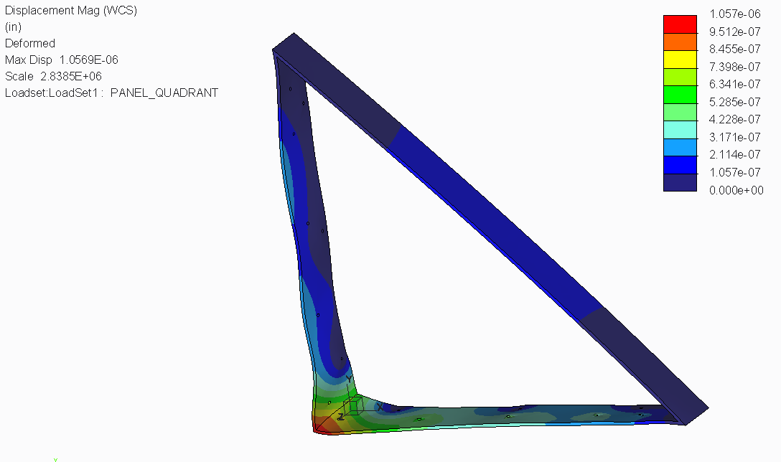
Quadrant 1 and 2 Panel
Holds Antenna Horns
Holds Horn Cover
Component Box
46 lbs

Slide 55
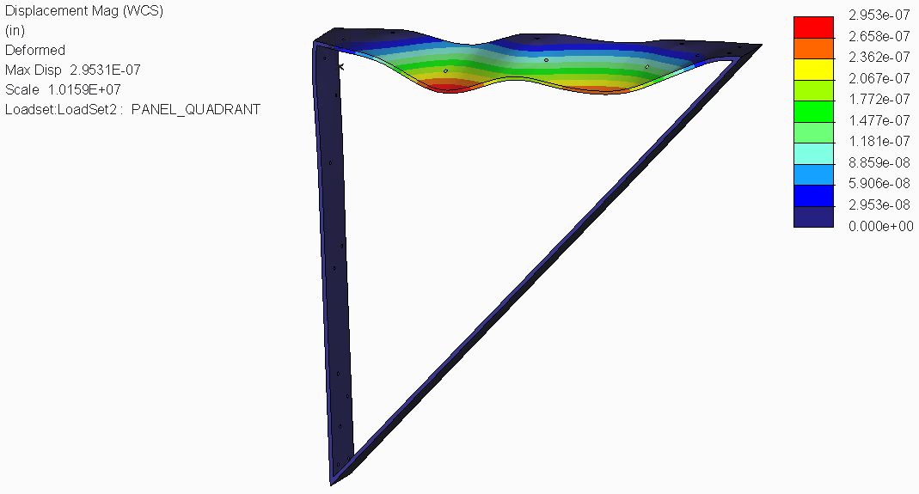
Quadrant 3 and 4 Panels
Hold Antenna horns
Component Box
38 lbs

Slide 56
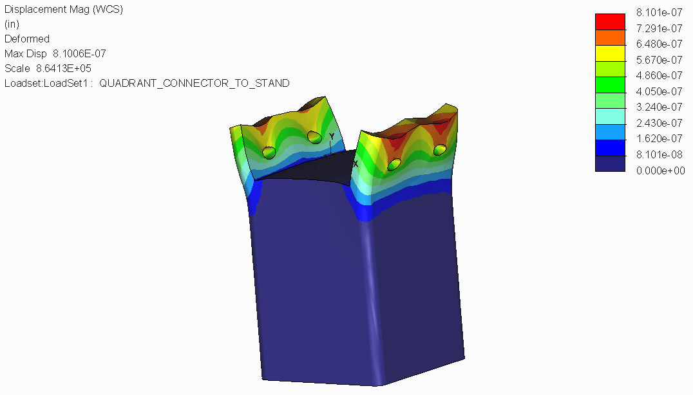
C-Channel Bracket
Holds entire Structure
Connect Structure to Stand
157 lbs

Slide 57
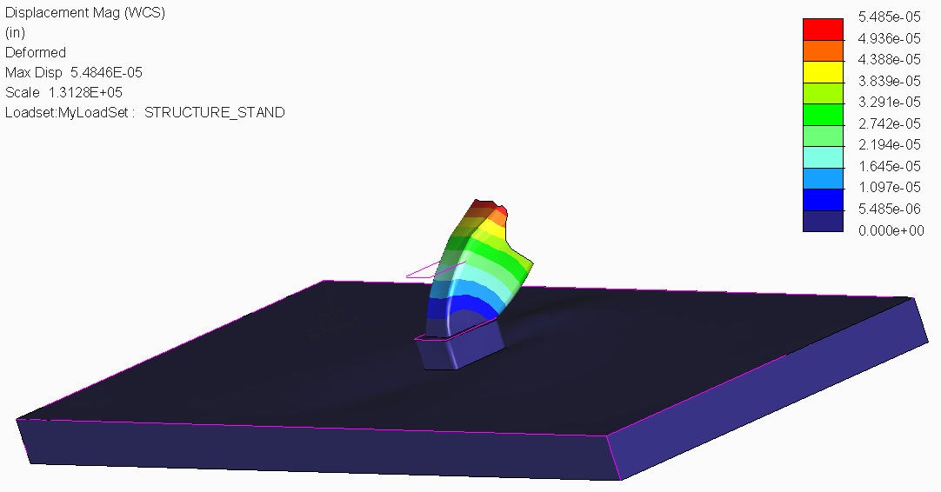
Antenna Structure Stand
Holds entire Structure
Balances Structure
162 lbs

Slide 58
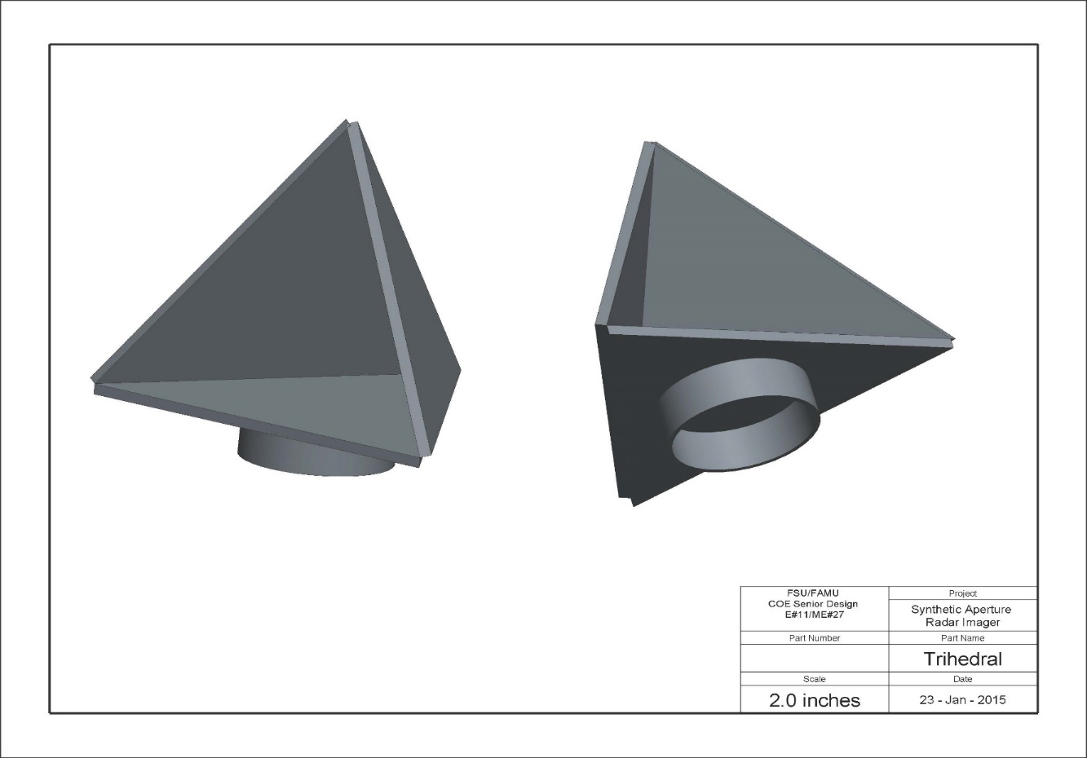
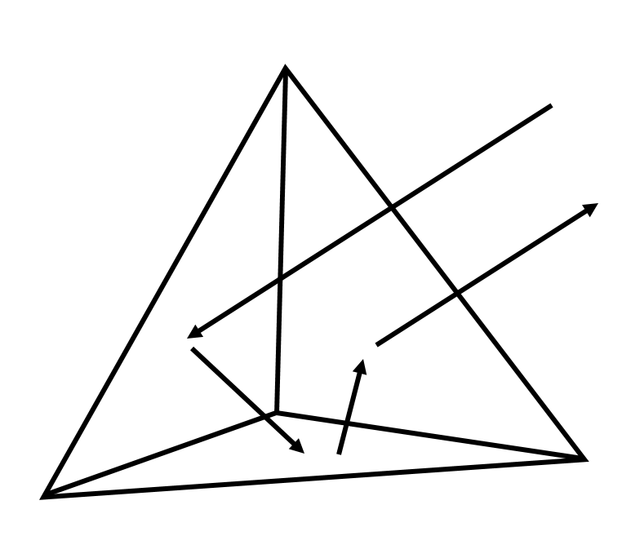
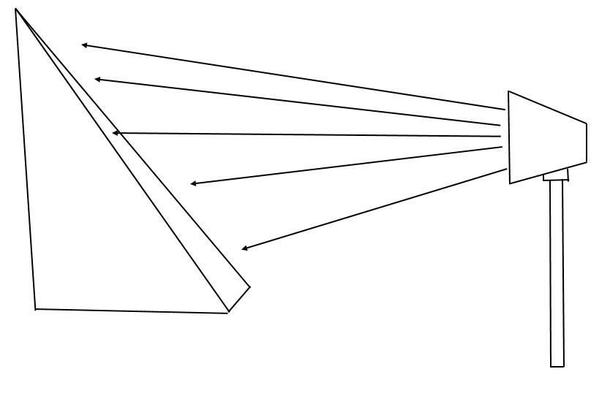
Trihedral
Triangular planes are joined together to form a triangular pocket to receive and reflect waves

Slide 59
Project Schedule
Major Milestones, Schedule Conflicts, & Goals
Jasmine Vanderhorst – Industrial Engineer

Slide 60
Schedule Update
Completed
Near Completion
Obtain Storage and Testing Facility
  Center for Advanced Power Systems (CAPS)
Level Shift Circuit Design, Transmit, Receive, Demodulator LO Chain Design
Antenna Aperture Design
Programming Descriptions
Structural Frame Design
Welding and Assembly (February 12-27, 2015)
Anechoic Foam Expense Assessment (February 13, 2014)
Contingency Plans

Slide 61
Ongoing & Upcoming Activities
Component Ordering & Shipping
Signal Processing & Image Calibration
Data Storing Software for FPGA to PCU
Power Supply Design
DC Wire Harness Design & Fabrication (February 16-23)
Software & Hardware Demonstration (February 23-27)
Final Hardware & Software Integration (March 2 – April 3)

Slide 62
Schedule Delayed
Delayed Parts
  VCO and RF Cables Not Yet Arrived
  Fairview Vendor ordered delayed by FAMU Provost office
  Fairview will not process 2nd order until 1st ordered paid out
Testing Equipment
  Received W9 from Electrorent
  Waiting on Price Quote for 2 Month Rental
  2 Week Processing Time

Slide 63
Critical Path
Antenna Frame Assembly
  Need in 2 weeks, vendor lead time is 3 weeks
Design of Wiring Schematic
Fabrication of DC Wire Harness
  Need pre-fab harnesses ready to go when assembly on frame begins
Syncing FPGA Coding and Signal Processing Information
CAPS Testing Schedule
  Contract for another vendor to do testing in same place
  Potential Time Conflicts
  3 People with badges need to submit testing schedule

Slide 64
Project Assessment
Budget, Strategy, Risks and Conflicts, & Future Tasks
Benjamin Mock – Industrial Engineer

Slide 65
Budget Chart

Slide 66
Large Budget Items & Mitigation Strategy
Switches
Test Equipment
Mechanical Frame
Anechoic Absorber
Quote/Vendor Comparison
Lead Time Analysis
Trade-Off Analysis
  DFMA

Slide 67
Procurement Conflicts
Large Ticket Items & FAMU Provost Office
SP16T Switch
Items/Components Still Being Determined
Unforeseen Component Procurement
  FAMU Reimbursement Strategy

Slide 68
Scheduled IE Tasks
Coordinate with CAPS to secure effective testing schedule
Fault Tree Analysis of radar system
Construct a user/operation manual
Construct business model (IE Curriculum)

Slide 69
Thank You!
Questions & Comments

