Slide 1



Electronic SAR Imager
Milestone #1
Needs Analysis and Requirements Specification
Team E#11/M#27

Slide 2
Presentation Introduction
Team Overview
Project Stakeholders
Code of Conduct
About Northrop Grumman
SAR Imager Overview
Necessary Components
Customer Wants & Needs
Requirements Specifications
Preliminary Test Plan
Preliminary Schedule, Budget, & Risk

Slide 3
Team Overview
Project Manager & Webpage Developer
  Jasmine Vanderhorst – Industrial Engineer
Assistant Project Manager & Antenna Engineering
  Matthew Cammuse – Electrical Engineer
Assistant Project Manager
  Malcolm Harmon – Mechanical Engineer
Lead Engineer & Programmer
  Patrick Delallana – Electrical & Computer Engineer
Co-Lead Engineer & Treasurer
  Benjamin Mock – Industrial Engineer
Co-Lead Engineer & RF Engineer
  Joshua Cushion – Electrical Engineer
Signal Processing Engineer & Document Control
  Julia Kim – Electrical Engineer
Co-Lead Engineer
  Mark Poindexter – Mechanical Engineer

Slide 4
Stakeholders
Northrop Grumman
  Corporate Sponsor: Pete Stenger
Electrical and Computer Engineering
  Lead Coordinator: Dr. Michael Frank
  Main Advisor: Dr. Simon Foo
  Co-Main Advisor: Dr. Shonda Bernadin
  Extra Reviewers: Dr. Bruce Harvey and Dr. Rajendra Arora

Slide 5
Stakeholders
Mechanical Engineering
  External Coordinators: Dr. Nikhil Gupta and Dr. Scott Helzer
  External Technical Advisor: Dr. Emmanuel Collins
  Teaching Assistants: Ricardo Aleman and Samuel Botero
Industrial Engineering
  External Coordinator: Dr. Okenwa Okoli
  External Advisor: Dr. James Dobbs
  Teaching Assistants: Emily Hammel and Margaret Scheiner

Slide 6
Code of Conduct
Meeting Times
  Tuesdays – 7:00 pm
Communication
  GroupMe App, Emails
Document Transfer
  Dropbox and Blackboard Group File Exchange
Conflict Resolutions
  Team Leader

Slide 7
Who is Northrop Grumman?
Mission: To be at the forefront of technology and innovation, delivering super capability in tandem with maximized cost efficiencies.
Headquarter: West Falls Church, Virginia
Leading global security company
4th largest defense contractor in the world (2010)

Slide 8
Project Overview
Assistant project manager: Malcolm harmon
Mechanical engineer

Slide 9
SAR Imager Overview
Objective: Develop a fully-functional, low-cost detection electronic SAR imager
  Low, but useful, image resolution
  Commercial-off-the-shelf (COTS) components
  Capital test equipment to get needed phenomenology information
Expected Output: Successful development of a low-cost prototype SAR imager

Slide 10
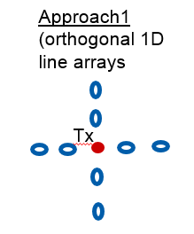
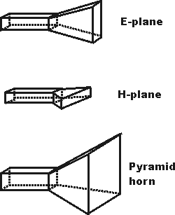
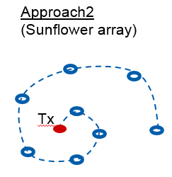
Antenna Aperture
Project Approach Option 1
  Orthogonal Array
  1-D sparse antennas which would combine images to get 2-D images
Project Approach Option 2
  Sunflower Array
  Sparse sunflower distribution across area eliminating spatial ambiguities to generate image

Slide 11
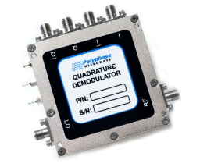
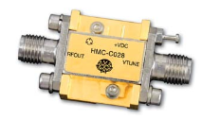
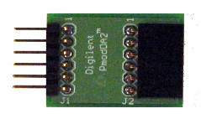


Components
Lead engineer & Programmer: Patrick delallana
Electrical & computer engineer

Slide 12
Necessary Components
Field Programmable Gate Array (FPGA)
Voltage Controlled Oscillator (VCO)
Power Amplifier
Antenna
  Horns
Low Noise Amplifier
Digital/Analog Converter
Analog/Digital Converter
Multiplier (x2)

Slide 13
Necessary Components
Switches
  SPDT- Single Pole Double Throw
  SPST – Single Pole Single Throw
Attenuator
  Reduces power of signal without changing waveform
Band Pass Filters
  Smoothes out the wave for the IQ demodulator
IQ Demodulator
  Determines the phase and the amplitude of the signal

Slide 14
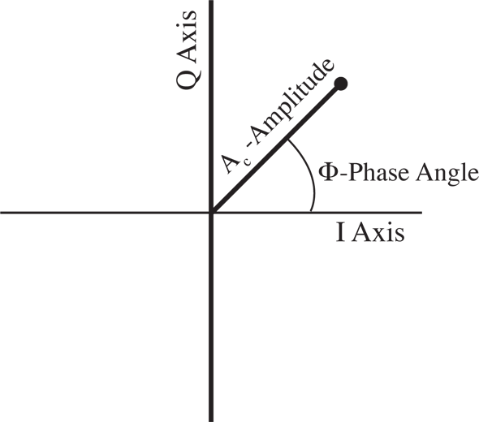
IQ Demodulator: Q vs I graph
Has L port, which receives signal from VCO
Signal from antenna gets mixed with L port signal
(both have the same frequency)
  IQ demodulator brings out I and Q portion
  Phase difference between antenna signal and L port signal

Slide 15

Customer Needs & Wants
Co-lead engineer: Mark Poindexter
mechanical engineer

Slide 16
Needs – Required Capabilities
CAP-001: Radar range of 20 feet
CAP-002: Operating frequency of X to Ku bands
CAP-003: Operation at safe frequencies
CAP-004: Detection of metal objects on test objects
CAP-005: Near real-time radar operation
CAP-006: Radar’s width of detection
CAP-007: Image generated from receiver data

Slide 17
Wants – Desired Capabilities
CAP-008: Radar detection of metal objects on multiple people
CAP-009: Detection of the area of body where metal object appears
CAP-010: System will focus on metal object as person moves
CAP-011: Real-time radar operation

Slide 18

Requirements Specification
Antenna Engineer & assistant Project manager:
Matthew Cammuse
Electrical Engineer

Slide 19
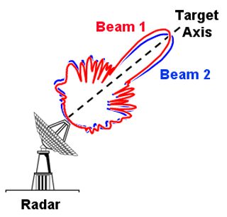
Functional Requirements
REQF-001: Frequency Range
  High as possible (Fit within cost range)
  X-Ku band
  Current request 10 GHz
REQF-002: Range to Scene
  20-40 feet
REQF-003: Scene Extent
  Radius around a average sized human
REQF-007: Safe Radius
  Based on test

Slide 20
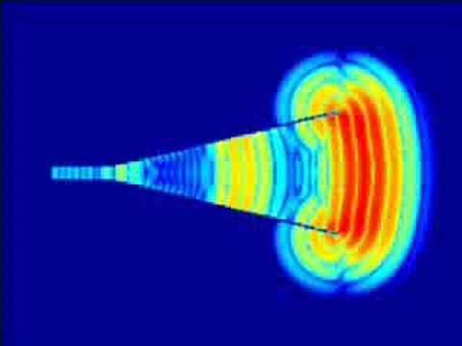
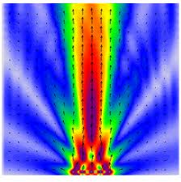
Functional Requirements
REQF-004: Cross Range Resolution
  Area of detection of objected
  Not overly detailed
  Optimal pixels: 3 inches x 3 inches
REQF-005: Down Range Resolution
  Volume of object
  Not too in depth
REQF-006: Pulse Width
  Distance: 20 ft.
  1 nanosecond per foot
  20 nanoseconds wide

Slide 21
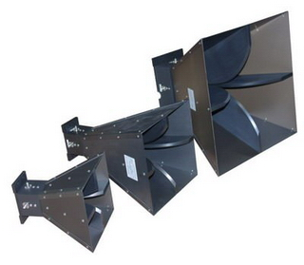
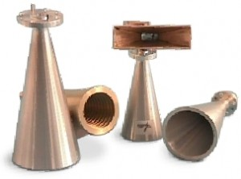
Functional Requirements
REQF-009: Antenna Size
  Phased array
  8 Rx
  2 Tx
REQF-010: Number of Phase Centers
  16
REQF-011: Distance between Phase Centers
  Array Factor vs. Elemental Patterns

Slide 22
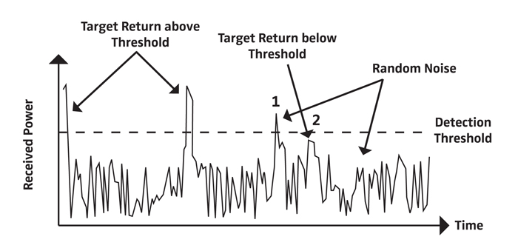
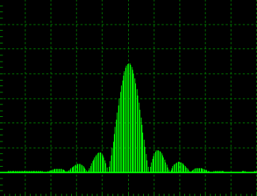
Functional Requirements
REQF-008: Transmit Power
  Low Powered
  Short Distance
REQF-012: Pulse Repetition Interval
  Based on designated test
  Start Slow
REQF-013: Receiver Noise Figure
  Expected Noise
REQF-014: Image Frame Rate
  Image generator
  Based on computer

Slide 23
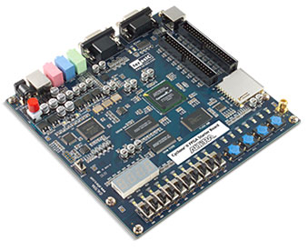

Non-Functional Requirement
REQN-001: Radiation Safety
  SAR imager functions to FCC regulations
REQN-002: Radar Transmitting Isolation
  Radiation does not distort other electrical systems
REQN-003: Cost Efficient
  Low price
  Dependent of frequency level
REQN-004: VHDL
  Coding language for FPGA board

Slide 24
Requirement Constraints
CONS-01: Antenna Amount
CONS-02: Antenna Arrangement
CONS-03: Testing & Radiation Safety
CONS-04: Project Timeline

Slide 25
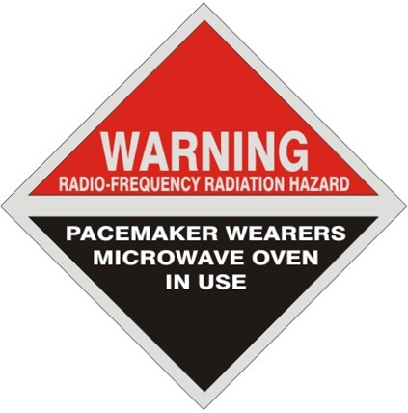
Constraints & Capabilities Testing Plan
Signal processing engineer & document control: Julia kim
Electrical engineer

Slide 26
Constraints Test Plan
CONT-001: Antenna Capability Test
CONT-002: Antenna Precision Test
CONT-003: Safety Test
CONT-004: Time

Slide 27
Capabilities Test Plan
TESTC-0001: Physical Inspection Test
TESTC-0002: Power Test
TESTC-0003: RF Safe Test
TESTC-0004: Operating signal test
TESTC-0005: Receiver Signal Test 1.0
TESTC-0006: Receiver Signal Test 2.0
TESTC-0007: Computer Image Test

Slide 28

Requirements Testing Plan
Co-lead & rf engineer: Joshua cushion
Electrical engineer

Slide 29
Requirements Test Plan
TESTFF-001: Frequency Range
TESTFF-002: Range of Scene to be Imaged
TESTFF-003: Scene Extent
TESTFF-004: Cross Range Resolution
TESTFF-005: Down Range Resolution

Slide 30
Requirements Test Plan
TESTFF-006: Pulse Width
TESTFF-007: Safe Radius
TESTFF-008: Transmit Power
TESTFF-009: Verify Proper Antenna Size
TESTFF-010: Number of Phase Centers

Slide 31
Requirements Test Plan
TESTFF-011: Distance between Phase Centers
TESTFF-012: Pulse Repetition Interval
TESTFF-013: Receiver Noise Figure
TESTFF-014: Image Frame Rate

Slide 32

Preliminary Budget, Schedule, & Risks
Co-lead engineer & treasurer: Benjamin mock
Industrial engineer

Slide 33
Project Funding
Funds are being provided from Northrop Grumman through the FAMU-Foundation
Approximate Budget $50,000
Purchasing Capability: P-Card
  For large purchases contact Donna Butka (FAMU/FSU COE – ECE)
FAMU Access & Cost Management
  Jasmine Vanderhorst

Slide 34
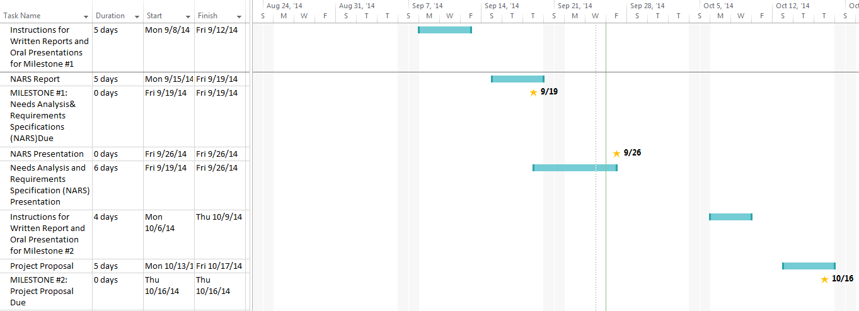
Preliminary Project Schedule

Slide 35

Preliminary Risk Assessment
Meeting Facilities & Reservations
Testing Facility Acquisition
Equipment and Parts Procurement
Design Assessment/Scope Adjustment
Documentation Control
Radiation Absorption
  OSHA 1910.97(a)(2)(i) 10 mW/cm²
  OSHA 1910.97(a)(3)(i) Appropriate Warning Sign

Slide 36
References
Stenger, Pete, “Electronic SAR Imager” – Posted on Blackboard
Stenger, Pete, “Radar Imager Performance Characteristics” – Posted on Blackboard

