Slide 1



Electronic SAR Imager
Team #E11 - #M27
Final Presentation
April 16, 2015

Slide 2
Team Agenda
Team Roles & Responsibilities
Project Overview
Electrical System
Mechanical Analysis
Project Management
Conclusion
Closing Questions

Slide 3
The Team Structure
Engineer | Jasmine Vanderhorst | Benjamin Mock | Joshua Cushion | Matthew Cammuse | Patrick De la llana | Julia Kim | Malcolm Harmon | Mark Poindexter
Field of Study | Industrial Engineering | Industrial Engineering | Electrical Engineering | Electrical Engineering | Electrical Engineering | Electrical Engineering | Mechanical Engineering | Mechanical Engineering
Tasks | Project Management Team Web Master Technical Writing & Formatting Presentations & Posters | Lead IE & Treasurer Procurement Budget Allocation Safety Analysis Risk Analysis | Lead EE & Radio Frequency Engineer Electrical System Design Testing Strategy & Application | Assistant Project Manager & Co-Lead EE Antenna Array Design Power System Wiring | Co-Lead EE FPGA Programming Timing, Switches, and A-to-D Conversion Coding VGA Code | Co-Lead EE & Recording Secretary Signal Processing Image Calibration | Assistant Project Manager Vendor Relations Antenna Frame Design Material Analysis User Manual | Co-Lead ME Vendor Relations Component Box Design Cabling Design Heat Transfer Analysis User Manual

Slide 4
Overview

Slide 5
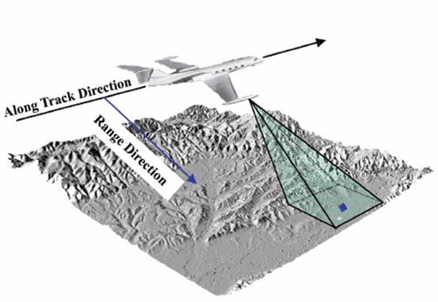
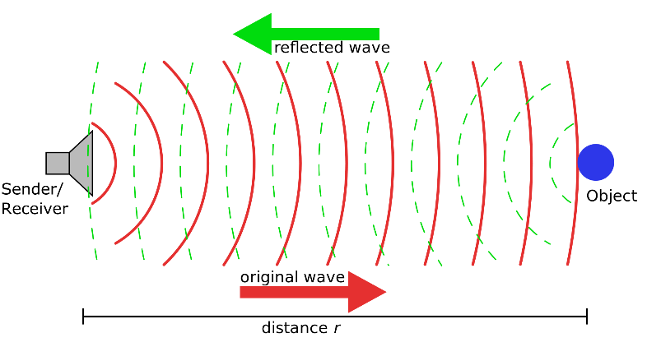
Project Introduction & Goals
SAR Introduction
Project Goal
What is an SAR?
Synthetic Aperture RADAR: Typically, a single rotating antenna is attached to an aircraft flying over a target zone capturing several high resolution images to create a single image map.
Why is an SAR needed?
Typical Use: Environmental Monitoring, Earth-Resource Mapping, and Military Applications
What is the project goal?
To develop a “static, multi-antenna Synthetic Aperture RADAR (SAR) imager”
Project Theory: 20 stationary antennas, creating a single low resolution image for the purpose of detecting metal objects and weapons
How will this type of RADAR be used?
Typical Use: Government Buildings, Schools, Airports, & various other homeland security applications

Slide 6
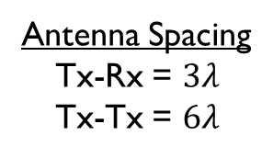
Imaging Radar Operational Concept
40 x 40 inch scene
Pulsed Transmit/Receive
Imaging Radar
Static parts
COTS components
Digital beam forming
16 - 2.5 inch
1-D Cells in
Azimuth and
Elevation
PC Display
20 foot range to scene center
5 x 5 feet
Beams are formed
digitally with Fourier
Transform, 16 in Azimuth
and 16 in Elevation
20nS wide RF
Pulse @ 10 GHz
16 - Azimuth
16 - Elevation
VGA Connection
X-Band Horn
Antenna Array
Antenna Spacing
Tx-Rx = $3λ$
Tx-Tx = $6λ$

Slide 7
Electrical Analysis

Slide 8
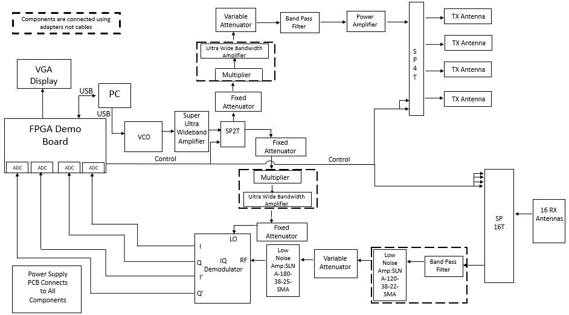
Electrical System Overview

Slide 9
Transmit Signal Chain – Power
Component | Input Power |  | Output Power |  | Frequency
 | [dBm] | [mW] | [dBm] | [mW] | [GHz]
Voltage Controlled Oscillator (VCO) | 0.000 | 1 | -4.000 | 0.398 | 5
Super Ultra Wideband Amplifier | -4.196 | 0.381 | 21.804 | 151.501 | 5
Single Pole Double Throw (SPDT) Switch | 21.530 | 142.233 | 19.530 | 89.743 | 5
Fixed Attenuator | 19.413 | 87.347 | 9.413 | 8.735 | 5
Frequency Multiplier | 9.413 | 8.735 | -3.088 | 0.491 | 10
Ultra Wide Bandwidth Amplifier | -3.088 | 0.491 | 8.913 | 7.785 | 10
Variable Attenuator | 8.795 | 7.577 | -3.205 | 0.478 | 10
Band Pass Filter | -3.323 | 0.465 | -6.323 | 0.233 | 10
Power Amplifier | -6.518 | 0.223 | 25.482 | 353.319 | 10
Single Pole Four Throw (SP4T) Switch | 25.482 | 353.319 | 22.482 | 177.079 | 10

Slide 10
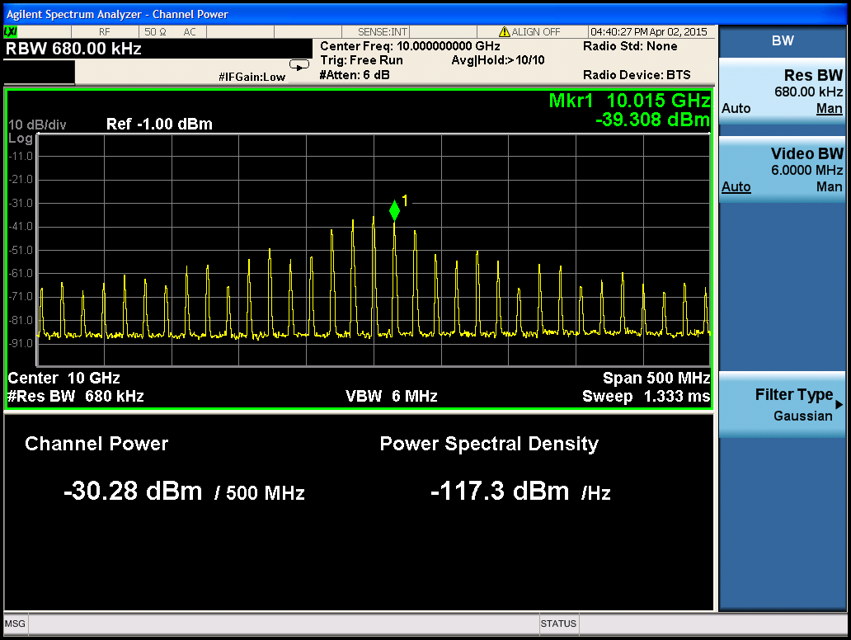
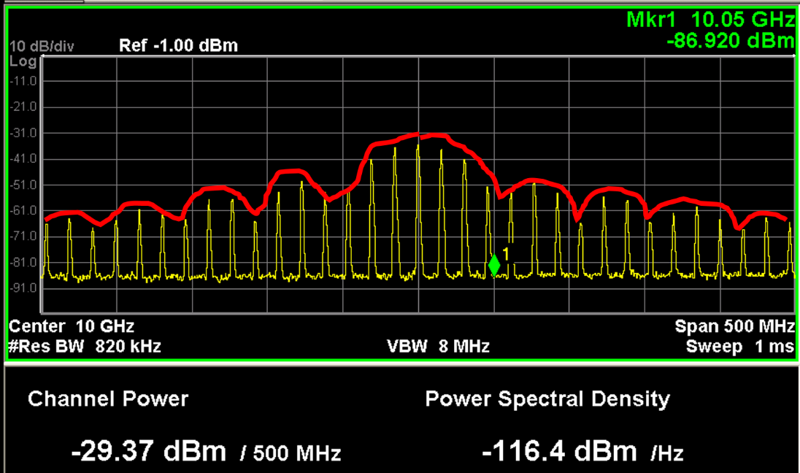
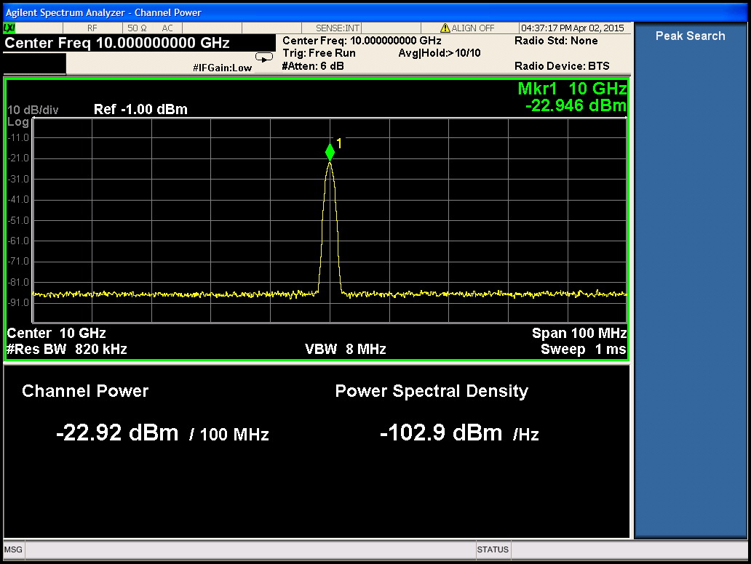
Transmit Signal Chain –
Test Strategies
Measure and verify each at the output of SP4T switch:
Peak Signal Power
  42dB (attenuation) – 22.92 dBm = 21.804 dBm
Average Signal Power
  Attenuation – measured power/span – 10*log (duty cycle)
    17.749 dBm and 16.839 dBm
Pulse Width = 20nS
  Null Frequency = 50 MHz
  1/null frequency
Period (T) = 65nS
  Frequency = 15.38 GHz
  1/T

Slide 11
Receive Signal Chain – Power
Component | Input Power |  | Output Power |  | Frequency
 | [dBm] | [mW] | [dBm] | [mW] | [GHz]
Single Pole Sixteen Throw (SP16T) Switch | -53.251 | 4.731E-06 | -57.951 | 1.603E-06 | 10
Band Pass Filter | -58.068 | 1.560E-06 | -61.068 | 7.820E-07 | 10
Low Noise Amplifier (LNA-SLNA-120-38-22-SMA) | -61.068 | 7.820E-07 | -23.068 | 4.934E-03 | 10
Variable Attenuator (SA4077) | -23.342 | 4.632E-03 | -37.342 | 1.844E-04 | 10
Low Noise Amplifier (LNA-SLNA-180-38-25-SMA) | -37.460 | 1.795E-04 | 0.540 | 1.132 | 10
Radio Frequency (RF) IQ Demodulator | 0.070 | 1.016E+00 | -6.930 | 0.203 | 10

Slide 12
Receive Signal Chain –
Test Strategies
Measure power and frequency of signal input into RF channel of IQ demodulator
Measure the output voltage from the I and Q channels of IQ demodulator as the corner reflector moves within the scene extent

Slide 13
IQ Demodulator (LO) Chain – Power
Component | Input Power |  | Output Power |  | Frequency
 | [dBm] | [mW] | [dBm] | [mW] | [GHz]
Voltage Controlled Oscillator (VCO) | 0.000 | 1.000 | -4.000 | 0.398 | 5
Super Ultra Wideband Amplifier | -4.196 | 0.381 | 21.804 | 151.501 | 5
Single Pole Double Throw (SPDT) Switch | 21.530 | 142.233 | 19.530 | 89.743 | 5
Fixed Attenuator | 19.413 | 87.347 | 9.413 | 8.735 | 5
Frequency Multiplier | 9.217 | 8.350 | -3.283 | 0.470 | 10
Ultra Wide Bandwidth Amplifier | -3.283 | 0.470 | 8.717 | 7.442 | 10
Fixed Attenuator | 8.599 | 7.243 | 5.599 | 3.630 | 10
LO (IQ Demodulator) | 5.129 | 3.258 | - | - | 10

Slide 14
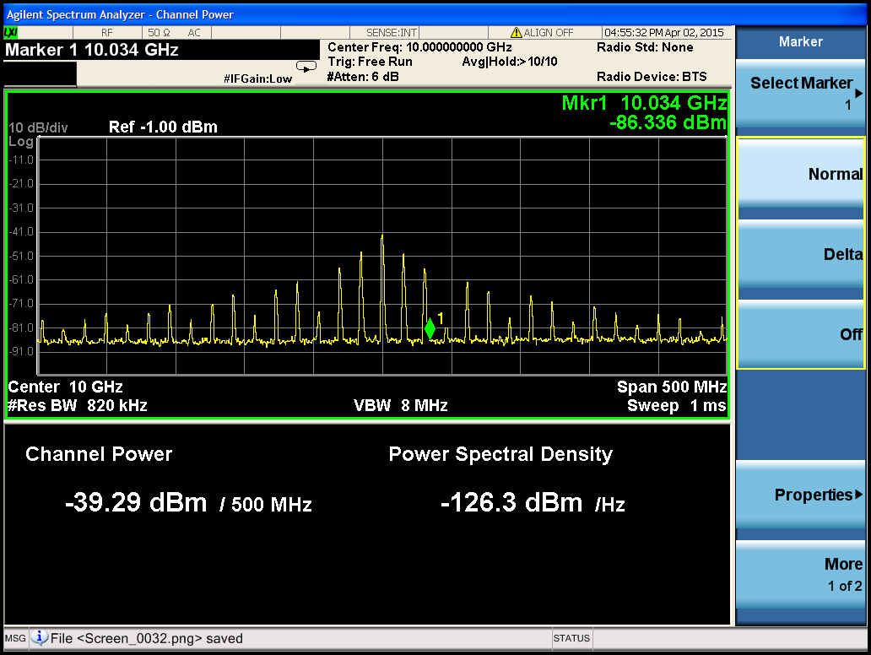
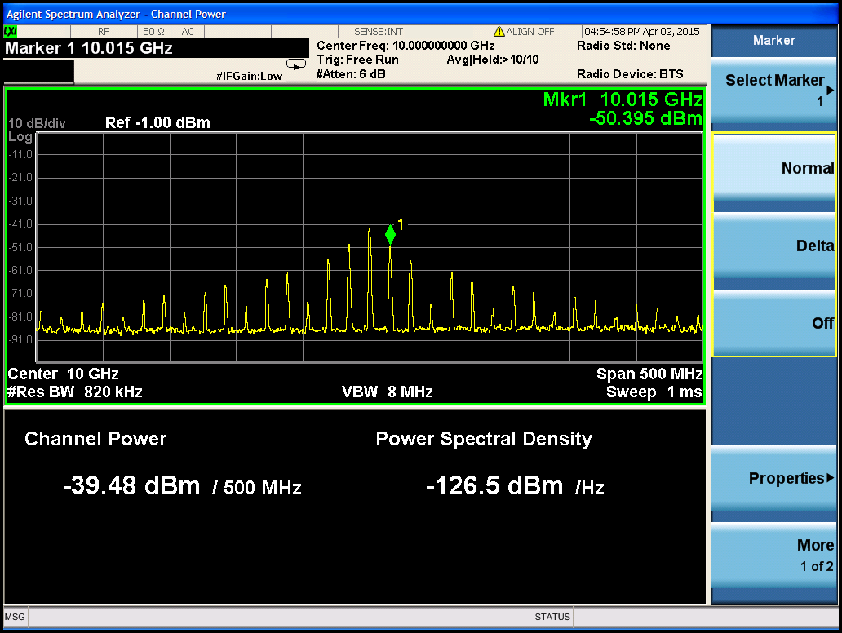
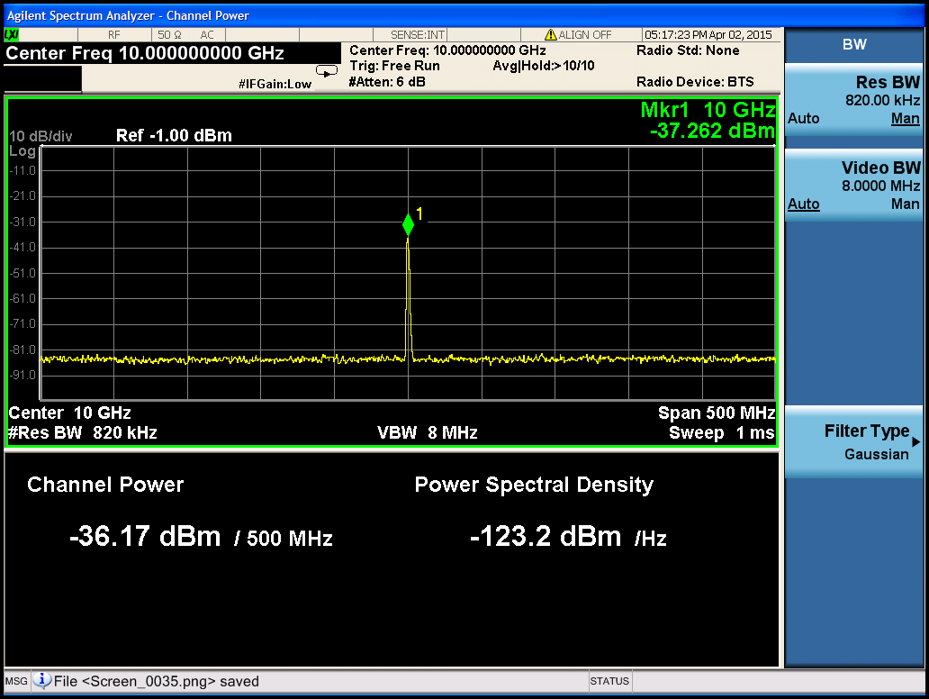
IQ Demodulator LO Signal Chain-
Test Strategies
Measure and verify each at the input of LO channel:
Peak Signal Power
  42dB (attenuation) – 37.262 dBm = 4.738 dBm
Average Signal Power
  Attenuation – measured power/span – 10*log
  (duty cycle)
    4.629 dBm and 4.819 dBm
Period (T) = 65nS
  Frequency = 15.38 GHz
  1/T
Pulse Width = 40nS
  Null Frequency = 50 MHz
  1/null frequency

Slide 15
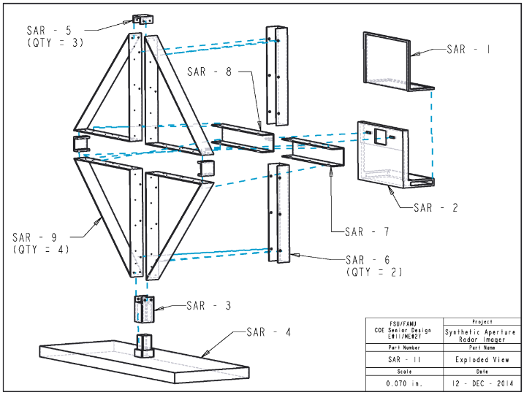
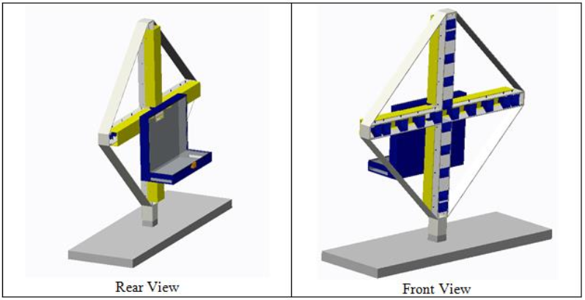
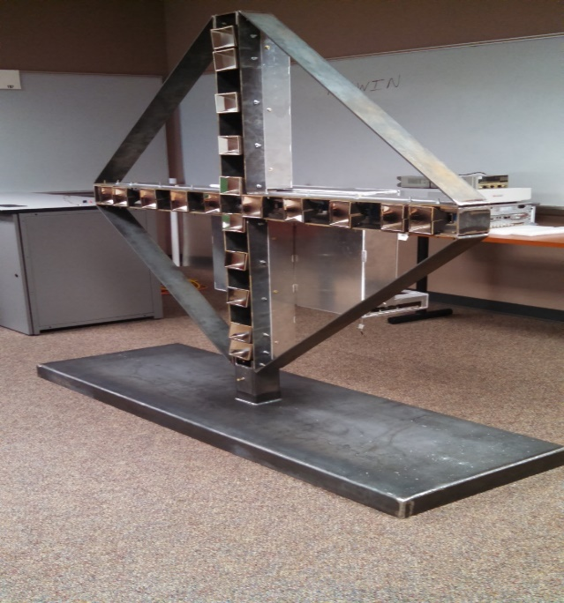
Mechanical Analysis

Slide 16
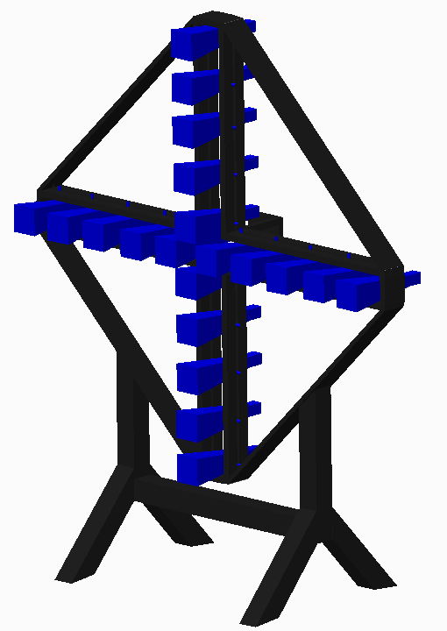
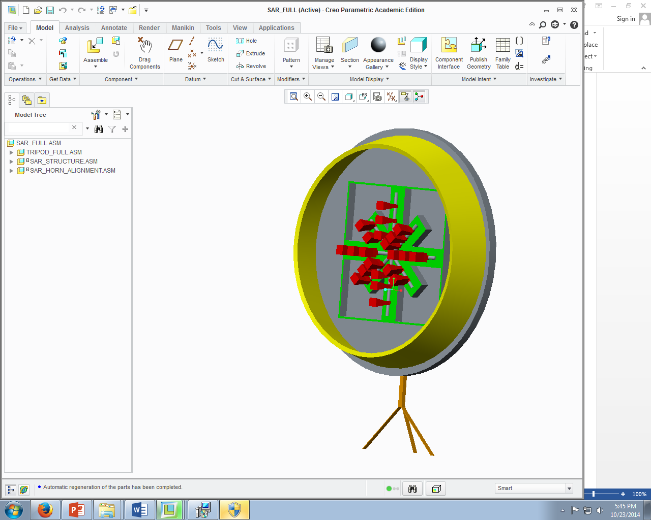
Prior Design
Analysis
Scale: 1(low) - 5 (high) (Constructability) | Design 1 | Design 2
Electrical Components | 4 | 3
Structure Mounting | 3 | 3
Scale: 1(low) – 5 (high) (Horn Alignment)
Phase Centers | 5 | 3
Horn Adjustability | 4 | 4

Slide 17
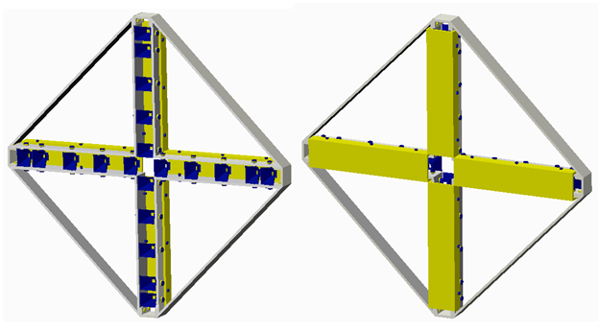
Restructured Body Design
Horn Placement Component Box | Horn Shield Back Plate Cover

Slide 18

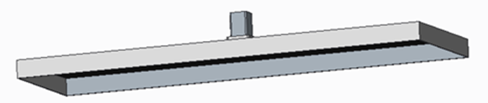
Restructured Stand Design
Before
3 inch THICK
Aluminum
24 in
Now
1/4 inch THICK
Steel
72 in

Slide 19
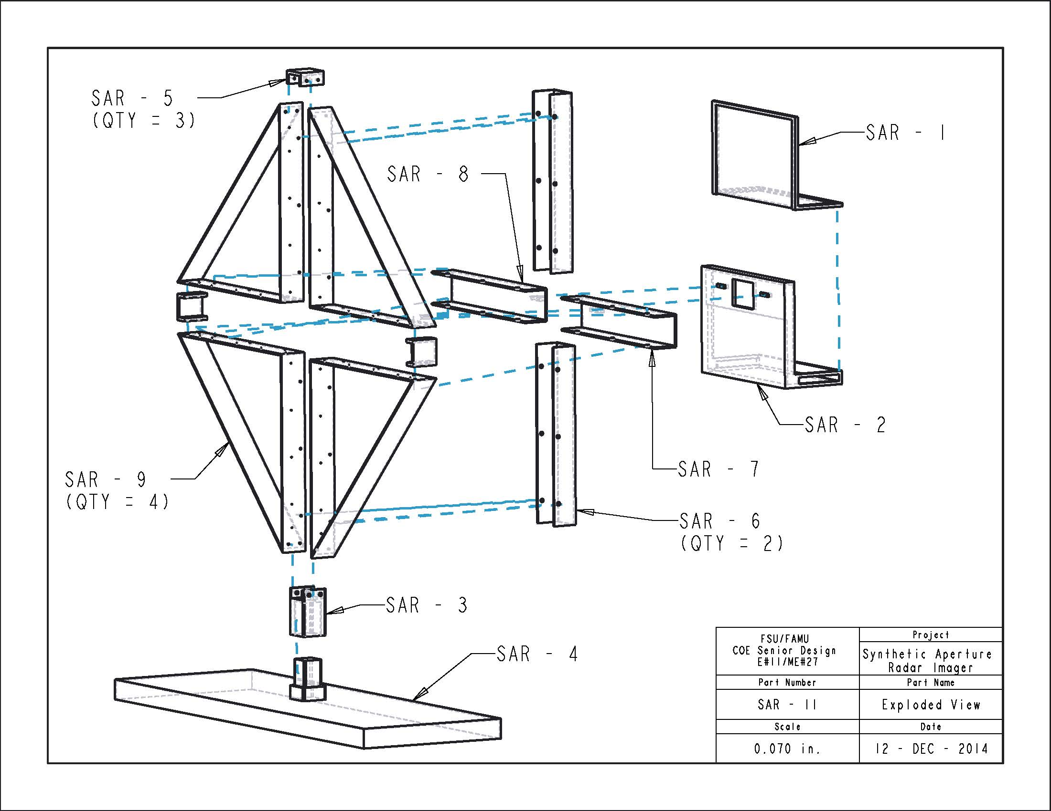
Antenna Structure Design
Component Box
Part # | Part Name
SAR - 1 | Comp. Box Lid
SAR - 2 | Comp. Box
SAR - 3 | Channel To Stand
SAR - 4 | Stand
SAR - 5 | Channel Connector
SAR - 6 | Vertical Horn Cover
SAR - 7 | Left Horn Cover
SAR - 8 | Right Horn Cover
SAR - 9 | Quadrant Panel

Slide 20
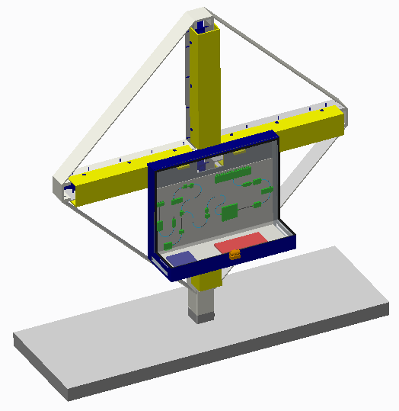
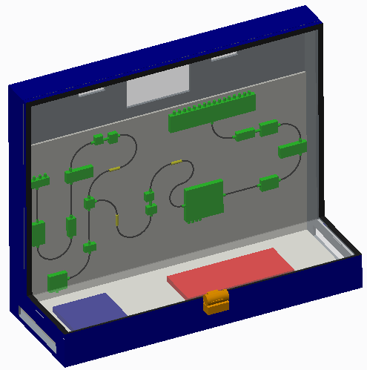
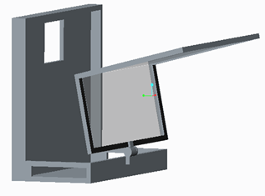
Component Box
Rotated Lid for easy access to Components
Manually mounted on structure for most convenient placement

Slide 21
Antenna Structure Design
Horn Covers
Part # | Part Name
SAR - 1 | Comp. Box Lid
SAR - 2 | Comp. Box
SAR - 3 | Channel To Stand
SAR - 4 | Stand
SAR - 5 | Channel Connector
SAR - 6 | Vertical Horn Cover
SAR - 7 | Left Horn Cover
SAR - 8 | Right Horn Cover
SAR - 9 | Quadrant Panel

Slide 22
Antenna Structure Design
Structure Frame and Stand
Part # | Part Name
SAR - 1 | Comp. Box Lid
SAR - 2 | Comp. Box
SAR - 3 | Channel To Stand
SAR - 4 | Stand
SAR - 5 | Channel Connector
SAR - 6 | Vertical Horn Cover
SAR - 7 | Left Horn Cover
SAR - 8 | Right Horn Cover
SAR - 9 | Quadrant Panel

Slide 23
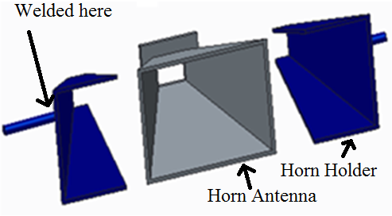
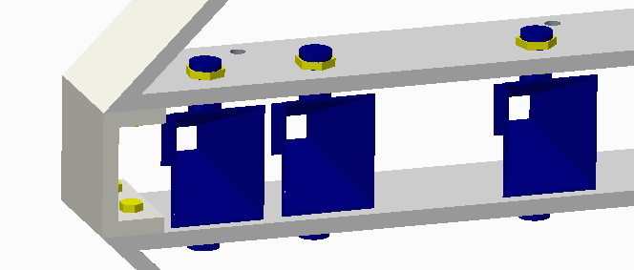
Horn Holders
Nut threaded rods to compress horn holders
Rotate about threaded rods axis for alignment
Threaded rod welded to horn holders

Slide 24
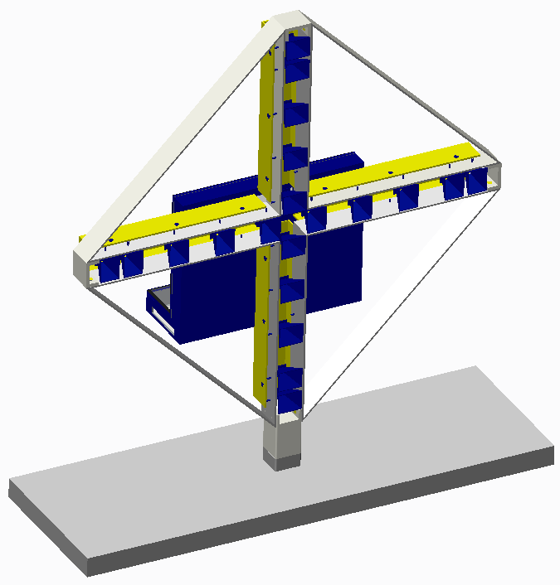
Final Antenna Structure

Slide 25
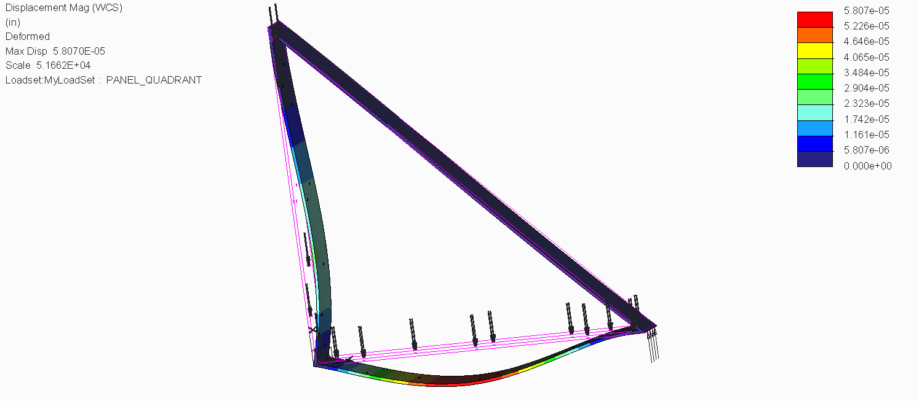
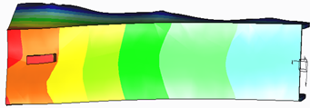
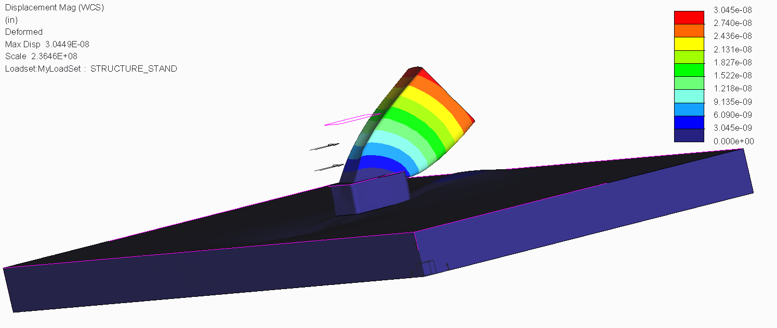
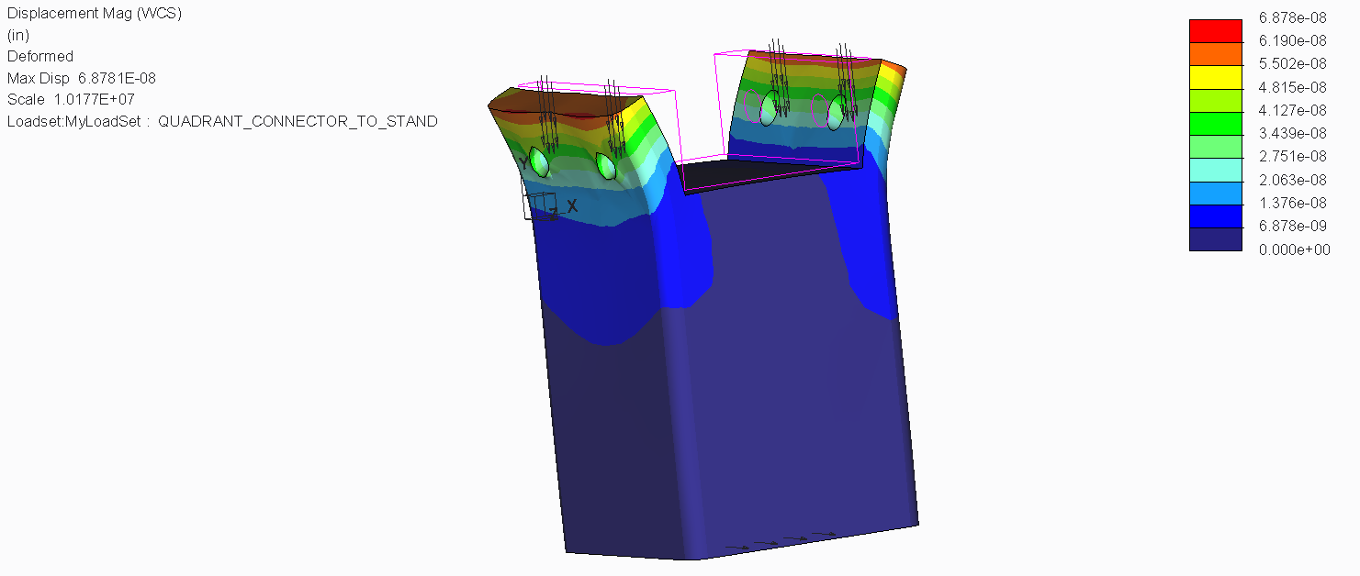
Stress Analysis - Antenna Structure
DRAMATIZED MAX DISPLACEMENT IN INCHES
Horn Covers
Max Dis.
9.0x10⁻⁷ in
Quadrant Panel
Max Displacement
1.1x10⁻⁶ in
Stand to Structure Connector
Max Displacement 8.1x10⁻⁷ in
Stand
Max Displacement
5.5x10⁻⁵ in

Slide 26
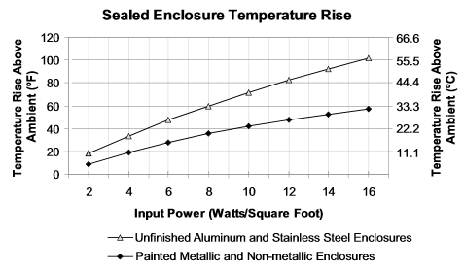

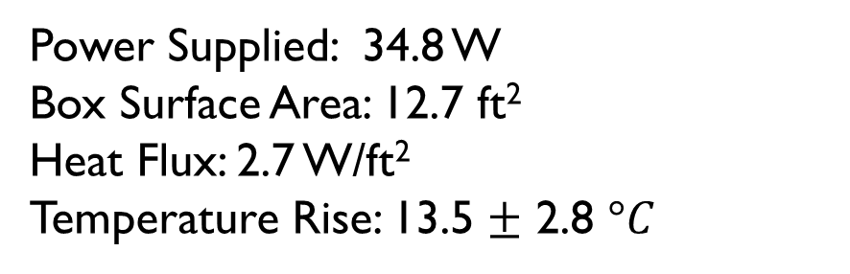
Heat Analysis - Component Box
Power Supplied: 34.8 W
Box Surface Area: 12.7 ft²
Heat Flux: 2.7 W/ft²
Temperature Rise: 13.5 $±$ 2.8 $°C$

Slide 27
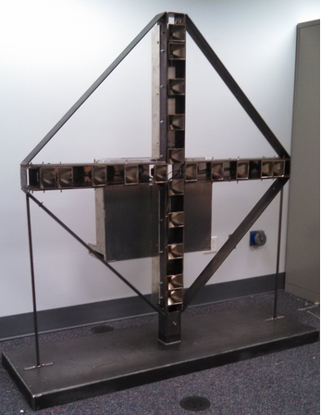
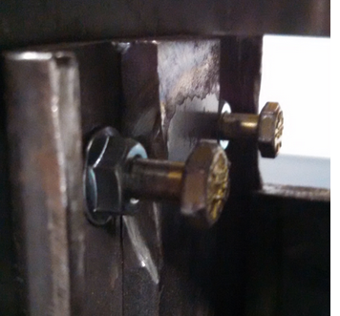
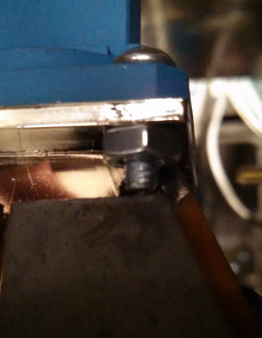
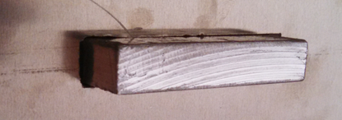
Horn Holders
Stand to Structure
Connector
Component Box
Support Poles
Results - Structure

Slide 28
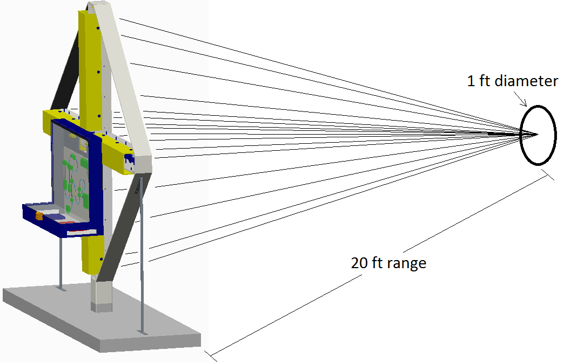
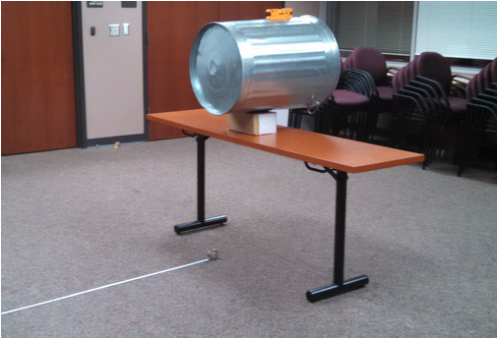
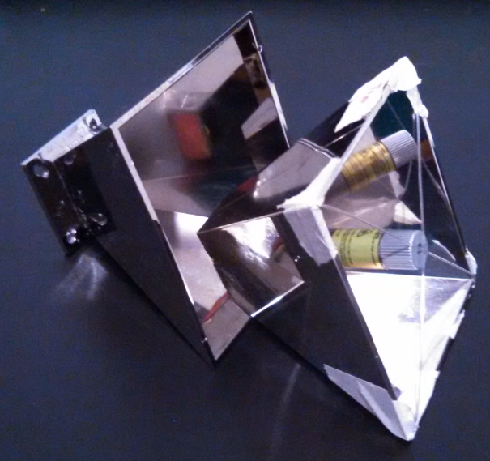
Results - Horn Alignment

Slide 29
Project Management

Slide 30
Budget Analysis
FINAL EVALUATION
INITIAL PROJECTION
Northrop Grumman sponsored up to $50,000
Projected $38,000 expense
Left a $12,000 buffer
Bill of Materials

Slide 31
Project Management
SCHEDULING STRATEGY
MANAGEMENT STRATEGY
Doodle
Gantt Chart – Microsoft Project
Integrated Ordering/Testing Schedule Path
Critical Path Mitigation
  Paralleled Task Completion Strategy
Project Manager
  Jasmine Vanderhorst
Assistant Project Managers
  Matthew Cammuse & Malcolm Harmon
Gate Review & Team Meeting Agendas
Ambitious Scope Readjustment
  Miniature Milestone Accomplishments

Slide 32
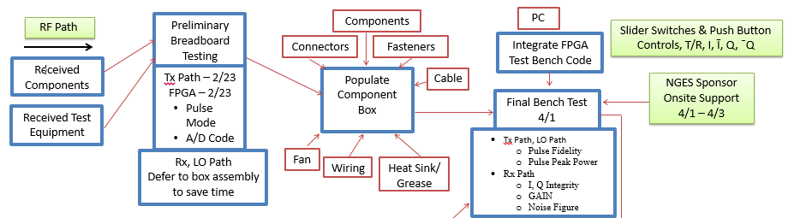
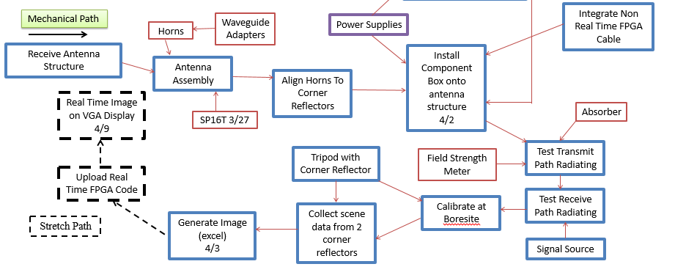
Project Flow – Parallel Schedule

Slide 33
Project Status
Electrical Component Design
  Percent Complete: 100%
Signal Processing Calculations
  Percent Complete: 100%
Programming
  Percent Complete: 75%
  Needed: VHDL Code for Signal Processing Functions
Structural Design
  Percent Complete: 100%

Slide 34
Lessons Learned
Understand difference between SAR theory and project implementation of SAR
Design electrical system and pick appropriate components
  Understand different concepts such as noise power, noise figure, etc.
Design appropriate structure to meet needs required
Utilize components and equipment properly to realize testing
Set in place contingency plans for backup
Manage parts acquisition and stay within budget

Slide 35
Conclusion
Transmit/receive path was achieved
  Measured results from testing were close to theoretical results
Pulses were coded and implemented effectively for transmit and receive
  Output voltages from IQ demodulator were obtained successfully and displayed
Efficient power supply box was designed and set up
Theoretical calculations for signal processing were realized
Structure for antennas and component box were manufactured
  Heat and stress analyses were realized for structure

Slide 36
Thank You!
Questions & Comments
Acknowledgements
Dr. Rajendra Arora
Dr. Shonda Bernadin
Dr. Emmanuel Collins
Dr. Simon Foo
Dr. Michael Frank
Dr. Nikhil Gupta
Dr. Bruce Harvey
Dr. Okenwa Okoli
Ricardo Aleman
Samuel Botero
Emily Hammel
Margaret Scheiner

