Slide 1




Pedibus
Team 22
Team Members:
Kyle Anderson
Stephen Avery
Alejandro San Segundo
Brett Willenbacher
Sponsor:
Ron Goldstein
Advisor:
Keith Larson
Professors:
Dr. Shih
Dr. Gupta
Team No.22
Slide 1 of 15
Alejandro San Segundo
Midterm I

Slide 2
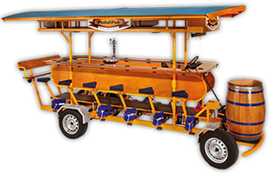
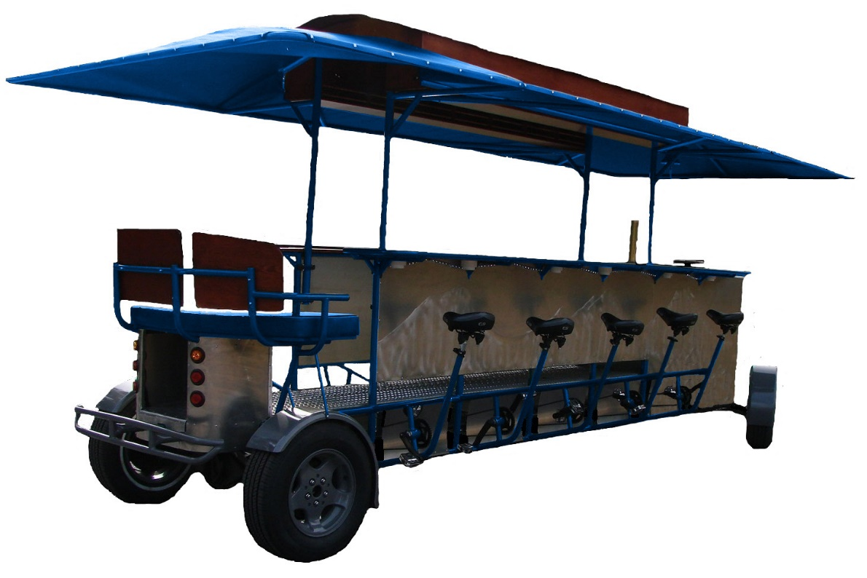


What is the Pedibus?
Team No.22
Slide 2 of 15
Alejandro San Segundo
Midterm I

Slide 3

Design Requirements
Pedibus Requirement | Status
10 pedaling passengers | ✓
Room for extra (non-pedaling) passengers | ✓
Rolling Chassis must be < 1499 lbs (FL law) | ✓
Off the Shelf parts | ✓
Torque output to climb 8° hill grade | ✓
Able to hold 3000 lbs payload | ✓
Free weight transportable | ✓
Reverse gear capability | ✓
Movable on single rider input | ✓
So, what does the Pedibus need to accomplish?
Team No.22
Slide 3 of 15
Alejandro San Segundo
Midterm I
Notes:
Point 1: 10 Peddlers, 1 driver, 1 “bartender”, and 2 non-peddlers
Point 2: Because of Tallahassee’s hills a crawl gear and cruise gears are recomended

Slide 4
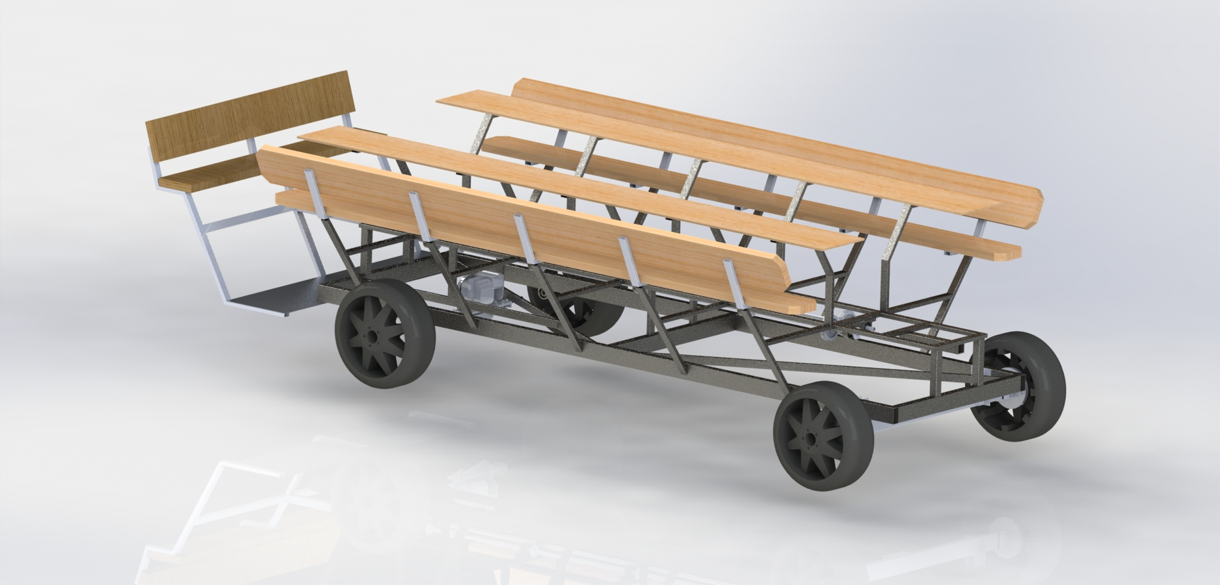
Team No.22
Slide 4 of 15
Brett Willenbacher
Midterm I

Slide 5
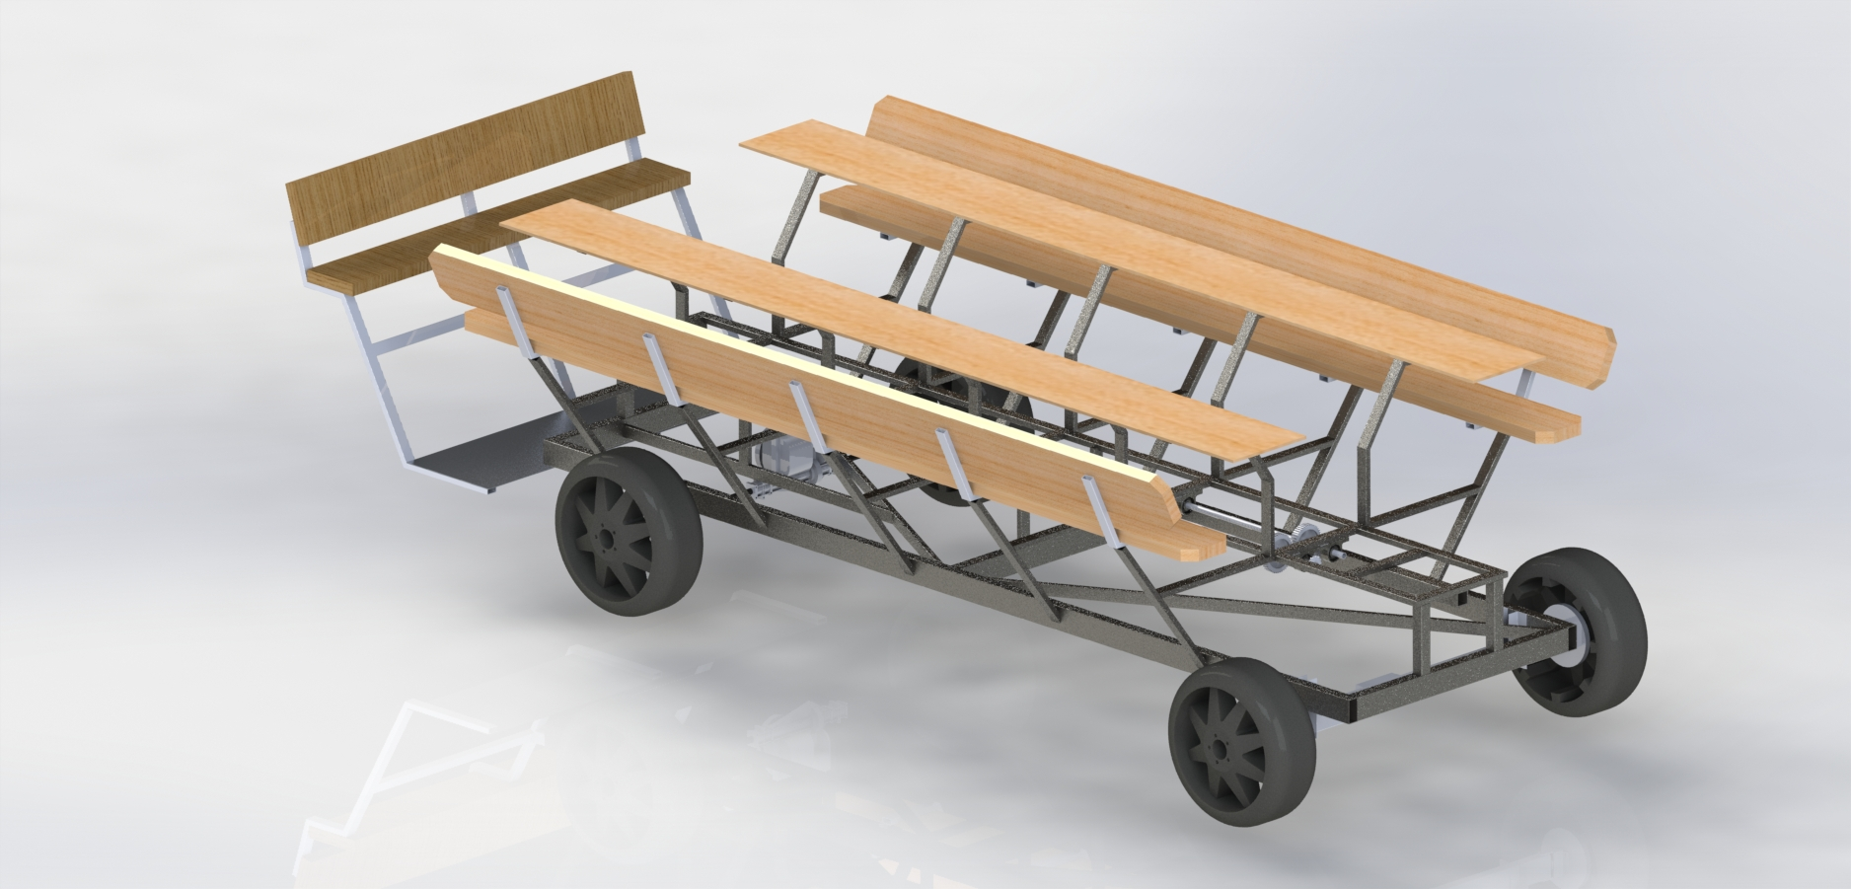
Team No.22
Slide 4 of 15
Brett Willenbacher
Midterm I

Slide 6
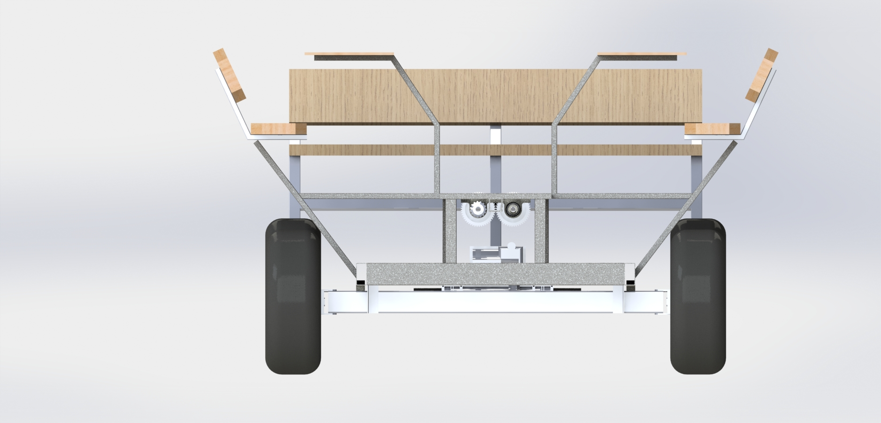
Team No.22
Slide 4 of 15
Brett Willenbacher
Midterm I

Slide 7
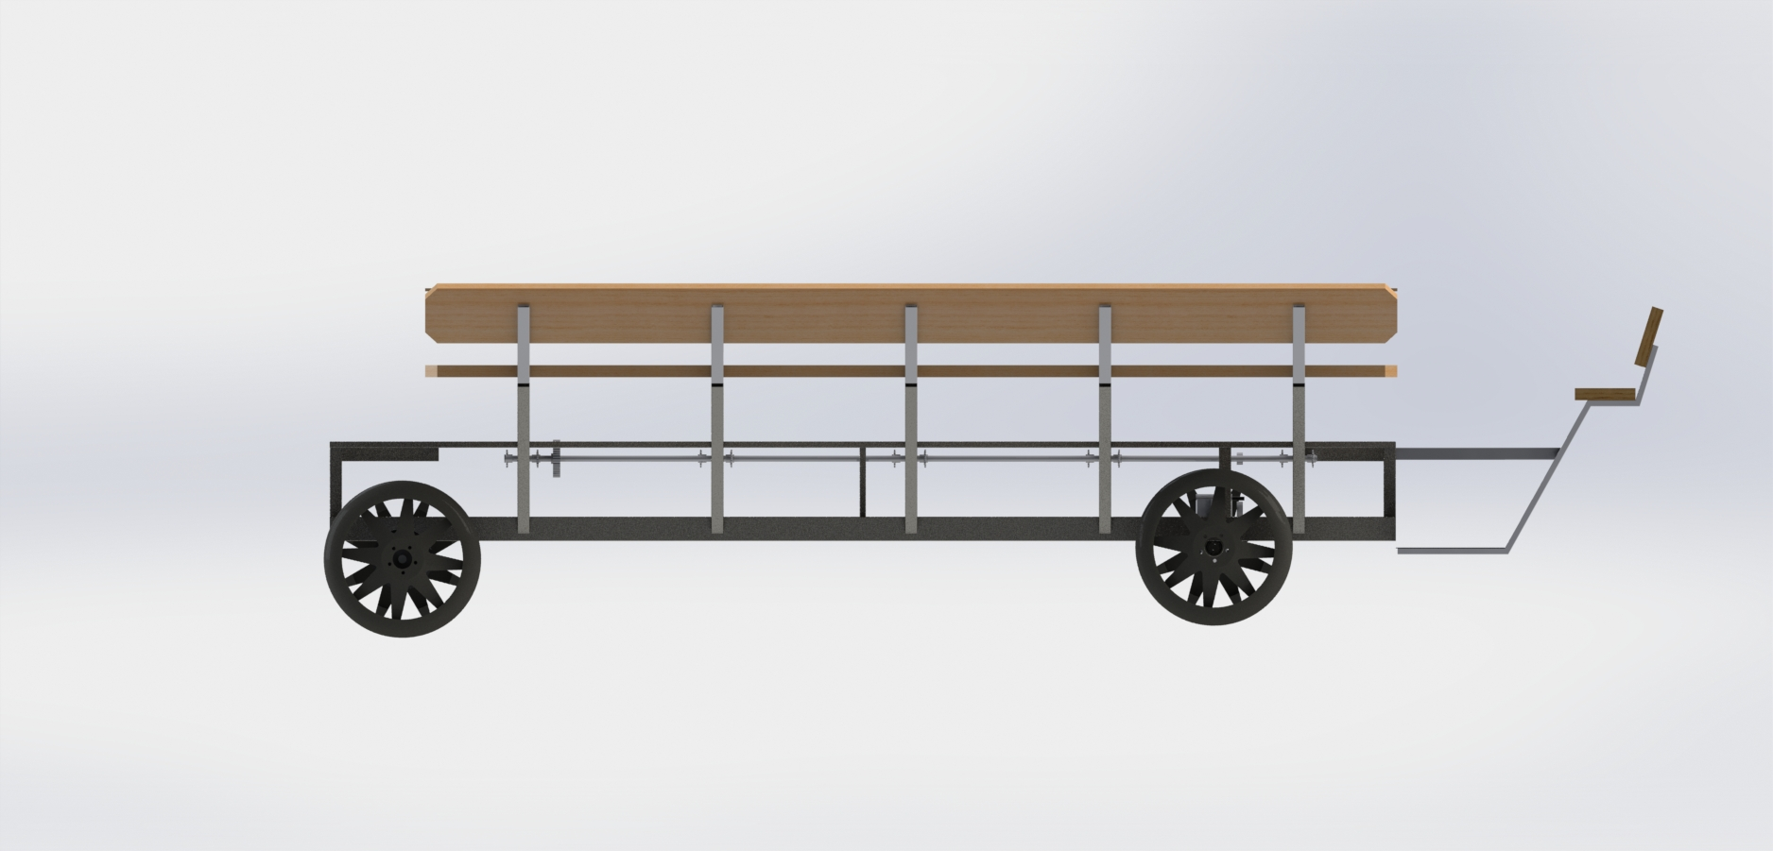
Team No.22
Slide 4 of 15
Brett Willenbacher
Midterm I

Slide 8
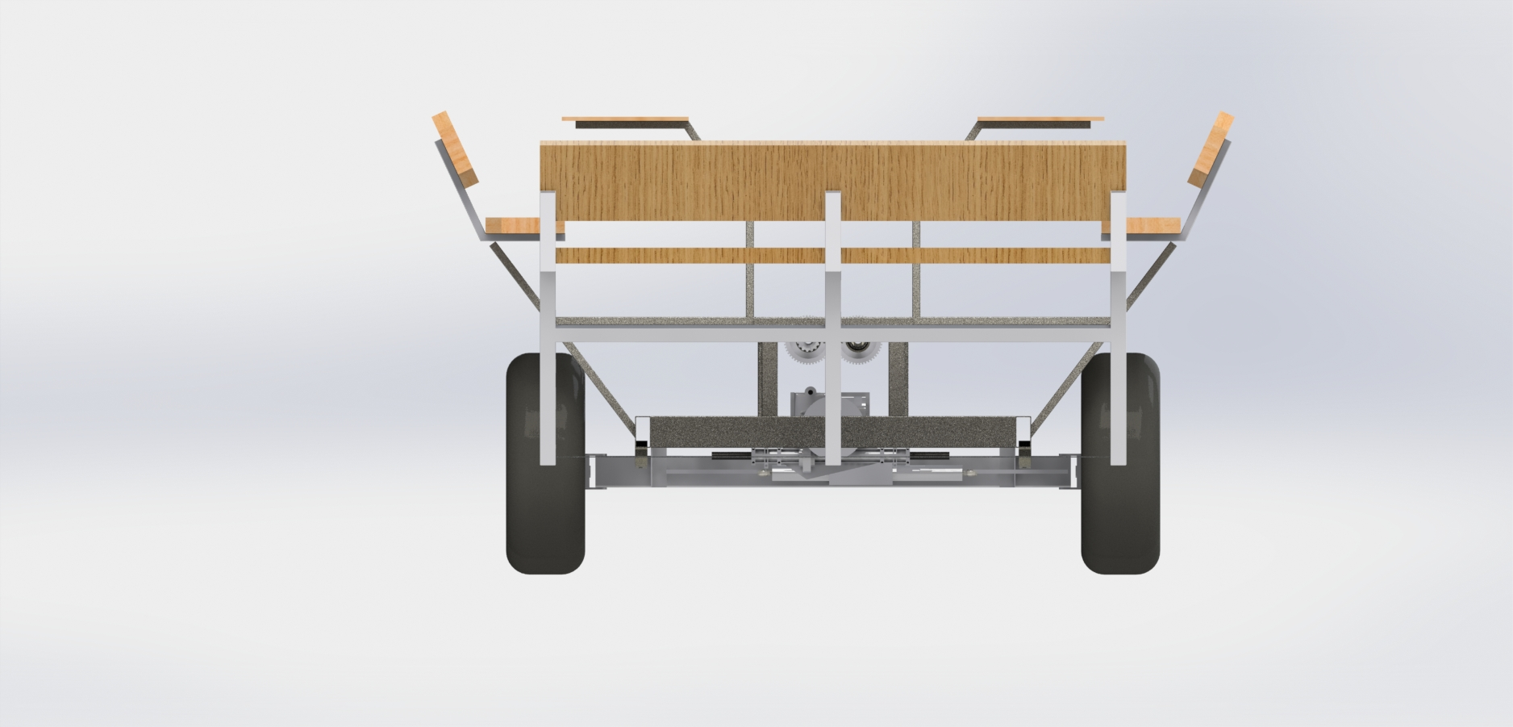
Team No.22
Slide 4 of 15
Brett Willenbacher
Midterm I

Slide 9
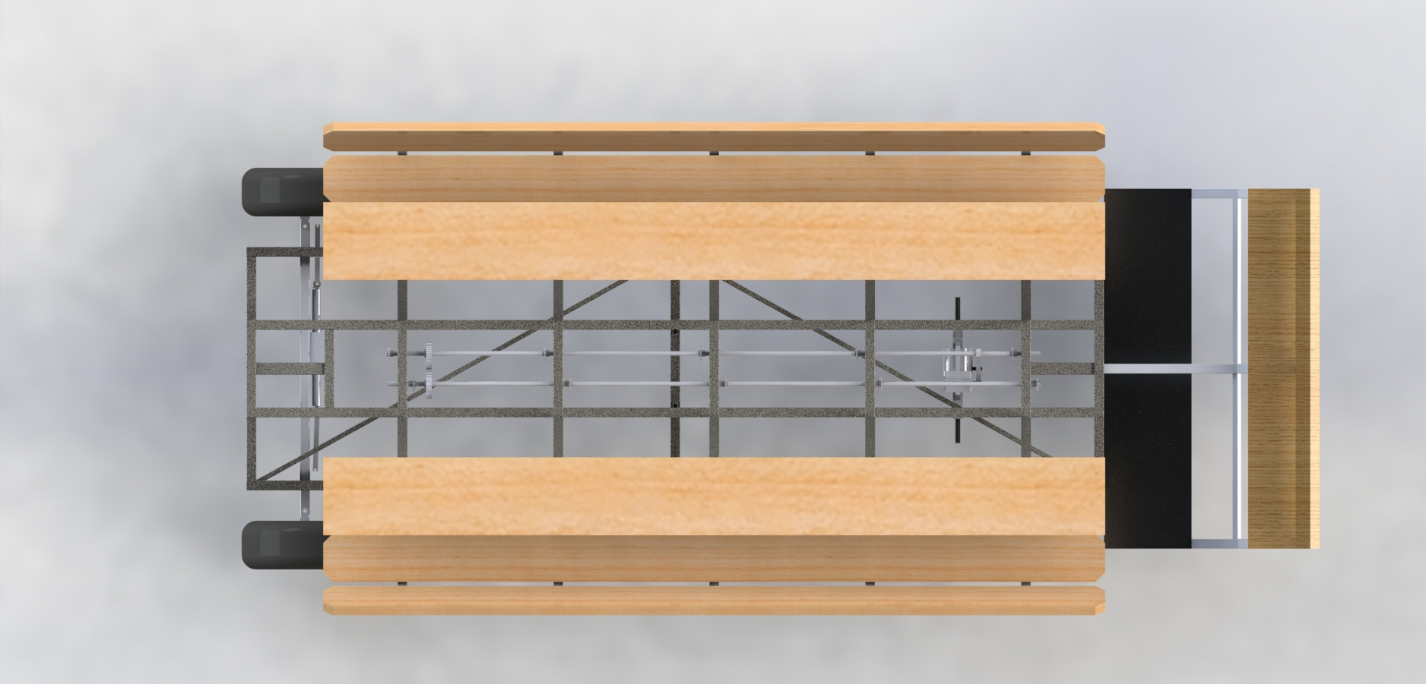
Team No.22
Slide 4 of 15
Brett Willenbacher
Midterm I

Slide 10
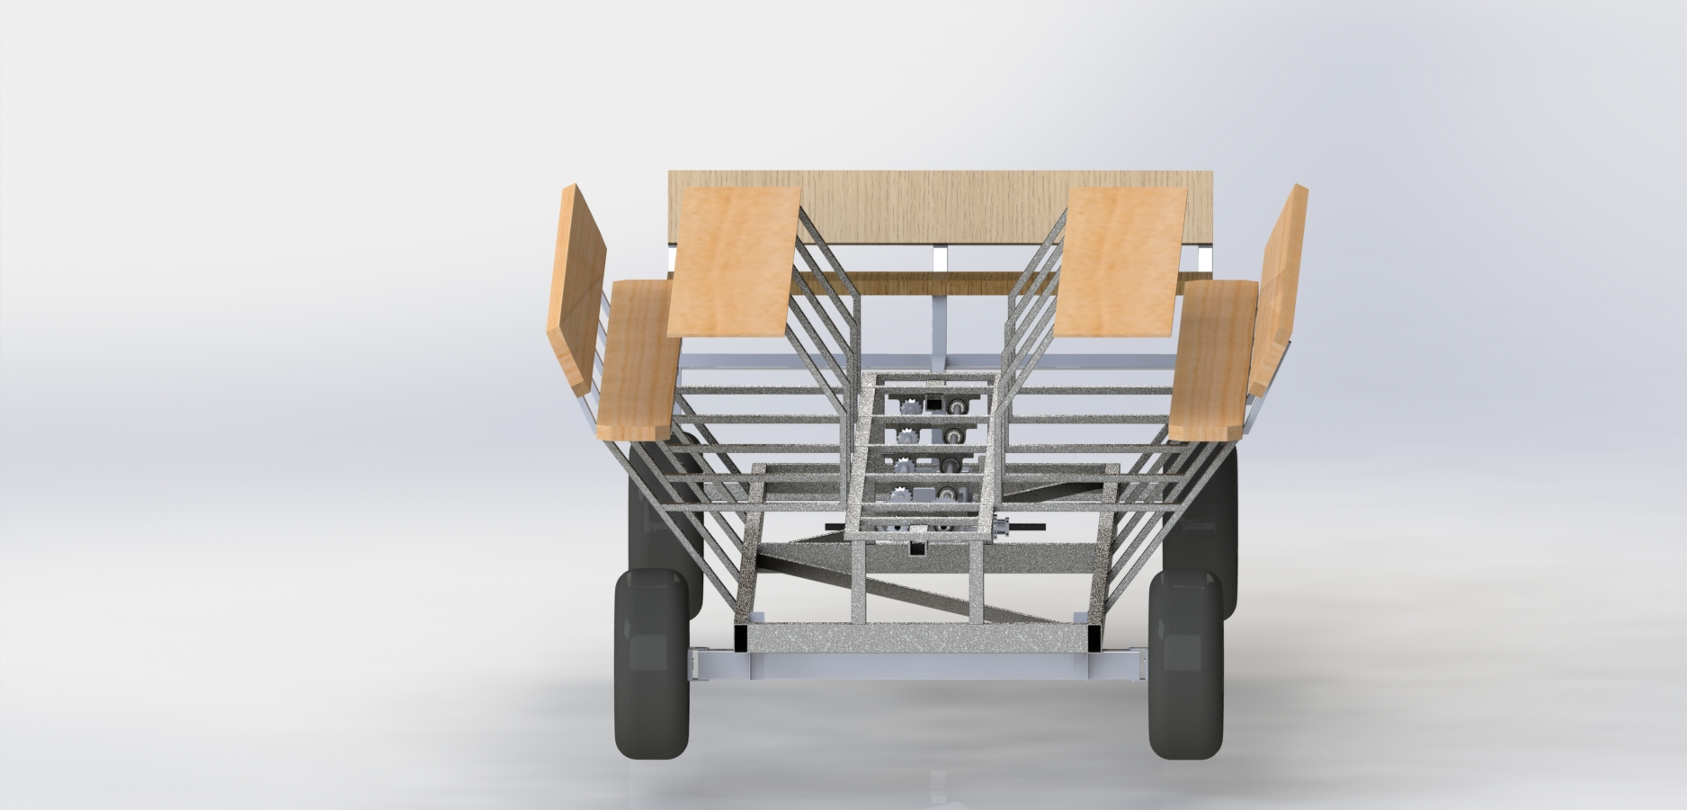
Team No.22
Slide 4 of 15
Brett Willenbacher
Midterm I

Slide 11
Team No.22
Slide 4 of 15
Brett Willenbacher
Midterm I

Slide 12
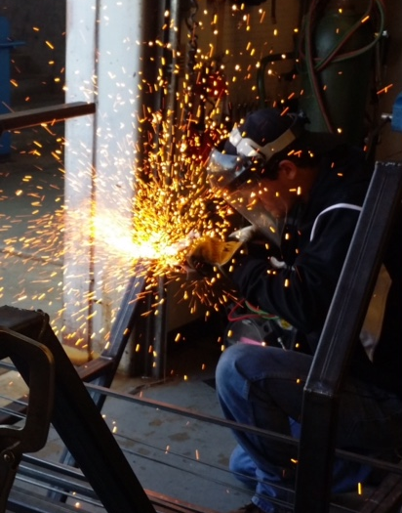
Status Update
All main structural components have been fabricated
Drivetrain and steering subsystems currently being fabricated
Kyle grinding down a bench post
Team No.22
Slide 5 of 15
Alejandro San Segundo
Midterm I

Slide 13
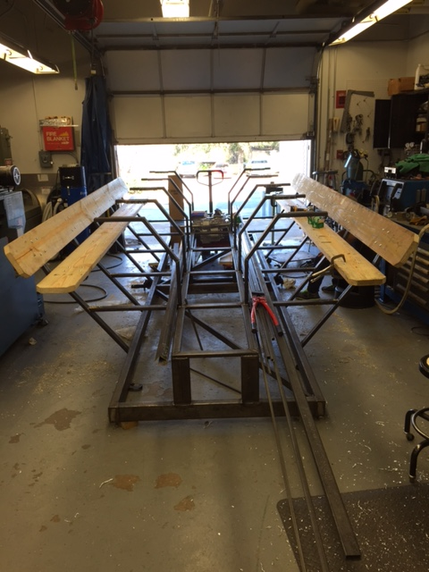
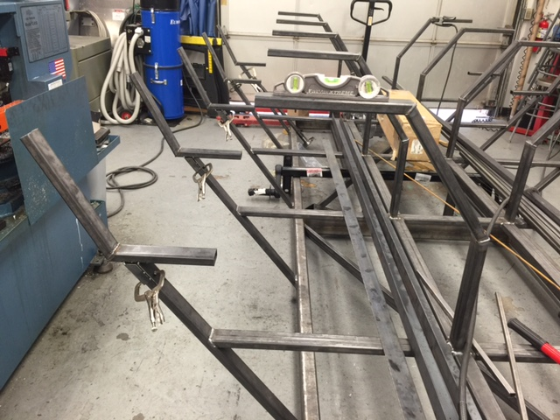
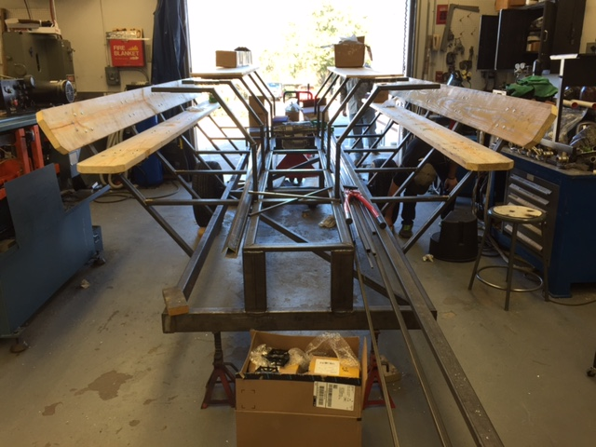
Progress: Frame and Seating
Frame:
Ladder style frame
A500 box steel construction
Seating:
Bench style seating
            Recumbent pedaling stance
Finalized frame fabrication with mounted seats and bar posts
Team No.22
Slide 6 of 15
Alejandro San Segundo
Midterm I

Slide 14
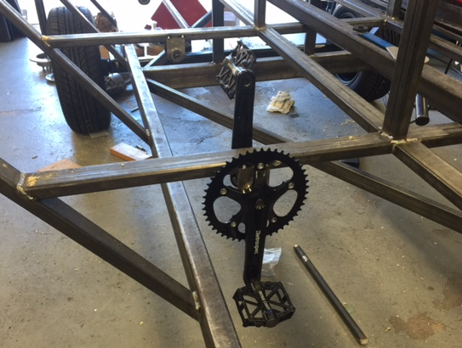
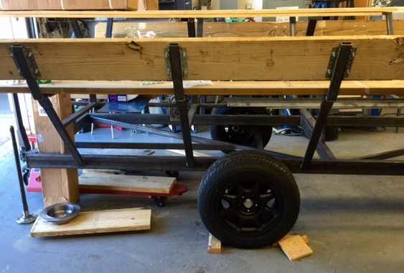
Progress: Pedaling and Towing
Pedaling:
Recumbent stance
Freewheeled shaft design for coasting
Towing:
Torsion Axle implementation
            Electric drum brakes on towing axle
Standard towing hitch mount
Fully assembled pedaling platform
Towing axle assembly
Team No.22
Slide 7 of 15
Alejandro San Segundo
Midterm I

Slide 15
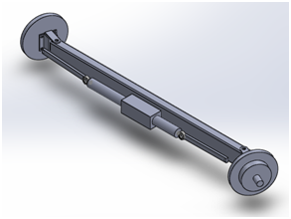
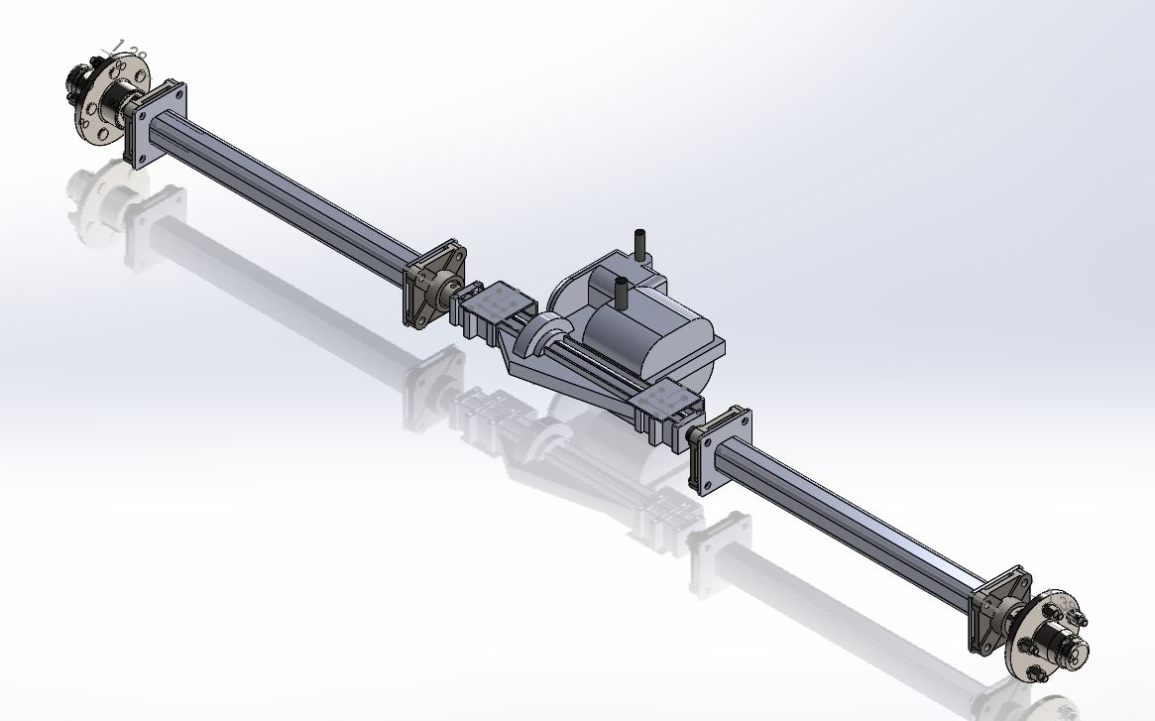
Work in progress
Steering:
Rack and pinion straight axle set up
Curb to curb < 45ft
Brass bushings used for smooth rotation
Transmission:
Dual Driveshaft to Manual Transaxle Design
            6 fwd speeds + Reverse
            Individually supported axle shafts
Belt Friction Clutch System
Team No.22
Slide 8 of 15
Alejandro San Segundo
Midterm I

Slide 16
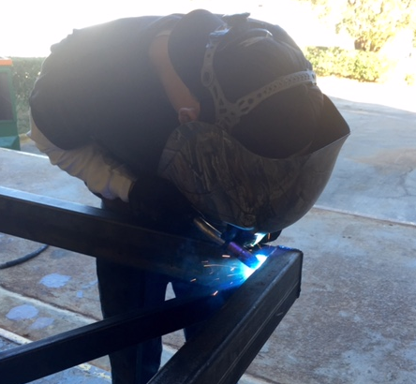
Work in progress
Bartop:
Pressure treated wood top
Stained and lacquered for protection
Added handrail for rider stability
Bar top supports with partially mounted bar top wood
Anderson welding steel frame members
Team No.22
Slide 9 of 15
Alejandro San Segundo
Midterm I

Slide 17

Upcoming Work
**All following components purchased and received. Awaiting for final assembly.
TO-DO:
Roof
Rear bench
Brake lines and fluids
Driver seat
Driver controls (pedals/shifter)
Brake lights
Flooring
Team No.22
Slide 10 of 15
Brett Willenbacher
Midterm I

Slide 18
Conquered Challenges
Challenge | Solution
Design width over legal towing limit (< 102in.) | Shortened bar width Rearranged seating posts’ lengths and angles Rearranged pedaling geometry
Pedal leg room not sufficient | Raised bartop using spacers
Pillow blocks and freewheel adapters did not fit the hot rolled steel driveshafts | Switched to cold rolled steel shafts for more uniform surface finish Ream out pillow blocks and adapters to fit shafts
Team No.22
Slide 11 of 15
Brett Willenbacher
Midterm I

Slide 19
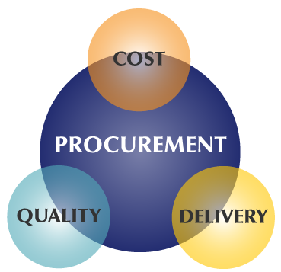
Procurement
All components, including:
  Fabrication materials
  Drivetrain components
Towing components
Bicycle components
Steering components
Driving/Operation components
Have been purchased and received.
Total Spent: $6,403.89
**Total spent as of 2/17/15
Team No.22
Slide 12 of 15
Brett Willenbacher
Midterm I

Slide 20
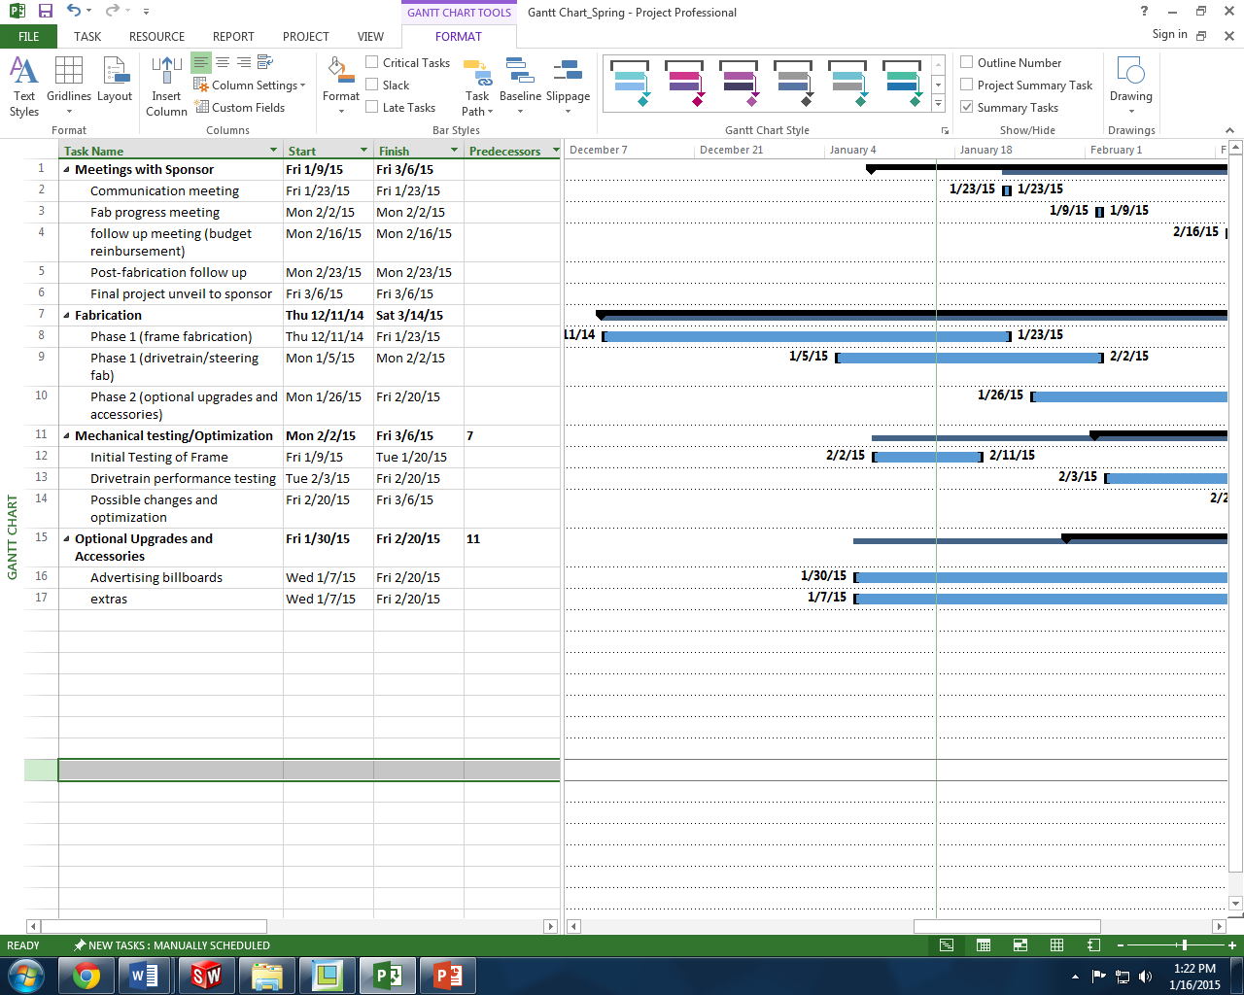
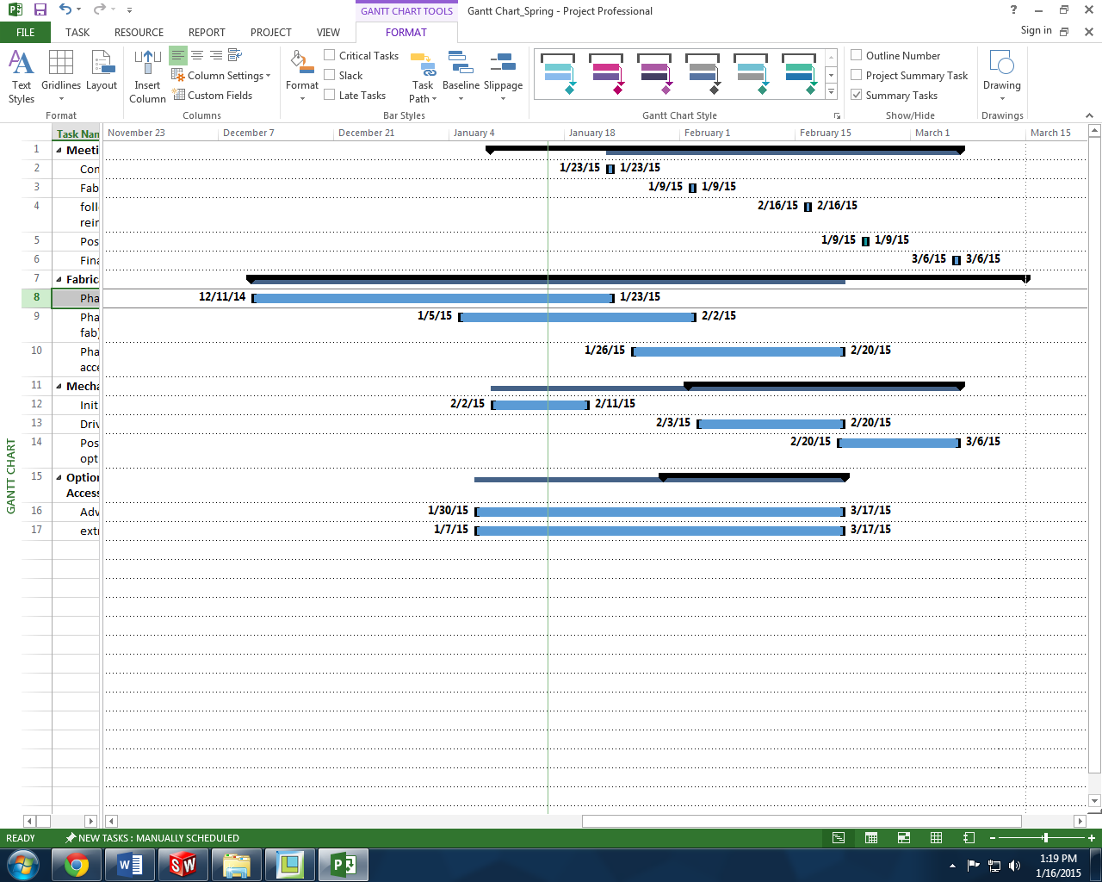
Timeline
**Currently on schedule to finish by March 14
Team No.22
Slide 13 of 15
Brett Willenbacher
Midterm I

Slide 21

Summary
Frame, seating, and towing platform built
Slight delay due to small obstacles
All components acquired
Currently installing subsystem assemblies
Team No.22
Slide 14 of 15
Brett Willenbacher
Midterm I

Slide 22

Questions?
Team No.22
Slide 15 of 15
Brett Willenbacher
Midterm I

