Slide 1




Pedibus
Team 22
Team Members:
Kyle Anderson
Stephen Avery
Alejandro San Segundo
Brett Willenbacher
Sponsor:
Ron Goldstein
Advisor:
Keith Larson
Professors:
Dr. Shih
Dr. Gupta
Team No.22
Slide 1 of 25
Alejandro San Segundo
Final Presentation

Slide 2
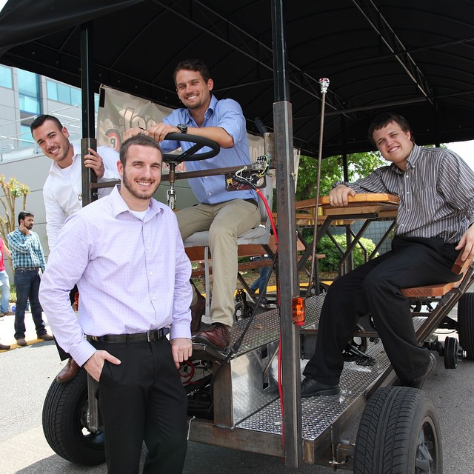
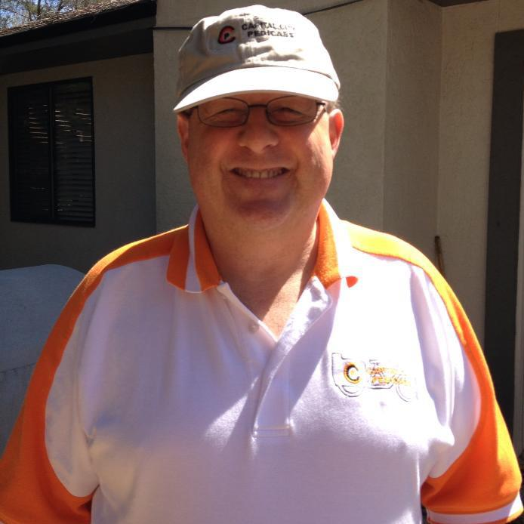
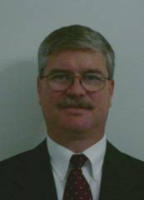
The Team
Sponsor:
Ron Goldstein
Advisor:
Keith Larson
Team Members:
(Left to Right)
Alejandro San Segundo
Brett Willenbacher
Kyle Anderson
Stephen Avery
Team No.22
Slide 2 of 25
Alejandro San Segundo
Final Presentation

Slide 3
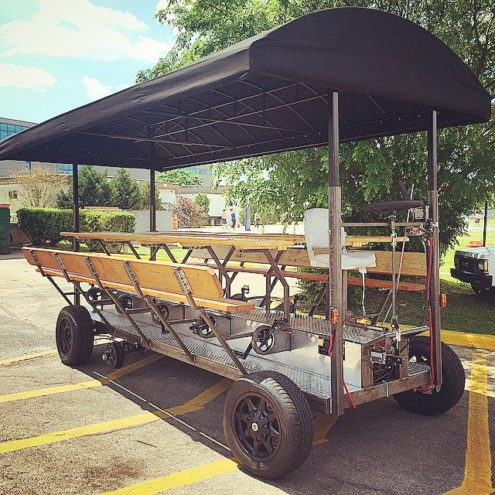
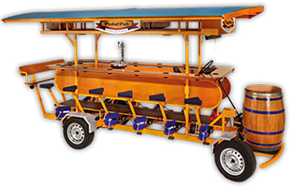
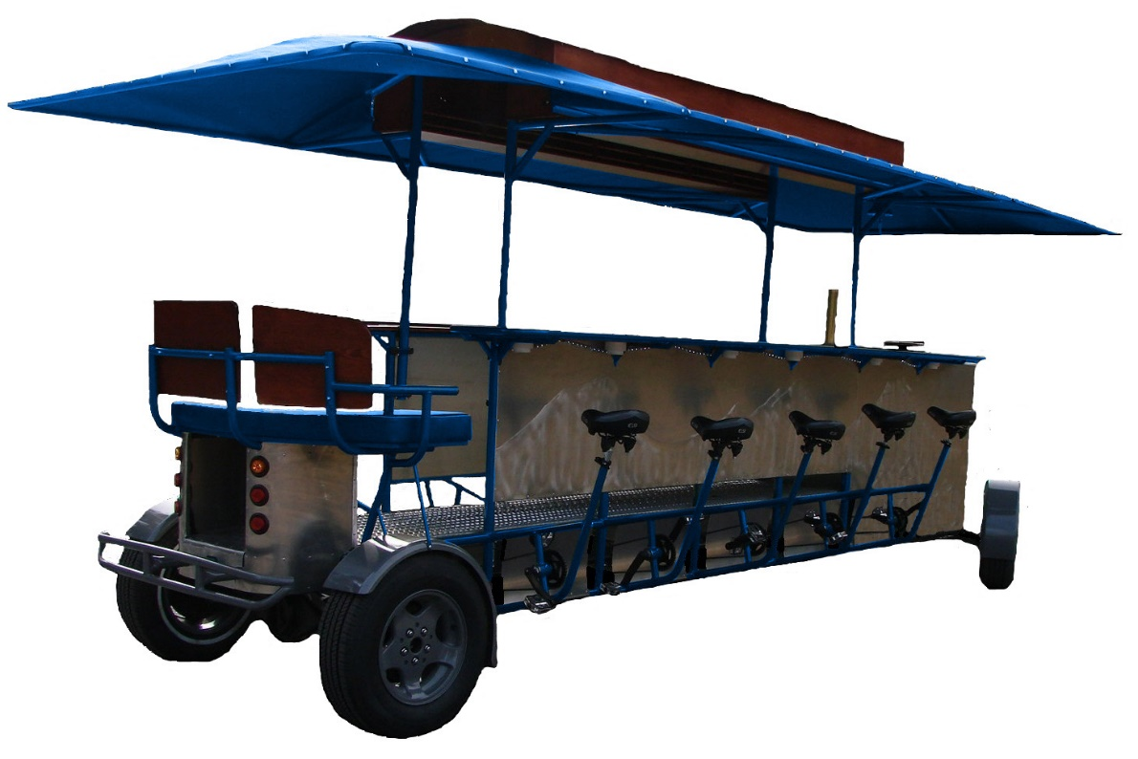


What is a Pedibus?
Team No.22
Slide 3 of 25
Alejandro San Segundo
Final Presentation

Slide 4
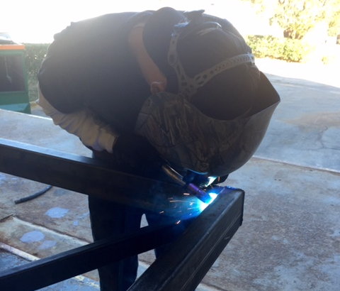
Project Definition
Pedibus Requirement | Status
10 pedaling passengers | ✓
Room for extra (non-pedaling) passengers | ✓
Rolling Chassis must be < 1499 lbs (FL law) | ✓
Off the Shelf parts | ✓
Torque output to climb 8° hill grade | ✓
Able to hold 3000 lbs payload | ✓
Free weight transportable | X
Reverse gear capability | ✓
Movable on single rider input | ✓
Project Scope
    Design and fabricate a one of a kind multi-user, pedal powered vehicle for the purpose of entertainment around Tallahassee and nearby areas.
Anderson welding steel frame members
Team No.22
Slide 4 of 25
Alejandro San Segundo
Final Presentation

Slide 5
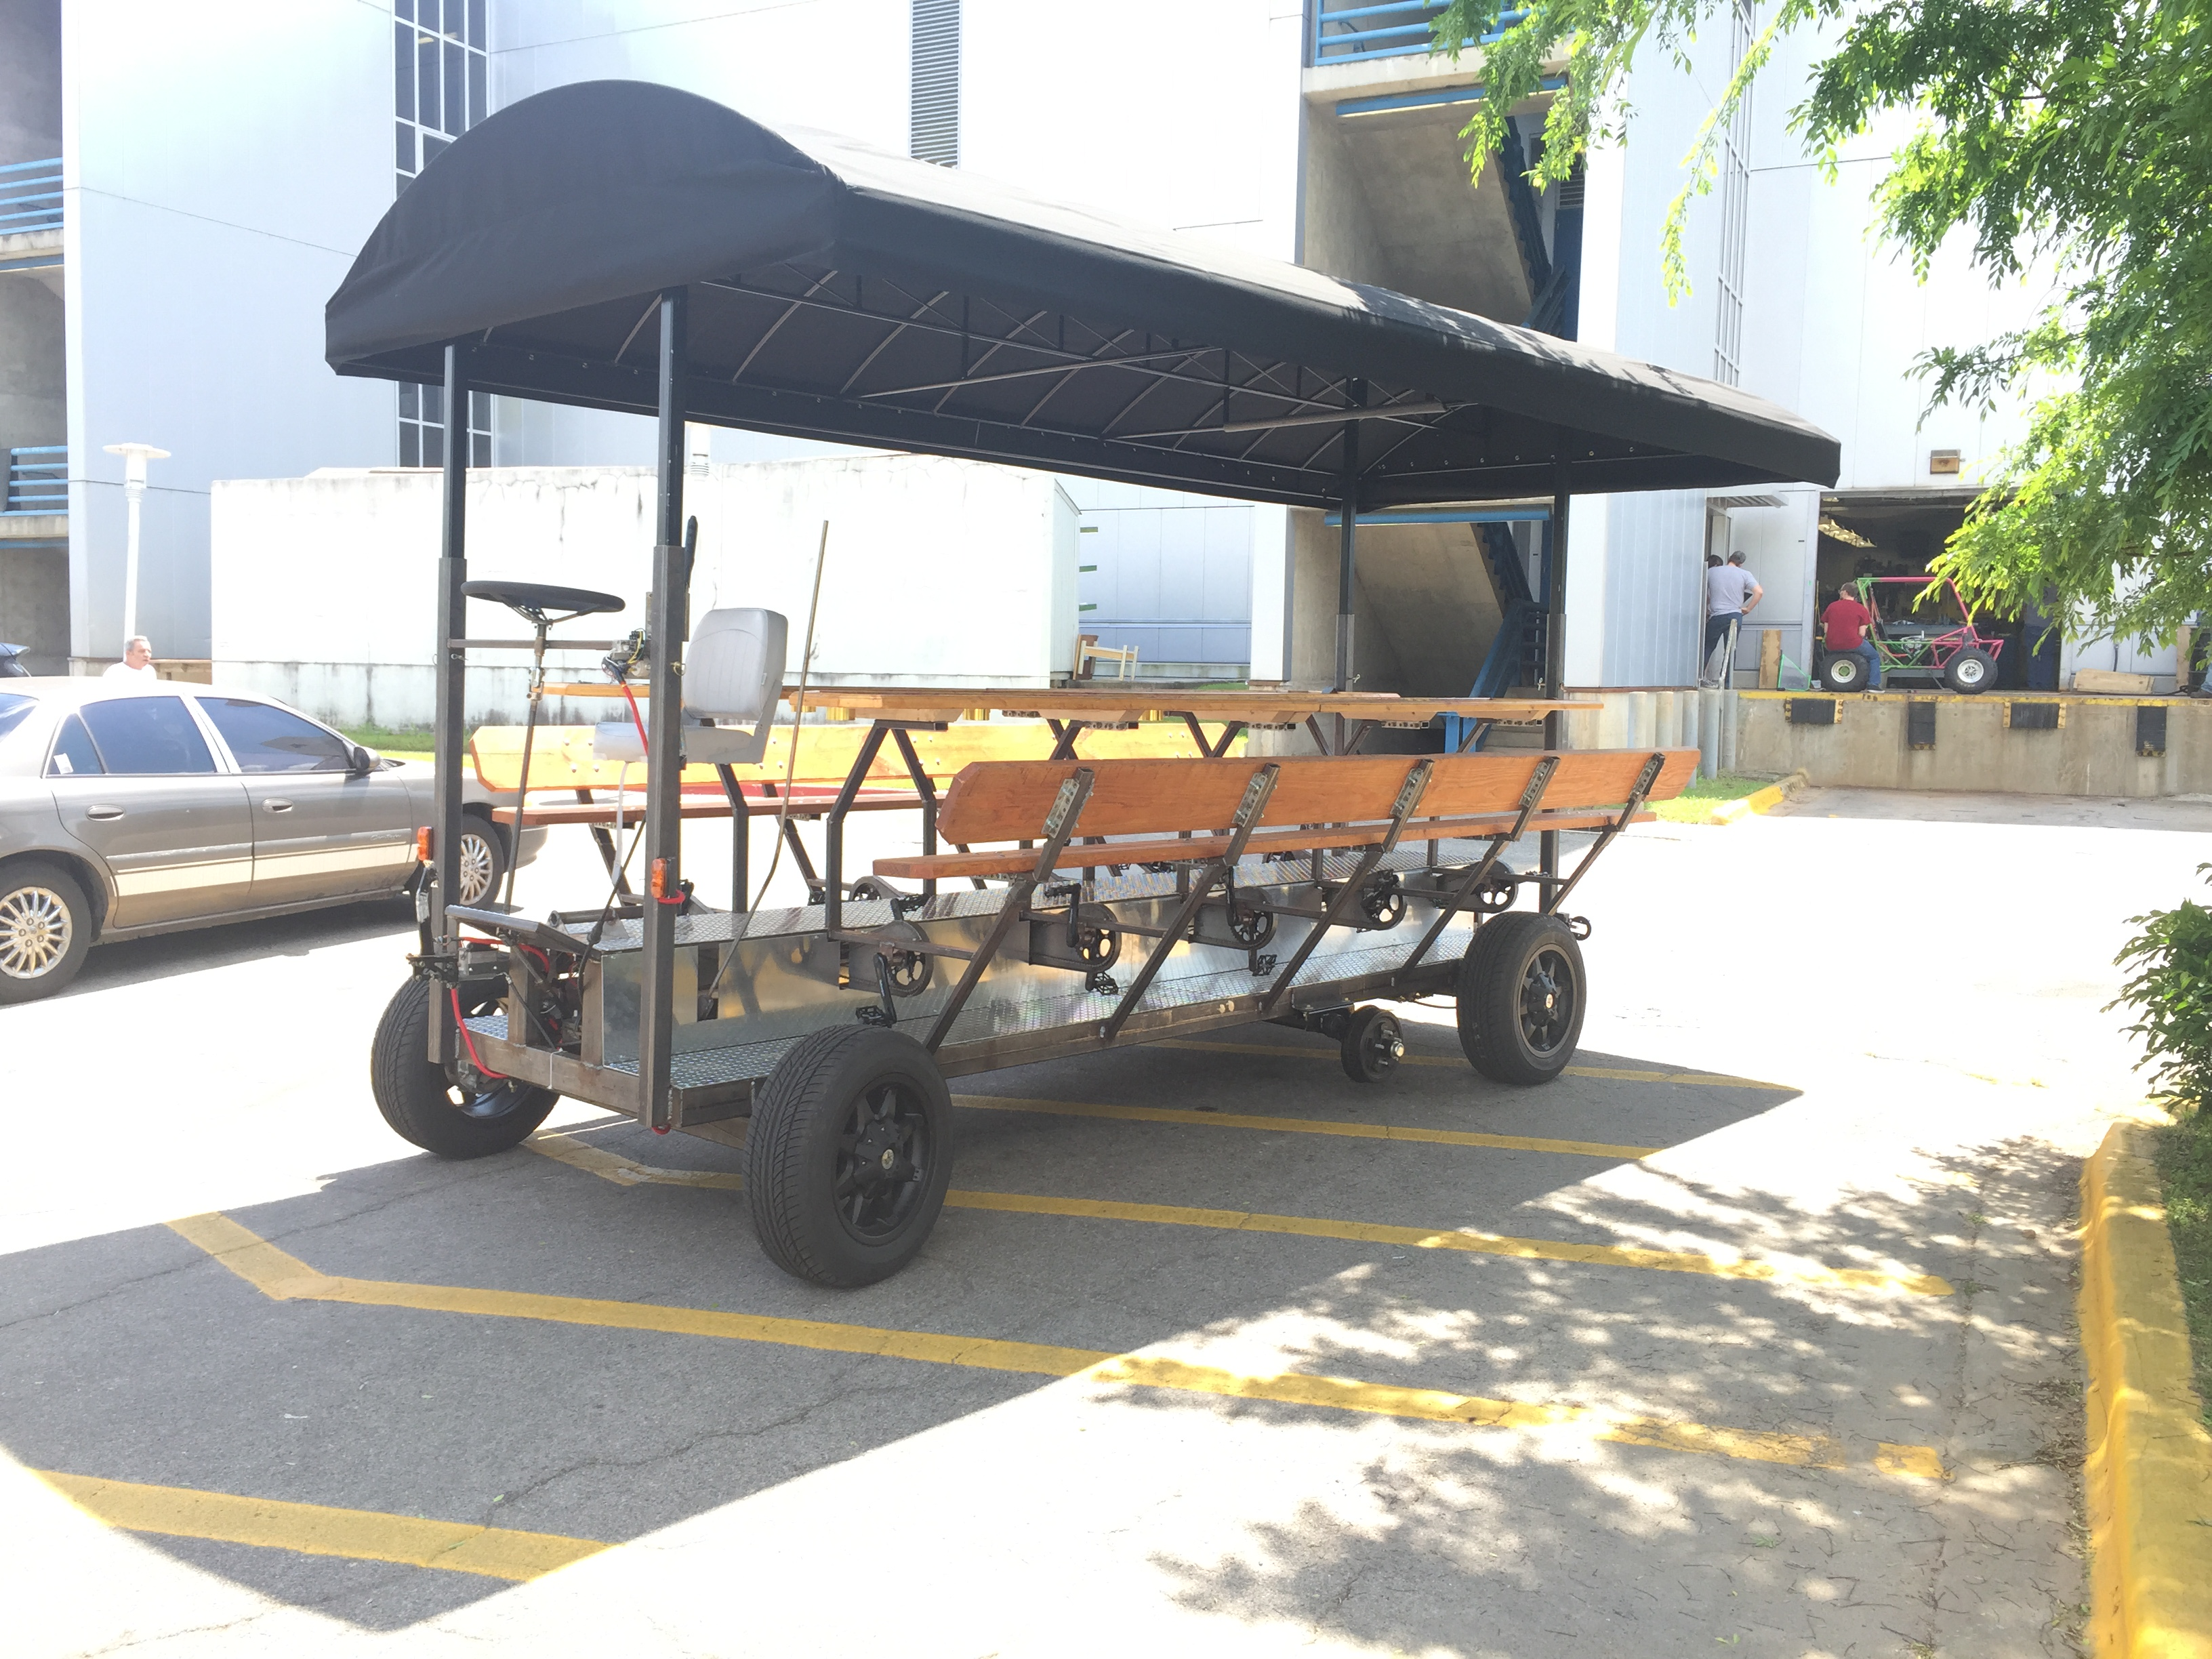
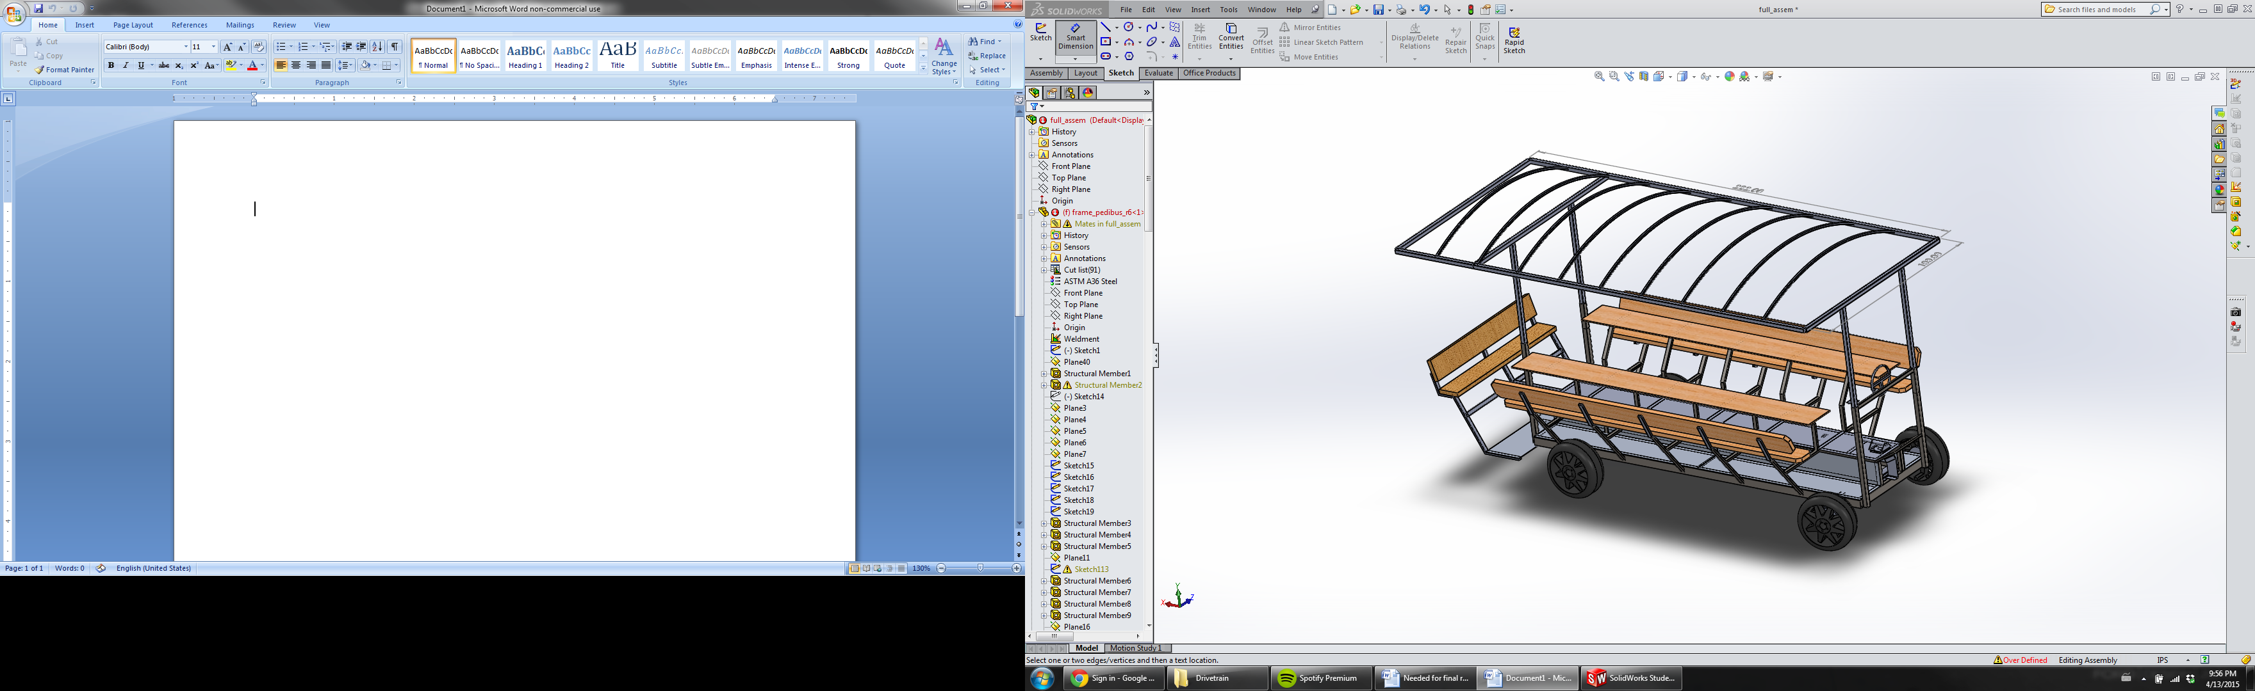
The Pedibus 2.0
Completed Pedibus
CAD renders of complete Pedibus assembly
Team No.22
Slide 5 of 25
Alejandro San Segundo
Final Presentation
Notes:
Point 1: 10 Peddlers, 1 driver, 1 “bartender”, and 2 non-peddlers
Point 2: Because of Tallahassee’s hills a crawl gear and cruise gears are recomended

Slide 6
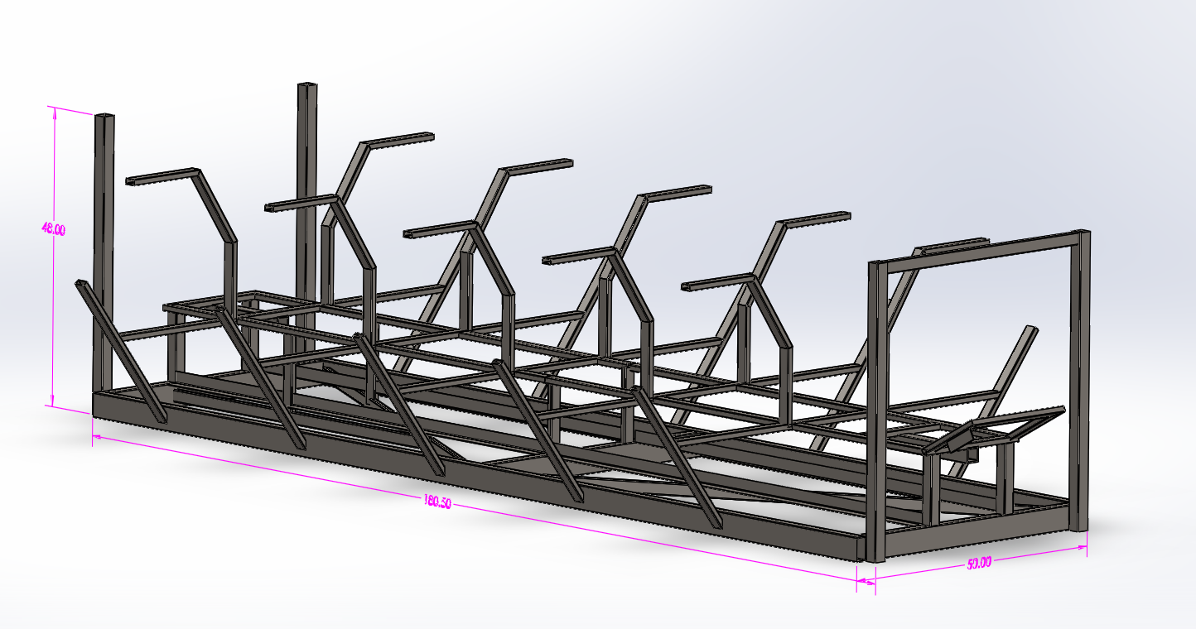
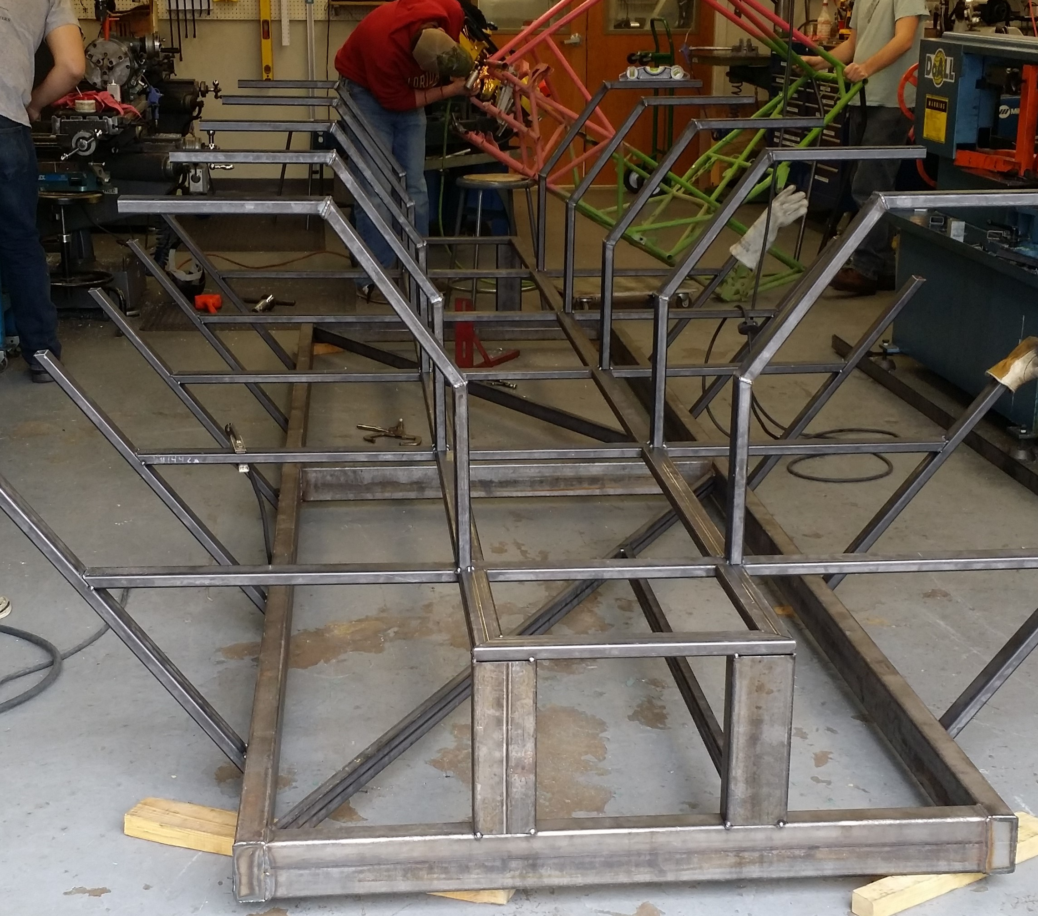
Design Breakdown: Frame
CAD renders of finalized frame design
Frame:
Ladder style frame
A500 box steel construction
Frame During Initial Fabrication
Team No.22
Slide 6 of 25
Stephen Avery
Final Presentation

Slide 7
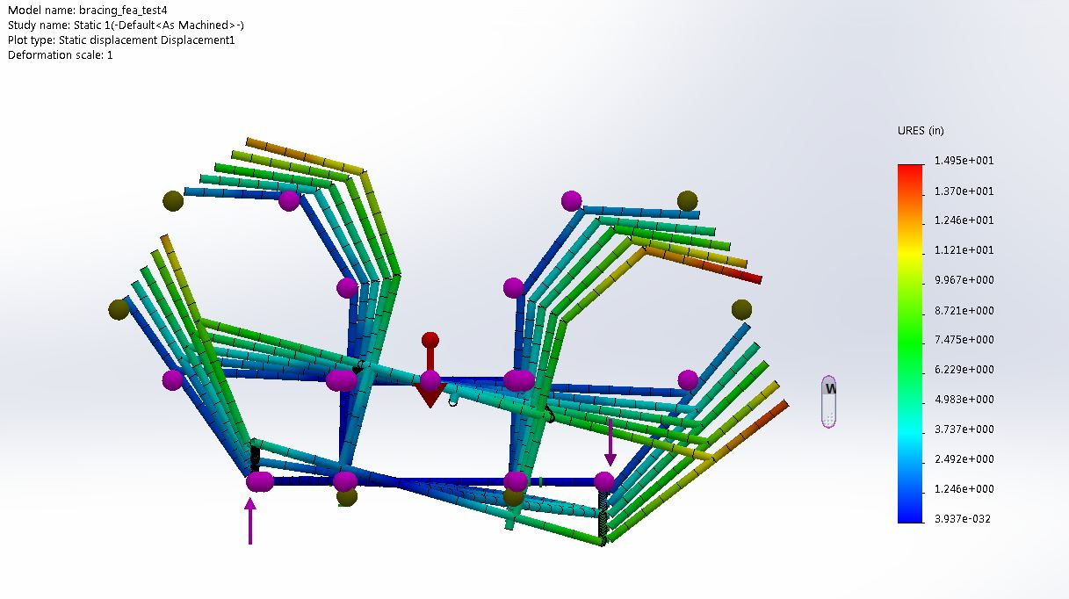
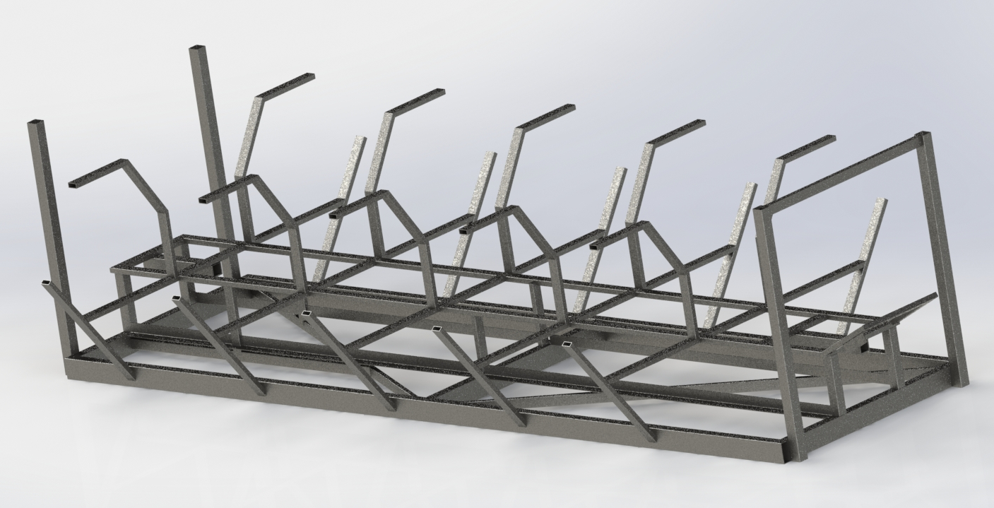
Design Breakdown: Frame
Design Considerations:
Manufacturing
Material Type
Bracing Configuration
Weight
    Size
    Component Placement
Frame Finite Element Analysis Sample (in.)
Team No.22
Slide 7 of 25
Stephen Avery
Final Presentation

Slide 8
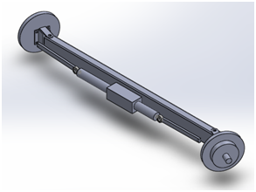
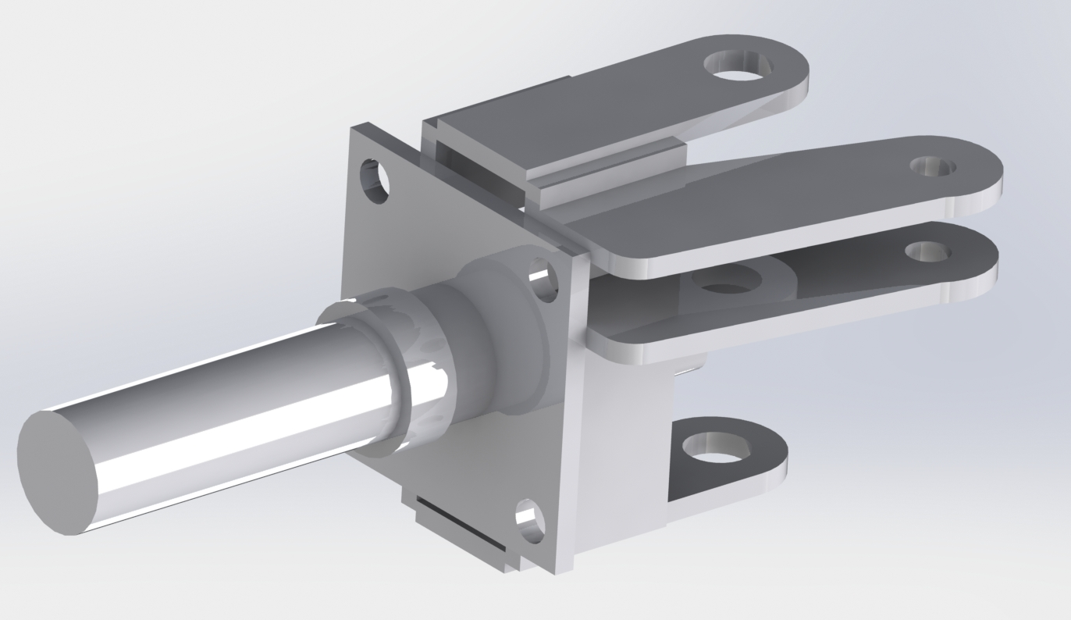
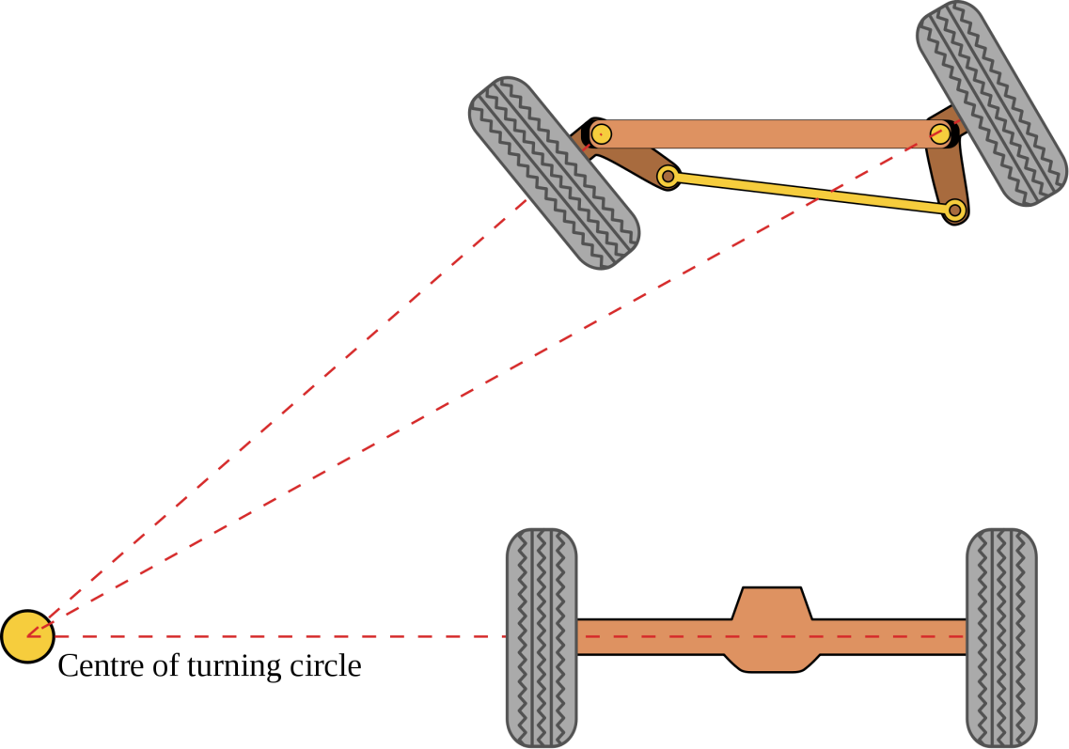
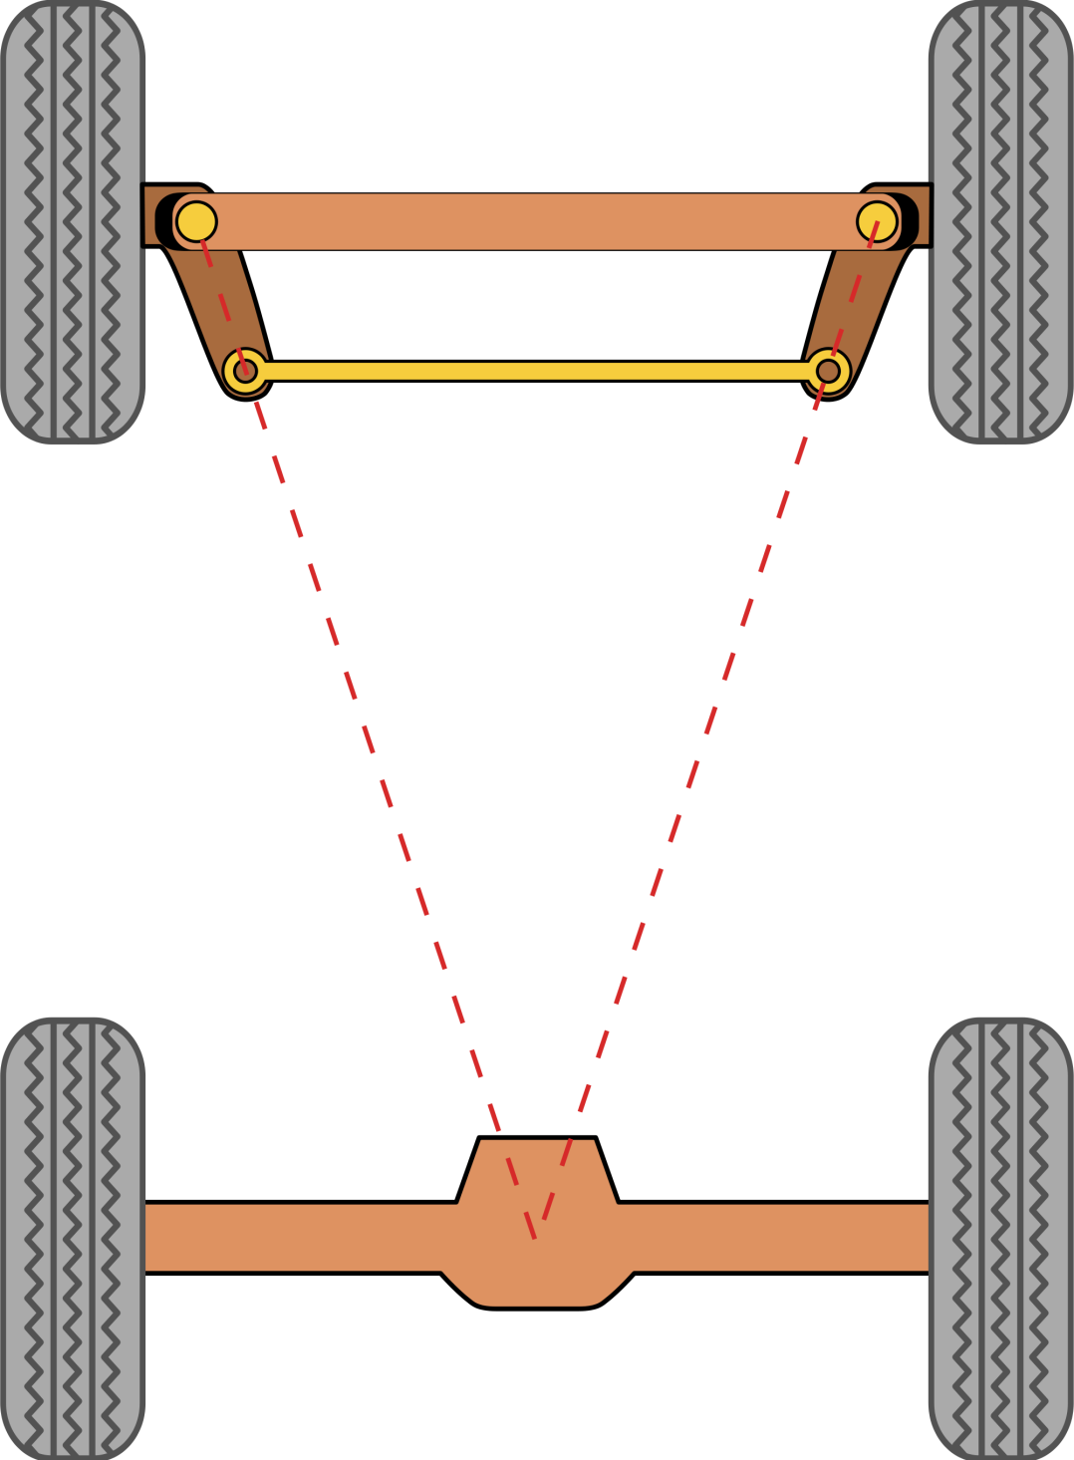
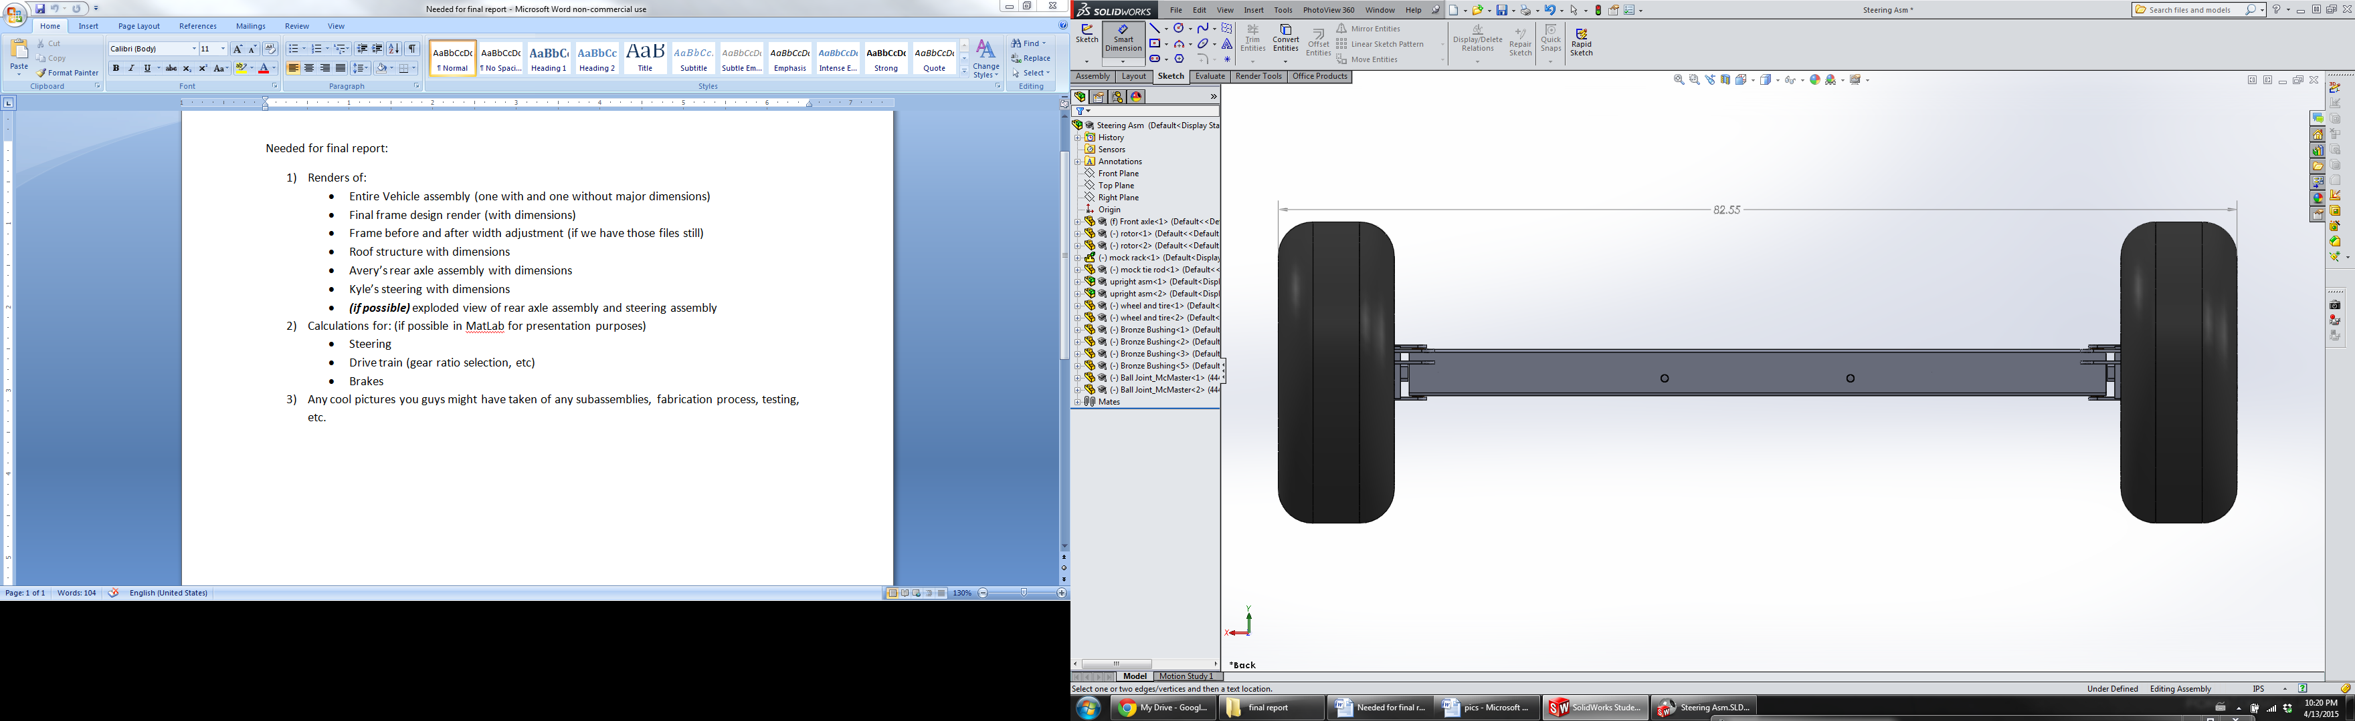
Design Breakdown: Steering
Steering:
Rack and pinion straight axle set up
Curb to curb < 45ft
Brass bushings used for smooth rotation
Team No.22
Slide 8 of 25
Kyle Anderson
Final Presentation

Slide 9
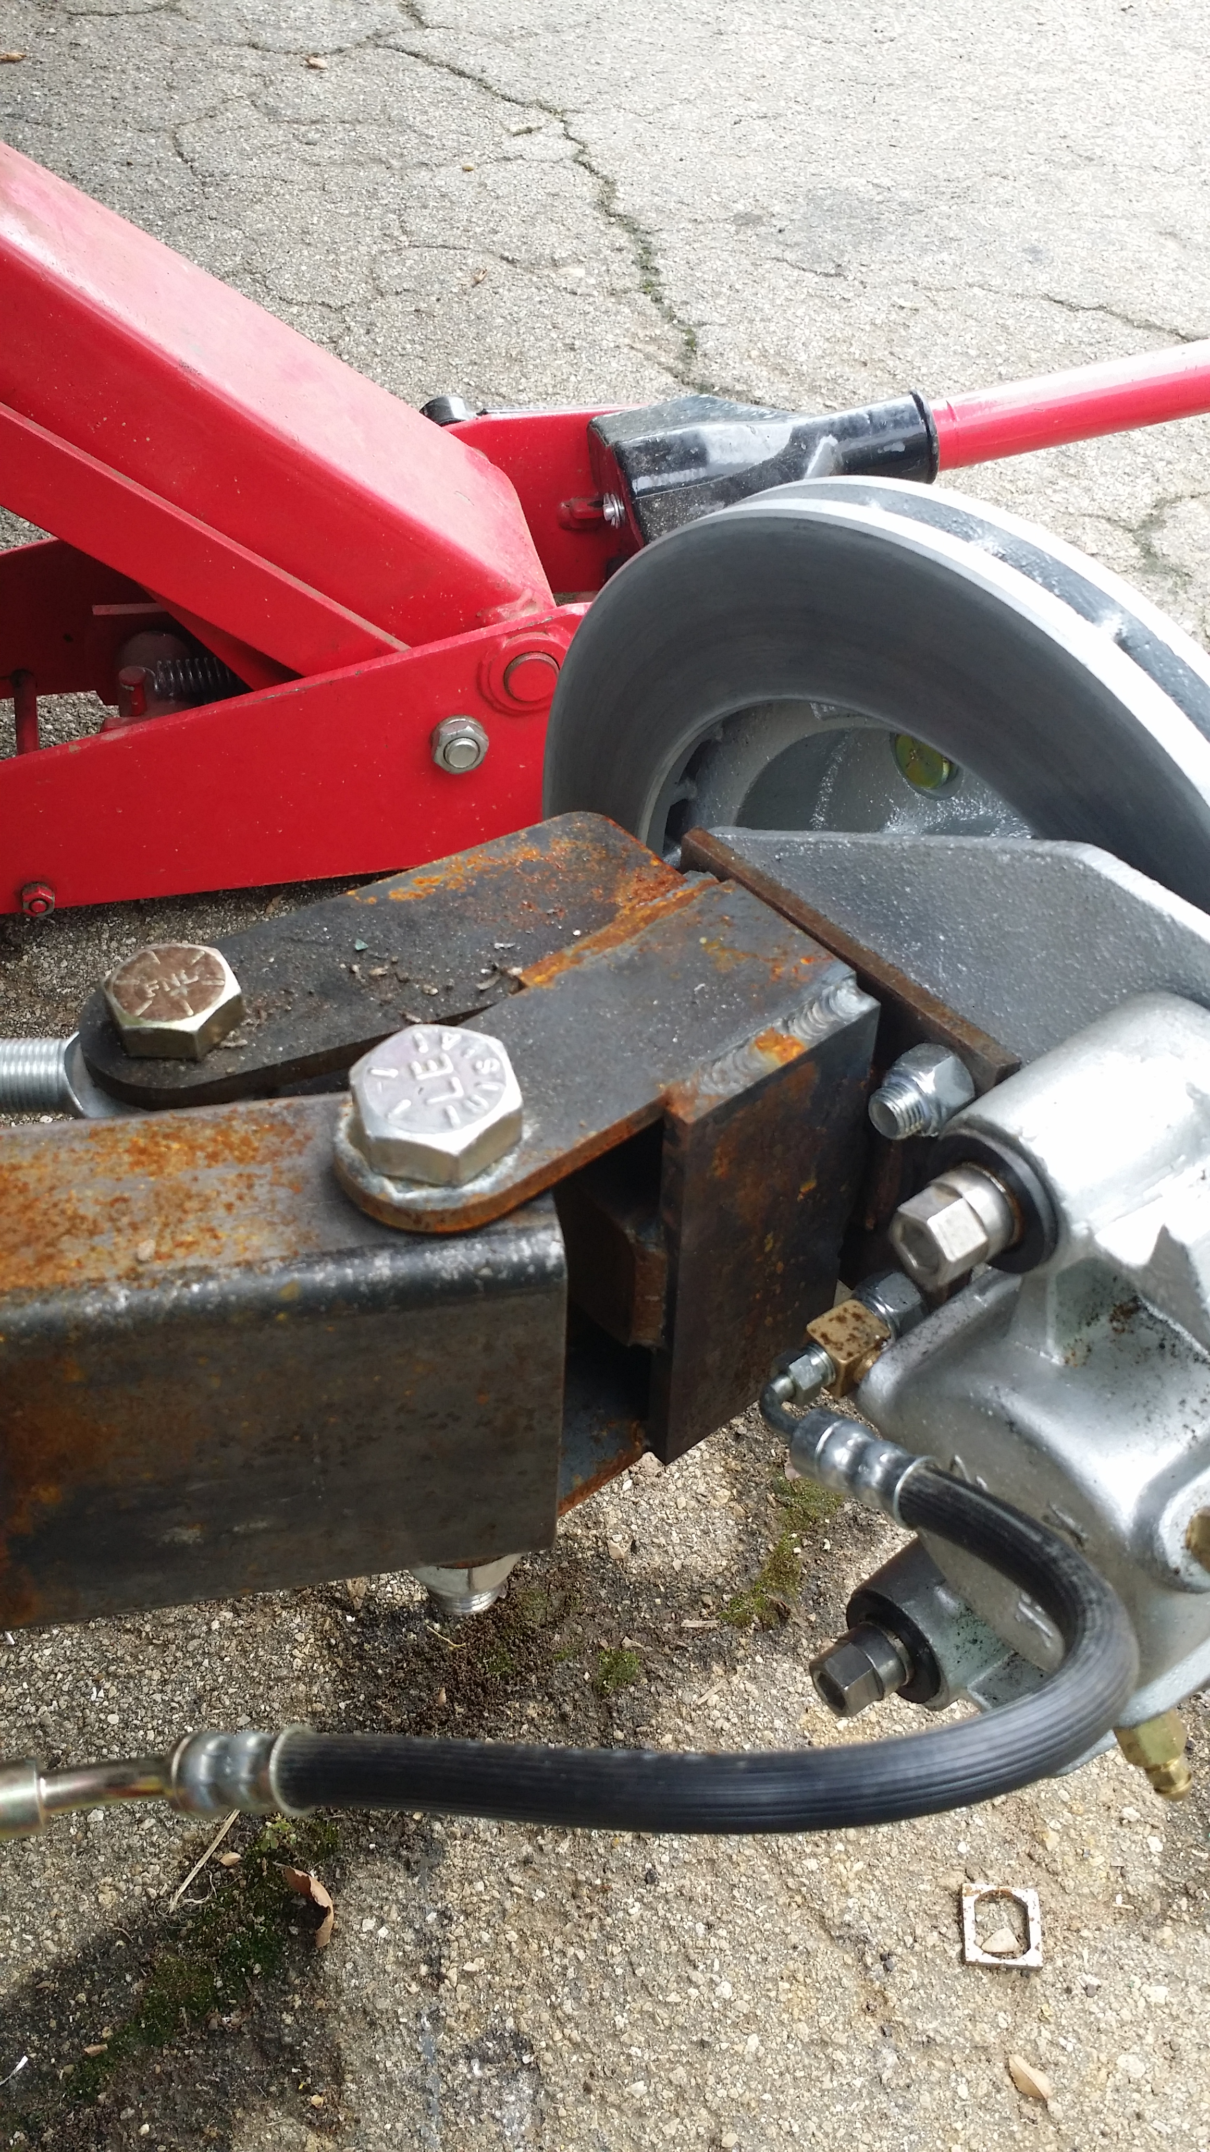
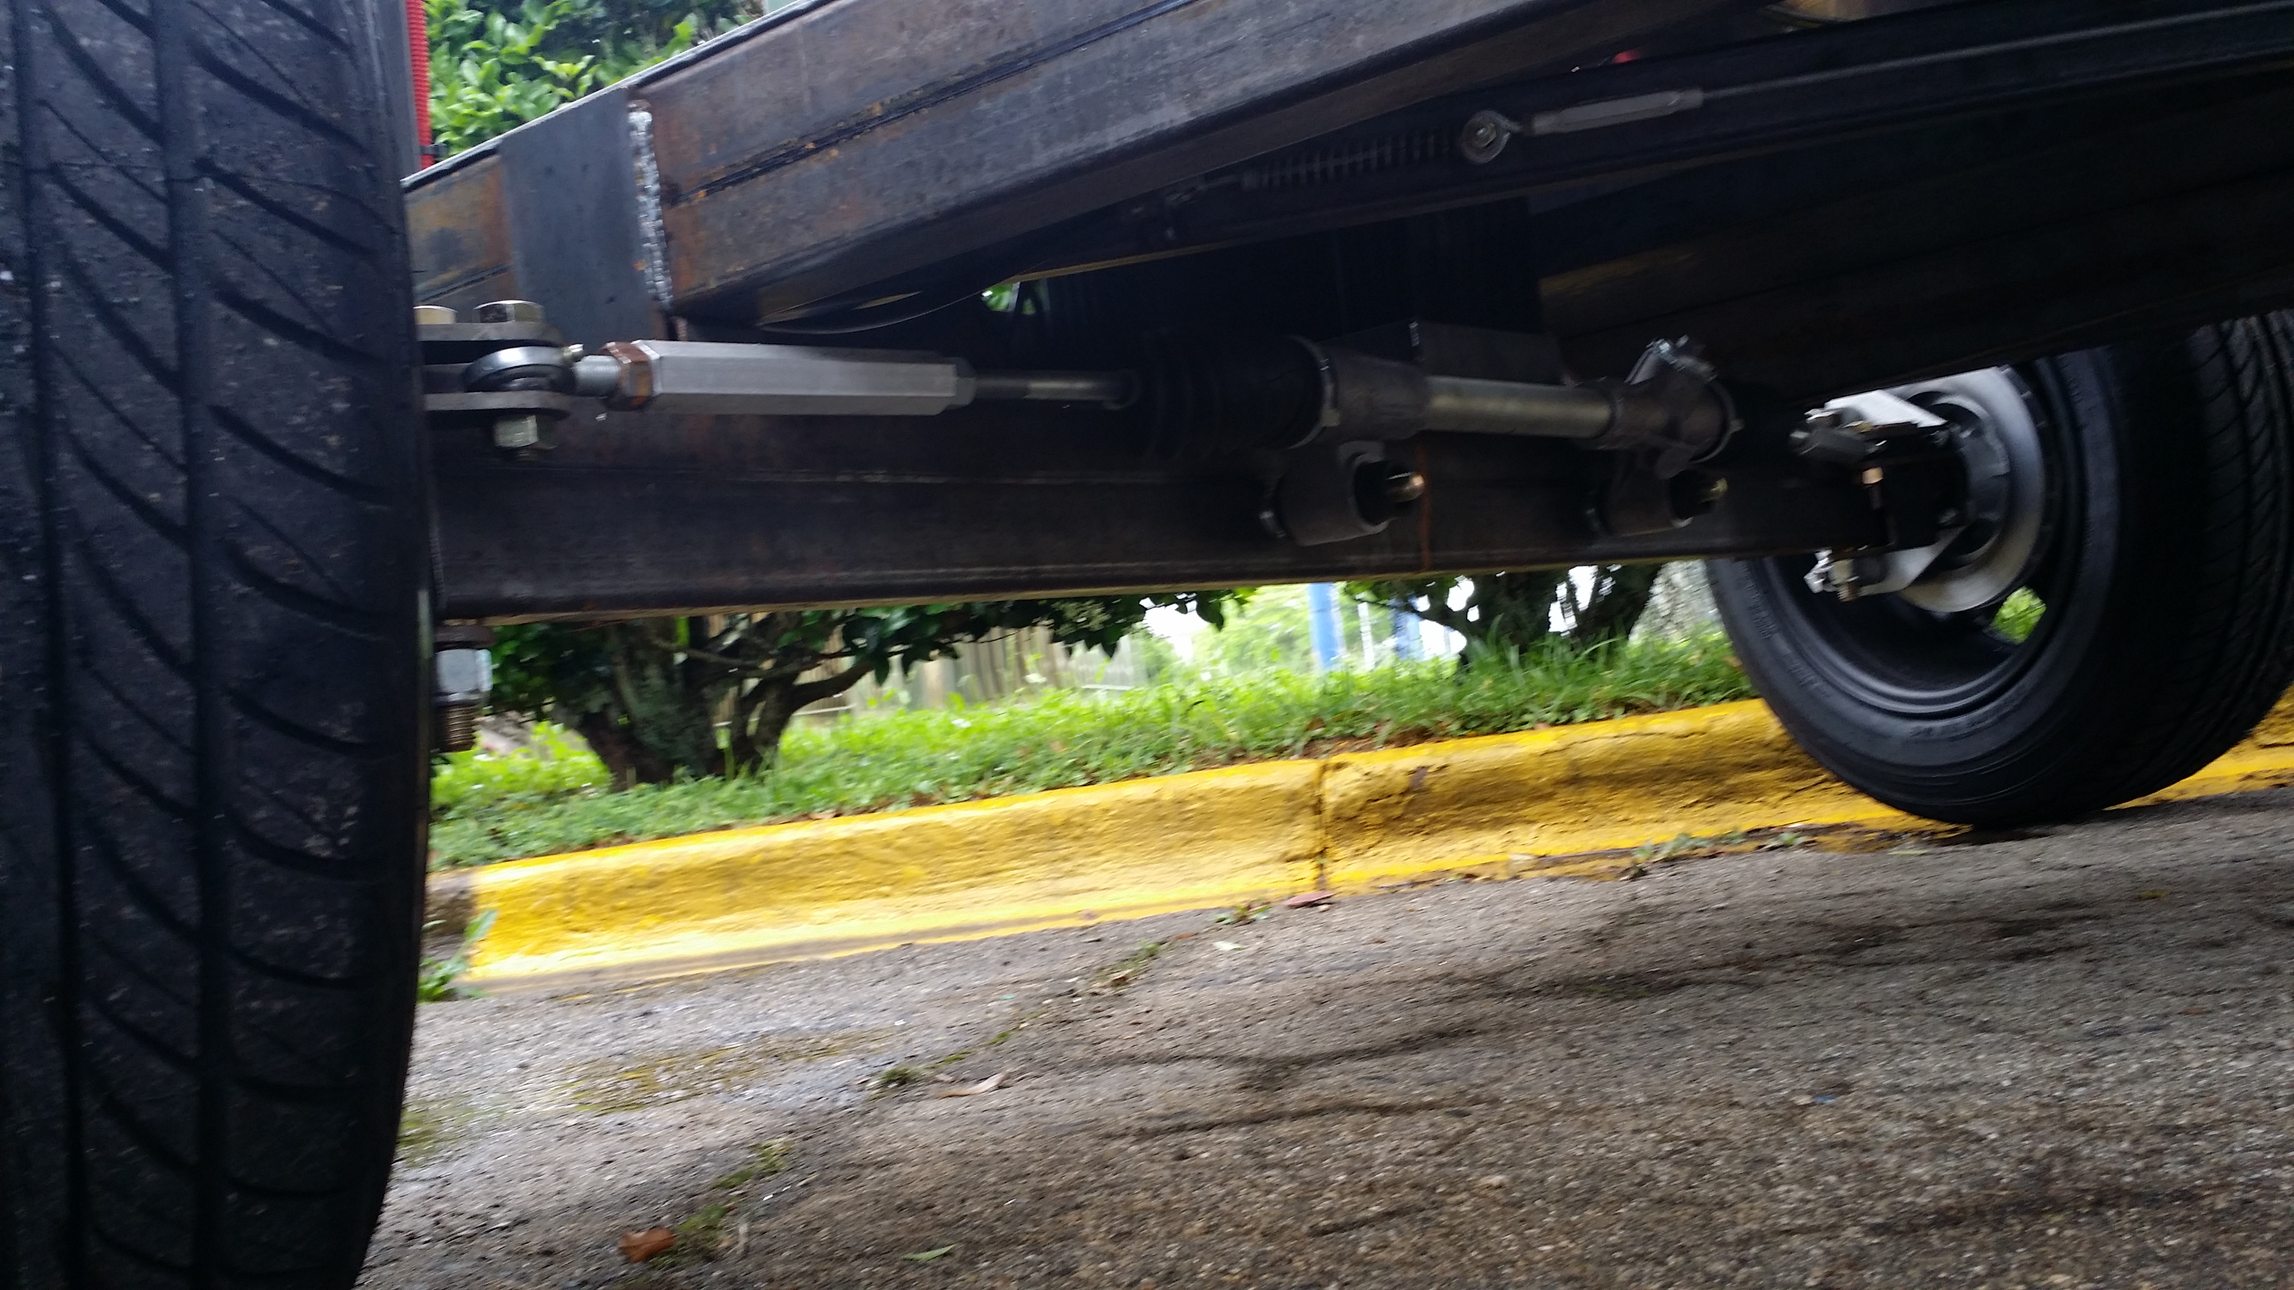
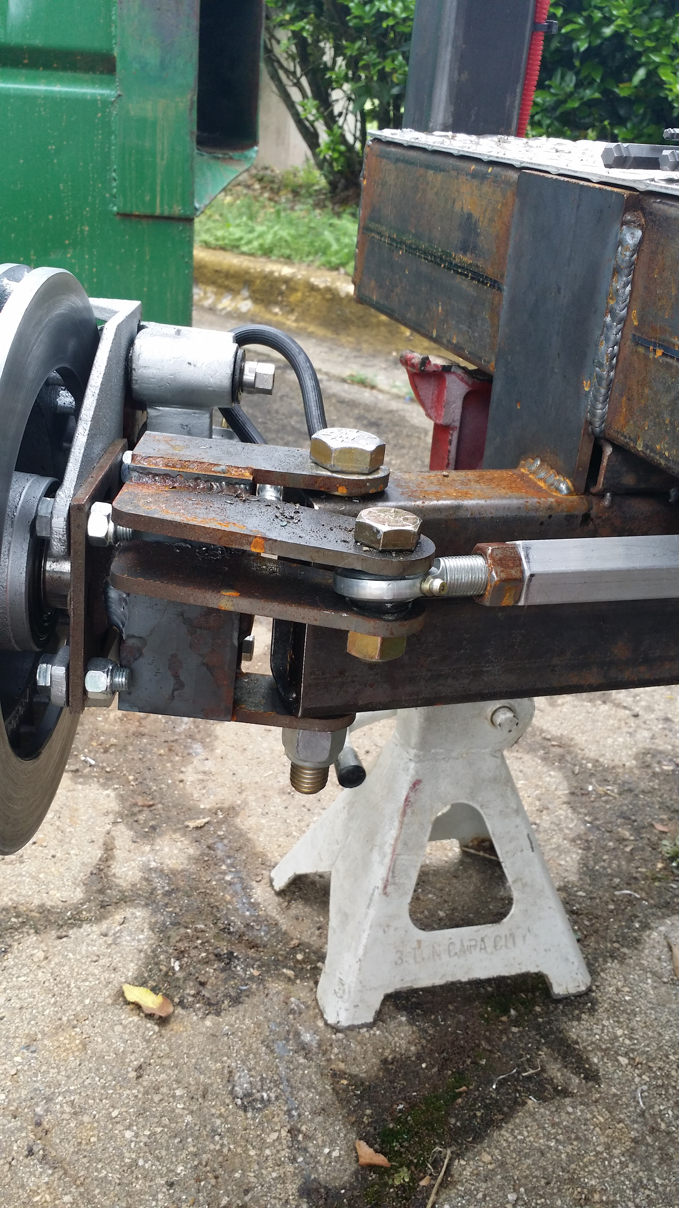
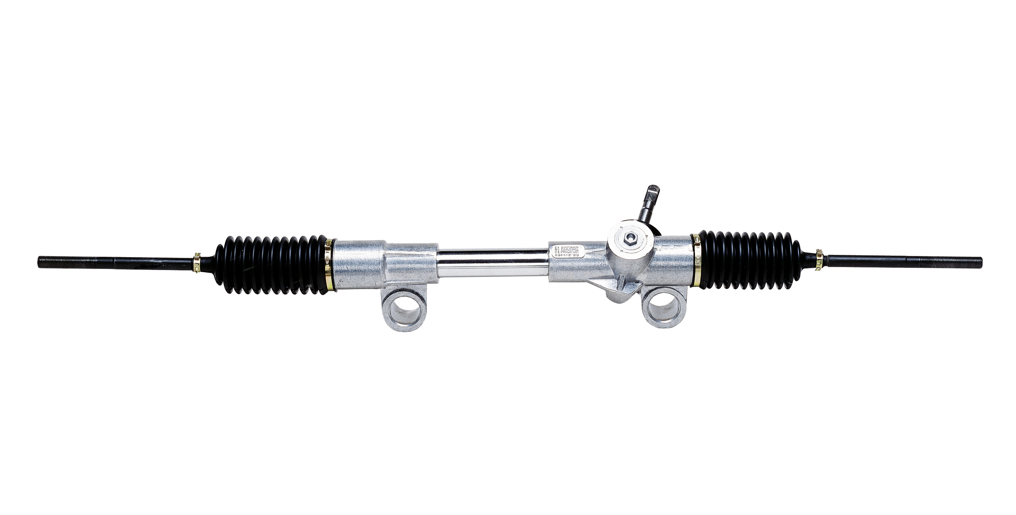
Design Breakdown: Steering
Steering:
Rack and pinion straight axle set up
Curb to curb < 45ft
Brass bushings used for smooth rotation
Team No.22
Slide 9 of 25
Kyle Anderson
Final Presentation

Slide 10
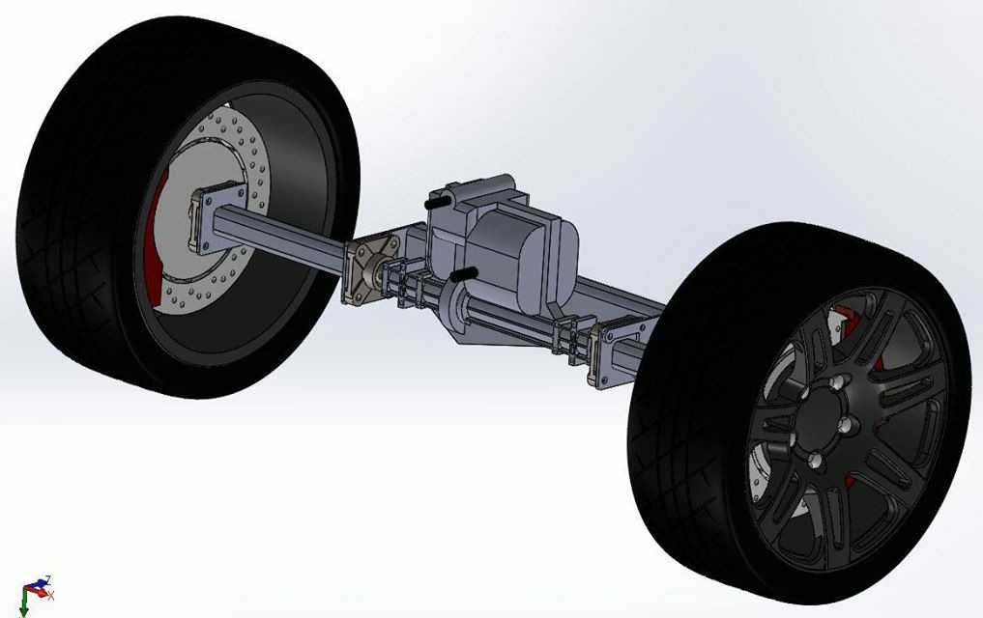
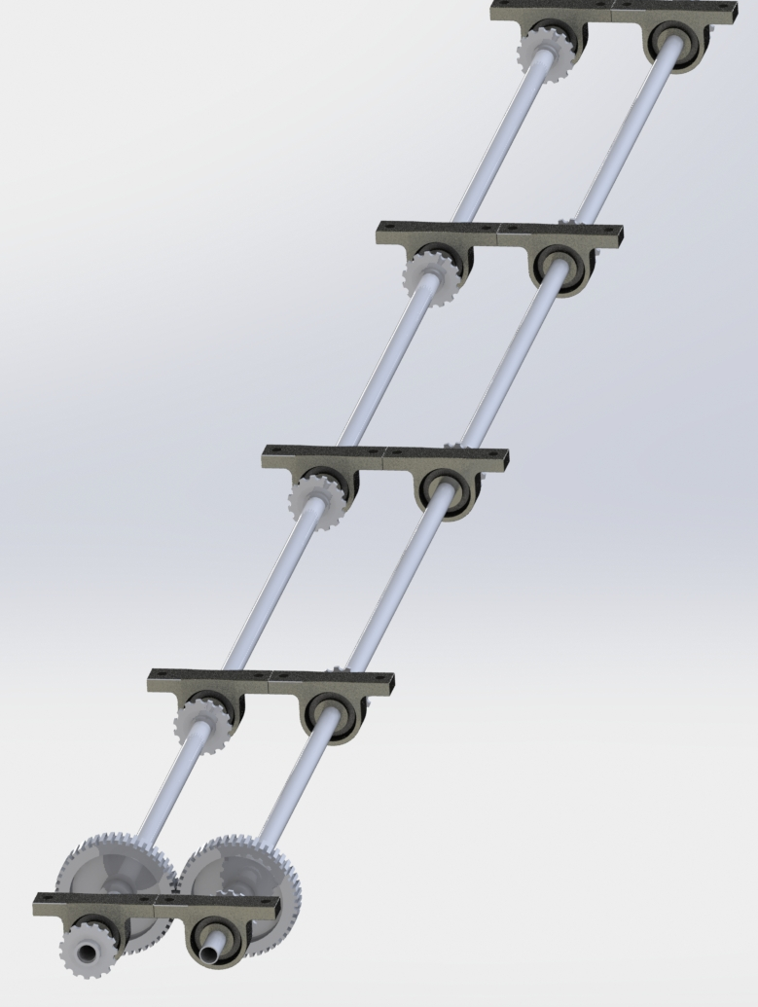
Design Breakdown: Drivetrain
CAD render of rear axle
Specifications:
Dual Driveshaft to Manual Transaxle Design
            6 forward speeds + Reverse
            Individually supported axle shafts
Industrial Chain Drive
CAD render dual shaft design mounted on pillow blocks
Team No.22
Slide 10 of 25
Stephen Avery
Final Presentation

Slide 11
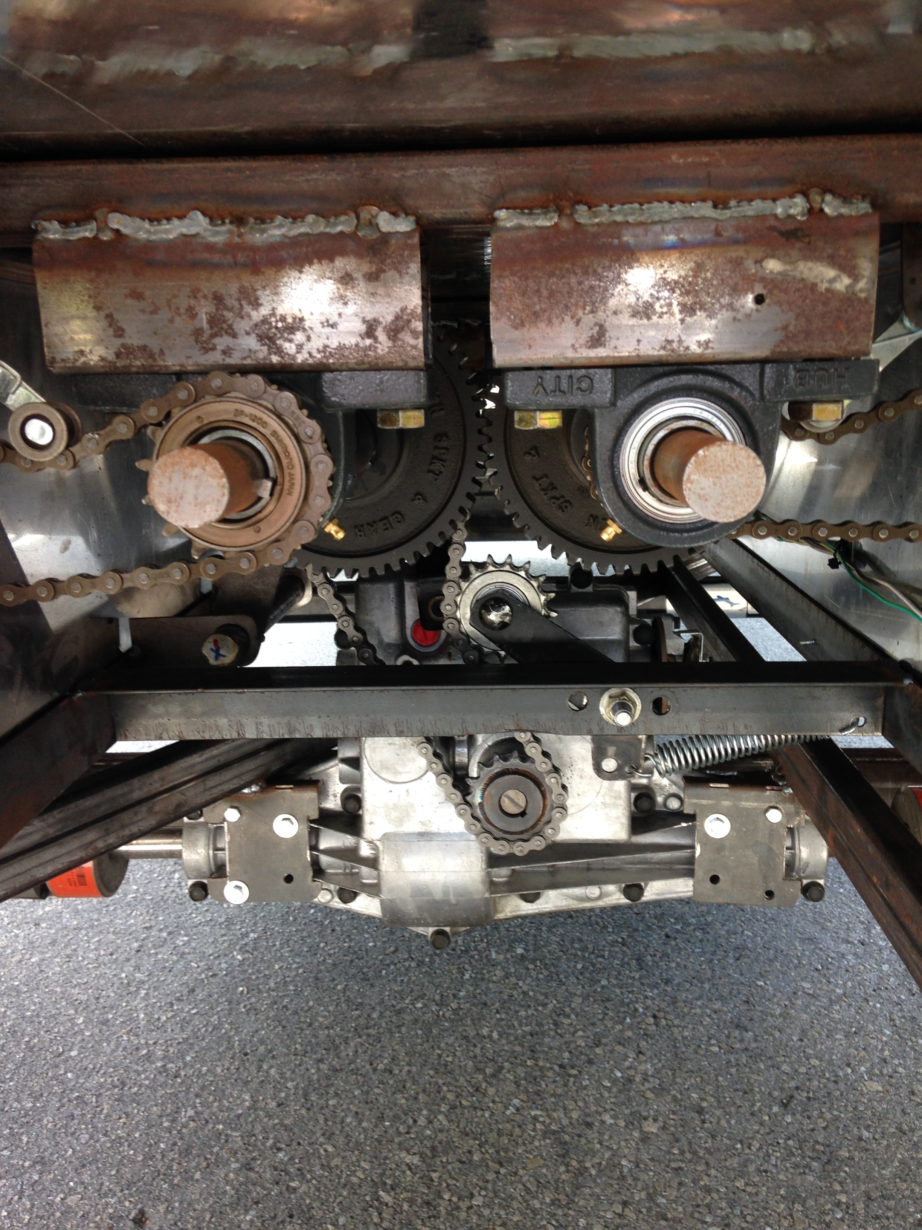
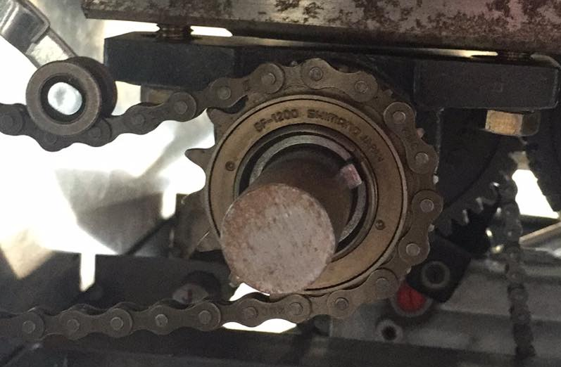
Design Breakdown: Drivetrain
Freewheeled driveshaft allow for individual cadence and no back drivability
Dual drive shaft design eliminates chain crossing
Reduces shaft torque by dividing over two
Dual shaft design mounted on pillow blocks
Freewheel sprocket mounted onto shaft
Team No.22
Slide 11 of 25
Stephen Avery
Final Presentation

Slide 12
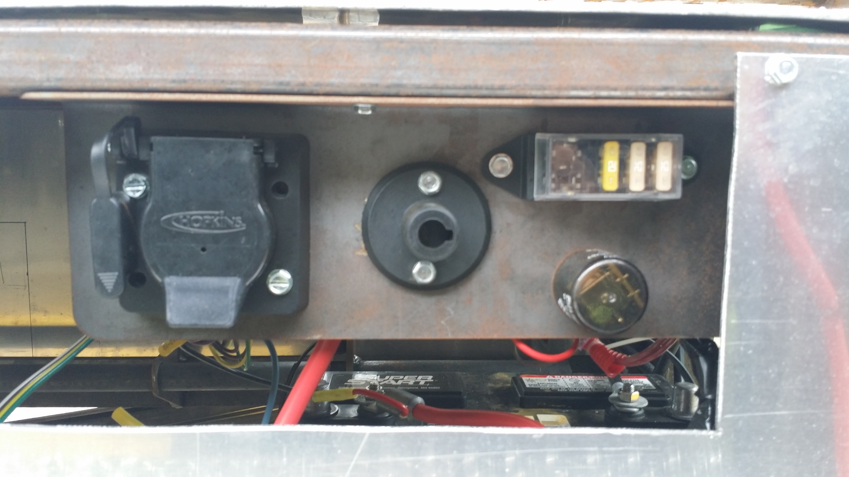
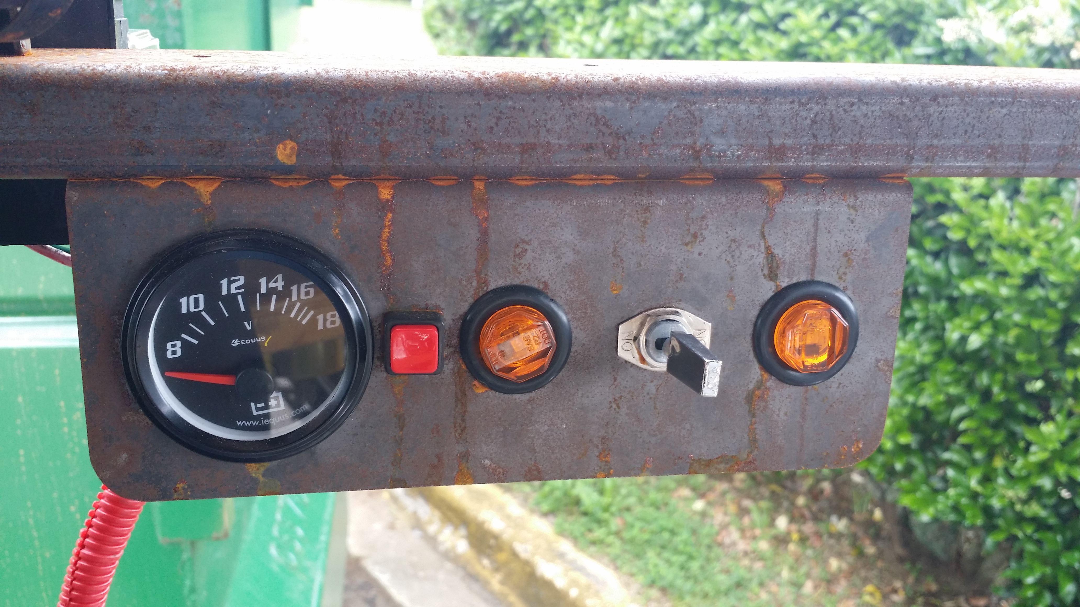
Design Breakdown: Electronics
Primary Control Panel:
Modular Lighting
Remote Charging
Fuse Block with Additional “Hot” Slots
Keyed Battery Shutoff
Driver’s Control Panel:
Voltage Meter
Hazard Lights
Turn signals
Team No.22
Slide 12 of 25
Stephen Avery
Final Presentation

Slide 13
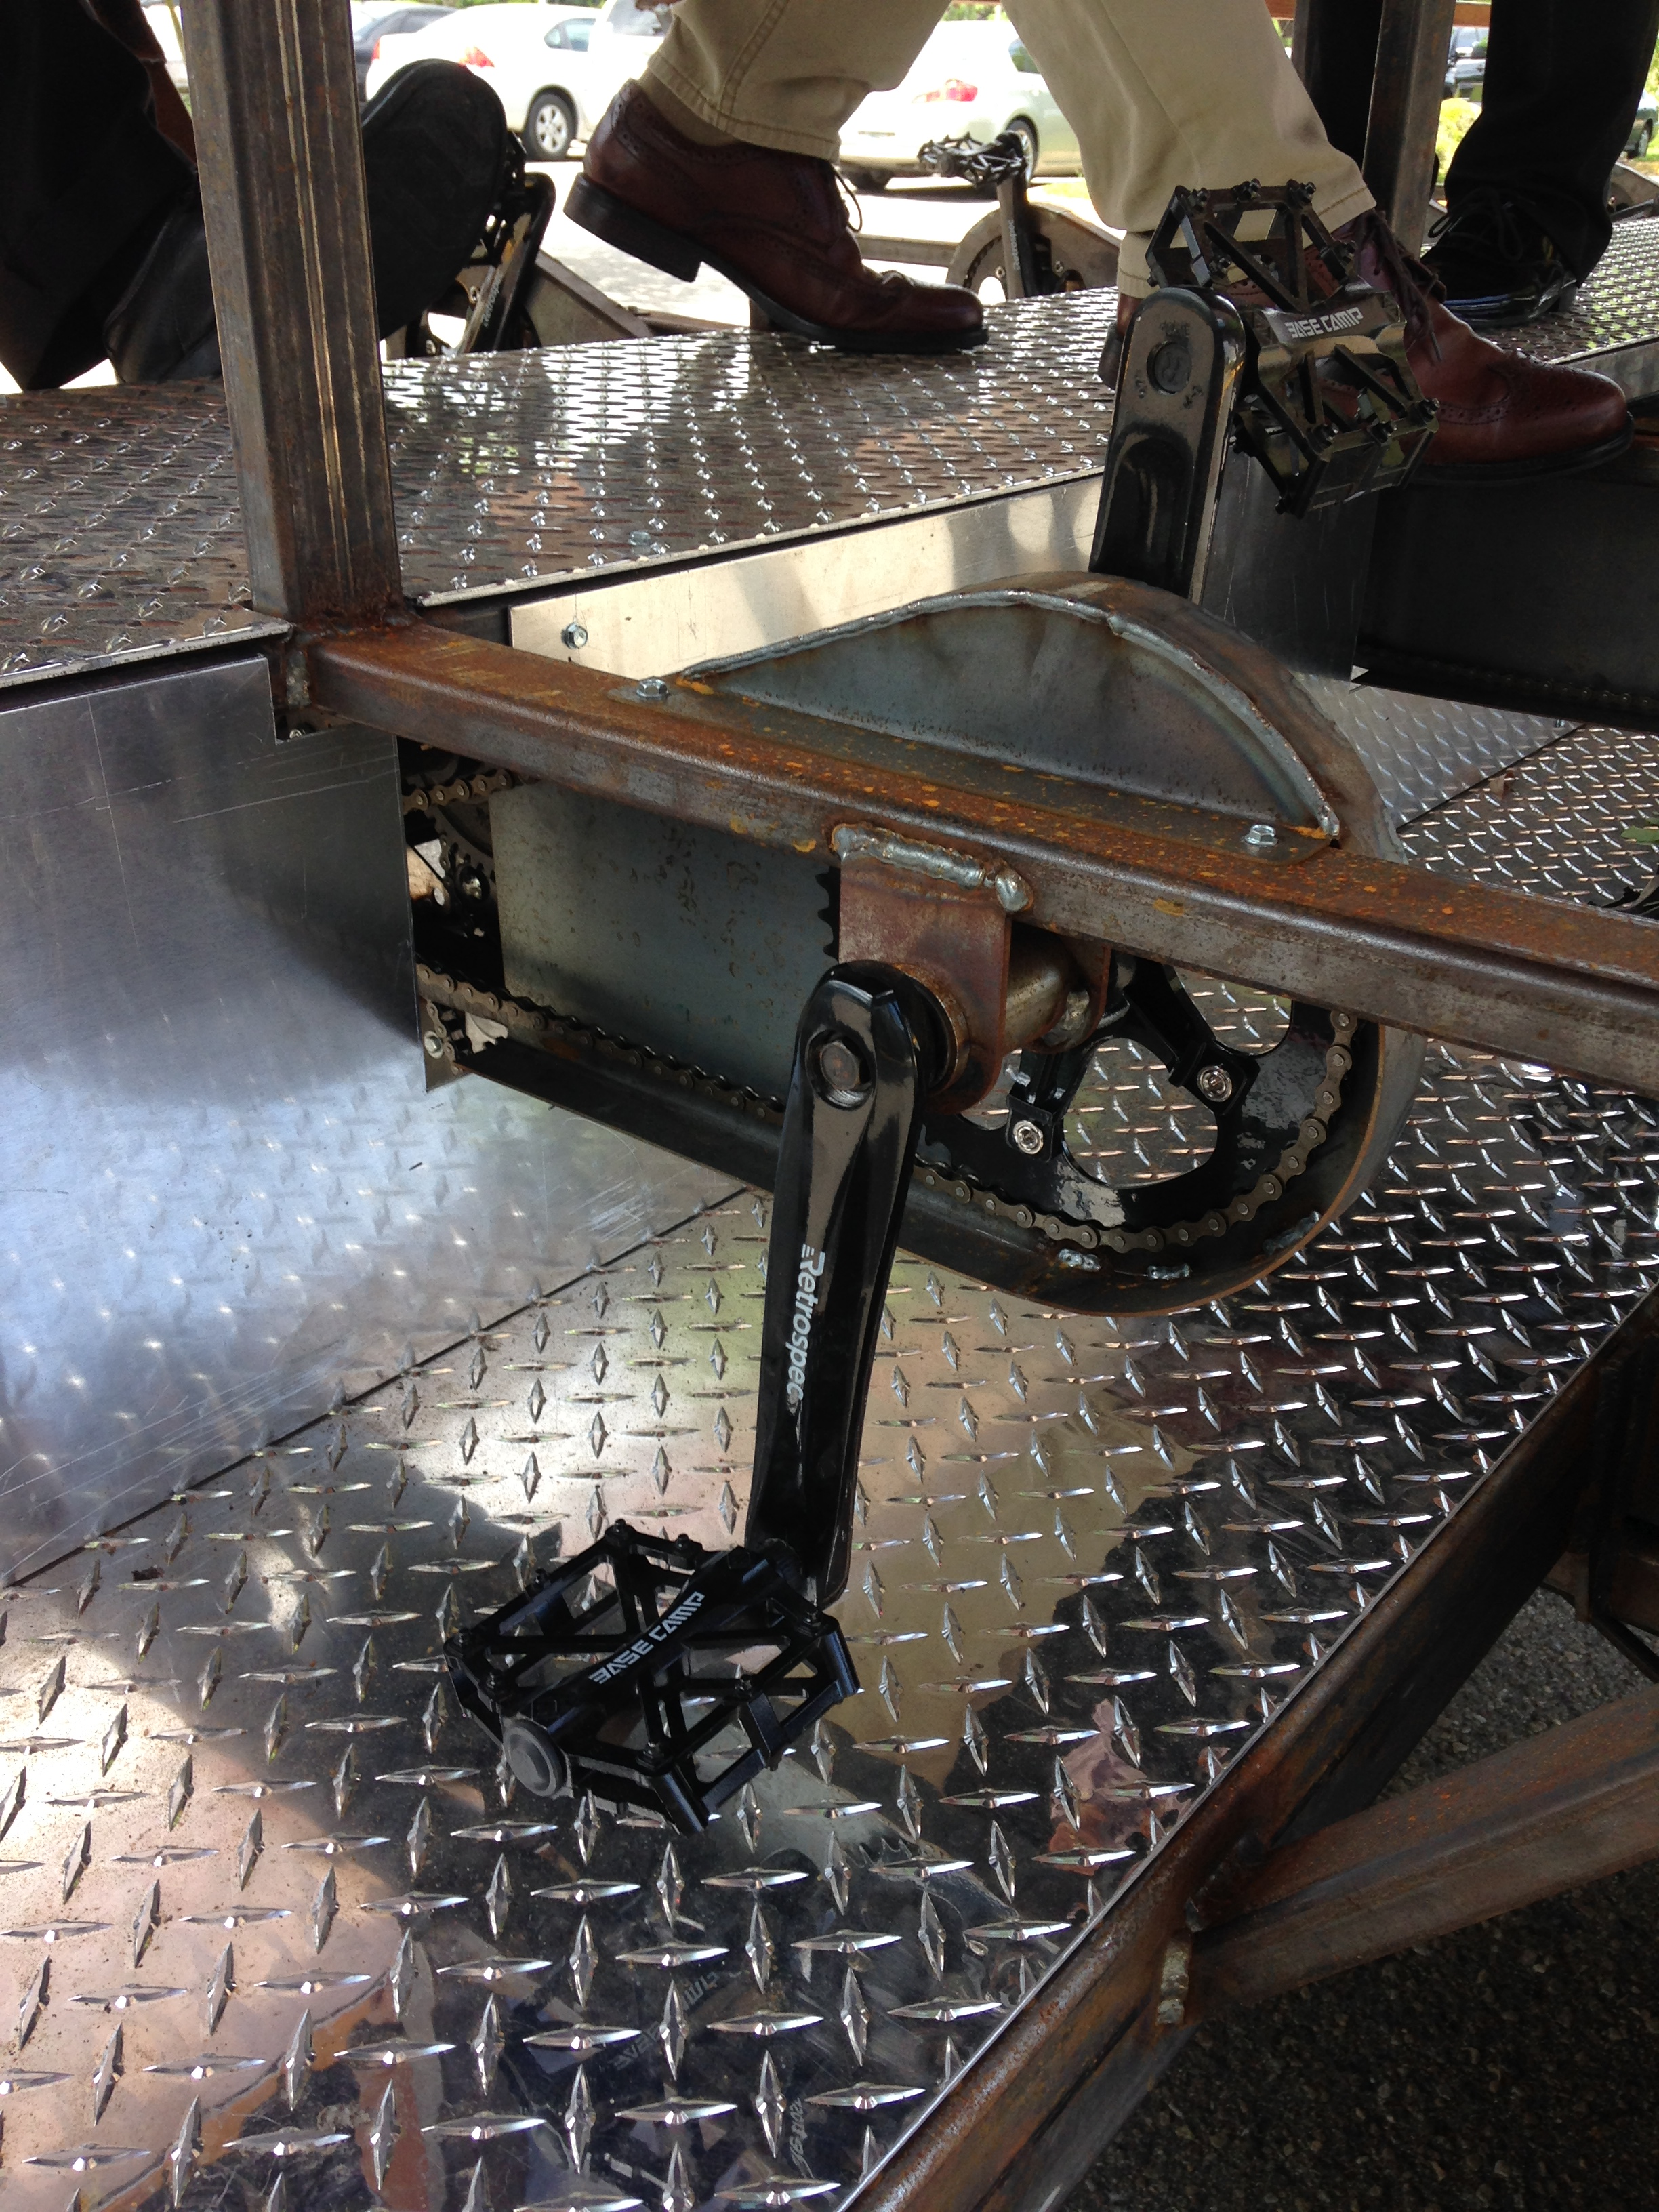
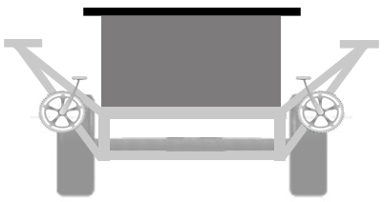
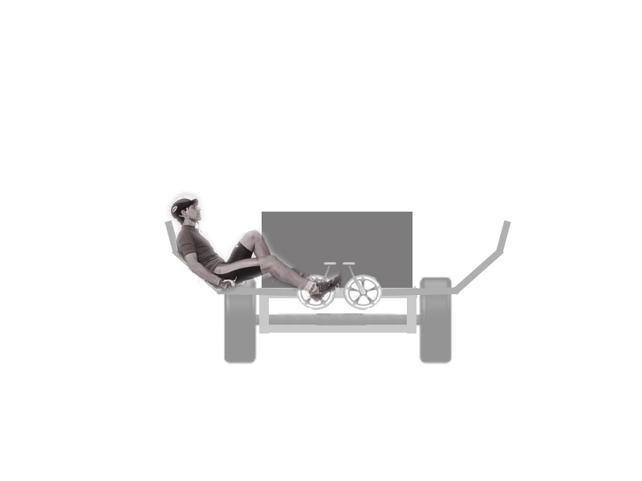
Progress: Pedaling Ergonomics
Pedaling:
Recumbent stance
Relaxed knee max knee bend angle (<70)
Freewheeled shaft design for coasting
Hibrid recumbent riding stance
Fully recumbent riding stance
Cranks and pedal mounted onto frame
Team No.22
Slide 13 of 25
Alejandro San Segundo
Final Presentation

Slide 14
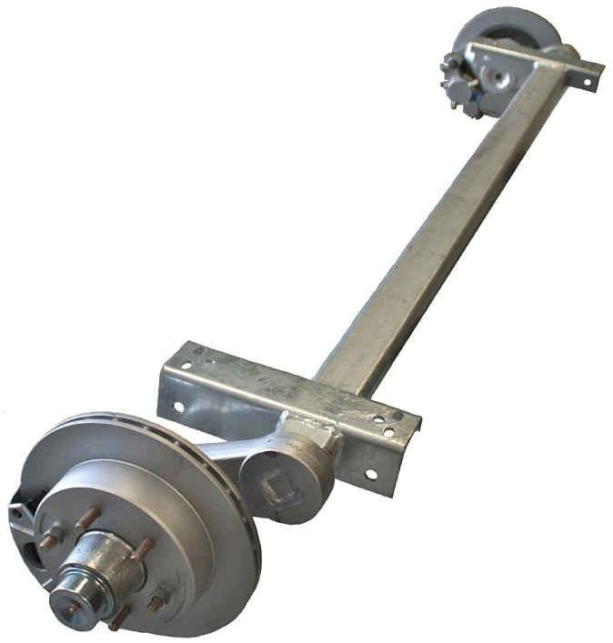
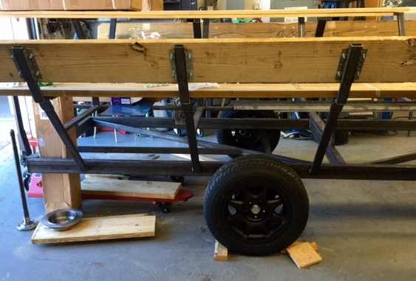
Progress: Towing Platform
Towing:
Torsion Axle implementation
            Electric drum brakes on towing axle
Standard towing hitch mount
Towing axle assembly
Torsion Tow Axle
Team No.22
Slide 14 of 25
Kyle Anderson
Final Presentation

Slide 15
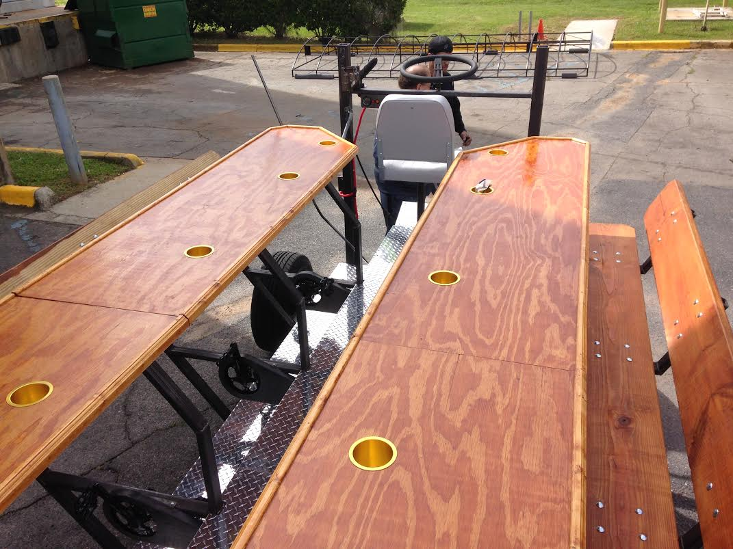
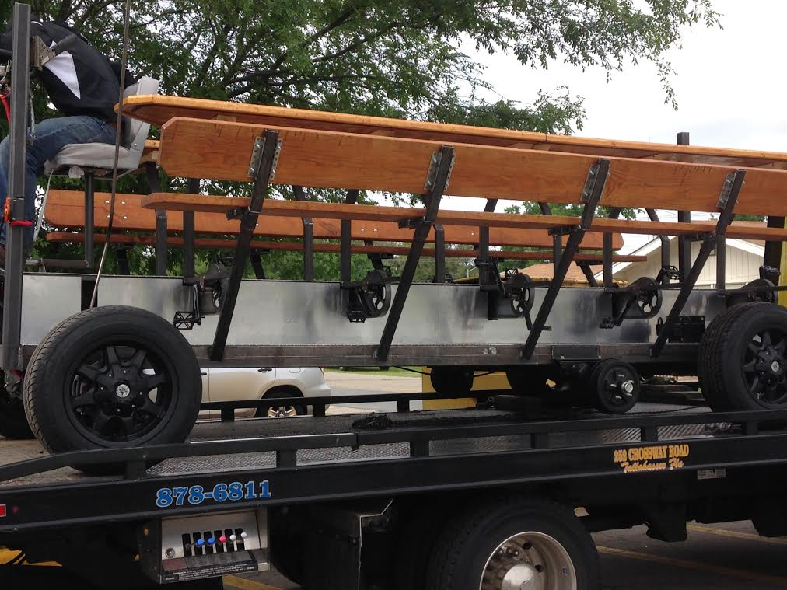
Design Breakdown: Woodwork
Bartop:
Pressure treated wood top
Coated for Weather protection
Added handrail for rider stability
Finished and mounted bar top
Bench Seating Arrangement:
Room for non-pedaling passengers
Semi-Recumbent Riding stance
Finished and mounted benches
Team No.22
Slide 15 of 25
Kyle Anderson
Final Presentation

Slide 16
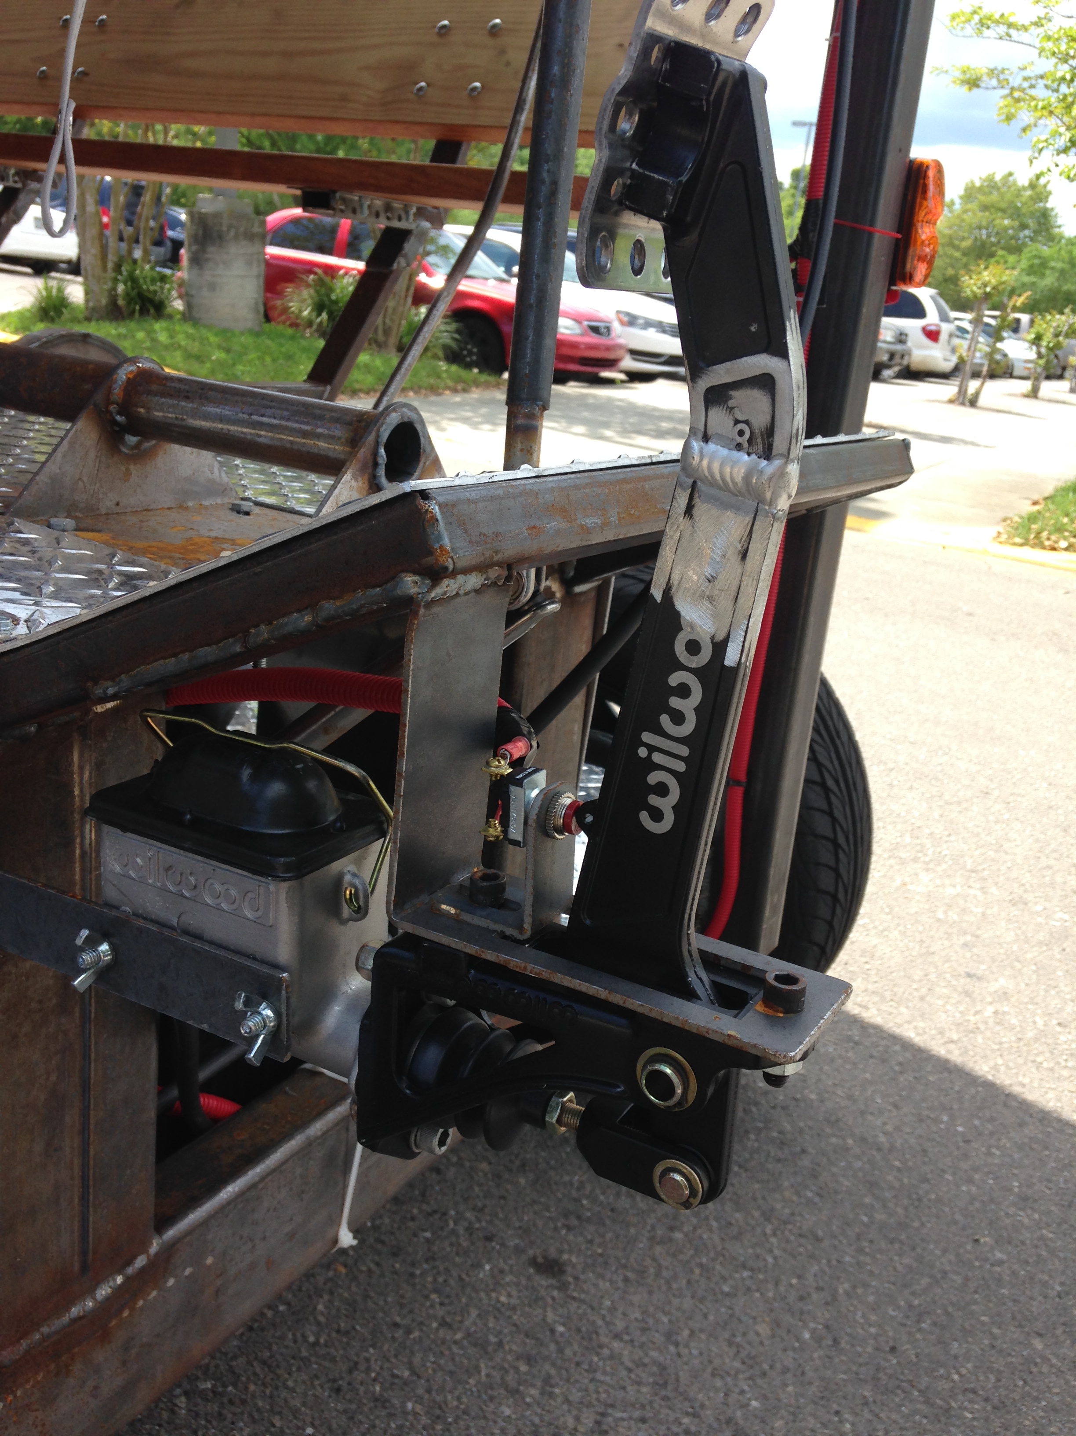
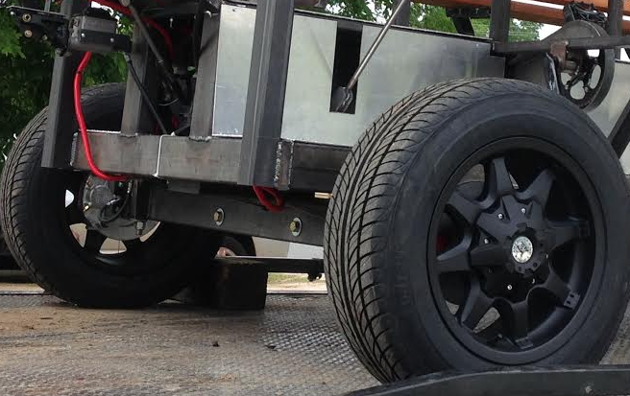
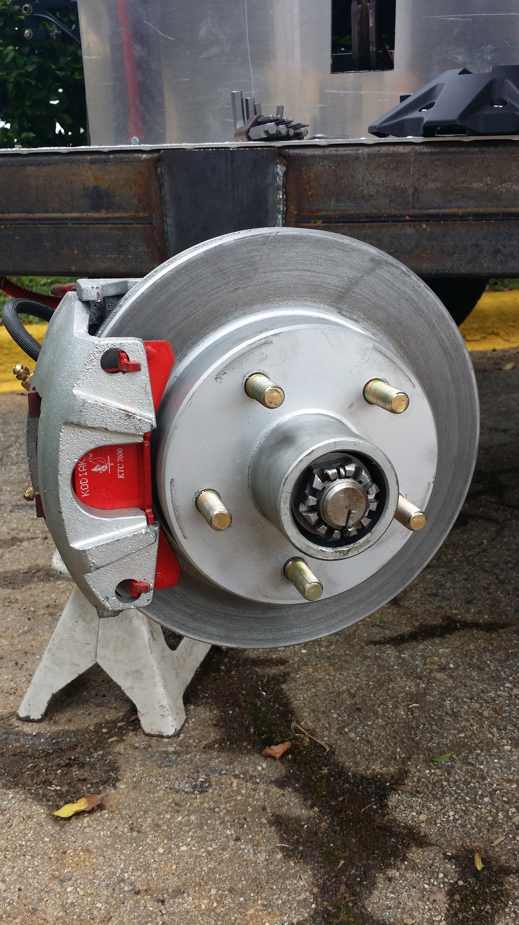
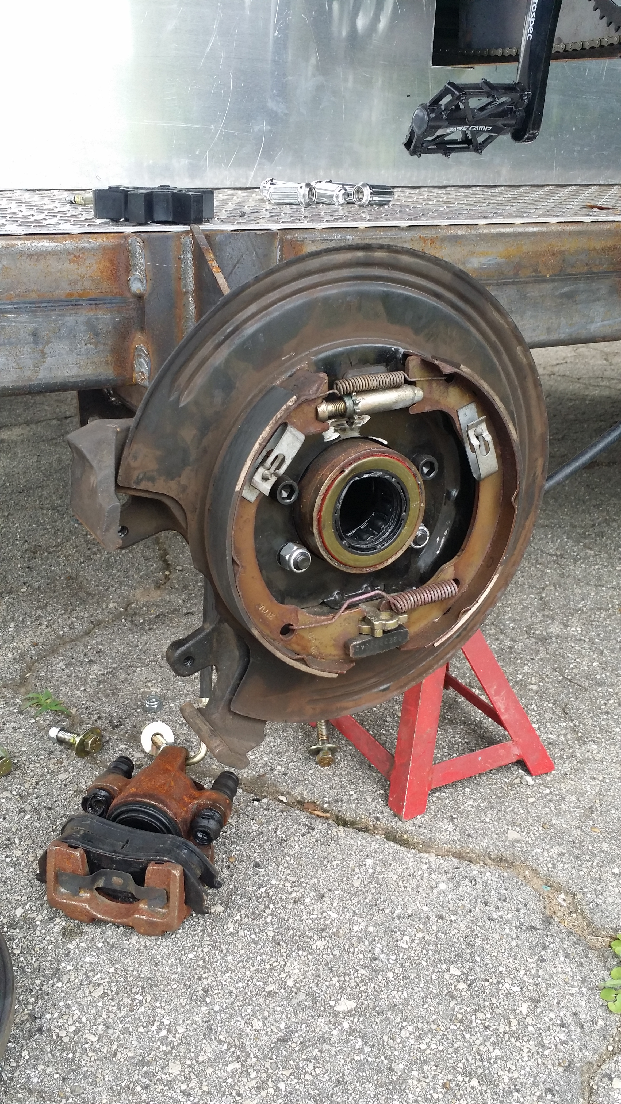
Design Breakdown: Wheels and Brakes
Axle | Brakes | Wheels | Tires | Bolt Patterns
Rolling Front | 10” Hydraulic Disc | 16” | Same | 5 on 4.5”
Rolling Rear | 8” Hydraulic Disc
Towing | 10” Electric Drum
Mounted wheel assembly
Front disk brakes
Electric drum brakes
Break pedal assembly
Team No.22
Slide 16 of 25
Stephen Avery
Final Presentation

Slide 17
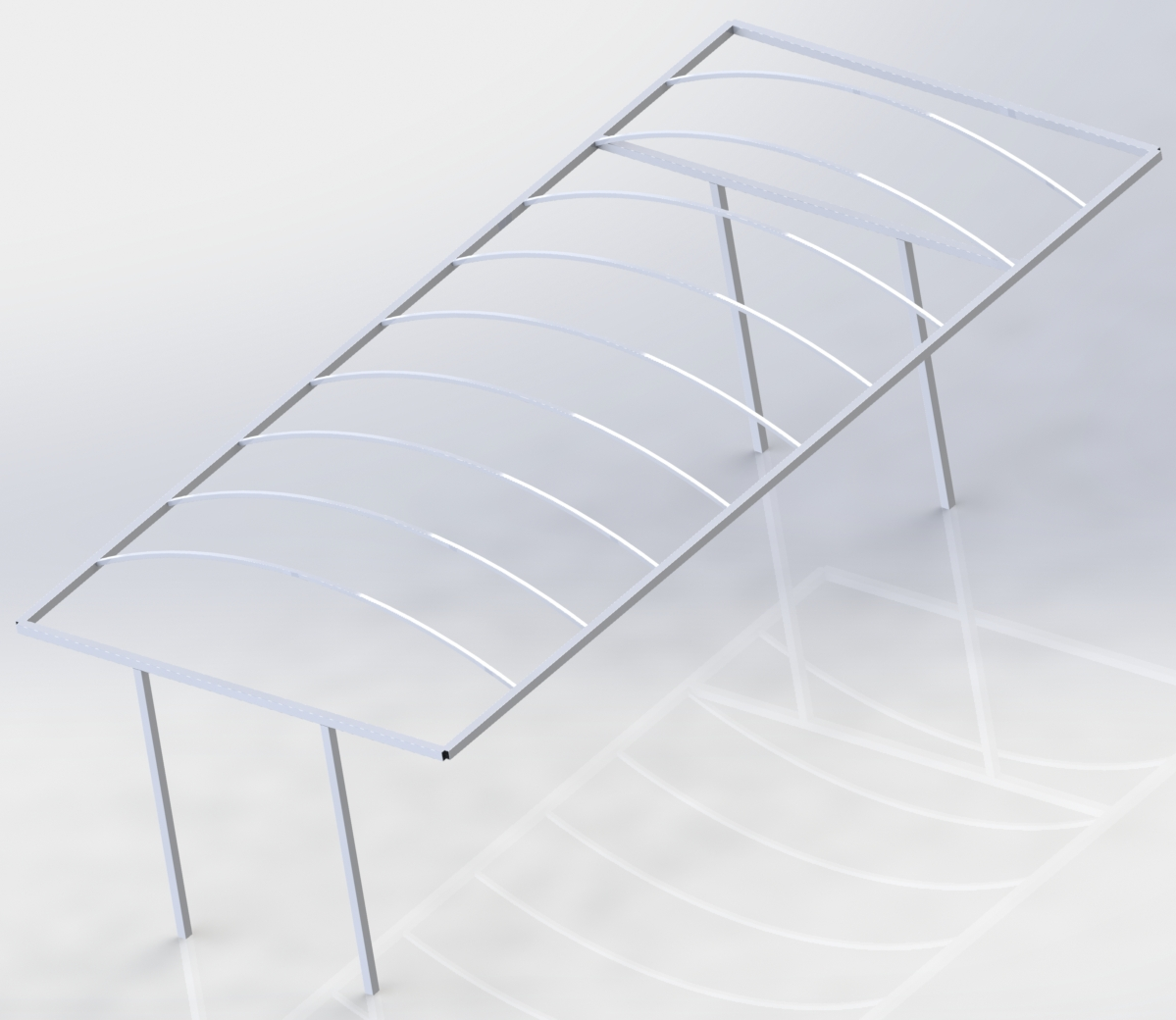
Design Breakdown: Roof Awning
Made by Capital awning Co.
Made of galvanized steel for strength and price
Finished roof assembly
CAD render of roof assembly
Team No.22
Slide 17 of 25
Kyle Anderson
Final Presentation

Slide 18
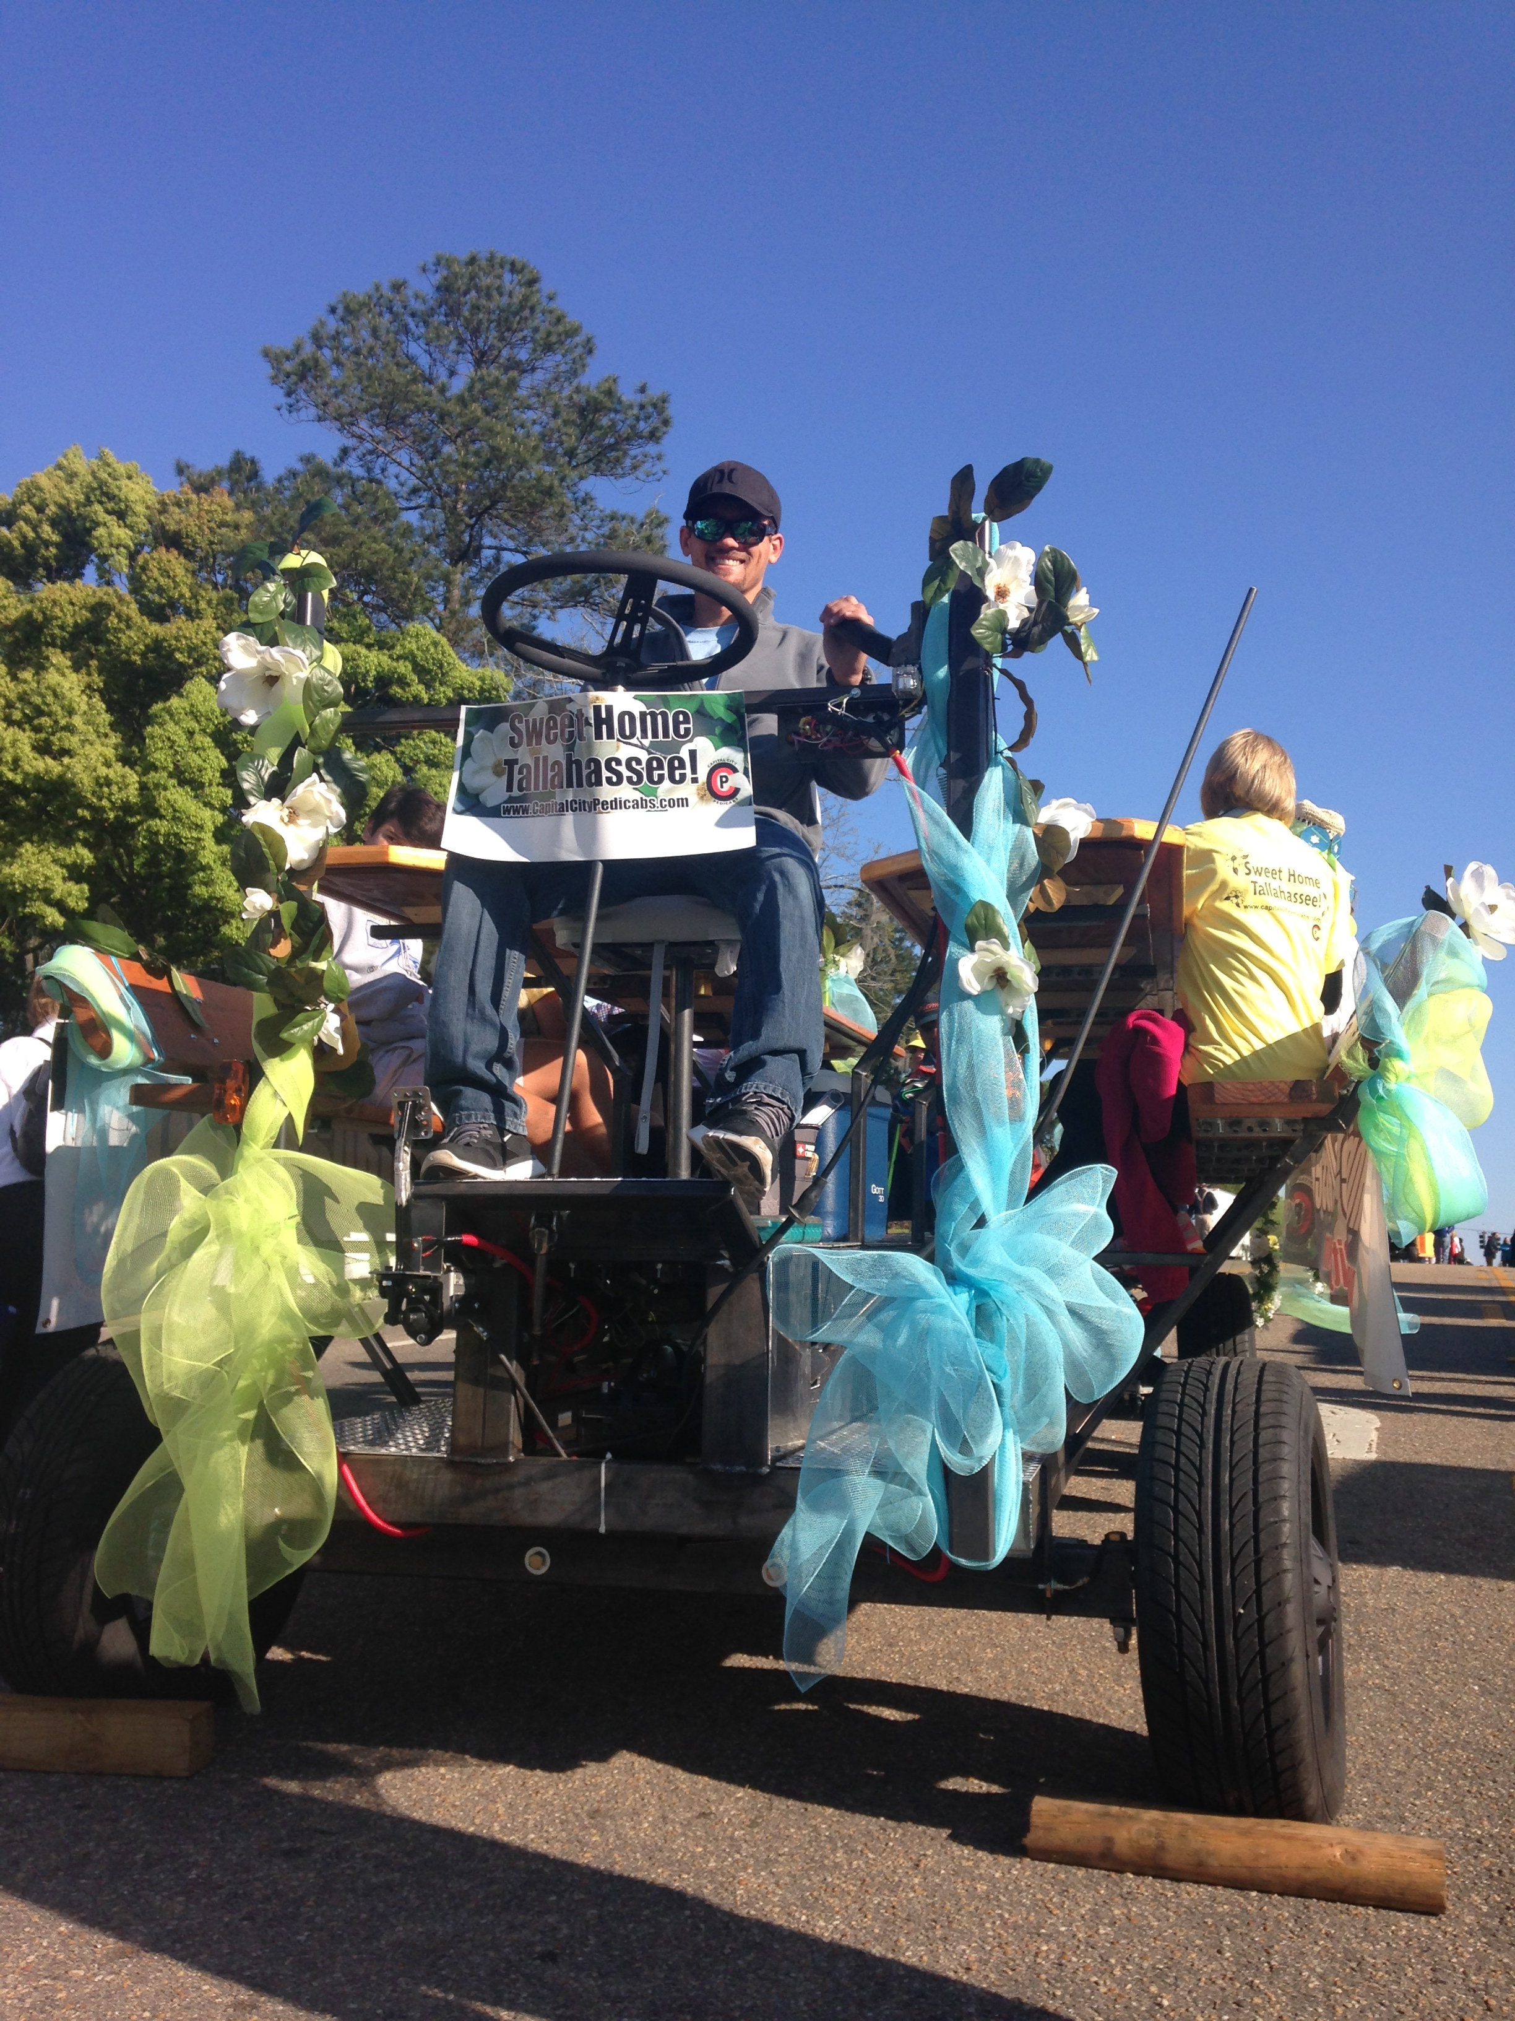
Vehicle Testing
Performance Test | Result
Pedaling performance (movable by single rider) | Pass
Max speed cadence comfort and vehicle reaction | Pass
Hill Climb (8ᵒ grade climb with 10 passengers) | Pass*
Steering testing (ease of steering/curb-to-curb < 45ft) | Pass
Breaking (max speed to full stop < 25ft) | Pass
*Manufacturing mistake caused failure. Has since been repaired.
The proud team captain aboard his ship
Team No.22
Slide 18 of 25
Alejandro San Segundo
Final Presentation

Slide 19
Procurement
All components, including:
  Fabrication materials
  Drivetrain components
Towing components
Bicycle components
Steering components
Driving/Operation components
Have been purchased and received.
Total Spent: $13,550
Total spent as of 4/16/15
Team No.22
Slide 19 of 25
Brett Willenbacher
Final Presentation

Slide 20
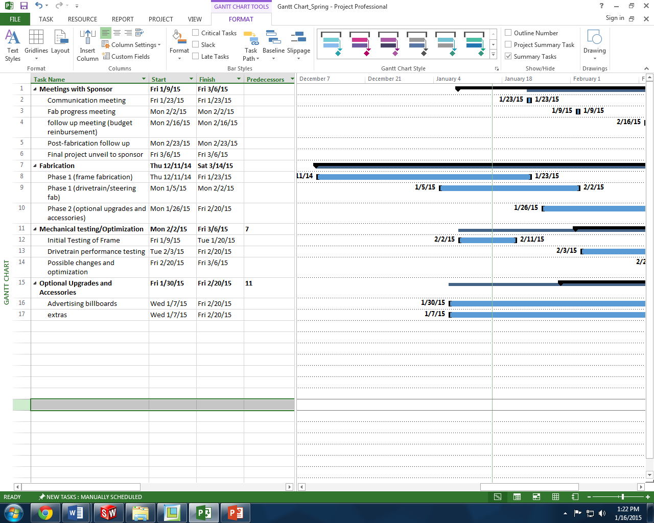
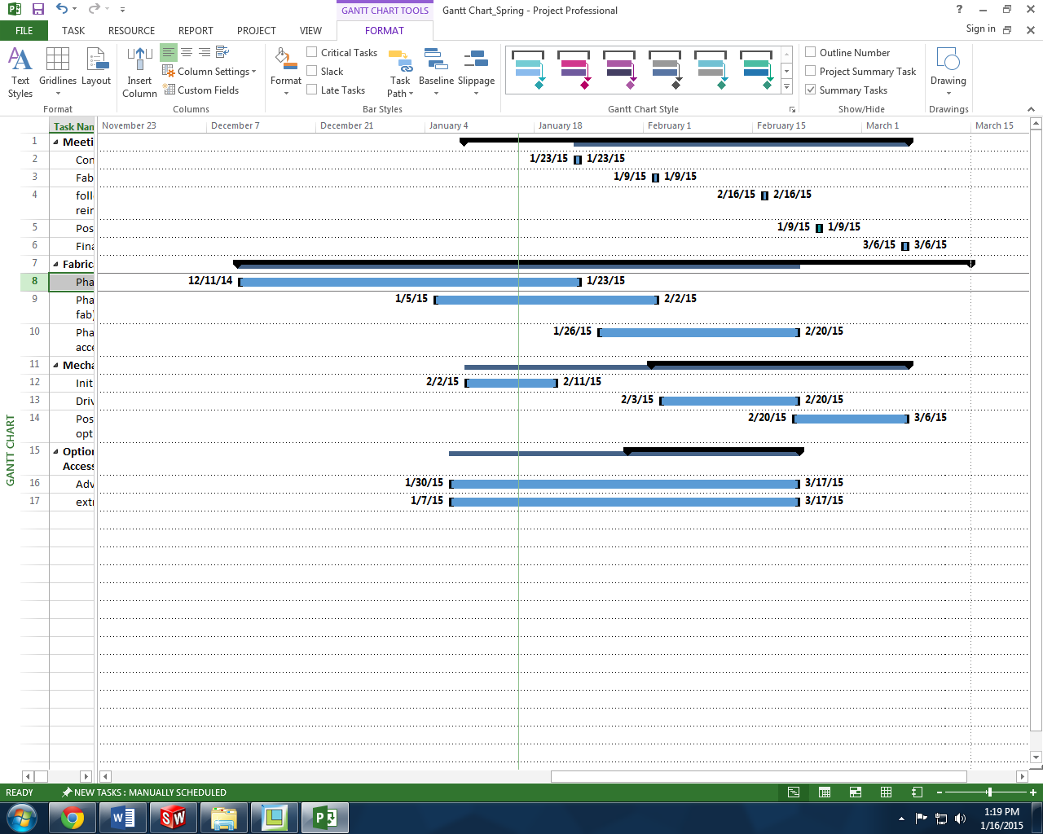
Timeline
**Finished on Time
Team No.22
Slide 20 of 25
Brett Willenbacher
Final Presentation

Slide 21
Project Issues
Problem | Solution
Rear Axle Key Shear Due to Manufacturing Error. | Replace and Re-machine Right Rear Axle
Lack of Emergency Brake | Automotive Parking Brake on Right Rear Axle
Noisy Floorboards | Insulate Panel Edges/Replace Fasteners
Drivetrain Slip | Replace Belt Drive with Chain Drive
Incorrect Final Gear Ratio | Change Lower Sprocket
Frame Over Legal Width | Cut and Lower Bench Seat Back
Insufficient Bar Top to Knee Clearance | Add Spacers to Bar Top Mounts
Poor Driveshaft Component Fit | Replace Driveshafts with Cold Rolled Steel
Team No.22
Slide 21 of 25
Stephen Avery
Final Presentation

Slide 22

Future Considerations
Post Build Suggestions:
Rear Bench
Finish Towing Provisions
Noise Insulation
Paint
Bar Walls
Drink Troughs
Additional Electronics
Fit and Finish
Team No.22
Slide 22 of 25
Kyle Anderson
Final Presentation

Slide 23
Project Take-Away
What was Learned:
Evaluate Man-Power vs. Work Load
Define Technical Requirements
Provide Sufficient Analysis of All Components
Team Communication and Delegation
Customer Involvement
Assign Importance and Priority to Tasks
Sufficient Testing Prior to Implementation
Team No.22
Slide 23 of 25
Stephen Avery
Final Presentation

Slide 24

Summary
Team No.22
Slide 24 of 25
Brett Willenbacher
Final Presentation

Slide 25
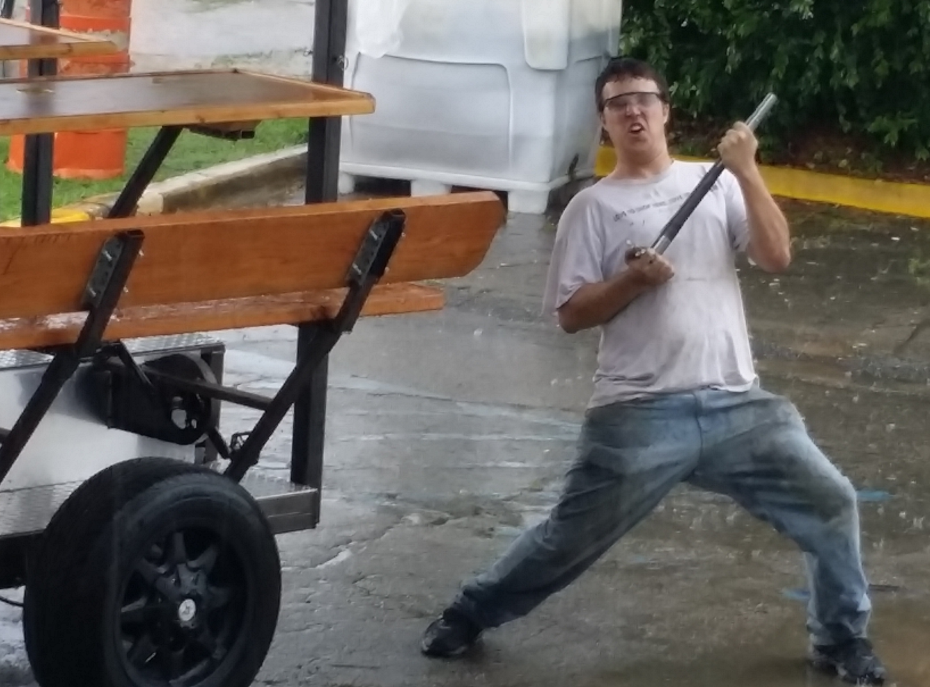
Questions?
Team No.22
Slide 25 of 25
Brett Willenbacher
Final Presentation

