Slide 1



The Gopher Tortoise Scope
Sponsored by
Kim Sash &
The Tall Timbers Research Station and Land Conservancy
In partnership with
Dr. Gupta, Dr. Shih, Dr. Clark, Dr. Harvey, Dr. Frank &
The FAMU-FSU College of Engineering
Presented by
Jane Bartley, ME (team leader)
Lester Nandati, Lead ME
Colin Riley, Lead EE
Also featuring
Bridget Leen, ME
Jordan Muntain, ME
Sina Sharifi-raini, EE
Notes:
JANE

Slide 2
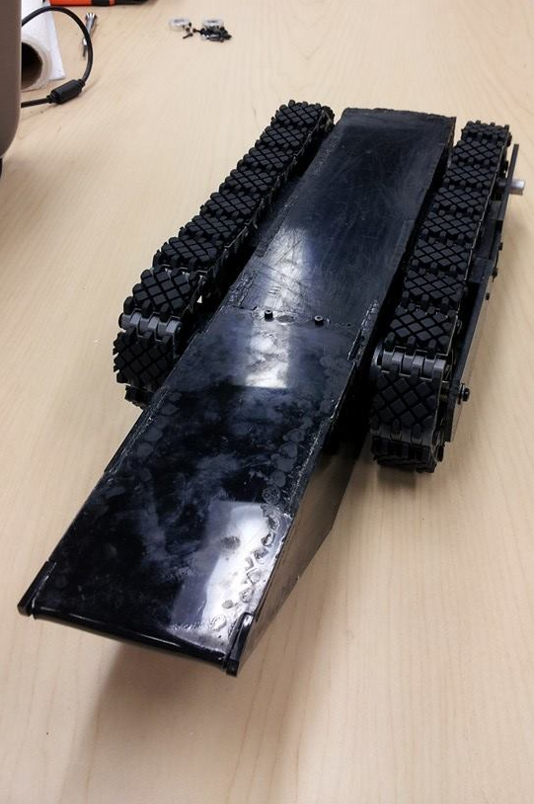
Overview
Background
Subsystems
Project Management
Final Product
Jane Bartley
Notes:
<background
Motivation
Design overview
Project management
Subsystem integration
Final Product
JANE>

Slide 3
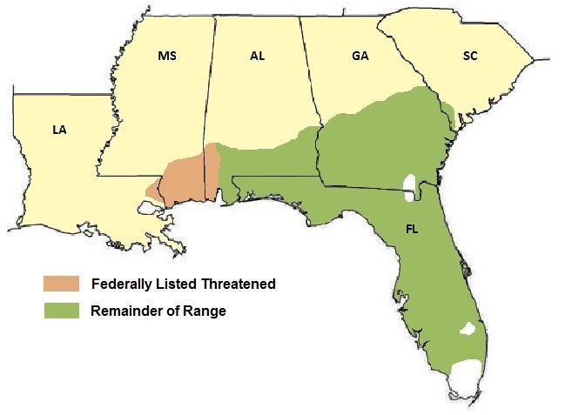
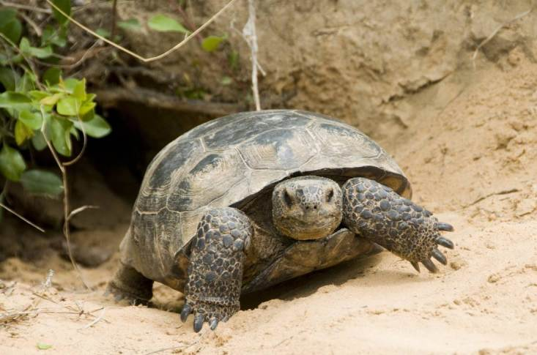
Motivation
Keystone species
Gopher tortoises can create burrows up to 50 ft long
Declining population
Populations statistics are measured using a scope
Figure 1. Gopher tortoise emerging from his burrow. [1]
Figure 2. Gopher tortoise habitat. [2]
Background | Subsystems | Project Management | Final Product
Jane Bartley
Notes:
Bullet pts 2 habitat, foresting
JANE

Slide 4
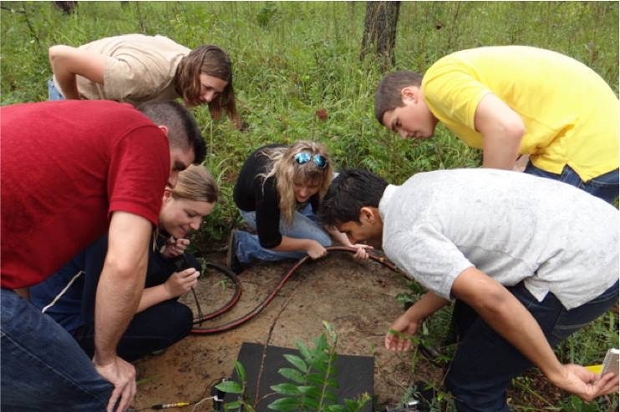
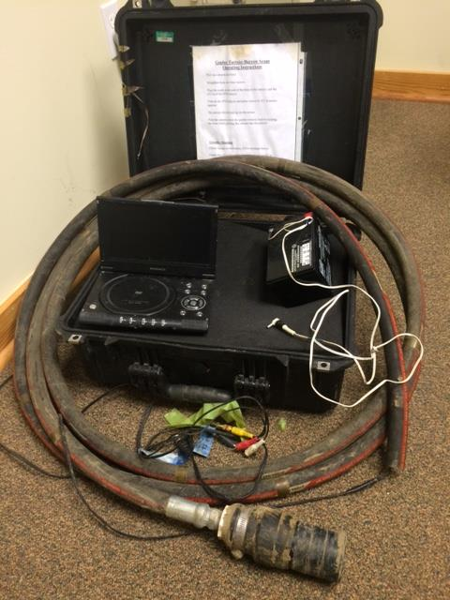
Scoping Process
Burrow conditions
  Wet and muddy
  Cramped with poor visibility
Current scope
  Hard to maneuver down the burrow
  Limited capability
  Not weather resistant
User Interface
Figure 3. Difficulties with current scoping method.
Scope
Background | Subsystems | Project Management | Final Product
Jane Bartley
Figure 4. Tall Timbers’ current gopher tortoise scope
Notes:
Have to bend down to see
JANE

Slide 5
Specifications
Primary
Secondary
Tertiary
Uses infrared camera
Weighs less than 40 lbs
Measures less than 4 in x 6 in x 10 in
Costs less than $1000 to duplicate
Splash proof
Capable of 8 hours of operation
Temperature and humidity data
Video and image capturing
GPS
Background | Subsystems | Project Management | Final Product
Jane Bartley
Notes:
LESTER

Slide 6
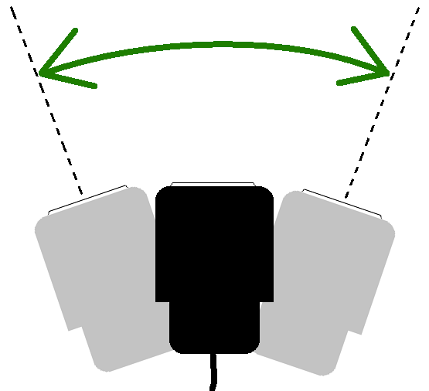
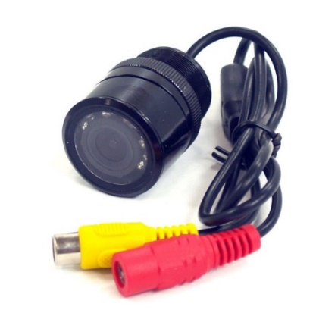
Camera System
Stand-alone IR camera
  7 Infrared LEDs
  Wide angle lens
  680p x 420p
  420 fps
Versatility
  Custom build housing
  Compact and affordable
  Panning system with 80° span
Stand-alone IR camera
  7 Infrared LEDs
  Wide angle lens
  680p x 420p
  420 fps
Versatility
  Custom build housing
  Compact and affordable
  Panning system with 80° span
Figure 5. Wide View infrared camera. [3]
Figure 5. Wide View infrared camera. [3]
Background | Subsystems | Project Management | Final Product
Lester Nandati
Notes:
<component determination>
Under Control functionality
-Dictate panning system
-Easier to modif
LESTER

Slide 7
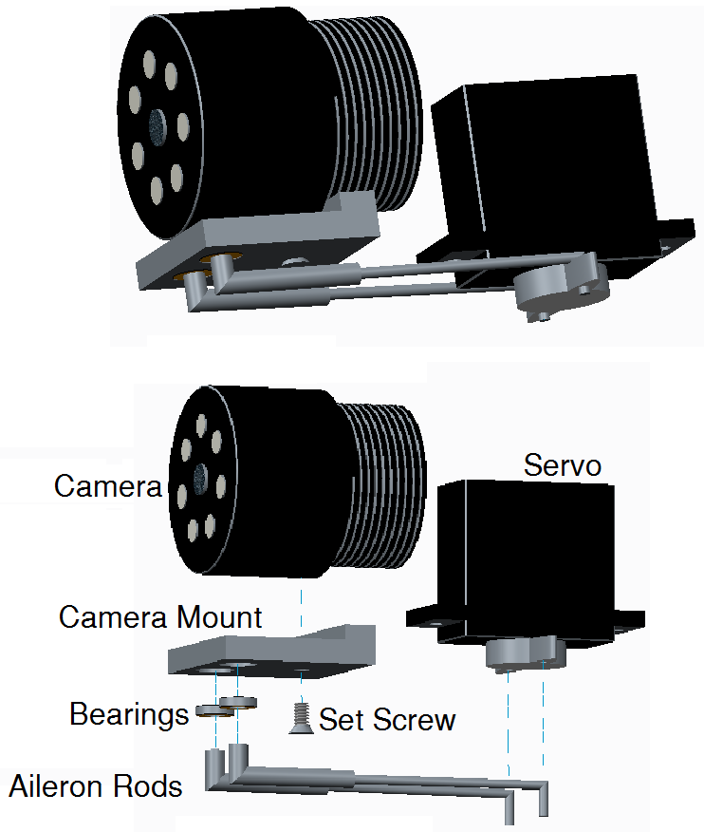
Camera Panning
Aileron system design
  Panning only
  Simpler and more compact
System is placed inside the rover so that the camera is in front of the tracks
Figure 6. Camera pan assembly.
Background | Subsystems | Project Management | Final Product
Lester Nandati
Notes:
JANE
-Should I mention the visibility through the side walls?

Slide 8
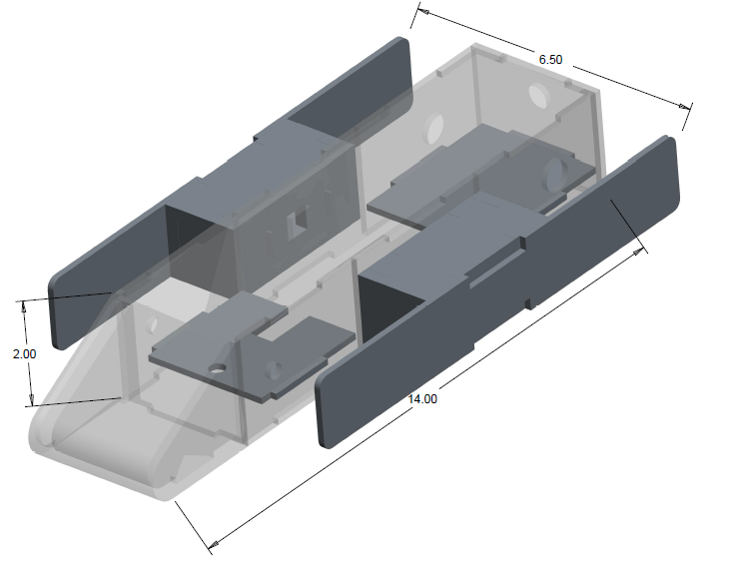
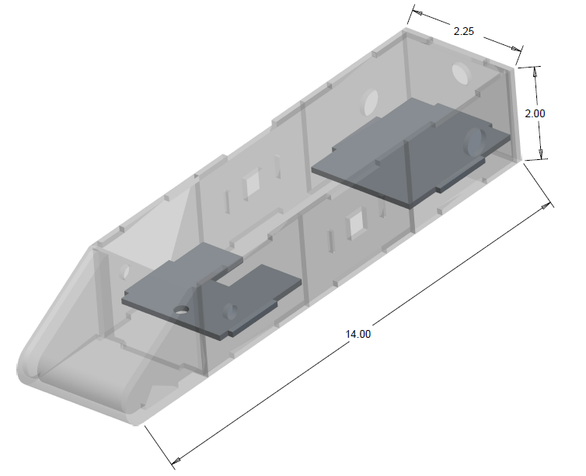
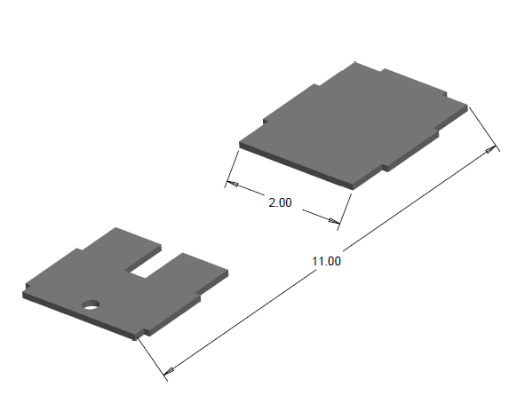
Body Development
Planar Chassis
Casing
  0.125 inch IR transmitting Plexiglas
  Angled front shield
Side boxes
  Temperature sensitive components
  Additional room
  Bearing and axle support
Planar Chassis
Casing
  0.125 inch IR transmitting Plexiglas
  Angled front shield
Side boxes
  Temperature sensitive components
  Additional room
  Bearing and axle support
Planar Chassis
Casing
  0.125 inch IR transmitting Plexiglas
  Angled front shield
Side boxes
  Temperature sensitive components
  Additional room
  Bearing and axle support
Figure 7. Stages of body casing.
Background | Subsystems | Project Management | Final Product
Lester Nandati
Notes:
LESTER

Slide 9
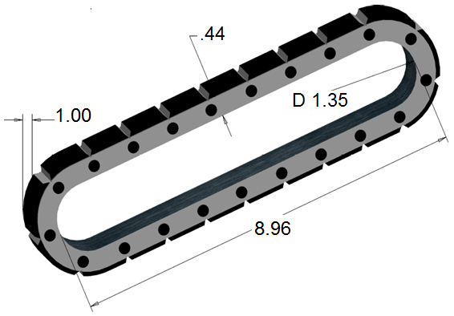
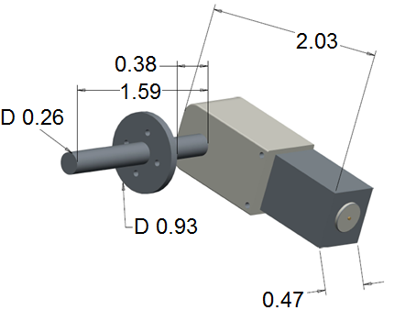
Locomotion
Treads
  Lynxmotion Tracks - Polypropylene/rubber
  Cut width of 2 inch treads in half
90° Gearmotors
  200:1 torque ratio
  Fully enclosed
  Built in clutch
  Machined couplers
Figures 8, 9. Tracks and gearmotors.
Background | Subsystems | Project Management | Final Product
Lester Nandati
Notes:
LESTER

Slide 10
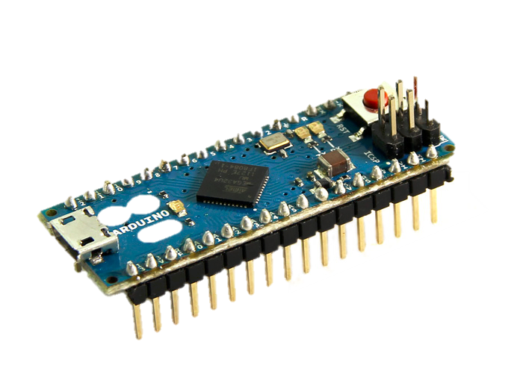
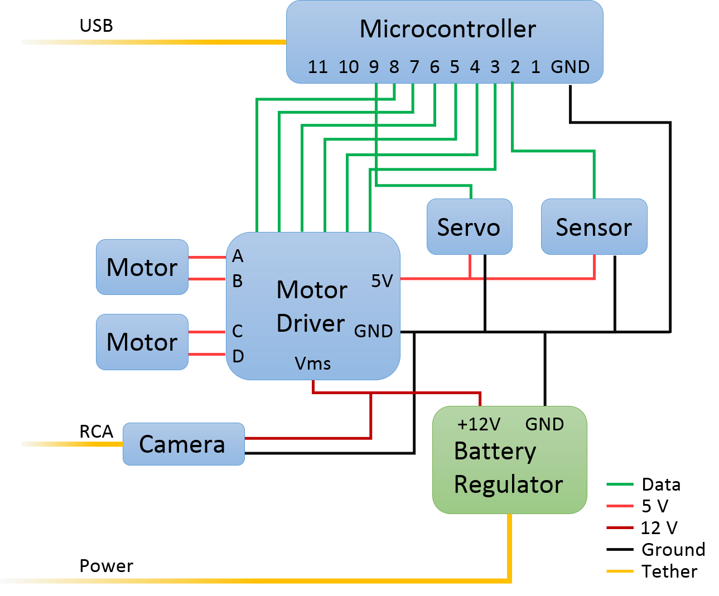
Rover Electronics
Arduino Micro
7 8-bit PWM channels
32 KB flash memory
16 MHz clock speed
USB 2.0 serial communication
1.9 x 0.7 inches
Background | Subsystems | Project Management | Final Product
Colin Riley
Notes:
COLIN

Slide 11
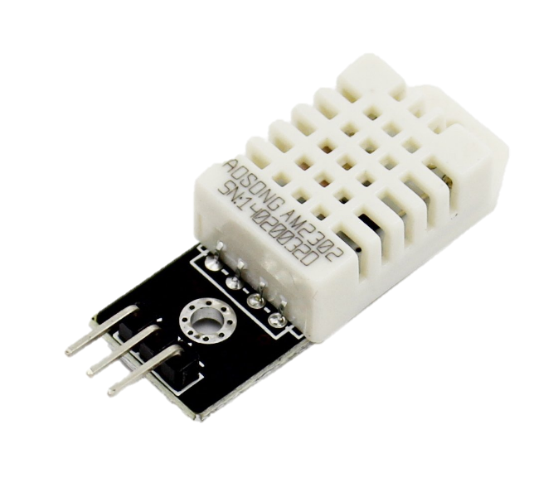
Rover Electronics
DHT22
Relative Humidity from 0% to 100% with ±0.05% accuracy
Temperatures from -45°C to 125°C with ±0.5°C accuracy
Refreshes every 2 seconds
Background | Subsystems | Project Management | Final Product
Colin Riley
Notes:
COLIN

Slide 12
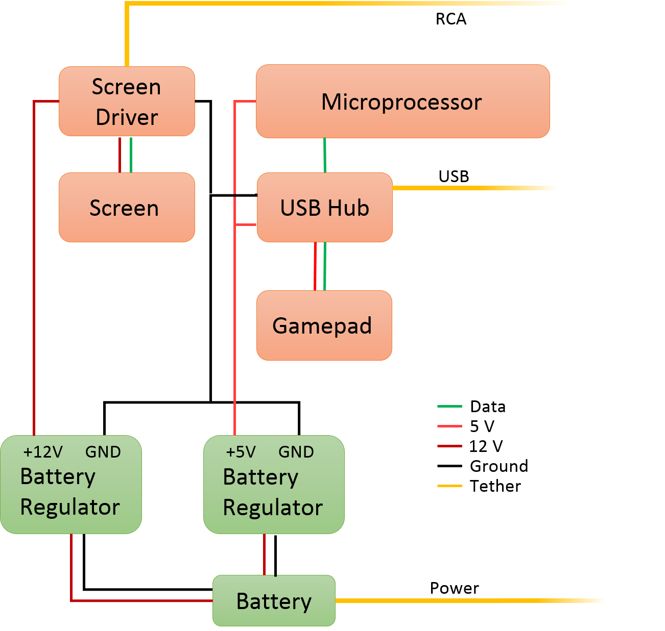
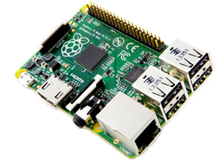
User Interface
Raspberry Pi B+
4 USB 2.0 ports
32 GB micro SD card
ARM 11 CPU
900 MHz clock speed
Background | Subsystems | Project Management | Final Product
Colin Riley
Notes:
COLIN

Slide 13
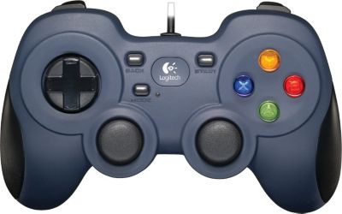
User Interface
Logitech Gamepad
Joystick for intuitive rover control
Directional pad to pan camera
Wired, USB connection
Camera Angle
Shutdown
Rover Motion
Background | Subsystems | Project Management | Final Product
Colin Riley
Notes:
COLIN

Slide 14
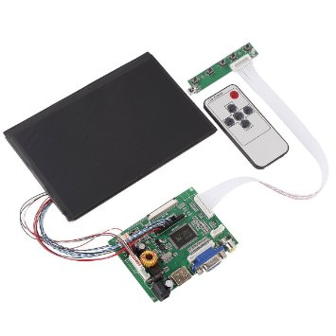
User Interface
Screen and Driver
7 inches
In-plane switching LCD
1280 x 800 pixels
60 frames/second
Background | Subsystems | Project Management | Final Product
Colin Riley
Notes:
COLIN

Slide 15
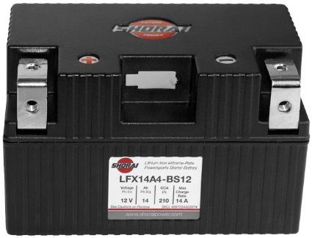
User Interface
Rechargeable Li-ion Battery
13.4 - 9 Volt operating range
2.5 hour battery life
5 hours to recharge
800 cycle expected life
Background | Subsystems | Project Management | Final Product
Colin Riley
Notes:
COLIN

Slide 16
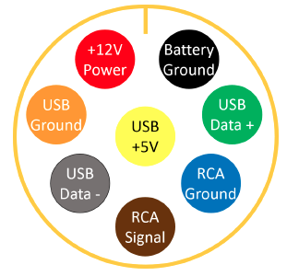
Tether
Features
  Kevlar
  50 ft long
  0.75 in diameter
  Tensile strength- 440 ksi
8-pin waterproof connection
  Secured at rover and at user interface
  Weight: 0.21 lbs
Features
  Kevlar
  50 ft long
  0.75 in diameter
  Tensile strength- 440 ksi
8-pin waterproof connection
  Secured at rover and at user interface
  Weight: 0.21 lbs
Figure 10. Tether internal wiring layout
Background | Subsystems | Project Management | Final Product
Colin Riley
Notes:
JANE

Slide 17
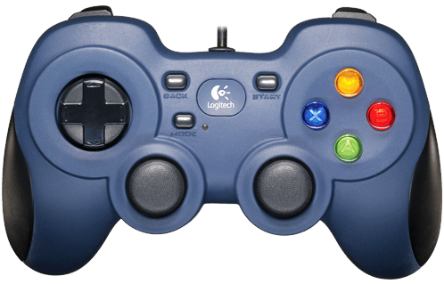
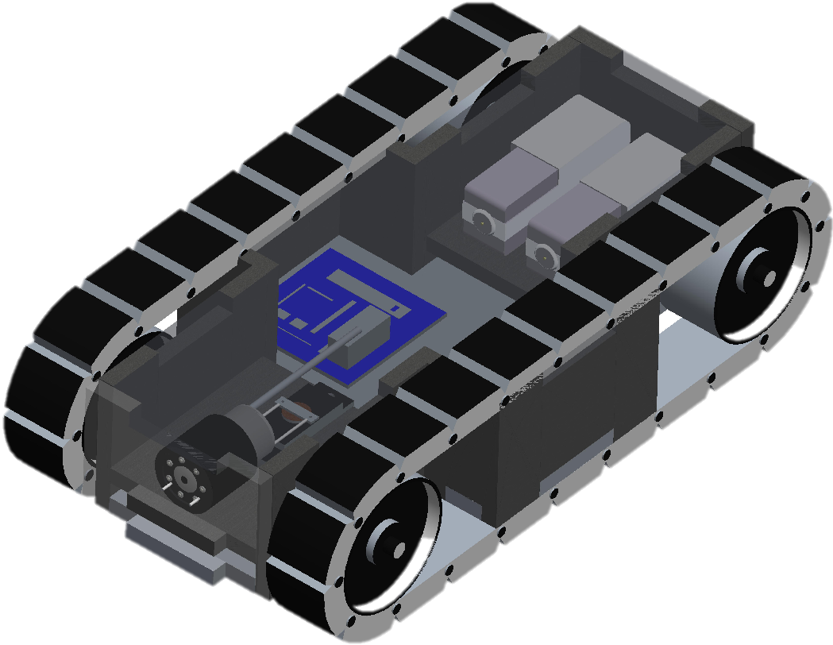
Top Level Design
Small rover carries camera underground
User Interface (UI) displays video and sends gamepad commands
50 foot tether provides
  Power
  Communications
  Video
Battery
User Interface
RCA Video
Above Ground
Active USB
Below Ground
Rover
Data
Power
Background | Subsystems | Project Management | Final Product
Colin Riley
Notes:
Segment pictures with text
COLIN

Slide 18
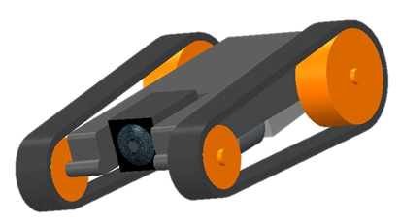
Project Management
Sep-Oct
Nov-Dec
Jan-Feb
Mar-Apr
Prototype designing
  Camera
  Data acquisition
  Chassis body
Procurements
  Motor driver
  IR Camera
  Raspberry Pi B+
$221 spent to date
Figure 11. Initial CAD drawings.
Background | Subsystems | Project Management | Final Product
Jane Bartley

Slide 19
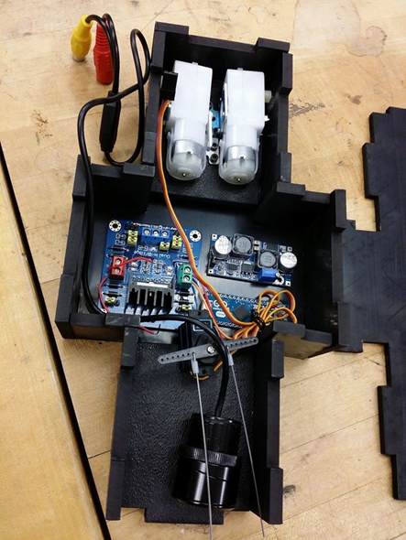
Project Management
Nov-Dec
Sep-Oct
Jan-Feb
Mar-Apr
Final rover design
  Motor selection
  User Interface development
  Subsystems finalized
Procurements
  Gamepad
  ABS and Plexiglass
$474 spent to date
Figure 12. Early prototype with components laid out.
Background | Subsystems | Project Management | Final Product
Jane Bartley

Slide 20
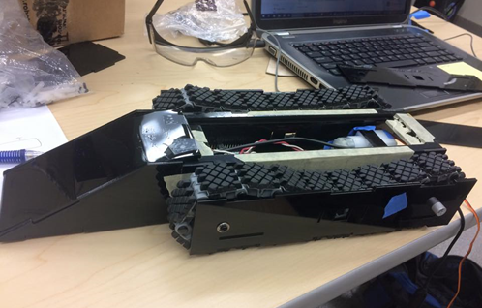
Project Management
Jan-Feb
Nov-Dec
Sep-Oct
Mar-Apr
Prototyping
  Communication testing
  Component housing
  Tether
Procurements
  Tether materials
  Battery and charger
$1169 spent to date
Figure 13. Later, refined prototype.
Background | Subsystems | Project Management | Final Product
Jane Bartley

Slide 21
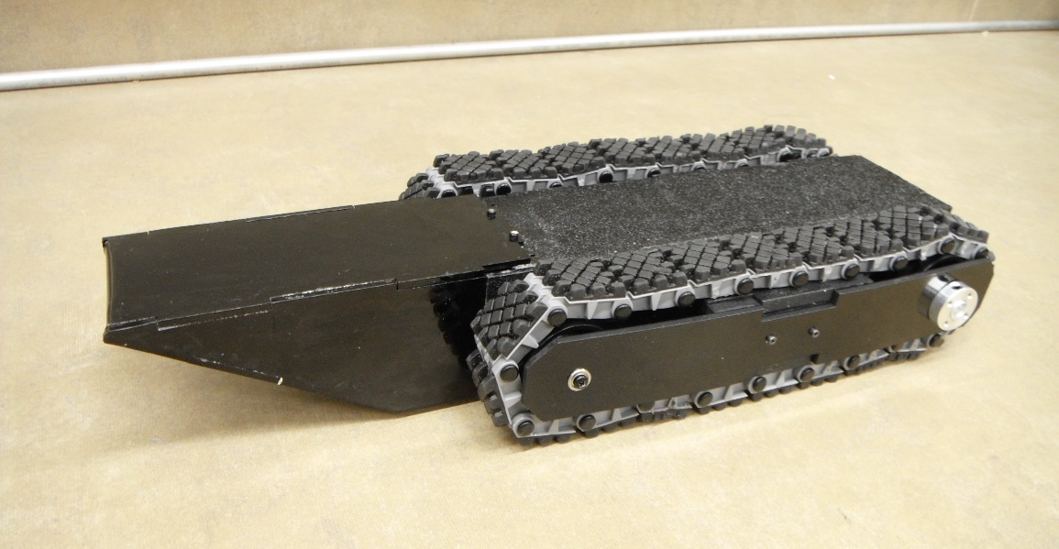
Project Management
Mar-Apr
Nov-Dec
Sep-Oct
Jan-Feb
Final Design
  Assemble and seal
  User interface testing
  Indoor mobility
  Outdoor performance
Procurements
  Pelican casing
$1608 spent to date
Figure 14. Final assembly.
Background | Subsystems | Project Management | Final Product
Jane Bartley

Slide 22
Product Evaluation
Primary
Secondary
Tertiary
Primary
Secondary
Tertiary
Primary
Secondary
Tertiary
Primary
Secondary
Tertiary
Uses infrared camera
Weighs less than 40 lbs
Measures less than 4 in x 6 in x 10 in
Uses infrared camera
Weighs less than 40 lbs
Measures less than 4 in x 6 in x 10 in
Uses infrared camera
Weighs less than 40 lbs
Measures less than 4 in x 6 in x 10 in
Uses infrared camera
Weighs less than 40 lbs
Measures less than 4 in x 6 in x 10 in
Costs less than $1000 to duplicate
Splash proof
Capable of 8 hours of operation
Costs less than $1000 to duplicate
Splash proof
Capable of 8 hours of operation
Costs less than $1000 to duplicate
Splash proof
Capable of 8 hours of operation
Costs less than $1000 to duplicate
Splash proof
Capable of 8 hours of operation
Temperature and humidity data
Video and image capturing
GPS
Temperature and humidity data
Video and image capturing
GPS
Temperature and humidity data
Video and image capturing
GPS
Temperature and humidity data
Video and image capturing
GPS
Background | Subsystems | Project Management | Final Product
Lester Nandati
Notes:
LESTER

Slide 23

The GT Cruiser
Background | Subsystems | Project Management | Final Product
Lester Nandati
Notes:
COLIN

Slide 24
Product Expansion
Possibilities of adding or removing features
  Ability to scope smallest burrows
    Lower cost
    Reduction of features
  Comprehensive features
    Expensive
    Large
  Ability to scope smallest burrows
    Lower cost
    Reduction of features
  Comprehensive features
    Expensive
    Large
  Ability to scope smallest burrows
    Lower cost
    Reduction of features
  Comprehensive features
    Expensive
    Large
Affordable rover with appropriate functionality and durability
Background | Subsystems | Project Management | Final Product
Lester Nandati
Notes:
LESTER

Slide 25
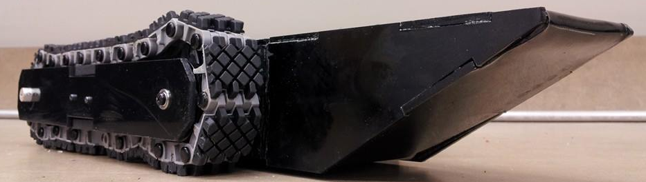
Questions?
For more information go to:
http://eng.fsu.edu/me/senior_design/2015/team21/index.html
References
[1] "Gopher Tortoise - Meryman Environmental." Gopher Tortoise. Meryman Environmental, 2015. Web. 14 Apr. 2015. <http://merymanenvironmental.com/gopher-tortoise/>.
[2] "Gopher Tortoise Council." About the Gopher Tortoise. Gopher Tortoise Council, 2015. Web. 14 Apr. 2015. <http://www.gophertortoisecouncil.org/about-the-tortoise/>.

Slide 26
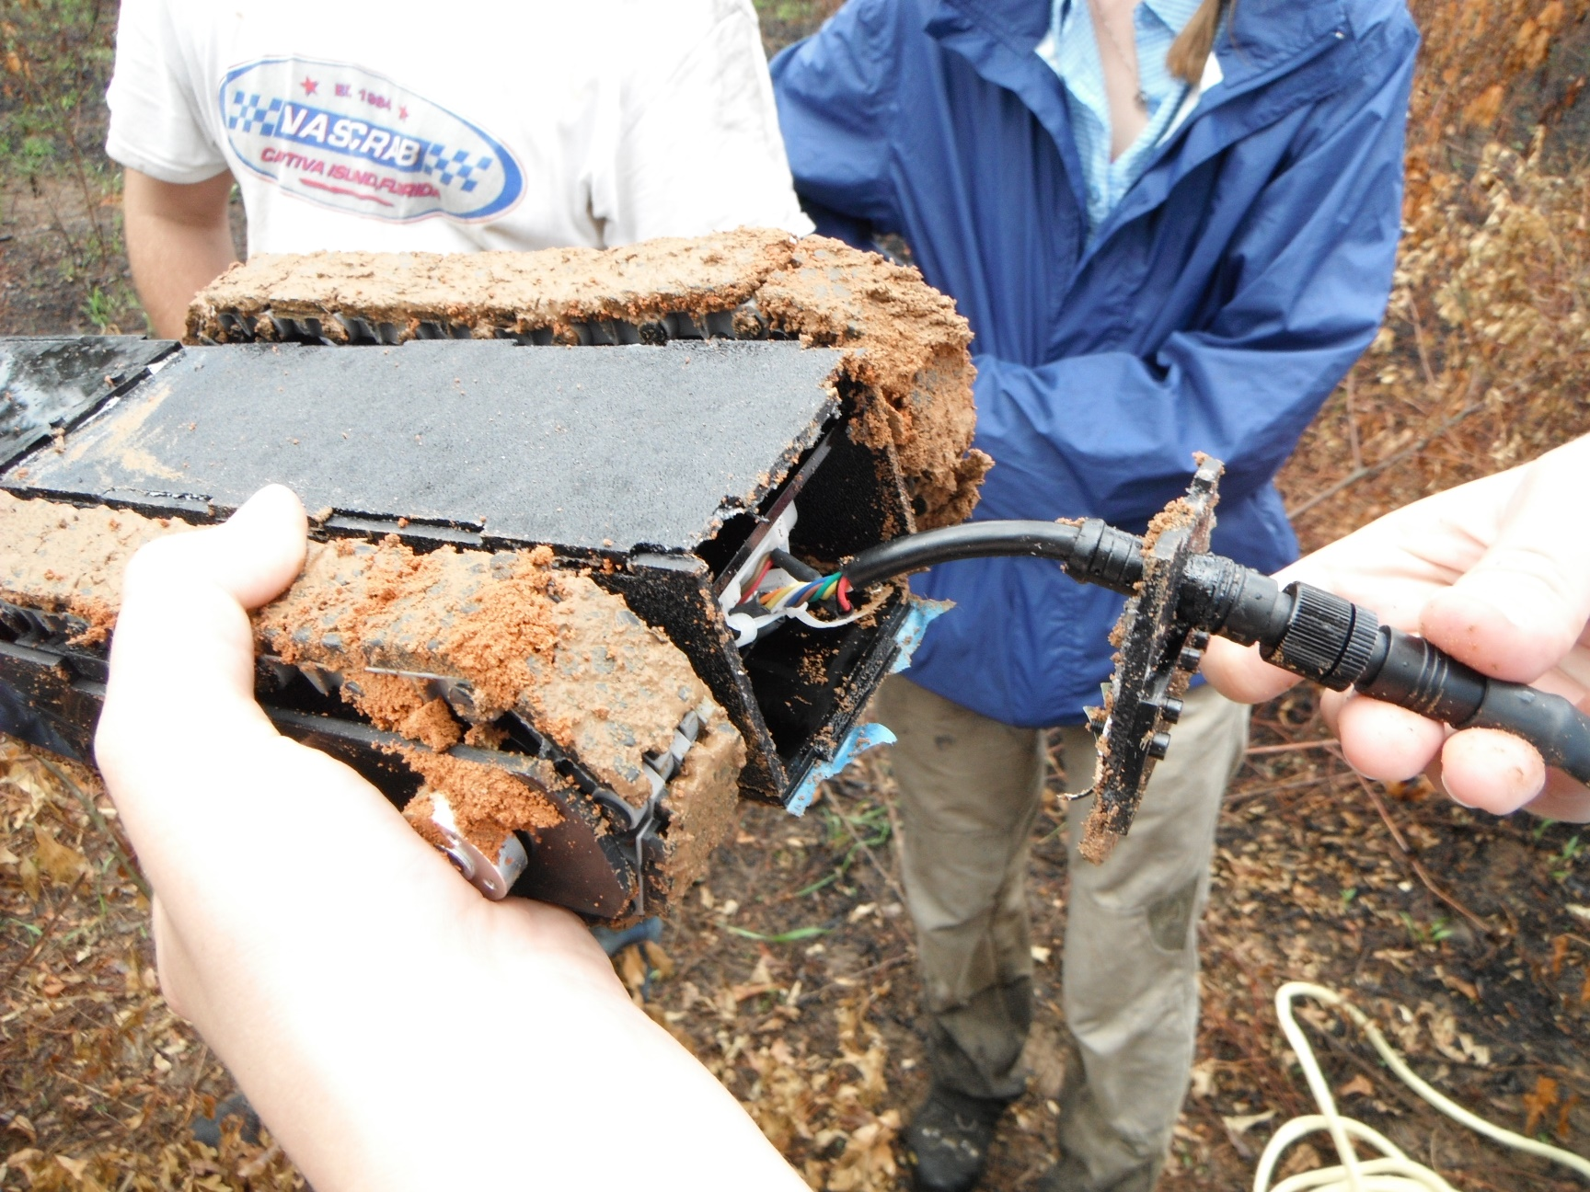
Appendix

