Slide 1
Prototype Machine for Coating Stabilized Lithium Metal Powder
Team #16 Marcos Leon, John Magner, Vannesa Palomo, Maria Sanchez, John Shaw,
Slide 1 of and Benjamin Tinsley

Slide 2
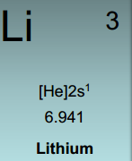
Background Information
For this project, we aim to create a prototypal machine for coating an electrode with a stabilized lithium metal powder.
Our sponsor is General Capacitors Inc.
  Dr. Zheng, founder and chief scientist of General Capacitors, is our main technical advisor.
Stabilized Lithium Metal Powder (or simply SLMP)
  Particle size: <50 Microns

Slide 3
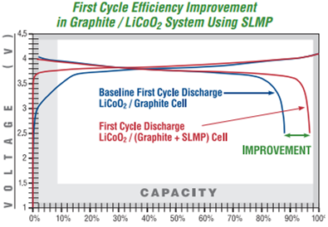
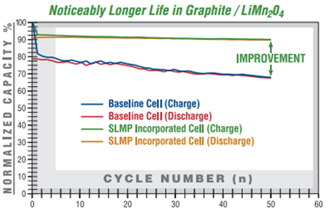
Background Information
We expect for our machine to coat battery electrodes with a uniform layer of SLMP increasing the batteries capacity by 5 to 15%.

Slide 4
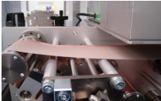
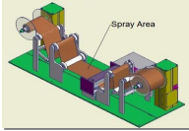
Current Methods
The only current technology available for coating SLMP is a slurry application developed by FMC Lithium
  In this method, the SLMP is mixed into a slurry using a volatile solvent.
  After application of the slurry, the solvent evaporates and leaves a well distributed coat of SLMP.

Slide 5
Constraints
The machine must be able to fit within the dry room.
SLMP is highly flammable and needs to be handled with care.
  Only used in a dry room
  Avoid static build up
Coat the electrode with uniform layer of SLMP
The total coating time must be less than 10 minutes
Must be able to coat variable anode sizes:
  Maximum size of 12 cm wide, 25 cm long
  Minimum size of 5 cm wide, 5 cm long
Our budget is $2000

Slide 6
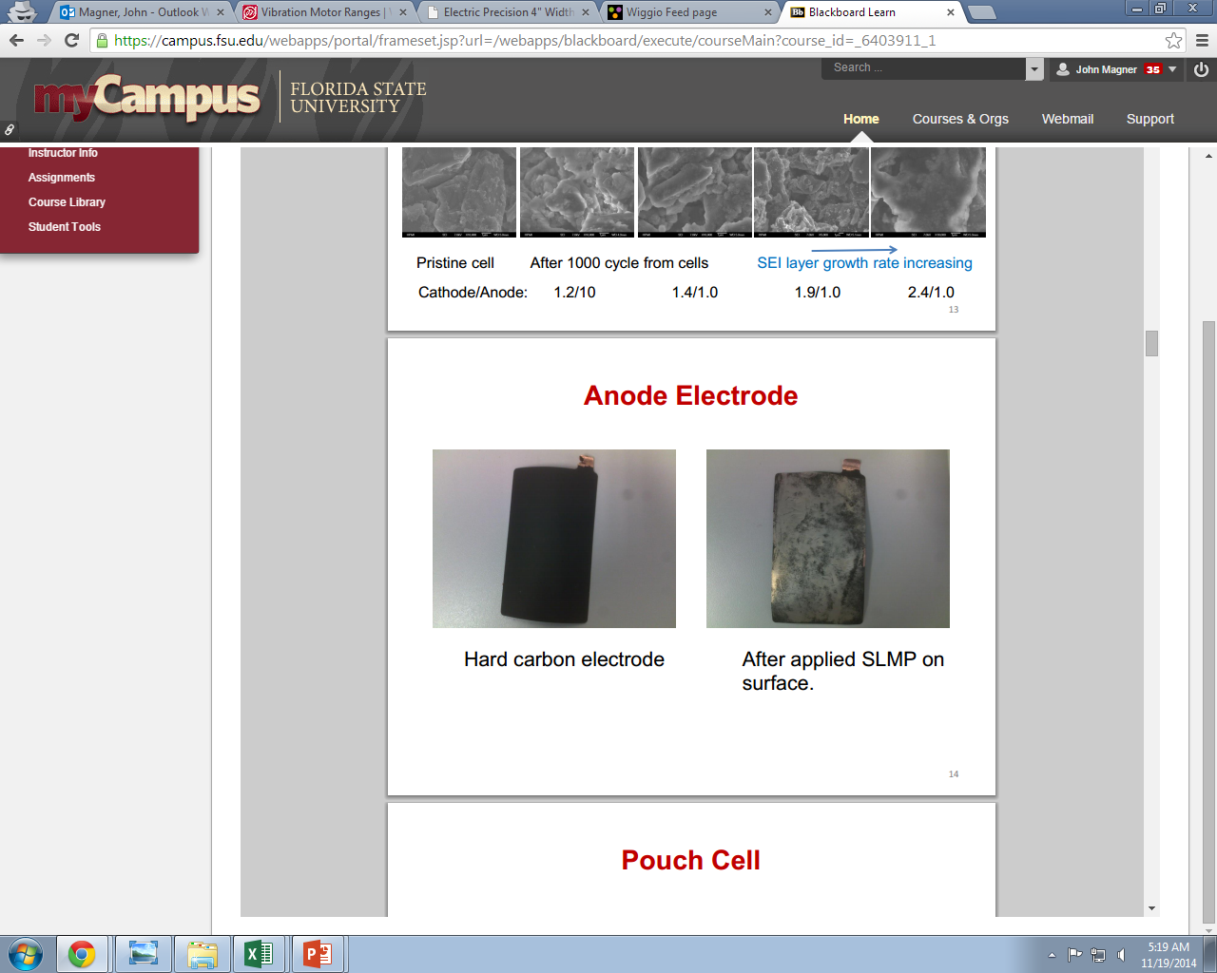
Approach to Problem
Problem Statement:
No prototype machine for this new technology has been created
Goal:
  To create a uniform layer of SLMP on a pre-existing anode
Our approach
    Dry dispersion: Surface application
Hard Carbon Electrode
Electrode with SLMP Applied

Slide 7
Concept of Design
Our design starts with the electrode being placed on a conveyor belt and moving laterally through the machine.
Sensors will be used to determine the area the machine needs to coat and the machine will adjust the width and coating length
The electrode will then travel under the SLMP dispersion system.
  A funnel with a vibrating actuator will dispense a steady flow rate of SLMP as the electrode is moved back and forward through the machine 5 times.
Once coated the electrode will travel through press rollers.
  These are set to a constant pressure and will crush the protective layer of lithiated carbon to activating the stabilized lithium and press the lithium onto the electrode.

Slide 8
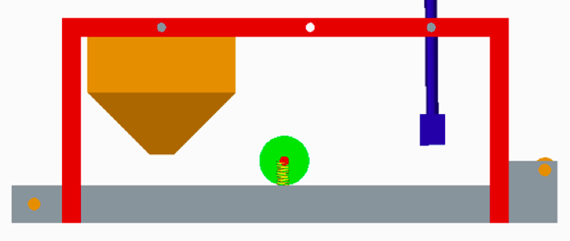
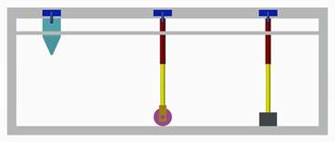
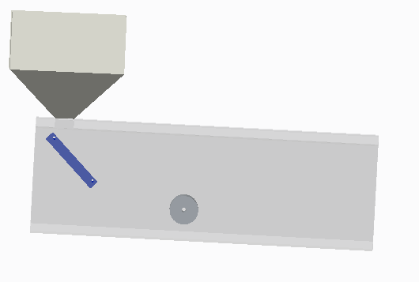
Initial Designs
Our design starts with the electrode being placed on a conveyor belt and moving laterally through the machine.
Sensors will be used to determine the area the machine needs to coat and the machine will adjust the width and coating length
The electrode will then travel under the SLMP dispersion system.
  A funnel with a vibrating actuator will dispense a steady flow rate of SLMP as the electrode is moved back and forward through the machine 5 times.
Once coated the electrode will travel through press rollers.
  These are set to a constant pressure and will crush the protective layer of lithiated carbon to activating the stabilized lithium and press the lithium onto the electrode.
Design #1
Design #2
Design #3

Slide 9
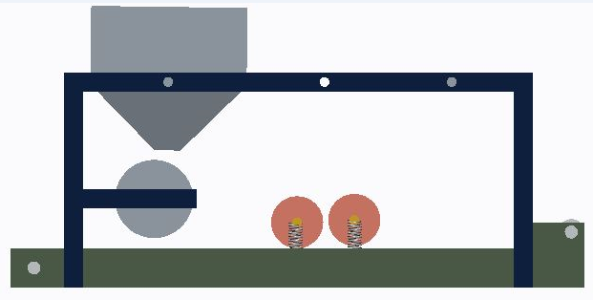
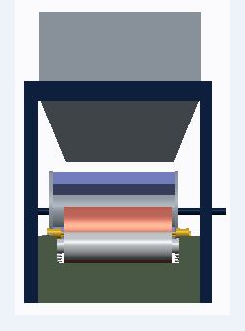
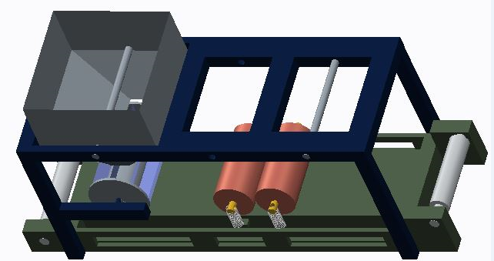
Rotary Metering Roller Design
This design uses a rotary metered roller to collect equal amounts of SLMP from a storage trough and dump it on the electrode as it rotates.
Reason for change
  Unsure if this design will improve uniformity
  This metered roller complicates the machine
  The press rollers are unnecessary since Dr. Zheng is providing us the Electric Precision 4” width Rolling Press with Dual Micrometer
Front View
Angled Aerial View
Side View

Slide 10
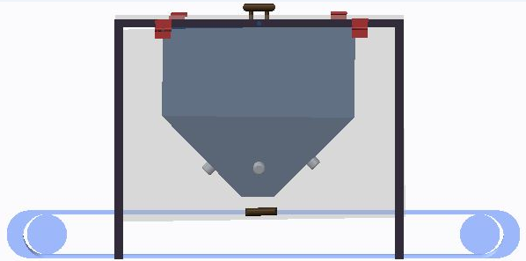
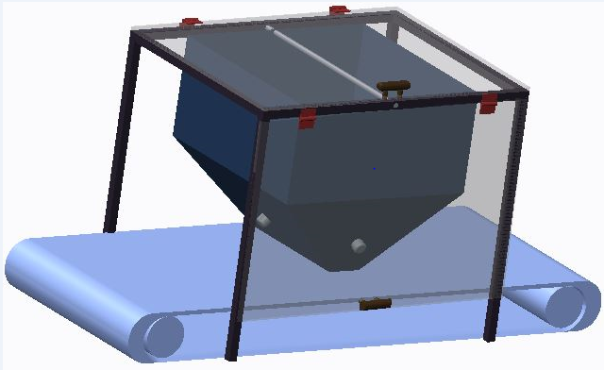
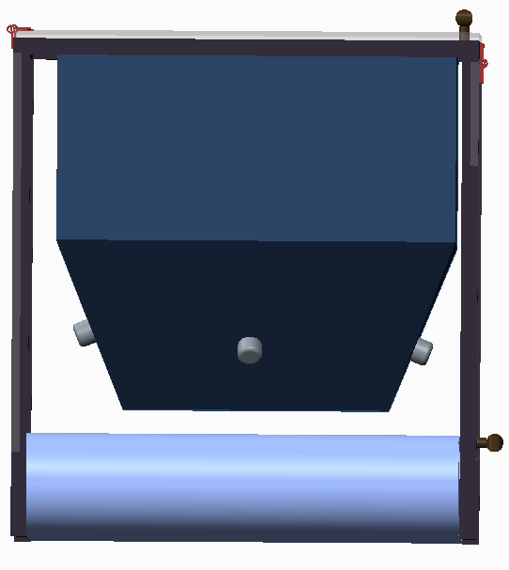
Current Design
This design consists of a precision move conveyor belt, a metal frame, plexiglass covering, a funnel, a screw mixer, actuators, and meshes.
It has eliminated the pressing rollers, the punch, and the rotary metering roller.
  After speaking to our sponsor these components were either deemed as implausible solutions or unnecessary.
  Added a starting line to place electrode when beginning coating
  Added a plexiglass outer shell
  removed milling gear
  removed punch and press rollers from our design
Front View
Angled Aerial View
Side View

Slide 11

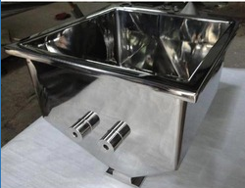


Mechanical Components
Funnel
  SS Fabrication - Square shaped hopper
  SSF - Powder hopper
  Mass flow of the funnel was calculated using the following equation:
    Nomenclature:
      ρ - density of granular material
      g - gravitational acceleration
      L - length of orifice
      B - width of orifice
      d - diameter of granular material
    This calculation is valid for free flow of granular materials
For a 12cm x 3cm orifice modeled by our current design:
Assuming the restricted mass flow will be 5% of freeflow:
SSF square hopper

Slide 12
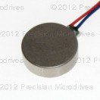
Mechanical Components
Vibration Actuator
  Dura Vibe 10mm Brushless Vibration Motor - 3mm Type
  Precision Haptic 10mm Linear Resonant Actuator - 4mm Type
    http://www.precisionmicrodrives.com/vibrating-vibrator-vibration-motors
Dura Vibe Brushless Vibration Motor

Slide 13
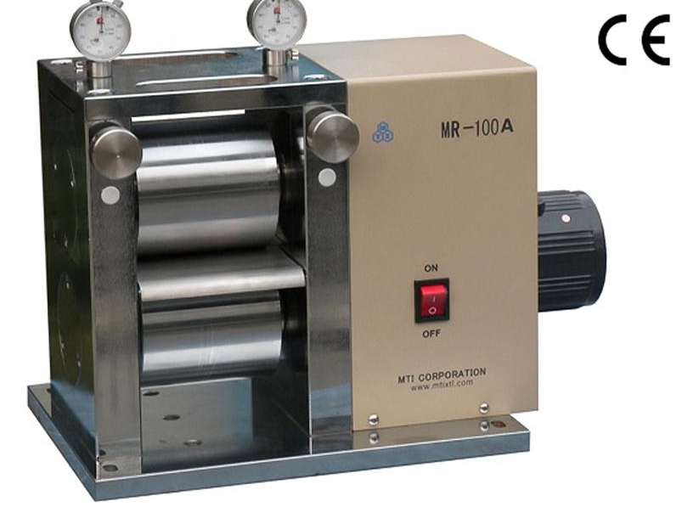
Mechanical Components
Conveyor belt
  Will consist of the two motor driven rollers and a belt
    Selection: Precision move conveyor belt
    Belt material: silicon rubber
      Manufacturer: Dorner
  Size:
    90 cm long
    13 cm wide
Electric Precision 4” width Rolling Press
with Dual Micrometer
  Supplied by our sponsor and liaison, Dr.Zheng.
  Manufactured by MTI Corporation
Electric Precision 4” width Rolling Press with Dual Micrometer

Slide 14
Mechanical Components
Meshes
Will be used to sift through SLMP to avoid particle agglomeration and to ensure a constant flow rate of SLMP being dropped onto anode
To find the correct mesh count the following equation was used:
PS= (1/MC) + tw
PS= particle size
MC=Mesh count
tw= thickness of wire
To calculate open area percentage the following equation was used:
% Open Area= (Opening size  Mesh Count)² x 100

Slide 15
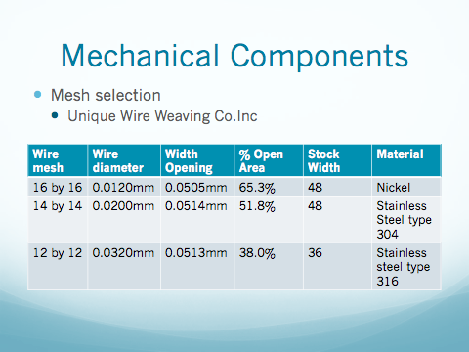
\

Slide 16
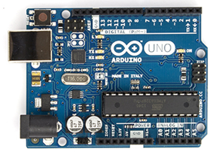
Electrical Component Selection
MCU - Arduino Uno R3 Microcontroller
This MCU will be the “brains” of the operation by:
  Controlling the motors
  Analyzing feedback from sensors
  Allowing for on/off switch to power the machine
Technical Specifications
  Input Voltage: 7-12V
  Digital I/O Pins: 14
  PWM Digital I/O Pins: 6
  Flash Memory: 32 Kb
  Clock Speed: 16 MHz
  Stackable allowing for more I/O Pins
  Capable of being powered by a USB connection
from an AC to 12 VDC converter.
Arduino Uno R3 Front View

Slide 17

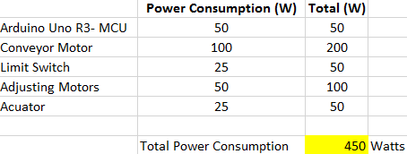
Electrical Components Continued
(2) 12V DC 30 RPM HOSSEN® motors for conveyor belt.
(2) 12V DC motors to allow for variable coating width.
(2) Limit Sensors to determine electrode size and coating area.
On/off Switch.
Character Display to communicate with user
12 key - keypad
A 1000W (Corsair RM1000) power supply will be needed to supply power.

Slide 18
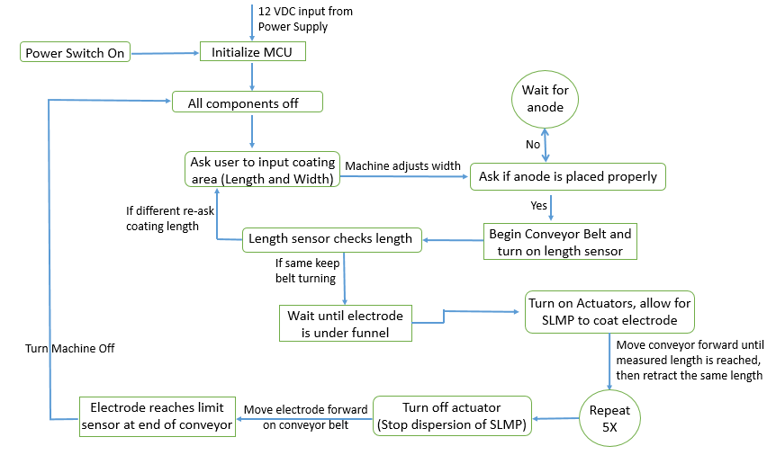
Flow Chart

Slide 19
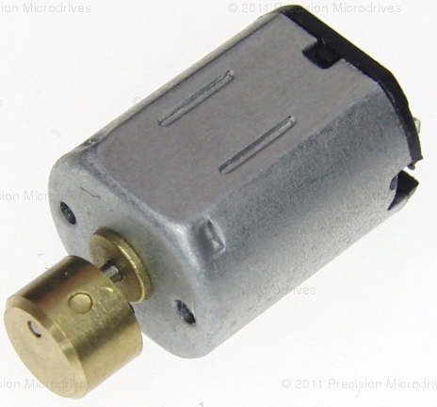
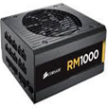
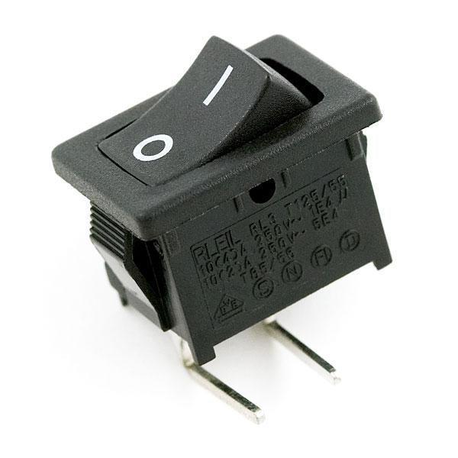
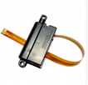

Final design Budget and component selection
Photo | Product | Manufacturer | Price | Material
 | Funnel
 | Meshes | Unique wire weaving Co. Inc
 | Conveyor Belt | Dorner or Bastian solutions
 | Actuator | Precision Motors
 | Press Roller | MTI Corporation | $3,498.00
 | Microcontroller | Arduino Uno R3 | $25.00
 | Power supply | Corsair RM1000 | $200.00
 | Switch | Sparkfun: SPST Rocker Switch | $1.00
 | Limit Sensor | PQ12 Limit Switch | $50.00
 | Motors | Hossen 12V DC | $13.98

Slide 20
Budget
Arduino Uno R3- MCU | 1 | $ 29.95 | $ 29.95
Conveyor Motor | 2 | $ 13.98 | $ 27.96
Limit Switch | 2 | $ 65.00 | $ 130.00
Adjusting Motors | 2 | $ 10.00 | $ 20.00
Switch | 1 | $ 1.00 | $ 1.00
1000 W Power Supply | 1 | $ 200.00 | $ 200.00
Conveyor Belt | 1 | $ 15.00 | $ 15.00
Wiring/ Connectors | 1 | $ 35.00 | $ 35.00
14 GA. Stainless Steel | 1 | $ 200.00 | $ 200.00
Table for Conveyor Belt | 1 | $ 100.00 | $ 100.00
Trough Funnel | 1 | $ 40.00 | $ 40.00
Meshes | 3 | $ 20.00 | $ 60.00
Actuator | 2 | $ 15.00 | $ 30.00
Hinges | 4 | $ 4.00 | $ 16.00
Plexiglass | 2 | $ 25.00 | $ 50.00
Vibration Damper | 4 | $ 9.00 | $ 36.00
Character Display | 1 | $ 5.00 | $ 5.00
Keypad | 1 | $ 6.00 | $ 6.00
Input Button | 2 | $ 2.00 | $ 4.00

Slide 21
Risks/Uncertainties
Although SLMP is designed not to be pyrophoric there is still a risk of combustion.
  A Copper powder, Graphite, or Lith-X fire hydrant will be needed nearby as a fire cannot be extinguished with water, sand, or carbon dioxide.
SLMP is dusty and if inhaled can cause bodily harm.
  An enclosure will surround the machine to ensure no SLMP escapes machine.
If a static charge is exposed to the SLMP it is capable of combustion.
    Ground all electrical components to prevent static build up.
If a machine malfunctions there are:
  A manual kill switch can be pressed by the operator
  Feedback sensors will turn off the machine if an error is detected.

Slide 22
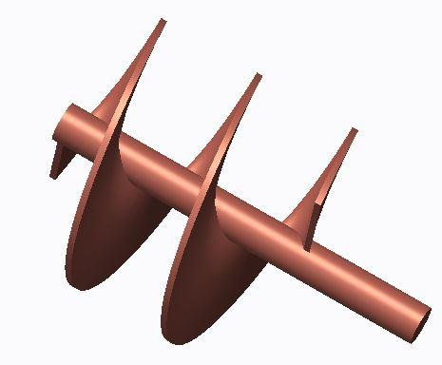
Mitigation
A benefit of our design is that there are many potential contingency plans
  Add a ramp at the end of the funnel
  Vibrate the funnel at different frequencies and amplitudes
  Vary mesh sizes and amount of meshes
  Change amount of times electrode passes through dispersion system
  Add a knife blade
  Add/Remove cylindrical gear with teeth
Possible stirring agitator to be placed in funnel

Slide 23
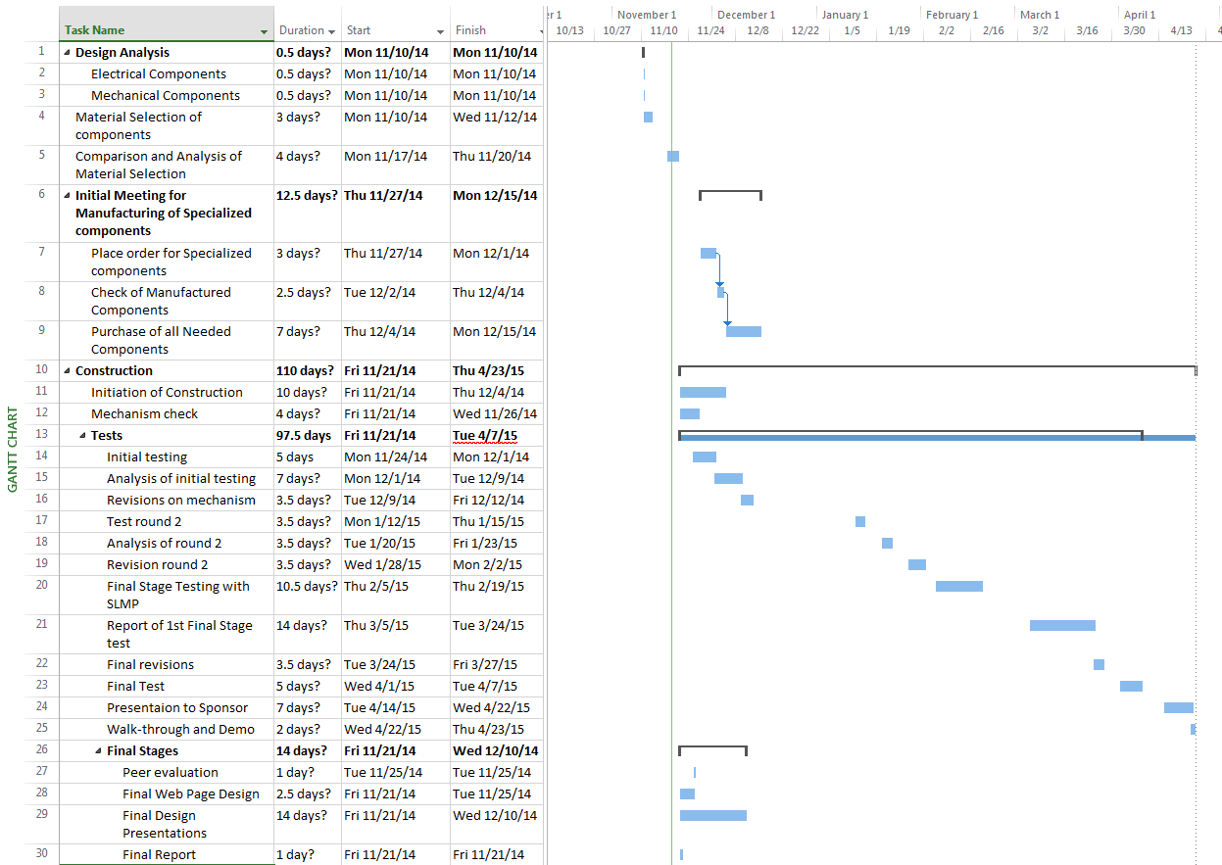
Plans for the future

Slide 24
References
FMC Corporation, O. "Introducing Stabilized Lithium Metal Powder." SLMP — More Energy, More Stability, More Value. Only from FMC Lithium. (n.d.): n. pag.Introducing Stabilized Lithium Metal Powder. FMC Lithium, 2010. Web. 2014.
Zheng, J.P. "Nano-structured Materials for Energy Storage and Conversion." Anode Electrode. N.p., n.d. Web. 2014.
©2010 FMC Corporation. All Rights Reserved. FMC, the FMC logo, FMC Lithium, the FMC Lithium logo, Lectro, and SLMP are trademarks of FMC Corporation or its subsidiaries or affiliates in the U.S. and other countries

Slide 25
Questions/Comments
 We would like to open the floor to any questions or comments.

