Slide 1
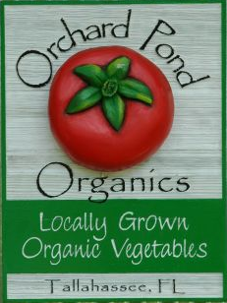

Weeding Robot Team 11
Sponsor: Jeff Phipps
Advisor: Dr. Clark
Student Members:
Ian Nowak (EE)
Coen Purvis (ME)
Amanda Richards (ME)
Grant Richter (ME)
Jeremy Rybicki (EE/CpE)
Nathan Walden (ME)

Slide 2
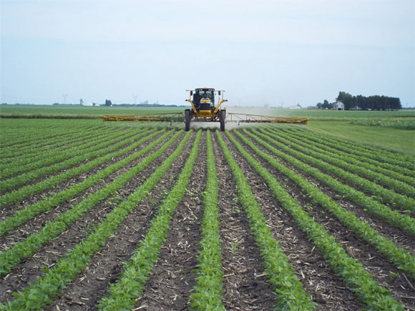
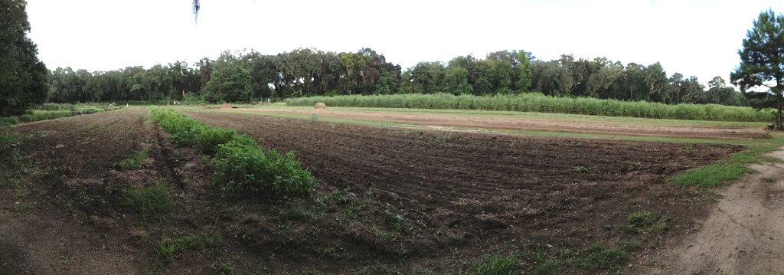
Background Information
Orchard Pond Organic Farm
About the sponsor
About the Farm
Why a weeding robot?
Team 11 Amanda Richards
Slide 2 of 14 Midterm I Presentation
Notes:
http://brandt.co/Portals/0/Blog/lex_spray.jpg

Slide 3
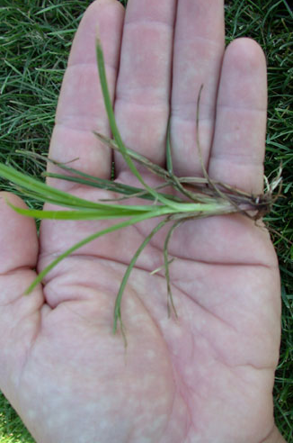
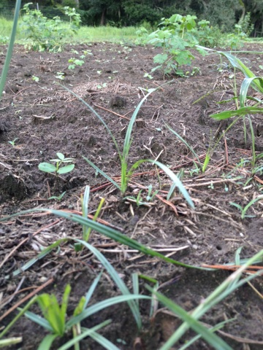
Scope of the Project
Constraints
  3/8th of an inch (1 PSI)
  Can’t disturb more than 1 inch
Key components
  Locomotion
  Navigation
  Weeding method
Nutsedge weed
Team 11 Amanda Richards
Slide 3 of 14 Midterm I Presentation
Notes:
http://a.static.trunity.net/files/110901_111000/110975/400px-Congress_weed.jpg

Slide 4
Robot Design - Locomotion
Wide variety of methods, necessary to consider the health of the plot
Decision matrix below shows comparison between different methods
Team 11 Amanda Richards
Slide 4 of 14 Midterm I Presentation

Slide 5
Robot Design – Weeding Methods
Focus of the project, will determine overall success of the robot
Specific methods still being discussed
Team 11 Nathan Walden
Slide 5 of 14 Midterm I Presentation

Slide 6
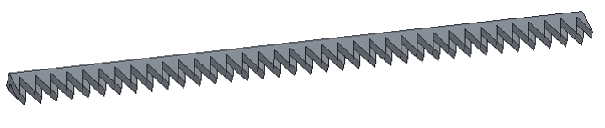
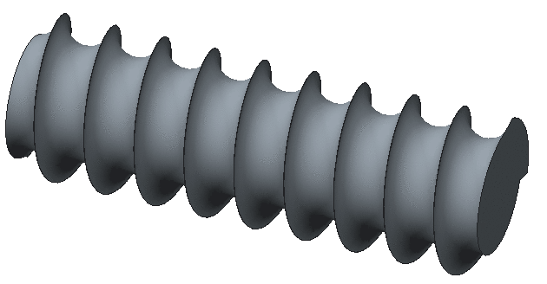
Weeding Method Designs
General Area Designs
Helix Design Concept
Aluminum
Teeth Design Concept
Aluminum frame
Rubber teeth
Team 11 Nathan Walden
Slide 6 of 14 Midterm I Presentation

Slide 7
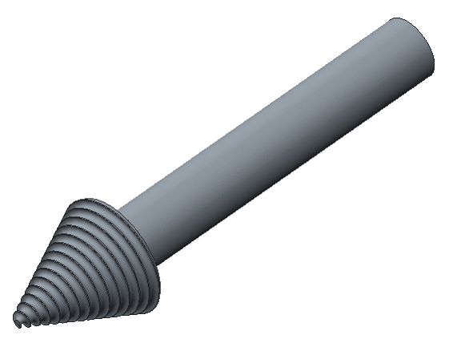
Weeding Method Designs – contd.
Find and Pick Designs
Root Drill Concept
Drill bit must be stronger material such as alloyed steel, shaft can be aluminum
Team 11 Nathan Walden
Slide 7 of 14 Midterm I Presentation

Slide 8
Robot Design – Weed Identification
Essential part of “Find and Pick”
Identifies one weed at a time
Team 11 Jeremy Rybicki
Slide 8 of 14 Midterm I Presentation

Slide 9
Robot Design – Navigation
Robot must be able to navigate around desirable plants, and remove undesirable weeds
Important to emphasize accuracy and reliability of this method
Team 11 Jeremy Rybicki
Slide 9 of 14 Midterm I Presentation

Slide 10
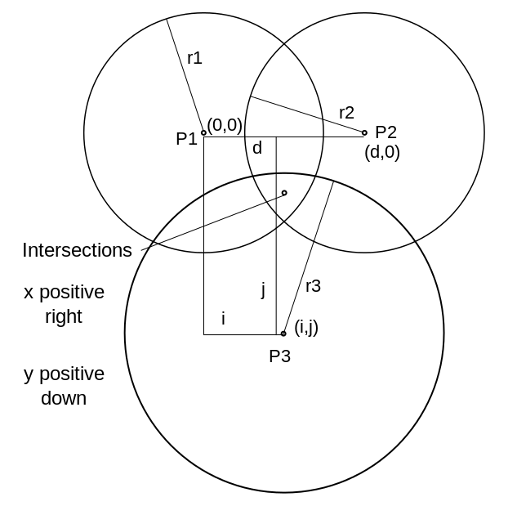
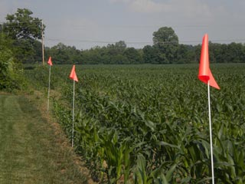
Navigation Concepts
Possible through
  Color detection with computer vision
  Distance calculations with radio frequencies
Team 11 Jeremy Rybicki
Slide 10 of 14 Midterm I Presentation

Slide 11
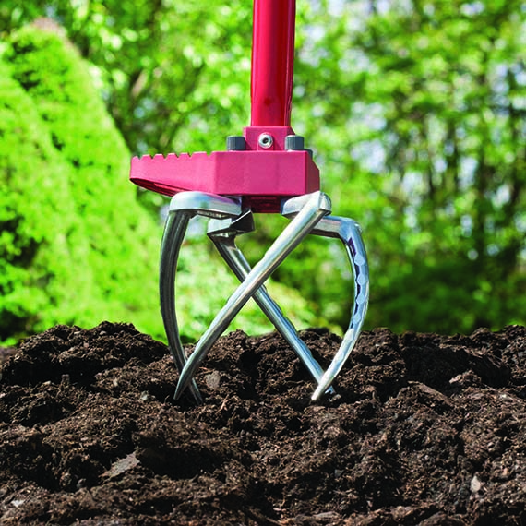
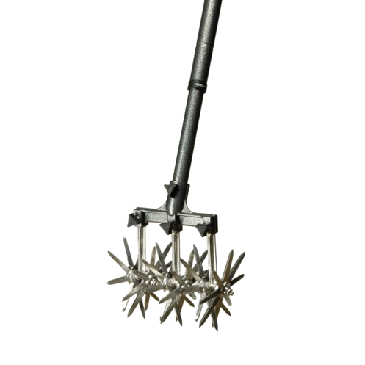
Challenges
Different types of weeds in plot
Primary challenge is “Find & Pick” vs. “General Area”
  Will determine how the rest of the design progresses
Sponsor wants 24/7 operability and waterproofing
  Charging station
Ground pressure
Team 11 Jeremy Rybicki
Slide 11 of 14 Midterm I Presentation
Notes:
http://www.gardenweasel.com/wp-content/uploads/2014/01/Claw-Pro-DSC02850GW_2013.jpg
http://ecx.images-amazon.com/images/I/71H1SugTkSL._SL1500_.jpg

Slide 12
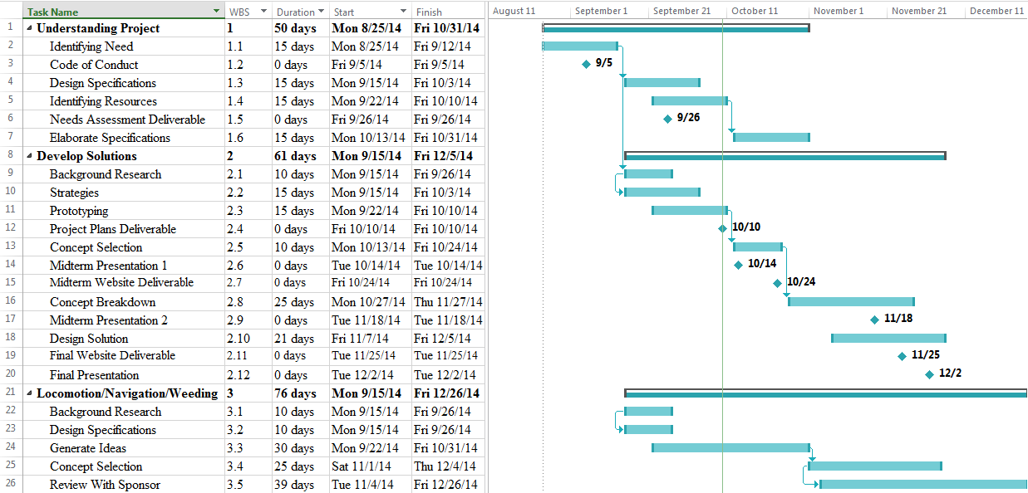
Schedule/Gantt Chart
Team 11 Nathan Walden
Slide 12 of 14 Midterm I Presentation

Slide 13
Future Steps
Based on the prototype drawings, the team will begin testing the design’s efficiency at weeding
A physical prototype of the frame will be constructed to predict future complications in fabrication
Ground pressure tests on the plots should be carried out to determine max weight of robot
Website: www.eng.fsu.edu/~rybicje/Team11/
Team 11 Amanda Richards
Slide 13 of 14 Midterm I Presentation
Notes:
Dr. Clark, treaded robot for prototyping

Slide 14
References
http://orchardpondorganics.com/
http://brandt.co/Portals/0/Blog/lex_spray.jpg
http://www.ppdl.purdue.edu/PPDL/images/yellownutsedge2.jpg
http://en.wikipedia.org/wiki/Trilateration
http://www.americansafetyflag.com/images/agricultural-field-markers.jpg
http://www.gardenweasel.com/wp-content/uploads/2014/01/Claw-Pro-DSC02850GW_2013.jpg
http://ecx.images-amazon.com/images/I/71H1SugTkSL._SL1500_.jpg
http://www.azwallpapers.net/wp-content/uploads/2013/06/Green-Nature-PowerPoint-Templates-Background.jpg
Team 11
Slide 14 of 14 Midterm I Presentation

