Slide 1
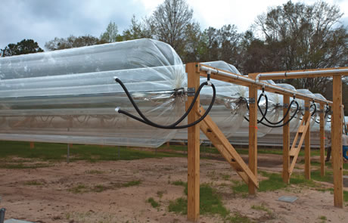
Solar Sausage for Water Desalination
Sponsor: Florida State University
Advisor: Dr. Shangchao Lin
Instructor: Dr. Scott Helzer
      Nikhil Gupta
  Dr. Chiang Shih
Group 7: Alexandra Filardo
Joseph Hamel
Alex Stringer
Crystal Wells

Slide 2
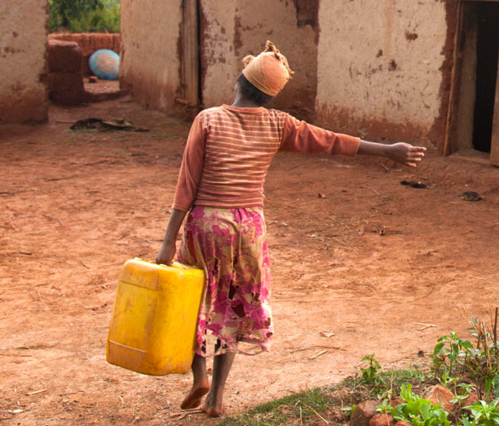
Needs Statement
“Much of the under developed world still lacks access to clean drinking water.”
Results of lack of access to clean drinking water:
Poverty
Illness and Disease
Political & Economic Instability
Solar Sausage for Crystal Wells
Water Desalination
Notes:
Reduced Education
Poor Hygiene
Pollutants
3.4 million people die from water-related illness every year – blueplanetnetwork
>186000 ppl/Tallahassee -→ that’s 18x the amount of people in Tallahassee

Slide 3
Key Technical Questions
Where is the optimal geographic location for the solar sausage?
How much water must be produced through each sausage?
What is the minimum temperature required to produce potable water?
What design allows for optimum marketability?
Solar Sausage for Joseph Hamel
Water Desalination
Notes:
Based on saline water access, weather conditions, temperature, etc.
Can the design be implemented at different geographic locations?
Must know the amount of water required per person per day and amount of people in the village to be sufficient
What temperature is optimal to boil the water but also not too hot so rate of condensation is still sufficient
Cheap enough to be mass produced?
Portable in case of unforeseen circumstances?
Can Prototype translate to life-size scale?

Slide 4
Goals and Objectives
“The goal of this project is to create a solar desalination system using the Solar Sausage.”
Objectives:
Provide a sufficient potable water for a small family
Stay within allowable budget
Remain simplistic in nature so that locals could easily be trained to operate and maintain
Solar Sausage must be easily transported and installed
Solar Sausage for Joseph Hamel
Water Desalination
Notes:
Solar Sausage has been developed as a cheap, easy way to focus solar energy. Applying this to a desalination technique could solve the need for more potable water in under developed countries that have much saline water with a lack of clean water

Slide 5
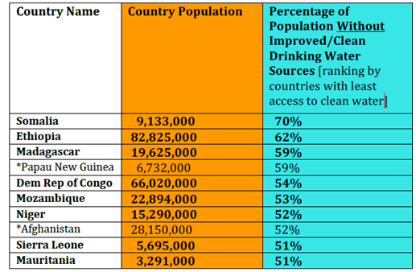
Geographic Selection
Top Choices
Implementation
Tallahassee has comparable seasonal temperatures
Solar Sausage for Crystal Wells
Water Desalination
Notes:
Congo: Small mileage of shoreline
Mozambique – relatable to Madagascar ; Madagascar fully surrounded by water
Sierra Leone & Mauritania have shoreline also
On shore & in land
Wells seen as unusable due to saltwater contamination
Daily Average of ~63F to ~82F
Coolest in July : ~48F – 70 F

Slide 6
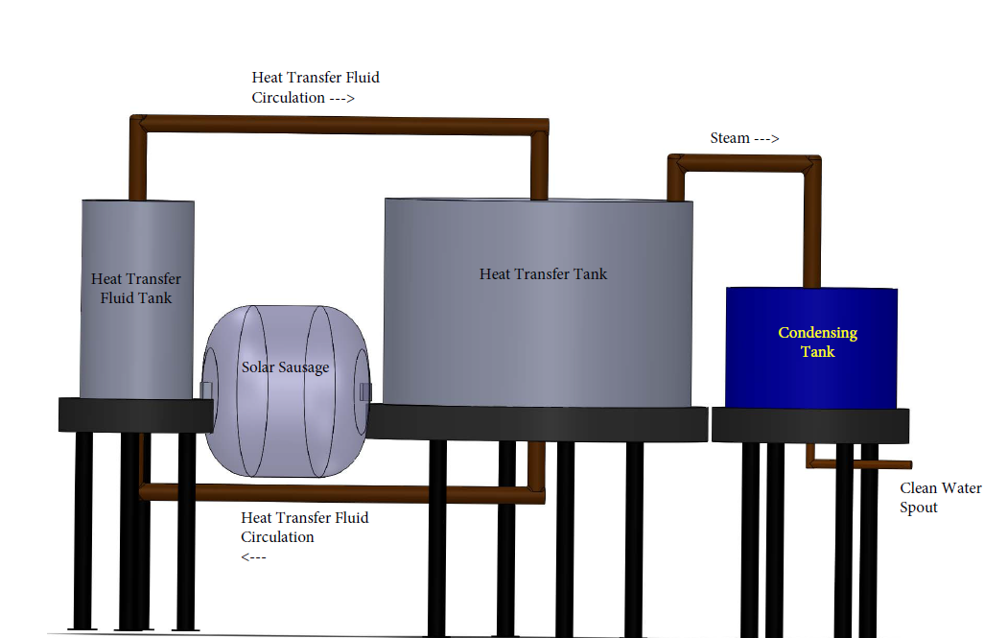
Design Concept #1
Heat Exchanger Method
*not to scale
Solar Sausage for Joseph Hamel
Water Desalination

Slide 7
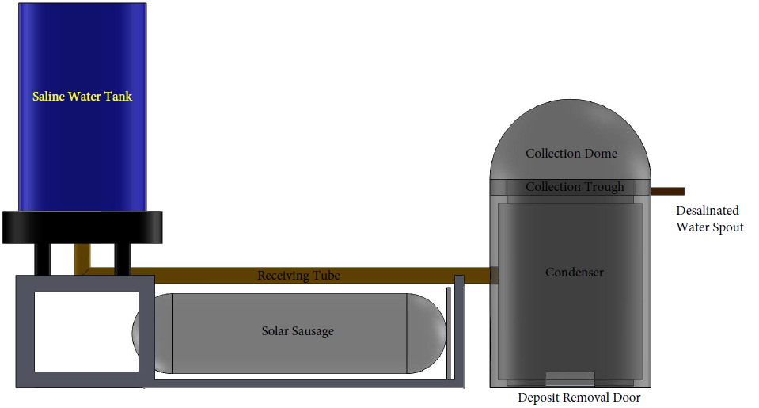
Design Concept #2
Direct Heat Transfer Method
*not to scale
Solar Sausage for Joseph Hamel
Water Desalination

Slide 8
Final Design
Solar Sausage for Joseph Hamel
Water Desalination
Notes:
Simplistic
Family-sized application
More versatile
More easily transported
Potential for solar sausage farm to sustain entire community in future
Increases marketability of project
Prototype Plans
Length – 5 ft
Diameter – 2 ft
Use existing materials (ian winger)

Slide 9
Challenges & Risks
Ability to deconstruct & reinstall
Withstand common weather
Hours of operation
Easily replaceable materials in developing countries
Adhesive
Solar Sausage for Crystal Wells
Water Desalination
Notes:
Natural disasters
Saline build up
Prone to cyclones (East Coast)
Monsoons (Dec-Mar)
Common Weather: Wind currents; rain storms
10AM - 3PM
Seasonal change
Declination of sun
Must be constructed with tri-fold technique
Glue must be superheated and avoid contact with air in order to be used (initial construction)

Slide 10
Preliminary Observations
Lower Salinity in Madagascar
Research of Ian Winger
Max Temperature: 400 C
0.01 PSI differential pressure for optimal focusing
Solar concentration up to 8 suns (8x normal Solar Intensity)
35 g/kg
Somalia ~35.5
Highest salinity is 40 g/kg
Solar Sausage for Joseph Hamel
Water Desalination
Notes:
Madgascar: 35 g/kg
(Somalia ~35.5)
Highest salinity is 40 g/kg

Slide 11
Projection of Completion
Gantt Chart
  Z:\My Documents\Senior Design.mpp
Solar Sausage for Joseph Hamel
Water Desalination

Slide 12
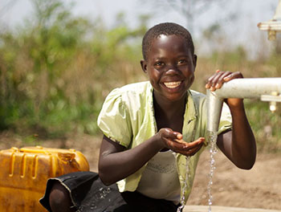
Summary
Clean water is a luxury.
Solution: Solar Sausage
  Direct Heat Transfer Method
  Deployment Opportunities
  Challenges & Risks
  Project Forecast
Solar Sausage for Crystal Wells
Water Desalination
Notes:
Clean water not easily available like we are used to.
Luxury as the lack of causes disease and leads to a cycle of poverty.
Solar Sausage provides a solution to developing countries in need of clean water.
Green Energy – Solar
Direct Heat Transfer method chosen opposed to H.E. because simpler, easily fixed, less components, easier to train people.
increases deployment area opportunities
-> broadens marketing opportunities & potential consumer base
Many challenges to account for : climate and materials
easily replacable parts
weather conditions (seasonal variation)
Project Forecast:

Slide 13
References
[1] http://www.who.int/pmnch/media/news/2012/201205_africa_scorecard.pdf
[2] http://www.dailymail.co.uk/sciencetech/article-2042116/Nasa-unveils-map-salt-levels-seas-world-transform-understanding-weather.html
[3] http://www.wateraid.org/mg
[4] http://thewaterproject.org/how-to-give-clean-water
Solar Sausage for Crystal Wells
Water Desalination

Slide 14
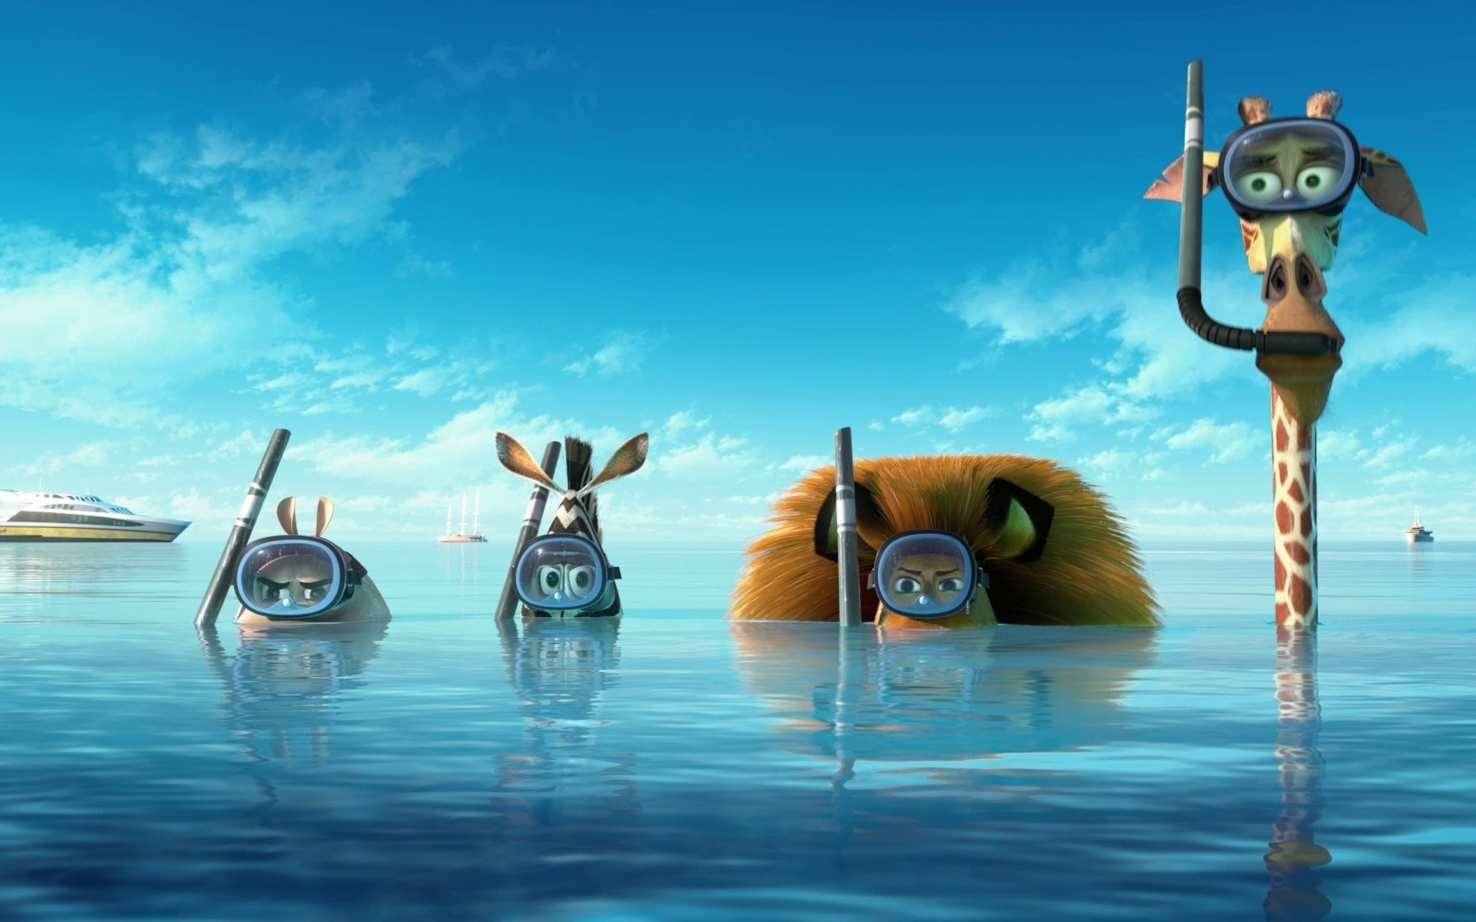
QUESTIONS?

