Slide 1
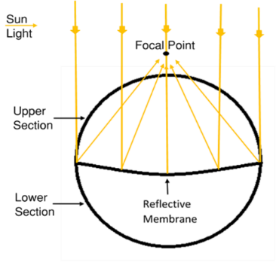
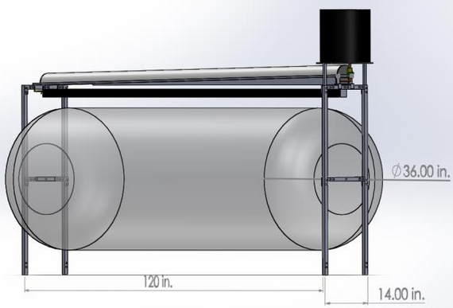
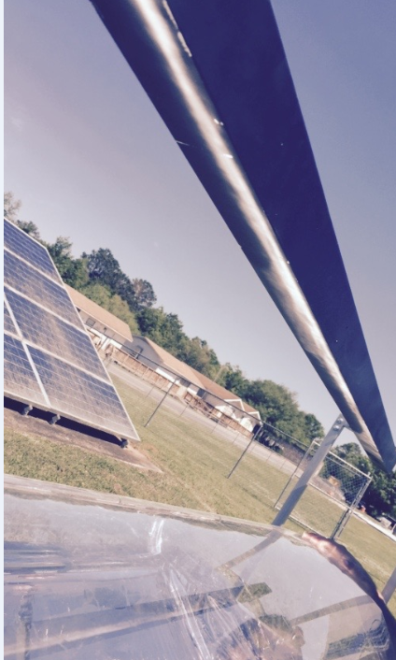
Solar Sausage for Water Desalination
Team 07: Alexandra Filardo, Joseph Hamel, Alex Stringer, Crystal Wells
FAMU-FSU College of Engineering, Tallahassee FL
Introduction:
How it Works:
Entrepreneurship in Engineering:
Motivation: Many of the developing countries lack access to clean drinking water
Goal: Utilize the Solar Sausage in mass production for desalinating water
Figure 1. Visual display of the Solar Sausage technology
The Solar Sausage is an inexpensive alternative to parabolic solar collectors
Desalination provides clean water where saline water is abundant
Entrepreneurial project with $5,000 budget and the intent to commercialize
Solar Sausage focuses light to trough
Saline water released from tank to trough and evaporated
Vapor collected in condenser and flows through channels to opposite end where it‘s collected
Cost per gallon must compete or beat competition
Operation manual must communicate to consumers of all backgrounds
Maintain simplicity to increase customer base
Use readily available materials to reduce labor costs and offer more simple replacement
Increase lifetime for enhanced marketing
Figure 3. Focal Point from Solar Sausage heating the trough
Figure 2. Solar Sausage for Desalination system
Objectives:
Significant Parameters:
Must be inexpensive since an entrepreneurial design is desired
Must support a small family
Easily transported and easily deconstructed
Simple and easy to use
Meet water standards set by World Health Organization
Focal point: 3/8 in. to 2 in.
Assembly/Disassembly time: 40 min. / 10 min.
Operation time: 6 hrs. (9 AM - 3 PM) *includes one hour preheat time
Daily output: 3 gallons / day
Price unit price: 61 ¢ / gallon
Future Work:
Improved pressure pumping system
Test potable water output with varying ambient temperature, pressure, etc.
Increase output or decrease cost where possible

