Slide 1


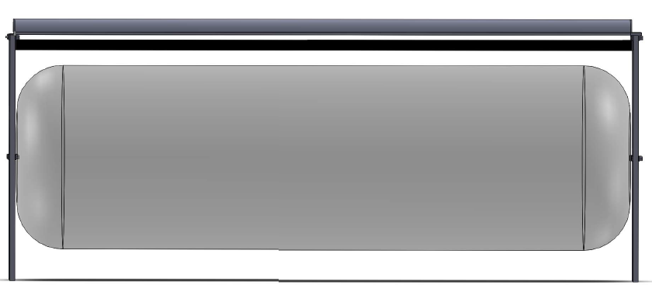
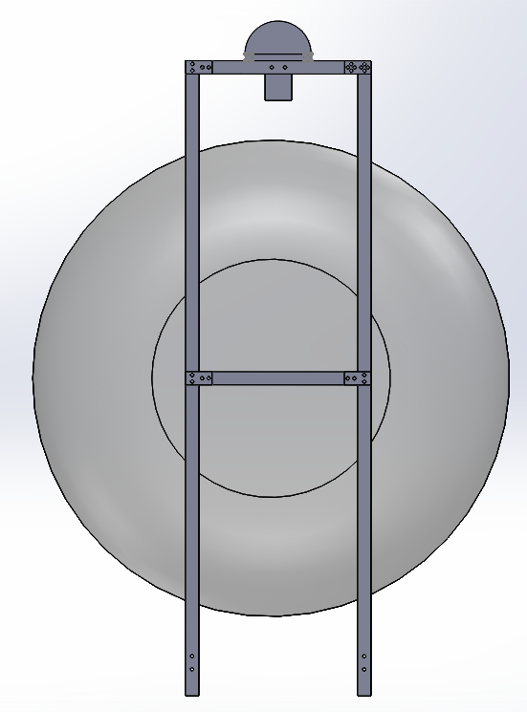

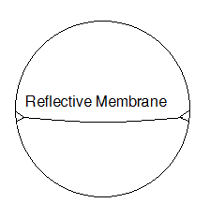
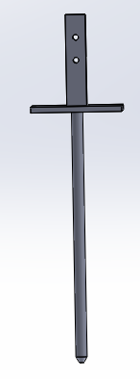
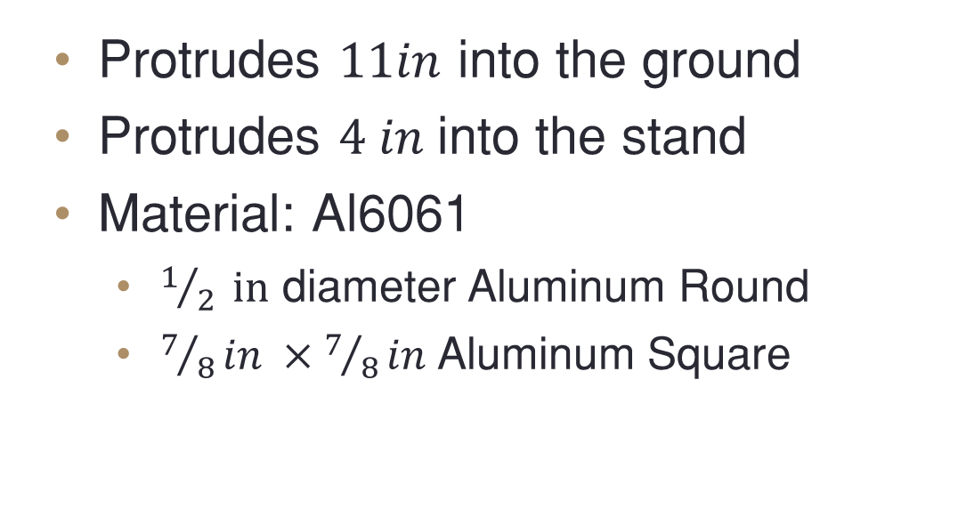
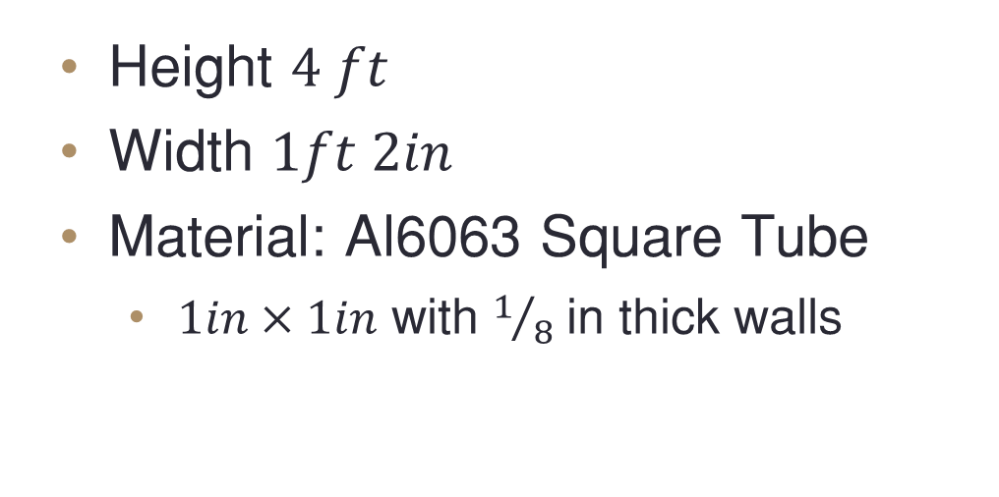
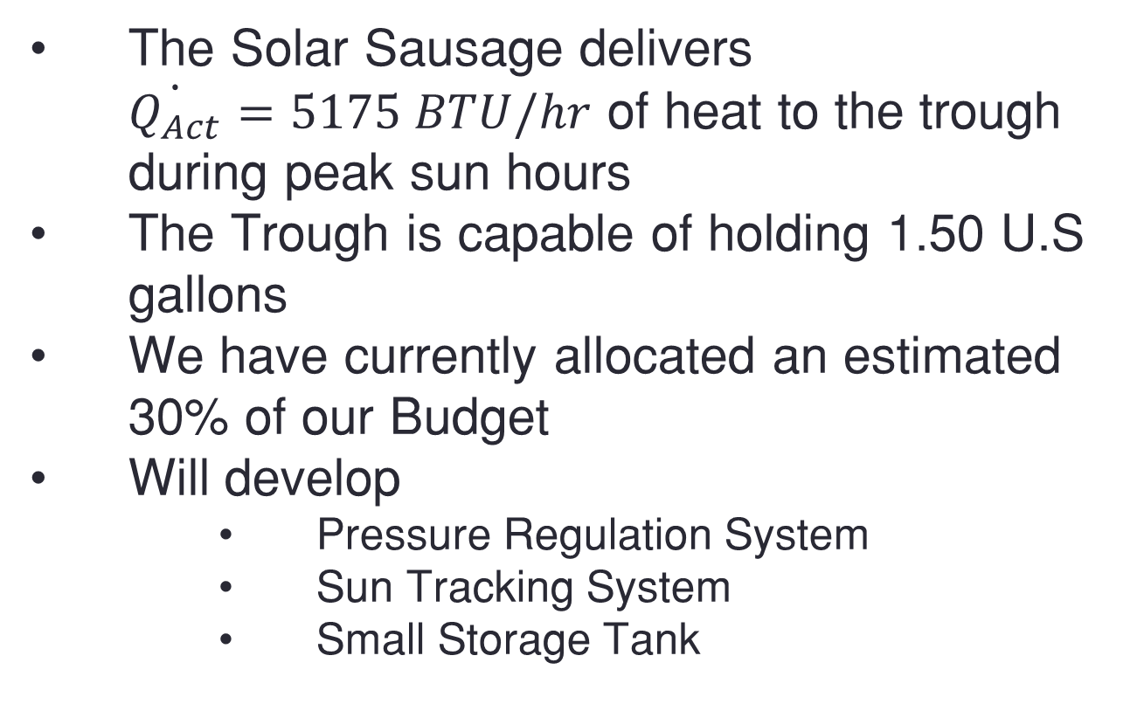
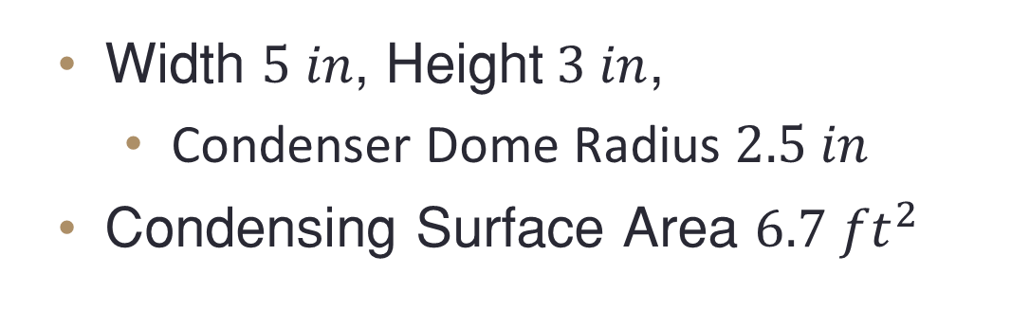
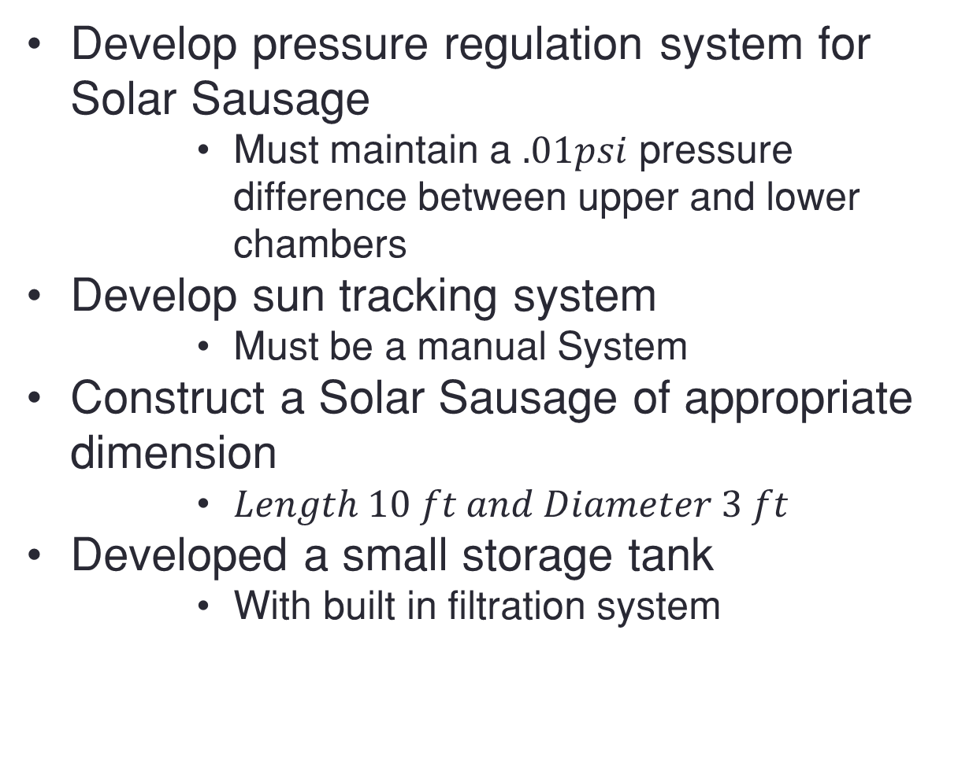
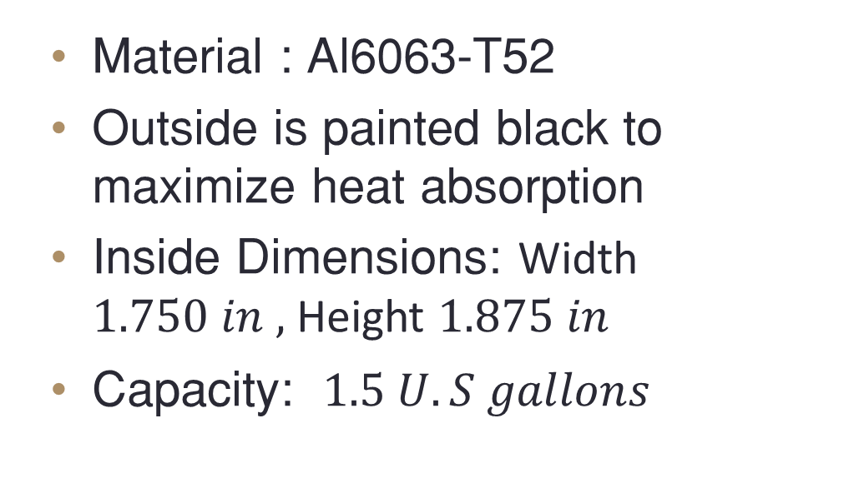
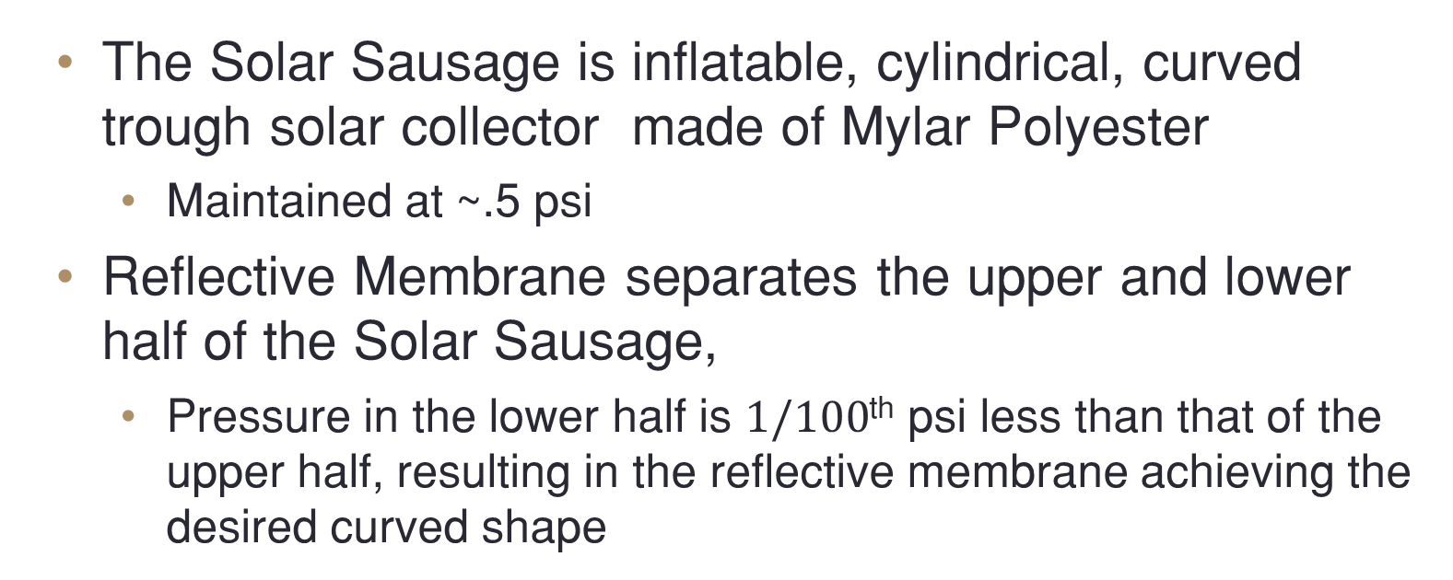
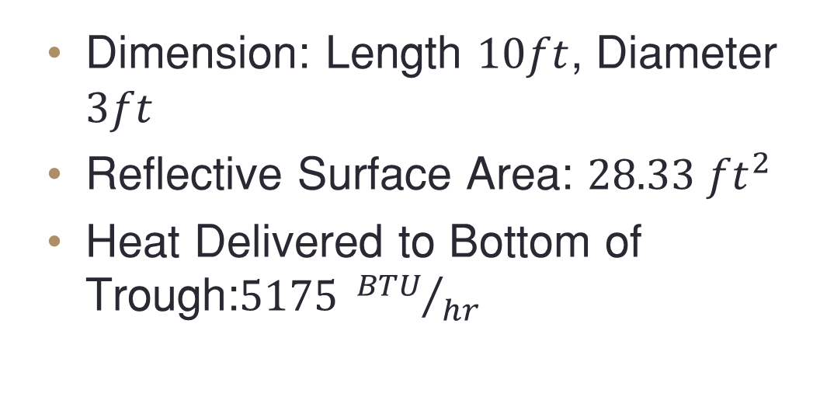
Team 7: Solar Sausage for Desalination
Entrepreneurship Project Sponsored by the FAMA-FSU College of Engineering
Alexandra Filardo, ME; Joseph Hamel, ME; Alexander Stringer, ME; Crystal Wells, ME
Dr. Shangchao Lin, Faculty Advisor; Ian Winger; Faculty Mentor
Needs Statement
Final Selected Design
Future Work
“Much of the under developed world still lacks access to clean drinking water.”
Results of lack of access to clean drinking water
  Poverty
  Illness and Disease
  Political & Economic Instability
C
Develop pressure regulation system for Solar Sausage
  Must maintain a $.01psi$ pressure difference between upper and lower chambers
Develop sun tracking system
  Must be a manual System
Construct a Solar Sausage of appropriate dimension
  $Length 10 ft and Diameter 3 ft$
Developed a small storage tank
  With built in filtration system
B
A
4ft 3in
Goals and Objectives
“The goal of this project is to create a solar desalination system using the Solar Sausage.”
Objectives:
  Provide a sufficient potable water for a small family
  Stay within allowable budget
  Remain simplistic in nature so that locals could easily be trained to operate and maintain
  Solar Sausage must be easily transported and installed
D
10 ft.
Summary
A) Solar Sausage
B)Trough
  The Solar Sausage delivers $\dot{Q_{Act}}=5175 BTU/hr$ of heat to the trough during peak sun hours
The Trough is capable of holding 1.50 U.S gallons
We have currently allocated an estimated 30% of our Budget
Will develop
  Pressure Regulation System
  Sun Tracking System
  Small Storage Tank
Dimension: Length $10ft$, Diameter $3ft$
Reflective Surface Area: $28.33 {ft}^{2}$
Heat Delivered to Bottom of Trough:$5175 {BTU}/{hr}$
Material : Al6063-T52
Outside is painted black to maximize heat absorption
Inside Dimensions: Width $1.750 in ,$ Height $1.875 in$
Capacity: $1.5 U.S gallons$
Solar Reflector
The Solar Sausage is inflatable, cylindrical, curved trough solar collector made of Mylar Polyester
  Maintained at ~.5 psi
Reflective Membrane separates the upper and lower half of the Solar Sausage,
  Pressure in the lower half is $1/100$^{th} psi less than that of the upper half, resulting in the reflective membrane achieving the desired curved shape
C) Condenser
D) Stand
Width $5 in$, Height$3 in$,
  Condenser Dome Radius $2.5 in$
Condensing Surface Area $6.7 {ft}^{2}$
Height $4 ft$
Width $1ft 2in$
Material: Al6063 Square Tube
  $1in×1in$ with $1/8$ in thick walls
References
  Seawater Desalination Power Consumption." Sustainable Solutions for a Thirsty Planet. WateReuse Association, 1 Nov. 2011. Web. 23 Sept. 2014. <WateReuse Association>.
  Aintablian, Xanthe. "Desalination Expands as Technology Becomes More Affordable." Water Desalination. AboutEducation. Web. 23 Sept. 2014.
  Engel, Yunus A. Fundamentals of Thermal-fluid Sciences. 4th ed. Singapore: McGrawHill, 2012. Print.
  Sinha, Sayontan. "Solar Insolation." Solar Insolation. Web. 21 Oct. 2014.
Spike
4 in
Protrudes $11in$ into the ground
Protrudes $4 in$into the stand
Material: Al6061
  $1/2 in$ diameter Aluminum Round
  $7/8in ×7/8in$Aluminum Square
11 in
Figure 1. Solar Sausage
Left: Full size Solar Sausage used for power generation, 50ft long and 6ft diameter
Right: Cross-Sectional view of Solar Sausage, the Reflective Membrane divides the upper and lower half

