Slide 1
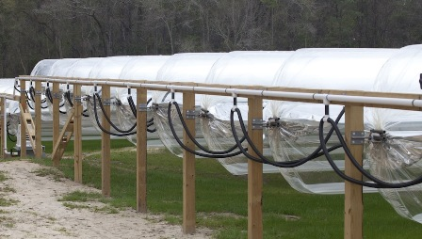
Solar Sausage for Desalination
Sponsor: FAMU-FSU College of Engineering
Advisor: Dr. Michael Devine
Dr. Shangchao Lin
Group: Alexandra Filardo
Joseph Hamel
Alexander Stringer
Crystal Wells

Slide 2
Overview
The Project
Objectives and Scope
Solar Sausage
The System
Design
Piping System
Storage Tank
Pressure Regulation System
Operation
Condenser
Maintenance
Sun Tracking System
Testing
Completed Testing
Future Testing
Safety Procedures & Water Quality
Commercialization Plan and Customer Profile
Budget
Schedule

Slide 3
The Project
Project Scope
Objectives
To create a solar desalination system utilizing an inflatable parabolic reflector called the Solar Sausage
To create a system that can be easily mass produced at low cost.
Produce drinking water with a saline concentration less than 100 ppm
Support a family of 5
Minimize cost
Create a user friendly system that can be easily transported and constructed

Slide 4
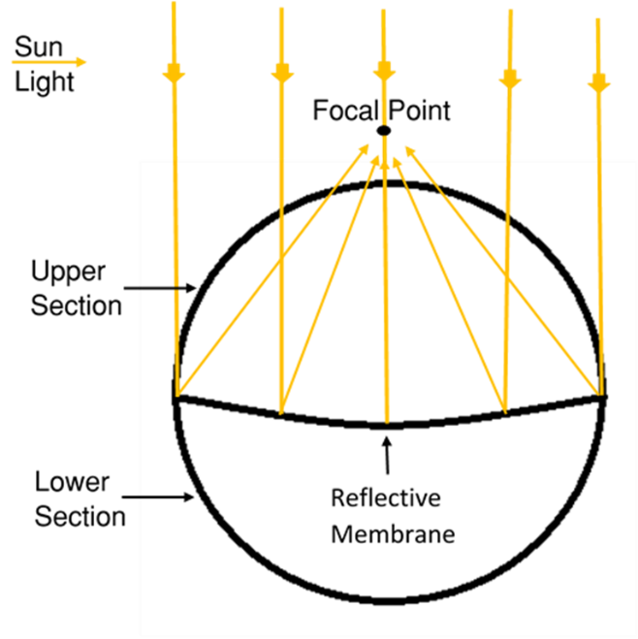
Solar Sausage
Inflatable parabolic reflector in the shape of a sausage
Made of a clear membrane and a Mylar reflective membrane
When inflated the reflective membrane separates the Solar Sausage into two sections
Upper Pressure: $.5 psi$
Lower Section is $1/{100} psi$ less than the top
Figure 1: Cross-Sectional view of the Sausage

Slide 5
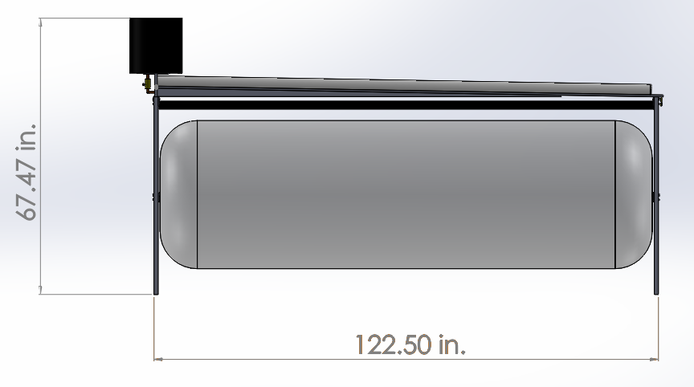
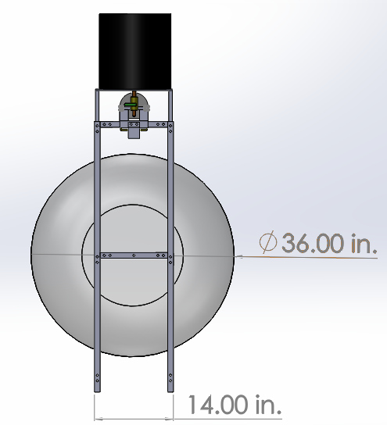
The System: Design
B)
Storage Tank
Condenser
A)
Trough
Stand
Solar Sausage
Figure 2: System Configuration
Side View
Cross-Sectional View

Slide 6
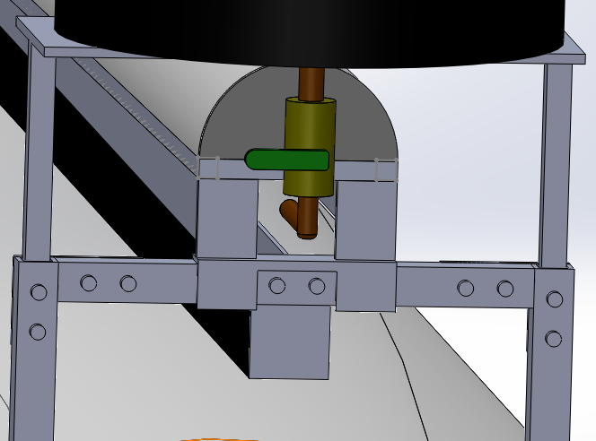
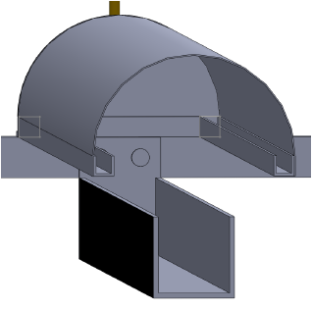
The System: Design
A)
B)
Figure 3: System Configuration Expanded View
Piping System
Interior View

Slide 7
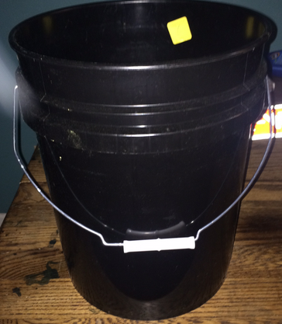
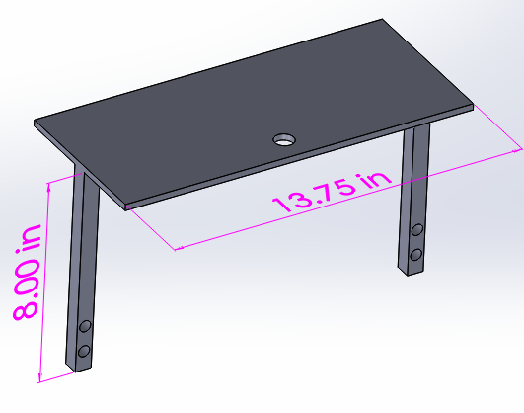
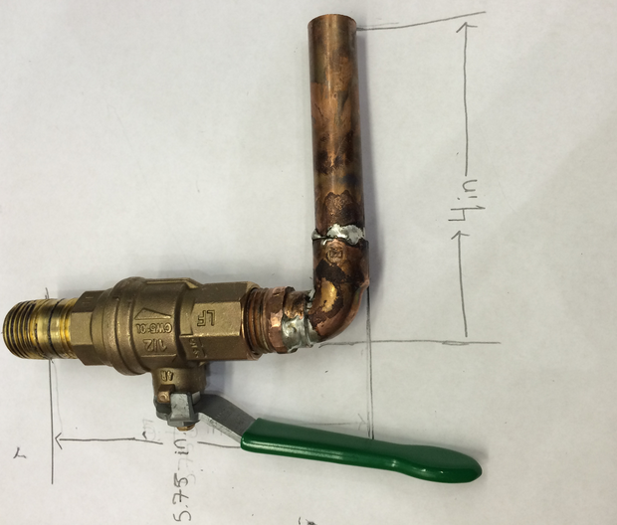
The System: Storage Tank
Storage Tank will be a five gallon bucket
Readily available filters
Approved by U.N for storing water
Height: $13.75 in.$
Diameter: $12.75 in.$
Bucket will sit on the Storage Tank Platform
Will be $5.5 in.$ above the stand
Saline water piping system
A ball valve is used to control the flow
B)
A)
C)
Figure 4: Storage Tank Components
5 Gallon Bucket
Platform
Piping System

Slide 8
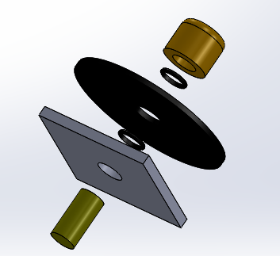
The System: Storage Tank Configuration
The piping system is used to secure the bucket to the platform
A $5/8 in.$ flare nut is used to lock everything in position
Two $5/8 in.$ rubber O-rings are make the storage tank water tight
Figure 5: Simplified Storage Tank Configuration

Slide 9
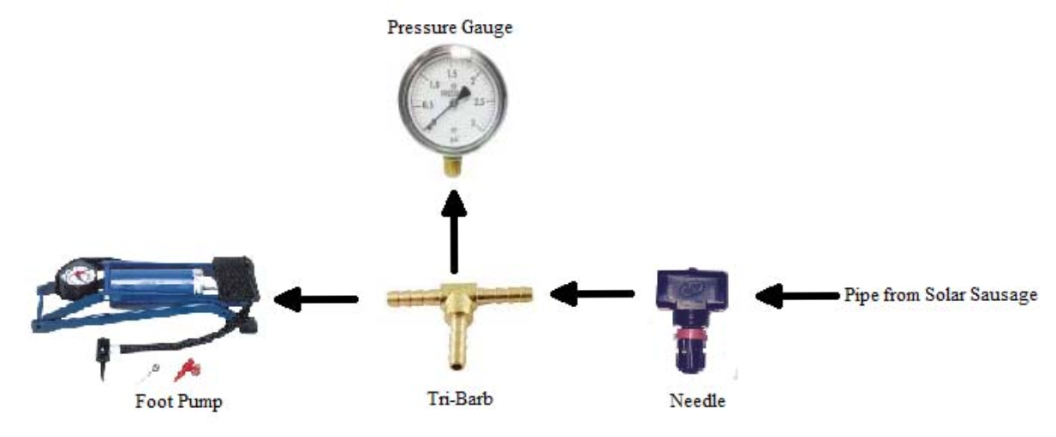
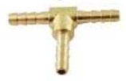
The System: Pressure Regulation
Two systems required
8 Pieces, 4 not shown
Needle Valve allows for precision control of the airflow
Pressure Gauge
11/8” ID plastic tubing
Pipe from Solar Sausage
Foot-Pump
Tri-Barb
Needle Valve
Figure 6: Simplified Pressure Regulation System Configuration

Slide 10
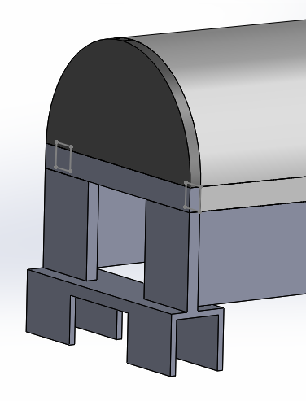
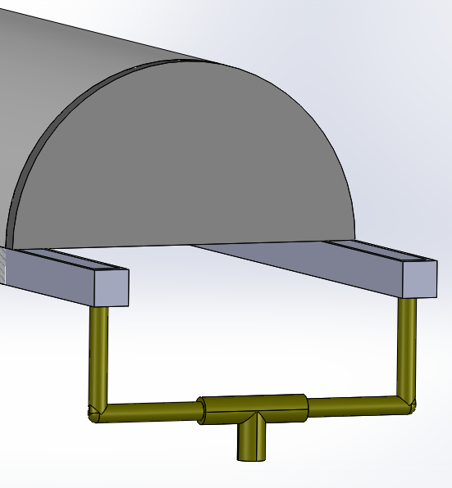
The System: Condenser
Length $120 in.$ Width $5 in.$ Height $3 in.$
Raised $2 in.$ at the storage tank end
Ideal gradient between $1°$ to $2°$
Guards along the aid in the collection of water vapor
Water exits out the collection pipe
A)
B)
Figure 7: Condenser Section
Raised end
Lowered end and collection point
Interior View

Slide 11
The System: Sun Tracking
Straps
Glued to sides of Solar Sausage (shown in red)
Crossed beneath Solar Sausage
Attached to weighted bar underneath
Converts linear translation to rotational motion
Direction of rotation of Solar Sausage dependent on bar motion
Ex. Moving bar to the right produces counterclockwise rotation of Solar Sausage
Figure 8: Simplified Diagram of the sun tracking system.
Notes:
This weighted bar & strap system has been used for similar applications previously at Sunnyland Solar (FSU’s previous SS farm)

Slide 12
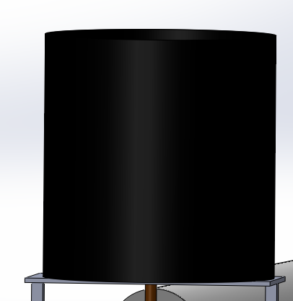
The System: Operation
Fill water storage tank with saline water to filter out debris
Notes:
Will produce 3 gallons per day

Slide 13
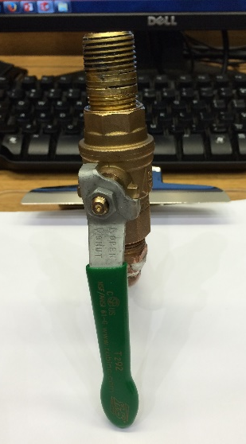
The System: Operation
Open valve to fill trough with filtered water

Slide 14
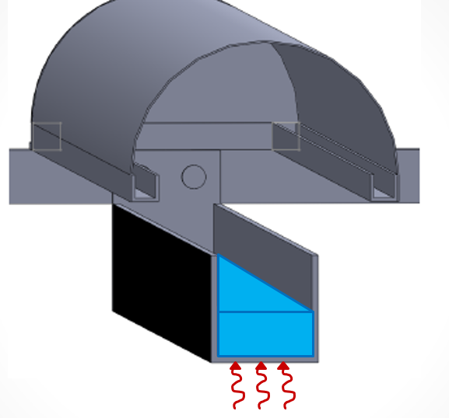
The System Operation
Use the Pressure Regulation System to create focal point and heat the trough

Slide 15
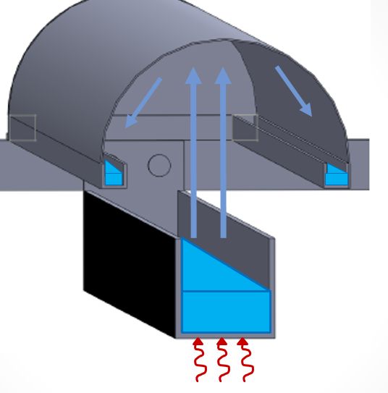
The System Operation
Water vapor rises into the dome, condenses then collects in the channels

Slide 16
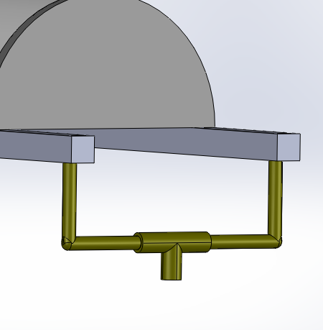
The System Operation
The gradient drives the water to the collection pipe. The desalinated water is collected in a container of choice by the operator
Desalinated Water

Slide 17
The System: Maintenance
Daily Maintenance
Clean Trough of all saline build up
Clean Condenser of all build up
Check Solar Sausage for any tearing
Weekly Maintenance
Rinse saline water filter of all dirt and debris
Clean desalinated water containers
Tighten all connections on the pressure regulation system
Clean Saline Water and Desalinated Water piping systems of all build up

Slide 18
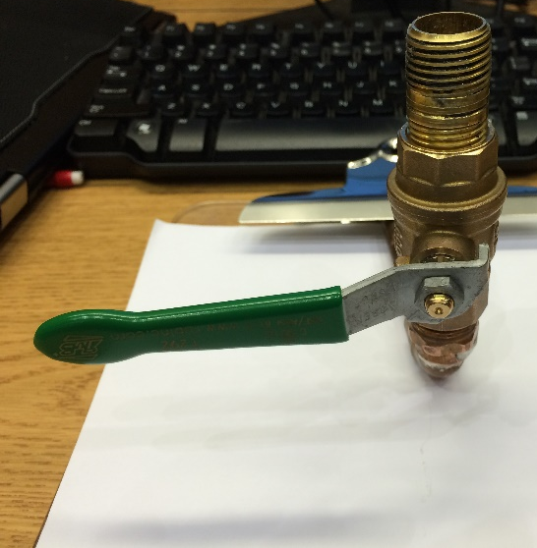
Testing: Completed Testing
Calibration and Confirmation of Equipment accuracy
Salinity: Accuracy of 2%
Thermometer: Accuracy of 1.5%
Relationship of flow rate and valve handle angle
Relationship of Flow Rate and Handle Position
Handle Position (degrees) | Average Flow Rate (gal/min)
20 | 0.00
45 | 0.60
60 | 1.44
90 | 3.14
(a)
(b)
Figure 2: Valve shown at
(a) 0˚ position (Closed) and
(b) 90 ˚ position (Open)
Notes:
Static calibration of equipment
Equipment accuracy done using distilled water & salt water (500ppm)
3 measurements for each water
each time accuracy percent was consistent
Equipment accuracy for thermometer used by measuring water @ 77F & oil at 300F
3 measurements each time
Flow doesn’t start until 20 degrees due to internal ball valve
60 degrees is ideal flow rate

Slide 19
Testing: Future Testing
Focal Point Concentration
Focal point width: $3/8 in$-$2 in.$
Procedure to maintain width
Sun Tracking System
Procedure to track the sun
North-South alignment
Adequate rotation value and frequency
i.e $Rotate 15° every 15 min.$
Flash Distillation
Valve placed at $20°$ to allow a slow-drip into heated trough
The evaporation rate will be calculated. This will be repeated in $5°$till Flash Distillation is no longer possible
Batch Distillation
The trough will be filled with $1.5 gallons$, and the time for it to evaporate will be measured
Notes:
Focal Point Concentration: to maximize results, FP must be > 3/8 in wide and < 2in wide
develop procedure to maintain this width
Sun Tracking System: procedure to track the sun
adequate rotation value & time - a value for # of deg/hour SS must be turned & frequency
Two Types of Distillation to be tested:
Flash Distillation: A process where the water is flash-evaporated
Batch Distillation: A process where a mixture is evaporated in batches

Slide 20
Testing: Safety & Quality
Safety Procedures
Water Quality
Heat-Resistant gloves will be worn during testing
All temperatures will be taken at a distance with a Pistol-Grip Infrared Thermometer
Trough and Condenser will be allowed 30 minutes to cool after testing before
The saline concentration of the drinking water produced will be measured
Measures saline concentration
$0 −99.9 ppm$
$100−999 ppm$
ExStik II Salinity Meter will be used
2% Accuracy

Slide 21
Business Plan
Commercialization Plan
Customer Profile
1st year: Network
2nd - 4th year: Enter market
5th/6th: development of domestic commercialized systems
Non-profit organizations & humanitarian engineering teams
On-site training by organization or team
Notes:
Commercialization Plan:
1 – secure vendors, develop contacts with non-profit organizations (ex. Engineers Without Borders, )
2/3/4 – develop brand recognition, attempt market saturation (product would become more widely known & used)
5/6 – development of domestic commercialized systems
Customer Profile:
Non-profits & engineering-minded humanitarian groups (usually mission-based work)
Small-scale engineering mission teams performing humanitarian work that is able to train current staff
Business Plans
International market within 4 years
Domestic mass production within 6 years

Slide 22
Budget
Notes:
Estimated Cost: ~$700.00/unit
Current Cost: $438.86 excluding condenser

Slide 23
Schedule

Slide 24
Summary
Desalination system utilizing the Solar Sausage technology
Design
Modular , little maintenance, components, and sun-tracking system
Testing
Completed: Determine optimal flow rate based on handle position
Future: Focal point concentration, Sun-tracking system values, Type of distillation
Safety & Quality: heat-resistant gloves and thermometers used, testing salinity
Business
International market within 4 years
Domestic mass production within 6 years
Budget
23% spent
Currently on Schedule
Weather conditions

Slide 25
Questions?
For more information: http://eng.fsu.edu/me/senior_design/2015/team07/

