Slide 1
Solar Sausage for Desalination
Sponsor: FAMU-FSU College of Engineering
Advisors: Dr. Michael Devine
Dr. Shangchao Lin
Instructors: Dr. Nikhil Gupta
Dr. Chiang Shih
Group 7: Alexandra Filardo
Joseph Hamel
Alexander Stringer
Crystal Wells

Slide 2
Overview
2
The Project
Objectives and Scope
Solar Sausage
System Overview
The Design
The Process
The Components
Maintenance
General Calculations
Past, Present, Future
Business Plan
Challenges Faced
Resources
Procurements
Budget
Manufacturing
Schedule
Solar Sausage for Water Desalination Joseph Hamel

Slide 3
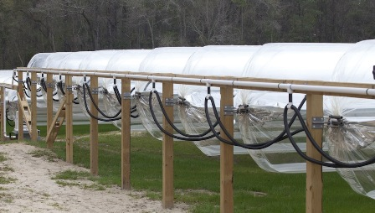
The Project
3
Project Scope
Main Objectives
To create a solar desalination system utilizing the Solar Sausage.
Create a system that can be easily mass produced at low cost.
The system must support a small family
Minimize cost
Make the system user friendly
Make the system easily transportable and easily deconstructed
Solar Sausage for Water Desalination Joseph Hamel

Slide 4
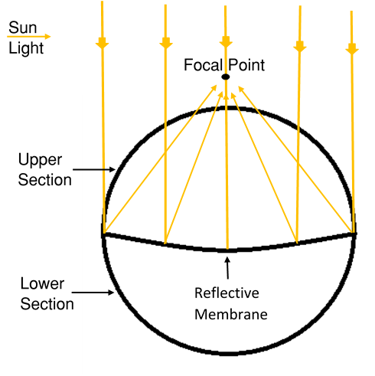
Solar Sausage
4
Is an inflatable parabolic solar concentrator made of Mylar Polyester
98% cheaper than traditional parabolic reflectors
The reflective membrane separated two sections
The pressure in the upper section is maintained at $.5 psi$. The lower section is maintained at $1/{100} psi$ less than the upper section
The pressure difference results in a focal point
Solar Sausage for Water Desalination Joseph Hamel

Slide 5
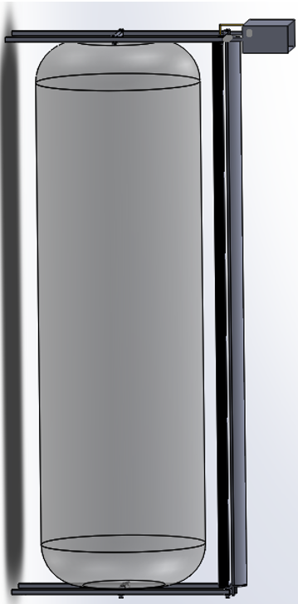
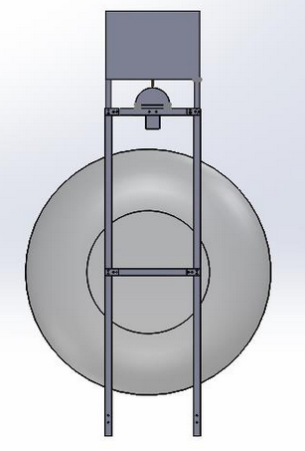
System Overview: The Design
5
Storage
Tank
Condenser
Trough
4 ft
Solar Sausage
3 ft
Stand
10 ft
Solar Sausage for Water Desalination Alex Filardo

Slide 6
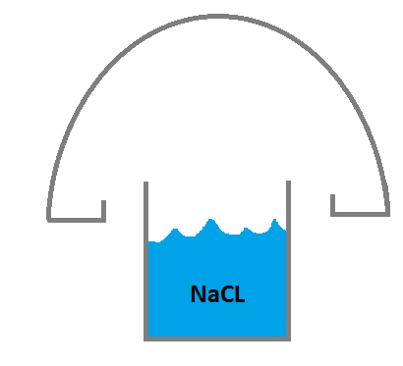
6
Solar Sausage for Water Desalination Alex Filardo

Slide 7
General Layout
Storage Tank
Trough
Condenser
Channels
Bladder
7
Trough
Solar Sausage
Solar Sausage for Water Desalination Alex Filardo

Slide 8
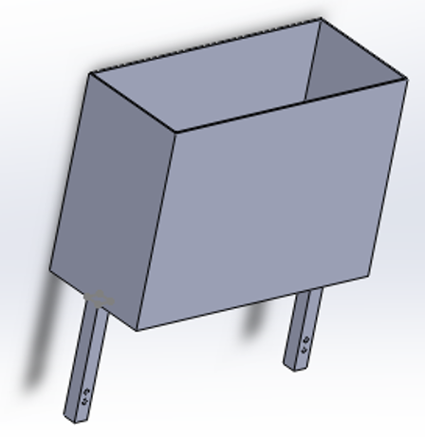
Storage Tank
8
Figure 4. Storage Tank
Filters and hold saline water to feed into the through
The Storage Tank volume is
$V=3.5 U.S gallons (13.25 L)$
Filter located in the upper portion of the tank will filter out particles larger than 100 microns
Storage tank will be painted black to maximize heat absorption from the sun
Manually operated valve will control the flow of filtered saline water into the trough
10 in
6 in
13.75 in
Solar Sausage for Water Desalination Joseph Hamel

Slide 9
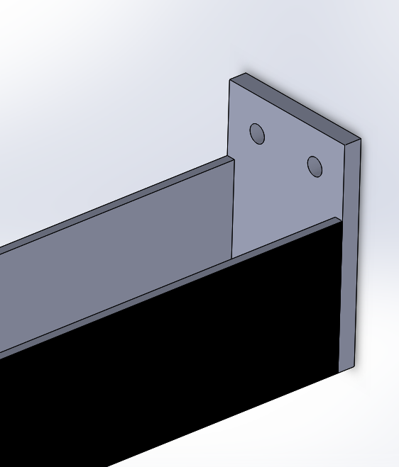
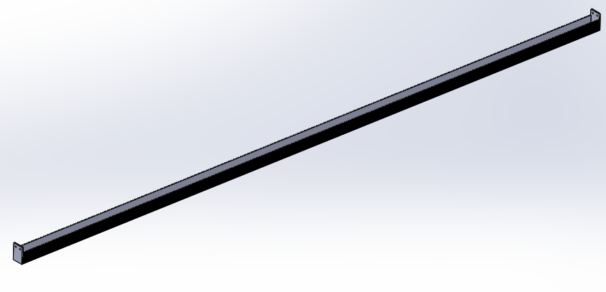
Trough
9
The trough runs the full length of the solar sausage and has a width of 2 inches
The focal point is only 3/8th of an inch wide
The troughs volume is
$V=1.5 U.S gallon (5.68 L)$
Heat Delivered to Trough
$\dot{Q_{Act}}=\frac{\dot{Q}}{L}=5,175.57\frac{Btu}{h} (1516.81 W)$
The trough is painted black to maximize heat absorption
Figure 2. Trough
Full Trough
End of Trough where it is bolted to the stand
2 in
b)
b)
a)
a)
10 ft
2 in
Solar Sausage for Water Desalination Joseph Hamel

Slide 10
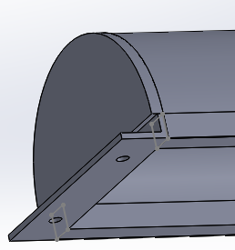
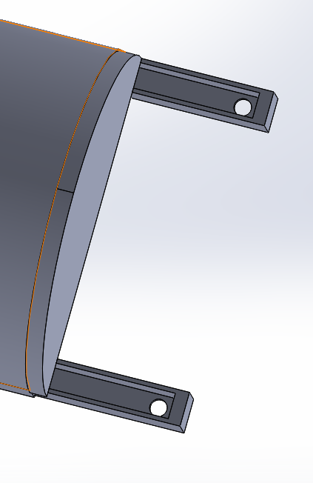
Condenser/Channels
10
Figure 3. Condenser
a) Connected to an elevated Bolt on the Stand.
b) The angle of the raised end drives the water down the channels
Is 5 inches wide runs the full length of the trough and sits directly over it
Has a condensing surface area of
$A_{Surface}=960 {in}^{2} \left(.62 m^{2}\right)$
As the water condenses it drips down into the channels along the side
One end is raised a few inches higher than the other. Driving the water down to the lower end where it is then collected
a)
a)
b)
1 in
2.5 in
3 in
b)
1 in
Solar Sausage for Water Desalination Joseph Hamel

Slide 11
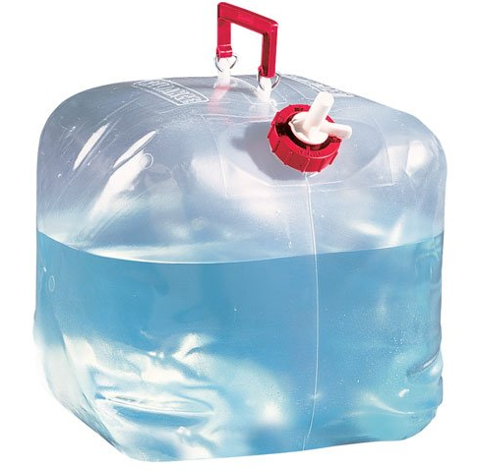
Bladder
11
Placed inside oil drums already readily available for customer
Collects clean water from channels
Removed and replaced once filled with potable water
Solar Sausage for Water Desalination Alex Filardo

Slide 12
Expected Worker Maintenance
12
Bring saline water to Solar Sausage site
Rotate Solar Sausage to align sun with trough
Daily Clean out of salt build up in trough
Replace potable water bladder once full
Rinse saline filter bladder weekly
Solar Sausage for Water Desalination Alex Filardo

Slide 13
General Calculations
12
Trough Volume
$v_{trough}=1.5 U.S Gallons$
Storage Tank Volume
$v_{tank}=3.5 U.S Gallons$
Total Reflective Surface Area
$A_{reflective}=4080 {in}^{2}$
Heat Delivered to the Trough
${\dot{Q}}_{trough}=5175 {Btu}/{hr}$
Saline Concentration
$C=3.5\%$
Start up time
$t_{transient}= .33 hr \left(20 min\right)$
Run time
$t_{run}=2.18 hr \left(131 min\right)$
Total Operating Time
$t_{operation}=2.51 hr (151 min)$
Solar Sausage for Water Desalination Alex Filardo

Slide 14
13
Past
Completed design/calculations for system
Present
Constructing system and testing Solar Sausage heating to trough
Beginning partnership with business group
Future
Prototype testing to confirm expected performance of design
Troubleshooting/resolving new issues arising during testing
Ordered all parts aside from condenser
Connecting with Engineering Without Borders
Assembled Solar Sausage prototype
Build completed marketing strategy with business group
Solar Sausage for Water Desalination Joseph Hamel

Slide 15
Business Plan
14
Reach out to potential investors
Water Aid
Water for People
Water for Good
Global Water
Identify market competition
Continue meeting with business group for successful business plan
Solar Sausage for Water Desalination Joseph Hamel

Slide 16
Challenges Faced/Lessons Learned
15
Challenges Faced
Designing the most optimal condenser
Touching base with Engineering Without Borders
Preventing contamination of water from aluminum
Lessons Learned
Building a report and present information of a long-term project
Building chemistry and working efficiently with group
Practicing professionalism contacting colleagues and superiors
Solar Sausage for Water Desalination Joseph Hamel

Slide 17
Procurement
16
Thus far the team has procured items to construct the
Stands (x2)
The Trough
These items were procured through McMaster Carr and Metals Supermarket
These items were procured at a cost of
$499.71
Solar Sausage for Water Desalination Alex Filardo

Slide 18
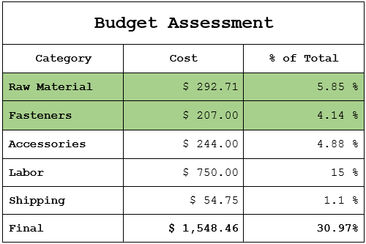
Budget
18
Solar Sausage for Water Desalination Alex Filardo

Slide 19
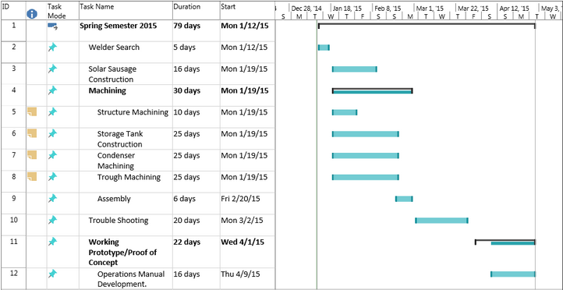
Gantt Chart
19
Solar Sausage for Water Desalination Alex Filardo

Slide 20
Summary
20
Goal: create an inexpensive, easily replicated solar desalination system utilizing the Solar Sausage
The system’s design was shown with main components
General calculations, expected maintenance work and future business plans were discussed
The monetary aspects such as procurement and budget are generalized
Timelines and scheduling were defined
Solar Sausage for Water Desalination Joseph Hamel

Slide 21
References
21
Vendor Purchase(s)
http://www.mcmaster.com/#
http://ecommerce.metalsupermarkets.com/MSC-Home.aspx
[1] Engel, Yunus A. Fundamentals of Thermal-fluid Sciences. 4th ed. Singapore: McGrawHill, 2012. Print.
[2] Sinha, Sayontan. "Solar Insolation." Solar Insolation. Web. 21 Oct. 2014.
[3] "Ocean Water: Salinity." Oceanography. Office If Naval Research. Web. 18 Oct. 2014.
Solar Sausage for Water Desalination Joseph Hamel

Slide 22
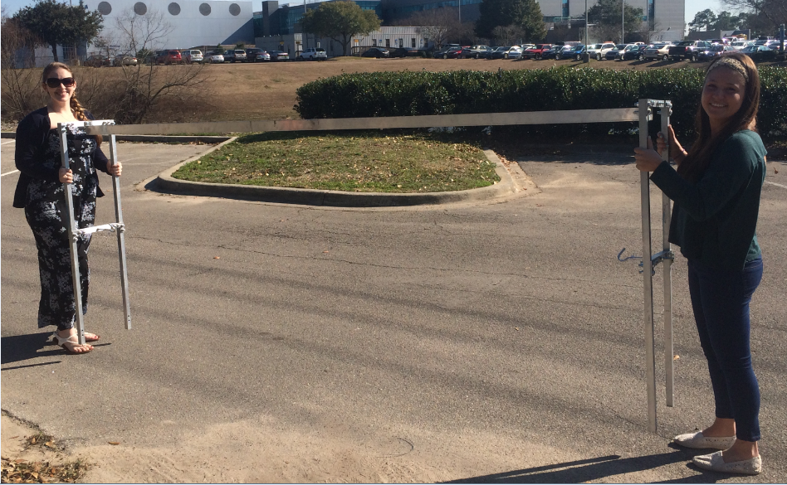
Questions ???

