Slide 1
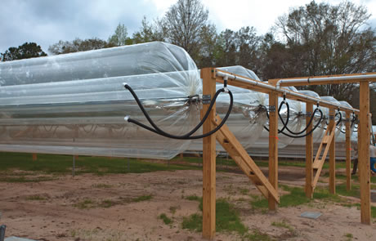
Solar Sausage for Water Desalination
Sponsor: Florida State University
Advisor: Dr. Shangchao Lin
Instructor: Dr. Scott Helzer
Nikhil Gupta
Dr. Chiang Shih
Group 7: Alexandra Filardo
Joseph Hamel
Alex Stringer
Crystal Wells

Slide 2
Needs and Goal Statement
Needs Statement
“Much of the under developed world still lacks access to clean drinking water.”
Goal Statement
“The goal of this project is to create a solar desalination system using the Solar Sausage.”
Solar Sausage for Alex Filardo
Water Desalination
Notes:
Reduced Education
Poor Hygiene
Pollutants
3.4 million people die from water-related illness every year – blueplanetnetwork
>186000 ppl/Tallahassee -→ that’s 18x the amount of people in Tallahassee

Slide 3
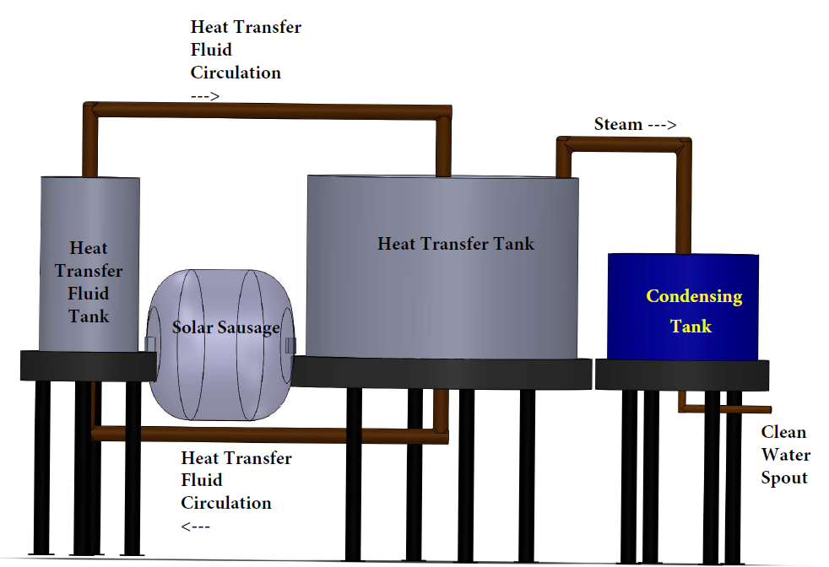
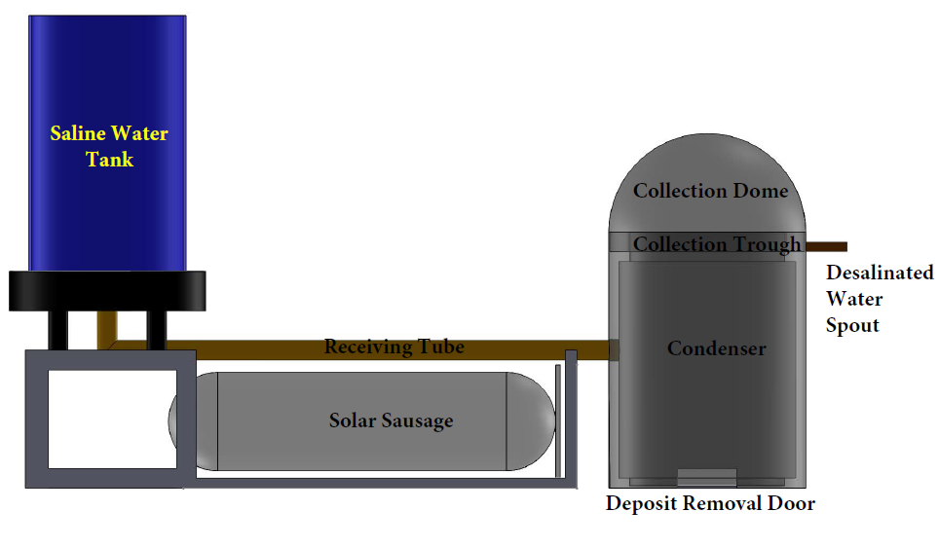
Design Concept #1 and #2
Heat Exchanger Method
Direct Heat Transfer Method
Solar Sausage for Alex Filardo
Water Desalination
Notes:
HE: Most expensive, most components, more maintenance required, complex design, more monitoring requried
DHTM: free-standing condenser required, takes up larger space, not easily adjusted for sun movement

Slide 4
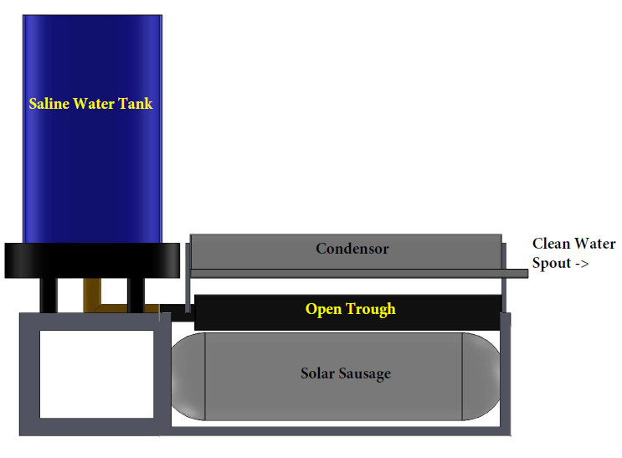
Final Design: Open Trough
Objectives
Provide a sufficient potable water for a small family in Madagascar
Stay within allowable budget
Remain simplistic in nature so that locals could easily be trained to operate and maintain
Solar Sausage must be easily transported and installed
Solar Sausage for Alex Filardo
Water Desalination

Slide 5
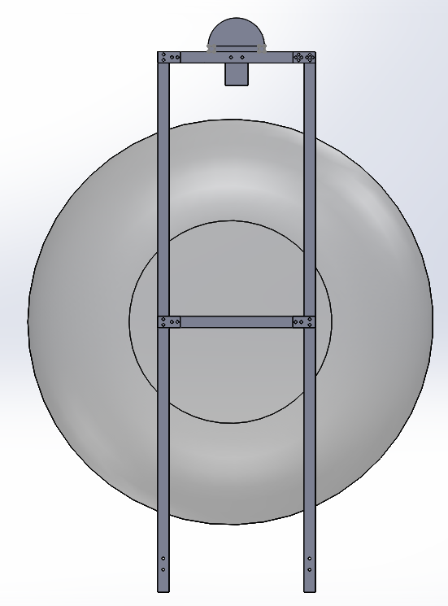
Revised Final Design
Solar Sausage for Alex Stringer
Water Desalination
Notes:
Larger solar sausage => greater material => greater cost

Slide 6
Material Selection
Desired Properties
Structural Material Decision Matrix
 | Density |  | Machinability | Tensile Strength |  | Cost
 | kg/m^3 | Rating | Rating | Mpa | Rating | $/ton |  | Total
Aluminum | 2770 | 8 | 10 | 276 | 4 | $2,017.50 | 8 | 204
Steel | 7854 | 3 | 7 | 415 | 9 | $766.00 | 10 | 175
Weight | 9 |  | 6 | 4 |  | 7
Structural Material Must be light weight
Good thermal conductivity
Easily machinable
Low Cost
Corrosion resistant
Condenser and Trough Material Decision Matrix
 | Emissivity |  | Machinability | Cost |  | Availability
 | ε | Rating | Rating | $/ton | Rating | Rating | Total
Aluminum | 0.09 | 6 | 10 | $ 2,017.50 | 8 | 10 | 240
Copper | 0.15 | 9 | 9 | $ 6,621.00 | 4 | 6 | 178
Weight | 4 |  | 6 | 7 |  | 10
Solar Sausage for
Water Desalination Alex Stringer

Slide 7
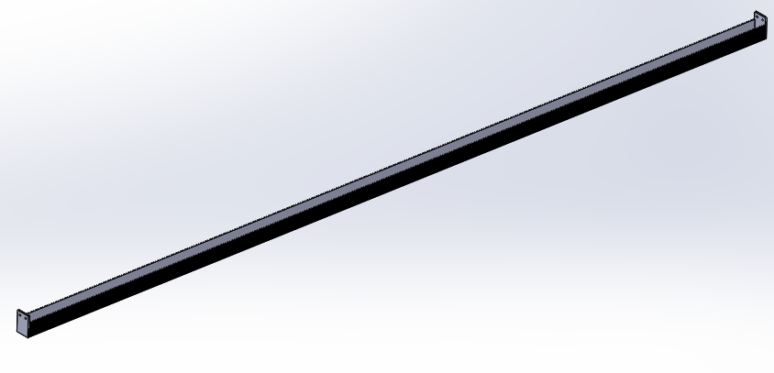
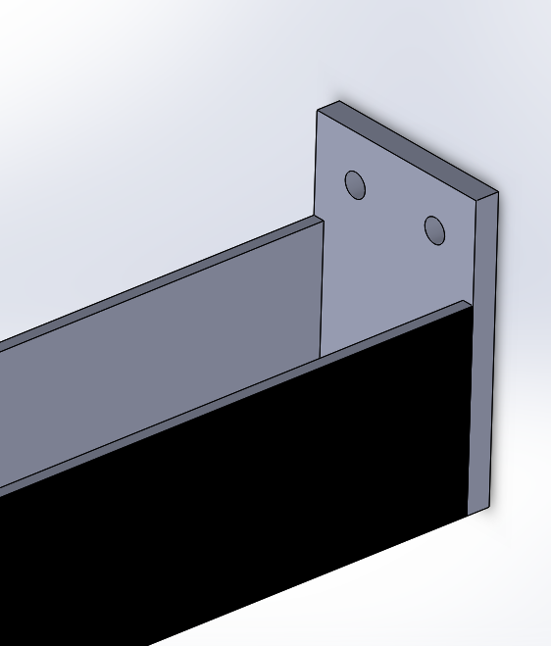
Components
Stand
$1in×1in$ Aluminum Tubing
1/8” Thick Wall
Crossbars
Length: $L=1ft$
a)
b)
Trough
Figure #. Trough
Full Trough
End of Trough where it is bolted to the stand
Width: $W=1.875 in ,$ Height: $H =1.875 in$, Length: $L=120 in$
The troughs volume is
$V=390 {in}^{3} or about 1.5 U.S gallon$
Solar Sausage for Alex Stringer
Water Desalination

Slide 8
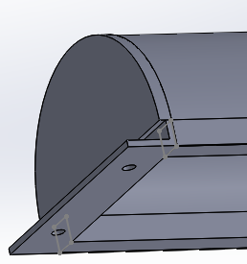
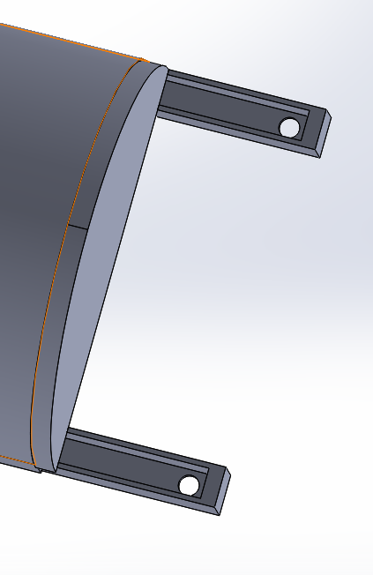
Components
Spike
Figure #. Condenser
a) Connected to an elevated Bolt on the Stand.
b) The angle of the raised end drives the water down the channels
Protrudes $11 in$ into the ground
$.5in$ diameter
Protrudes $4 in$ into the stand
Condenser
a)
Width: $W=5 in$, Height: $H=3.5in$, Length: $L=120 in$
Condenser Dome Radius: $R_{D}=2.5 in$
Surface Area
$A_{Surface}=960 {in}^{2} or .62 m^{2}$
b)
Solar Sausage for Alex Stringer
Water Desalination

Slide 9
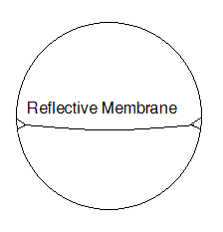
Technical Information
Solar Sausage
The Solar Sausage utilized will have a
Radius: $R=36 in$ and Length: $L=120 in$
The total Reflective Surface Area is
$A_{Reflective}=4080{ in}^{2} or 2.6{3 m}^{2}$
The Solar Sausage has three points of compounding loss
16%, when entering the Solar Sausage
10%, reflective membrane loss
12%, when exiting the Solar Sausage
Using these values a loss coefficient, $L,$was calculated
$L=1.5$
Figure #. Solar Sausage Cross-Sectional View
Solar Sausage for Alex Stringer
Water Desalination

Slide 10
Energy Analysis
Solar Insolation
Heat Delivered to the System
During peak hours the average Solar Insolation, $S=1000 \frac{W}{m^{2}}$
This values vary based on the collectors angle or latitude to the sun
$S_{θ}=1000\cos{θ}$
The latitude of Tallahassee is $θ=30°$
$S_{θ}=866.16 \frac{W}{m^{2}}$
Heat Delivered
$\dot{Q}=S_{θ}A_{Reflective}=2279.5 W$
Actual Heat Delivered
Taking into account the compounding losses
$\dot{Q_{Act}}=\frac{\dot{Q}}{L}=1516.81 W$
Solar Sausage for Alex Stringer
Water Desalination

Slide 11
Evaporation and Condensation
Evaporation Rate
Condensation Requirements
Its important to know the maximum rate of evaporation
Maximum Evaporation Rate Occurs at the maximum water temperature
$T_{w}=105℃$
Maximum Evaporation Rate
${\dot{M}}_{evap}=0.7 g/s$
Heat that must be removed from condenser
$h_{g@105°C}=2683.4$ kJ/kg
${\dot{Q}}_{cond}={(\dot{M}}_{evap})\left(h_{g@105°C}\right)=1.878 W$
Minimum Condenser Area
$A_{1}=0.03 m^{2}$
Solar Sausage for Alex Filardo
Water Desalination

Slide 12
Heat Loss
Trough Heat Loss
Maximizing Heat Input
Area of Trough
$A=\left(120 in\right)\left(2 in\right)=240 {in}^{2}=0.155 m^{2}$
Heat lost from one-side wall
${\dot{Q}}_{out}=9.65 W$
Total heat loss from sides
${\dot{Q}}_{out}=19.30 W$
Coat bottom of trough in black paint
Maximizes heat absorption
Line sides of trough with insulation
Reduces heat loss
Pressure Regulation System
Maintains focal point concentration
Sun Tracking
Maximize the amount of Solar Insulation Captures
Solar Sausage for Alex Filardo
Water Desalination

Slide 13
Budget
Master Budget
 | Estimated
Category | Cost | % of Tot. Spent | % of Tot. Budget
Raw Material | $ 325.45 | 22% | 7%
Fastners | $ 39.31 | 3% | 1%
Accessories | $ 226.00 | 15% | 5%
Labor | $ 750.00 | 50% | 15%
Shipping | $ 160.89 | 11% | 3%
Total | $ 1,501.65
Total Budget | $ 5,000.00
% Budget Spent | 30%
Solar Sausage for Alex Filardo
Water Desalination

Slide 14
Projected Work
Future Task
Develop pressure regulation system for Solar Sausage
Must maintain a $.01psi$ pressure difference between upper and lower chambers
Develop sun tracking system
Must be a manual System
Construct a Solar Sausage of appropriate dimension
$Length=10 ft and Diameter=3 ft$
Developed a small storage tank
With built in filtration system
Solar Sausage for Alex Stringer
Water Desalination

Slide 15
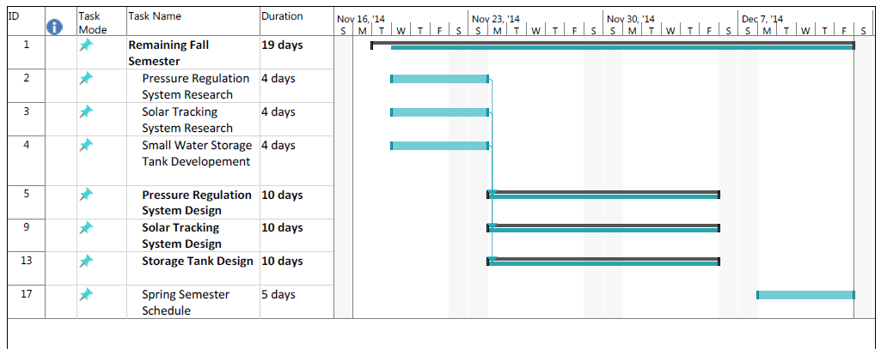
Gantt Chart
Solar Sausage for Alex Stringer
Water Desalination

Slide 16
Summary
The Solar Sausage delivers $\dot{Q_{Act}}=1558.9 W$ of heat to the trough during peak sun hours
The Trough is capable of holding 1.75 U.S gallons
We have currently spent an estimated 30% of our Budget
Will develop
Pressure Regulation System
Sun Tracking System
Small Storage Tank
Solar Sausage for Alex Filardo
Water Desalination
Notes:
Clean water not easily available like we are used to.
Luxury as the lack of causes disease and leads to a cycle of poverty.
Solar Sausage provides a solution to developing countries in need of clean water.
Green Energy – Solar
Direct Heat Transfer method chosen opposed to H.E. because simpler, easily fixed, less components, easier to train people.
increases deployment area opportunities
-> broadens marketing opportunities & potential consumer base
Many challenges to account for : climate and materials
easily replacable parts
weather conditions (seasonal variation)
Project Forecast:

Slide 17
References
[1] Seawater Desalination Power Consumption." Sustainable Solutions for a Thirsty Planet. WateReuse Association, 1 Nov. 2011. Web. 23 Sept. 2014. <WateReuse Association>.
[2] Aintablian, Xanthe. "Desalination Expands as Technology Becomes More Affordable." Water Desalination. AboutEducation. Web. 23 Sept. 2014.
[3] West, Tyler. "Low - Energy Desalination Units for Developing Countries." Web. 23 Sept.
2014. <http://www.pitt.edu/~tew32/WA3.pdf>.
[4] Engel, Yunus A. Fundamentals of Thermal-fluid Sciences. 4th ed. Singapore: McGrawHill, 2012. Print.
[5] "Ocean Water: Salinity." Oceanography. Office If Naval Research. Web. 18 Oct. 2014. <http://www.onr.navy.mil/focus/ocean/water/salinity1.htm>.
[6] Sinha, Sayontan. "Solar Insolation." Solar Insolation. Web. 21 Oct. 2014.
Solar Sausage for
Water Desalination

Slide 18
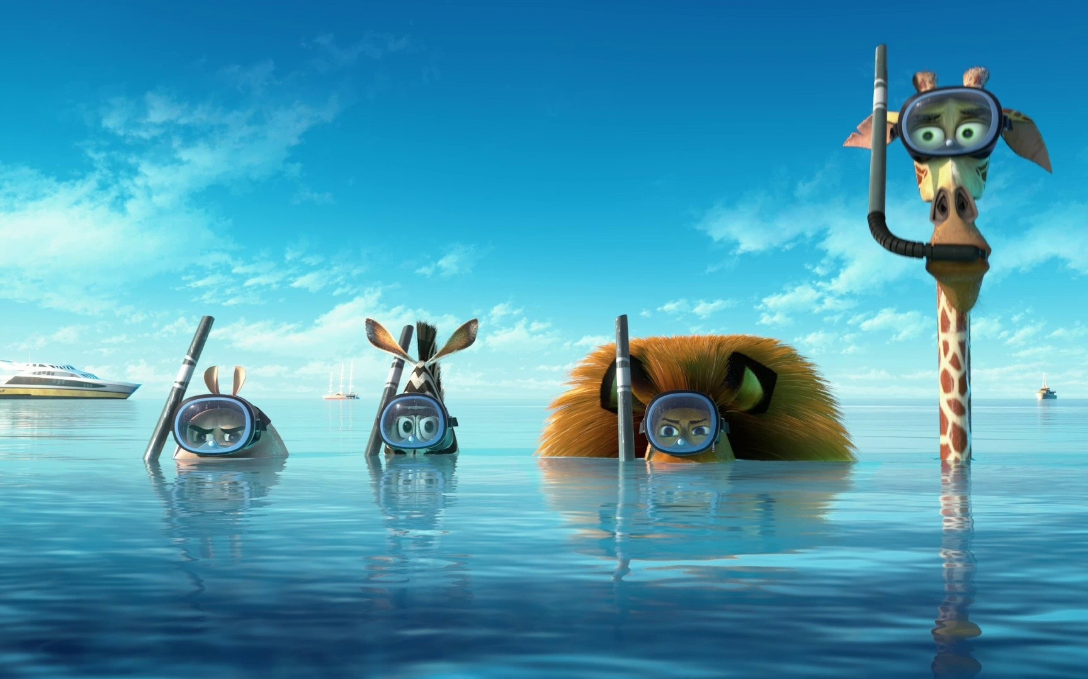
QUESTIONS?

