Slide 1
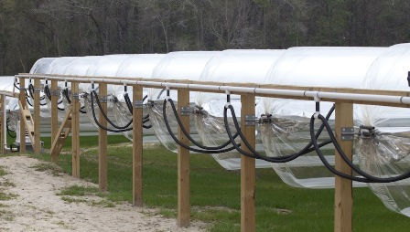

Solar Sausage for Desalination
Sponsor: FAMU-FSU College of Engineering
Advisor: Dr. Michael Devine
Dr. Shangchao Lin
Group: Alexandra Filardo
Joseph Hamel
Alexander Stringer
Crystal Wells

Slide 2
Background
Need for Water
Desalination
“Much of the developing world still lacks access to clean drinking water.”
Lack of clean drinking water contributes to:
  Illness and disease
  Poverty
Salt Water → Fresh Water
Energy intensive process
World leaders in desalination
  Israel, Saudi Arabia, and United Arab Emirates
Mutli-Stage Flash Distillation
  Uses the waste heat from adjacent power plants
Osmotic Drives
  Saline water forced through small membrane
  Requires electricity
Can use solar energy as heat source

Slide 3
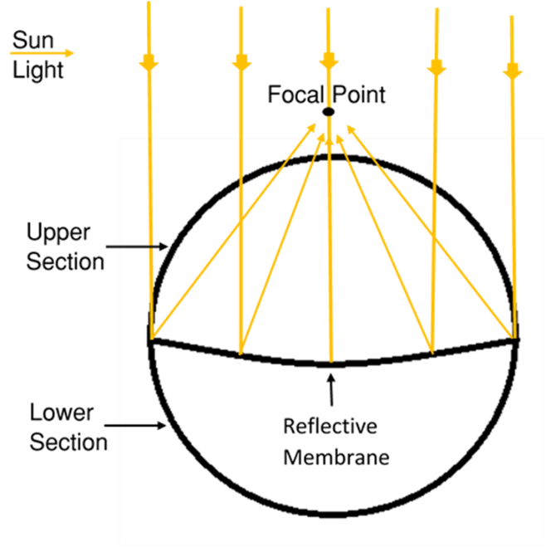
Background
Solar Sausage
Inflatable solar collector
Invented by Ian Winger
First prototype introduced to Florida State in 2009
Made of a clear membrane and a Mylar reflective membrane
Achieved 752⁰F at focal point at special laboratory settings with receiving tube
Figure 1: Cross-sectional view of Solar Sausage

Slide 4
Project Scope
Project Specifications
Entrepreneurship in Engineering
Is an entrepreneurial project with a budget of $5000
Tasked with using the Solar Sausage technology to desalinate water
Cost per gallon must compete or beat competition
Maintain simplicity
Readily available materials
Universal operation manual

Slide 5
Project Direction
Technical Questions
Project Objectives
Can it be operated manually?
How much water should be produced to support an average family?
What is the best design for functionality and commercialization?
Produce drinking water with a saline concentration less than 1000 ppm
Support a family of 4 - 5
Minimize cost
Create a user friendly system that can be easily transported and constructed

Slide 6
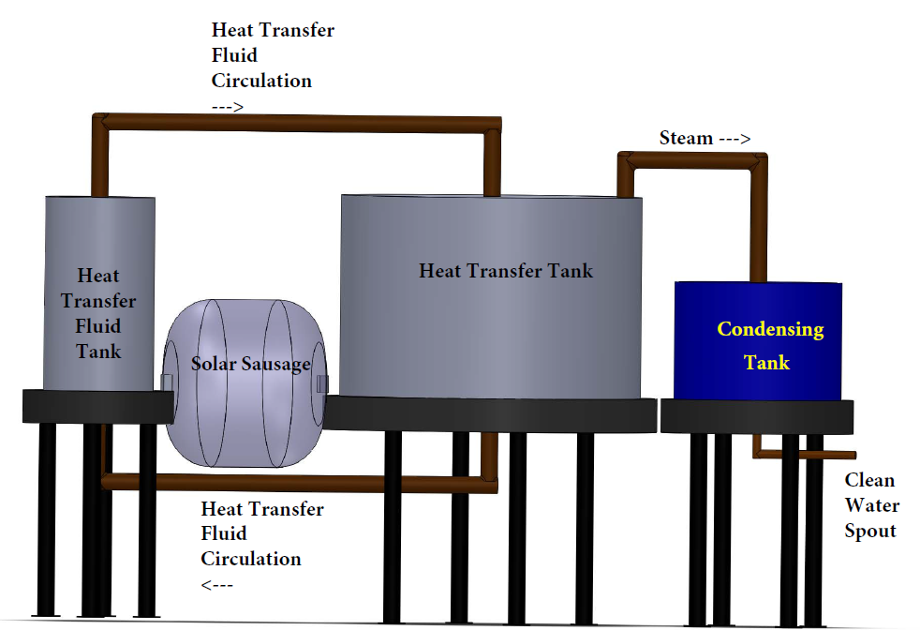
Design Concept 1
Heat Transfer Method
Uses eutectic salt and thermal siphoning
Density change in salt causes salt to circulate
Disadvantages:
  Lack of portability
  Expensive
  Not environmentally friendly
Figure 2: Heat Transfer Method

Slide 7
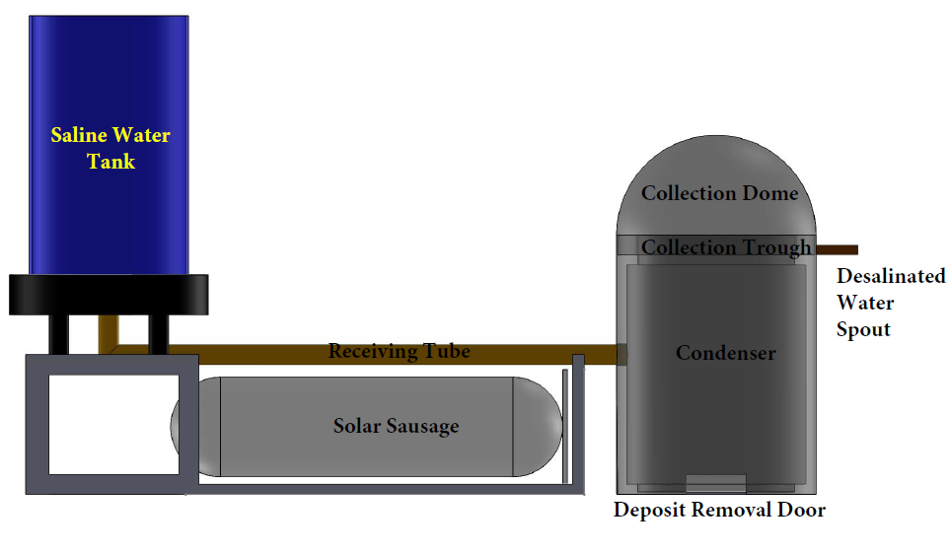
Design Concept 2
Direct Heating Method
Heats saline water in receiving tube
  Replaces heat exchanger
Storage is raised to lead saline water through the tube
Disadvantages:
  Lack of portability
  Receiving tube is likely to corrode
  Requires control system to regulate
  flow
  Limited operation time
Figure 3: Direct Heating Method

Slide 8
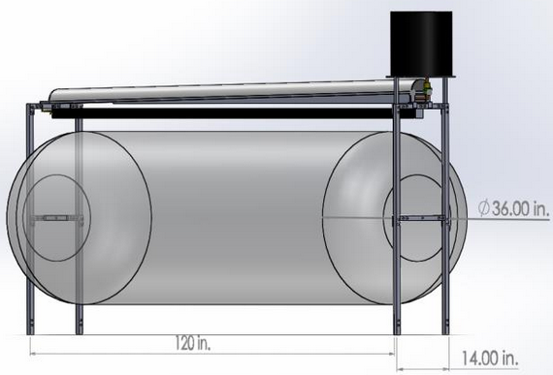
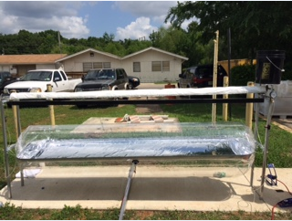
Final Design
Open Trough Method
Figure 4: Assembled View
Figure 5: Deployed View

Slide 9
Final Design Advantages
Modular design
Inexpensive
Easily repaired
Components made of readily available material
Versatile design
  Pasteurization possible

Slide 10
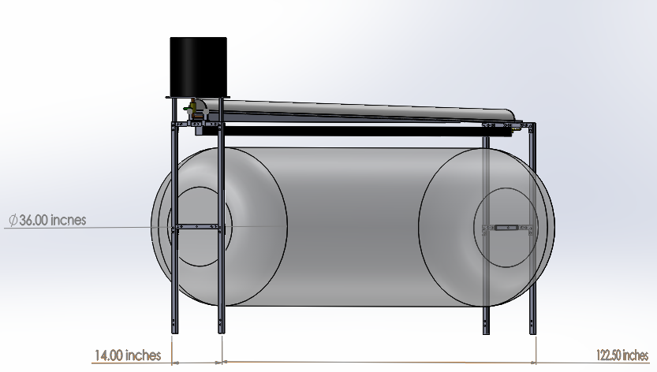
Major Components
Condenser
Length: 126 inches, Width: 5 inches, Height: 3 inches
Raised 2 inches at storage tank end
Water exits out the collection pipe
Storage Tank
5 gallon bucket, U.N water safe
0.5 inch ball valve controls the flow
Trough
Length: 120 inches
2 inch square aluminum channel
Holds 1.5 gallons of water
Stand
Constructed of 1 inch square aluminum tubing
Height: 48 inches
Width: 14 inches
Solar
Sausage
Solar Sausage
Length: 120 inches
Width: 36 inches
Figure 6: Component analysis

Slide 11
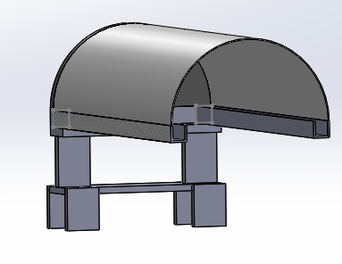
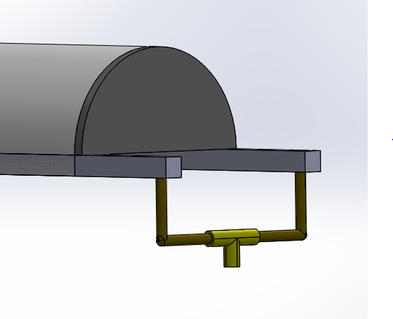
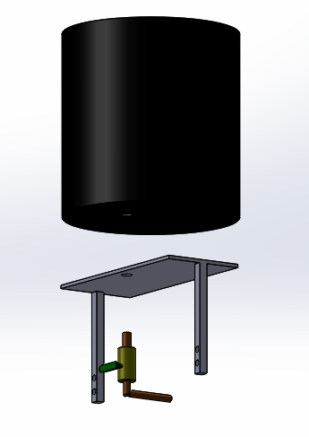

General Process
[5] Vapor
Condenses
[1] Saline
Water
[4] Water
Vapor
[6] Desalinated
Water
Solar Sausage
[2] Filtered
Saline
Water
Figure 7: Assembled and process views
[3] Heat Delivered to Trough
[1] Storage tank is filled with saline water, large
debris is filtered out
[2] Trough is filled with saline water
[3] The Solar Sausage delivers heat to the through,
heating the water
[4] Water vapor rises into the condenser
[5] The water vapor condenses and collects in
the channels along the sides
[6] A gradient drives the water down channels,
the desalinated water exits

Slide 12
Testing Confirmation
Pressure Regulation
Focal Point
Pressure difference confirmed according to visual focal point width
Visually confirmed against the bottom of the trough
Evaporation
Condensation
Confirmed through heating of trough with predetermined amount of water to evaporate
Confirmed through controlled environment conditions with predetermined amount of water to condense
  Steam cookers used to produce vapor

Slide 13
Testing and Results
Pressure Regulation
Focal Point
Set between chambers of Solar Sausage
Top Chamber: 1.0 psi
Bottom Chamber: 0.5 psi
  Found through visually creating focal width on trough
0.5 psi differential
  Expected 1/100th psi differential
  Variance due to change in focal line height away from Solar Sausage
Necessary width of 3/8th in. - 2 in.
  Achieved during testing
Decreased width → increased temperature
Lower focal point height → increase top chamber pressure
Higher focal point height → increase bottom chamber pressure

Slide 14
Testing and Results
Evaporation
Condensation/Collection
Full system tested without condenser
Water temperature achieved 120⁰F with focal point tested
Water evaporation occurred
Evaporation rate of 0.074 gal/hr
  Testing conditions: bottled water starting at room temperature, sunny with overcast
  Expected 0.67 gal/hr
  Variance due to inconsistent sunlight
    Optimal temperature: 220⁰F
Confirmed proof of concept
  Achieved 0.008 gal/hr
  Evaporation rate 0.35 gal/hr
Tarp used for condensing hood for prototype
  Custom machine required to bend aluminum into radius of design
Losses
Notes:
Input water: 56 fl oz.
Condensed water: 1.2 fl oz.
Losses: manufatcuring defects (crinkling of tarp, not clean aluminum with weld to channels)
Open to atmosphere

Slide 15
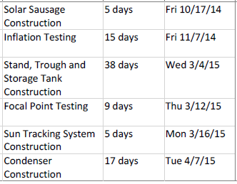
Project Management
Schedule
Resource Allocation
Weather and condenser construction delays occurred
Utilized college machine shop and local welding services
Stored and constructed system at the college of engineering
Resource Allocation
Resource | Type | Provider
Solar Sausage | Research and Material | Ian Winger
Machining | Service | College of Engineering
Welding | Service | Tallahassee Welding and Machine Shop
Storage | Facility | College of Engineering
Figure 8: Gantt Chart Overview
Figure 9: Resource Allocation

Slide 16
Budget
Total budget: $5,000
Total Spent: $1,485.62
  30% of total
Total System Cost: $855.26
  Inexpensive for higher marketability
  Assuming 3 gallon output: 81¢ / gallon
Vendors:
  McMaster Carr
  Metals Supermarket
Figure 10: Budget

Slide 17
Overcoming Challenges
Challenges Encountered
Lessons Learned
Entrepreneurship
Prevent contamination from Aluminum
Condenser design
  Tarp used for prototype to resolve issue
Schedule delays
  Outsourced welding
  Testing contingent upon weather conditions
Expect the best, plan for the worst!
  Contingency plans
  Account for delays when creating a schedule

Slide 18
Conclusion
Design is sufficient for evaporating and condensing water.
  Full system tested without condenser
  Condenser tested separately
  Components proven to work individually so system concluded to work with overall system inefficiencies discovered with future testing
Prototype sets basis for a marketable and functional product to provide potable water to coastal regions
Modifications need to be made to increase output and efficiency
  Particularly in the condenser

Slide 19
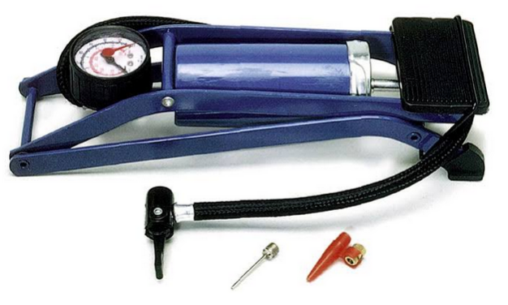
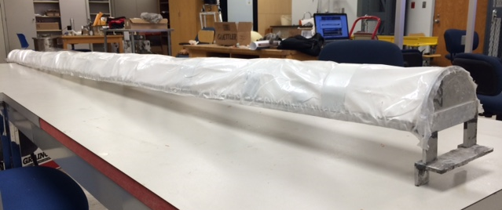
Future Work
Test system as a whole unit
Improved pressure pumping system
  Current design is foot pump requiring 30 min for startup time
Increase output and efficiency
  Better evaporation and condensation rates
  Possible solutions
    Enclosed condenser
Decrease cost
  Provides better cost against competitors
Figure 11: Current pressure pump
Figure 12: Current condensing hood

Slide 20
Questions?
eng.fsu.edu/me/senior_design/2015/team07

Slide 21
Analysis slides

Slide 22
Testing and Results
Evaporation
Condensation/Collection
Full system tested without condenser
Water temperature achieved 120⁰F with focal point tested
Water evaporation occurred
Evaporation rate of 0.074 gal/hr
  Testing conditions: bottled water starting at room temperature, sunny with overcast
  Expected 0.67 gal/hr
  Variance due to inconsistent sunlight
    Optimal temperature: 220⁰F
Confirmed proof of concept
  Achieved 0.008 gal/hr
Achieved 0.008 gal/hr
  Evaporation rate 0.35 gal/hr
  Expected
    Condensation rate: 0.54 gal/hr
    Evaporation rate: 0.67 gal/hr
  Losses
Tarp used for condensing hood for prototype
  Custom machine required to bend aluminum into radius of design
Notes:
Input water: 56 fl oz.
Condensed water: 1.2 fl oz.

Slide 23
Testing Data
H20 Heat Capacity (Btu/lbm*F) |  |  | 1
Amount of Water in Trough (lbm) |  |  | 1.1
Time (s) | Init. Temp (F) | Final Temp (F) | ∆T | Heat Input (Btu) | Rate of Heat Input (Btu/hr)
67 | 77 | 89 | 12 | 13.2 | 709.25
127 | 86 | 103 | 17 | 18.7 | 530.08
54 | 101 | 112 | 11 | 12.1 | 806.67
77 | 111 | 120 | 9 | 9.9 | 462.86
 |  |  |  | Average Heat Input (Btu/hr) | 627.21

