Slide 1

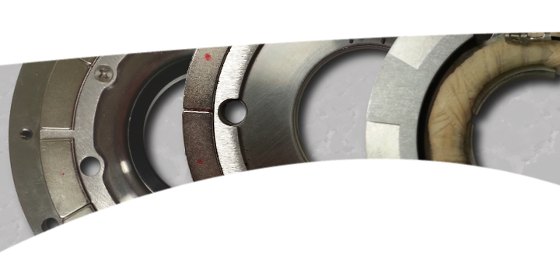
Danfoss Turbocor
Magnet Insertion Process
Team 5 November 14, 2013
Team Leader: Jaro Volny
Coordinator/Financial Advisor: Henry Ferree
Webmaster: Timothy Blum
Mentor: Dr. Simone Hruda
Liaison Engineer: Paul Lulgjuraj
www.turbocor.com
Jaro Volny

Slide 2
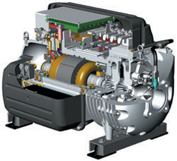
Background
Pioneer and world leader of the oil-free centrifugal compressor
World’s most efficient commercial refrigerant compressors
World’s first totally oil-free compressor
  Magnetic bearings result in a levitated rotating shaft
Timothy Blum

Slide 3
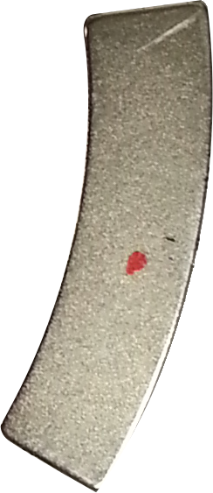
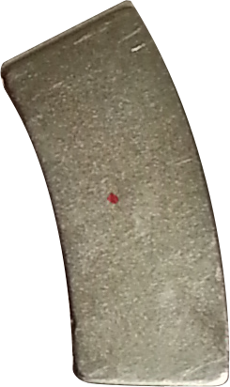
Bearings and Magnet Overview
The three different bearings are named:
  Big
  Small
  Twin
Used in different model compressors designed for specific applications and operations
Two different magnets used in the bearing’s design:
  The shorter magnet is used on the “big” and “twin” bearings
  The longer magnet is used on the “small” bearing
  The red dot is to identify the orientation of the magnet
Timothy Blum

Slide 4
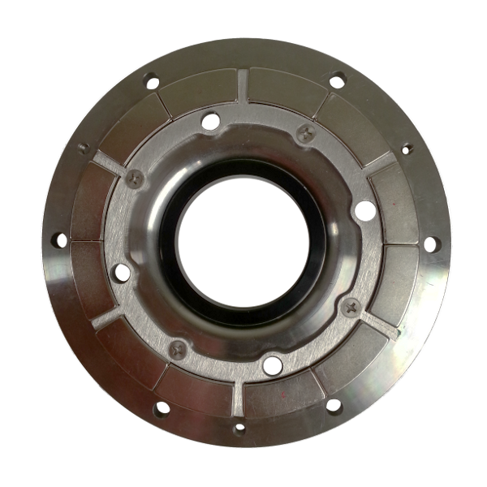

“Big”
12
1
Largest bearing outer diameter (6.37 inches)
12 magnets in 6 pairs
  6 spacer regions separating magnets
Magnets pairs are separated evenly by 60 degrees
4 coolant holes
Uses short magnet design
11
2
10
3
9
4
8
5
7
6
Timothy Blum

Slide 5
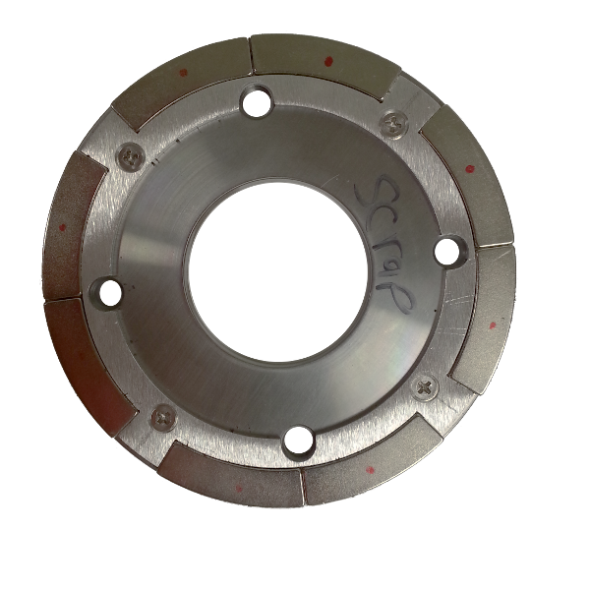

“Small”
8
1
Bearing outer diameter (5.38 inches)
8 magnets in 4 pairs
  4 spacer regions separating magnets
Magnets pairs are separated evenly by 90 degrees
4 coolant holes
Uses long magnet design
7
2
6
3
5
4
Timothy Blum

Slide 6
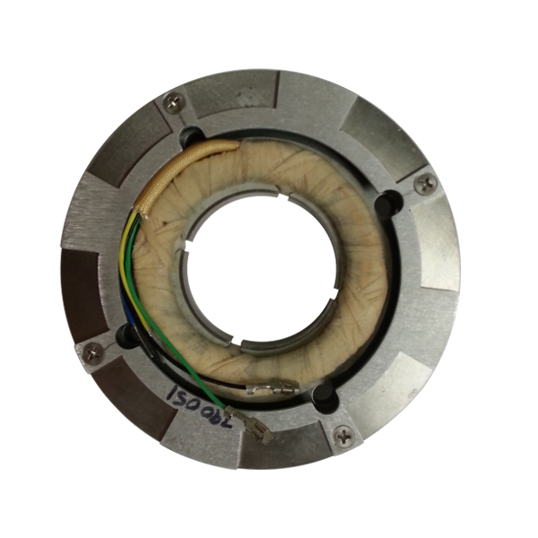
“Twin”
8
Bearing outer diameter (5.38 inches)
8 magnets
Magnets are not separated evenly due to spacer geometry
4 coolant holes
Uses short magnet design
7
1
2
6
5
3
4
Timothy Blum

Slide 7
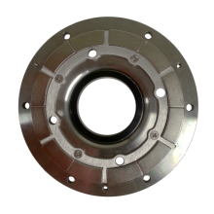
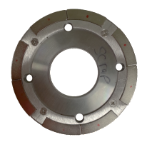
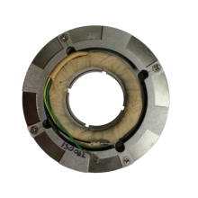
Bearing Compatibility
Magnets in pairs
Even spacer separation
Big
Small
12 magnets to insert
60°spacer
120°spacer
Longer magnet design
4 coolant holes in same location
Short magnet design
8 magnets to insert
Uneven spacer geometry
Twin
Timothy Blum

Slide 8

Current Magnet Insertion Issues
  Existing automated assembly machine is not reliable
    Control issues
    Magnet spacer rejection causes jamming
  Currently assembled by hand by a technician
    Ergonomic issues due to strong magnetic forces
      High impacts cause magnets to fracture
    Proper magnet placement
      Magnet misalignment causes bearing assembly failure
    Proper magnetic pole orientation
      Improper orientation causes compressor to fail
Henry Ferree

Slide 9

Handling Magnets
Henry Ferree

Slide 10
Project Path
  Reparation of existing automated machine
    Pros: Safe & design has already been developed
    Cons: Lots of electronics, controls, & sensors
  Develop a simple insertion mechanism
    Pros: New & improved
    Cons: Requires new design & increases cost
  Develop a handheld tool to aid insertion process
    Pros: Simple & cost effective
    Cons: Little improvement
Henry Ferree

Slide 11
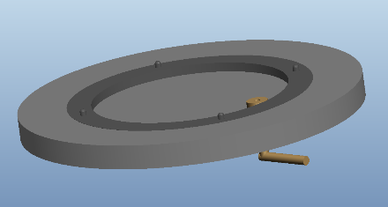
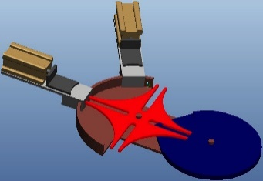
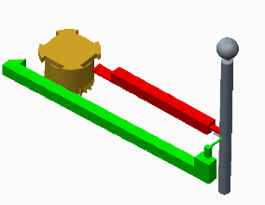
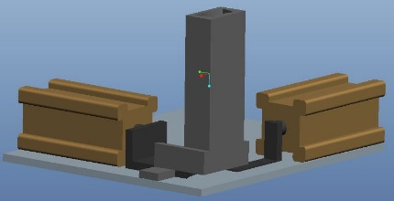
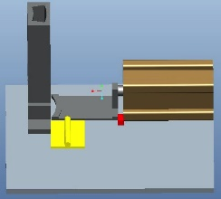
Project Path
  Develop a simple insertion mechanism
  Two main issues with selected path:
    1. Rotating the bearings to specific magnet location.
      3 concepts:
    2. Inserting the magnets.
      2 concepts:
Henry Ferree

Slide 12

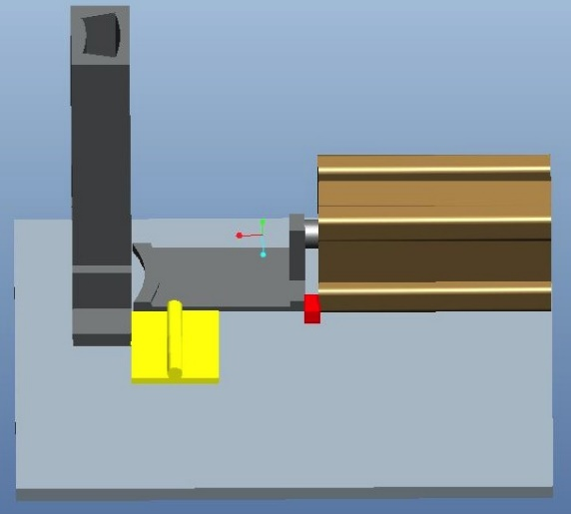
Concept Selection
Rotary Indexing Mechanism
  Dual Actuator Geneva Wheel
    Simple for technician to set up and run
    Allows possibility to integrate switches for automation
    Will have to design for changing Geneva wheels for each bearing
Magnet Inserting Mechanism
  Single Action Magnet Inserter
    Lower cost
    More compact
Jaro Volny

Slide 13
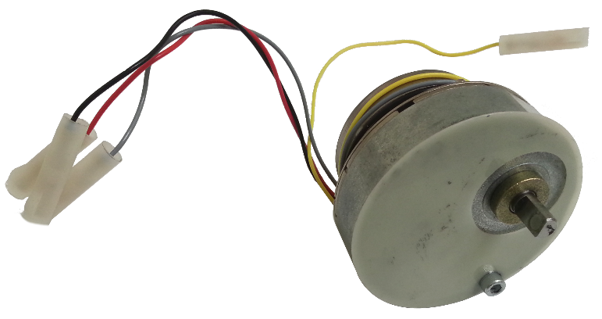
Project Scope Changes
After selecting rotary indexing and magnet insertion mechanisms, Turbocor saw an issue with design adaptability
Bearing design changes may be implemented in the near future
  Any changes to bearing, specifically spacer dimensions, would mean geneva mechanism would no longer index at correct locations
Turbocor recommended the use of a stepper motor that could be reprogrammed in the event of future bearing design changes
Team had to reconsider project path
Jaro Volny

Slide 14
Revised Project Path
  Reparation of existing automated machine
    Pros: Safe & design has already been developed
    Cons: Lots of electronics, controls, & sensors
  Develop a simple insertion mechanism
    Pros: New & improved
    Cons: Requires new design & increases cost
  Develop a handheld tool to aid insertion process
    Pros: Simple & cost effective
    Cons: Little improvement
Jaro Volny

Slide 15
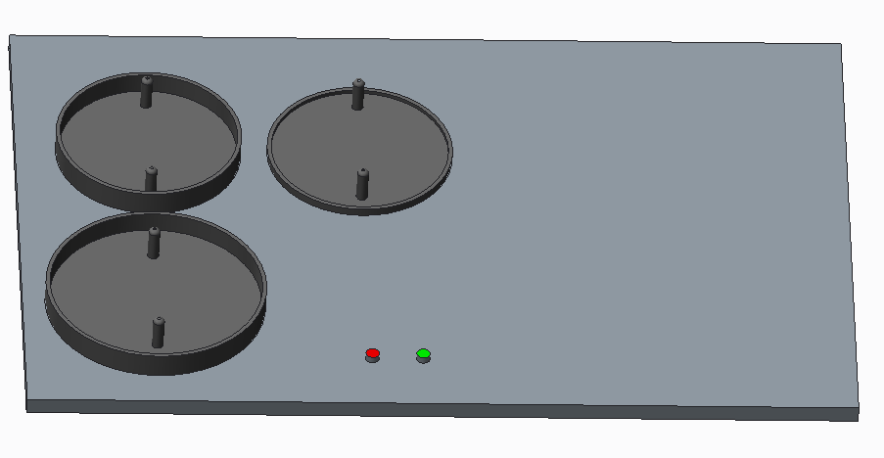
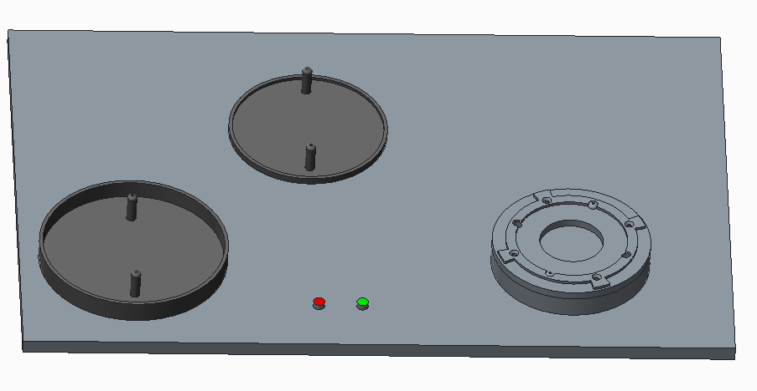
Accomplishing Objectives with Stepper Motor
With a stepper motor, new design challenges have been presented
Hardware:
  Logic board
  Sensors
  Buttons and switches
Programming:
  Getting the motor to rotate bearing to proper location
  Firing actuator at proper timing intervals
Safety:
  Enclosure
  Emergency switch
Jaro Volny

Slide 16
Future Work
Procurement of proper motor items:
  Logic board (PLC, Baby Orangutan, DragonBoard, Mini DragonBoard)
  Power Supply
  Wiring
  Motor Controller
  Switches
Programming motor
Enclosure and structural drawings
Nest materials
GOAL: Drawings to Turbocor by end of Fall semester!
Jaro Volny

Slide 17
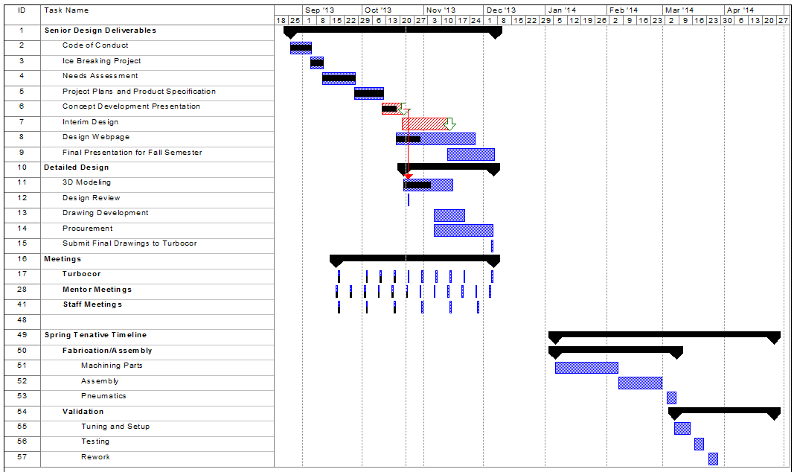
Gantt Chart
Jaro Volny

Slide 18
References
Danfoss turbocor. (n.d.). Retrieved from http://www.turbocor.com
[Web log message]. (2011, February 07). Retrieved from http://mechanicaldatahelp.wordpress.com/2011/02/07/20-geneva-mechanisms/
Jaro Volny

Slide 19
Questions?
Jaro Volny

Slide 21
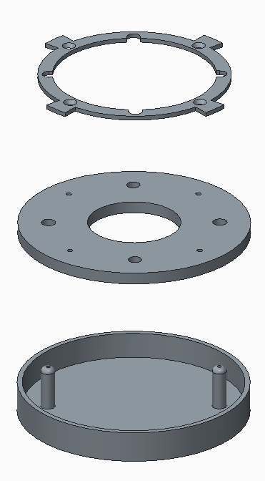
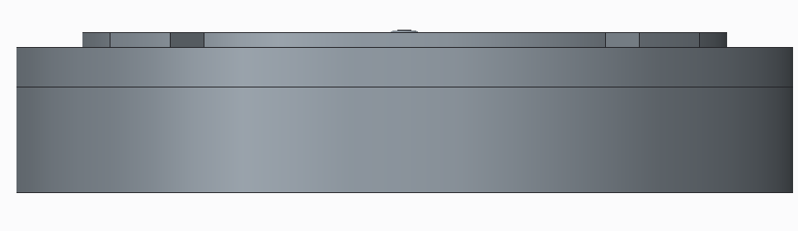
Nest Description
Nest will have removable pins that hold specific bearings.
Will also serve as a “shim” to make each bearing height align with insertion surface.
Nest will fit onto stepper motor pinion and system will begin indexing.

Slide 22
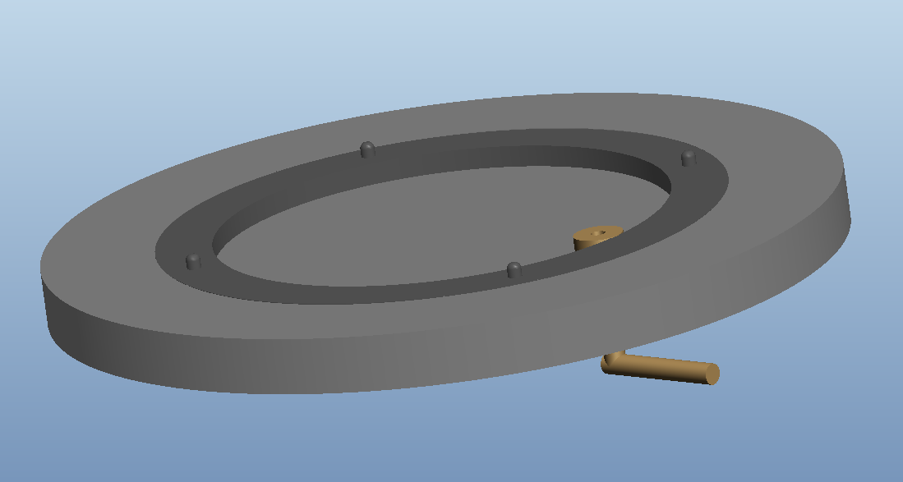
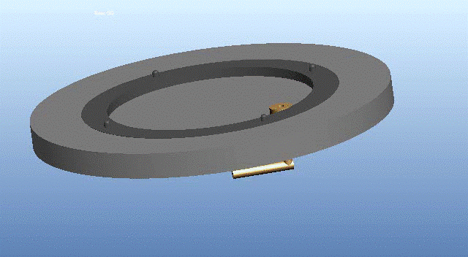
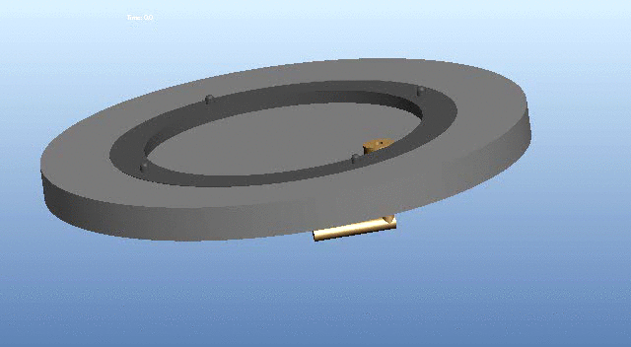
Rotary Indexing Prototype #1
Internal Gear-set with Crank
Pros:
Simple design
Adaptable to all bearing sizes
Possible conversion to an automated mechanism
Cons:
Safety
Large rotational input
Actuator triggered by hand
Jaro Volny

Slide 23

Rotary Indexing Prototype #2
Dual Actuator Geneva Wheel
Pros:
Works for bearings with same number of magnets
Simple design
Possible conversion to an automated mechanism
Cons:
Two linear actuators
Cost
Requires user to input preset conditions before use
Jaro Volny

Slide 24
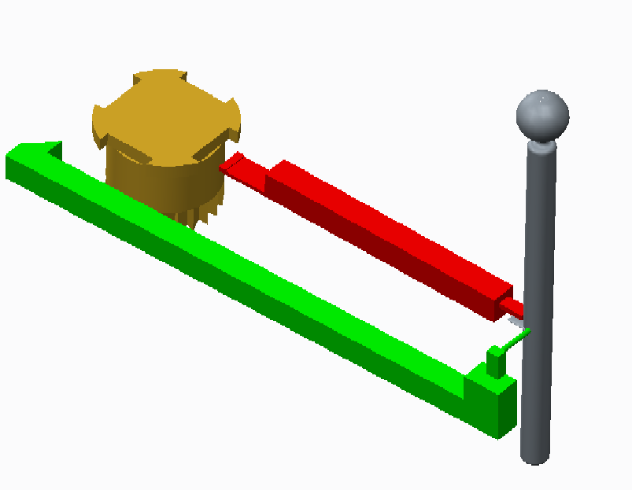
Rotary Indexing Prototype #3
Indexing Lever Arm
Pros:
Cost
Simple design
Single input
Does not require any linear actuators
Cons:
Each bearing requires a separate mechanism
Jaro Volny

Slide 25

Inserting Mechanism Prototype #1
Double Action Magnet Inserter
Pros:
Simple design
  Used by existing faulty automated machine
Cons:
Two linear actuators
Cost
Size
Jaro Volny

Slide 26

Inserting Mechanism Prototype #2
Single Action Magnet Inserter
Pros:
Single linear actuator
Compact
Cons:
Reliability
Jaro Volny

Slide 27
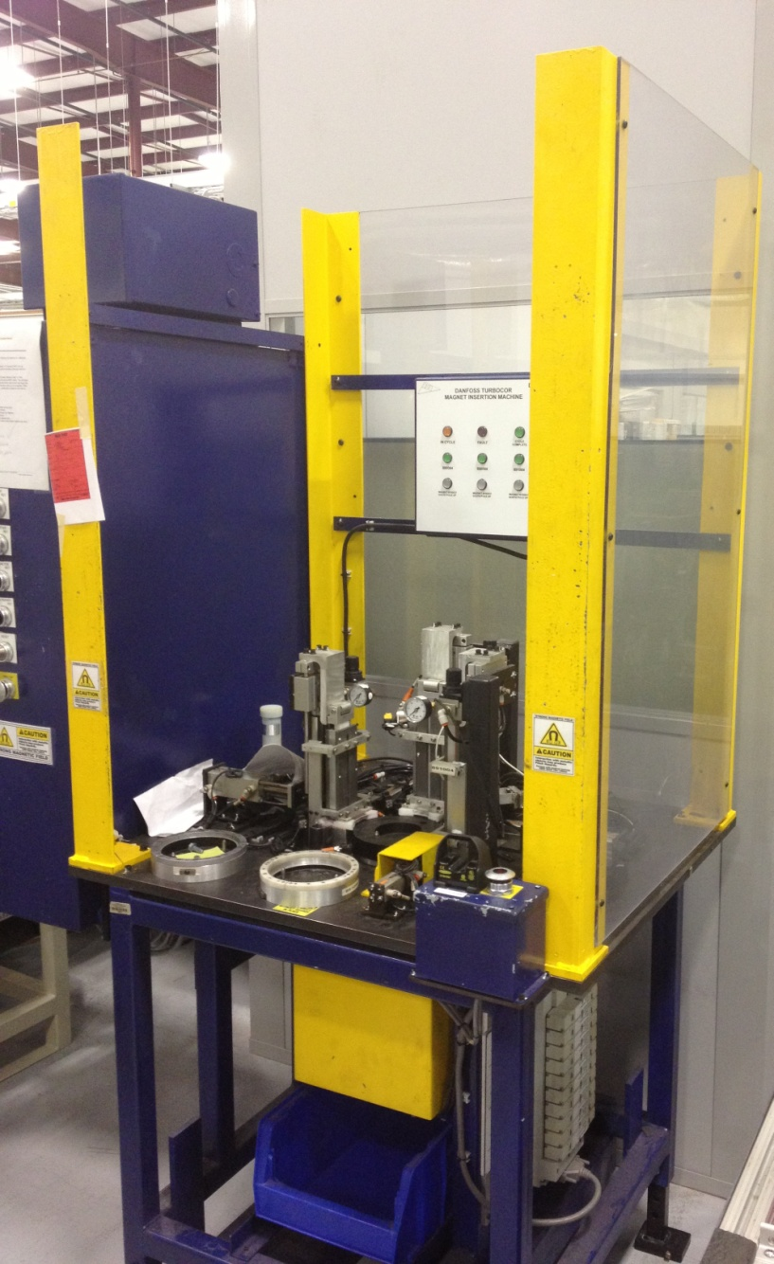
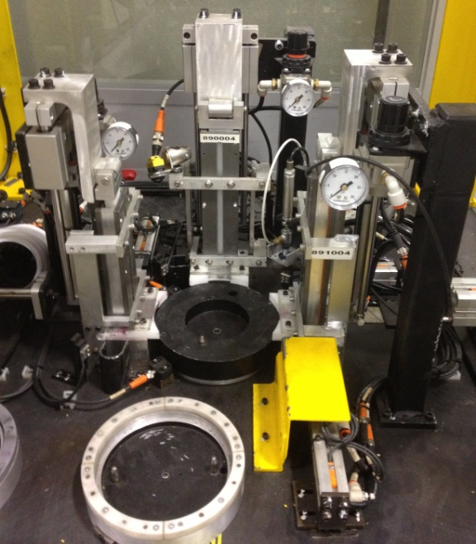
Automated Magnet Insertion Machine

Slide 28
What is left to be done
Gantt Chart & future work (last slide)
Formatting/spelling & grammar check
Pictures if needed
Choosing indexing mechanism with Turbocor
Project Path animations explaining that 1 of 3 rotary indexing mechanism and 1 of 2 insertion mechanisms need to be chosen
All bottom headings need to be taken out except for page number

