Slide 1
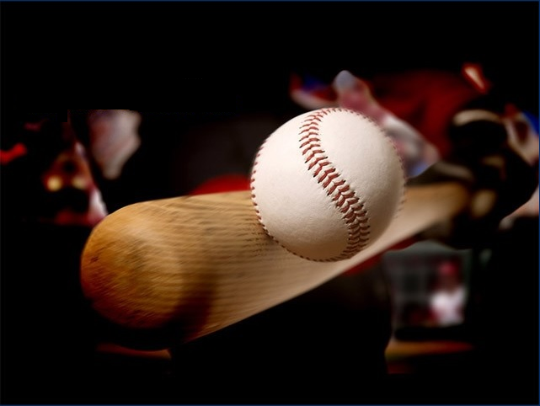
“Wear It” Protective Vest
Team Members:
Kyler Hast ME
Kyle Meredith ME
Ryne Wickery ME
Garth Fletcher IE
Maria Miro IE
Cecilia Wong IE
Sponsored by: Mr. Gavin Boone
ME Advisor: Dr. Kamal Amin
IE Advisor: Dr. David Olawale
October 22, 2013

Slide 2
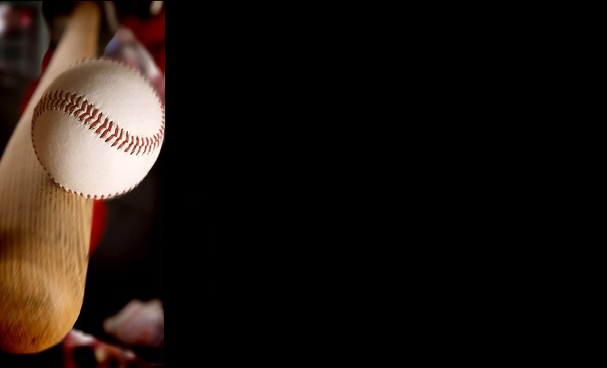
Project Scope
Create a vest prototype that protects the players from being injured by the baseball when batting.
The vest will cover the entire back of the player as well as the ribs, and neck part unprotected by the helmet.
Cecilia Wong IE

Slide 3
Objectives
Analyze materials.
Determine the ideal material.
C. Analyze designs to determine best choice
for protective vest.
D. Choose design.
E. Construct / Test / Analyze a prototype.
Cecilia Wong IE

Slide 4
Background
The inspiration for this design arose from Mr. Gavin Boone seeing a player being struck in the back of the neck during a game.
Mr. Boone recognized there was a need for a protective garment that would protect the neck and other vital areas.
The protective vest will have all the necessary elements for a sports garment; safe, lightweight, comfortable, stylish.
Kyle Meredith ME

Slide 5
Design Concept 1
Ryne Wickery ME

Slide 6
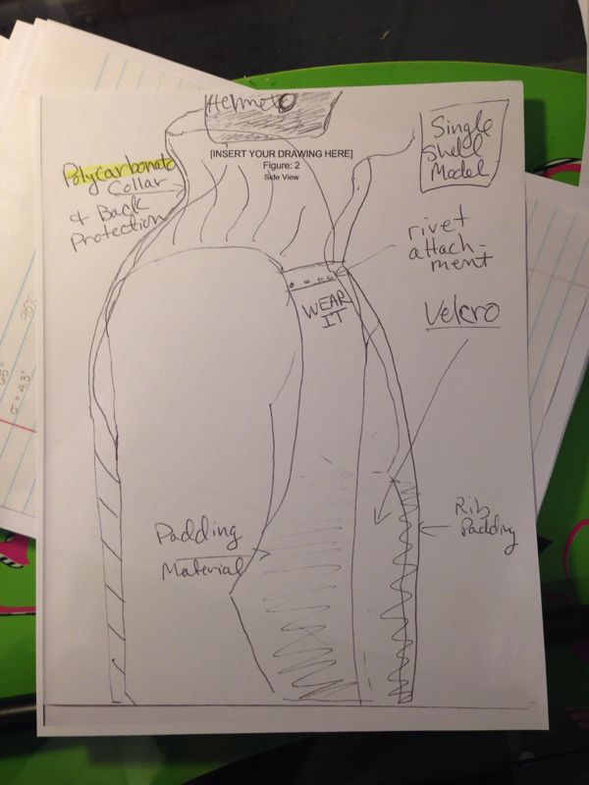
Ryne Wickery ME

Slide 7
Design Concept 2
Kyler Hast ME

Slide 8
Kyler Hast ME

Slide 9
Design Concept 3
Garth Fletcher IE

Slide 10
Garth Fletcher IE

Slide 11
Materials
Material | Density (Mg/m³) | Tensile Strength (MPa) | Fracture Toughness (MPam) | Cost ($/Kg)
Polyurethane | 1.12 – 1.24 | 35.9 – 56.5 | 1.84 – 4.97 | 4.10 – 5.60
Polyethylene | 0.939 – 0.96 | 20.7 – 44.8 | 1.44 – 1.72 | 1.30 – 1.40
Kevlar | 1.44 | 3.6 – 4.1 GPa | --- | 50 (spool of thread)
Flexible Polymer Foam | 0.016 – 0.115 | 0.24 – 2.95 | 0.005 – 0.09 | 2.90 – 3.10
Ryne Wickery ME

Slide 12
Challenges/Risks
Must ensure that vest will prevent the impact of baseball from doing extensive damage
Determining what constitutes “extensive” damage
Vest must allow batter to retain the originally ability to bat
Kyler Hast ME

Slide 13
Challenges/Risks
Runner must retain the ability to run the bases and slide
Numbers must be visible, but are located in an area that is covered by the vest
Vest should be able to be put on and removed quickly
Kyler Hast ME

Slide 14
Selection Criteria
Cost efficient.
Material combination.
Safety requirement.
Good quality.
Does not hinder player performance.
Extra features provided.
Garth Fletcher IE

Slide 15
House of Quality
Cecilia Wong IE

Slide 16
Future Plans
Maria Cristina Miro IE

Slide 17
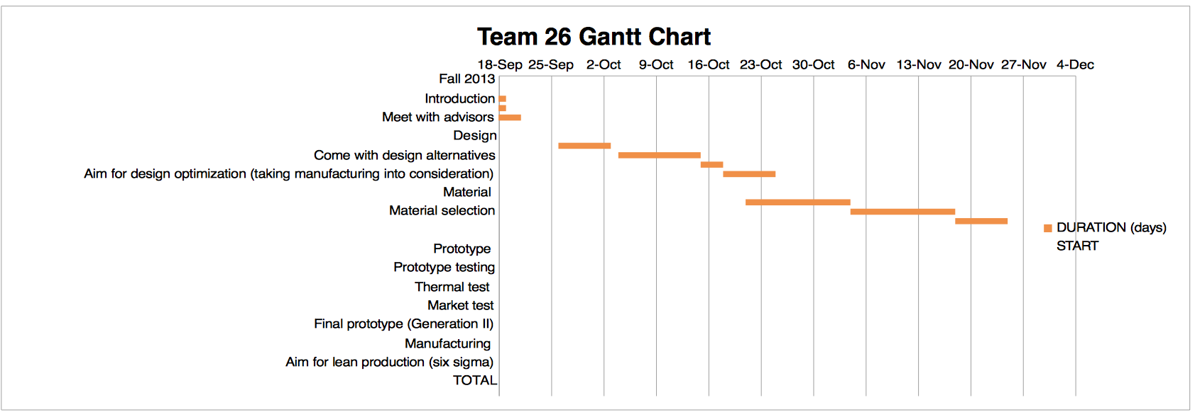
Gantt Chart
Maria Cristina Miro IE

Slide 18
Final Summary
Discussed current problem and scope of project.
Went over multiple design options for our vest.
Introduced possible materials to use for our vest
In The Coming Weeks:
Finalize Material Selection
Acquire Test Samples of Materials to Analyze
Start Developing Prototype
Kyle Meredith ME
Kyle Meredith ME

Slide 19
Questions?
Kyle Meredith ME

