Slide 1
“Wear It” Impact Baseball Vest
Team Members
Garth Fletcher
Kyler Hast
Kyle Meredith
Maria Miro
Ryne Wickery
Cecilia Wong
Advisors
Dr. K. Amin
Dr. D. Olawale
Sponsor
Gavin Boone
March 20, 2014

Slide 2
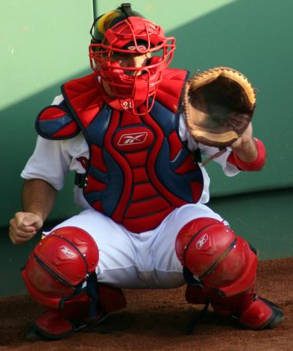
Background
Batter may incur severe or painful injuries from being hit by a baseball.
These types of injuries may deter younger children from playing baseball.
With an effective protective collar injuries to the spine and neck can be prevented.
No current protection is available for the neck region.
Garth Fletcher

Slide 3
Scope
Design a collar to prevent injury from baseball impact.
Design the collar so it does not hinder performance.
Design collar to be integrated into current vests.
Garth Fletcher

Slide 4
Material Selection
EVA Foam
High Density Polyethylene
Garth Fletcher

Slide 5
Why EVA Foam
Good Characterize
Toughness
Flexibility
Resistance to chemical
Many different application
Shock absorber
Garth Fletcher

Slide 6
Why EVA Foam
Minimize kinetic energy by an impact
Lifespan of 3 years
Viscoelastic recovery occur after impact
Garth Fletcher

Slide 7
Why HDPE
Characteristics
Thermoplastic
Large density ratio
Lightweight
Resistant to water and most solvents
Application
Bull riding vest
Fuel tanks
Storage
Garth Fletcher

Slide 8
Collar Design
Cecilia Wong

Slide 9
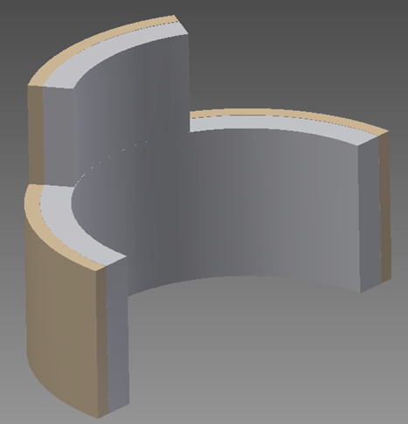
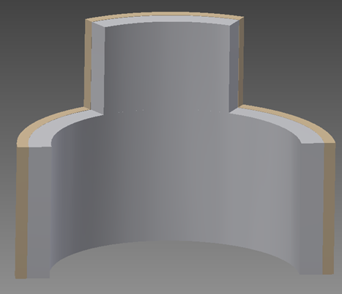
Flat Neck Plate
Cecilia Wong

Slide 10
Collar Attachment
Between the two materials
Contact cement
To the vest
Nylon fabric sleeve sewn to the vest neckline.
Cecilia Wong

Slide 11
Testing Procedure/Plan
Kyle Meredith

Slide 12
Compression Testing
Machine is located in HPMI; not currently functional
6 in X 6 in flat piece of sample will be used
Measures impact energy and deformation of sample
Enables team to determine correct size of final collar design
Video processing also being considered
Kyle Meredith

Slide 13
Testing Procedure
Force Sensor mimics surface area of ball
Multiple heights are being considered(3 ft, 6ft, etc)
Sample will sit at base of machine(free, unclamped)
Deformation is measured after each drop
Impact energy is calculated from values
Velocity profile may also be obtained from video processing
Kyle Meredith

Slide 14
Questions?

