Slide 1
“Wear It” Impact Baseball Vest
Team Members
Garth Fletcher
Kyler Hast
Kyle Meredith
Maria Miro
Ryne Wickery
Cecilia Wong
Advisors
Dr. K. Amin
Dr. D. Olawale
Sponsor
Gavin Boone
February 13, 2014

Slide 2
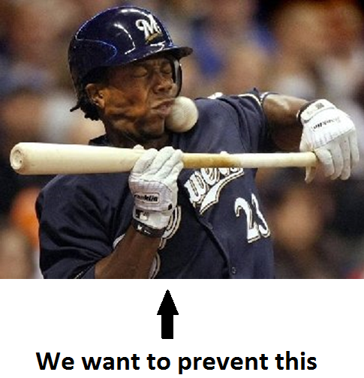
Overview
Background
Updated Scope
Analysis
Design
Material Selection
Testing
Ergonomics
Updated Schedule
Kyler Hast

Slide 3
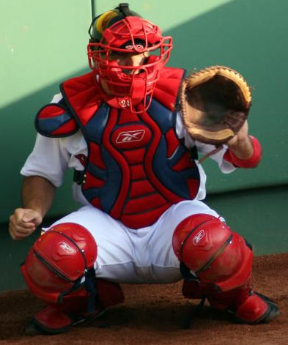
Background
Batter may incur severe or painful injuries from being hit by a baseball.
These types of injuries may deter younger children from playing baseball.
With an effective protective collar injuries to the spine and neck can be prevented.
No current protection is available for the neck region.
Kyler Hast

Slide 4
Updated Scope
Design a collar to prevent injury from baseball impact.
Design the collar so it does not hinder motion/performance.
Design collar to be integrated into current vests.
Kyler Hast

Slide 5
Analysis
Impact time
2.455*10⁻³ sec
Force of ball at 100mph
2.581 kN (580 lbf)
Surface area of ball compressed
0.503 in²
Impact Energy = 141 J
Kyler Hast

Slide 6
Collar Design
Final design will be selected from one of the following designs
Final selection will be based on finite element results
Ryne Wickery

Slide 7
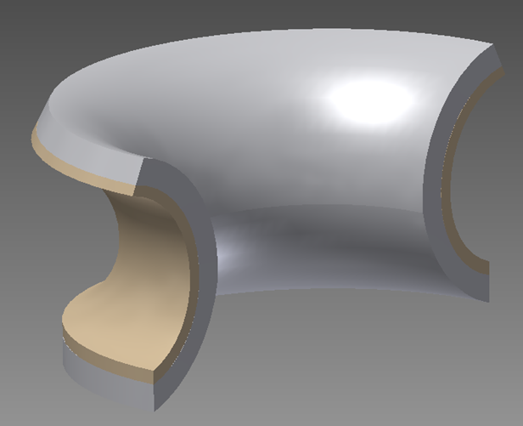
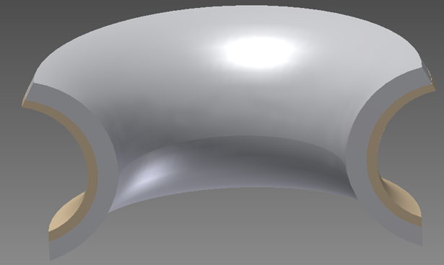
Crown Neck Plate
Ryne Wickery

Slide 8
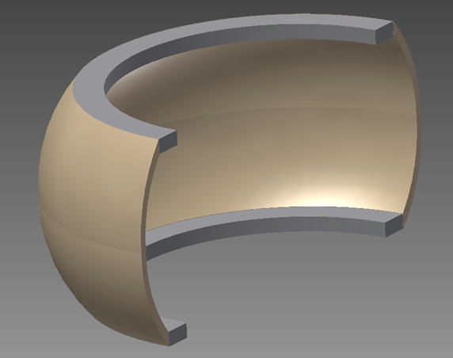
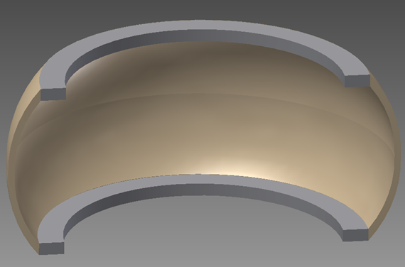
Arched Neck Plate
Ryne Wickery

Slide 9
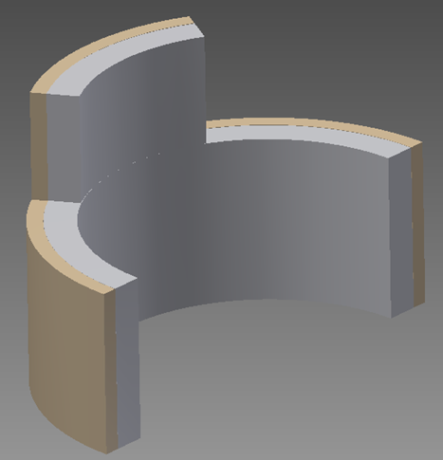
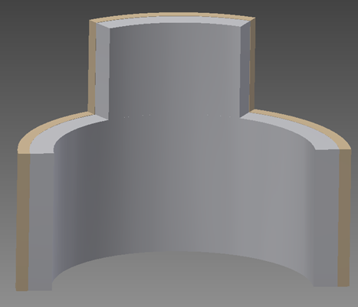
Flat Neck Plate
Ryne Wickery

Slide 10
Final
Material Selection
Ryne Wickery

Slide 11
High Density Polyethylene
Will be used for the hard shell of the collar
Thermoplastic
Relatively large strength-to-density ratio
Currently used in bull riding protection vests, and also in ballistic protection
Ryne Wickery

Slide 12
EVA Foam
Padding material for the collar
Used in current protective gear
Water resistant
Won’t absorb sweat
Can be formed to collar shape
Recoverable
Relatively lightweight
Maria Miro

Slide 13
Ergonomics
Comfort
Foam will be comfortable to player
Fit
Thermoplastic, and elastic foam will allow collar to be molded as desired [Retain mobility]
Safety
Collar will protect player from damage caused by impact
Chemical
Polyethylene and EVA will not react with skin of player that would cause rash or disturbance.
Maria Miro

Slide 14
Future Plans
Finite Element Analysis
Will be used to Select Final Design
Will allow us to determine material dimension (thickness)
Procurement
Acquire material samples for compression testing
Compression Testing
Sample of Collar construction will undergo compression testing to mimic impact.
This will allow us to confirm conclusions from finite element analysis
Maria Miro

Slide 15
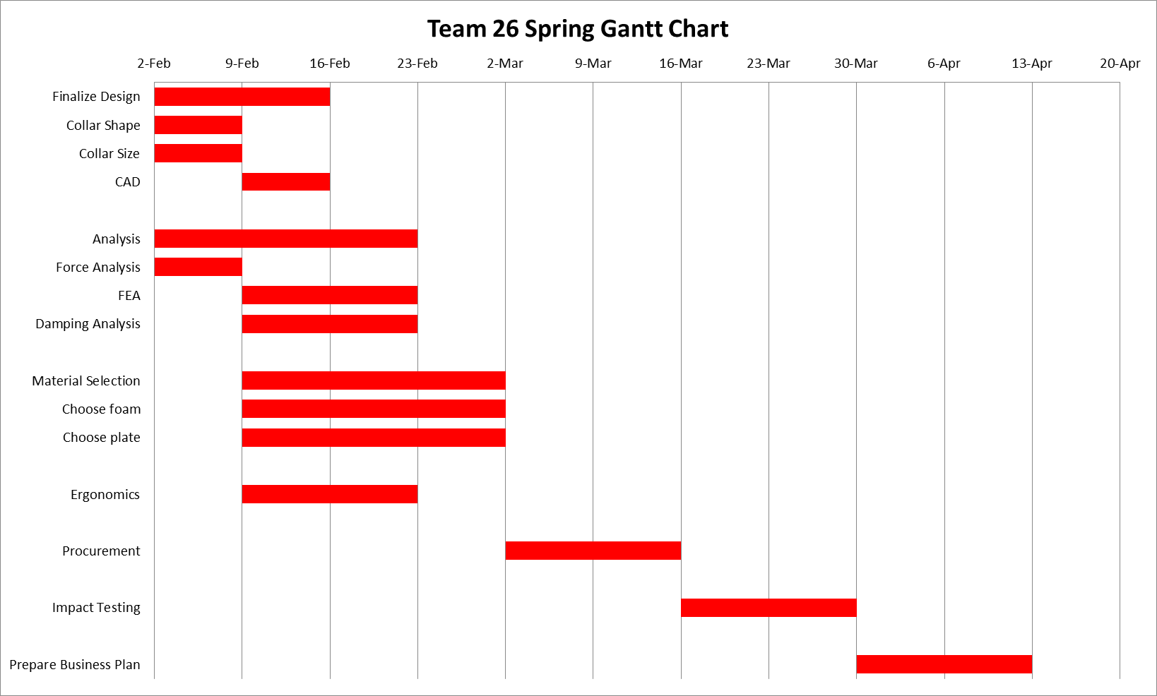
Maria Miro

Slide 16
Questions?

