Slide 1

Self-Stabilizing Pool Table
Team 19 Group Members:
Norman Gross & Alexander York
Advisor: Keith Larson
4/17/2014

Slide 2

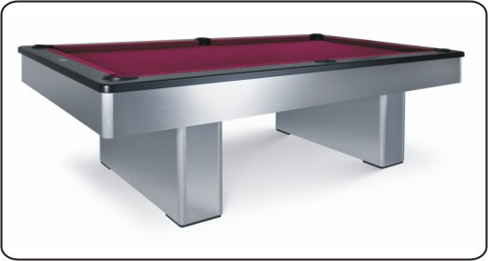
Motivation
Notes:
Beyond Innovation has the solution to this problem. A prototype is being developed to reduce the footprint of the pool table by up to 75%. This will give the table a capability of vertically stowing itself in a discrete housing in case the additional space is needed. Along with its storage ability, the table will also have a self-stabilization feature that levels the slate-top to have a perfectly horizontal playing field. The design of this table will have both the look and the feel of a standard slate pool table.

Slide 3
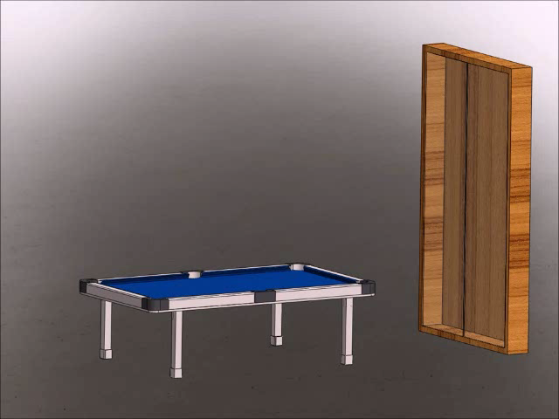
Project Scope
Reduce the footprint by 75%
Vertically Stowable
Self-Leveling
Notes:
Beyond Innovation has the solution to this problem. A prototype is being developed to reduce the footprint of the pool table by up to 75%. This will give the table a capability of vertically stowing itself in a discrete housing in case the additional space is needed. Along with its storage ability, the table will also have a self-stabilization feature that levels the slate-top to have a perfectly horizontal playing field. The design of this table will have both the look and the feel of a standard slate pool table.

Slide 4
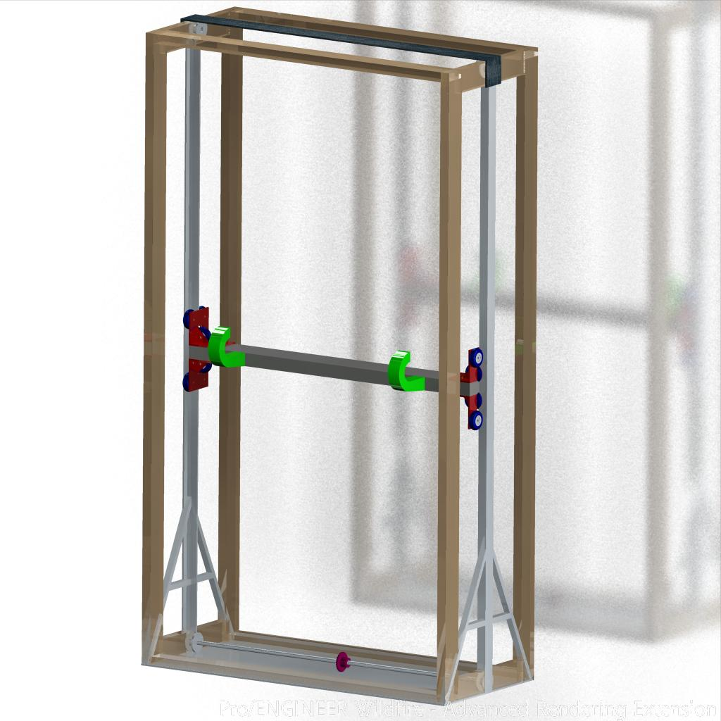
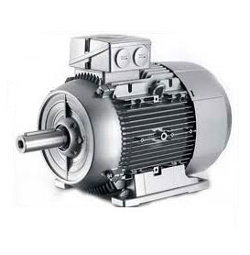
Stowing
Housing
Internal Frame
  Steel
External Frame
  Wood
AC Motor
  Sprockets
  Chain Driven
Notes:
Discuss Motor selection for lifting mechanism

Slide 5
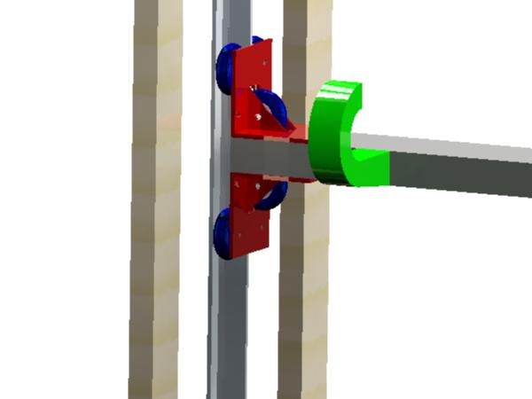
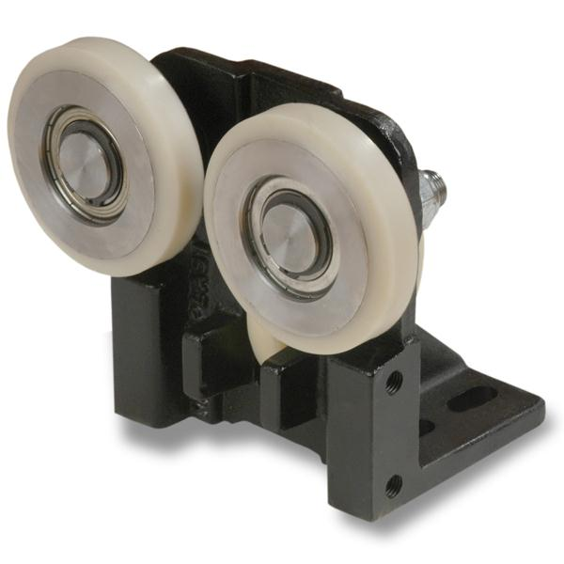
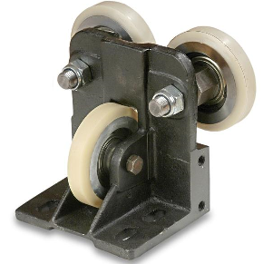
Stowing
Lifting Mechanism
Linear Guides
  Seen on elevators
Guide Rails
  Minimize moments
Hooking arms

Slide 6
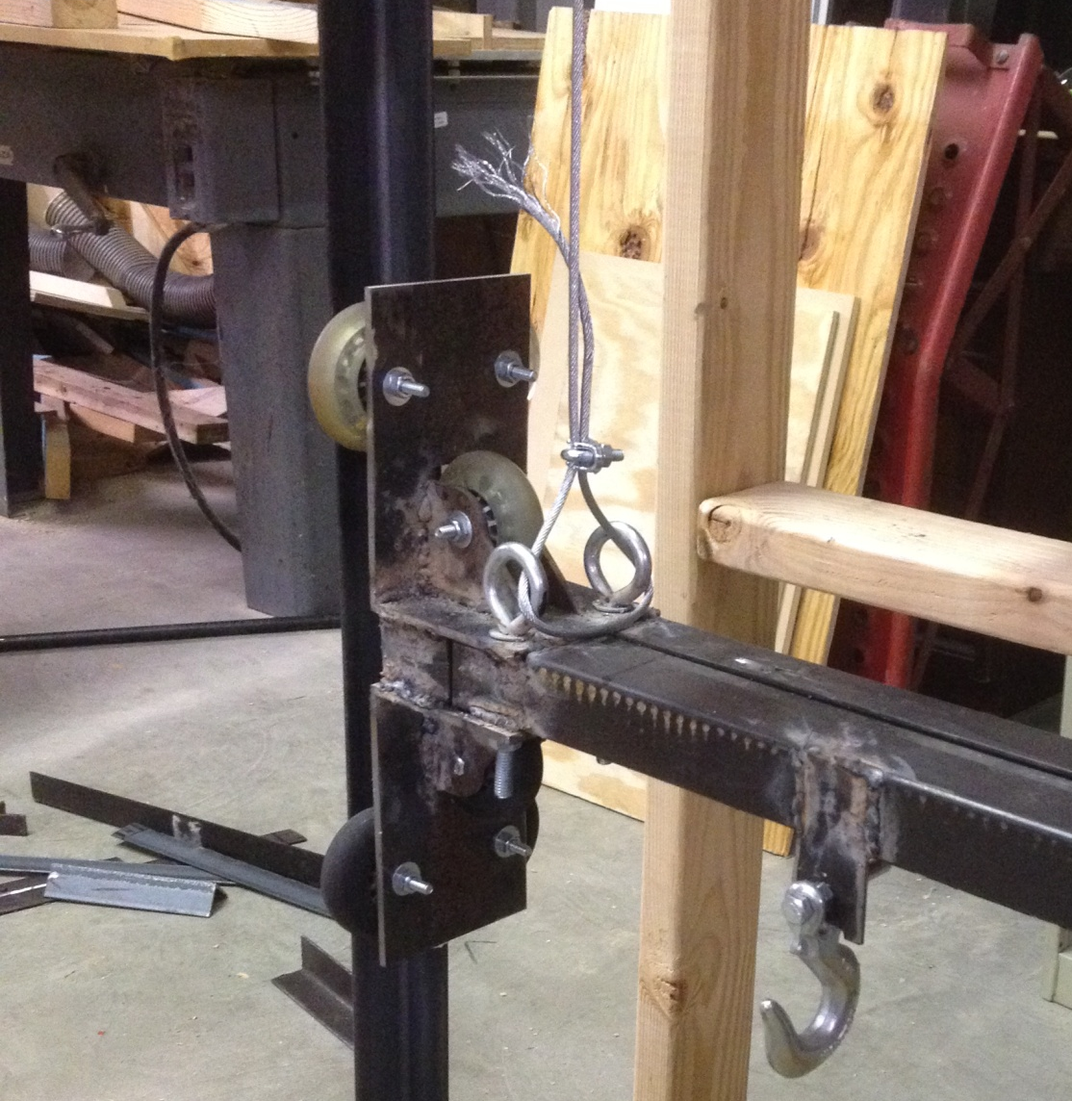
Stowing

Slide 7
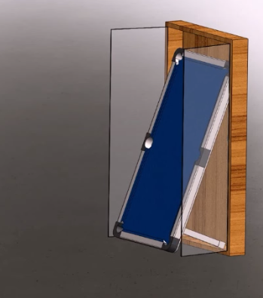
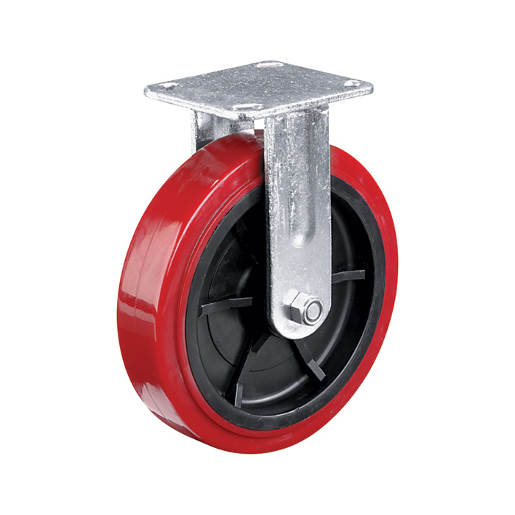
Transition
Notes:
Show all angles of transition

Slide 8
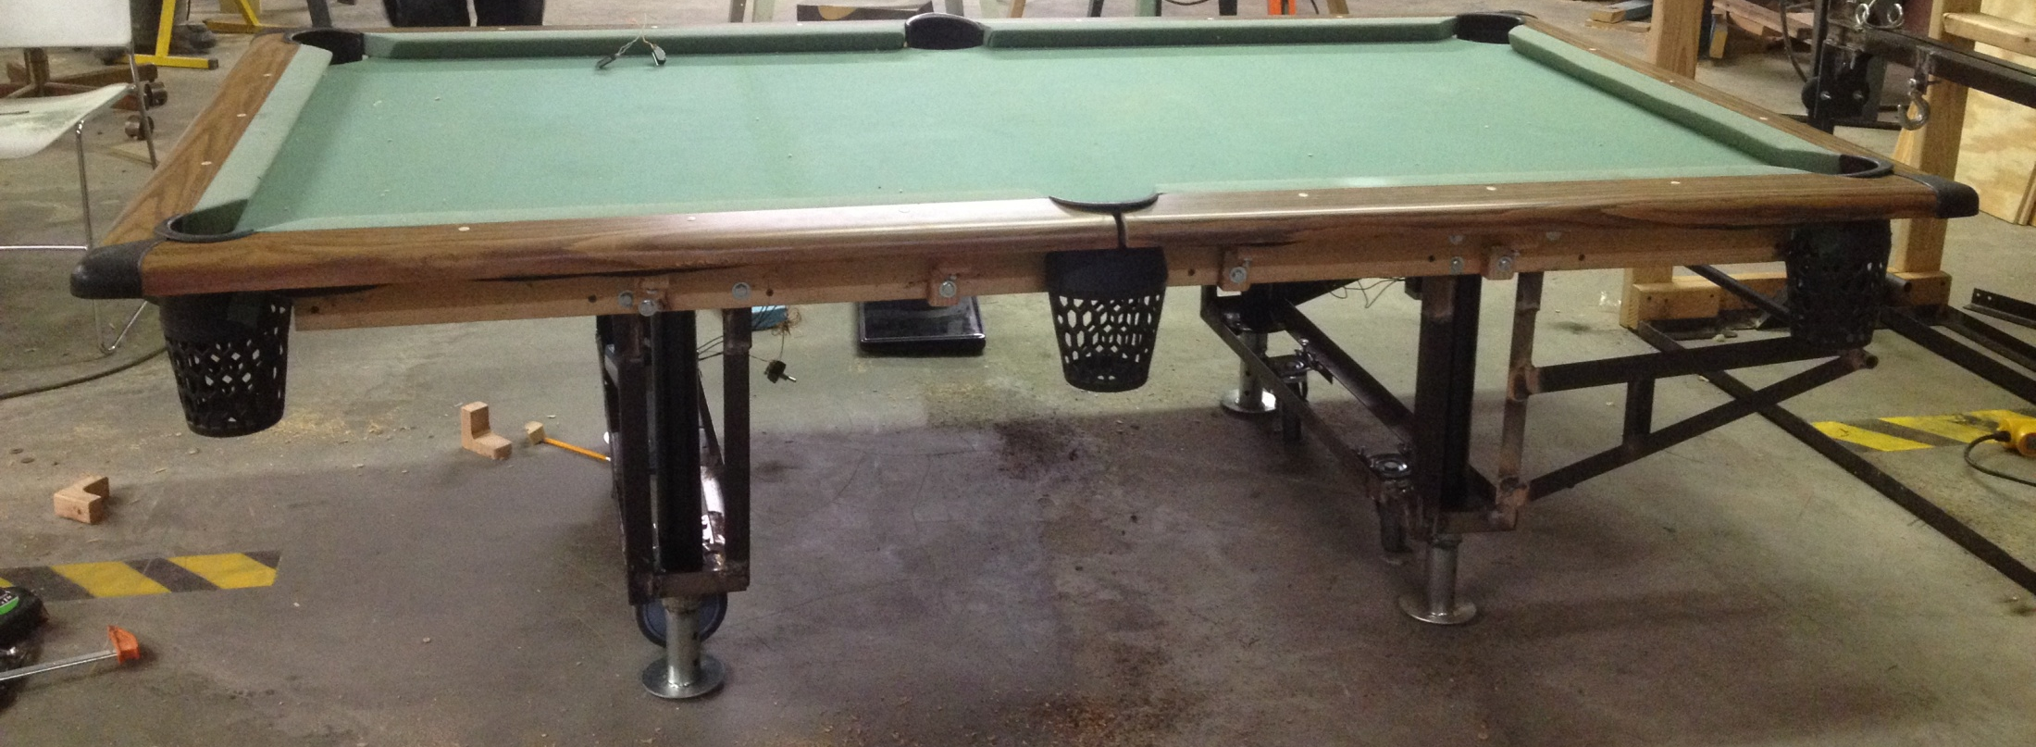
Prototype
Notes:
MDF is a uniform density panel with a fine and smooth surface ideal for shaping and routing. MDF can be easily painted, cut, machined and cleanly drilled without splintering or chipping.

Slide 9
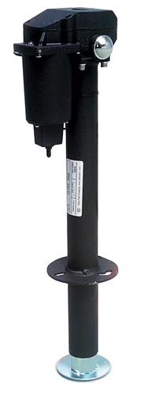
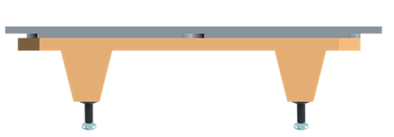
Table
Table
4 linear actuators
4 XY Inclinometer sensors
Microcontroller

Slide 10
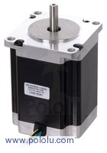
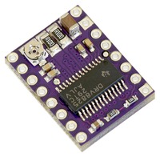
Linear Actuators
Original Setup:
4 DC Motors
  No encoders
  Limited accuracy during leveling
Corrected Setup:
4 “Four Phase NEMA 23” Stepper Motors
  Increased accuracy
  Smaller power consumption
  Higher Hold Torque rating
Each phase draws 1 A at 8.6 V
Holding torque of 14 kg-cm (190 oz-in)
Can be used as a unipolar or bipolar stepper motor
Has a 1.8° step angle 200 steps/rev

Slide 11
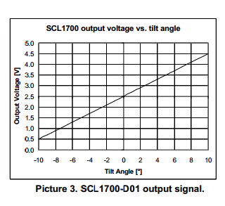
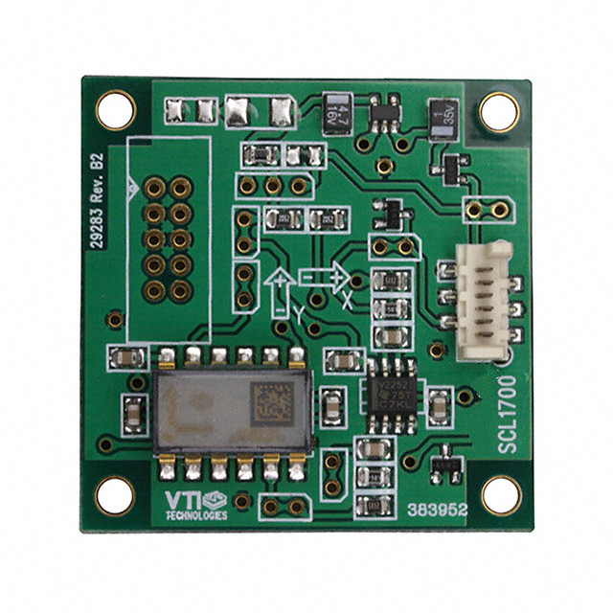
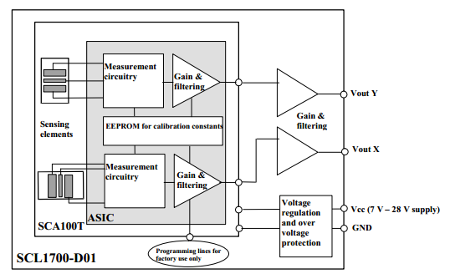
XY Inclinometer
4 XY Inclinometer sensors
  2 pairs each identically oriented on opposite sides of the table; using each other and gravity as reference points
Resistive Sensors
Operates on 5V Logic
Analog Output

Slide 12
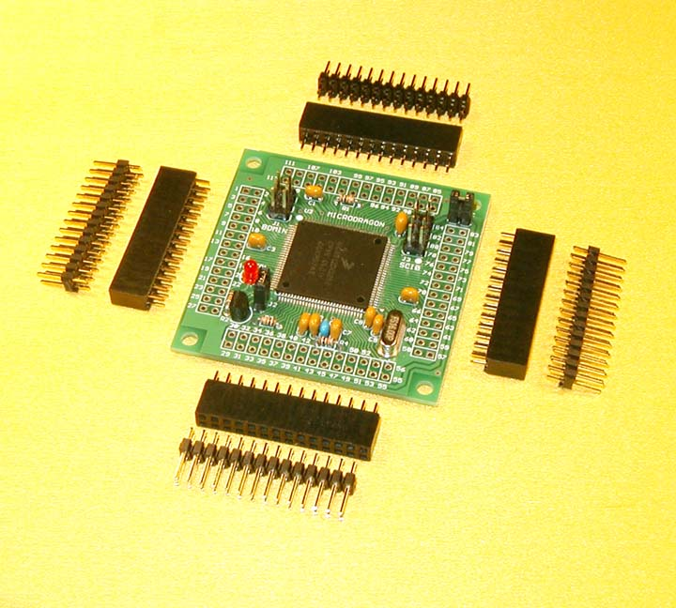
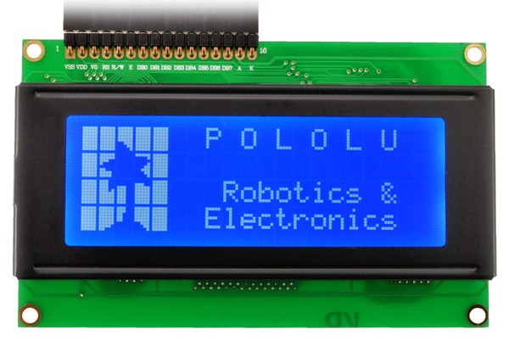
Microcontroller
Micro Dragon Microcontroller
Processing:
16 MHz crystal, 8 MHz default bus speed and up to 25MHz bus speed via PLL
Pre-installed with Serial Monitor for CodeWarrior
91 of MC9S12DG256 I/O pins are accessible on male header connectors for user applications
MCU also includes the following peripherals:
  3 SPIs
  2 SCIs
  2 CANs
  I²C interface
  8 16-bit timers
  8 PWMs
  16-channel 10-bit A/D converter

Slide 13
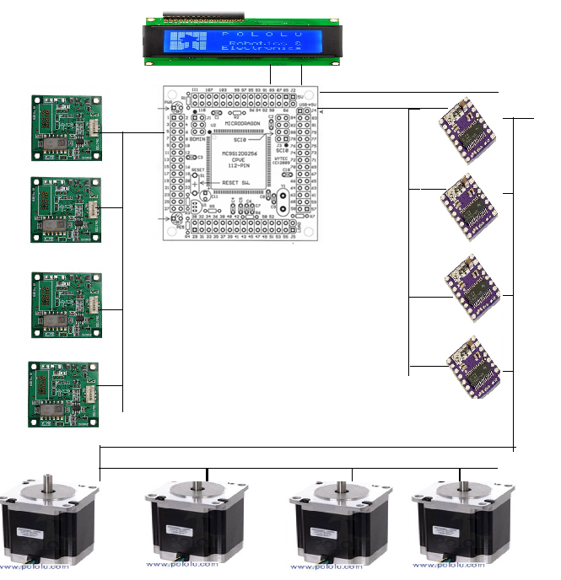
Leveling Control

Slide 14
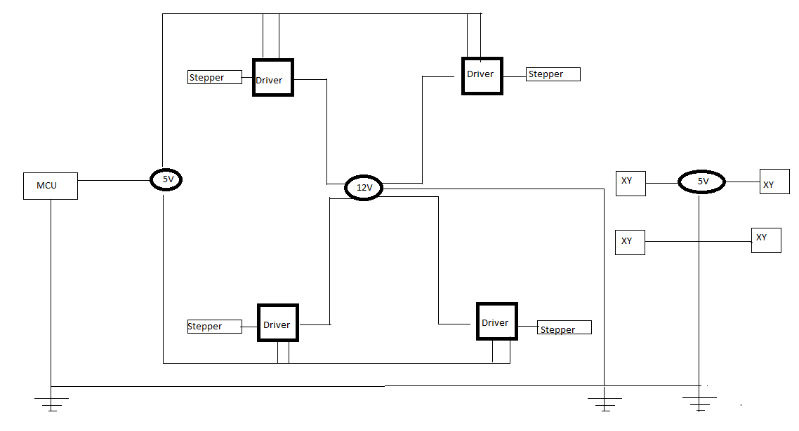
Power Consumption

Slide 15
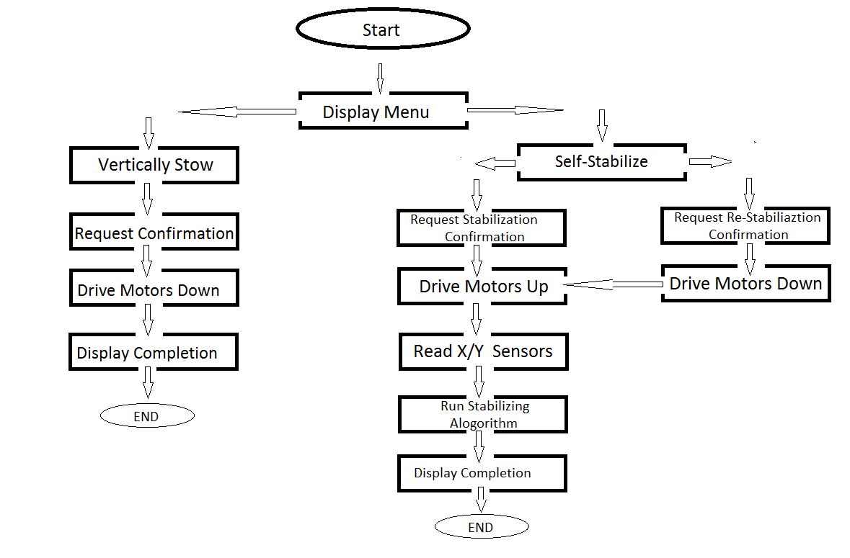
Process Flow

Slide 16
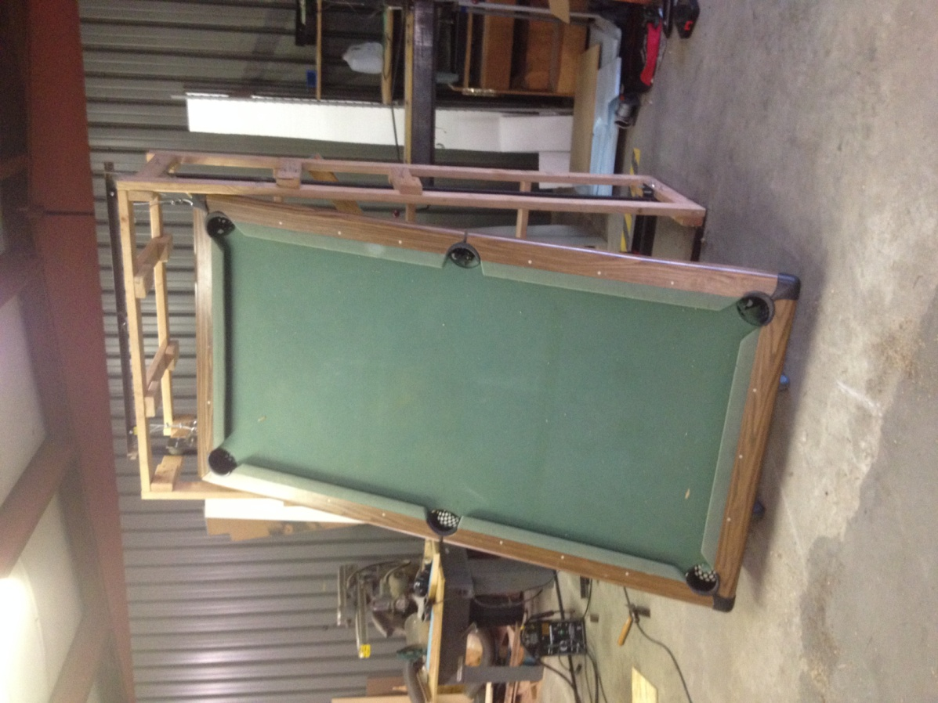
Demonstration

Slide 17
Questions

Slide 18
Citation
http://muller.lbl.gov/teaching/H7B/pages/ElasticModuliTable.htm
http://www.pianoworld.com/faq.htm

