Slide 1

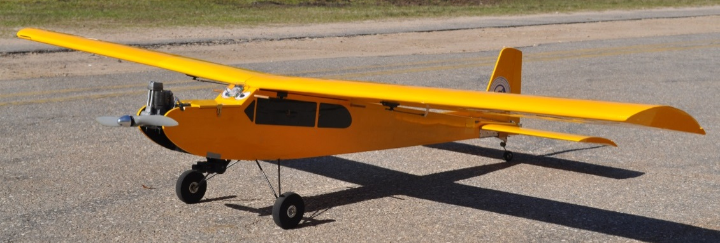


Final Presentation-Spring ‘13
Team 6: Autonomous Aerial Vehicle
AUVSI 2013 Student Unmanned Air Systems Competition
Team Members: Ken Anderson, Arielle Duen, Eric Milo, Ernandes Nascimento,
Cristopher Timmons, Robert Woodruff & Matthew Yasensky
Project Advisors: Dr. Chiang Shih, Dr. Michael P. Frank, Dr. Kamal Amin

Slide 2
Today’s Topics
Team History
Competition Overview and Needs Assessment
Flight Progress
Autopilot and Navigation
Camera/Gimbal System
Imaging Processing
Schedule/Budget
Summary

Slide 3

Team History
Fall Semester
  Half of Team Studying in Brazil
  FIPSE
    Fund for the Improvement of Post-Secondary Education
    Exchange Program
      Florida State University
      Universidade Federal de Itajubá, Minas Gerais, Brazil
    Promotes the Development of
      Engineering Curriculum
      Mentored Internships
      International Collaborative Design Projects
Spring Semester
  Additional Team Member

Slide 4
Needs Assessment
Need for Advancement of Autonomous Technology
  Military Missions
  Search and Rescue
  Private Sector Automation
Recent News has Given Drone Technology a Negative Spin
  Collegiate Involvement

Slide 5


Project/Competition Overview
AUVSI-Competition Project
  Association for Unmanned Vehicle Systems International
Search and Rescue
  Natural Disaster Scenario
I.S.R.
  Intelligence
  Surveillance
  Reconnaissance

Slide 6
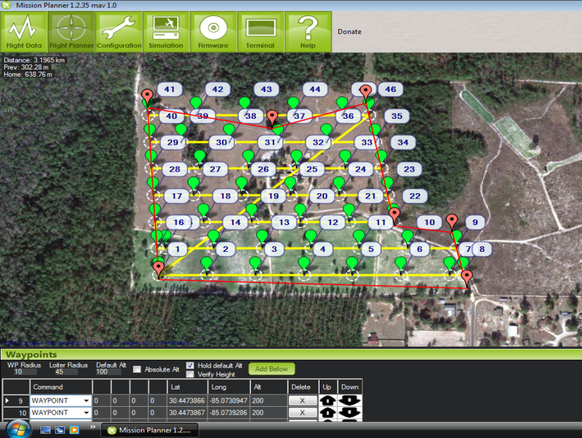

Competition Objectives
  Waypoint Navigation
  Coordinate Change
  Autonomous Takeoff and Landing
  Autonomous Area Search for Ground Targets
  Image Recognition of Ground Targets
  Safety Precautions

Slide 7
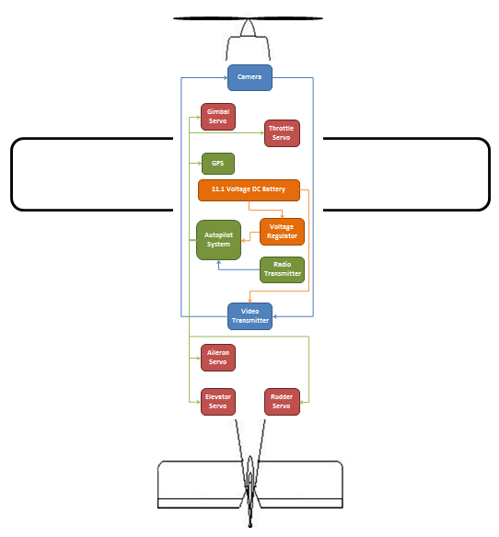
Aircraft Functionality
Mechanical Systems

Slide 8
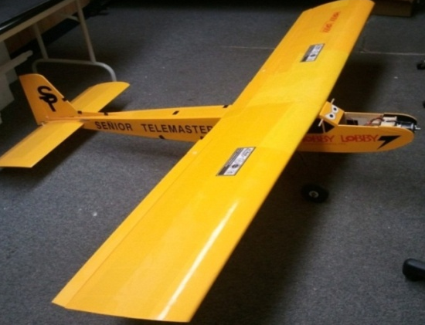
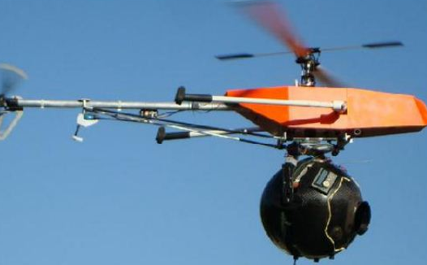
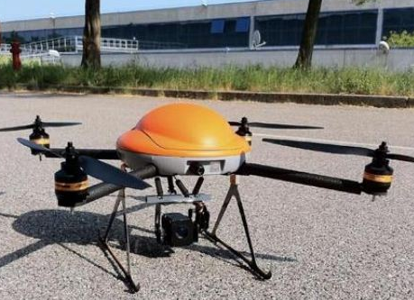
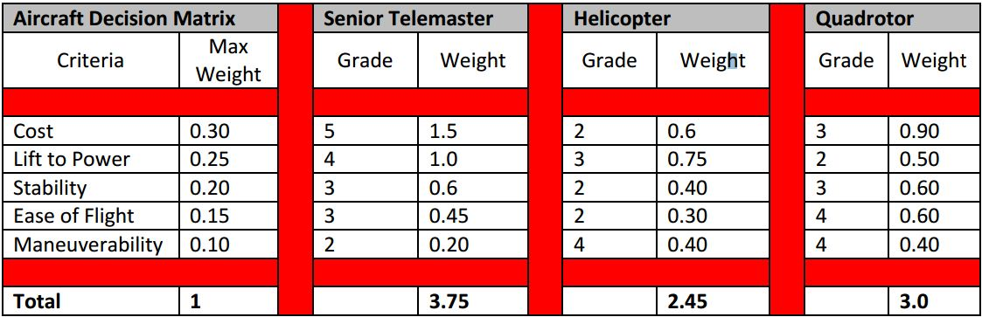
Airframe Concepts

Slide 9
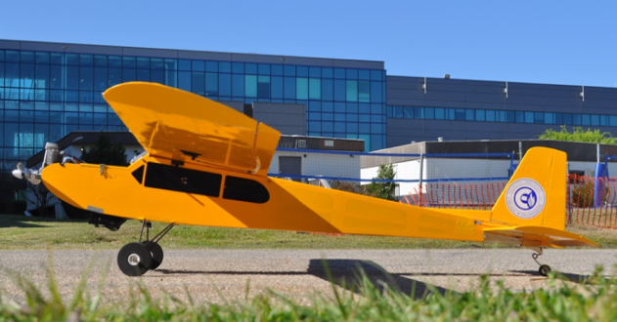
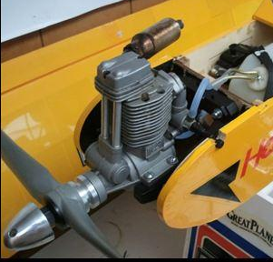
Airframe/Propulsion System
Senior Telemaster
94 in wingspan
1330 sq inches wing area
17 lbs (fully loaded)
25/55 mph cruise/top speed
Magnum XL 91 Nitro
4-stroke/0.91 cu inch
2,000-12,000 practical RPM
22 oz fuel = 50 min of flight

Slide 10
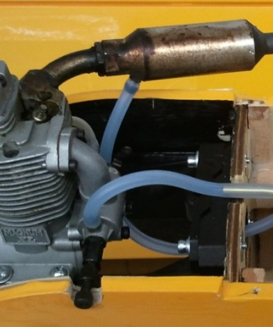
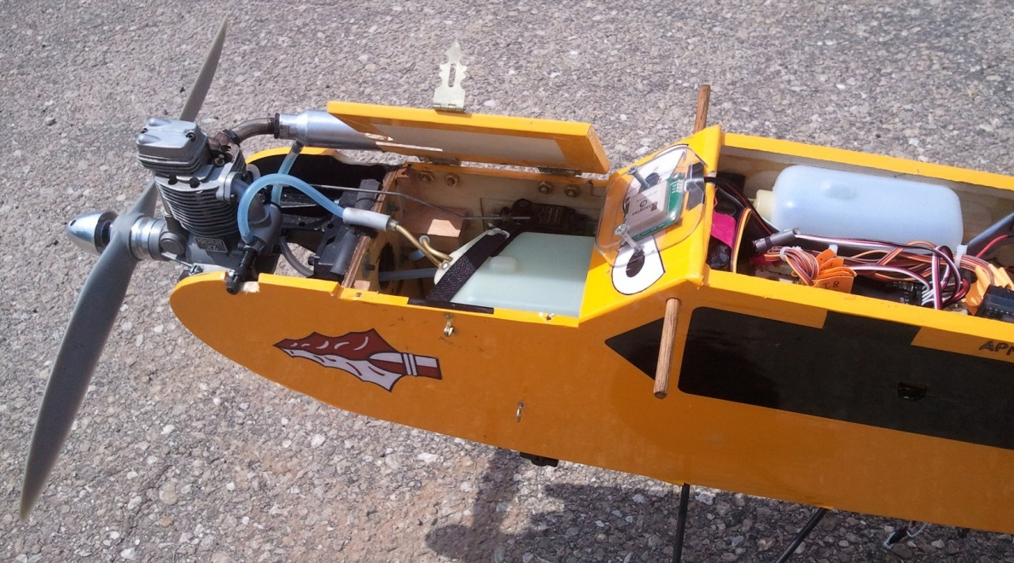
Achieving Flight Time
Fuel Tank Configuration Concept:
  ≈2.5 min per 1 oz fuel
  16 oz + 6 oz = 22 oz
  Estimated 55 min flight time
Fuel Tanks Installed
  Demonstrated 50 min flight time
Pressure Line
Fuel Line
Feeder tank
Engine
Fuel Tank

Slide 11
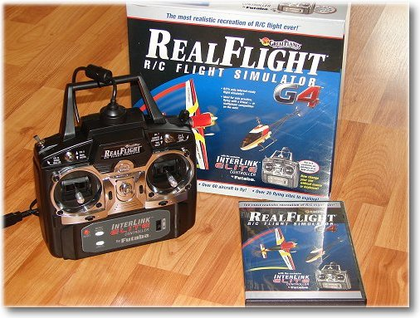
Learning to Fly
Real Flight Simulator:
  20+ hours of flight experience
Buddy Box Practice:
  Multiple practice flights
11

Slide 12

AMA Membership
Academy of Model Aeronautics
  -Requirement to fly in the competition and Tallahassee
AMA Benefits:
  -$2.5 million Comprehensive General Liability Protection
  -$25,000 Accidental/Medical coverage
  -$1,000 Fire, Theft, and Vandalism coverage
12

Slide 13
Navigation Systems
Autopilot

Slide 14
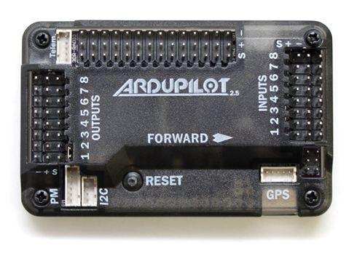
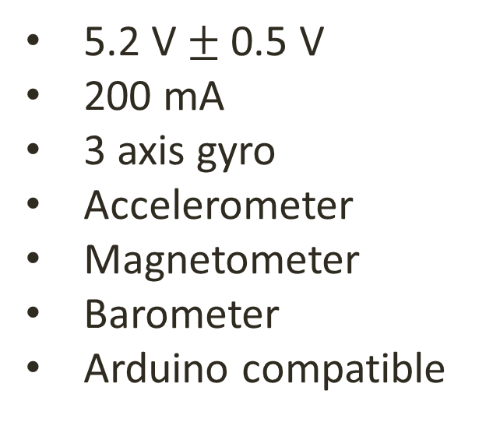
Ardupilot Mega 2.5
5.2 V$±$0.5 V
200 mA
3 axis gyro
Accelerometer
Magnetometer
Barometer
Arduino compatible
Onboard 4 MP Dataflash chip for automatic data logging
Digital compass powered by Honeywell’s HMC5883L-TR chip

Slide 15
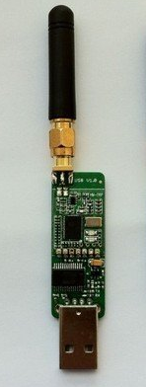
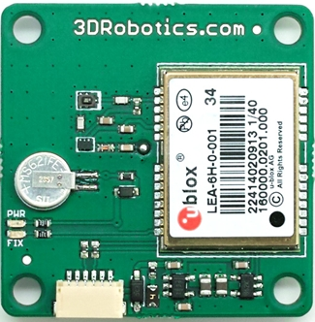
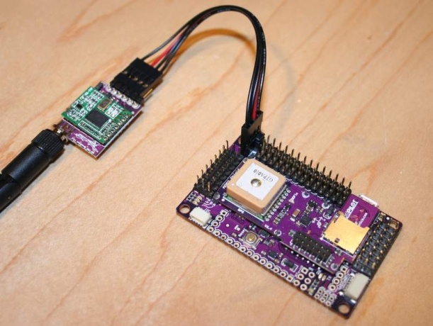
3DR GPS uBlock LEA-6
3DR Radio Telemetry Kit
900 MHz
200 dBm transmit power
250 kbps air data rate
Adaptive time division multiplexing
Built in error correcting
Approx. 1 mile range
5 Hz update rate
3.3 V regulator
I2C EEPROM for configuration storage

Slide 16
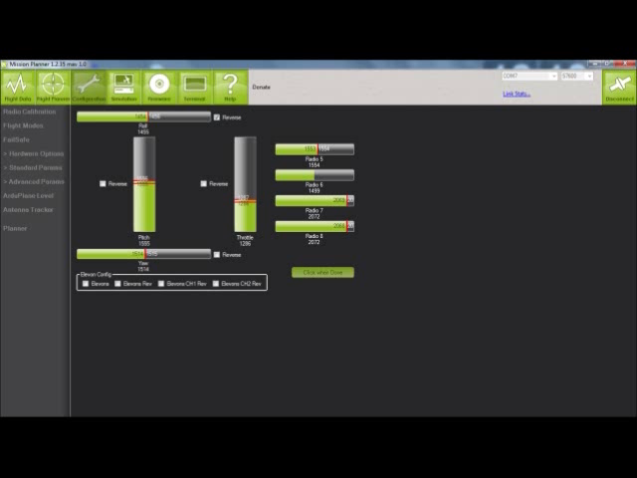
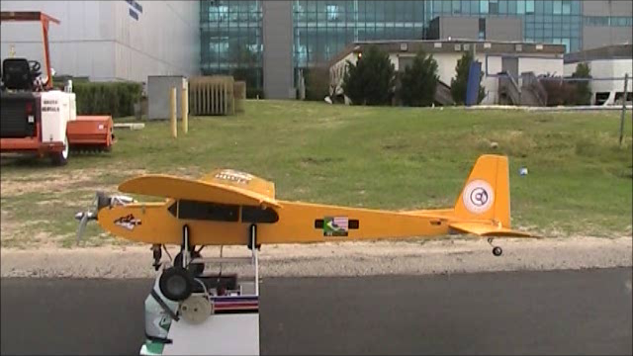

Slide 17
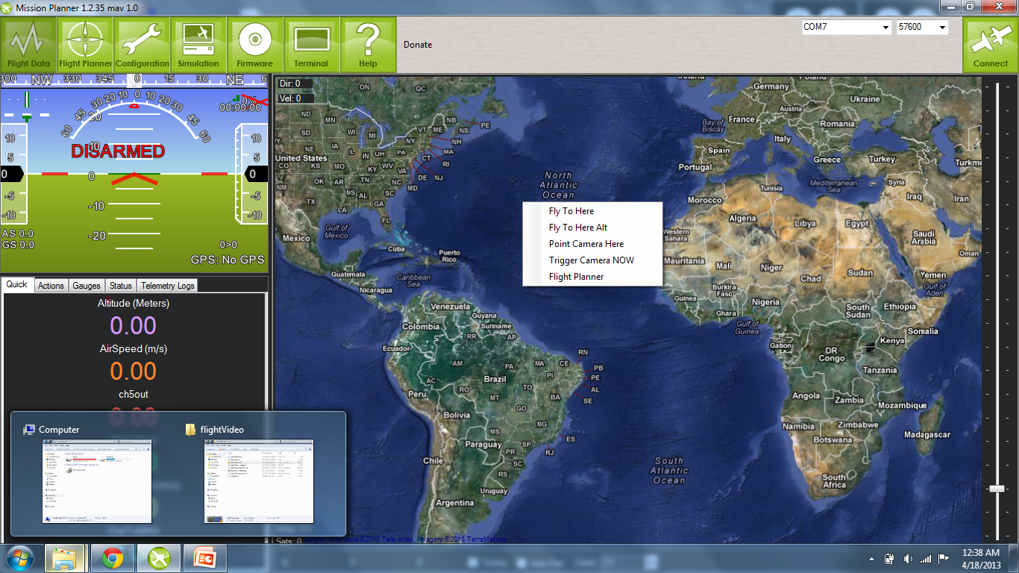
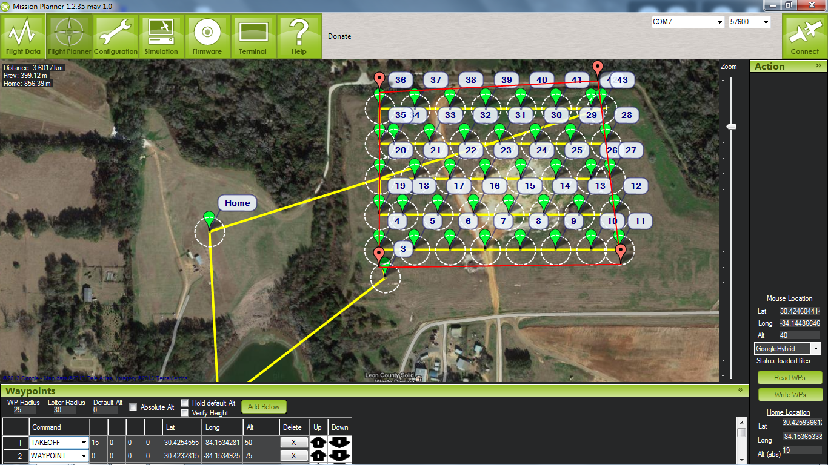
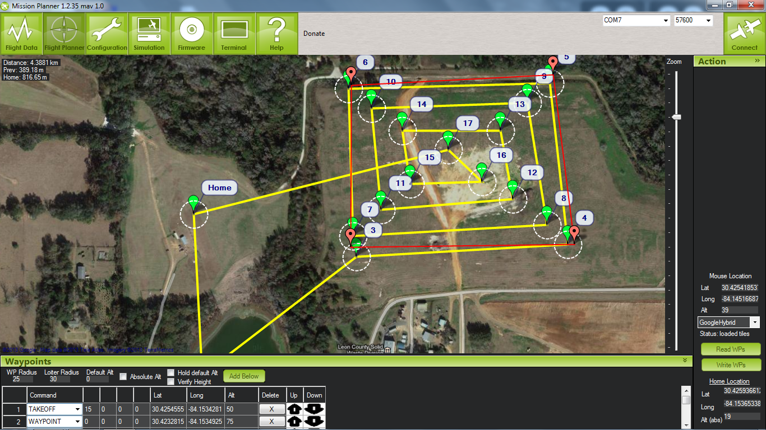

Slide 18
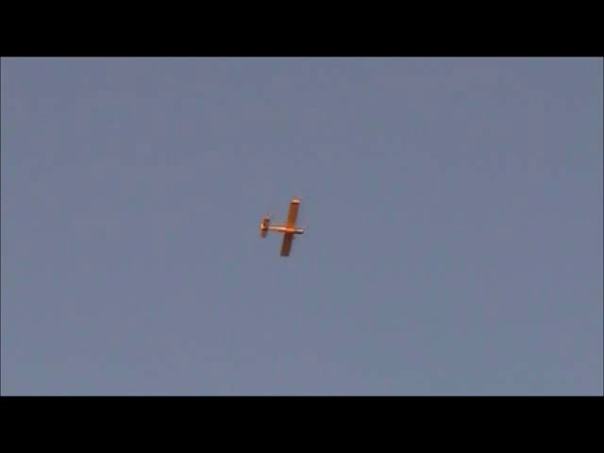
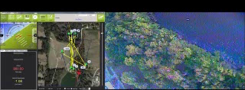

Slide 19
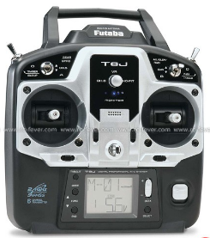
Safety Features
Futaba 6J 6 Channel Digital Prop. RC System Transmitter
The plane will return to home and loiter around home after 20 seconds of lost signal
The plane must perform a controlled crash after 3 minutes of lost signal

Slide 20
Camera Attachment
Gimbal System

Slide 21
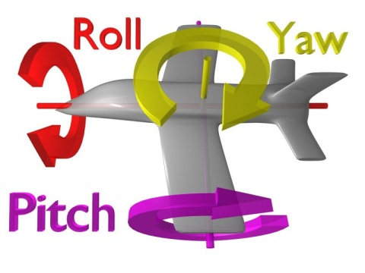
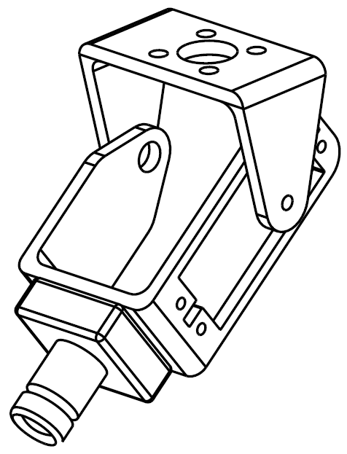
Gimbal System
  Gimbal Concept
  Redesigning the Sytem
    First system was oversized
      Large camera and gimbal
      Scaled down camera and gimbal
      Eliminated unnecessary components
    Latest design features
      Wider angle of view
      More concise
      Less weight, CG dislocation
      Higher ground clearance

Slide 22
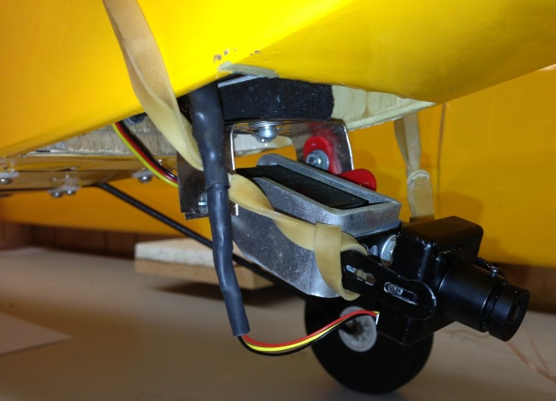
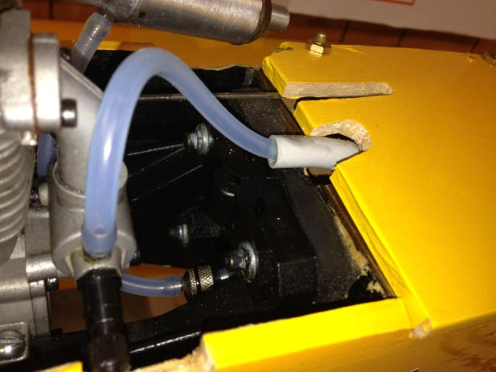
Gimbal System
  System Implemented
  System works properly on test flight
    Autopilot is able to control servos
    Servos are calibrated correctly
  Vibrations
    Last tests with damping materials were not as good as expected
    Newer tests are currently being done
      Rubber Bands

Slide 23
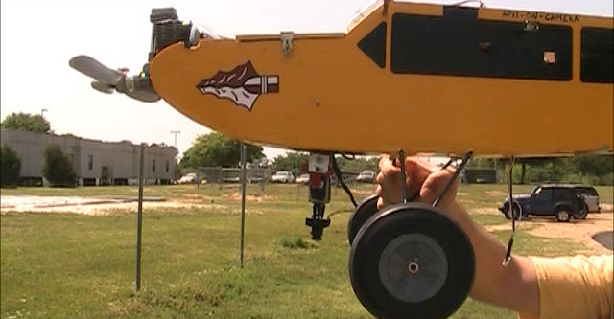
Gimbal System
  Angular Correction Video

Slide 24
Camera System
Image Processing

Slide 25
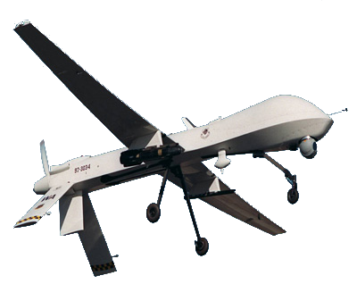


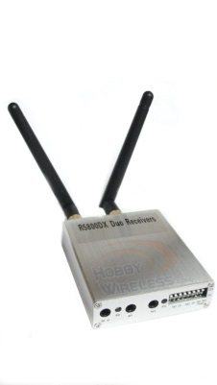
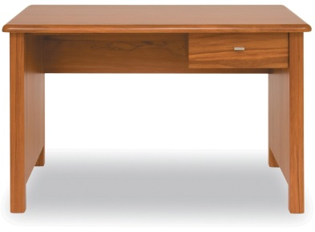
Image Processing – Top Level
CCD
Camera
5.8GHz Video Transmitter
5.8GHz Video Receiver
Composite-to-USB Encoder

Slide 26
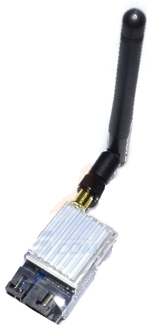
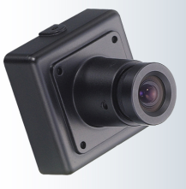
Transmission Subsystem
Power Supply
  Rechargeable Li-Po Battery
  11.1 V, 2200 mAH
Video Transmitter
  Composite video (NTSC)
  5.8 GHz
  400 mW
Camera
  Sony CCD
  700 TVL Resolution
11.1 V Li-Po Battery

Slide 27
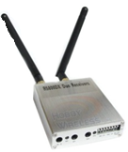
Receiving Subsystem
Video Receiver
  R5800DX
  5.8 GHz sampling frequency
USB Encoder
  Input: Composite Video
  Output: USB
Asus Laptop
  Intel Core i5 Processor
  4 GB RAM memory
USB Encoder
AC Wall Outlet

Slide 28
Software Subsystem
GPS Data
Is there a target present?
Video Data
Yes
Match GPS data to image
No
Acquire next frame of video
Extract Target Data
Orientation
Location of Target
Target Shape
Target Color
Char Shape
Char Color
Store Data
Yes
Duplicate of previous target?
Disregard Data
No
Save to Output File

Slide 29
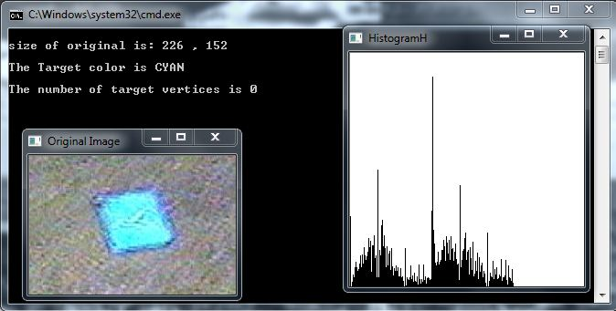
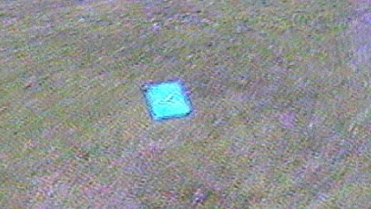

Image Processing - Results
Image Processing from in-flight video

Slide 30
Budget
FIPSE Budget = $2000
Remaining = $340

Slide 31
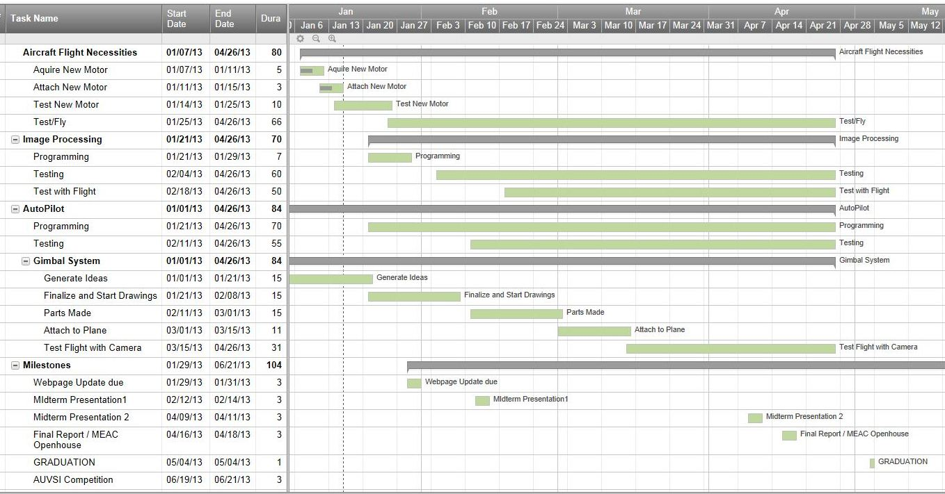
Schedule – Spring Semester
31

Slide 32
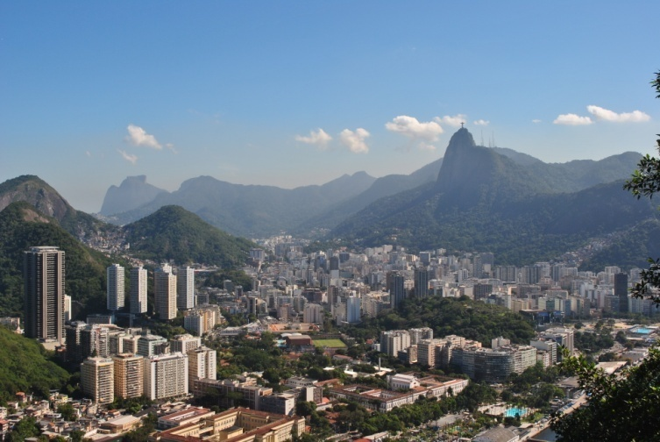
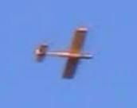
Summary
FIPSE
  A unique experience over international boundaries
  Exposure to interesting challenges
  Expanded skill-set of our team
What we have
  All hardware necessary to meet thresholds of competition
  A UAV capable of autonomous flight and real-time image processing

Slide 33
Summary Cont’d
Autopilot System
  3-Axis Gyroscope
  3-Axis Magnetometer
Ublox GPS
Telemetry Transmitter
Radio Receiver
Video Transmitter
Electronics Power Supply
Pitot Probe
Magnum XL Engine
Sony KPC Camera
Gimbal System

Slide 34
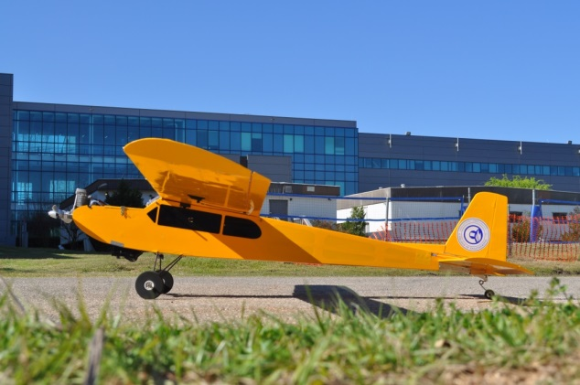
Summary Cont’d
Remaining threshold
What we could have done differently
  Consider needs, not only what is available
    We allowed for 60 minute flight time, which may not have been necessary
Future recommendations
  New vehicle
  Electric Motor
  Have a Pilot
  Computer Engineer

Slide 35

Thanks and Appreciation
Dr. Shih
Dr. Amin
Dr. Frank
Mechanical Faculty
Electrical Faculty
Hobbytown USA
Seminole RC Club
Senior Design TA’s
SENIOR CLASS 2013

Slide 36
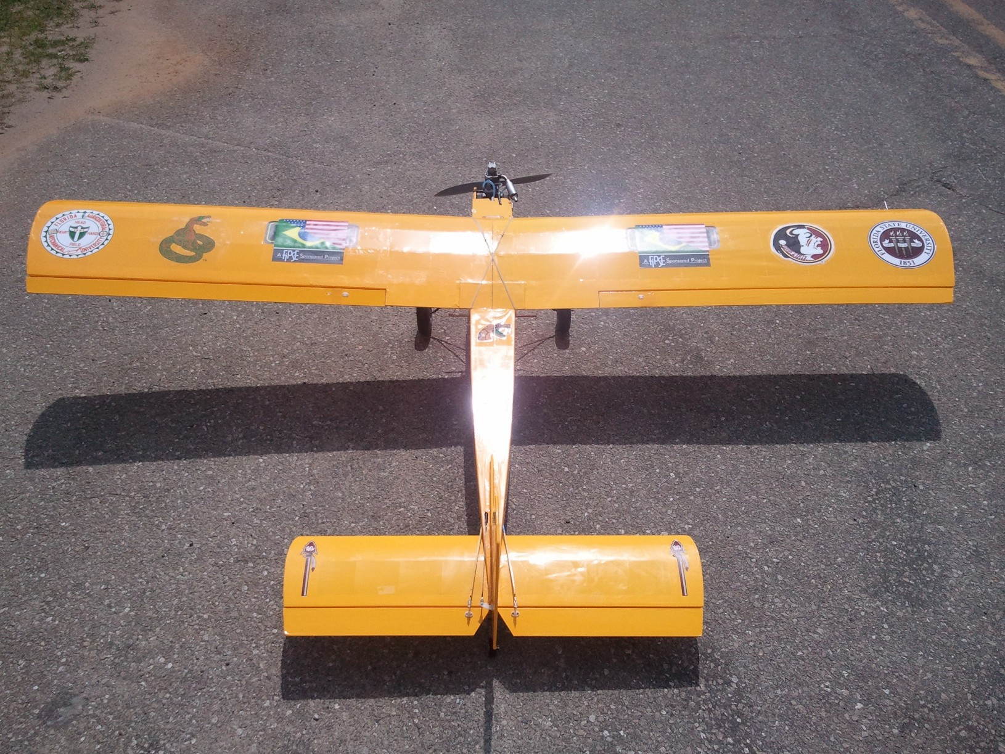
Questions?

Slide 37
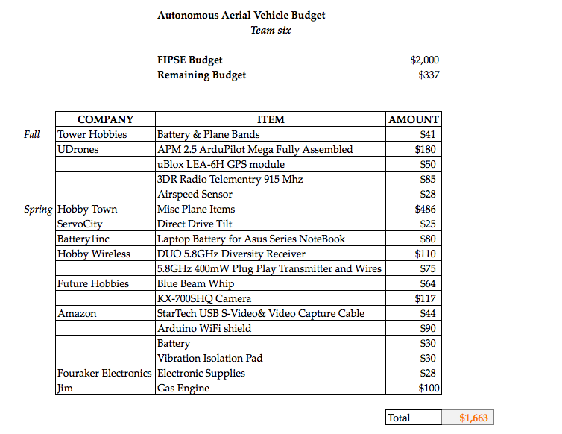
Budget

