Slide 1

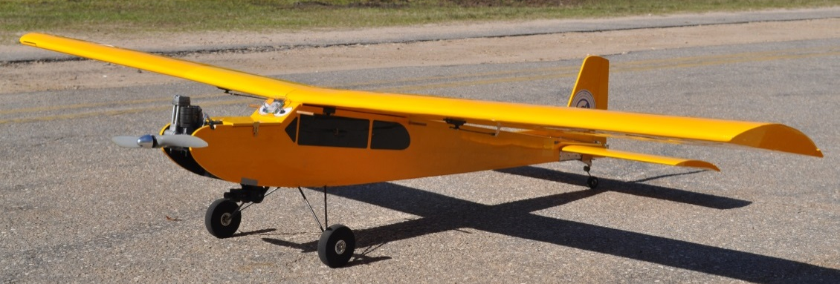

Design Review #2-Spring ‘13
Team 6: Autonomous Ariel Vehicle
AUVSI 2013 Student Unmanned Air Systems Competition
Ken Anderson, Arielle Duen, Eric Milo, Ernandes Nascimento,
Cristopher Timmons, Robert Woodruff & Matthew Yasensky

Slide 2
Today’s Topics
Brief Overview of Project/Competition
Flight Progress
Imaging Processing Update
Camera/Gimbal System Update
Autopilot and Navigation Update
Schedule/Budget
Summary
Presented By: Ken Anderson

Slide 3


Project/Competition Overview
AUVSI-Competition Project
  Association for Unmanned Vehicle Systems International
Search and Rescue
  Natural Disaster Scenario
I.S.R.
  Intelligence
  Surveillance
  Reconnaissance
Presented By: Ken Anderson

Slide 4
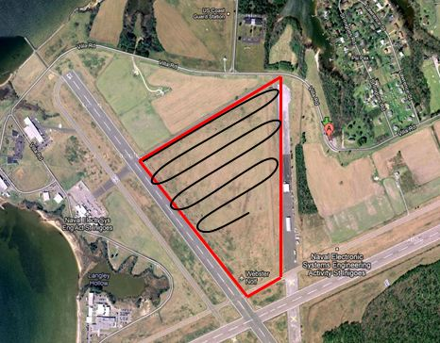
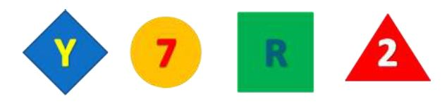
Competition Objectives
  Waypoint Navigation
  Coordinate Change
  Autonomous Takeoff and Landing
  Autonomous Area Search for Ground Targets
  Image Recognition of Ground Targets
  Safety Precautions
Presented By: Ken Anderson

Slide 5
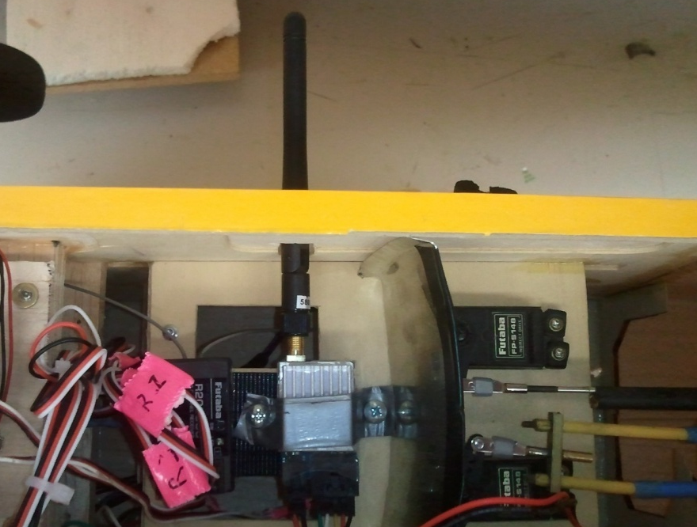
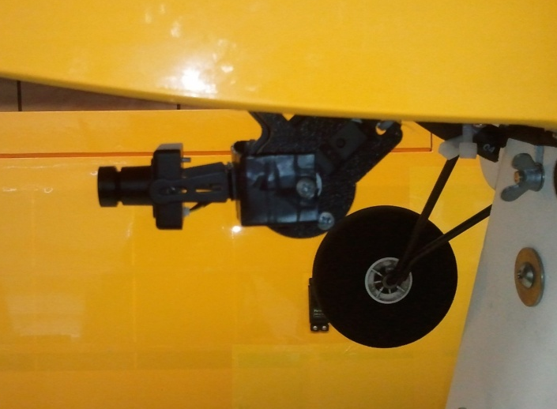
Plane updates
Additional electronics added:
  Camera/Gimbal Mounted
    2 servos = 2 DOF
  Video Transmitter mounted
    Battery pack installed
Presented By: Eric Milo

Slide 6
Hardware Installed and Functional
Autopilot System
  3-Axis Gyroscope
  3-Axis Magnetometer
Ublox GPS
Telemetry Transmitter
Radio Receiver
Video Transmitter
Electronics Power Supply
Pitot Probe
Magnum XL Engine
Sony KPC Camera
Gimbal System

Slide 7
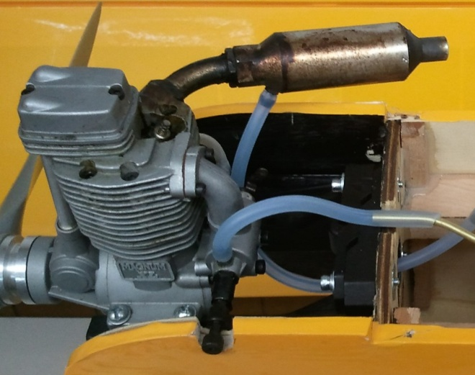
Extending our flight time
Current Fuel Setup:
Pressure Line
Fuel Line
Engine
Future Fuel Setup:
Fuel Tank
Pressure Line
Spare Bladder
Fuel Line
Engine
Presented By: Eric Milo
Fuel Tank

Slide 8
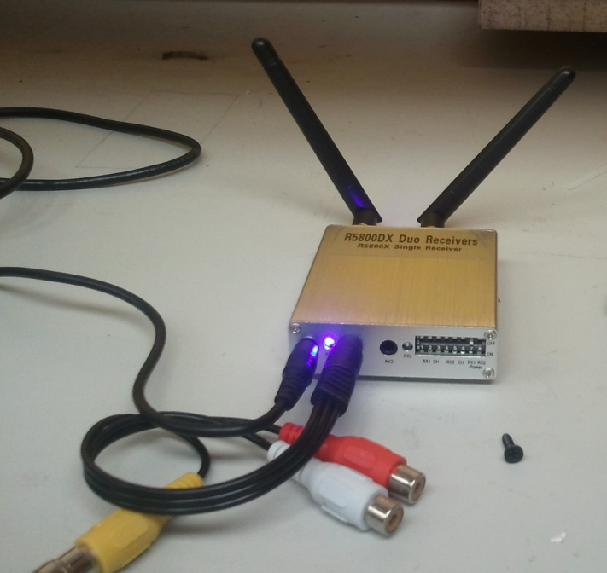
Image Processing Update
Hardware
  Implemented system hardware on air vehicle
  Implemented composite-to-USB encoder
  First successful wireless video communication
Software
  Utilization of new hardware with existing software
Presented By: Robert Woodruff

Slide 9
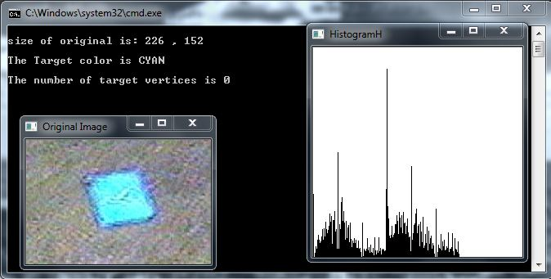
Image Processing Update
In-flight Video
Image Processing from in-flight video
Presented By: Robert Woodruff

Slide 10
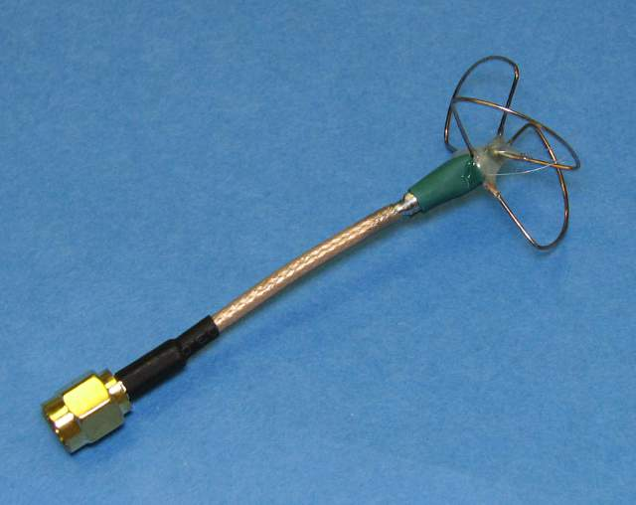
Image Processing – Future Work
Hardware
  Video Interference
    Shield communication cables
    Pursue more efficient antennae
  Vibrations
  Better ground targets
Software
  Real-time image processing
  Refine existing algorithms
Presented By: Robert Woodruff

Slide 11
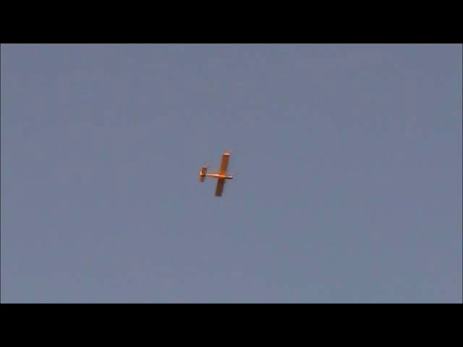
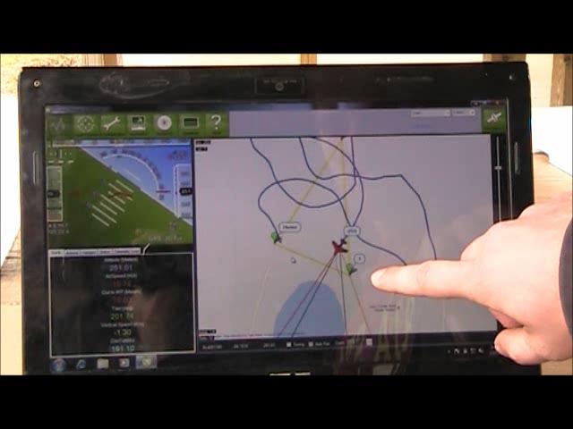

Slide 12
Gimbal System Update
  Autopilot is able to control the servos
  The old system needed improvements
    Rolling degree of freedom compromised
    Old system was designed for a bigger camera
    Camera too close to the ground during landing/taking off
  Problem: system not working properly on flight
Presented By: Ernandes Nascimento

Slide 13
Gimbal System Update
  Redesigning the System
    Better view clearance
    Less space required
    Easier assembly on the plane
    Better correction angle for rolling movements
    Less weight on the plane
    Less center of gravity dislocation
  Vibrations problem reduced
Presented By: Matt Yasensky

Slide 14
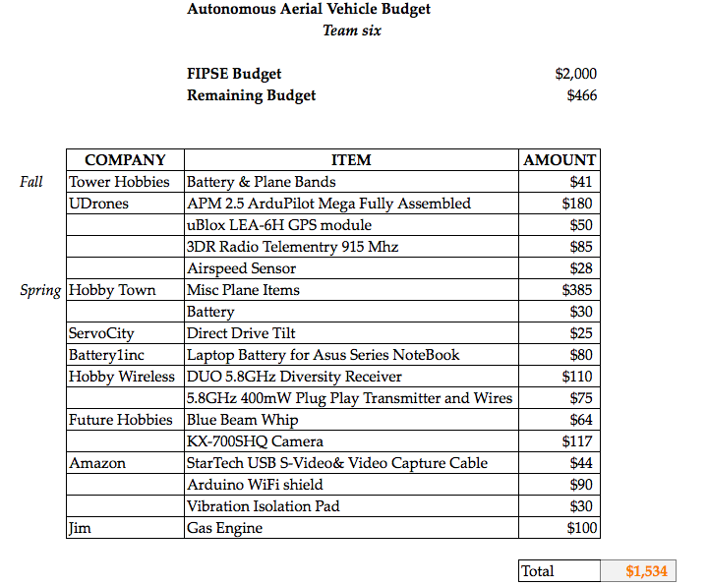
Budget
Presented By: Arielle Duen

Slide 15
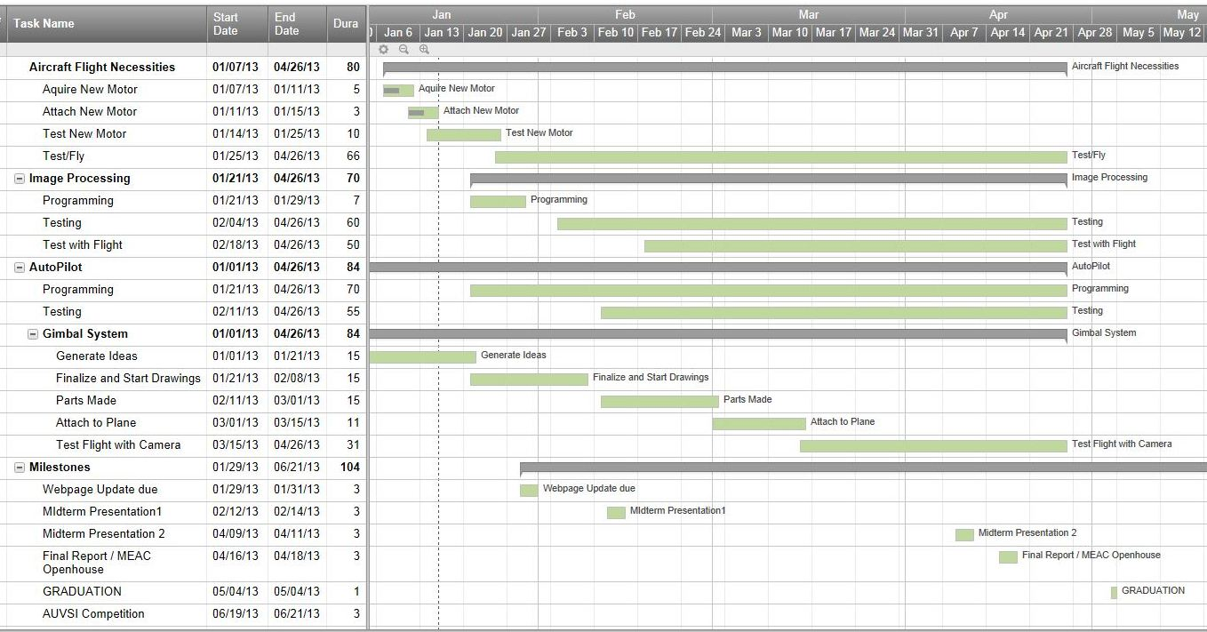
Schedule – Spring Semester
15
Presented By: Arielle Duen

Slide 16
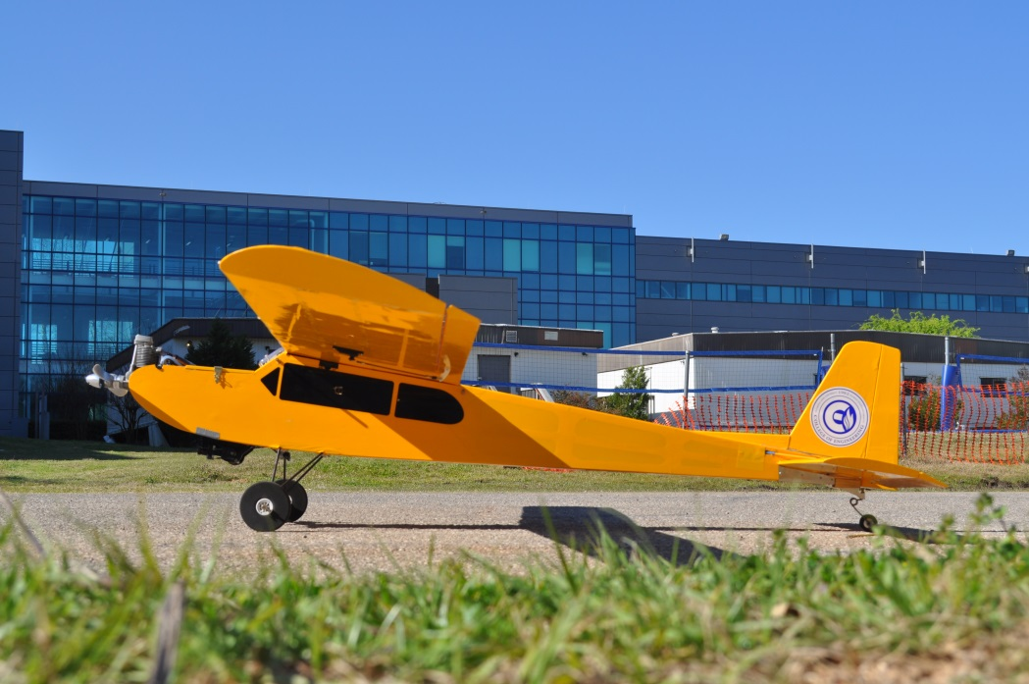
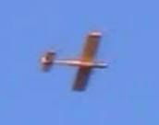
Summary
  Text
  Text
  Text
  Text
Presented By: Arielle Duen

Slide 17

Questions?

