Slide 1
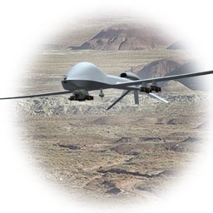
Interim Design Review
AUVSI
2013 Student Unmanned Air Systems Competition
Team 6: Autonomous Ariel Vehicle
Robert Woodruff
Matthew Yasensky
Cristopher Timmons
Ken Anderson
Arielle Duen
Eric Milo

Slide 2
Today’s Topics
Competition Objectives
Guidelines, Constraints and Safety
Equipment Choice
Flight Software
Imaging Software
Camera to Aircraft Attachment
Project Hurdles
Conclusion
2

Slide 3
Mission
Search and Rescue
Natural Disaster Scenario
I.S.R.
Intelligence
Surveillance
Reconnaissance
3

Slide 4
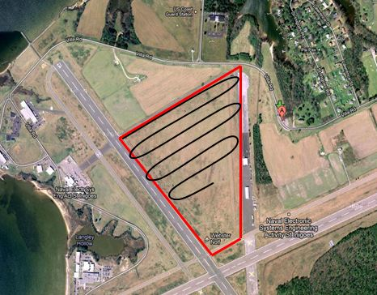
Objectives
Optimization of navigation and imaging software
Waypoint Navigation
Coordinate Change
Autonomous Takeoff and Landing
4

Slide 5
Objectives Cont’d
Autonomous Area Search for Ground Targets
Image Recognition of Ground Targets
Proper Camera Choice for Mission
5

Slide 6
Objectives Cont’d
Local Pilot and Licensing Capabilities
Compliance to 2013 AUVSI Competition Guidelines
Safety Precautions
Manual Over Ride
Automatic Base Return
Flight Termination
6

Slide 7
Major Components Overview
Aircraft Platform
Imaging System/Processing
Autonomous Navigation
7

Slide 8
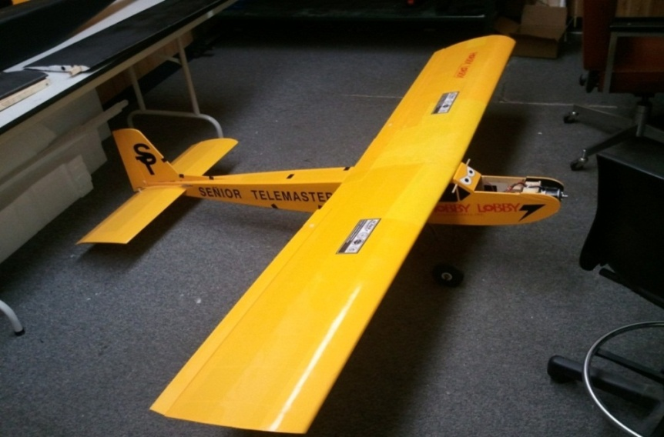
Aircraft Platform
Fixed Wing Aircraft – Senior Telemaster
8

Slide 9
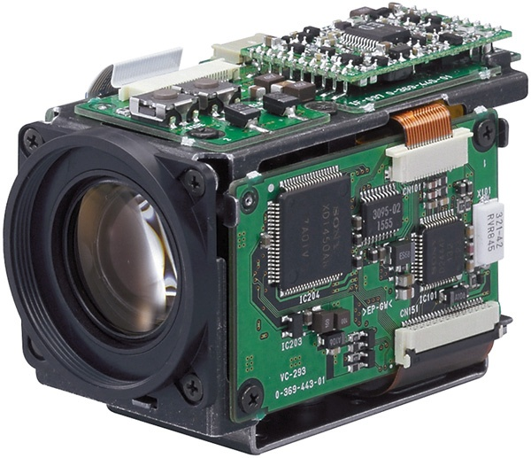
Imaging and Processing
Imaging Hardware – Sony FBC IX11A
Camera Mount/Swivel
Image Transmission
Image Acquisition
Image Processing
9

Slide 10
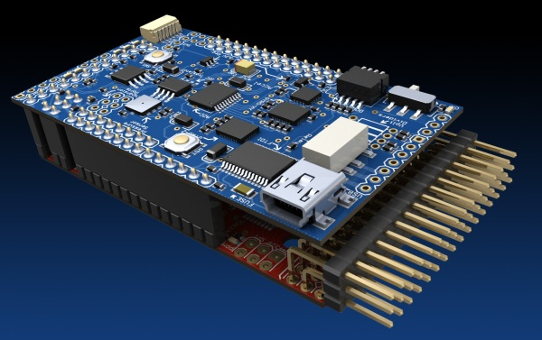
Autonomous Navigation
Autopilot – ArduPilot (Arduino Platform)
Telemetry Kit
Ground Station Control Center
10

Slide 11
Autonomous Navigation
Cristopher Timmons
11

Slide 12
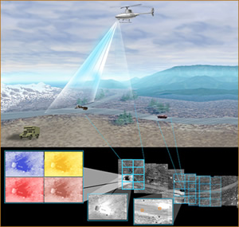
Image Processing
Robert Woodruff
12

Slide 13
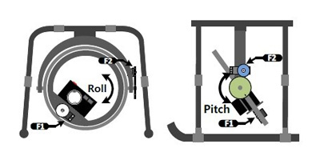
Gimbal System and Purchasing
Matthew Yasensky
13

Slide 14
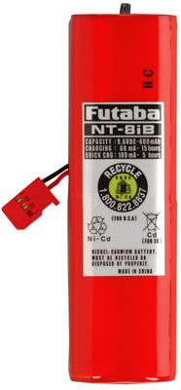
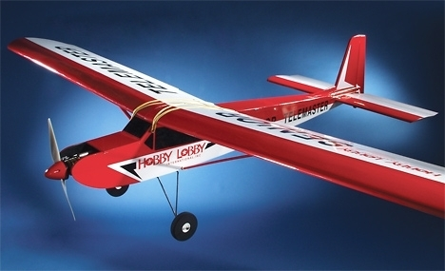
Procurement
Additional Purchased Items
Tower Hobbies
Futaba NT8IB NiCd 8-Cell 9.6V 600mAh Transmitter J
Plane Bands
14

Slide 15
Future Procurement
Planning to purchase
Camera Software
Gimbal System Components
Receiver
Propeller
15

Slide 16
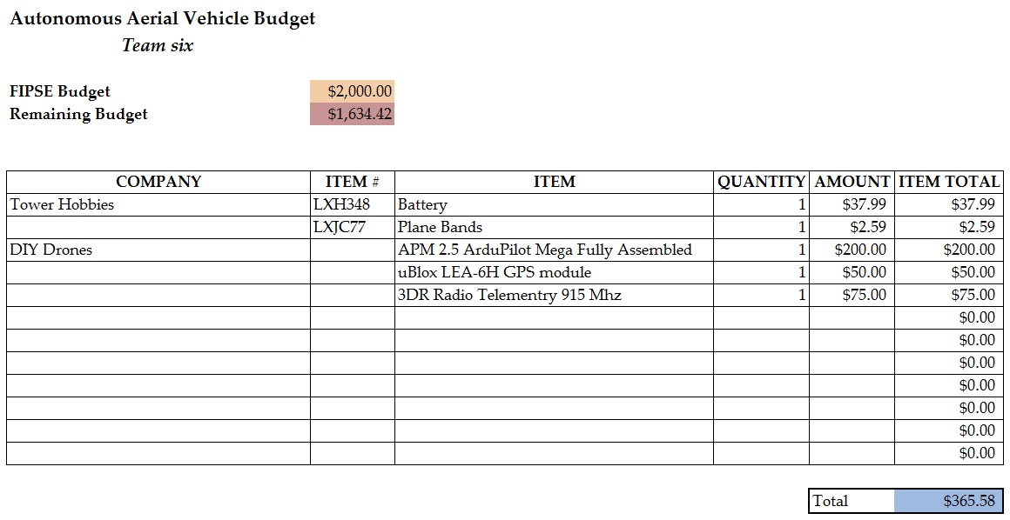
Budget
16

Slide 17
Hurdles
Minor
Purchasing battery pack
Gaining info on auto pilot system
Major
Camera setup
Image Processing
RC Pilot License
17

Slide 18
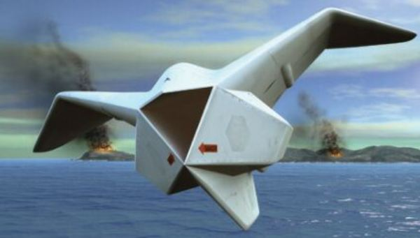
Conclusion
Competition Project
Split Tasks b/w Brazil and Tallahassee
Goals for Entire Team
18

Slide 19
QUESTIONS?
19

