Slide 1
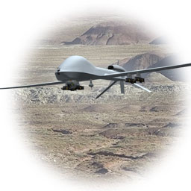




Concept Design Review
AUVSI
2013 Student Unmanned Air Systems Competition
Team 6: Autonomous Ariel Vehicle
Robert Woodruff
Matthew Yasensky
Cristopher Timmons
Ken Anderson
Arielle Duen
Eric Milo

Slide 2
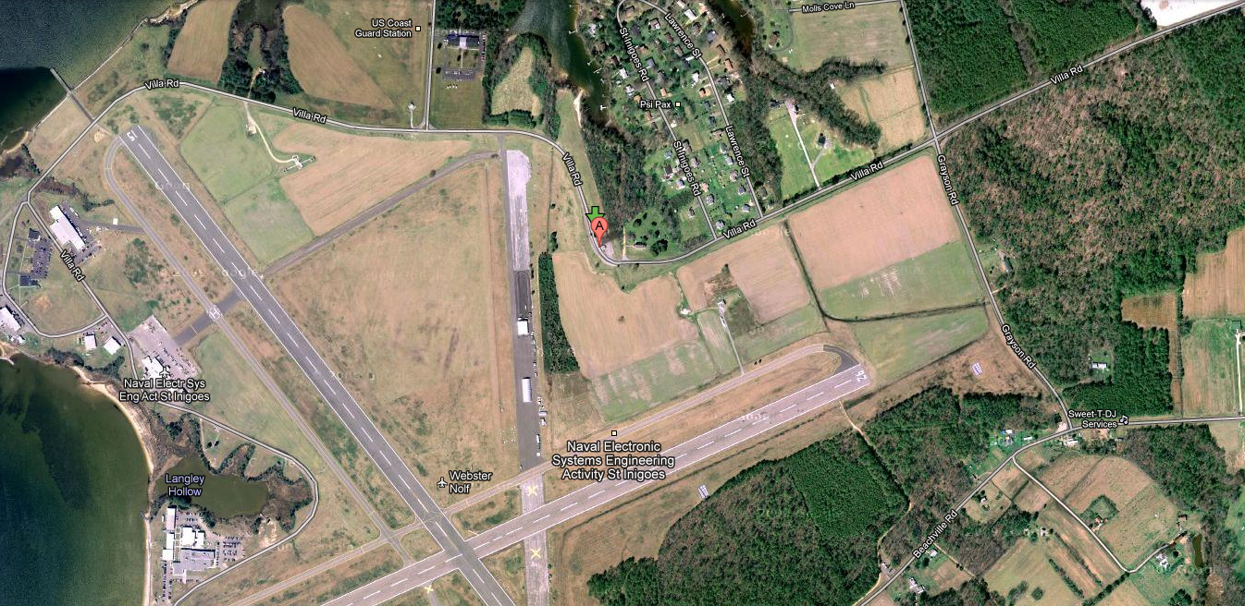
Mission
1
Search target area
Identify targets
Relay information to ground

Slide 3
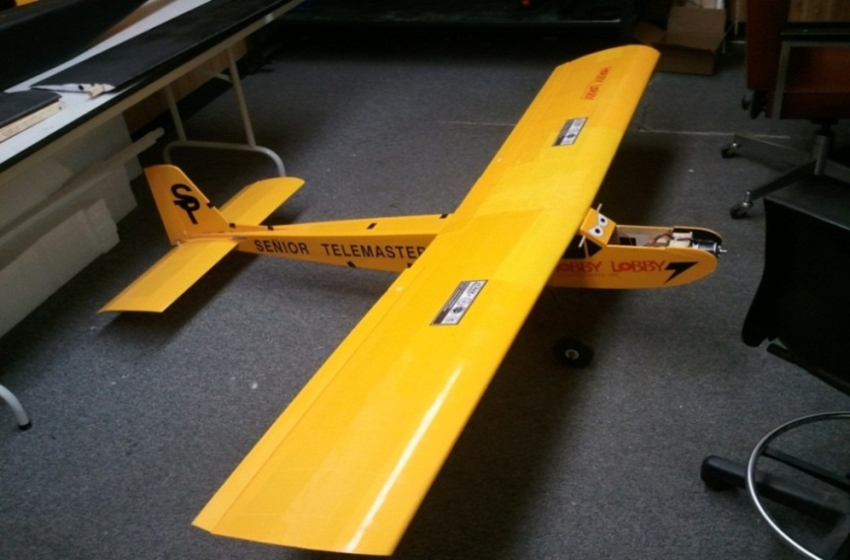
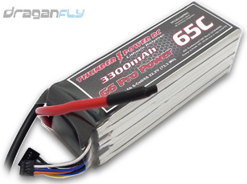
Equipment Rollover
2
Senior Telemaster (8ft Wingspan)
Sony FCB IX11A Block Camera
LiPo-Thunder Power 3300mAh

Slide 4

Equipment Concept Categories
3
Arial Vehicles
Helicopter
Quadrotor
Airplane
Autonomous Software
Paparazzi Tiny V2.11
ArduPilot Mega

Slide 5
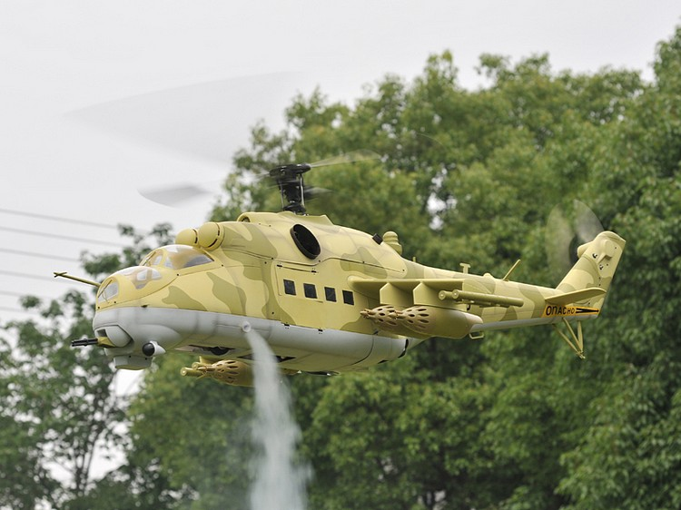
Vehicle 1: Helicopter (Rotary)
4
Pros
  Hovering
  Takeoff/Landing
Cons
  Cost
  Stability
  Lift

Slide 6
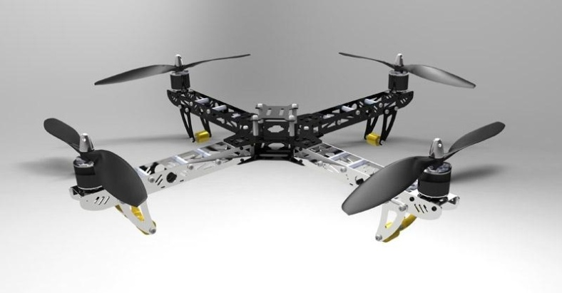
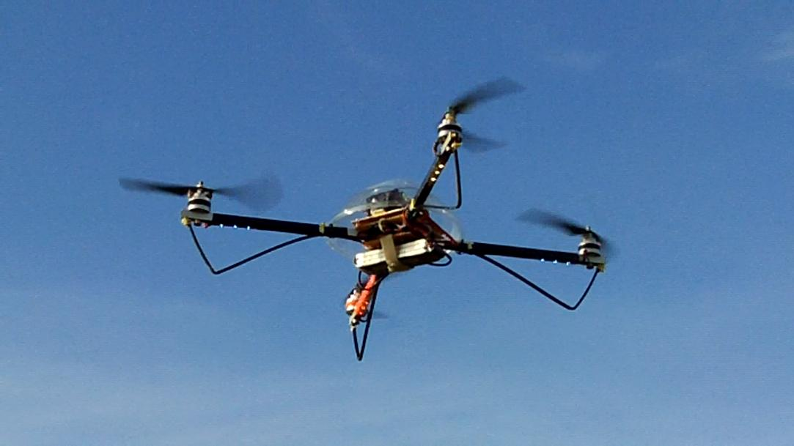
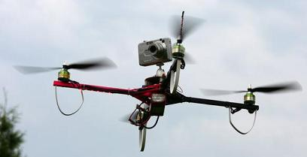
Vehicle 2: Quadrotor (Rotary)
5
Pros
  Hovering
  Takeoff/Landing
  Precise controls
Cons
  Lift
  Battery life

Slide 7
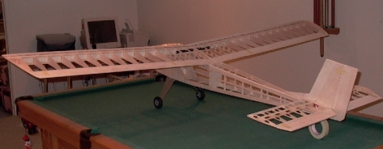
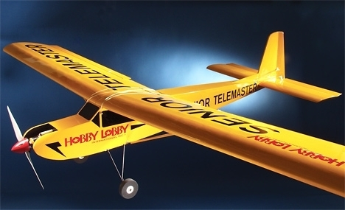
Vehicle 3: Airplane (Fixed Wing)
6
Pros
  Lift
  Time
  Cost
  Stability
Cons
  Takeoff/Landing
  Continuous flight

Slide 8
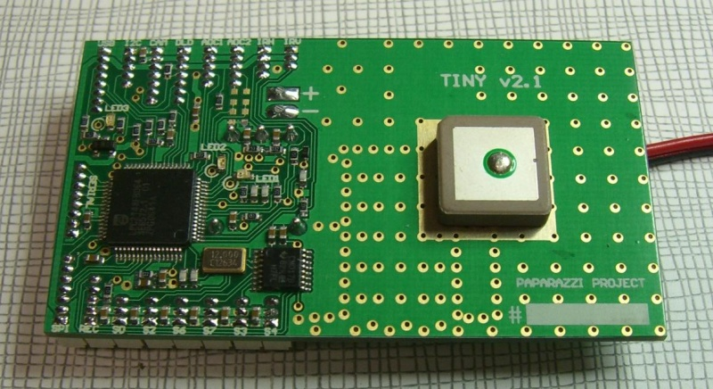
Autonomous Software: Paparazzi Tiny V2.11
7
Pros
  Fully Assembled
  Size/Weight
  Open Source
  Information
  Safety
Cons
  Linux Based
  Acquisition

Slide 9
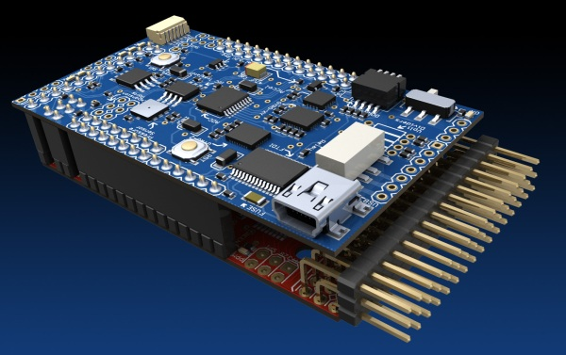
Autonomous Software: ArduPilot Mega
8
Pros
  Full Assembled
  Windows Based
  Mission Planner
  Open source
  Safety
Cons
  Fixed Wing Only
  Processing Power

Slide 10



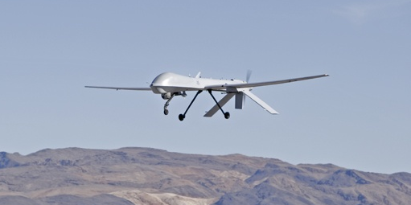
Integration
9

Slide 11
References
10
http://www.auvsi-seafarer.org/news-events/2012-competition.aspx
http://diydrones.com/profiles/blogs/quad-rotor-observer-v5-flights
http://www.rc-helicopter.co.uk/
http://www.rcgroups.com/forums/showthread.php?t=463310
http://www.aerosente.com/2009/04/
Pounds, P.; Mahony, R., Corke, P. (December 2006). "Modeling and Control of a Quad-Rotor Robot". In the Proceedings of the Australasian Conference on Robotics and Automation. Auckland
http://www.premierelect.co.uk/industrial-cameras-sony-block-cameras-c-26_137.html
http://www.u-nav.com/images/

Slide 12
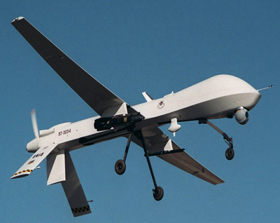
1
1
Questions??

