Slide 1


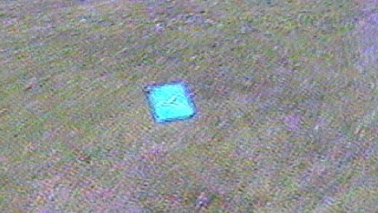
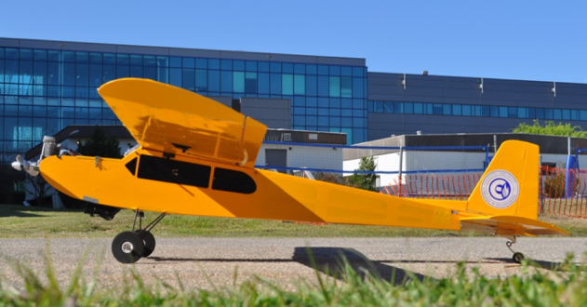

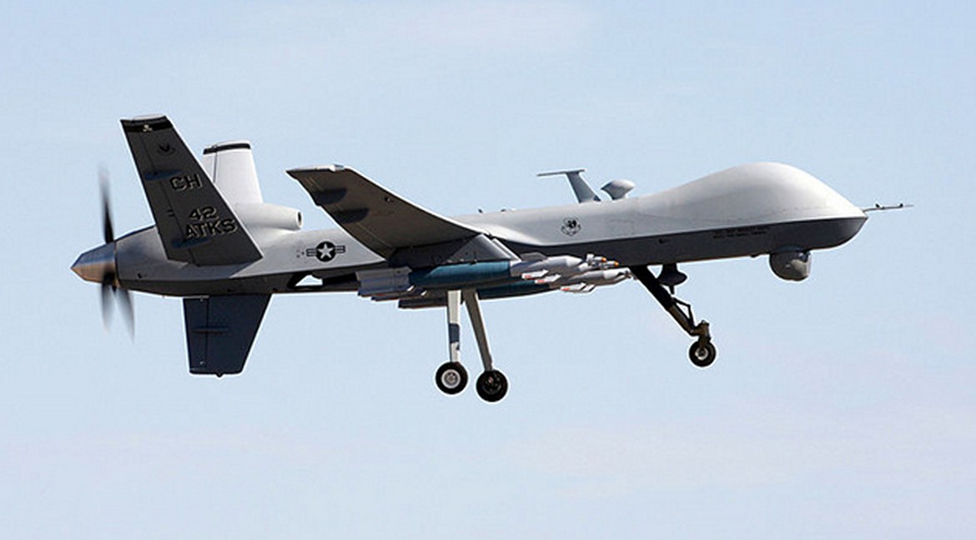
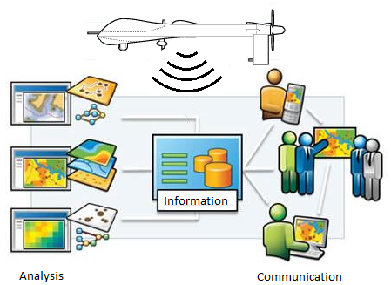
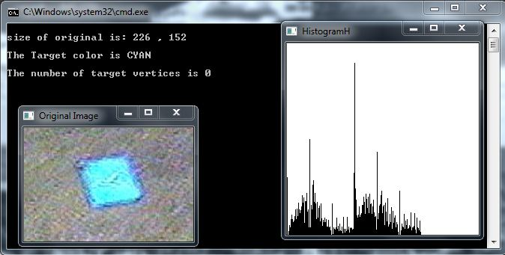
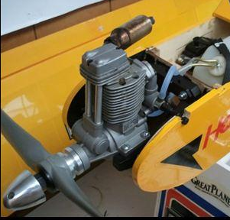
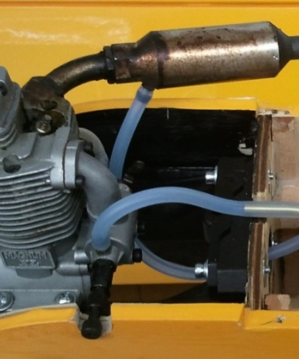
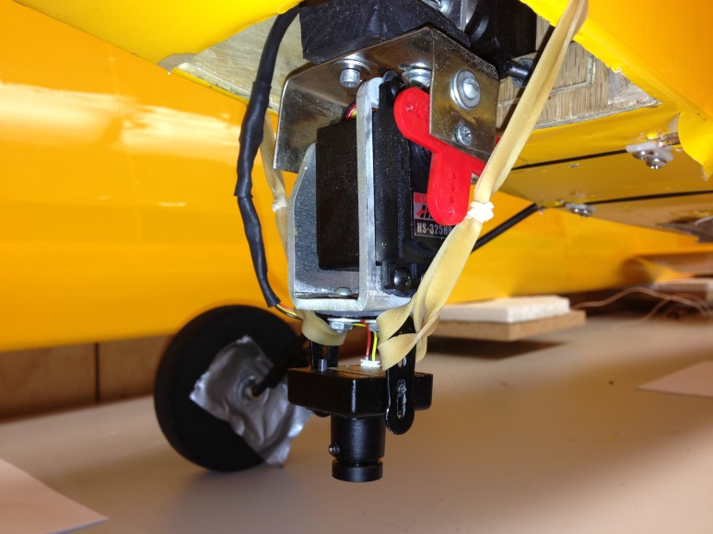
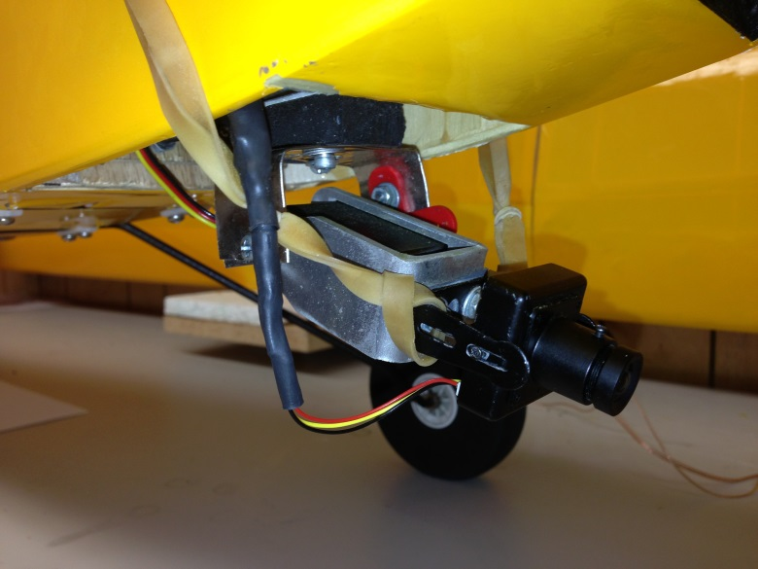
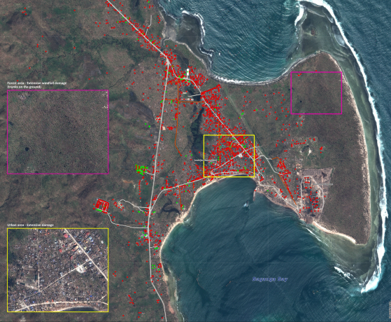
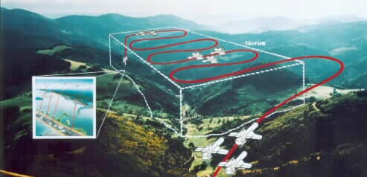
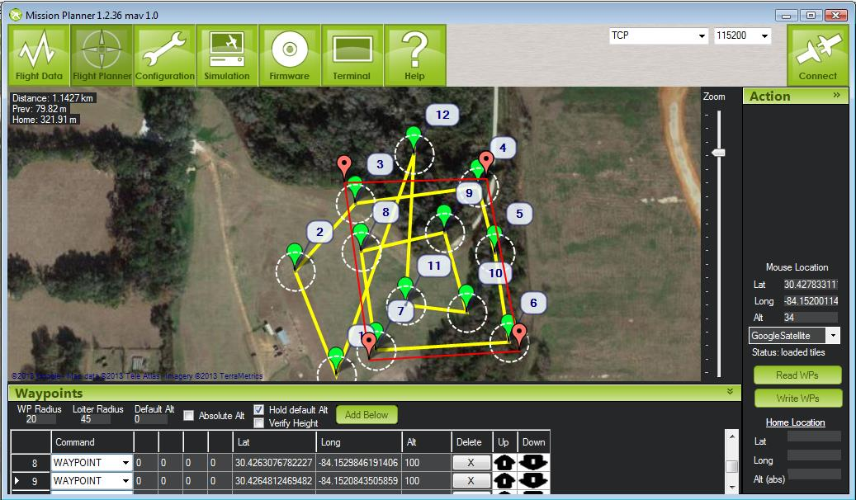
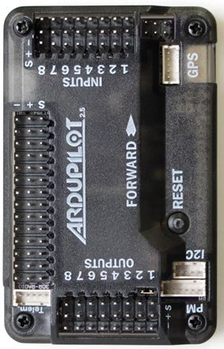
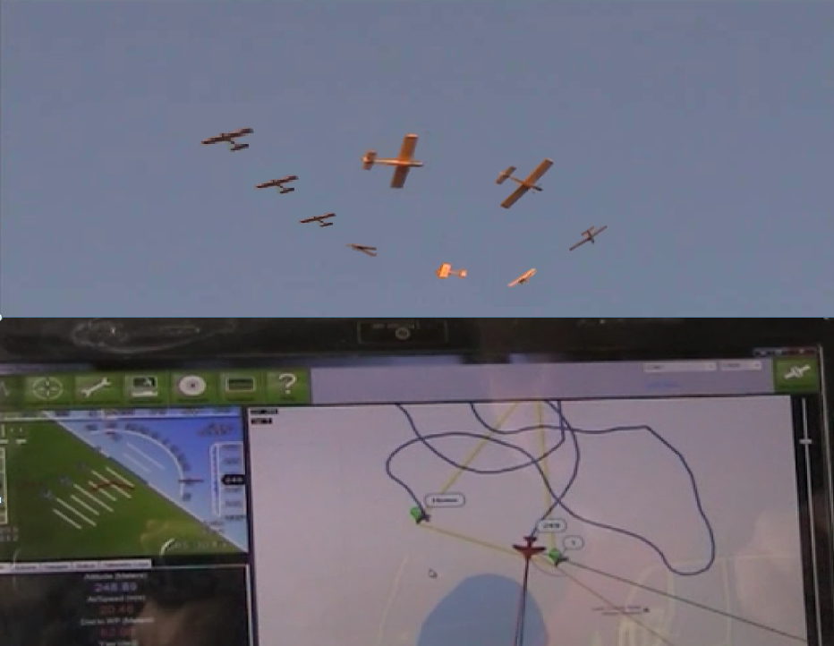




Team 6: Autonomous Aerial Vehicle
Team Members
Department of Mechanical Engineering: Ken Anderson, Arielle Duen, Eric Milo, Ernandes Nascimento and Matthew Yasensky
Department of Electrical Engineering: Cristopher Timmons and Robert Woodruff
Project Advisors
Department of Mechanical Engineering: Dr. Chiang Shih, Dr. Kamal Amin
Department of Electrical Engineering: Dr. Michael P. Frank
Justification and Background
Unmanned Air Vehicles are an increasingly valuable asset in various applications. UAVs eliminate the need for on-board pilots and as such, the limitations associated with providing a livable environment for the pilot. Their use has increased significantly since their inception, and the next step in this developing interest is to apply complete automation to the systems already being used. The benefits for furthering this technology are plentiful in the private and public sector alike. Scenarios for data tracking, weather crafts and first responder missions have all utilized the UAV. The Association for Unmanned Vehicle Systems International (AUVSI) has created an objective-based competition that will enable undergraduate students to be introduced to the field of unmanned air vehicles, automation, and image processing. This competition will encourage the development of this technology and give engineering students an opportunity to facilitate an engineering project.
Airframe
For this years competition, teams are allotted a maximum of 60 minutes to complete all specified requirements. In order to fully utilize the given mission time we will be using a modified Senior Telemaster as the airframe for our UAS. The Telemaster is powered by a Magnum XL 4-stroke motor that with enough fuel gives us the capability to stay in the air up to 60 minutes. The fuel tank configuration used can be seen below. The muffler is used to pressurize the feeder tank which pumps fuel into the main tank. The motor then extracts fuel from the main fuel tank. The Telemaster has a 94in wingspan with 1330sq inches of wing area that supply a large amount of lift. Fully loaded, the 17lb Senior Telemaster travels at a cruise speed of 25mph with a maximum speed of 57mph.
Image Processing
The primary objective of image processing within the scope of our project is to extrapolate six characteristics from each ground target using a ground computer in communication with our on-board imagery system. The figures below show a top level design diagram and an example of ground target characteristic extraction using a frame from live video.
Is there a target present?
Yes
GPS Data
Video Data
No
Match GPS data to image
Acquire next frame of video
Extract Target Data
Orientation
Location of Target
Target Shape
Target Color
Char Shape
Char Color
Store Data
Disregard Data
Yes
No
Duplicate of previous target?
Pressure Line
Send to Output File
Fuel Line
Feeder tank
Concept of Operations
An earthquake has impacted a small island nation in the Caribbean. Several boatloads of pirates who have been operating in the area have landed and are attempting to take advantage of the ensuing chaos. The overwhelmed local government has put out a call for help and the US Marines have responded. Their tasking includes humanitarian relief and security. Your unmanned aerial system (UAS) is supporting their mission with intelligence, surveillance and reconnaissance (ISR). In order to support them, your UAS must comply with Special Instructions (SPINS) for departure and arrival procedures, and then remain within assigned airspace. It will be tasked to search an area for items of interest, and may be required to conduct point reconnaissance if requested. Additionally, the UAS may be tasked to relay data from a third party Simulated Remote Information Center (SRIC). Immediate ISR tasking may be requested outside currently assigned airspace, causing the UAS operators to request deviations.
Gimbal System
The gimbal system is a mechanical/electrical device responsible for moving the camera towards targets. For most of the mission time it is necessary to have the camera pointed perpendicularly to the ground, and to do so, two standard servos are controlled by the autopilot board. As the plane moves in roll and pitch directions, the servos work against the movement to keep camera position.
Engine
Fuel Tank
Mission Planner
Our mission requires us to autonomously navigate waypoints, conduct an area search, and have the capability to change a waypoint mid-flight. The Adrupilot Mega 2.5 (centered below) coupled with APM Mission Planner allows us to achieve these goals as well as some bonus objectives such as autonomous takeoff and changing the search area mid-flight. The picture below on the left shows the circular pattern we are using to scan the search area and the picture below to the right shows the plane loitering around its final waypoint, both in the air and on the Mission Planner flight data screen.
RC Licensing and Piloting
Team six is currently AMA (Academy of Model Aeronautics) licensed. This allows us to fly at all AMA sponsored airfields locally and nationally. Two members of Team 6 have flight training and are capable of piloting the UAS.

