Slide 1


68K Turbine Blade Handling
Final Presentation
Team 14
Patrick Filan
Clint Kainec
John Kemp
Sponsor
TECT Power – Ashok Patel
Advisors
Dr. Patrick Hollis
Dr. Kamal Amin

Slide 2
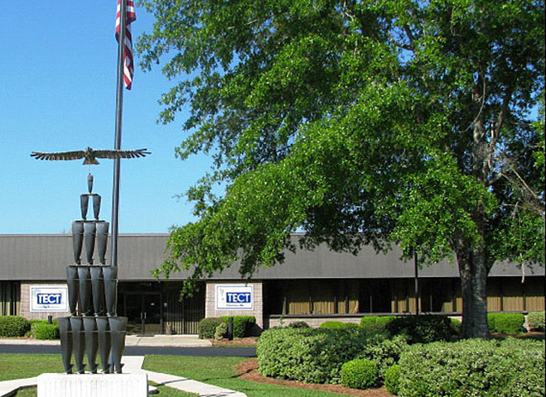
Sponsor: TECT Power
Thomasville, GA
  50min north of Tallahassee
A turbine part manufacturing facility
  Machining, finishing, testing
  Other subsidiaries for design, forging, etc.
Manual and automated mills

Slide 3
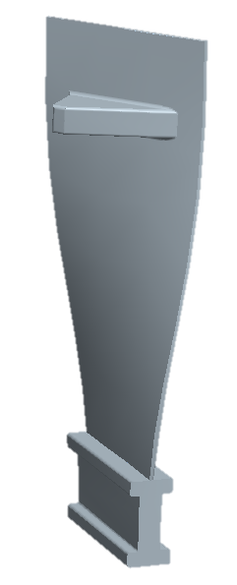
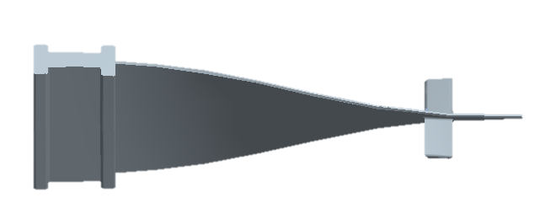
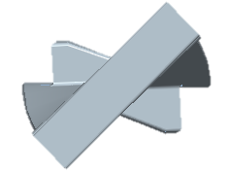
Project Scope
tip
68K Turbine Fan Blade
  45lb Titanium-aluminide
  3ft x 1ft x 0.125in
  Raw forging
Goal
  Must transport and place into mills
    7 machines
    Differing angles and placement in machines
midspan
twist
root
Figures – a representative model of the 68K blade with geometry labeled in red

Slide 4
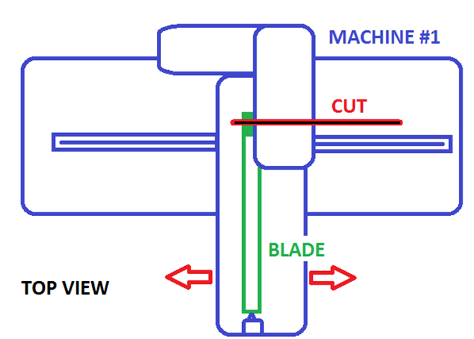
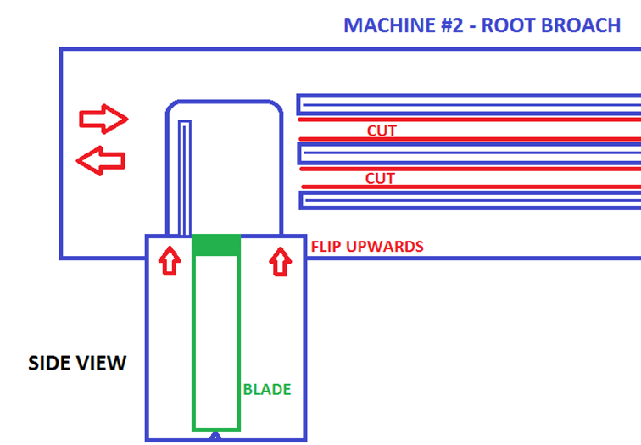
Problem
Manual lifting of the 68K turbine blade
  Safety concerns
Several machines
  Obstructions
  Placement
  Orientation
Figures – diagrams of two machines in the machining area (end-mill and broach wall)

Slide 5
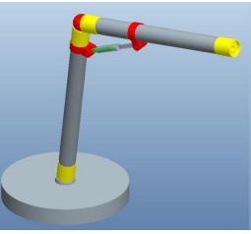
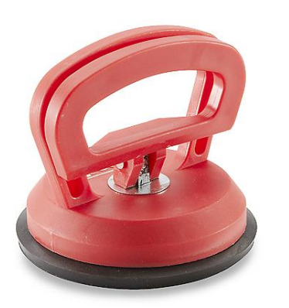
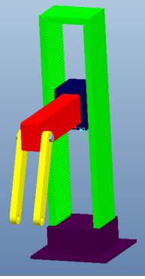
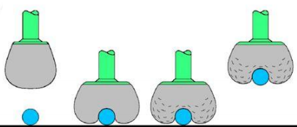
Design Concepts
Orientation system
  Arm-like manipulator
  Bi-axial lift
Gripping system
  Form-fitting grips
  Suction cups
Figures – Rejected designs for the two systems

Slide 6
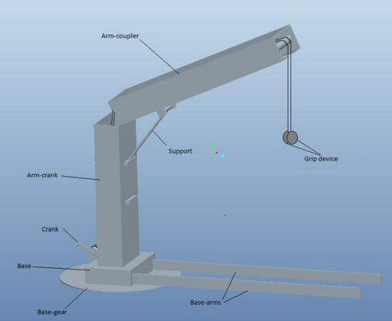
Design Selection
Speed
Maneuverability
Degrees of freedom
Robust
  7 machines – all loadable from the top
Grips must not fail
Must fit budget
Figure – The original selected design before modification

Slide 7
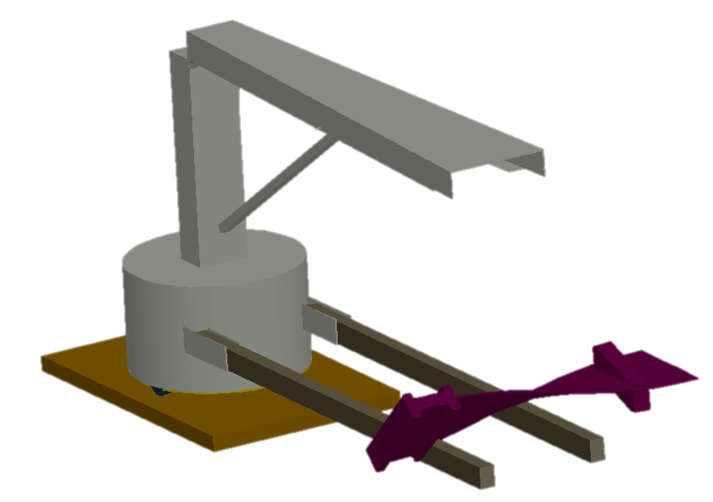
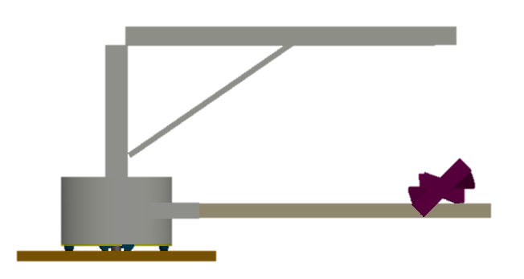
Orientation System: Crane
Accommodates all 7 machines
5 DOF
  Harness: 1 added DOF
1 blade at a time
  Local storage
Wooden supports for adjustment
cart base
harness
main arm
motor-driven lines (2)
68K blade
wooden supports
support beam
electrical housing
base wheels (6 )

Slide 8
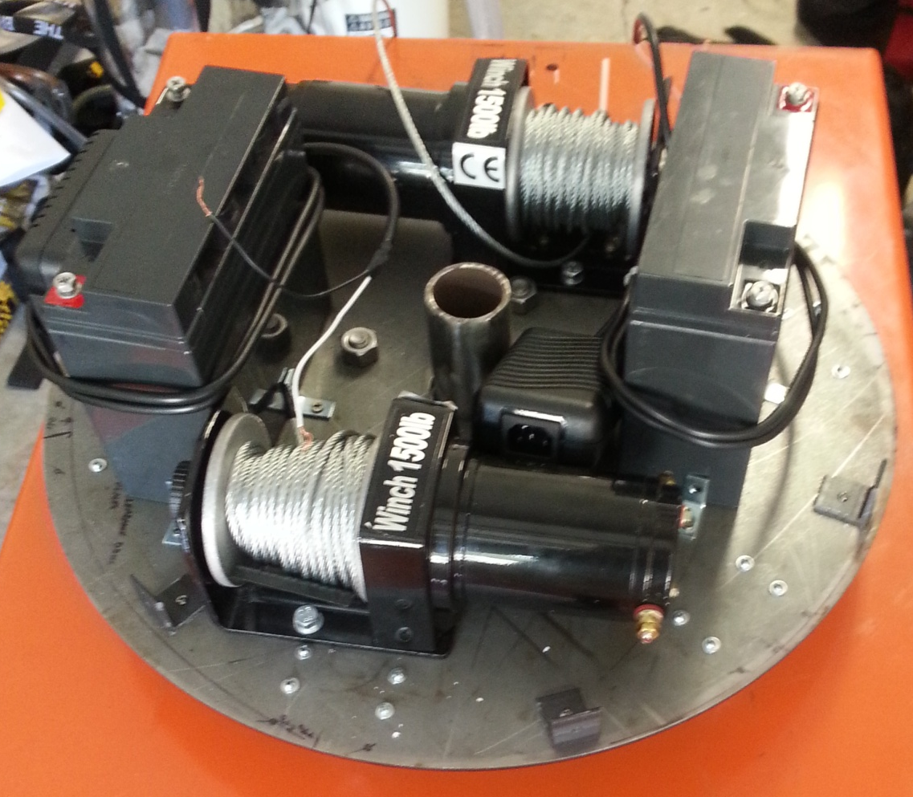
How it Works
Mounted on hydraulic lift cart
  Can rotate about top
Two motor-driven lines
  Independently driven
    Wired controllers
  Attach to harness
Blade can be held:
  Horizontally
  Vertically
  At various angles

Slide 9
Gripping Concept: Blade Harness
Purpose:
Fits on the blade
  Stays on blade
Adjust blade angle and orientation
  Attaches around midspan and towards the root
Design:
Nylon webbing
Plastic buckles
Midspan
Straps around the midspan keep the harness from slipping
Harness
Weight distributed evenly along the blade
Attachment Loops
Choice of loop determines the angle of the blade
Figures – An example of how the harness will fit (above) and a representative scale model of the harness with buckles (left).

Slide 10
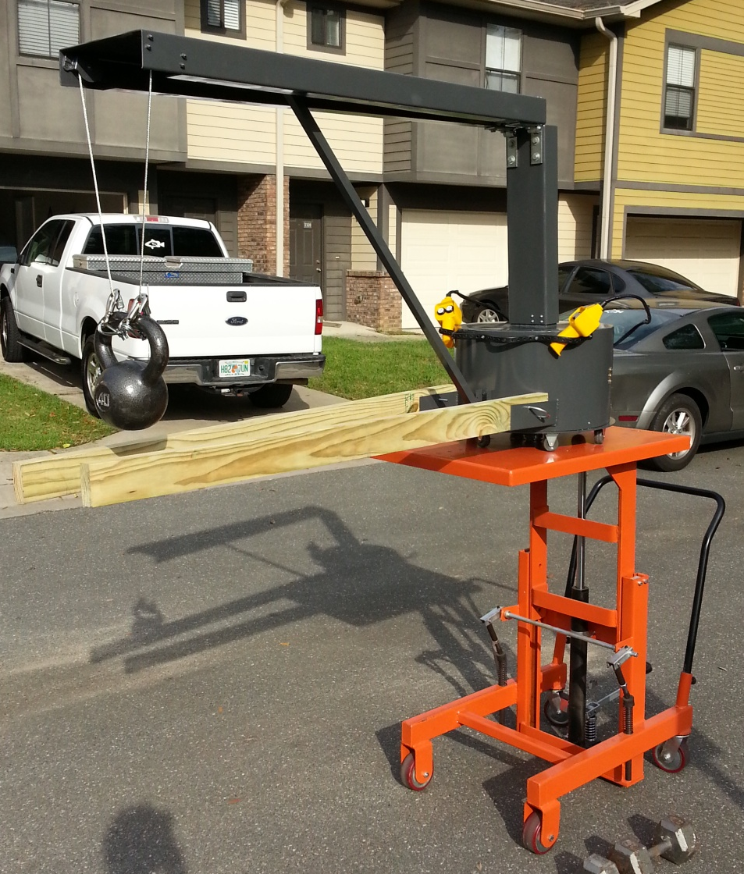
Completed Design
Dimensions
  H: 5 to 7.5ft
  W: 2ft
  D: 7ft
Weight
  ~250lbs
Lifting capability
  150lbs+

Slide 11
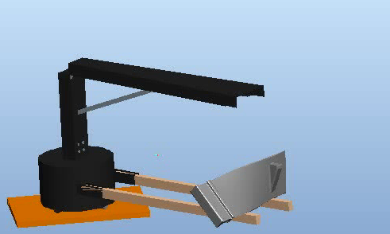
Testing
Lifting simulation
  Used mock “blade”
Lifting height: 7ft
Reach: 6ft
Aisle width: 4ft
No tipping at 45lbs

Slide 12
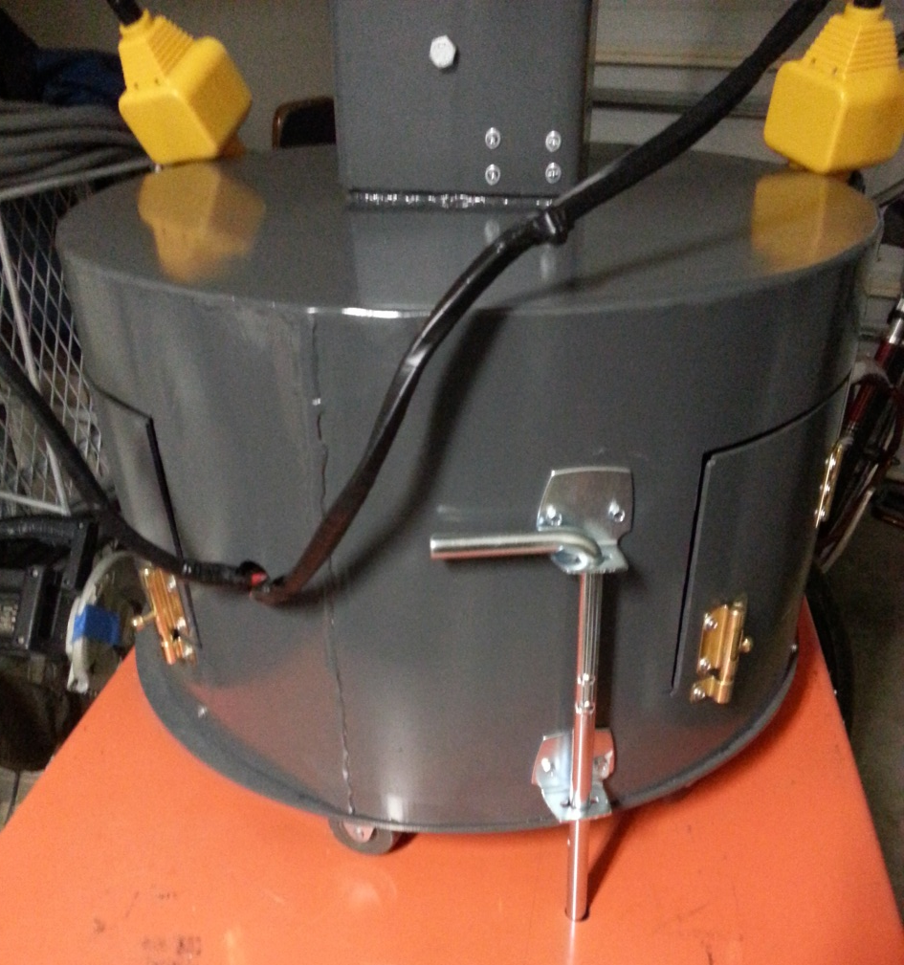
Safety
Crane
  No tipping
  No bending
  Locking mechanisms
Cart needs brake
    Removed last year

Slide 13
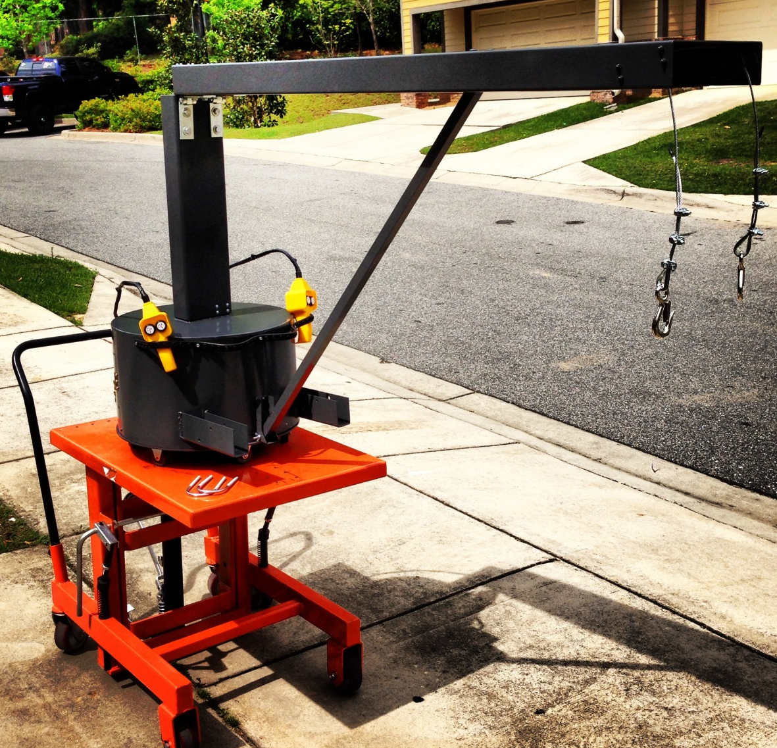
Project Summary
Completed prototypes
  Cart & crane
  Harness mock-up
Eliminated manual lifting
  Minor physical effort required
Ready for operation at TECT Power

Slide 14
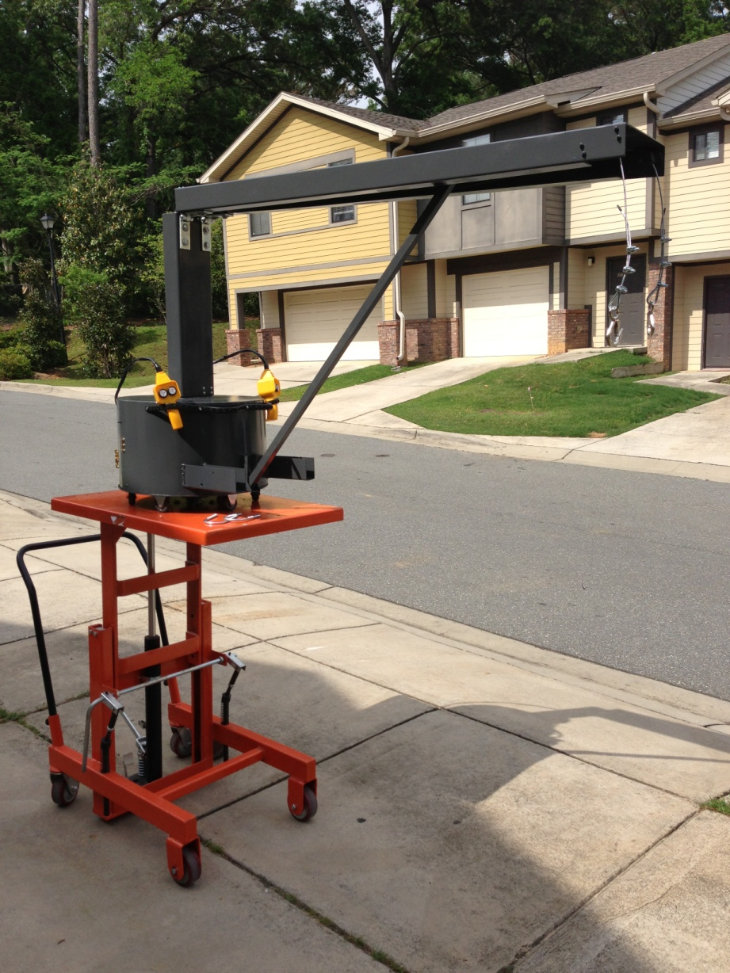
Future Work
Design optimization
  Crane
    Consolidate controllers
    Counterweight
  Harness
    Fitted design – actual blade needed
Safety
  Braking – cart and device
  Emergency shut-off
Accommodate later machines
  Currently only root machines

Slide 15



Questions, Comments?

Slide 16
References
Newton, Jason, et al. "TECT." n.d. Team 9. October 2012. <http://eng.fsu.edu/me/senior_design/2012/team9/>.
Special Thanks
Jason Newton, Alumnus & Graduate Student at FSU
Ashok Patel, Environmental Health & Safety Manager at TECT Power
Dr. Patrick Hollis, Associate Professor at FSU
Dr. Kamal Amin, Adjunct Professor at FSU
Dave Morgan, Lead Foreman at Westgate Sheet Metal

Slide 17
Budget Analysis
Under budget
  Saved money in manufacturing

