Slide 1




Smart Material Museum Exhibit
Spring Final Presentation
Senior Design Group 13
Glen Ashworth
Daniel Roque
Isaac Piersall
Laura Wainikainen

Slide 2
Overview
Problem/Intro
Challenger Center Requirements
Background
Overall Design
Breakdown/Flowcharts
Electronic Components
Stand and Target Layouts
Video
Budget
Closing

Slide 3
Problem/Intro
Design, build, and test a museum exhibit
Smart material
  piezoceramic
Interactive and entertaining

Slide 4
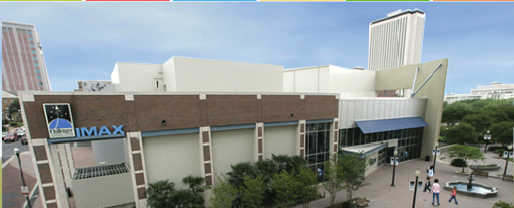
Sponsor: Challenger Learning Center
Located on Kleman Plaza in downtown Tallahassee
Home to an IMAX 3D Theater, space mission simulator, and Downtown Digital Dome Theatre & Planetarium

Slide 5
Challenger Center Requirements
Simple and safe
Space themed
Sized appropriately
Budget $1500

Slide 6
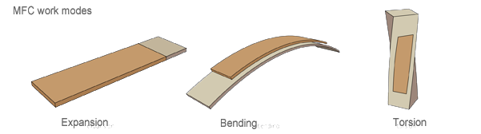
Background/Inspiration
What is smart material?
Piezoceramic specifics
  MFC (macrofiber composite)
  Electrical Mechanical

Slide 7
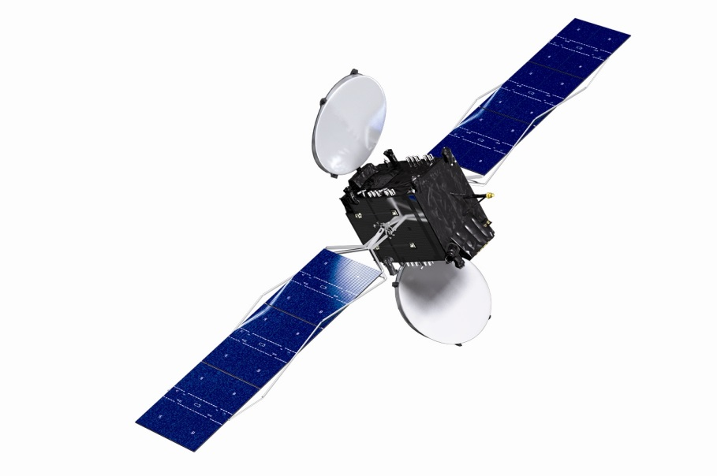
Background/Inspiration
Various applications
  Micro-positioning and vibration damping of optics
  Signal sensors
  Monitoring support structures
Use in space
  Satellites
  Improves communication

Slide 8
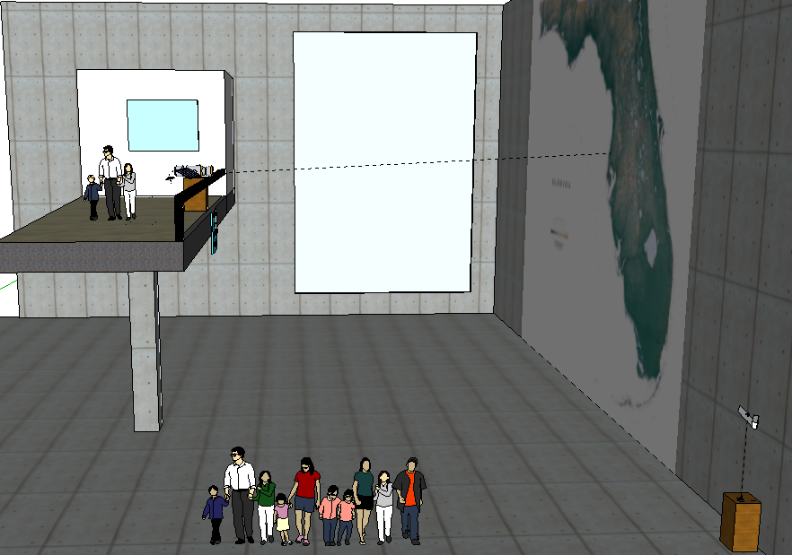
General View of Lobby

Slide 9
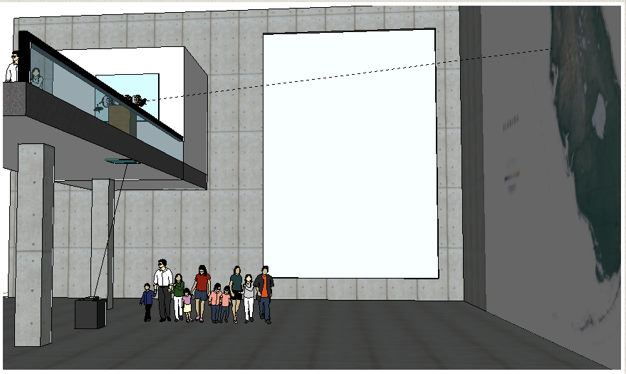
View of Exhibit
Exhibit Stand with Joystick and Controls
User Input (Joystick control and arcade buttons)
Joystick microswitches turn on/off
Arduino reads microswitches
Target laser switched on by yellow button

Slide 10
View of Exhibit
Laser switched on and aimed at a target
Arduino provides input signal to amplifiers
Amplifiers power piezoelectric materials
Piezoelectric materials bend, reflecting the laser at the proper angle

Slide 11
View of Exhibit
Location of pan/tilt kit with a separate laser mounted on top
Target with light sensors for each direction of motion
Laser hits target light sensors
Light sensors signal fed to the second Arduino

Slide 12
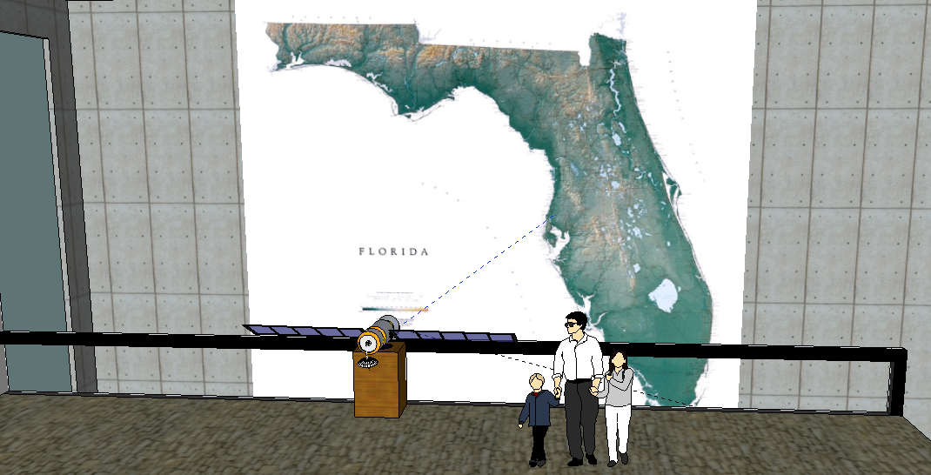
Map View
Laser mounted on pan/tilt servo motors
Arduino powers the pan and tilt servos, which move according to which light sensor is hit by the laser
Output laser is displayed on the map

Slide 13
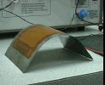
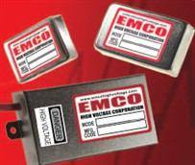
Electronics
Smart Material Corp
MFC M4010-P1
  elongator
  operates from -500 to 1500 v
  environmentally sealed package
  flexible, durable, and damage tolerant
  conforms to surfaces
Emco C10 amplifiers
  Input voltage: 11.5-16 V
  Power: 1 Watt
  output: 0-1000v @ 0-1 mA
  programming voltage: 0-5

Slide 14
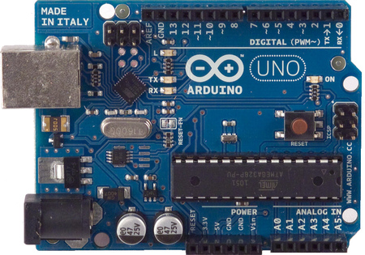
Electronics Cont.
Arduino Uno
  Based on the ATmega328
  16 digital inputs/outputs
    6 are PWM
  6 A-D converters
Power Supplies
  6 v, 2 amp for the satellite section
  12 v, 3 amp for the piezo section

Slide 15
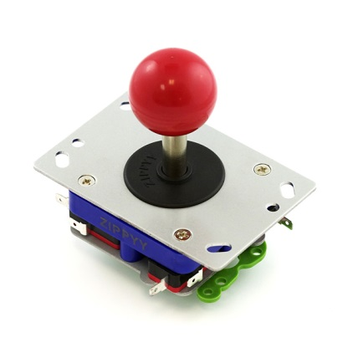
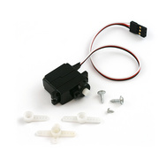
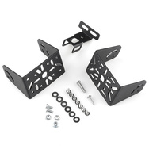
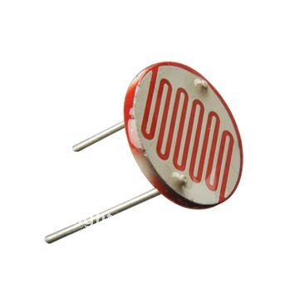
Electronics Cont.
Joystick
  4 microswitches, ea. rated for 2 A @250v
  durable contruction
Servos
  operating voltage: 4.8-6 v
  operating range: ~170 deg
Photoresistors
  120 to 1100 ohms
    close light source to ambient light
  used with resistors to create a voltage divider

Slide 16
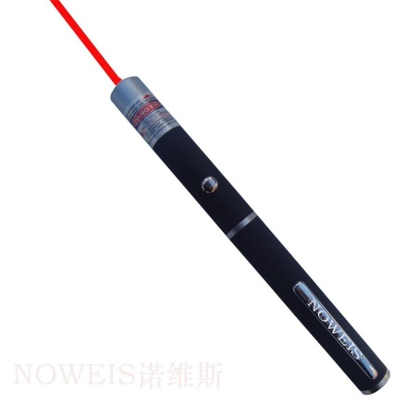
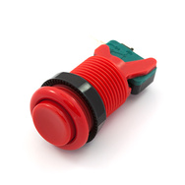
Electronics Cont.
Laser Pointers
  operate up to 1mW of power
  Class 2: considered safe during normal use
    blink reflex of eye will prevent damage
Assorted Resistors
  used as pull-up resistors for the input
  used with capacitors to make a RC low pass filter
Arcade Buttons
  Durable (tested to 10,000,000 cycles)
  microswitches rated to 3A @ 120V

Slide 17
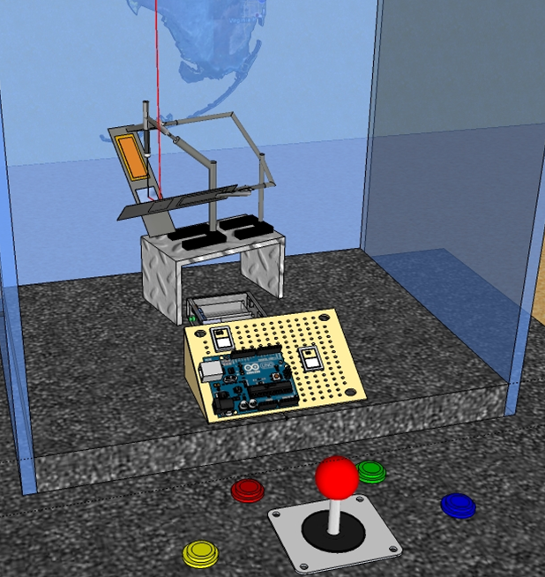
User Interface
Outgoing
Laser Light Beam
Piezoelectric MFC
Mirror
C10 Amplifiers
Power Source
Arduino Uno

Slide 18
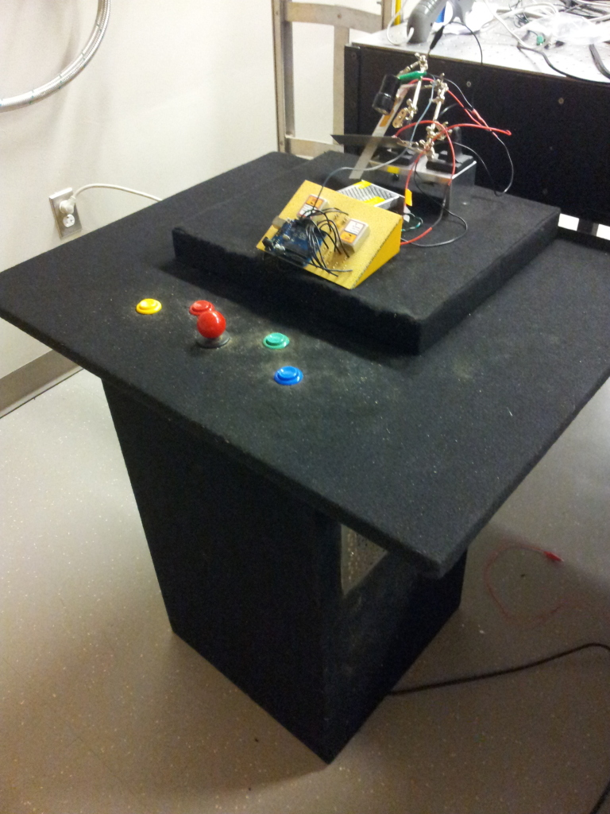
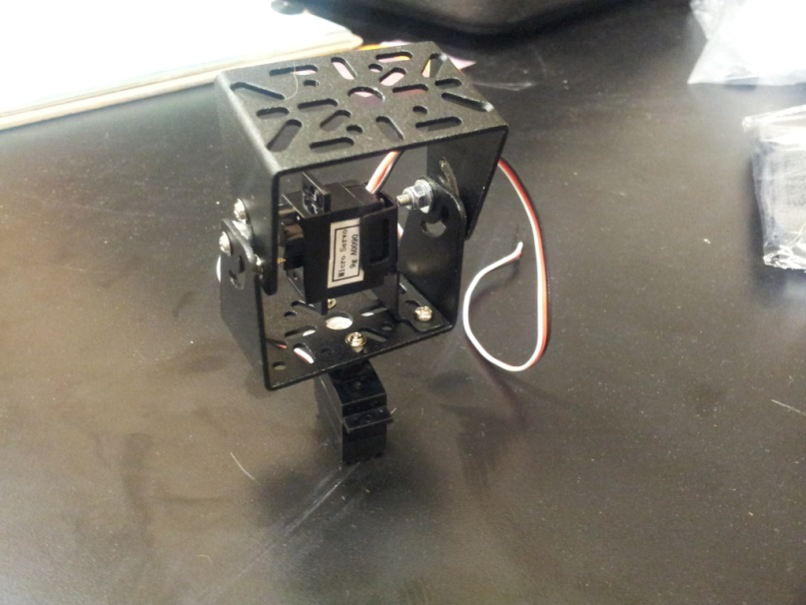
Exhibit Stand
Pan/tilt kit

Slide 19
Videos
Laser Movement: http://youtu.be/W8oDQ-zhKU8
Piezoelectric Material: http://youtu.be/9JU9q-LVN-E

Slide 20
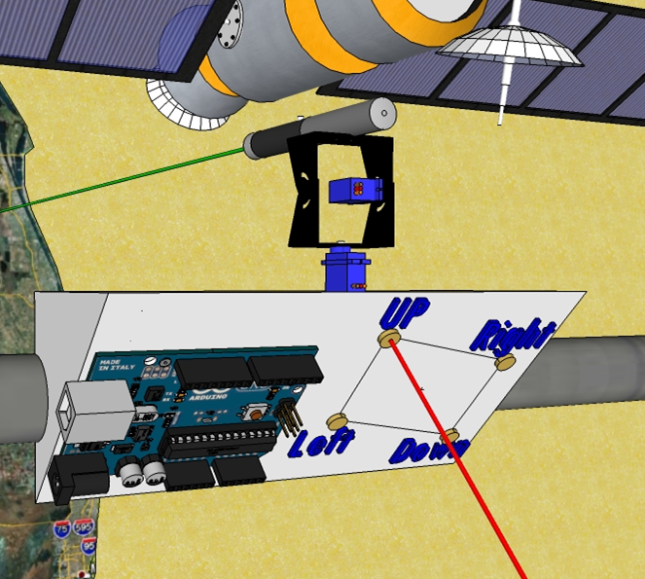
Satellite Target
Green Laser
Outgoing
Laser Beam
Servo
Motors
Pan/Tilt Bracket
Photocell
Array
Arduino
Uno
Incoming
Laser Light Beam

Slide 21
Video
Laser controlled pan/tilt kit: http://youtu.be/UP5KaqaDGHQ

Slide 22
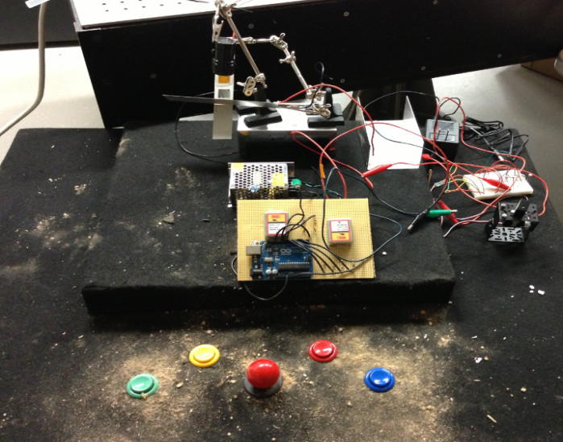
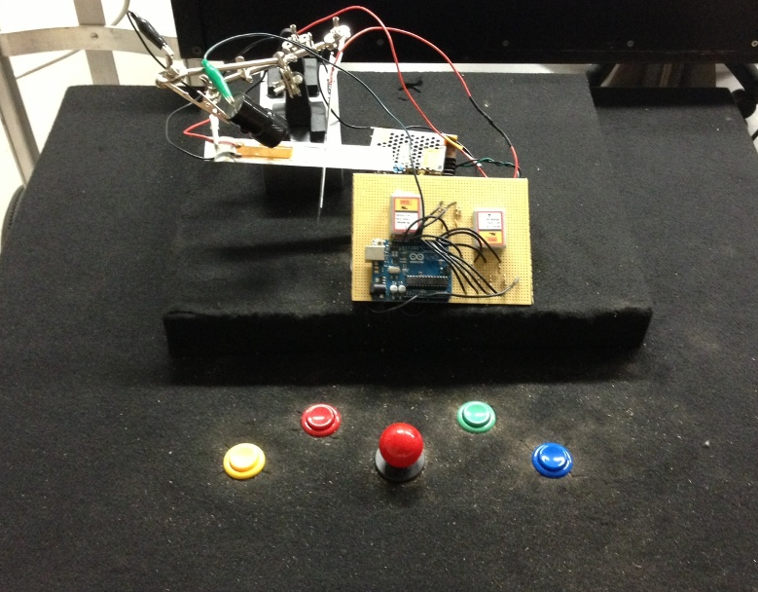
Challenges Encountered
Analog to Digital Converter (Joystick)
  Digital Joystick
Adjustable arms to hold MFCs
Sawdust

Slide 23
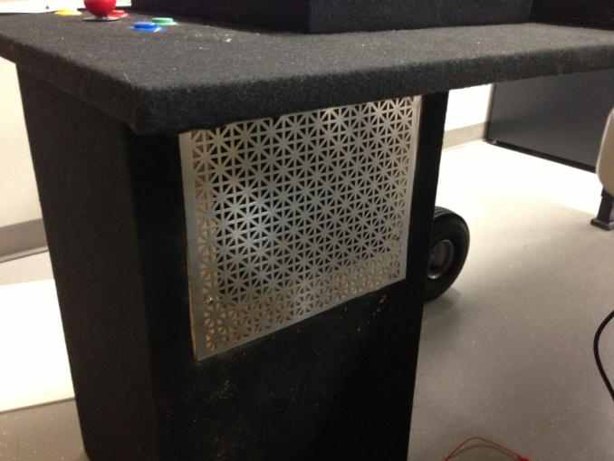
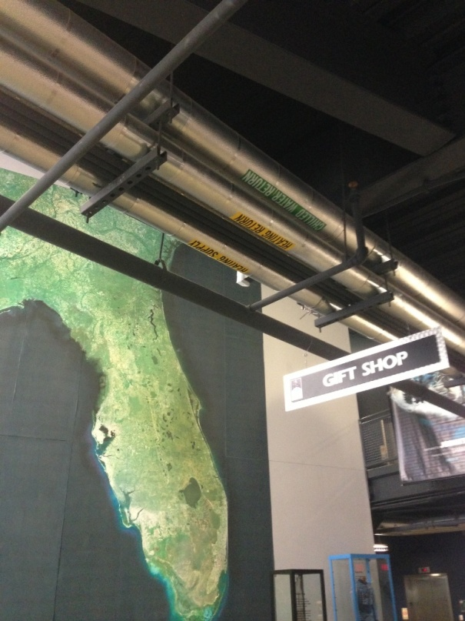
Safety
Electronics Components Encased
Limit in Coding
  0-255
Height of Satellite Target

Slide 24
Cost Analysis
Budget: $1500
Remaining Funds: $780
Item | Price
Piezoelectric MFCs | $ 120
Amplifiers | $ 340
Microcontrollers | $ 60
Miscellaneous Electronics | $ 150
Exhibit Stand | $ 50
Total | $ 720

Slide 25
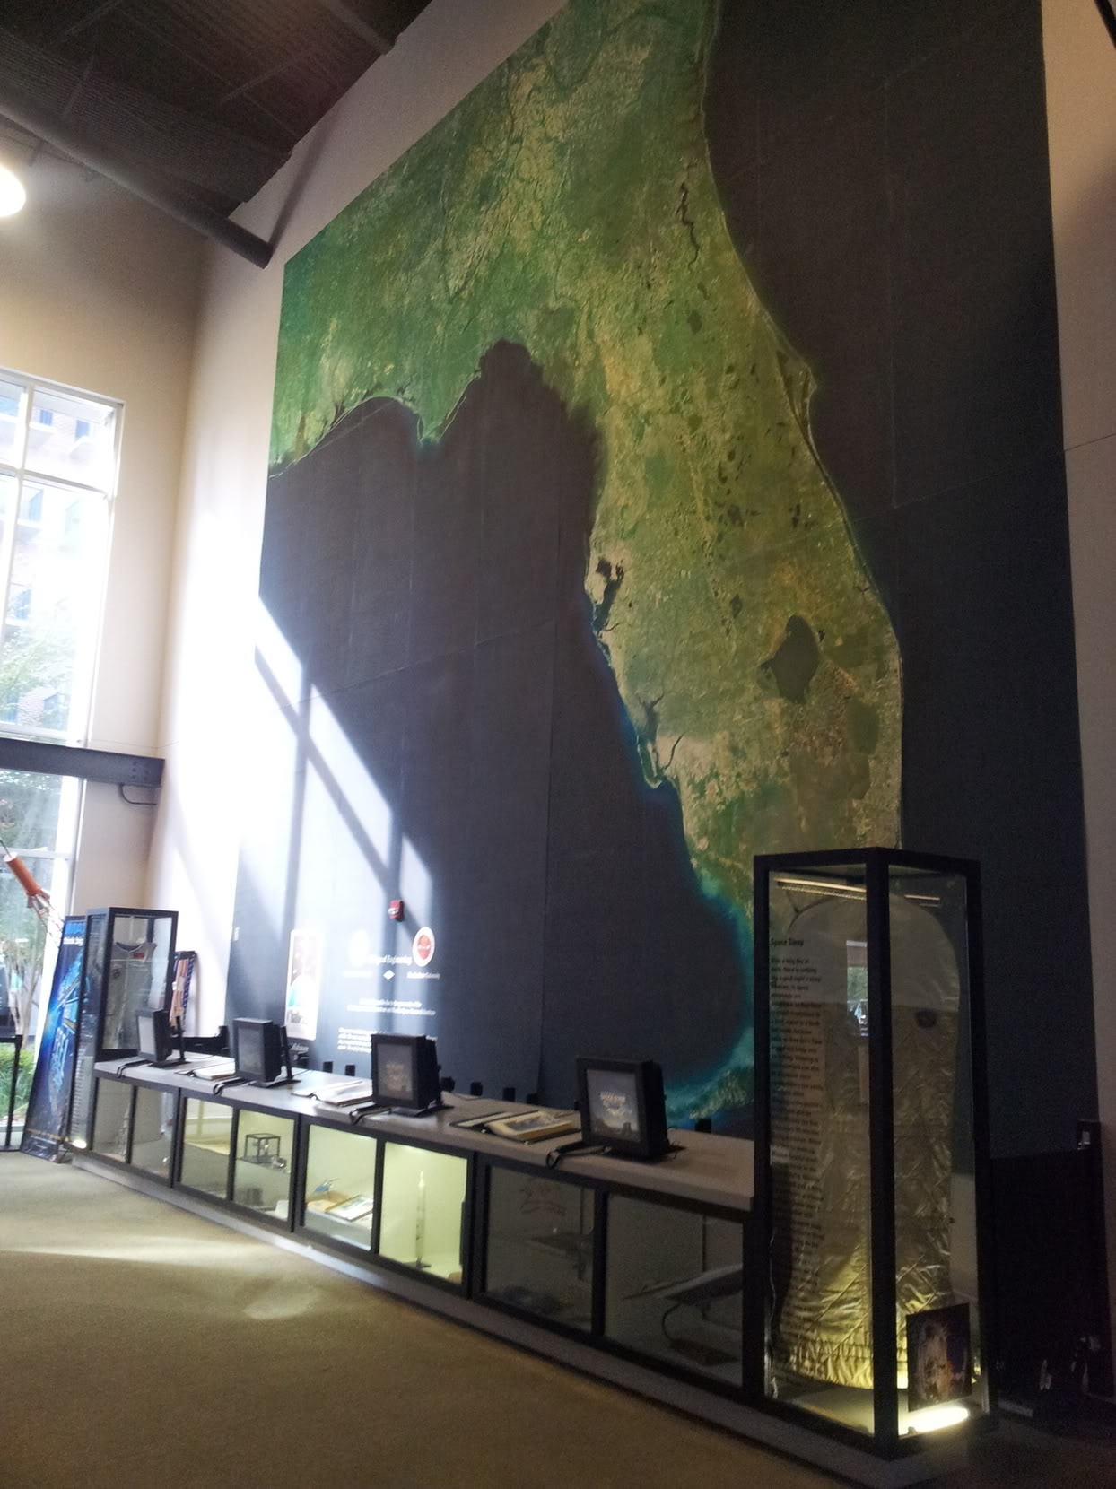
Recommendations for Future Work
Light sensors on Florida map
Wireless control station inside of “Mission Control”
Webcam placed on satellite facing map

Slide 26
What’s Next?
Complete satellite target
Acrylic provided by Challenger Learning Center (4/19/13)
Assembly at Challenger Learning Center
Open House Saturday at 10:00AM
NASA Space Grant Assignments
  Final Report
  Video Clips

Slide 27
Questions?

