Slide 1




Smart Material Museum Exhibit
Spring Midterm Presentation
Senior Design Group 13
Glen Ashworth
Daniel Roque
Isaac Piersall
Laura Wainikainen

Slide 2
Overview
Problem/Intro
Recap of Design
Testing Results
Resolution
Code Progress
Budget Update
Gantt Chart
References

Slide 3
Problem/Intro
The goal of this senior design project is to design, build, and test a museum exhibit
Exhibit must utilize and demonstrate the behavior of a smart material and its applications
Smart material chosen for this project is the piezoelectric type
Exhibit must be interactive and entertaining for students
Final product should be delivered to the museum ready for display

Slide 4
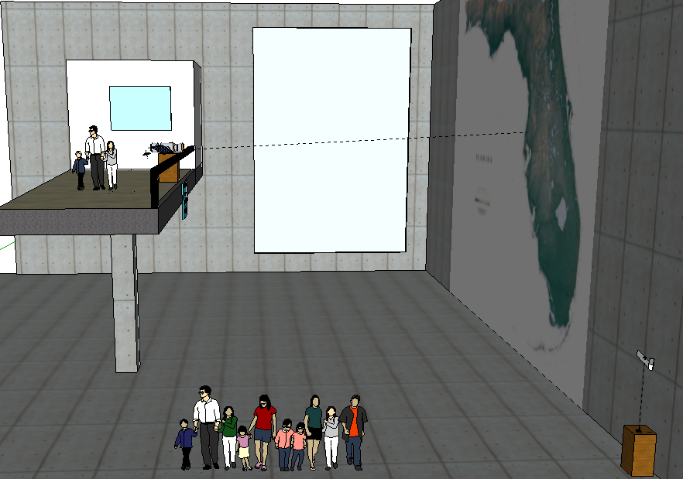
General View of Lobby

Slide 5
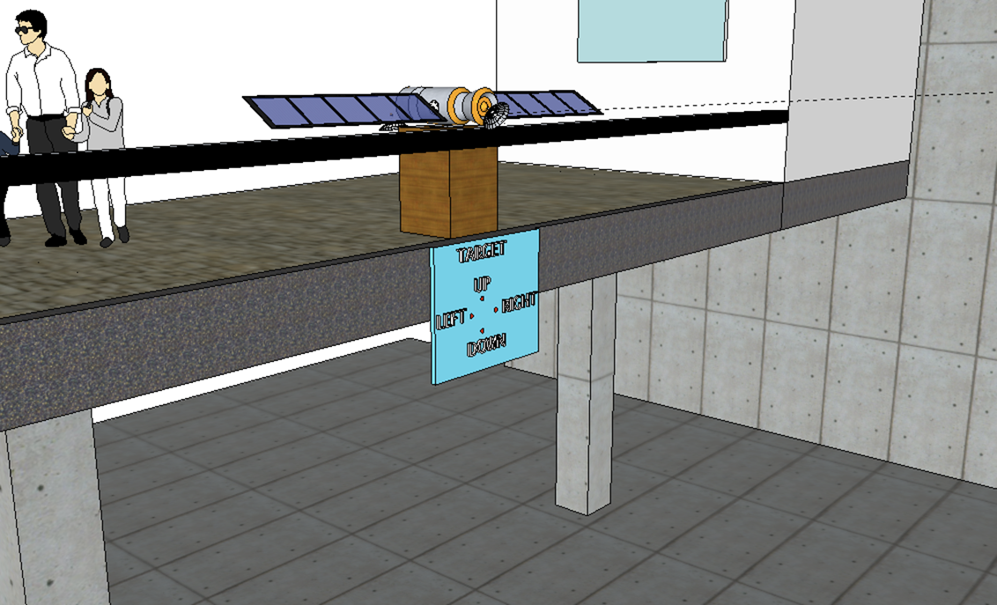

Balcony View

Slide 6
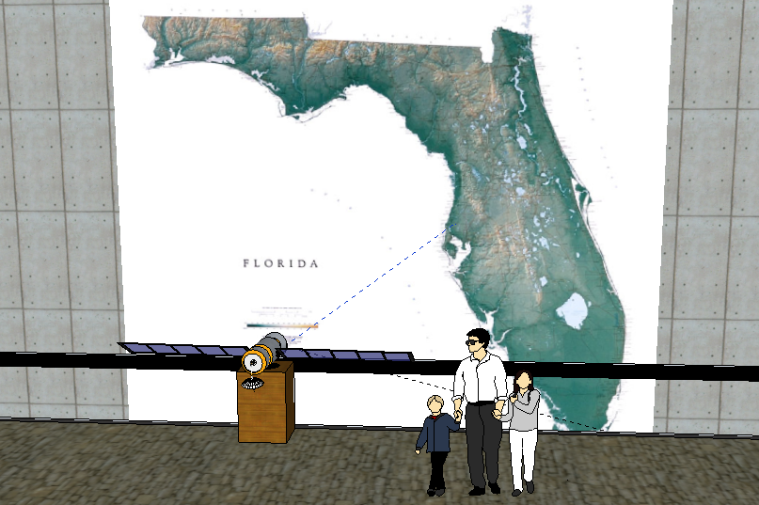
Map View

Slide 7
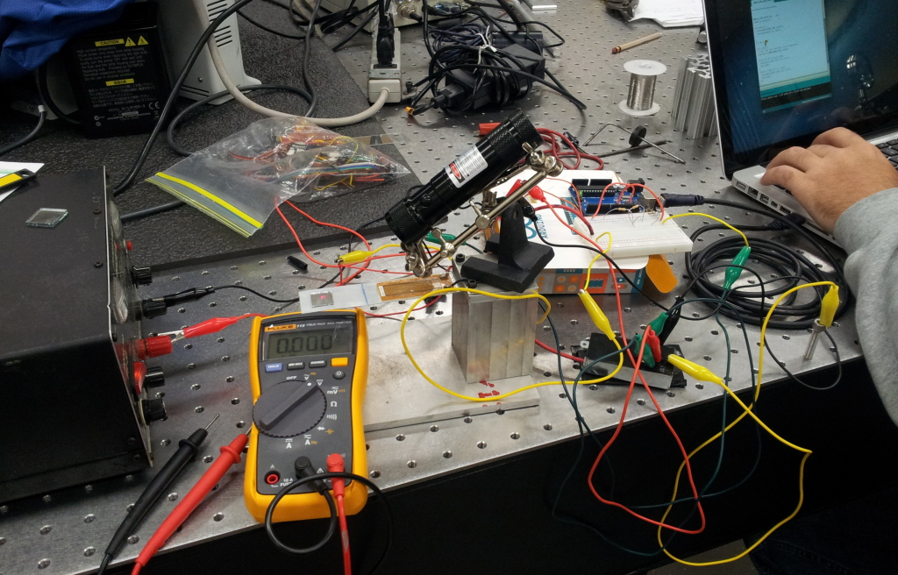
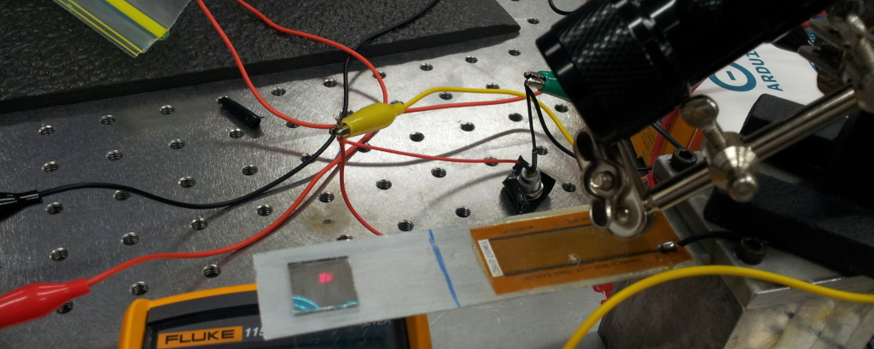
Testing
MFC Movement Test Setup: 8 cm of displacement at a distance of 2 m
Close up: MFC mounted on thin sheet of aluminum with mirror mounted on tip

Slide 8
Displacement of Laser
Similar Triangles
8 cm
Testing in Lab
2 meters
40 cm
Predicted at the Challenger Learning Center
10 meters

Slide 9
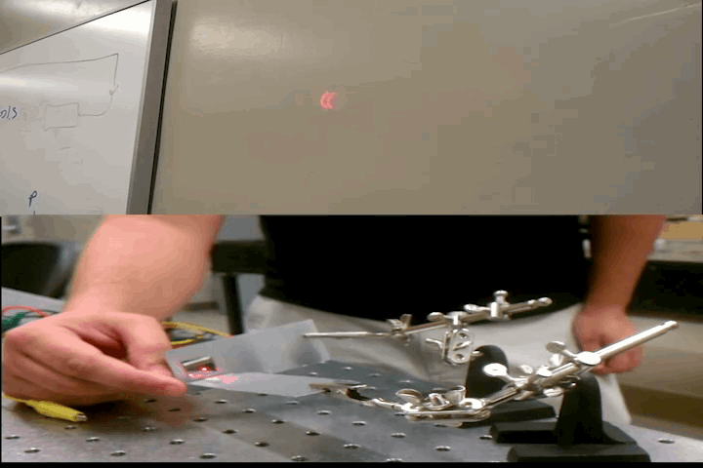
Left and Right Movement

Slide 10
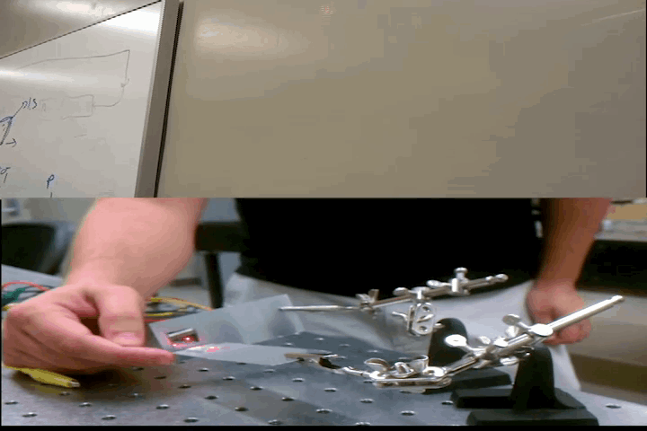
Up and Down Movement

Slide 11
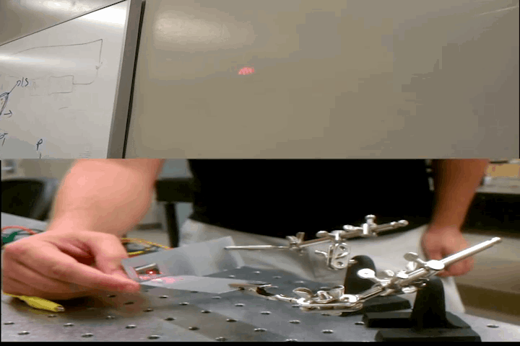
Diagonal Movement

Slide 12
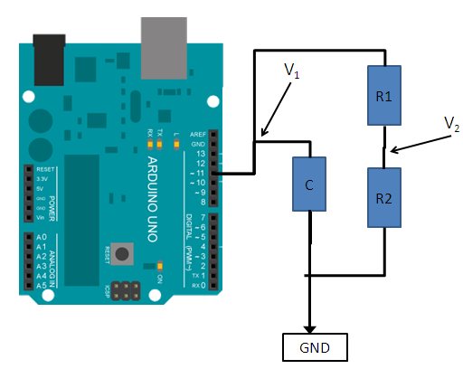
Resolution
 | Arduino (V1) | Voltage divider (V2) | C80 (testing) | C10 (ordered)
Max | 5 | 0.665 | 8000 | 1000
Resolution | 255 | 255 | - | -
Resolution (V) | 0.0196 | 0.0026 | 31.3725 | 3.9216
Resolution tip (deg) | - | - | 0.84 | 0.12
Resolution reflected (deg) | - | - | 1.68 | 0.24
Amplification | - | - | 1600 | 200
Servo Resolution: 180 deg and resolution of 0.2 deg
Voltage Divider |  | I (mA) | 1.01
 | Resistance | Volt. Drop | Power (mW)
R1 | 4300 | 4.33 | 4.370
R2 (V2) | 660 | 0.665 | .671
Total | 4960 | 5.00 | 5.040

Slide 13
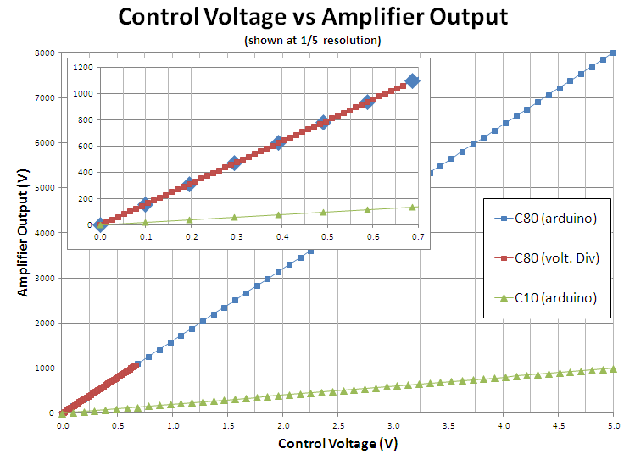

Slide 14
Coding
Piezo control
  Reads 4 pins connected to a digital joystick
  Increments/decrements duty cycle
  Outputs two PWM signals one to each amplifier
Servo Control
  Reads 4 pins each connected to a photo-resistor circuit
  Increments/decrements servo position
  Outputs two PWM signals, one to each servo

Slide 15
Bill of Materials
 | ITEM | DESCRIPTION |  | QUANTITY | COST | Total Cost
User Interface | Piezoelectric Material | Smart Material Corp |  | 2 | $ 58.00 | $ 116.00
 | Laser | 5 mW Green |  | 2 | $ 30.00 | $ 60.00
 | Laser/Piezo Stand | SE MZ101B Helping Hands |  | 2 | $ 8.00 | $ 16.00
 | Microcontroller | Arduino Uno |  | 2 | $ 29.95 | $ 59.90
 | Amplifier | EMCO-C10 |  | 2 | $ 170.00 | $ 340.00
 | Mirror | Wall-mountable |  | 1 | $ 29.46 | $ 29.46
 | Small Mirrors | Micheal's |  | 1 | $ 4.00 | $ 4.00
 | Joystick | Arcade Joystick- Short Handle |  | 1 | $ 14.95 | $ 14.95
 | Exhibit Stand | Wood |  | 1 | $ 50.00 | $ 50.00
 | Exhibit Case | Acrylic |  | 1 | Provided by Sponsor
Satellite Target | Pan/Tilt Kit | ROB-10335 |  | 1 | $ 5.95 | $ 5.95
 | Small Servo Motor | ROB-09065 |  | 2 | $ 8.95 | $ 17.90
 | Target | Craft Materials |  | 1 | $ 10.00 | $ 10.00
 | Mock Satellite | Craft Materials |  | 1 | $ 25.00 | $ 25.00
 | Photocell (.43” thick) | Jameco Part no. 120299 |  | 4 | $ 7.16 | $ 28.64
 | Op Amp (LM358) | Jameco Part no. 120862 |  | 2 | $ 0.50 | $ 1.00
 | Comparator (LM393) | Jameco Part no. 24281 |  | 2 | $ 0.50 | $ 1.00
 |  |  |  |  | TOTAL | $ 779.80
Currently:
Microcontroller in lab
Piezoelectric materials in the lab
EMCO-C80 amplifier
When parts are delivered:
Arduino Uno
EMCO-C10 amplifier
Challenger Learning Center
Mock satellite
Poster with directions

Slide 16
Schedule
January |  |  |  | February |  |  |  | March |  |  |  | April
6-Jan | 13-Jan | 20-Jan | 27-Jan | 3-Feb | 10-Feb | 17-Feb | 24-Feb | 3-Mar | 10-Mar | 17-Mar | 24-Mar | 31-Mar | 7-Apr | 14-Apr | 21-Apr
 |  | Restated Scopes and Plans Review
 |  |  |  |  | Initial Purchasing
 |  |  |  |  |  | Initial Testing
 |  |  |  |  |  | Design Review Presentation #1
 |  |  |  |  |  |  |  | Continued Testing
 |  |  |  |  |  |  |  |  |  | Prototype Building
 |  |  |  |  |  |  |  |  |  | Installation
 |  |  |  |  |  |  |  |  |  | Testing at Challenger Learning Center
 |  |  |  |  |  |  |  |  |  |  | Design Review Presentation #2
 |  |  |  |  |  |  |  |  |  |  |  |  | Testing/Analysis
 |  |  |  |  |  |  |  |  |  |  |  |  | Open House
Building initial prototype
  Testing and analyzing data
  Using materials in the lab
Build photo-resistor circuit
  Test displacement of the 2nd laser on the wall
Complete prototype and test in the lab
Installation of final design the week of March 10
  March 16: Open House at Challenger Learning Center
  Make design adjustments according to the size of the room and the placement of the modules

Slide 17

Questions?

Slide 18
References
"Performance High Voltage Power Supply Manufacturer." EMCO High Voltage Power Supply Manufacturer. N.p., n.d. Web. 25 Oct. 2012. <http://www.emcohighvoltage.com/>.
"MFC." Macrofiber Composite. Smart Material, n.d. Web. 22 Oct. 2012. <http://www.smart-material.com/MFC-product-main.html>.
"Piezo Actuators to Enable High-resolution Cosmic Dust Analysis." SME Achievements. European Space Agency, n.d. Web. 22 Oct. 2012. <http://www.esa.int/SPECIALS/SME_Achievements/SEMAADO7BTE_0.html>.
"From the Satellite to the Ground." Imagine the Universe. NASA, n.d. Web. 22 Oct. 2012. <http://imagine.gsfc.nasa.gov/docs/sats_n_data/sat_to_grnd.html>.

Slide 19
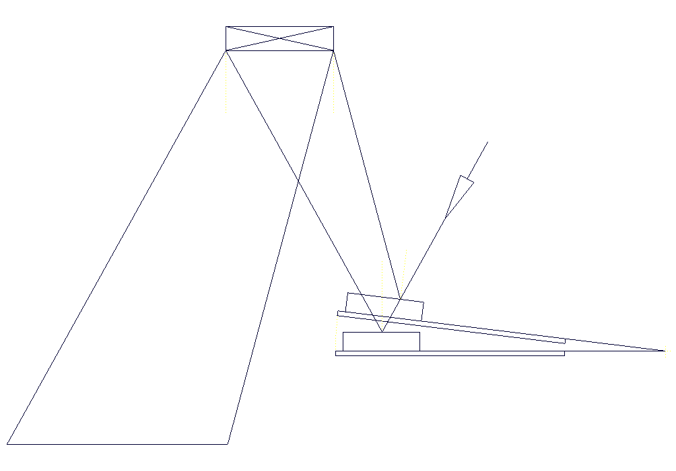
MFC Movement and Calculations
Smart Material Corp.
  Macro Fiber Composite (MFC)
    MFC P1 type (d33 effect)
      Elongator
    Max operating voltage
      -500 to 1500 V
Code provided by: Mike Hayes
>> laminar_actuator_tip_disp
Tmetal | 2.2 mm
Voltage | 1500 volts
Lin | 2.15 inches
difT | 1.9364 mm

Slide 20
Amplifiers
EMCO High Voltage
  C series- 1 watt amplifiers
    Needs a 1 watt 11.5-16 VDC power adapter
    Input 0-5 V
    Output 0-1500 V

Slide 21
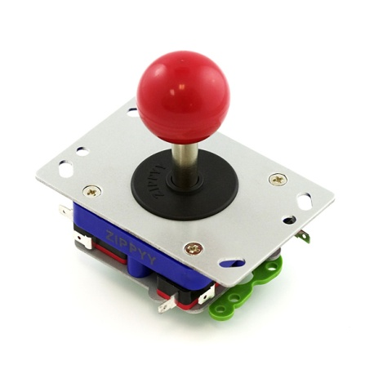
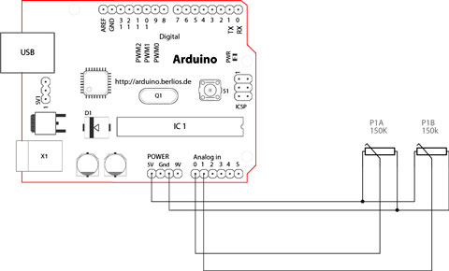
Misc. Parts
Light sensors
  Photodiode, phototransistor, photo-resistors
User interface
  Joystick (Digital)
  Arduino
  Amplifiers
Amplifiers

Slide 22
Satellite
Majority of the satellite structure is for aesthetics
Mounted on/near railing
The outside will be stationary
Cheap materials
Laser mounted on pan/tilt kit mounted in hollow opening

Slide 23
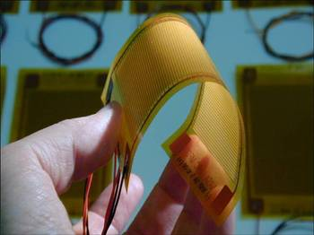
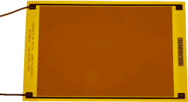
Inspiration
Piezoelectric materials currently used in satellites today
Applications include micropositioning and vibration damping of optics, signal sensors, and monitoring support structures
We will utilize an MFC (macrofiber composite), invented by NASA in 1996

Slide 24
What Are Smart Materials?
Materials with a property that can be controlled by an outside source such as stress, temperature, or electric and magnetic charge
Piezoelectric materials: can produce a voltage if bent or altered and conversely the material will bend and produce a mechanical stress when a voltage is applied to it
Energy Transfer
Mechanical Electrical

