Slide 1
Formula Electric
Progress Report Presentation
Mechanical
Tomas Bacci
Stephen Kempinski
George Nimick
Sam Risberg
Electrical
Danny Covyeau
Scott Hill
Industrial
Corey Souders
Ryan Luback
Aldreya Acosta
Team: ME 21/ECE 3
1/19/12

Slide 2
Scope
The scope of the Electric Formula Racer project is to design and build a fully functional SAE Competition Vehicle powered by an electric motor and suitable for the non-professional autocross competitor.
Main components
  Chassis (3D model and build)
  Drivetrain (rear differential, motor, etc.)
  Suspension (hubs, springs, brakes, control arms, etc.)

Slide 3
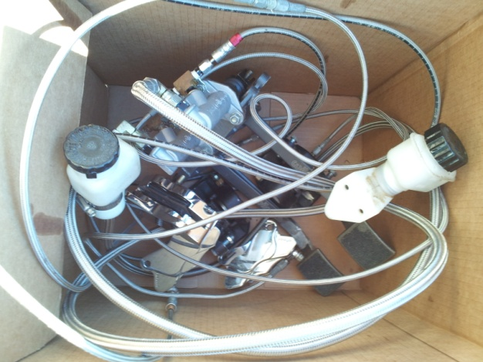
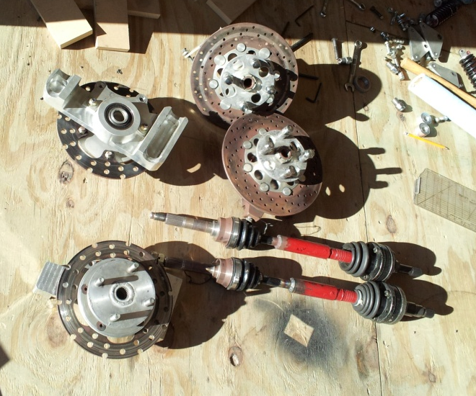
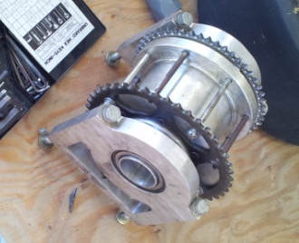
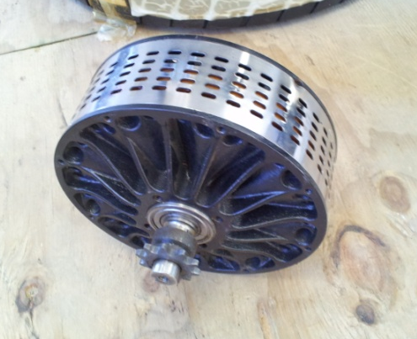
Components from previous Hybrid Car
Electric Motor
LSD
Axles
Hub bearings
Braking components

Slide 4
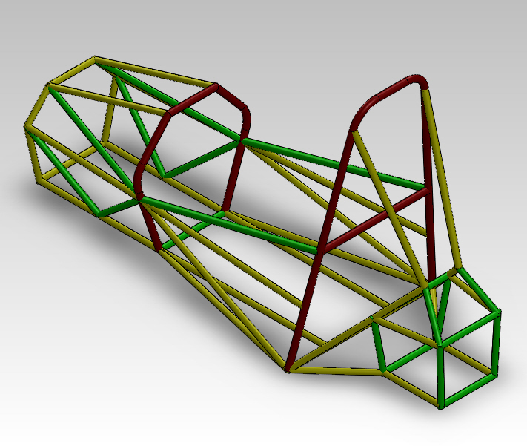
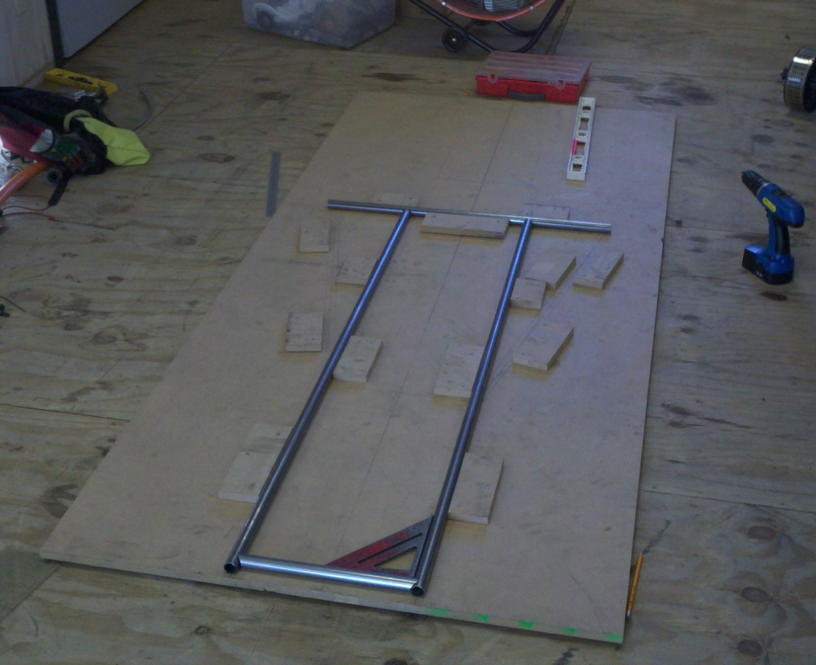
New Chassis
Completed 3-dimensional model
Construction underway
  Jigs assembled to ensure
  accuracy to model
Communication with
mechanical scrutineers
Disassembly of old car

Slide 5
Drivetrain
Motor Selection – Agni Electric Motor
  Dynamometer Testing
Batteries
  Lithium Polymer
    3.7V, 5Ah, 20C
    72V, 120 batteries
    6 parallel sets, replicated 20 times in series
Motor Controller
1:4.5 Gear ratio
Chain-driven
Torsen Limited-Slip Differential

Slide 6
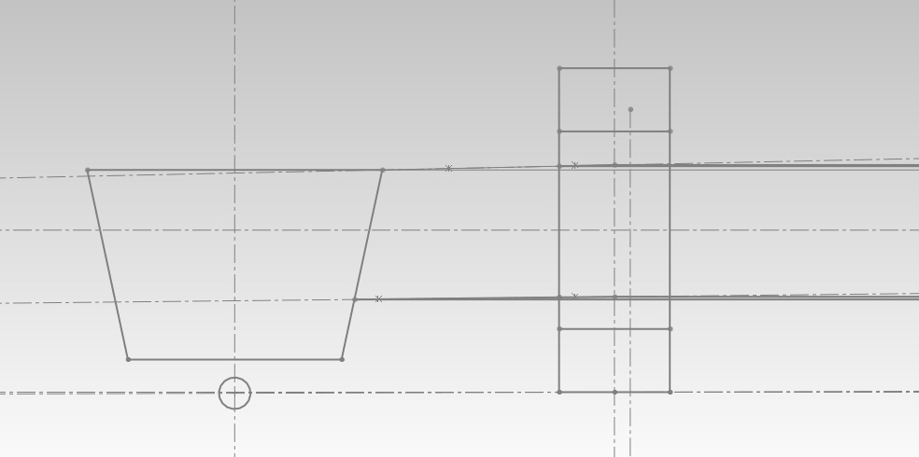
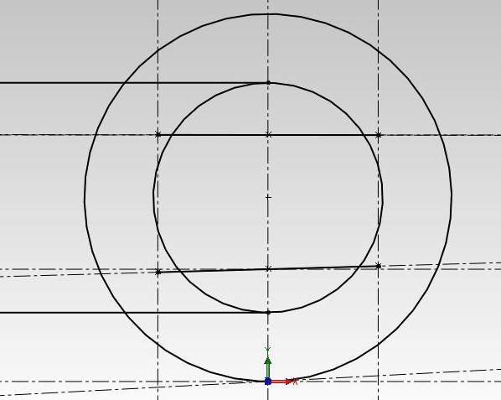
Suspension
FVSA
  Establish parameters
    Roll Center
    Instant center
SVSA
  “Anti” feature Calculations
    23% AD

Slide 7
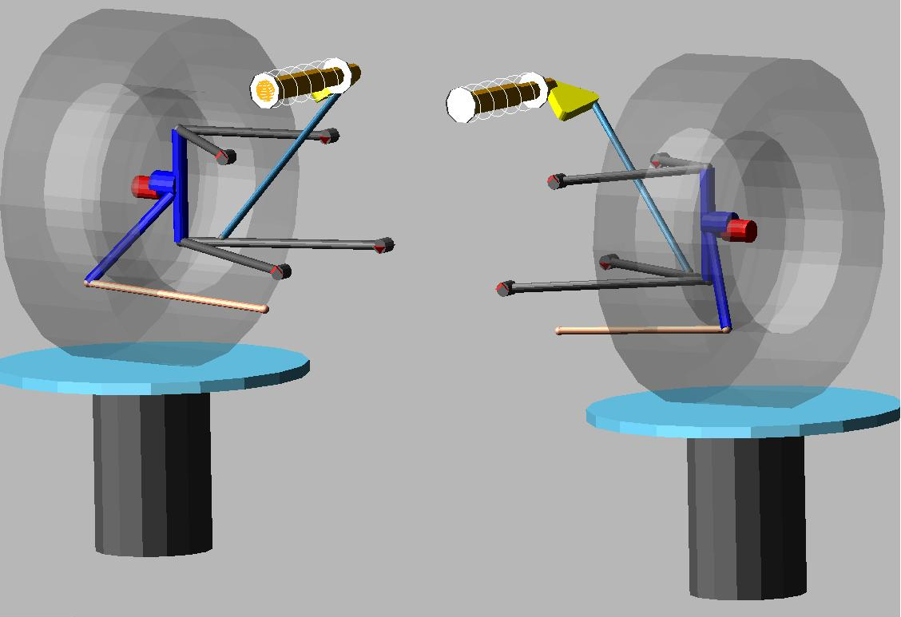
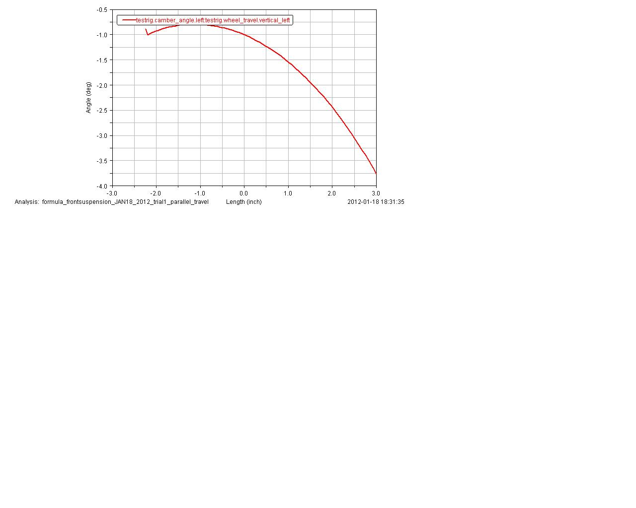
Suspension
ADAMS-CAR
  Simulation
    Measure suspension characteristic changes with wheel displacement
  New springs
    Reduced stiffness

Slide 8
Approach
Exceed minimum requirements with available budget
  Competition and performance
Divide responsibilities based on individual strengths
“Measure twice and cut once”
  Design and model components to ensure fitment
  Compare to rule restrictions

Slide 9
Funding Status
Contributions:
  Mechanical Dept. - $2000
  Electrical Dept. - $1000
  Industrial Dept. - $1500
  Dean’s Office - $2500
  Cummins (recently) - $2000
Created Sponsorship Packet
  Distributed to over 50 companies

Slide 10
Schedule for Near Future
Build Majority of Chassis
Complete Suspension design
Finalize material selection to make the mold for the body
Place additional orders

Slide 11
Summary
Chassis construction is underway
On schedule to meet deadlines
Designs nearly complete on all major components
Visit us on the Web!
  http://eng.fsu.edu/me/senior_design/2012/team21/index.html
  Check out the website for updated pictures and documents.

Slide 12
