Slide 1
Milestone 3 Presentation:
System Level Design Review
Team 3 : Electric Formula Vehicle

Slide 2
Top Level Electrical Design and Motor Performance Assesment
Presented By: Danny Covyeau

Slide 3
Top Level Electrical Diagram

Slide 4
Major Changes
1 Motor, 1 Controller
  Removed 3 Motors, 1 Controller, & 2 Contactors
Differential
  Easier for ME design and greater expandability for future teams
No ECU
  Reduces latency between throttle change and mechanical output, simplifies EE design

Slide 5
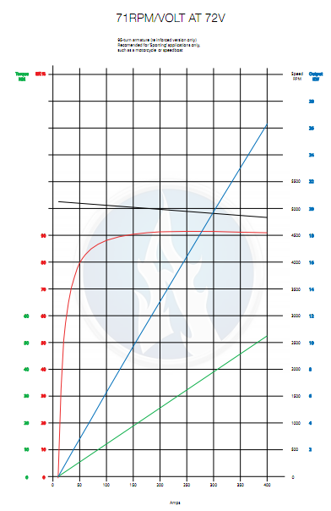
Agni 95-R Motor
Peak Efficiency: 93%
Constant Torque: 42 Nm
Continuous Output Power: 22 kW
Weight: 24 lbs
Popular, dependable choice among Formula Hybrid teams

Slide 6
Motor Performance Assessment
C_{F} | Mass Over Rear Axle (assuming 50:50 weight distribution) | Wheel Radius, r | Peak torque before tire slips τ = M*g*r*C_{F}
0.9 | 150 kg | 0.254 m | 336 Nm
0.8 | 150 kg | 0.254 m | 299 Nm
0.5 | 150 kg | 0.254 m | 187 Nm
0.1 | 150 kg | 0.254 m | 37 Nm
Peak Motor Speed: 6000 rpm
Peak vehicle speed: 79.3 mph
Assuming no tire slip,
  0 – 75 meter Acceleration = 7.8 seconds
a = 2.48 m/s^2

Slide 7
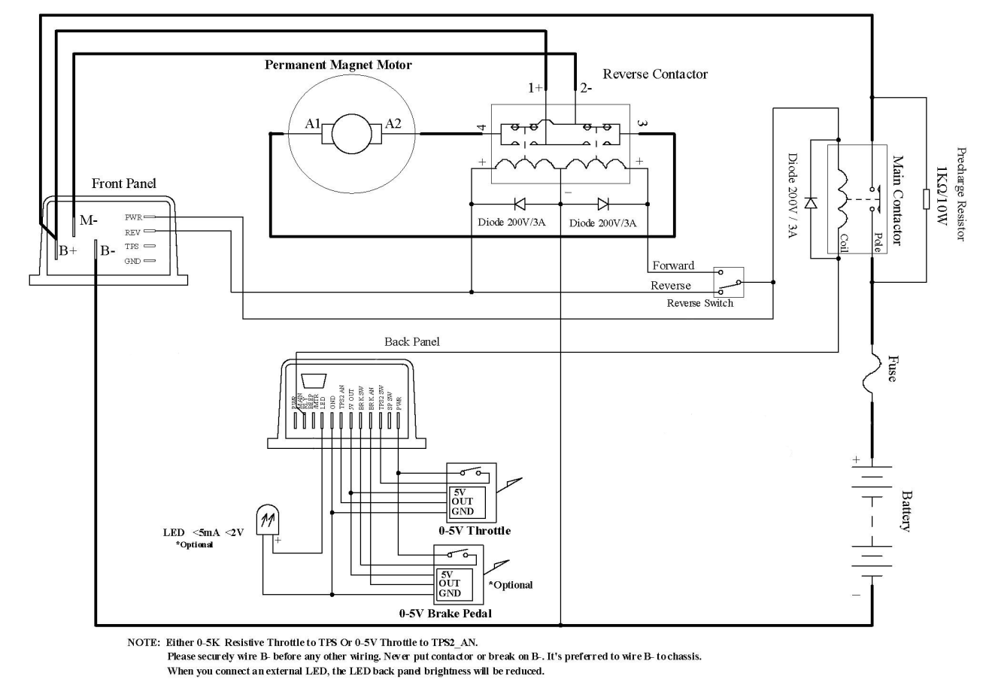
Kelly KD72501 Motor Controller
Optically Isolated:
  throttle potentiometer
  brake potentiometer
  switches
Uses high power MOSFETs to achieve ~99% efficiency
200 Amps continuous
500 Amp peak for 1 minute
Built in regenerative braking that can recapture up to 100 amps
  Still requires mechanical brakes
Programmable controller with a user-friendly GUI
* Courtesy Kelly KD User Manual

Slide 8
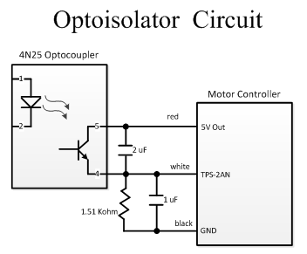
Optoisolator Circuit
Used to separate HV and LV circuits as required by the 2012 Formula Hybrid Rules
To the left is an example of the isolation circuit used for the throttle potbox

Slide 9
Battery Sizing and Power Requirement Analysis
Presented By : Scott Hill

Slide 10
Driving Cycle
Scott Hill
A sample driving cycle was made based on the rules listed in the formula hybrid rulebook.
Based on previous years a lap time of 100s is being designed for. For simulation purposes this time was reduced by a factor of 10. The velocity was also reduced by a factor of 10.
Since both were reduced the acceleration is unaffected.

Slide 11
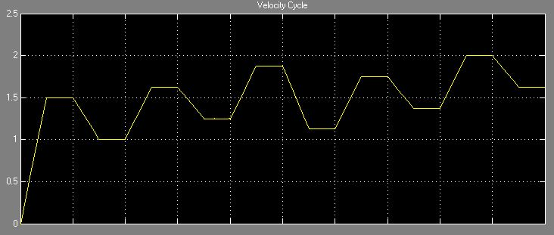
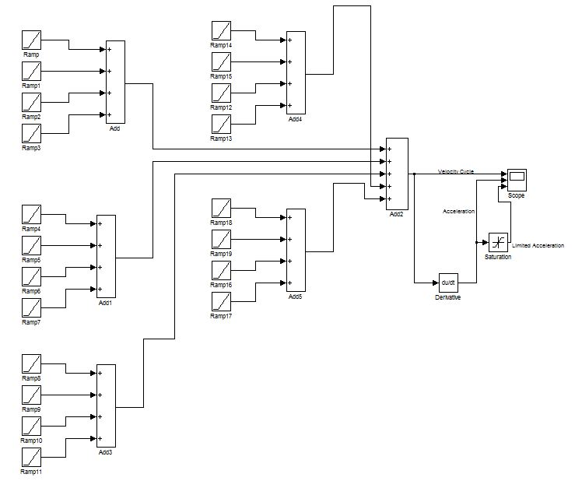
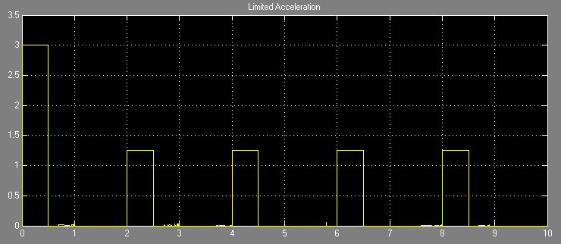
Driving Cycle Cont.
Scott Hill
Since Regenerative Braking will not be used
only the acceleration powered by the batteries
was considered in the sizing.

Slide 12

Analysis of Equations used
Scott Hill
was used to determine the power required by the vehicle.
List of equation parameters:
  C_{R} = 0.015 (Rolling resistance)
  m = 450lb or 204kg (Mass of vehicle)
  g = 9.81m/s² (Acceleration of gravity)
  Sin(θ) = 1 (Incline assumed to be on a level surface)
  ρ_{a} = 1.205 kg/m³ (Air density)
  C_{D} = 0.85 (Drag coefficient)
  A_{f} = 0.82 m² (Frontal area)
Notes:
According to the formula hybrid rules the endurance track has different kinds of obstacles that require different speeds as the vehicle goes around the track.
Therefore a simple constant velocity model cannot be used to get an accurate amount of energy required by the vehicle.
Talk about how the drag coefficent had such a large effect on the required power

Slide 13
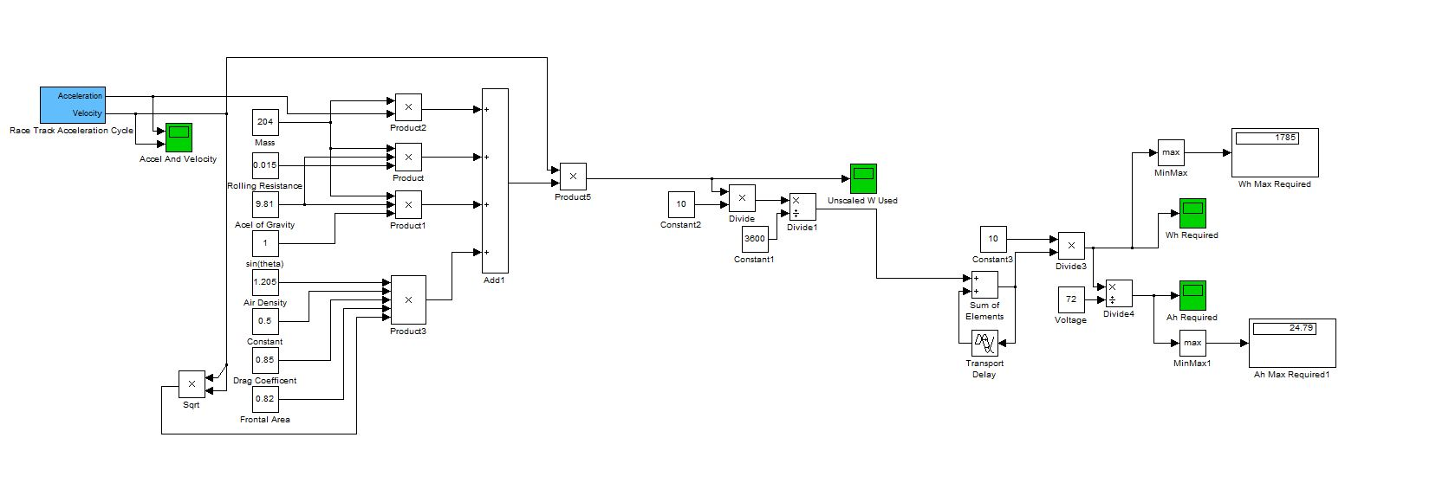
Power Calculations
Scott Hill
Driving
Cycle
Scaling
Conversions
Conversion From
Wh to Ah and total
Capacity Required
Scaling Conversions
Power Used Summer
And Conversion From
W to Wh and Ah

Slide 14
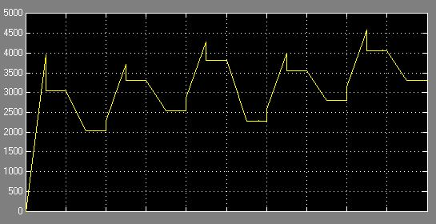
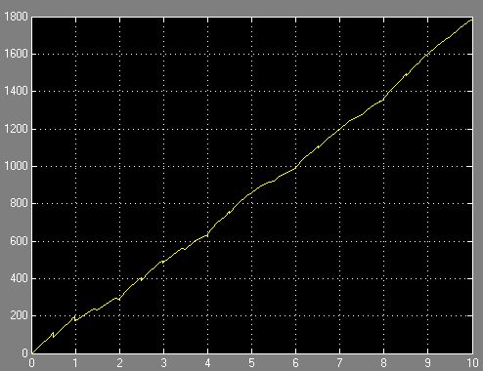
Results From Power Calculation Model
Scott Hill
Power used during driving cycle (W)
Wh required to complete
10 laps of track at 100s per lap
Wh Requirement

Slide 15
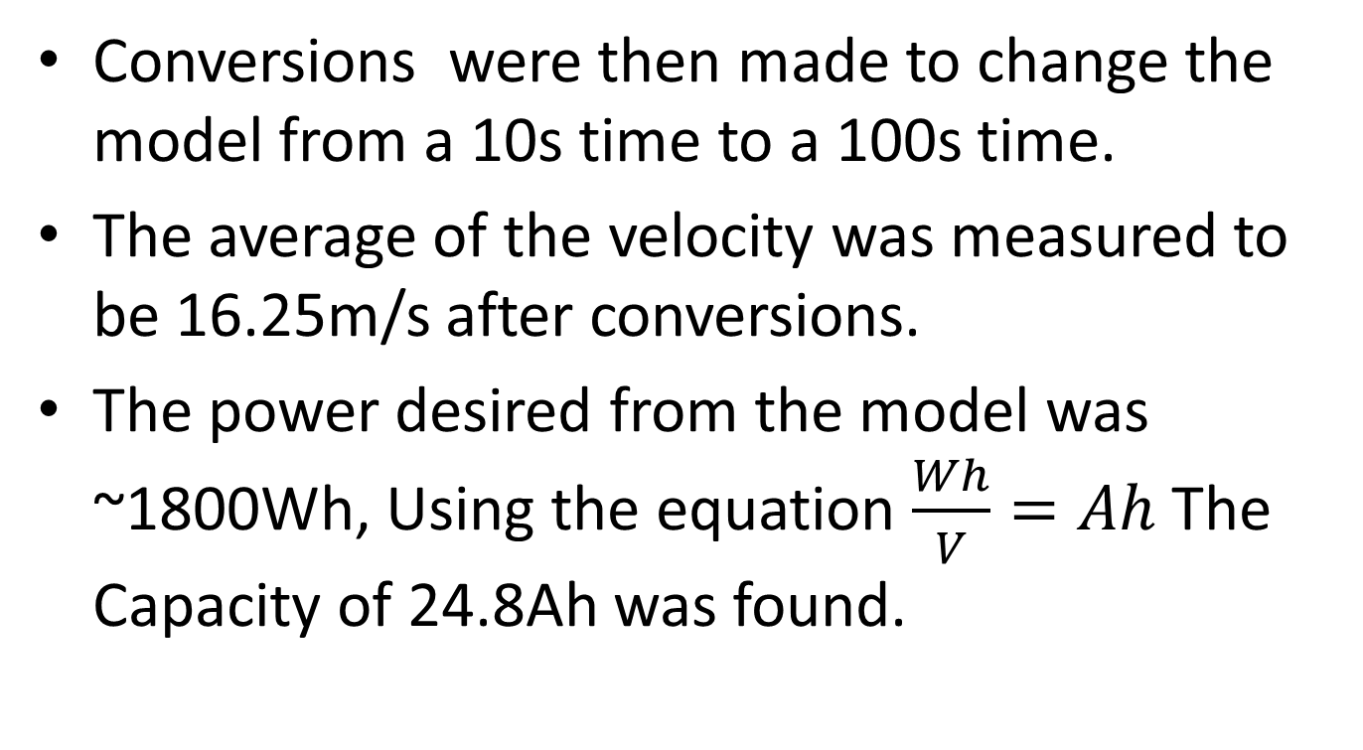
Conclusions From Model
Scott Hill

Slide 16
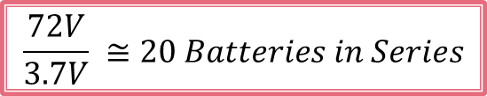
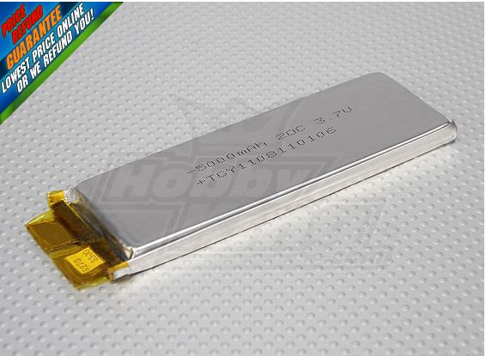
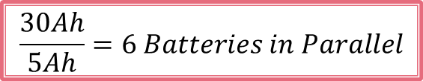
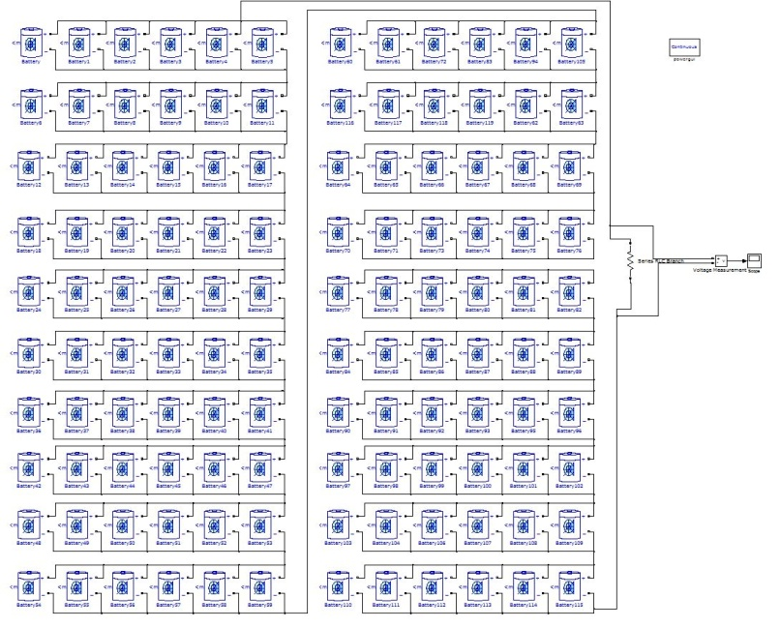
Battery Sizing
Since the capacity is 24.8Ah (accounting for losses we will use 30Ah) and we are using 5Ah batteries and we desire 72V our configuration was found using the following equations.
Turnigy 1s Lipoly (Single Cell)
Battery Characteristics:
E = 5Ah
V = 3.7V (Nominal)
Discharge Rate = 20C
Cost = $8.99
Batteries Required = 120
The configuration that will be used is 6 batteries
in parallel repeated 20 times in series
*This configuration also reduces the cost of the BMS
that is mentioned in the next slide.

Slide 17
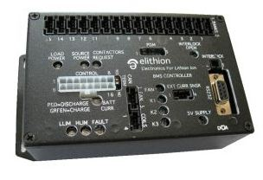

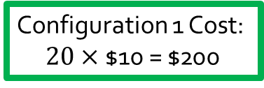
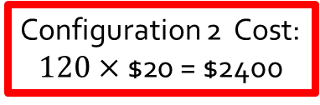
BMS
BMS Master
Cell Board
Elithion BMS will be used in the vehicle design.
  Pros: Already have the BMS master from previous years, thus reducing cost significantly, also cell boards cost only $10
  Cons: Other systems run faster and provide more information about the batteries.
The cell boards can handle an unlimited number of cells in parallel but only 1 per series connection.
Thus using the previously mentioned configuration the system needs 20 Cell boards vs 120 if the team did 20 batteries in series repeated 6 times in parallel.
Vs.

Slide 18
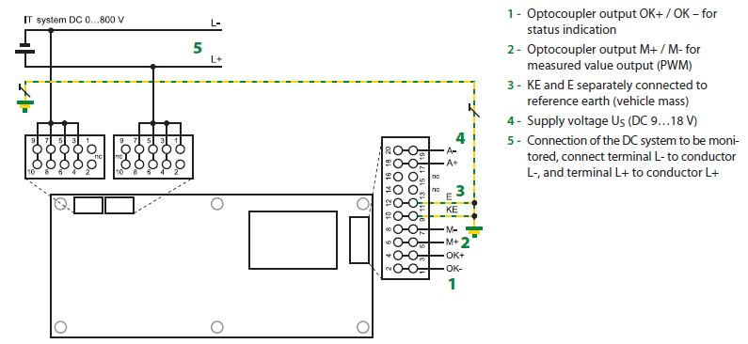
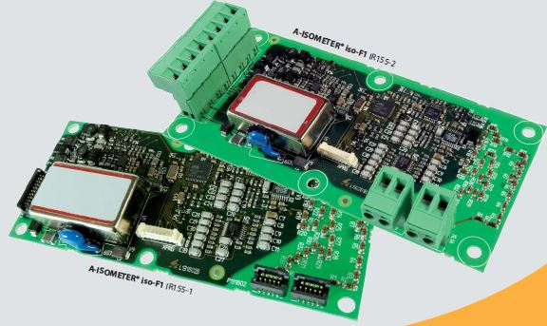
Ground Fault Detection
The ground fault detection device that will be used in the vehicle is the A-ISOMETER IR155-2 made by BENDER group. This device is being provided to the team free of charge where the team only has to pay $25 shipping and handling in order to receive the item.
This fault detection device is made for unearthed DC systems and is rated from 0V all the way up to 800V
A-ISOMETER Wiring Diagram
A – ISOMETER IR155-2

Slide 19
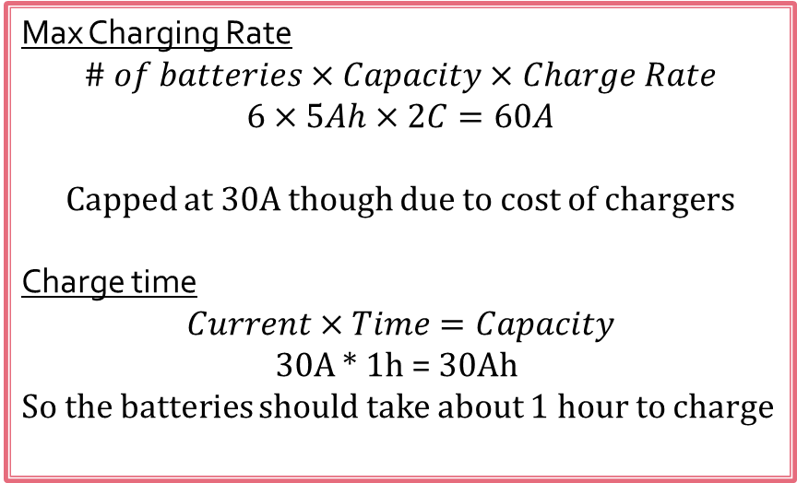
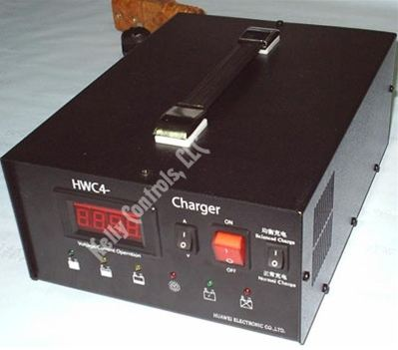
Charging System
Since the car will only have one battery pack though the vehicle will only need 1 charger.
The charger that the team has chosen for the vehicle is the HWC4 Series charger with an output of 72V/30A and has a 220VAC input.
This design also reduces the cost of the charger by around $200
Battery Charger
Cloud Electric

Slide 20

Low Voltage Accumulator
The low voltage accumulator on the vehicle will consist of a single 12V lead acid battery. It will be used to power all of the sensors that are not attached to the high voltage circuit. The low voltage accumulator will also be grounded to the frame of the vehicle.
Low Voltage Accumulator
http://www.buy.com/retail/product.asp?sku=208713947&listingid=26348394

Slide 21
Chassis Design
Presented By: George Nimick

Slide 22
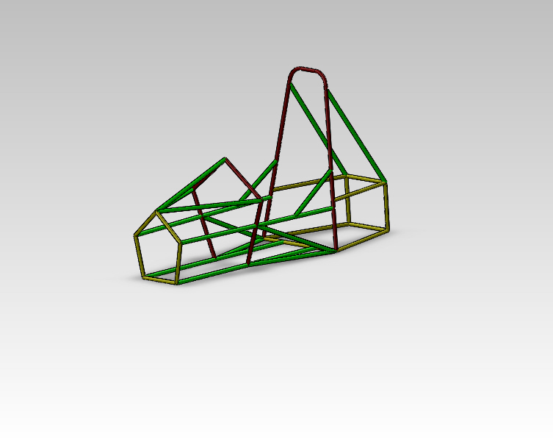
Chassis Design - Approach
Purpose
  Structural Barrier
    Debris and accidents
    Enclosure
    Incorporation of a body
  Platform for mounting systems
    Steering, Braking, Suspension, Propulsion, Driver Equipment

Slide 23
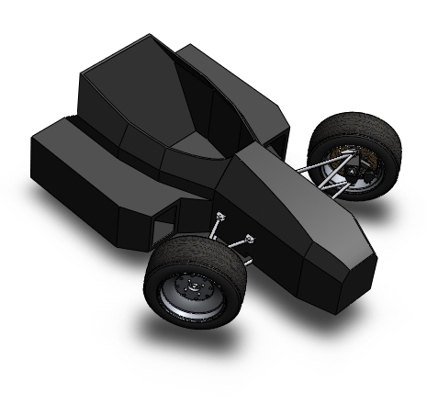
Chassis – Material Selection
Major types:
  Monocoque
  Tubular
    Metal
      Steel
      1018 vs. 4130
Restrictions based on rules
  Angles
  Distances
  Wall thicknesses

Slide 24


Chassis - Calculations
Bending Stiffness
  Proportional to E*I
  Primarily based on I
Bending Strength
  Given by
Compare to requirements in rules

Slide 25
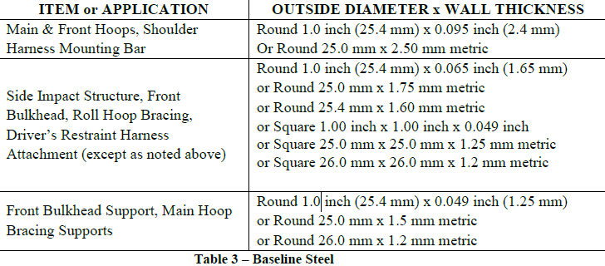
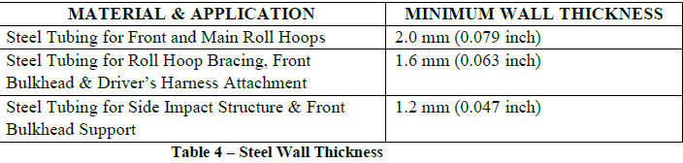
Chassis – Tubing Specifications

Slide 26
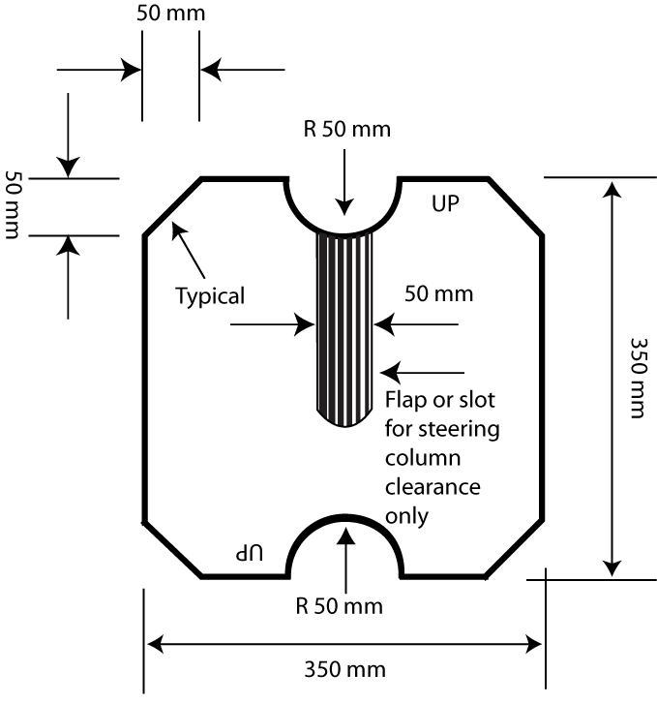
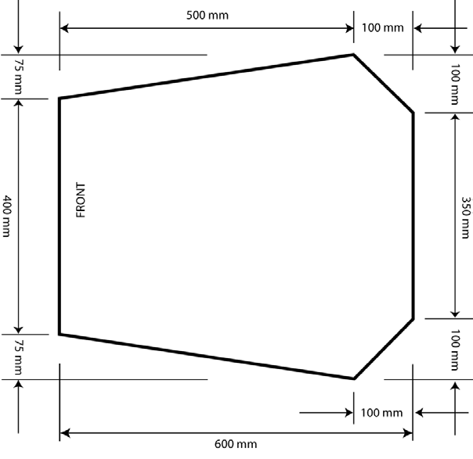
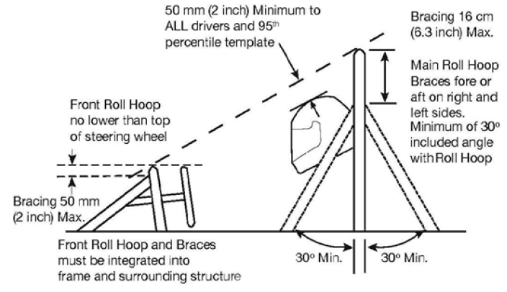
Chassis - Restrictions
Template for
Cock-pit Opening
Template for Cross-Sectional Area
Roll Hoop Restrictions

Slide 27
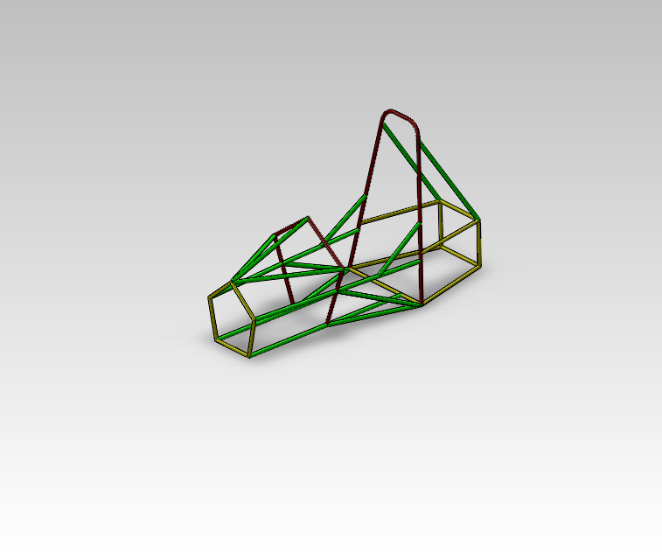
Chassis

Slide 28
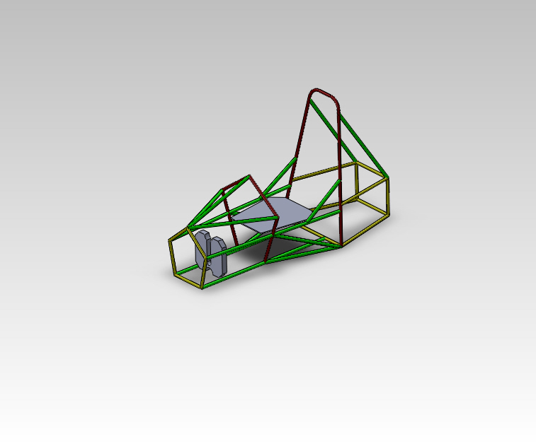
Chassis

Slide 29
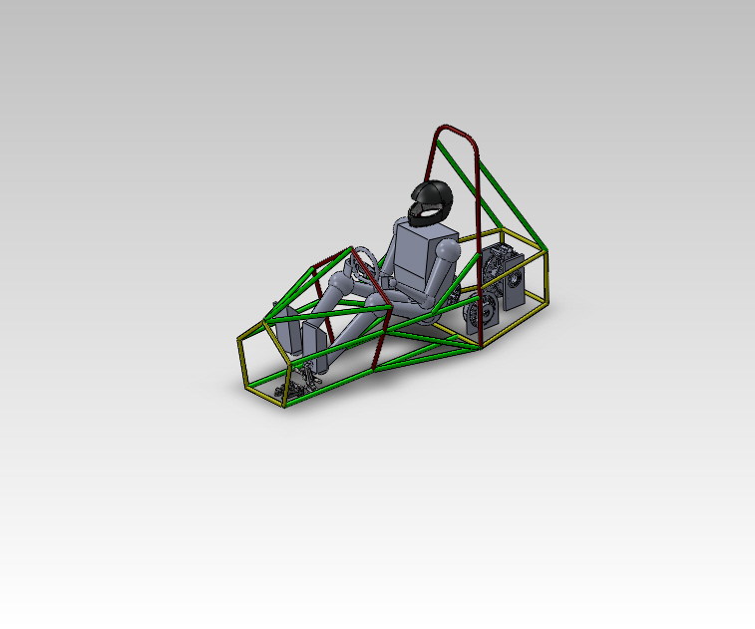
Chassis

Slide 30
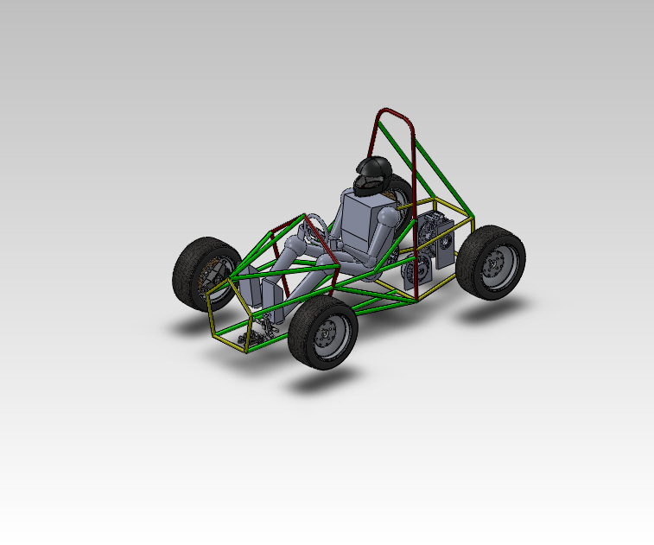
Chassis

Slide 31
Chassis Characteristics
Characteristics:
  Overall length: 82 inches
  Height: 49.68 inches
  Widest Point: 30 inches
  Approximate weight: 60 lbs.

Slide 32
Steering Design
Presented By: Tomas Bacci

Slide 33
Requirements
  Effectively steer vehicle and optimize cornering ability
  Be packaged effectively
  Cover a front track width of 48 in
Competition:
  Mechanical system that must affect at least two wheels
  Steering system must have less than 7 ° of free play in the steering wheel
  Steering stops, quick disconnect of wheel, circular wheel

Slide 34
Steering Design Characteristics
Rack and Pinion steering
Reverse Ackermann Geometry
Low kingpin inclination ~4°

Slide 35
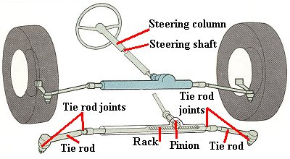
Rack and pinion
Rotation on wheel displaces a rack horizontally
Rack connects to uprights through the use of tie rods
www.motorera.com

Slide 36
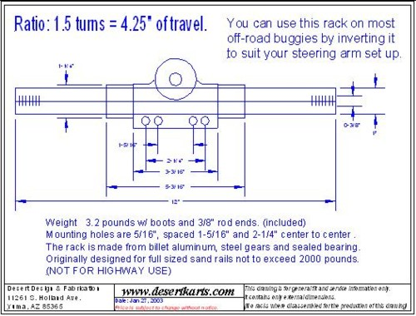
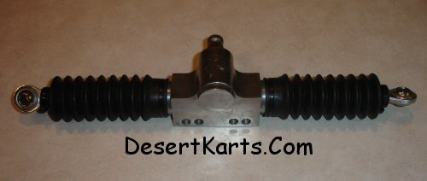
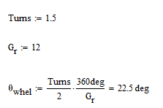
Rack and pinion Selection
14" Mini Dune Buggy Rack and Pinion Steering Unit
12:1 ratio, low, common for racing where quick response is desired
  At this ratio, with 1.5 “lock-to-lock” distance, each wheel can turn a maximum of approximately 22.5°, which is more than will be needed

Slide 37
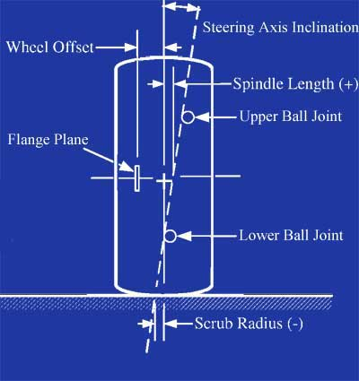
Kingpin Inclination
- Relatively low at 4°. With a positive spindle length (almost every car), the higher the kingpin inclination, the more the wheels will raise when steered from center. This low value will minimize this effect.
King pin angle subtracts from the negative camber gain due to caster on the outside wheel.
  Negative caster on outside wheel helps in cornering

Slide 38
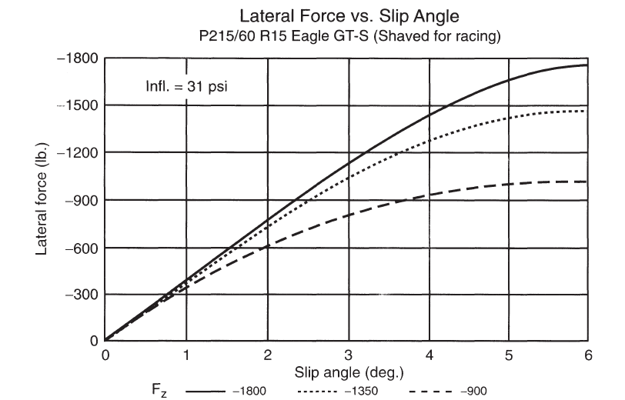
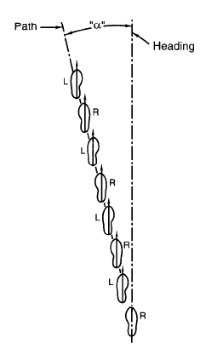
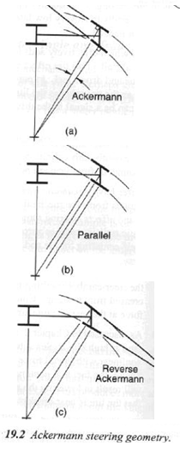
Reverse Ackermann Geometry
Initially considered using Ackermann, where the inside wheel turns sharper than outside wheel to guide the car into a common center
  Better suited for city driving, slow turns
Due to high lateral accelerations in competition, tires will operate mainly on their slip angles. Reverse Ackermann will be used
-Tire performance curves show less slip angle at lighter loads reach the peak of cornering force curves
-During a turn, more weight is shifted to the outside wheel
- Reverse Ackermann geometry allows the outside wheel to turn sharper than the inside wheel

Slide 39
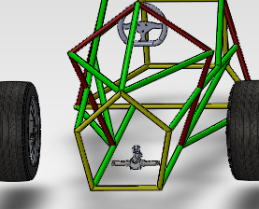
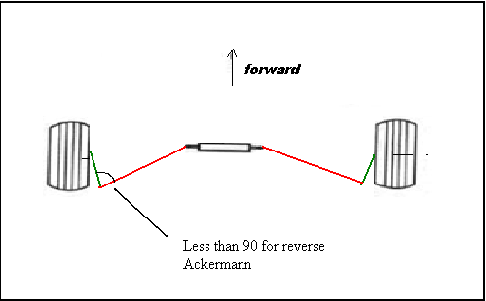
Placement
Rack will be placed low in front section of chassis
Angle between tierod and upright attachment will sit at 85°. This will implement a slight amount of reverse Ackermann steering geometry into our system.
We will need to tilt the rack towards the steering wheel to allow for the transfer of motion between the steering wheel and rack.
A metal plate will be inclined on a member of the chassis, and welded. The rack will bolt to this plate

Slide 40
Competition requirements
Rack and pinion selected has less than 7 degrees of free play on the wheel
    Verified by 2010 team at competition and functionality verified by the current team
Quick release mechanism and steering wheel also will most likely be reused and its been verified that they are still up to competition standards.

Slide 41
Suspension
Presented By: Stephen Kempinski

Slide 42
Competition Constraints
3.2.1 Suspension
fully operational suspension system with shock absorbers, front and rear
usable wheel travel of at least 50.8 mm (2 inches), 25.4 mm (1 inch) jounce and 25.4 mm (1 inch) rebound, with driver seated.
3.2.2 Ground Clearance
with the driver aboard there must be a minimum of 25.4 mm (1 inch) of static ground clearance under the complete car at all times.

Slide 43
Competition Constraints Continued
3.2.3 Wheels and Tires
3.2.3.1 Wheels
The wheels of the car must be 203.2 mm (8.0 inches) or more in diameter.
3.2.3.2 Tires
Vehicles may have two types of tires as follows:
Dry Tires – The tires on the vehicle when it is presented for technical inspection are defined as its “Dry Tires”. The dry tires may be any size or type. They may be slicks or treaded.
Rain Tires – Rain tires may be any size or type of treaded or grooved tire provided:

Slide 44
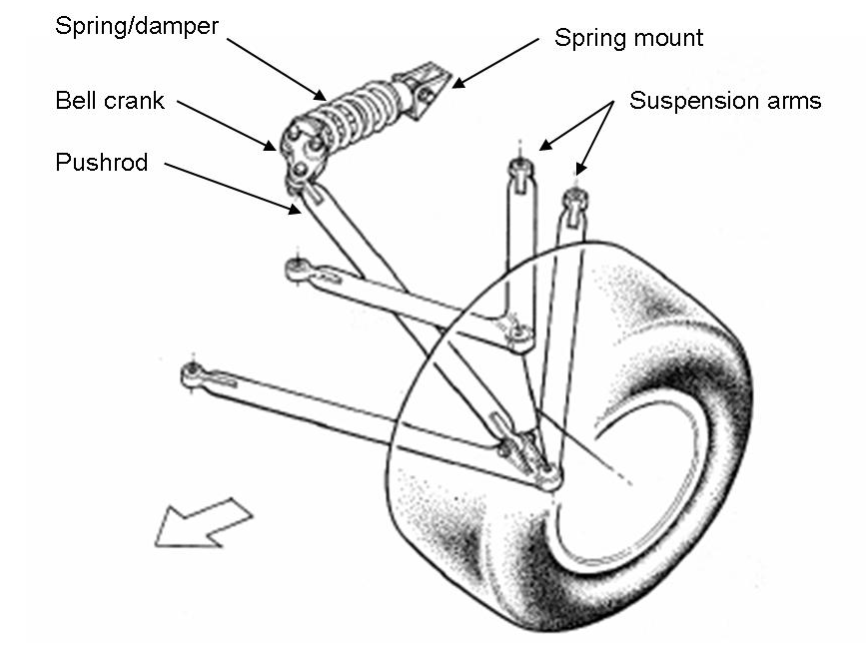
Suspension design overview
Independent
Short-Long Arm
Push-rod
Better ride quality
Improved handling
fully adjustable
Short Long Arm Suspension
Lower A-Arm is longer than the Upper A-Arm
Reduced changes in camber angles
Reduces tire wear
Increases contact patch for improved traction

Slide 45
Design Method
Determine Wheel-Base, Track-Width
Design for FVSA
Design for SVSA

Slide 46
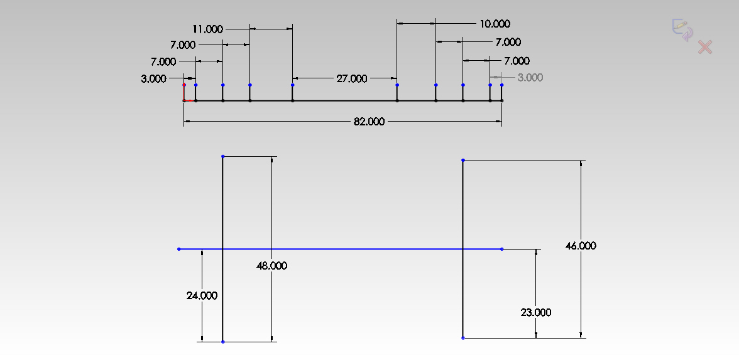
Wheel-Base / Track-Width
Overall Chassis Length of 82 inches
Selection of 62 inches (Minimum 60 inch Wheel-Base)
Ratio of track width to wheel-base
  Averaged from well scoring FSAE winners

Slide 47
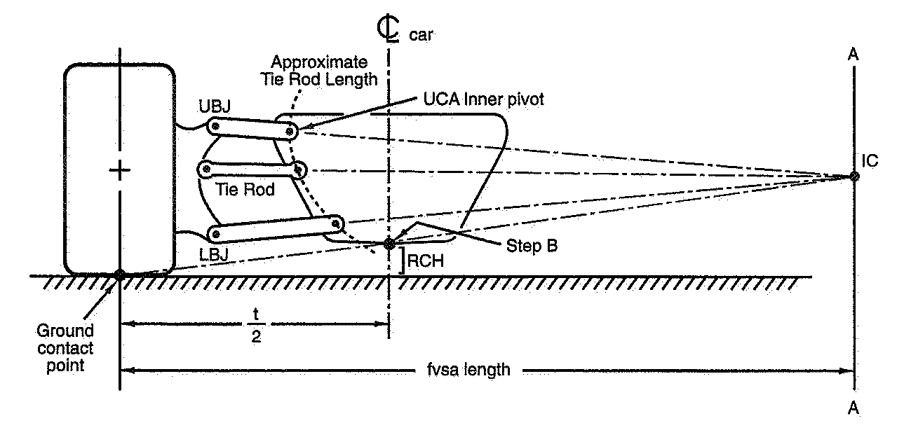
Front View Swing Arm
Defines static location
  Instant Center
  Rolling Instant Center

Slide 48
Scrub
resulting lateral motion relative to the ground during vertical wheel travel
Minimal Change in scrub achieved When IC is located at the ground plane
Maintains width of contact patch

Slide 49
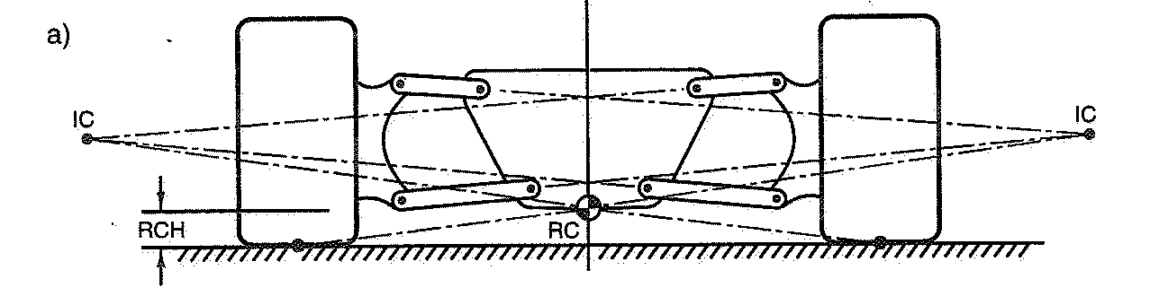
Roll Instant Center
Location close to Center of Gravity
  Body roll is reduced
Location close to ground
  non-rolling overturning moment is reduced

Slide 50
FVSA Length
Length is defined from IC to center of Contact patch
  A long FVSA length results in smaller camber gains/losses

Slide 51
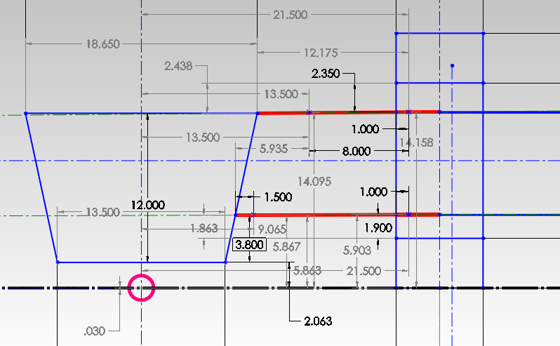
FVSA- RIC location

Slide 52
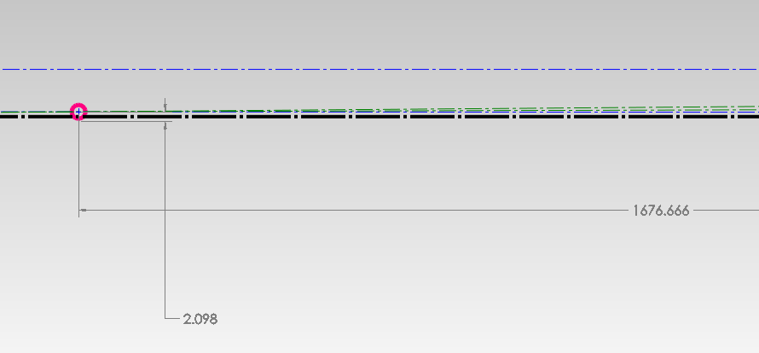
FVSA – IC Location

Slide 53
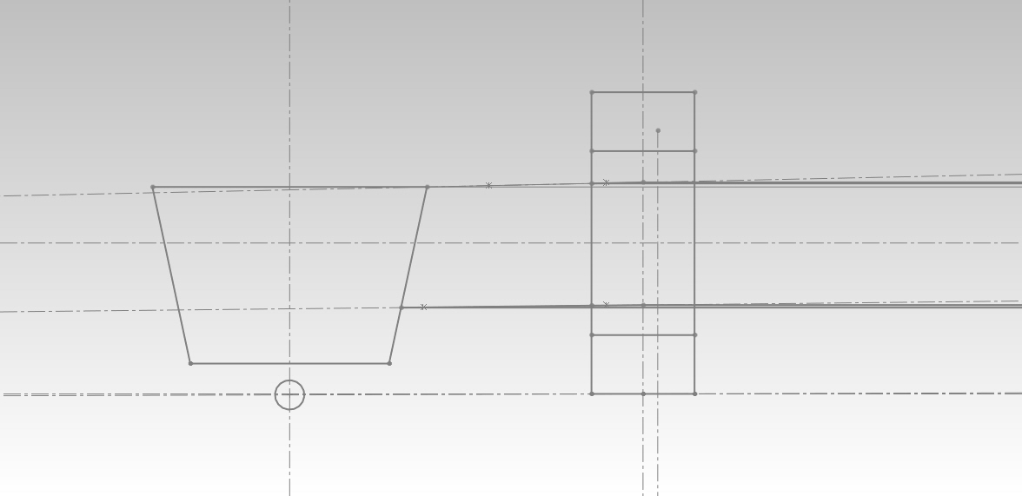
FVSA- RIC location

Slide 54
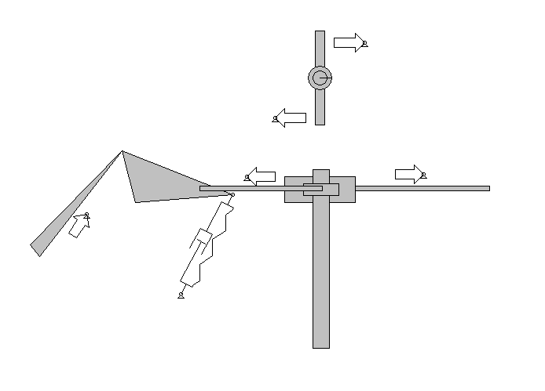
Anti-Roll Mechanism
Account for body roll
Translates lateral Force from outside tire to inside
Improves traction on inside tire
Watts Linkage Integrated into a push-rod design

Slide 55

Side View Swing Arm
Controls Anti-features
  Anti-Lift
  Anti-Dive
Parallel control arms
  Optimum for zero anti-features

Slide 56

Rear Suspension
Independent
Short-Long Arm
Push-rod
Additional Toe link added for constraint

Slide 57
FVSA and SVSA
Similar construction and methods
Rear will account for anti-features
Important to keep traction on the rear tires

Slide 58
Budget and Tech Inspection
Presented By: Corey Souders

Slide 59


Total Budget
Design 1: One motor Vehicle: $7,863
Design 2: Two motor Vehicle $12,632

Slide 60
Upgradable Design
Possible addition of further components
Allows for flexibility without hindering forward progress
Avoid purchases that would not benefit both alternatives
Minimized purchase risk

Slide 61
Technical Inspection
Assure that design flaws do not continue in project
Meet competition requirements
Address safety concerns in vehicle construction and operation
Anticipate complications in design realization

Slide 62
Budget Risk Analysis
Presented By: Aldreya Acosta

Slide 63
Budget Risk
Risks producing budget overruns
Support costs, unexpected material or equipment costs and component or system failures

Slide 64
Factors of Risk
Overextension
Hidden Costs
Component Failures

Slide 65
Overextension
Uncompleted Vehicle(Capabilities)
Probability- Proper planning
Consequences- unaffordable parts, design(optimized)
Strategy- Fundraising

Slide 66
Hidden Costs
Unseen Future cost(overestimate)
Probability- Small parts
Consequences- Overlooked inventory
Strategy- Cushion of funds

Slide 67
Component Failures
Broken parts(wasted funds)
Probability- Managing small replacement parts
Consequences- Bankrupt project and Injuries
Strategy- Safety(testing)

Slide 68
Scheduling Risk Analysis
Presented By: Ryan Luback

Slide 69
Scheduling Risks
Schedule risks are those occurrences that directly impact the project being completed on time.
These risks can include a number of things including, illnesses, personnel problems, delivery of components, changes to the project requirements, availability of support ect.
The Team has found four major scheduling risks

Slide 70
Risk 1: Full Completion of the Vehicle
Probability - high
Consequences - catastrophic
Strategy - Gantt chart

Slide 71

Gantt Chart

Slide 72
Risk 2: Receiving Parts
Probability - high
Consequences - severe
Strategy - have all parts ordered before Christmas break

Slide 73
Risk 3: Obtaining Funding
Probability - low
Consequences – minor in terms of completing project, however severe in doing well in the competition
Strategy -set deadline in which the team finalizes the design according to their budget

Slide 74
Risk 4: Changes in the Design
Probability - very high
Consequences - range from minor to catastrophic
Strategy - plan for everything that may affect the design

Slide 75
Braking System Design
Presented By: Sam Risberg

Slide 76



Brakes and Components
Brakes will use:
-Wilwood Calipers
-Motorcycle rotors and pads

Slide 77




Brake Force Calculations

Slide 78
Brake Force Calculations
With a calculated stop time of 3.1 seconds from 70 mph, which is more then sufficient for competition
The force needed for this on the pedal is 203 Newtons
The energy absorbed is 416 kg

Slide 79

Brake Bias Bar
-Need control over front and
rear brake pressure
-Brake bias bar solves this problem via pedal position
-Will allow less braking in the rear so regenerative braking can be utilized
3D model by Anthony Sabido

Slide 80
Desired Bias
A desired bias of 80% front braking and 20% rear is required.
This will allow for most of the pedal pressure to work on the front brakes and allow the electric motor in the rear to absorb the energy from braking turning it into battery power if desired.
Most modern cars are ~70% front and ~30% rear braking, so out bias will not effect brake feel

Slide 81

3-D Model Together
The following model shows the steering rack and brake assembly In relation to driver seat
Pedal will be mounted ridigly to a plate that also houses the master cylinders and brake bias bar.

