Slide 1
Autonomous Underwater Vehicle:
Milestone #4 Test Plan & Conceptual Design Review
Group 4
Victoria Jefferson Reece Spencer
Andy Jeanthenor Yanira Torres
Kevin Miles Tadamitsu Byrne

Slide 2
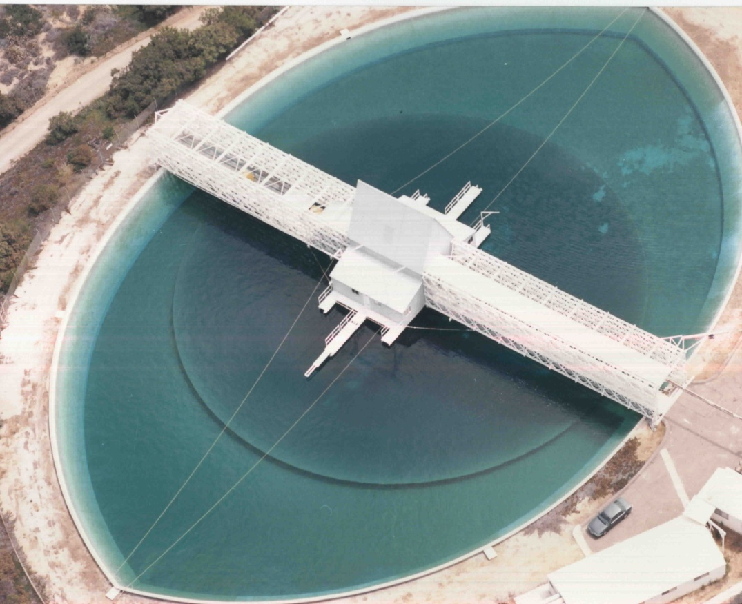
Project Overview
Autonomous Underwater Vehicle Competition
  Competing in Camp Transdec, CA in July 2011
Competition Overview
  AUV will complete tasks underwater
  15 minute time limit per run
  6 underwater tasks
  Graded on completion of tasks as well as team design

Slide 3
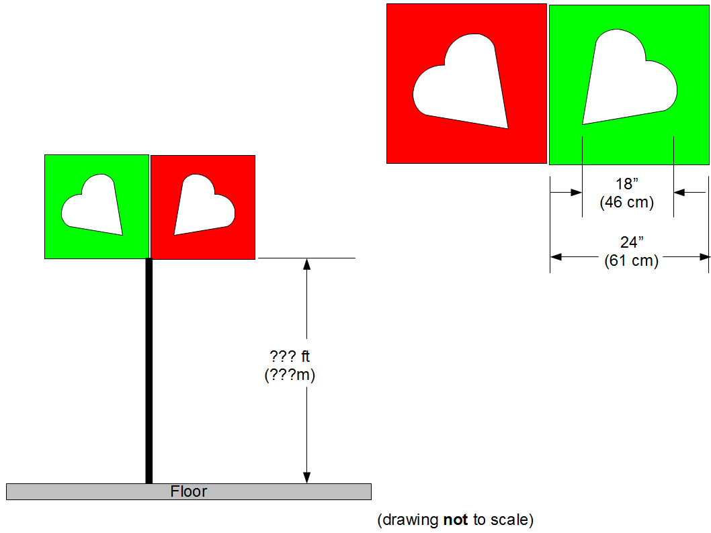
Preliminary Rules
Theme: RoboLove
Tasks
  Validation gate
  Orange Path
  Marker Dropper
  PVC Recovery
  Acoustic Pinger
Weight and size constraints
  Must weigh under 110 pounds
  Six-foot long, by three-foot wide, by three-foot high

Slide 4
Presentation Order
  1) Introduction
  2) Major Components
    Frame/Hull/Body
    Power System
    Thruster
    Mechanical Grabber & Dropper
    Microcontroller
    Sensors
      IMU
      Cameras
        Camera Housing
      Hydrophones
  3) Schedule
  4) Budget

Slide 5
Major Components of the System

Slide 6
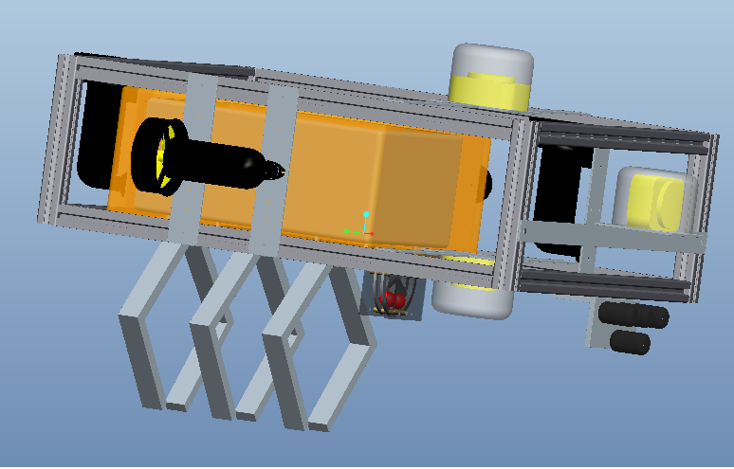
Frame Overview
80/20 Aluminum
Allows for easy adjustability
Mitigates vibration reduces hydrophone interference
Hull placed within the frame

Slide 7
Hull Overview
Hull consists of a watertight Pelican Box
Purchasing Pelican Box is simpler than designing watertight housing and is also inexpensive
Hull will house all onboard electronics
Reduces the risk of water damage to electronics
Exterior components will be connected via Fischer connectors

Slide 8
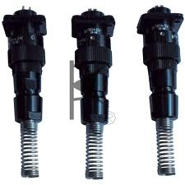
Body and Hull Tests
Unit Test
  Determine if the Pelican Box is water tight at a depth of 15 feet with all modifications
Integration Tests
  Pelican Box with Watertight Connectors

Slide 9
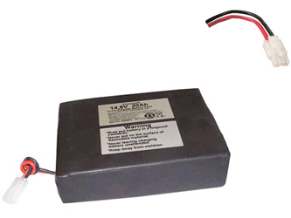
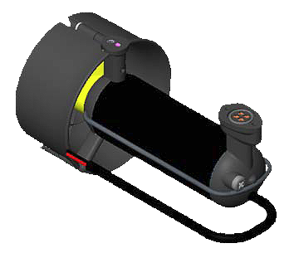
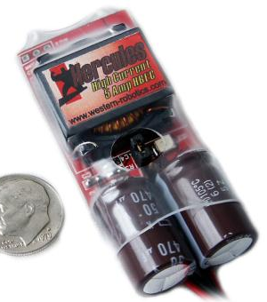
Vehicle Power System
Batteries
Two 14.8 V DC batteries combine for 29.6V DC output
Built-in PCM maintains a voltage between 20.8 V and 33.6 V
Motors
Max Power: 150W(each motor)
Motor Controller included
Switching Voltage Regulator (S.V.R.) for USB Power
  15V-40V input
  Output 5.3V, 6A

Slide 10
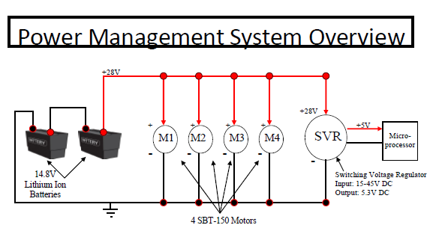

Slide 11
Power System Tests
Objective: Ensure sufficient AUV run time
All components from previous slide will be connected as illustrated
Test goals
  Desired run time: 1 hour
  Expected run time: 1.5 hours
  Minimum necessary run time: 15 minutes

Slide 12
Thruster Overview
SeaBotix SBT150:
Chosen for functional ability and water resistance as well it’s built-in motor controller, voltage regulator, and low power consumption
Four thrusters will be placed on the AUV in a configuration that will allow for forward/reverse powertrain, left/right turning and depth control
Similar to BTD150 but includes motor controller

Slide 13
Thruster Tests
Unit Tests
  Testing from 0-100% power in 10% increments
  After submerged testing, test for water leakage around motor
Integration Test
  Test all 4 motors in conjunction with AUV for location of placement among vehicle

Slide 14
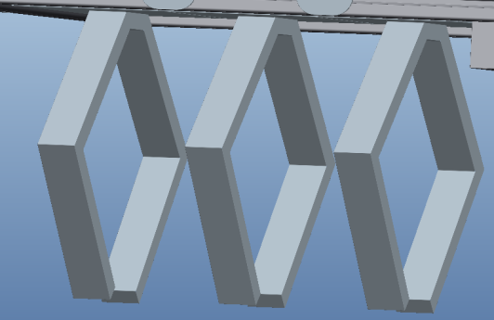
Mechanical Grabber
Used to complete the final task of the mission
Grasp and release mechanism located at the bottom of the AUV
Our design will depend on the size and orientation of the object
The current design is to have a mechanical claw attached to a solenoid that will attach to an object in the water

Slide 15
Mechanical Grabber Tests
Integration Test
  Grab and Release mechanism
  Servo assembly

Slide 16
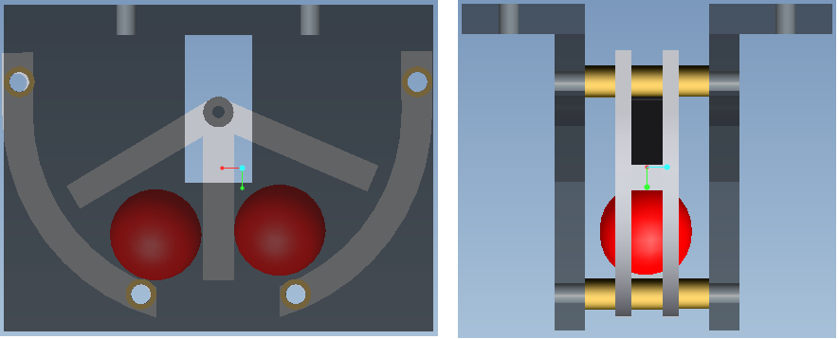
Marker Dropper
Use to complete tasks in which a marker must be dropped
Will be machined out of aluminum
Utilize waterproof servomotor that will rotate marker dropper mechanism to release markers
Traxxas servomotors will be used
This method was chosen because it was the most cost efficient

Slide 17
Marker Dropper Tests
Unit Tests
  Capable of releasing both markers individually.
    It will initially be tested in air then again in water to ensure that there are no leaks present that will affect the performance.
  Ultimately the dropper will also be tested in the pool environment to ensure optimal performance.

Slide 18
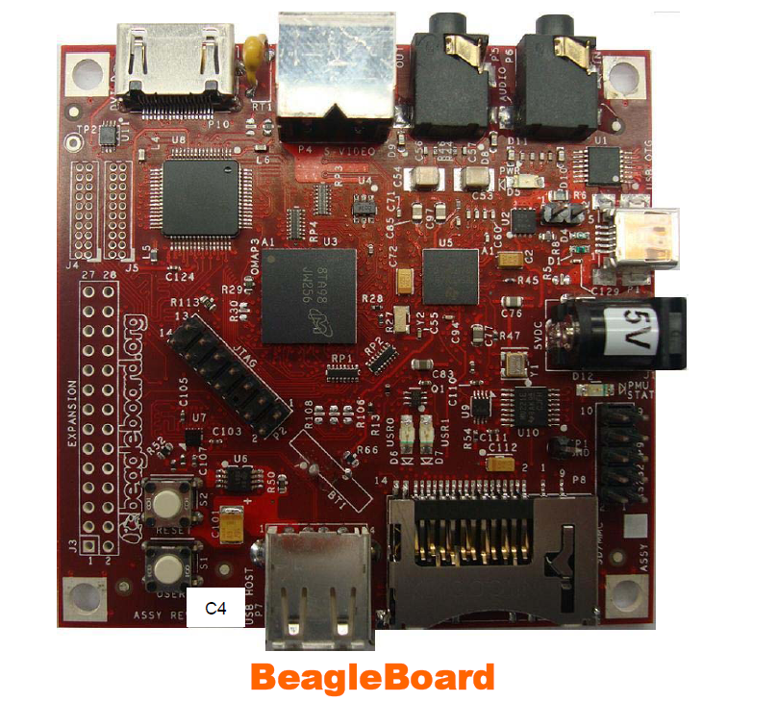
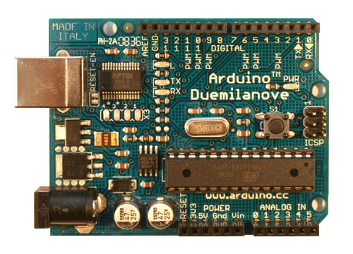
Microcontrollers
The BeagleBoard(CPU):
USB/DC Powered
“Brain” of AUV
Inputs/Data Processing:
  Hydrophones
  Cameras
  IMU
Outputs:
  PWM Motor Signal (via Arduino Board)

Slide 19
Microcontrollers
Software:
Operating system will be a Linux distribution
Angstrom
  Open embedded
Mission code will be written in a combination of C/C++
Output will be sent via PWMs from the Arduino Board to the motor controllers to drive the motors
Program will be decision based using FSMs and will run real-time

Slide 20
Hardware Structure
Camera A
Camera B
Camera C
Thrusters
IMU
USB Hub
Arduino Board
Motor Controllers
Servo Motors
BeagleBoard
Hydrophone Board
Marker Dropper
Mechanical Grabber
Voltage Regulator
Hydrophone Array

Slide 21
Software Structure
Start
Path Found?
Detect Current Task
Path Lost?
Follow Path To Objective
Y
N
N
Y
Search For Path
Objective Found?
N
Y
Complete Objective
N
Have All Task Been Completed
Y
Store Data and Increment Task Counter
Finish

Slide 22
Risks Associated with…
The Microcontroller and Software
Error in sensor-microcontroller communication Software not executing tasks properly Critical Scheduling issues

Slide 23
Microcontroller Tests
Unit Tests:
  Component Communication
  Input Sensor Analysis
  MCU Hardware Tests
  Test Goals:
  MCU hardware works properly
  Full component communication is established
  Software works properly

Slide 24
Prioritization of Sensors
Cameras
  Function: Eyes underwater
  Need: Critical (used in all tasks)
IMU
  Function: Sense of Direction Underwater
  Need: Moderate
Hydrophones
  Function: Ears Underwater
  Need: Low (used in only one task)

Slide 25
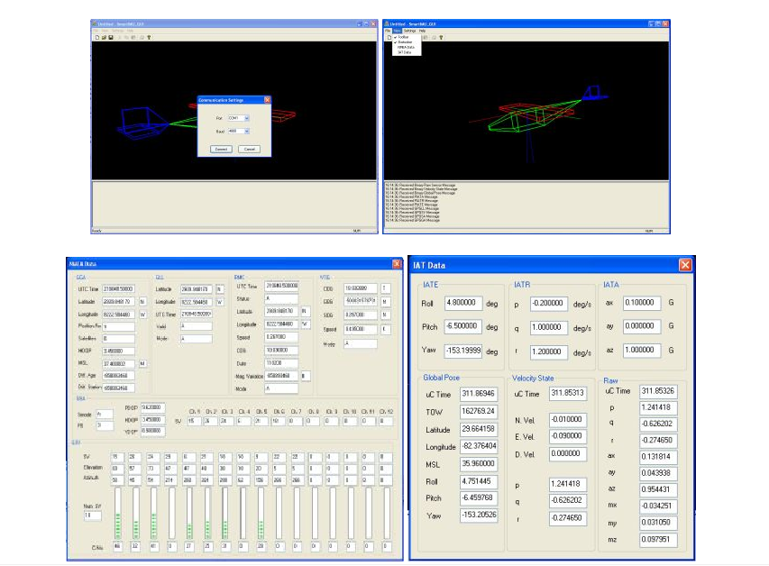
Software for Sensors
Cameras
  OpenCV
IMU
  RS-232 interface
  SmartIMU Sensor Evaluation Software
  Linux C Source Code
Hydrophones
  In the process of finding a Linux software capable of processing and managing data

Slide 26
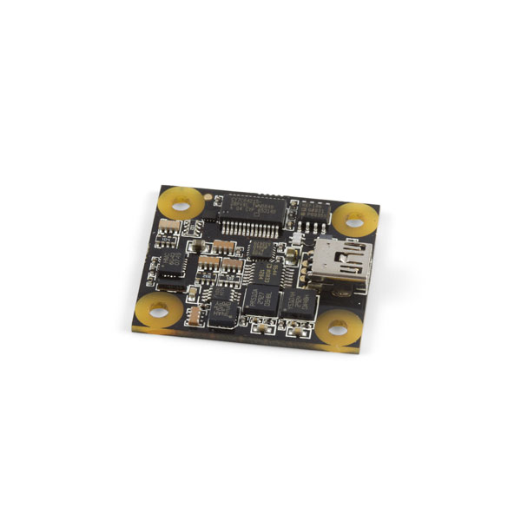
Inertial Measurement Unit (IMU)
Navigation/Stability Control
PhidgetSpatial 3/3/3-9 Axis IMU
  Accelerometer: measure static and dynamic acceleration (5g)
  Compass: measures magnetic field (±4 Gauss)
  Gyroscope: Measures angular rotation (400°/sec)
Chosen for low cost and because it contained a compass instead of magnetometer unlike other IMUs

Slide 27
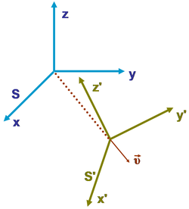
IMU Tests
Unit Tests
  Perform on Windows OS to ensure the operational capabilities of device
  Perform on Linux to test for consistency with microprocessor platform

Slide 28
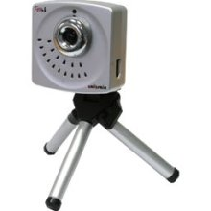
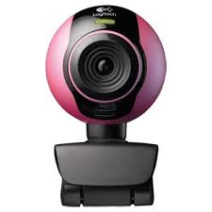
Cameras
Cameras chosen:
  3 Unibrain Fire I CCD webcams
  LogiTech C250 will be used for initial performance assessment of OpenCV
Needed for light/color and shape recognition
CCD camera chosen for ability to operate in low light conditions
The cameras chosen for cost efficiency as well as compatibility with our software

Slide 29
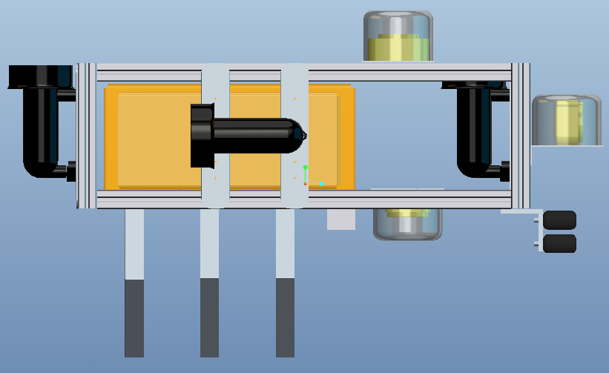
Cameras
Positioning
  Forward facing CCD camera for floating objects
  Downward facing CCD camera for objects on the pool floor
  Overhead camera for shape recognition
Housed in watertight casing to protect from water damage

Slide 30
Risks Associated with…
The Cameras
Failure of one or more cameras Damaged Malfunctioning Camera not compatible with microcontroller Camera power failure

Slide 31
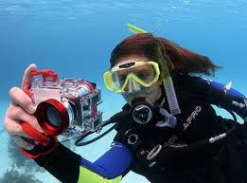
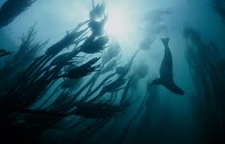
Camera Tests
Unit Tests
  Test to ensure proper configuration in OpenCV software environment
  Test for acceptable quality images
  Compatible with microprocessor
Integration Tests
  Image quality under the camera housing and underwater

Slide 32
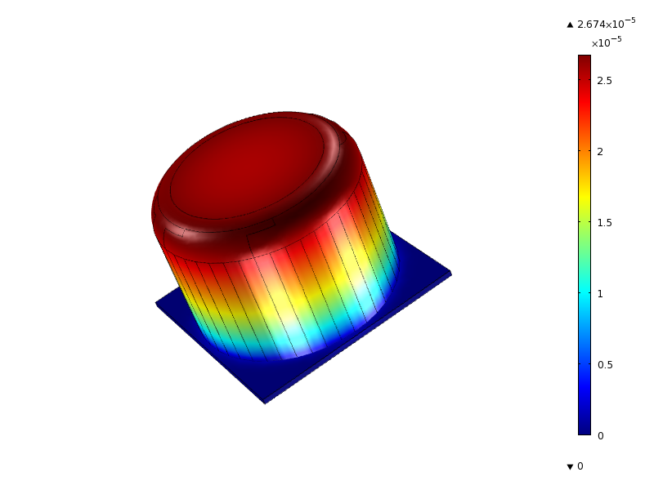
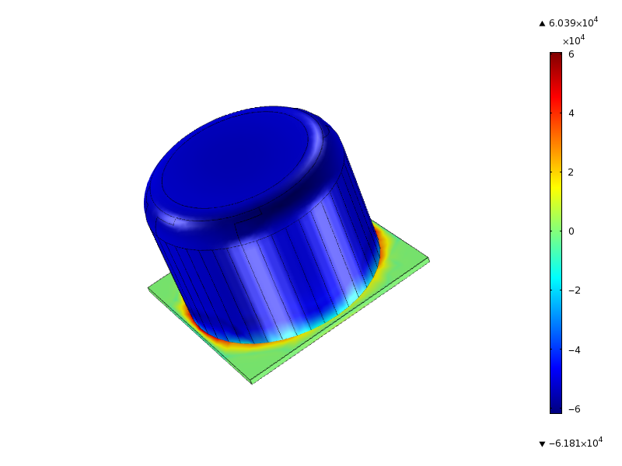
Camera Housing Analysis
Total Deflection (in)
Stress Tensor (Pa)
PVC piping
Viewing lens
Aluminum Plate

Slide 33
Risks Associated with…
The Camera Housing
Leaks as a result of: Fracture Improper sealing

Slide 34
Camera Housing Tests
Unit Test
  Determine if the housing is water tight at a depth of 15 feet
  Determine if analysis simulated was accurate
    Camera Housing can withstand pressure associated with being underwater
Integration Test
  Camera housing will be tested the cameras in them as mentioned in the Camera Integration test

Slide 35
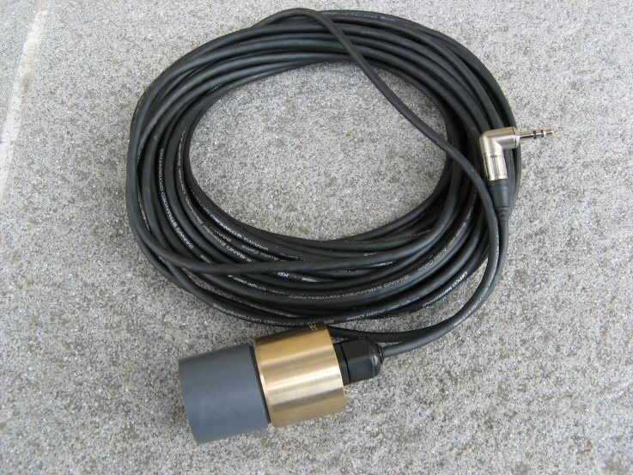
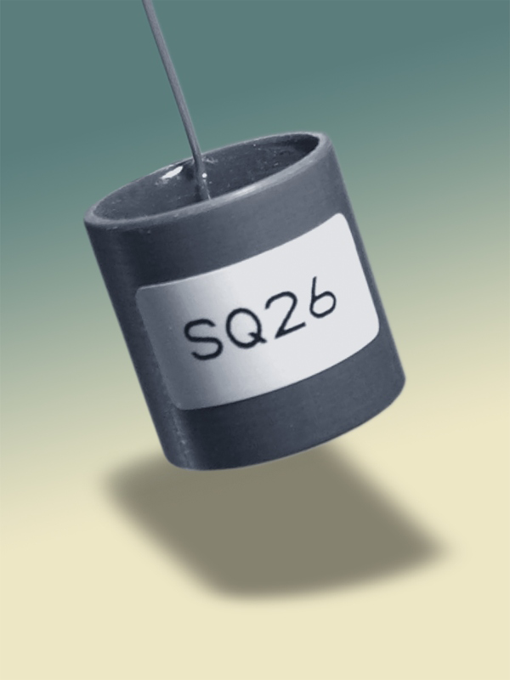
Hydrophones
SensorTec SQ26-01 hydrophone
  Full audio-band signal detection and underwater mobile recording
  Operates at desired sound level
  Performs in desired frequency range (22-40 kHz)

Slide 36
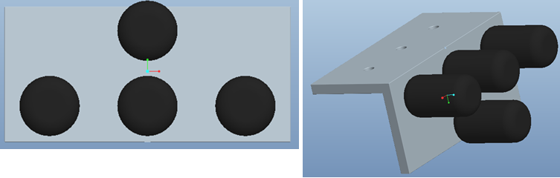
Hydrophone Configuration
4 hydrophones will be utilized to determine the location of the pinger
2 hydrophones will be placed horizontally to determine direction
The other two will be vertical in order to determine the depth

Slide 37
Risks Associated with…
The Hydrophones
Failure of one or more hydrophones Damaged Malfunctioning Hydrophones not compatible with microcontroller

Slide 38
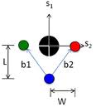
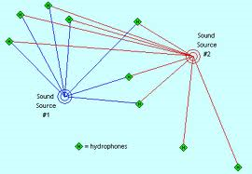
Hydrophone Tests
Unit Tests:
  Hydrophone performance
  Hydrophone configuration

Slide 39
Schedule

Slide 40
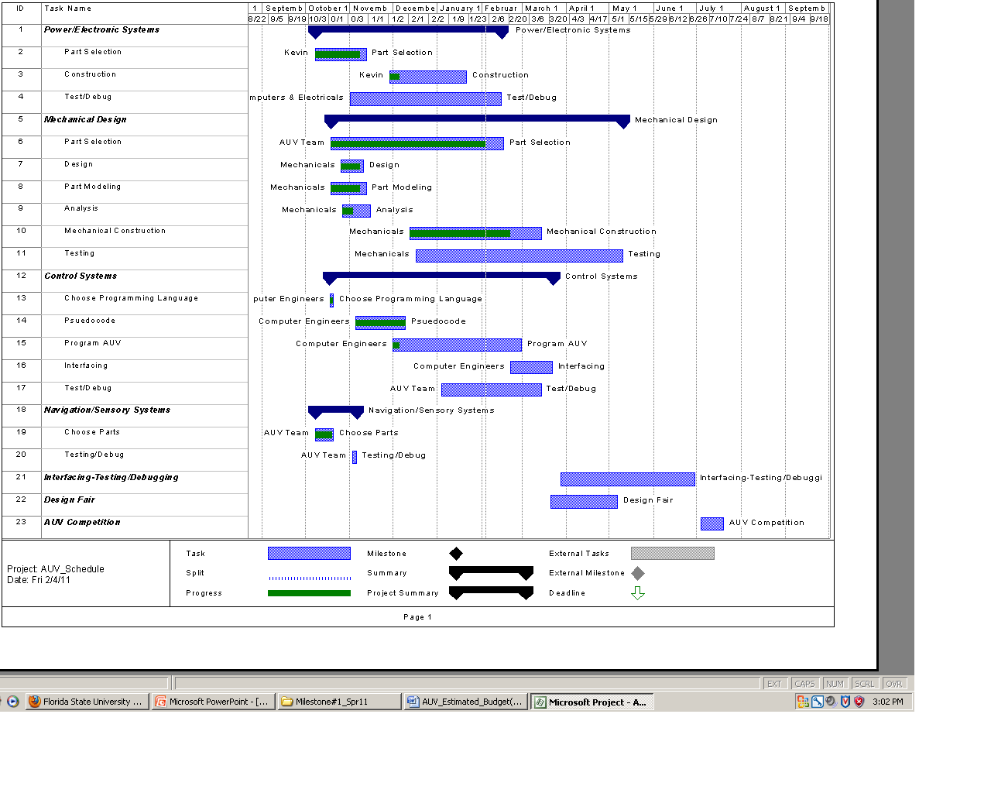

Slide 41
Risks Associated with…
The Schedule
Temporary loss of team member Permanent loss of member Robosub damaged on way to competition Malfunctioning parts Parts are not compatible with each other Team is critically behind schedule

Slide 42
Budget

Slide 43
Item | Quantity | Price
Main Battery | 2 | $800.00
Voltage Regulator | 1 | $80.00
Motors/Thrusters | 4 | $3,000.00
Hydrophones | 4 | $800.00
Microcontroller | 1 | $40.00
BeagleBoard | 1 | Free
CCD Camera | 3 | $390.00
Pelican Case | 1 | $150.00
Wires/Electronic Kits/Cables & Connectors | N/A | $1,200.00
8020 Frame | N/A | $220.00
Aluminum Plate 14 in x 12 in x ¼ in | 1 | $70.00
Inertial Measurement Unit | 1 | $170.00
Total Expenses | N/A | $6,920.00

Slide 44
Item | Price
Transportation | $6,000.00
Hotel Accommodations | $4,000.00
Miscellaneous Expenses | $2,000.00
Total Expenses | $12,000.00

Slide 45
Risks Associated with…
The Budget
Robosub damaged on way to competition Malfunctioning parts Parts are not compatible with each other Insufficient equipment funds Insufficient travel funds

Slide 46
References
"Official Rules and Mission AUVSI & ONR's 13th Annual International Autonomous Underwater Vehicle Competition." AUVSI Foundation. Web. Sept.-Oct. 2010. <http://www.auvsifoundation.org/AUVSI/FOUNDATION/UploadedImages/AUV_Mission_Final_2010.pdf>.
Barngrover, Chris. "Design of the 2010 Stingray Autonomous Underwater Vehicle." AUVSI Foundation. Office of Naval Research, 13 July 2010. Web. 09 Nov. 2010. <http://www.auvsifoundation.org/AUVSI/FOUNDATION/UploadedImages/SanDiegoiBotics.2010JournalPaper.pdf

