Slide 1
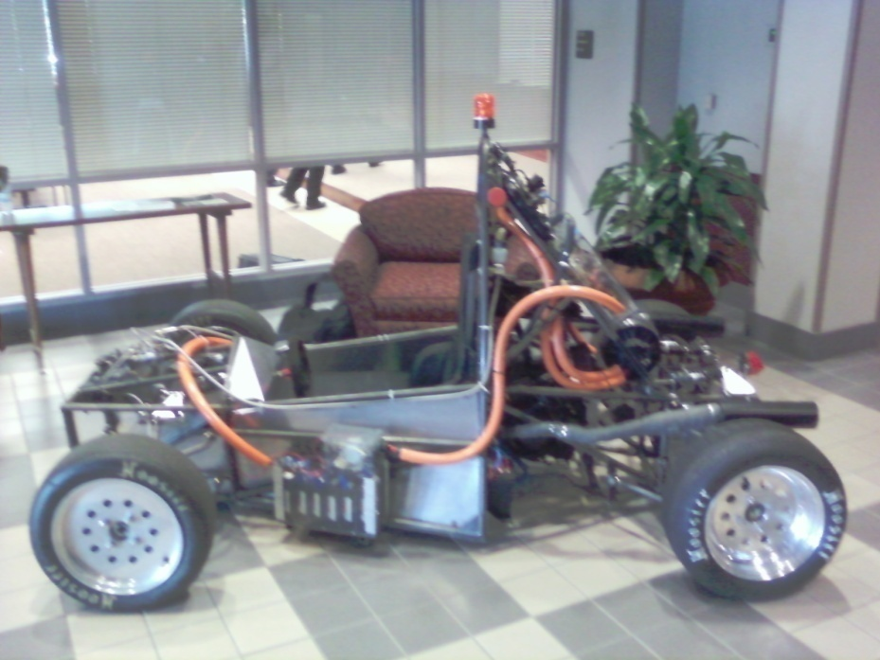
Formula Hybrid Project
Team Members:
Israel Daramola
Thomas Emerick
Stephanie Medina
Lorenzo Neal
Philip Young
Ryan Zombek

Slide 2
Agenda
Overview and Objectives of the Design Team
Needs Analysis
Requirements Specifications
Constraints and Test Plans
References

Slide 3
Overview and Objective of the Design Team

Slide 4
Purpose & Objectives
The Formula Hybrid Car Project’s main purpose this school year is to continue to enhance the structure and development of a full-hybrid vehicle to serve three main objectives.
  1.) Incorporate the Combustion Engine
  2.) Construct the coupling of the Electric Motor and Combustion Engine
  3.) Design the Transmission.
  4.) Continue the Battery Management System
  5.) Redesign the Suspension
  6.) Replace and Redesign the calipers within the Brakes
  7.) Redesign the Body and Shell in the vehicle
  8.) Integrate Regenerative Braking

Slide 5
Administrative Assignments
Stephanie Medina: Project Manager
Lorenzo Neal: Treasurer
Israel Daramola: Secretary
Philip Young: ME Technical Lead
Thomas Emerick: Mechanical Design Lead
Ryan Zombek: Rules and Safety Officer

Slide 6
Key Technical Assignments and Methodology
Lorenzo Neal: Incorporating the Combustion Engine with the Coupling of the Electric Motor
Israel Daramola: Designing the Transmission (Parallel Hybrid)
Stephanie Medina: Continuing the Battery Management System
Philip Young: Redesigning the Suspension
Thomas Emerick: Redesigning the calipers in brakes, body and shell.
Ryan Zombek: Integrating Regenerative Braking

Slide 7
Needs Analysis

Slide 8

Overview of the Project
SAE Formula Hybrid International Competition
    Design and engineering challenge for students across the globe
    Must design an open-wheel, single-seat, plug-in hybrid racecar

Slide 9

Overview of the Project
Benefits of the Competition:
  Give students the opportunity to work across disciplinary boundaries
  Encourage creative and forward thinking
      Green initiative
      Fuel efficiency in a high-performance application
      Drive train innovation
      Win by innovation!

Slide 10

Overview of the Project
Challenges of the Competition:
  Project management
  High-Power Electronics
      motors, generators, controllers, regenerative braking
  Mechanical design
      suspension, steering, braking, chassis design, body design
  Data acquisition and analysis
  Race strategy and management

Slide 11
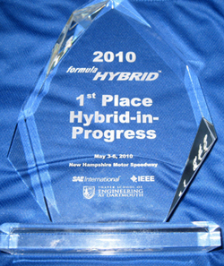
Statement of the Problem
How do we improve on the current vehicle in order to compete at the highest level?
Breakdown of SAE Formula Hybrid competition
    Acceleration - Drag Test
    Braking – Brake Test, Drag Test, Autocross Test
    Handling – Autocross Test, Endurance Test
    Fuel Efficiency – Endurance Test

Slide 12
Statement of the Problem
Required Capabilities:
    CAP-001: Vehicle must be able to simultaneously draw power from internal combustion engine and electric motor
    CAP-002: Vehicle must be able to withstand erratic motion in a stable manner, such as sudden turns and braking
    CAP 003: Vehicle must be able to come to a complete stop in a stable manner

Slide 13
Statement of the Problem
Desired Capabilities:
    CAP 004: Vehicle should have battery management system incorporated
    CAP 005: Vehicle should have regenerative braking incorporated
    CAP 006: Vehicle should combine electric motor throttle and combustion engine throttle into one pedal
    CAP 007: Vehicle should have speed and rpm sensors and dials incorporated for driver safety

Slide 14
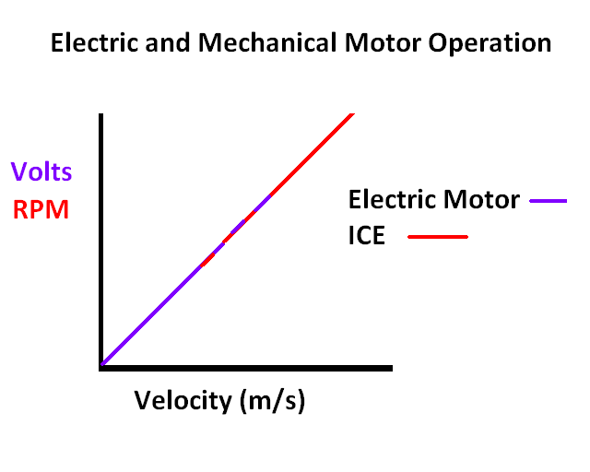
Operational Description
General Operation
  Environmental Interactions
  One operator controls the vehicle.
  Controls for ignition and emergency shutdown
  are incorporated into the system
Electric Motor and ICE coupling
  A single control feature governs both the electric motor and the ICE.
  Electric Motor accelerates the vehicle to a specific speed after
  which the ICE kicks on and continues accelerating the vehicle
  Speed, ICE RPM, and accumulator/electric system status are
  displayed to the driver in real time

Slide 15
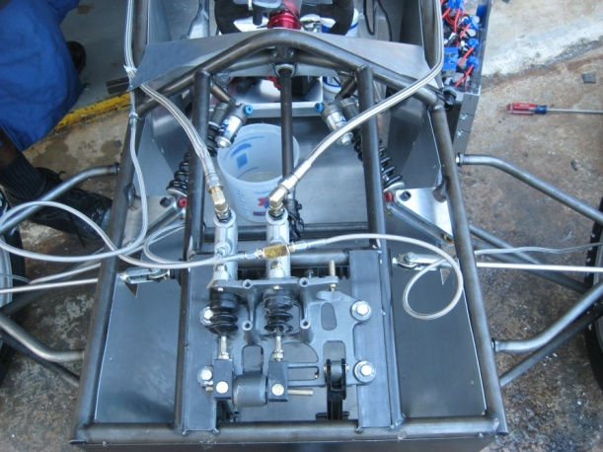
Operational Description
Steering
  Implemented into the system using rack and pinion, tie rods, hiem joints, clevis rods, steering shaft, and steering wheel
Braking
  Regenerative brakes and conventional disk brakes are
  operated under different controls

Slide 16
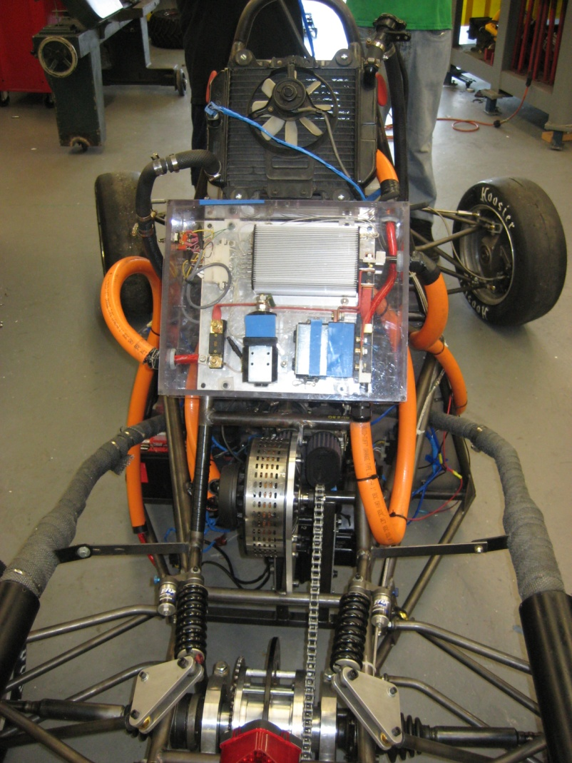
Operational Description
Regenerative Braking
  Main means of braking, electric motor acts as the means to regenerate electricity to batteries through braking.
  Brake pedal used to engage regenerative braking
  Regenerative braking applied to
  rear axle because vehicle is RWD
  Current braking design has brake centered on the driveshaft and mounted around the differential.

Slide 17
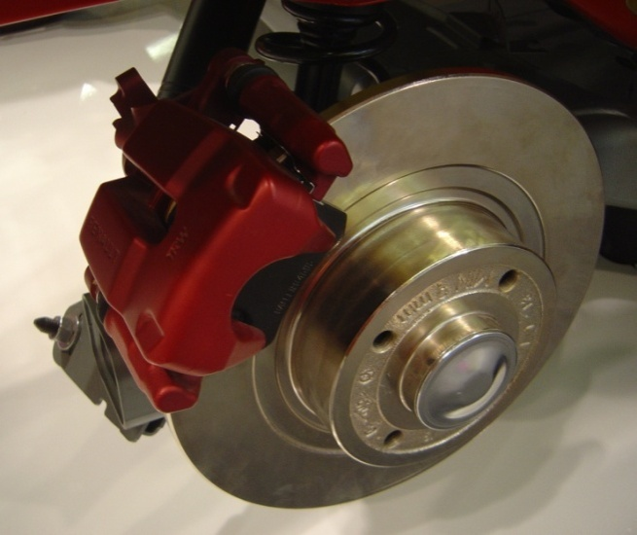
Operational Description
Conventional Disk Braking
  If regenerative braking is used must have second method of braking
  Disk brakes will be located on at least the front wheels and rear axle
  Operated Hydraulically by pull lever similar to E-brake on conventional cars
  Calipers need to be replaced due to age, size, and unwanted
  friction when brakes are not applied

Slide 18
Requirements Specifications

Slide 19
Functional Requirements
For the purposes of competing in the Formula Hybrid dynamic events a “Formula Hybrid Vehicle” is defined as a vehicle meeting the rule 3.5.1 “Formula Hybrid Definition” must:
    Completes the 75 meter electric only acceleration run, “Acceleration Event”, in less than ten (10) seconds.
  Engine
    Engines must be Internal Combustion, four-stroke, with a maximum displacement of 250cc for spark ignition engines and 310cc for diesel engines and can be modified or stock.
  Stock
    Any twin cylinder engine from a motorcycle approved for licensed use on public roads
  Modified
    Modification or removal of the clutch, primary drive and/or transmission
    Changes to fuel mixture, ignition or cam timings
    Replacement of camshaft (Any lobe profile may be used.)
    Replacement or modification of any exhaust system component
    Replacement or modification of any intake system component; i.e., components upstream of (but NOT including) the cylinder head .The addition of forced induction will move the engine into the modified category
    Modifications to the engine casings. (This does not include the cylinders or cylinder head.
    Replacement or modification of crankshafts for the purpose of simplifying mechanical connections .Stroke must remain stock.)

Slide 20
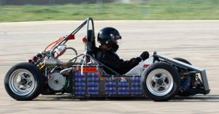
Functional Requirements
Breaking
  The car must be equipped with a braking system that acts on all four wheels
  A brake pedal over-travel switch must be installed on the car. This switch must be installed so that in the event of brake system failure such that the pedal over-travels, the switch will:
  Shut down all drive systems and trip the accumulator isolation relays
Transmission
  Any transmission and drive train may be used
Steering
  Quick Disconnect
  Circular Shape
  The steering system must affect at least two (2) wheels

Slide 21
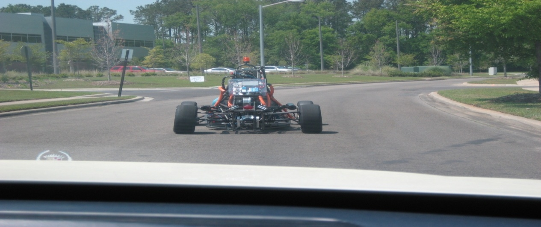
Functional Requirements
Starter
  Each car must be equipped with an on-board starter or equivalent
  A manual starting system operable by the driver while belted in is permissible
Throttle
  Mechanical throttle actuation is used, the throttle cable or rod must have smooth operation, and must not have the possibility of binding or sticking
  Electronic throttle must be of a fail-safe design to assure that any single failure in the mechanical or electrical components of the throttle actuation system will result in the engine returning to idle

Slide 22

Non-functional Requirements
The car body is required to be open wheeled and open cockpit with no openings throughout the actual body of the car except for the cockpit.
The car must have a wheelbase of at least 1525 mm (60 inches).
There must be an amber strobe light compliant with SAE
Standard J1318 Class 3 (Federal Signals Renegade®, Star Warning Systems 200Z or equivalent) on the highest point on the roll bar, which indicates when a vehicle is energized. The car needs to also meet the structural requirements sketched out in the rulebook.
  Each vehicle needs to satisfy both the 45 degree (45°) fuel and fluid tilt requirement and the 60 degree stability requirement
  A fireproof barrier must be provided between energy storage containers and the cockpit
  This barrier must cover the vertical interface between container and cockpit, and also span the complete top surface of the container so that continuous protection is provided for the driver
  The barrier may be an integral part of the energy storage container, or the cockpit

Slide 23
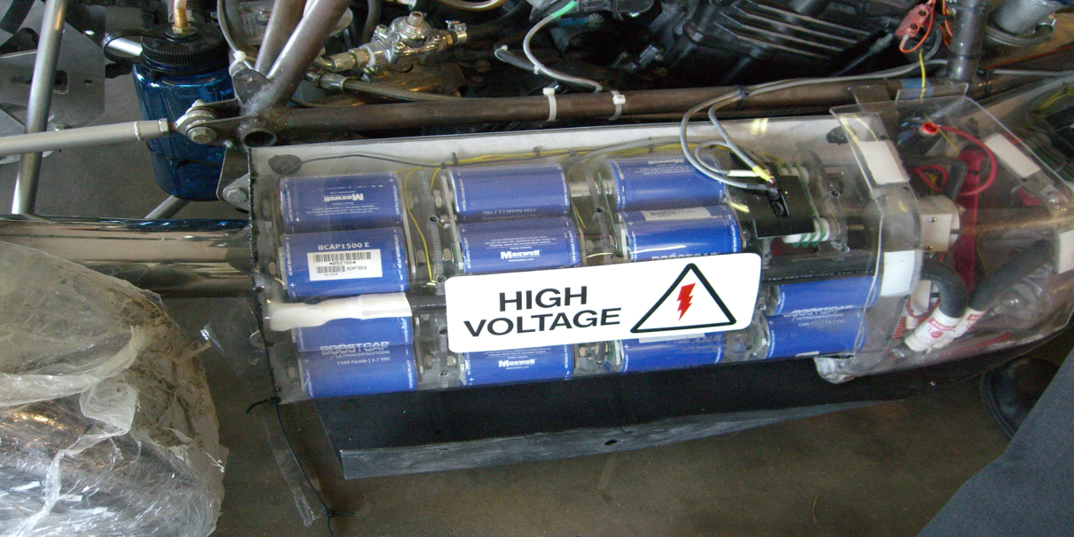
Non-functional Requirements
There must be no connection between the frame of the vehicle (or any other conductive surface that might be inadvertently touched by a crew member or spectator), and any part of any HV circuits. HV and low-voltage circuits must be physically segregated
All threaded fasteners utilized in the steering, braking, driver’s harness and suspension systems must meet or exceed, SAE Grade 5, Metric Grade 8.8 and/or AN/MS specifications
Each car must be equipped with an on-board starter or equivalent, and be able to move without any outside assistance at any time during the competition.

Slide 24
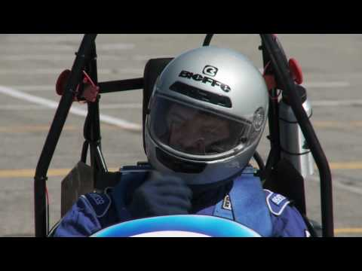
Non-functional Requirements
There must be a minimum of three shutdown buttons (Master Switches), one on each side of the car just behind the driver’s compartment at approximately the level of the driver’s head, and one on or near the instrument panel easily reachable by the driver. These buttons, after being pushed must break the flow of current holding the accumulator isolation relays closed, shut down the engine, fuel pump(s), all power generation systems, and disconnect the Low Voltage systems from the LV battery
All drivers must be able to exit to the side of the vehicle in no more than 5 seconds
The driver must have adequate visibility to the front and sides of the car. With the driver seated in a normal driving position he/she must have a minimum field of vision of 200 degrees. The required visibility may be obtained by the driver turning his/her head and/or the use of mirrors
As far as the class goes there are also certain requirements that are to be met such as maintaining and updating an engineering notebook, which documents the decisions, designs/calculations/analysis and interactions made with the team or other people providing insight or help. On an individual basis, there is also a specific objective of being able to give both oral and written reports on the success and specifications of the project

Slide 25
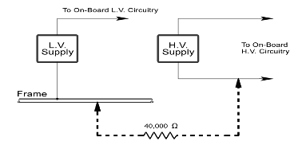
Non-functional Requirements
All vehicles must be equipped with an on-board Ground Fault Detector (GFD). This must be a Bender IR486, IR475LY, IR155-1, IR155-2, 8 or equivalent if approved by the organizers. The output relay of this device must be wired in series with the shutdown buttons
No HV connections may be exposed. Non-conductive covers must prevent inadvertent human contact. This would include crew members working on or inside the vehicle. Covers must be secure and adequately rigid. Body panels that must be removed to access other components, etc. are not a substitute for enclosing HV connections
Insulated wires must be commercially marked with a wire gauge, temperature rating and insulation voltage rating

Slide 26
Constraints & Test Plans

Slide 27
Constraints
Engines with exhaust cannot exceed 110 dBA
Fully operational suspension system with shock absorbers, front and rear, with usable wheel travel of at least 2 inches, with a 1 inch jounce and 1 inch rebound
The brake pedal must be designed to withstand a force of 2 kN without any failure in the brake system or brake pedal
Allowable steering system free play is limited to 7 degrees total measured at the steering wheel
Up to 50% of brake pedal travel may be dedicated to activating regenerative braking systems, but the remaining travel must be mechanically activate the hydraulic system
The impact attenuator must be at least 7.8 inches long and installed forward on the front bulkhead

Slide 28
Preliminary Test Plan
Must Test Acceleration
  Complete the 75 meter run in less than 10 seconds using only the
  electric motor
  If test fails, cannot further compete in competition
Must Test Endurance
2011 Formula Hybrid Energy Allocation: 20 MJ
Complete as many laps as possible in 60 minutes with a given amount of fuel
Lap time not relevant
Must Test Autocross
Objective is to test the cars on maneuverability and the handling on a tight course without the hindrance of competing cars (2 Laps/Best time)
The autocross event combines the performance features of acceleration, braking and cornering into one event

Slide 29
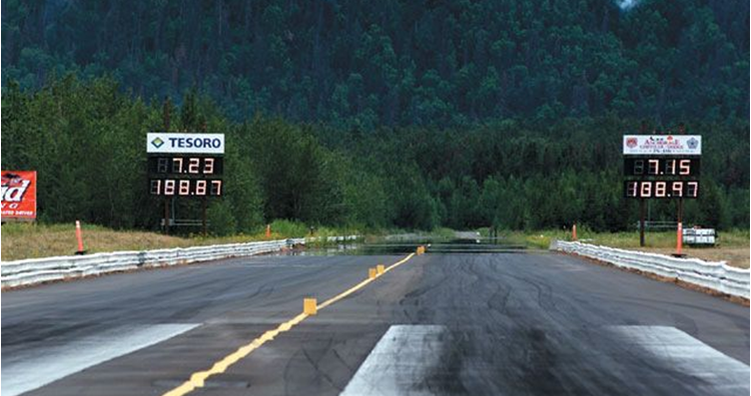
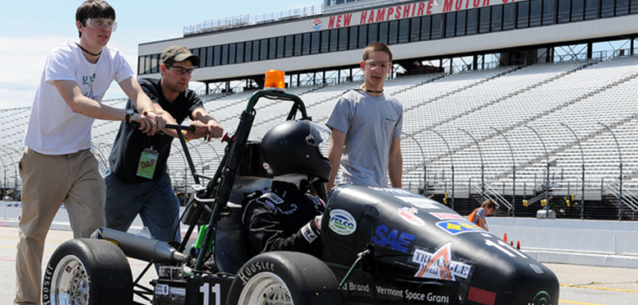
Capabilities Test Plan
Acceleration
  To test the acceleration we will create a 75 meter drag strip
  Each group member will do there own run
  Using a stop watch we will record each trial run
  Finally we will take the average of all 6 runs
and make sure that our average
velocity is safely under the
required time of 10s
  Compare to last years best run in acc
  Florida State/FAMU average
  over three runs 7.972 s
  The winner (University of Vermont avg 5.28 s)

Slide 30


Capabilities Test Plan
Endurance
  To test the endurance we will do mock trial runs on a quarter mile track
  First make sure we have exactly 20 MJ of energy onboard
  Accomplish this by filling batteries completely with known energy, and then convert the needed amount of gasoline to MJ. (Appendix B)
  3 Different drivers each with their own number of completed laps. (Take Average)
  Compare to the winner of last year (Full Hybrid)
  Florida St./FAMU completed 13 laps in 18:45:740
  1st place was Politecnico De Torino with 13 laps in 14:57:818

Slide 31
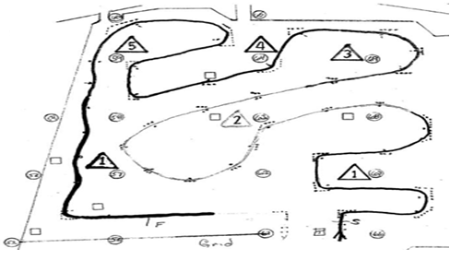
Capabilities Test Plan
Autocross
    Given the specifications from the 2011 Official Hybrid Rulebook we will build similar slaloms and run trial heats recoding the times
    The length of each run will be approximately (1/2) mile
    Multiple Straights (200ft) , Constant Turns (75 feet), Hairpin Turns (30ft), Slaloms (25 feet) and misc (11.5ft)
    Average speeds should be 25 mph to 30 mph
    Minimum of three drivers each completing their own run
    Take the average time and compare to last years winner
    Florida St./FAMU
    average lap time was 1:15:35
    The winner was Texas A&M
    with average time of 41.43 s
Preliminary Course Design

Slide 32
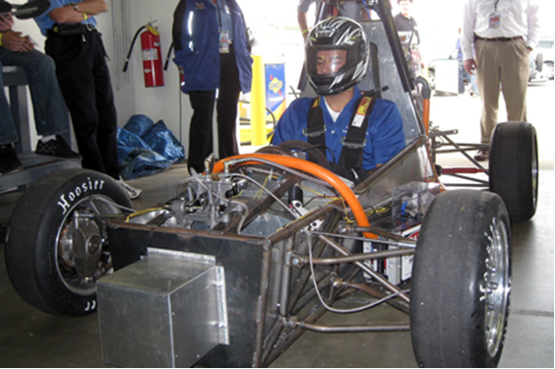
Requirements Test Plan
Must Test Impact Attenuator (Required)
  Must submit data to show that our impact attenuator is safe
  Safe is collision at 7m/s giving a deceleration of the vehicle not to exceed 20g, with a peak deceleration less than or equal to 40 g’s
  To accomplish this we will hook an accelerometer to our proof of concept design and crash it with the required specs, or model it in Pro/E
  Lastly we will modify our design if
  necessary, if not submit
  results well in advanced
Previous Impact Attenuator

Slide 33
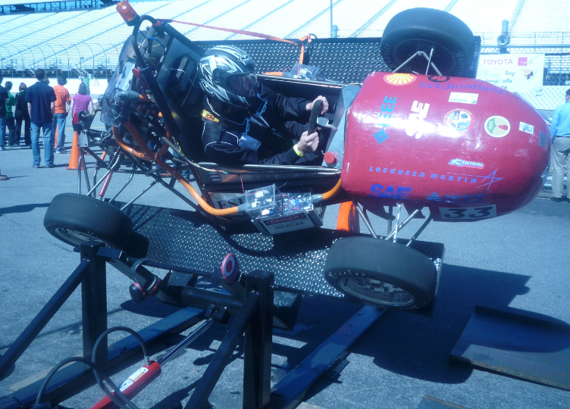
Constraints Test Plan
Must Test Ground Fault Detector
We will test this constraint by connecting a 40kΩ resistor between points on the HV circuit and the grounded frame with the HV systems at full charge.
This must cause the ground fault detector to trip, and the vehicle electrical systems to shut down.
Must Test Tilt Table
To test this the vehicle must not roll over when tilted at an angle of 60 degrees, corresponding to 1.7 G’s
The tilt test will be conducted with the tallest driver in the normal driving position
Also we will inspect to make sure the car is capable of being titled to a 45 degree angle without leaking fuel or fluid of any type

Slide 34
References

Slide 35
References
"Formula Hybrid Forums :: View Topic - Hybrid Powertrain Configurations." Formula Hybrid. SAE International IEEE, 26 Feb. 2008. Web. 13 Sept. 2010. http://www.formula-hybrid.org/forums/viewtopic.php?t=160
Nice, Karim. "How Differentials Work" 02 August 2000. HowStuffWorks.com. 17 September 2010 http://auto.howstuffworks.com/differential.htm
SAE International. "2011 Formula Hybrid Rules." (2011): 1-124. Web. 24 Sept. 2010. http://www.formula-hybrid.org/pdf/Formula-Hybrid-2011-Rules.pdf
"Case Studies Battery Management System (BMS) Validation Test Stand." Engineering and Software Services for Manufacturing, Testing, and Development. Web. 28 Sept. 2010. http://www.dmcinfo.com/Case-Studies/View/ProjectID/200/Battery-Management-System-BMS-Validation-Test-Stand.aspx

Slide 36
Questions?

Slide 37
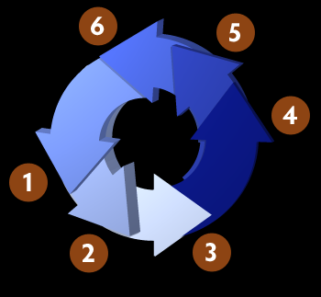
Methodology
State the problem and Identify needs
Research, Fundraising, and Donations
Design
Design Selection
Purchase and Build
Testing

Slide 38

Expected Results
Competitive Prototype Parallel Hybrid Car
Benefit - Good Acceleration and high efficiency at high speeds
Series better for stop and go traffic
Integrated Control of Electric Motor and ICE
Programming and Computer System complex for throttle control
Easy to use once in place
Suspension and Braking
Added weight and better Control
Battery Mgmt System
Drains Batteries evenly and charges to
a safe voltage

Slide 39
BMS Test Plan
Manufacturing processes for battery cells have a high degree of inherent variation, requiring a more advanced and robust BMS.
Test case: Charge (1) accurately simulating the required sensors and battery cell stack inputs to the BMS, and (2) measuring, collecting, and processing the digital and analog outputs produced by the BMS system as a result of those inputs
  Take a full battery with a half charged battery and hook up to the BMS system
  After a steady time, they should both be ¾ full

