Slide 1

Wii Care
James Augustin
Benjamin Cole
Daniel Hammer
Trenton J. Johnson
Ricardo Martinez

Slide 2

Introduction and Background
Therapy and Rehabilitation Using Wii-Motes

Slide 3
Introduction
Hippocrates
  Medicine
First professional association, 1921
American Physical Therapy Association(APTA),1940s
74000 members, 200+ programs
Demand
  Quantify Range of Motion (ROM)
    Insurance Claims

Slide 4
Background
Physiotherapy
  low cost alternative to surgical treatment and/or medication.
  Journal of the American Medical Association (JAMA)
spine-related expenditures continue to increase without positive results of improvement.
  American Physical Therapy Association (APTA)
patients who receive physical therapy for musculoskeletal disorders experience better outcomes at a lower cost than the use of medication drugs.
Physical therapists
  Early intervention treatment; Prevent chronic ailments
    Fitness and wellness-oriented programs
      that promote healthy, active lifestyles.

Slide 5
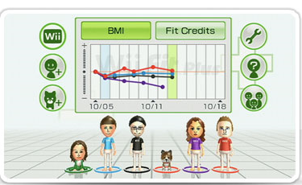
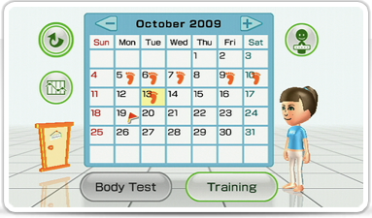
Background
Nintendo’ interests
  stabilizing one’s well-being
  American Heart Association
  Wii Fit
    Daily activity
    Calendar; prescription

Slide 6
Problem Definition
Sensory device and interface to record cervical movement using Nintendo Wii components and other Bluetooth compatible devices.
  Health care/Rehabilitation
  Low cost
  Adaptability for different Environments
  Low maintenance
  Easy Replacement

Slide 7
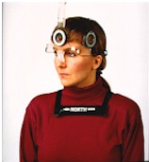
Devices in Use
  Inclinometer
    Compass
    Tilt w.r.t. gravity
  $400

Slide 8
Problem Definition
  Tape measurements
    Sternal Notch-chin
      Flexion/Extension
    Acromion Process-Chin/Lobe
      Rotation
      Lateral Flexion/Extension
    Human Error

Slide 9
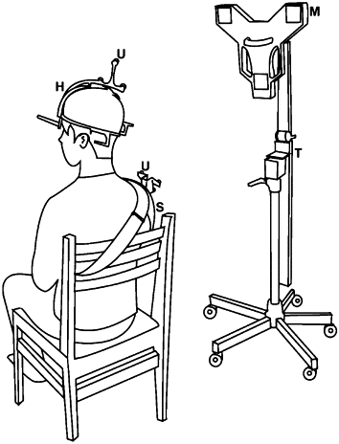
Problem Definition
  Ultrasound
    Shoulder reference; transmitters
    Microphone transducer sensors
    Expensive

Slide 10
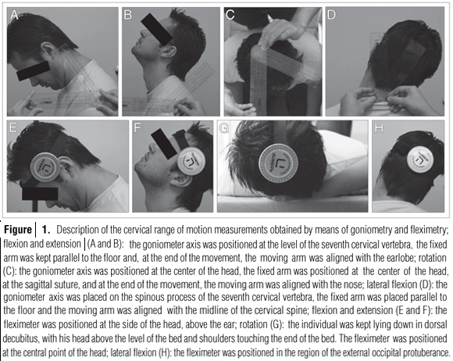
Problem Definition
  Goniometer
    Pivoting Protractor
    Error
      Accuracy

Slide 11
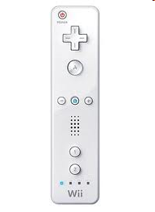
Problem Definition
Wii-Care Project
  Low cost
  Wii Components
  Quantify Accurate Range of Motion

Slide 12

Concept Generation and SElection
Optimization of Design Options

Slide 13
Concept Generation and Selection
Variety of concepts analyzed
Overall design chosen to be using multiple Wii controllers and 4 infrared LEDs
Most accurate, highest versatility, and little extra complexity

Slide 14
Decision Matrix
Criteria | Weighing Factor | 1 Wiimote |  |  | Multiple Wiimotes |  |  | Accelerometer
 |  | 1-4 LEDs | 4+ LEDS | Array | 1-4 LEDs | 4+LEDs | Array
Cost | 0.1 | 9 | 8 | 7 | 7 | 6 | 5 | 9
Durability | 0.1 | 8 | 8 | 6 | 8 | 8 | 6 | 4
Adaptability/Versatility | 0.2 | 6 | 6 | 6 | 9 | 9 | 9 | 7
Efficiency | 0.05 | 7 | 7 | 6 | 5 | 5 | 4 | 9
Portability/Lightweight | 0.1 | 8 | 8 | 9 | 7 | 7 | 8 | 5
Ease of Use/Setup | 0.1 | 8 | 8 | 9 | 8 | 8 | 7 | 9
Accuracy | 0.1 | 9 | 9 | 8 | 10 | 10 | 8 | 7
Design Complexity | 0.2 | 9 | 5 | 9 | 8 | 6 | 7 | 9
Aesthetics | 0.05 | 9 | 9 | 9 | 8 | 8 | 8 | 9
Total |  | 8 | 7.1 | 7.65 | 8.05 | 7.55 | 7.2 | 7.5

Slide 15

Meeting With Harris
Meeting with John Rust on November 19th
Key Issues brought up:
  Sensitivity of Wii controller’s IR camera
    How accurate can it determine depth?
  How to differentiate the LEDs
More testing with the Wii controllers

Slide 16
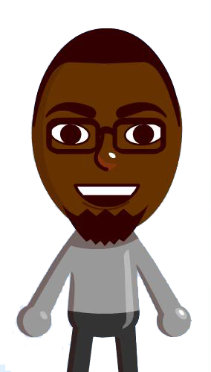
Station Updates
Reference Point and Plane Isolation

Slide 17
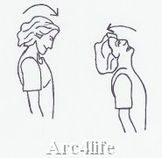
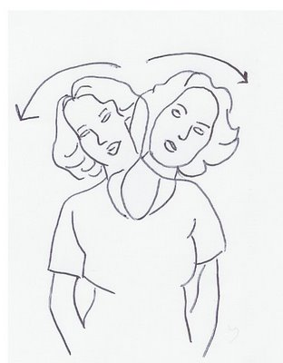
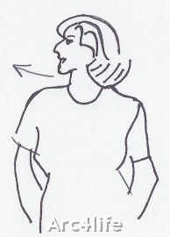
Therapist Consultation
Tyressa Judge- Physical Therapist for FSU Thagard
3 primary motions-Flexion/Extension, Lateral F/E, Rotation
Any other motion is a combination of the 3.
Disability is measured based on angles achieved.

Slide 18
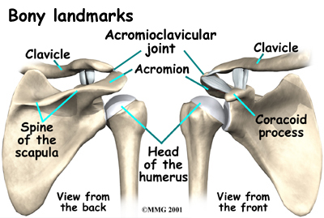
Therapist Consultation
Patient sits down as she measures the patient’s range of motion.
Uses patient’s acromioclavicular joint as a reference point.
Uses patient’s nose to determine rotation angle

Slide 19
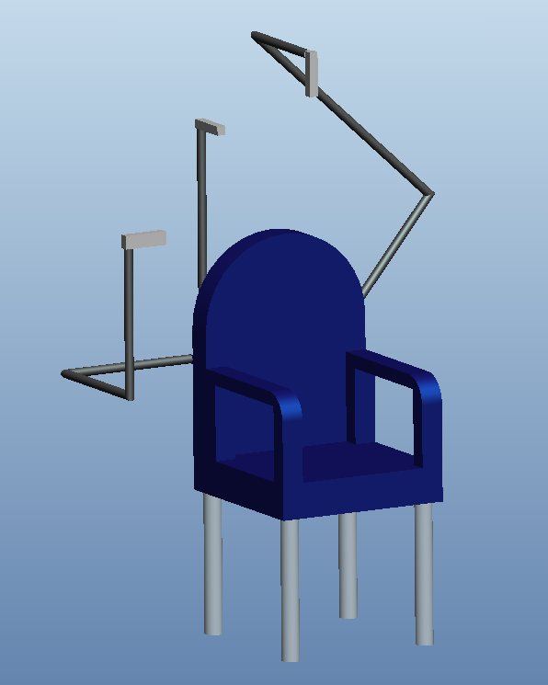
Updated Design
Implements 3 Wii-Motes
Microphone stands attached to chair
Chair handles provide additional support for acromioclavicular joint

Slide 20
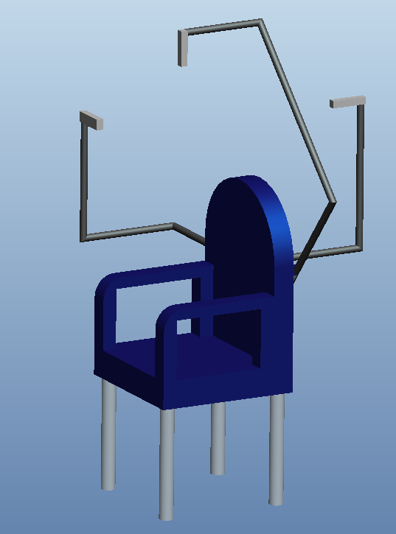
Updated Design
Each camera strategically placed to capture a specific motion
Cameras are positioned perpendicularly to the microphone stand.

Slide 21
LED Placement Updates
The Baseball Cap Concept

Slide 22
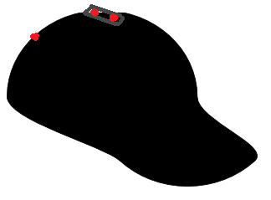
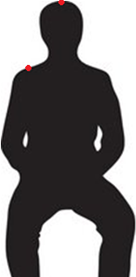
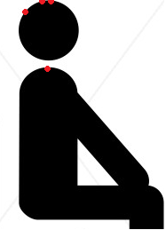
Updated Design
LED Placement
  On top of head
  Reference: acromioclavicular joint

Slide 23
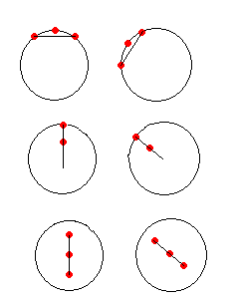



Calculating the Angles
Side View
Rear View
Top View
Simple Trigonometric Equations
Allows to capture full range of motion

Slide 24

Programming
The Inner Workings and Communication

Slide 25
What We Know
Wiimote Data Processing
  Infrared
    Raw data is processed as 4-byte-long integers
    Points are given in (X,Y) coordinate pairs
  Accelerometer
    Raw data is processed as 4-byte-long floats (decimals)
We have a capable Java library
  WiiRemoteJ- credits to Michael Diamond

Slide 26
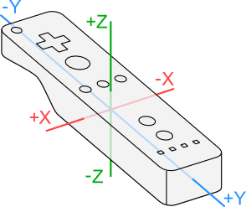
What We Are Ready To Know
“HOW” data is sent from Wiimote to computer
  Bluetooth in-depth
  Understand and standardize a way for WiiRemoteJ to be accessed on ALL probable platforms
    Important for replication
?

Slide 27
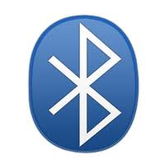
Programming Design and Analysis
Bluetooth
  Bluetooth Stacks
    Software that implements the Bluetooth protocol
    Drivers that make Bluetooth radios work
    Two Types:
      General purpose – for devices with considerable resources
      Embedded system – for peripherals

Slide 28
Programming Design and Analysis
Bluetooth
  Native Stacks
    Winsock (Microsoft Windows’ native Bluetooth stack)
    OS X (Apple Mac OS X’s native Bluetooth stack)
    BlueZ (Linux’s de facto Bluetooth stack)
  Third-Party Stacks
    BlueSoleil
    WIDCOMM

Slide 29
Programming Design and Analysis
Bluetooth
  Bluetooth Protocols
    describe the syntax, semantics, and synchronization of communication
    “protocols : communications :: programming languages : computations”
    Examples:
TCP
OBEX
RFCOMM
SDP
L2CAP
★

Slide 30

Programming Design and Analysis
Java and Bluetooth
  JSR-82 Implementation
    Java Specification Request (JSR) No. 82
    It’s basically a Java library or archive file (.jar)
    Lets the Java app access the stack
    Very few in existence

Slide 31
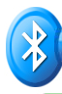

Programming Design and Analysis
Java and Bluetooth
  Commercial JSR-82 Implementation Options
    ElectricBlue- “uses the native Microsoft stack, and hence can be run on any Windows XP/Vista that has the Microsoft Bluetooth Stack Installed”
    Avetana- “enable[s] Bluetooth Development on Desktop PCs (running Windows, Linux or Mac OS X) using the standardized JSR-82 APIs”

Slide 32
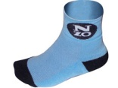

Programming Design and Analysis
Java and Bluetooth
  Free/Open JSR-82 Implementation Options
    BlueSock- “aims to wrap the Microsoft Windows Bluetooth API's with JSR-82 using JNI”
    BlueCove- “currently interfaces with the Mac OS X, WIDCOMM, BlueSoleil and Microsoft Bluetooth stack found in Windows XP SP2 and newer”
★

Slide 33
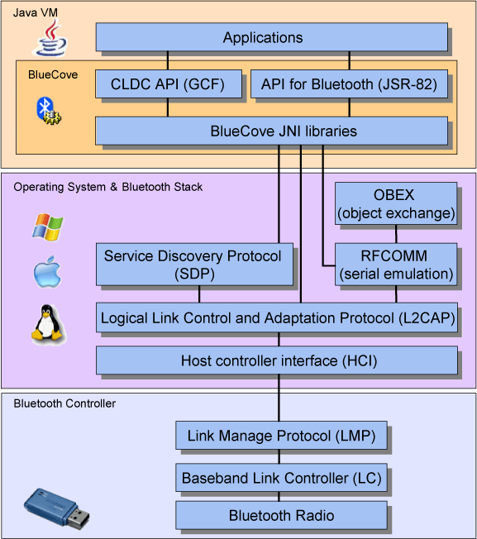
Programming Design and Analysis
BlueCove

Slide 34
Concept Generation and Selection
Because we:
  Need the L2CAP protocol
  Want the app to work on multiple systems
  Want to make the app low-cost
The best combo of software is
  A WIDCOMM stack, which provides L2CAP support &
  the BlueCove JSR-82 imp, which is free / open source.
  Both are usable on ALL major operating systems

Slide 35
Concept Generation and Selection
C♯ still in mind
  The previously tested C♯ option, WiimoteLib, worked smoothly
    Lack of portability
  If Java and the WiiRemoteJ library continue to raise difficult (compatibility) issues:
    Abandon the Java language
    Use C♯

Slide 36
Prototyping and Written Programs
public partial class WiiCareDraft : Form
{
Wiimote myWiimote;
Mutex m = new Mutex();
float myX, myY, myZ;
int acX, acY;
public WiiCareDraft()
{
InitializeComponent();
myWiimote = new Wiimote();
myWiimote.Connect();
myWiimote.SetReportType(InputReport.IRAccel, false);
myWiimote.SetLEDs(false, false, false, false);
myWiimote.WiimoteChanged += new EventHandler<WiimoteChangedEventArgs>(myWiimote_WiimoteChanged);
}

Slide 37

Materials Selection
Product Selection and Use

Slide 38
Materials / Item Selection
Microphone stand and booms
  Easy to install on a chair
  Allows for easy installation with Wiimote mount
Office chair with arm rests
  Comfortable and easy to modify
Widcomm Bluetooth stack
  Compatible with Wiimote and JAVA library
Kensington Bluetooth dongle
  Compatible with WIDCOMM stack

Slide 39
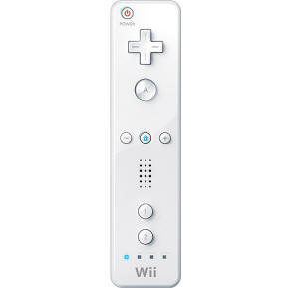
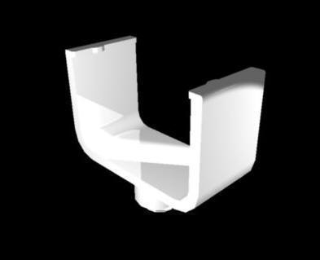
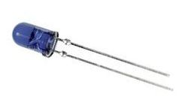

Materials / Item Selection cont.
Wii Controllers
Wiimote Mount
Infrared LEDs
Donated hat

Slide 40
Cost Analysis
Item | Quantity | Cost
Wii Controller | 7 | $300
LEDS | 20 | $17.98
Bluetooth Dongle | 2 | $30
Microphone Stand and Booms | 3 | $60
Wiimote Mount | 4 | $59.80
Hat, Batteries, and Chair | 1/14/1 | $0
Total |  | $467.78

Slide 41
Summary
Therapist + Harris Consultations
3 wii-motes with 4 LED hotspots
Hat style headset with reference on shoulder
Folding chair style assembly
Infra-red data is processed as 4-byte-long integers in txt file
Java library: WiiRemoteJ
Bluetooth Software: WIDCOMM stack + BlueCove JSR-82 imp
Low Cost: $467.78
    $200 reproduction cost

Slide 42
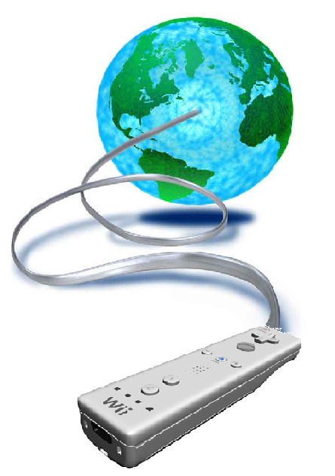
What's Next?
Java Bluetooth Dongle
Wii-Mote Stands
Harris Teleconference
Wiimote Analysis/Testing
LED Sensitivity Analysis
Assembly Portability
Programming
  Explore WIDCOMM stack + BlueCove JSR-82 imp
  Model 3d head in environment
  Model graphing environment
  Calibration; Interface; Display

