Slide 1

Wii Care
James Augustin
Benjamin Cole
Daniel Hammer
Trenton J. Johnson
Ricardo Martinez

Slide 2

Project Scope
Many concepts considered for design of a low-cost head tracking system.
  Components of Wii game System
Allow patients to perform cervical exercises prescribed by physical therapists
  Unsupervised
  At home
Visual based prescriptions
  Graph Comparison
  Letter Mimicking
Rehab session logged on memory chip
  Later analyzed by Physical Therapists

Slide 3
Project Scope
2 Wii-motes, Up to 4 LEDs
  IR tracking
    Wii-mote is sensor
    LEDs are tracked devices
      Worn by user
Specifications:
IR LED: 1.28V @100mA
Battery: Varies →e.g. AA: 1.5V; 2850mAh

Slide 4
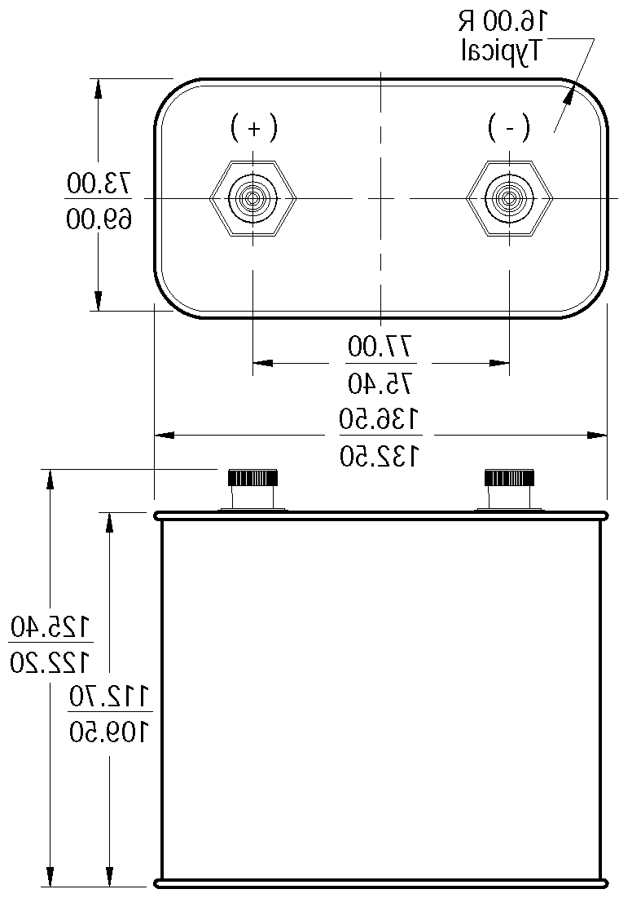
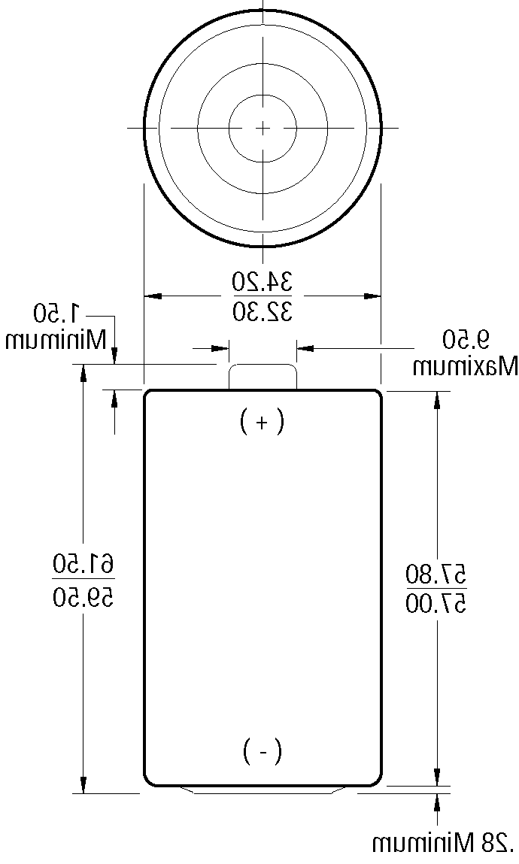
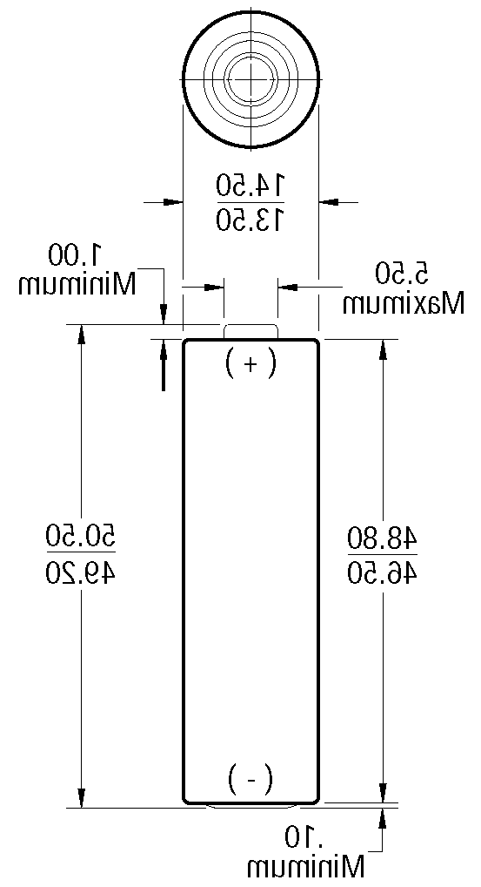
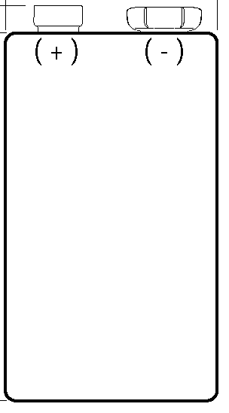
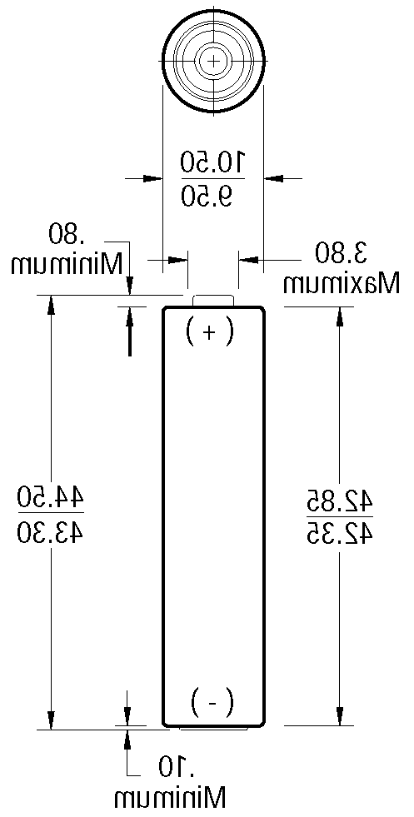

Battery Comparison
Formula:
  Time = Battery Capacity / LED load
    Time(h)
    Capacity(mAh)
    Load(mA)
Batteries considered:
  Lantern,
  9V,
  AA & AAA
  Button Cell

Slide 6
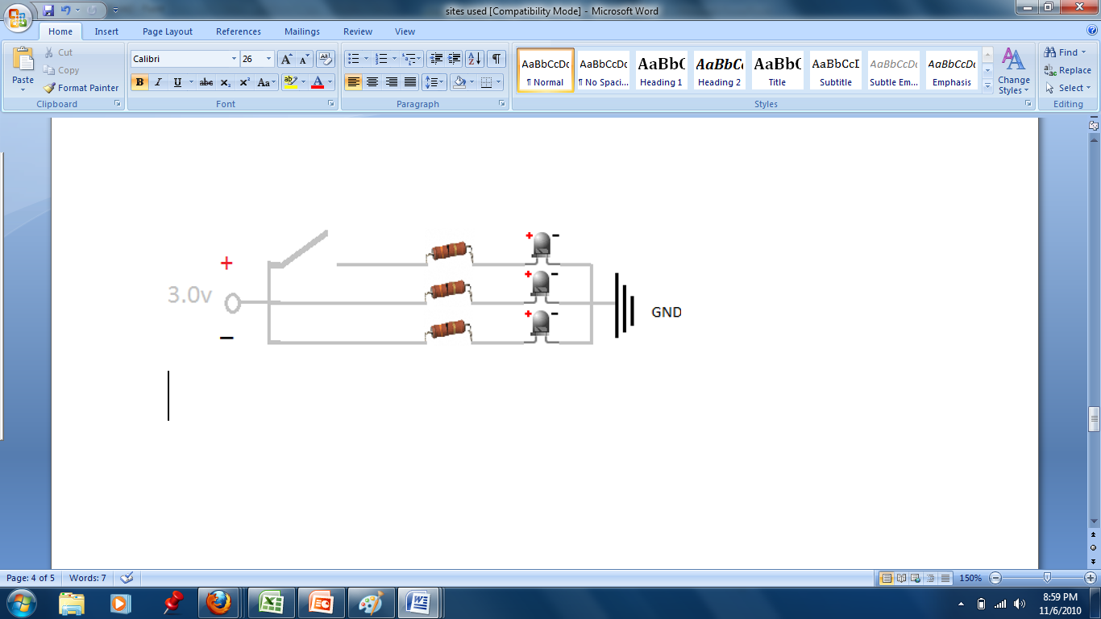
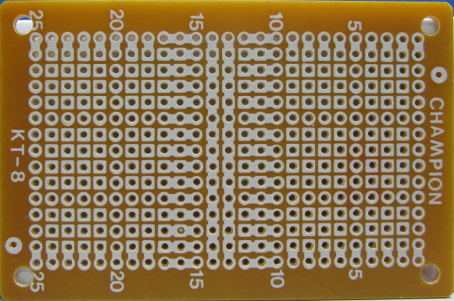
Power Setup
P = Voltage x Current

Slide 7
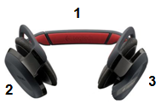
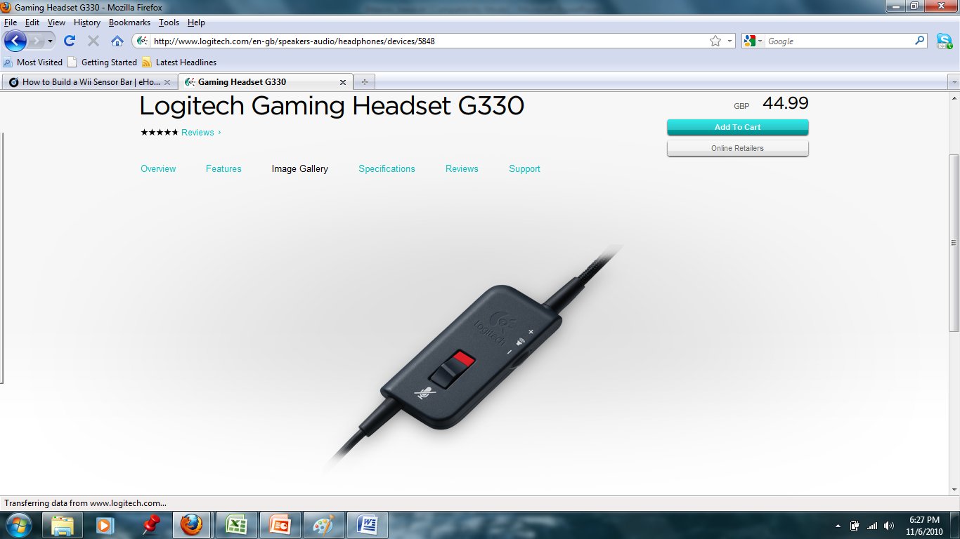
Head Mount & Battery Compartment
IR LEDs attached at each number
  Triangulation
Compartment for Circuit
  Clip on
Notes:
LEDs at each number

Slide 8

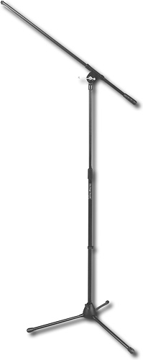
Wii-Mote Station
Boom Microphone Stand
Adjustable height from 36”-63”
Additional 30” Boom
Approximately $35 (tax included)

Slide 9
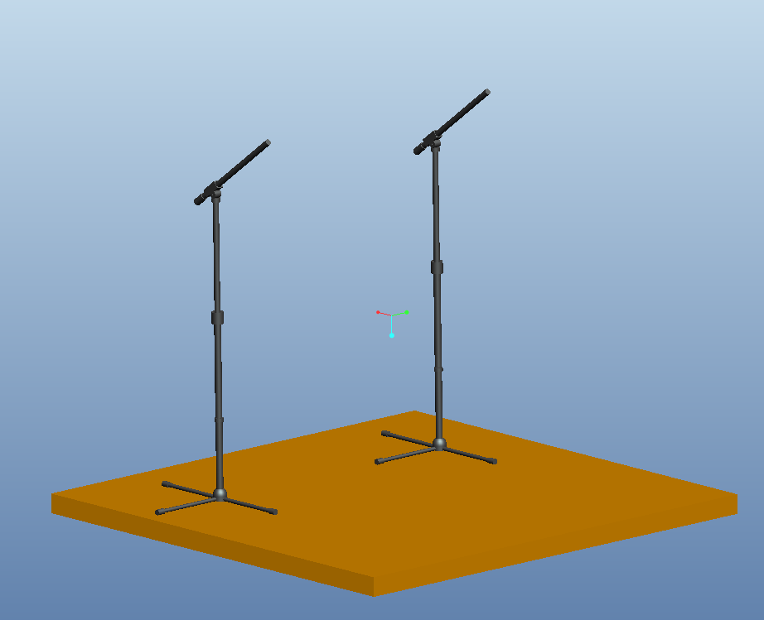
Wii-Mote Station
Implement two microphone stands to create an aerial field of view.
Wii-Motes will be placed where microphones would be.

Slide 10

Programming
Wiimote Data
  Infrared
    Raw data is processed as 4-byte-long integers
    Points are given in (X,Y) coordinate pairs
  Accelerometer
    Raw data is processed as 4-byte-long floats (decimals)

Slide 11
Programming
WiimoteLib
  Managed code for .NET framework
  Written in C#
  Allows for all configurations of Wiimotes
    Variations of attachments
  Incompatible with Mac OS and Linux systems
    Compatible with Java Native Interface (JNI)

Slide 12
Programming
WiiRemoteJ
  Pure Java library for Wii Remote
  Also very flexible
  Works smoothly with multiple Wiimotes

Slide 13
Programming
Next Steps
  Explore the Java 3D library
    Try to model a head in a 3D environment
  Find a good Java graphing library

Slide 14

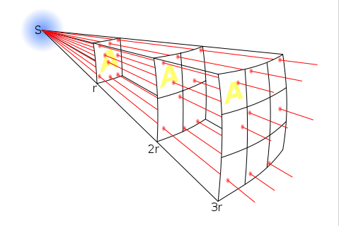

Triangulation
Controller determines X,Y, and Z coordinates of IR points
Z coordinate determined by “size”
Using known distances, angles can be determined through trigonometric functions
Reference point is the Wii controller

Slide 15
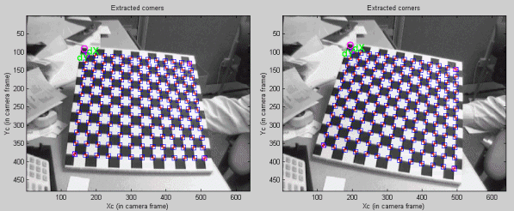
Calibration
Calibration can be done using MATLAB
Multiple cameras (i.e Wii controllers) can be calibrated using Camera Calibration Toolbox

Slide 16
Cost Analysis
Item | Quantity | Cost
Wii Controller | 7 | $140
Headset | 2 | $60
Batteries (AA) | 12 | $20
LEDS | 12 | $24
Bluetooth Dongle | 1 | $42
Bluetooth Stack (Bluesoleil) | 1 | $21
Microphone Stand | 2 | $60
Total |  | $367

Slide 17

Summary
2 wii-motes with up to 4 LEDs
Wraparound headphone style headset
Battery Choice: AA
Boom microphone style stand
WiimoteLib
X,Y,Z data registered as a Float; Saved as Text file; Calibrated by Toolbox and Matlab (referenced from controller)
Orientation Program
Low Cost: $367 (~$200 to reproduce)

Slide 18
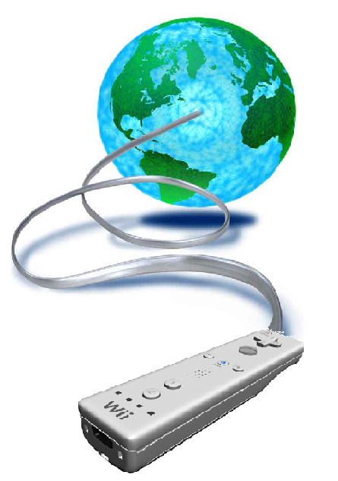
What's Next?
Order Parts
Therapist Prescription
Wii-Mote View Analysis
Headset Stress Analysis
LED Sensitivity Analysis
DC-DC Converter
Stand Coupling
Programming
  Explore Java Lib
  Model 3d head in environment
  Graphing Lib
  Calibration; Interface; Display

