Slide 1


Wii Care
James Augustin
Benjamin Cole
Daniel Hammer
Trenton J. Johnson
Ricardo Martinez

Slide 2
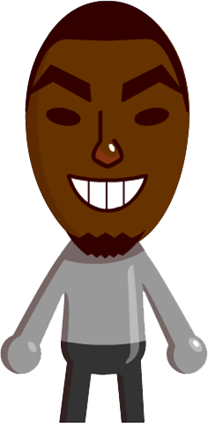
James aUGUSTIN
Introduction

Slide 3
Outline
Introduction
Scope
Market Products
Our Product
Demonstration
Error/Improvements
Conclusion

Slide 4
Scope
Sensory device and interface that quantifies range of motion for physical therapists monitoring patients during cervical rehabilitation
Wii Components
-Infrared LEDs
Low cost
  - $2500 budget
Transportable e.g. wireless
Physician and patient accessibility
  -Universal OS
  - Sharing between patient and therapist

Slide 5

Scope
  Sponsor and client
  John Rust
  Error:
    ±5° angularly
    0.25 inch horizontally/vertically
  Physical Therapist-Tyressa Judge
    influenced design
    e.g. algorithm (only extremes of ROM)

Slide 6
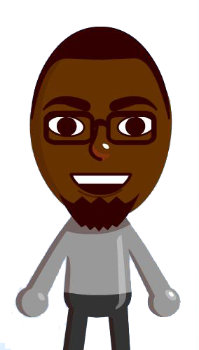
Benjamin Cole
Market products & need

Slide 7
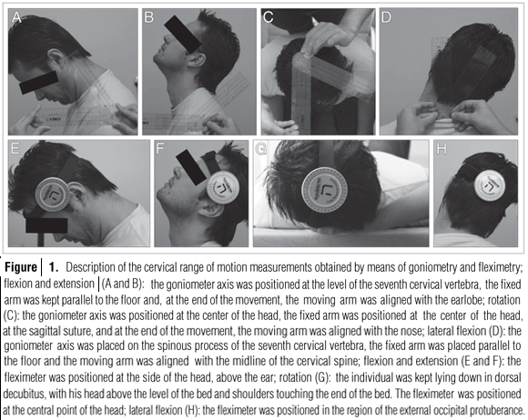
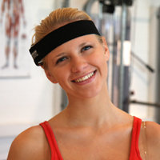
Market Products
  Goniometer- Pivoting Protractor
    Prone to human error
  Inclinometer- measures tilt with respect to gravity

Slide 8
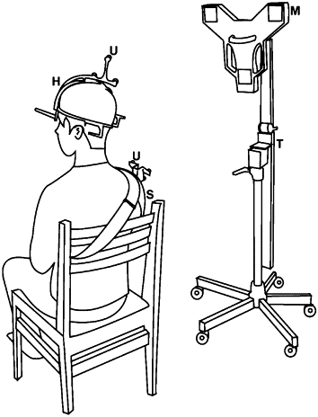
Market Products
  Ultrasound
    Shoulder reference; transmitters
    Microphone transducer sensors
    Expensive

Slide 9
The Need
Technology which is:
  Lightweight
  Low Cost
  Accurate
  Transportable
  Record and Playback Data

Slide 10
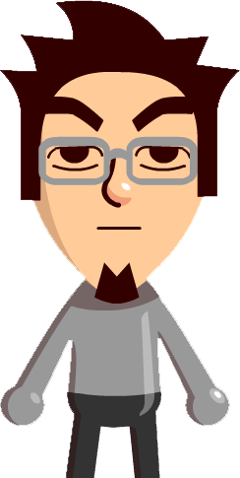
Ricardo Martinez
Our product
(Hardware & Algorithm)

Slide 11
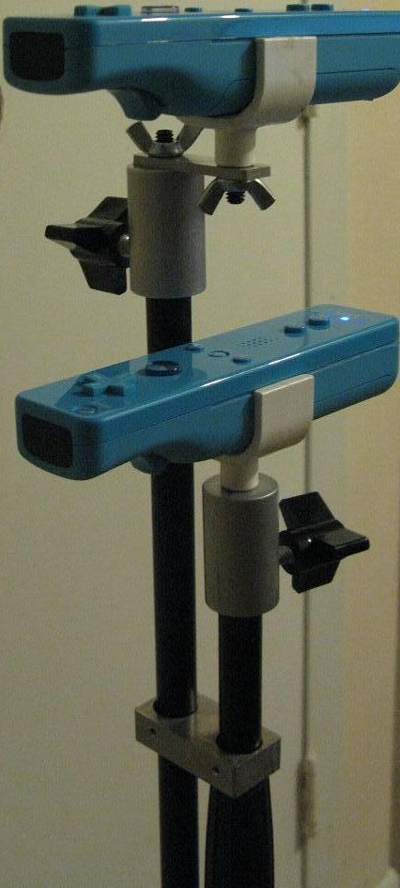
Setup
Two Wii-motes positioned with equal pose and 10 cm translation.

Slide 12
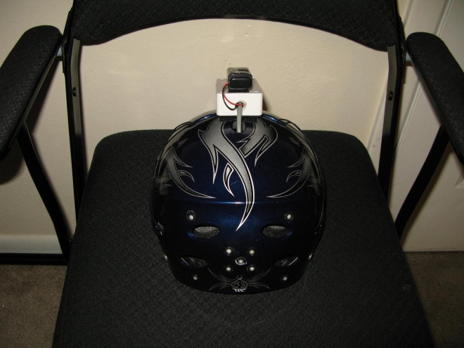
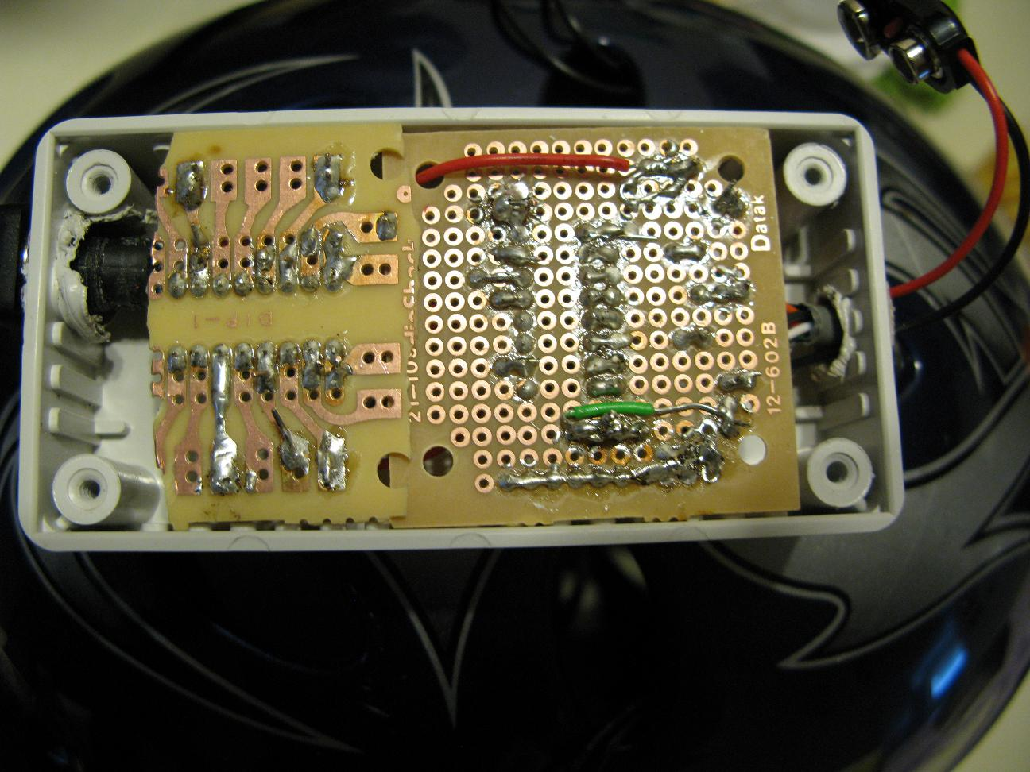
Setup
Helmet with 4 embedded Infrared LEDs.
Software acquires data; algorithm computes distances and angles

Slide 13

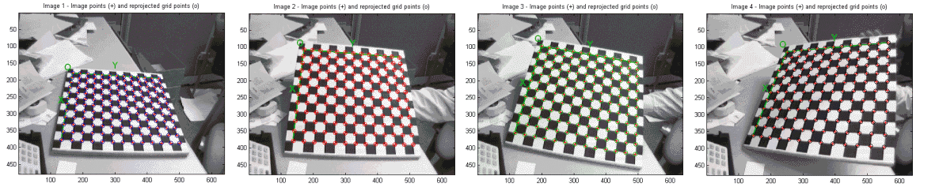
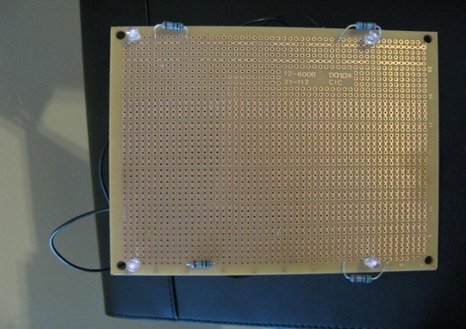
Algorithm
Thales Formula
Non-linearity requires regression to get accurate distance measurement
Focal Length and Camera Center distance (B) determined using MATLAB Calibration Toolbox

Slide 14
Z-Distance Mapping
Regression fit of Z=c/x
Range of Operation: 1.5 ft – 4 ft

Slide 15
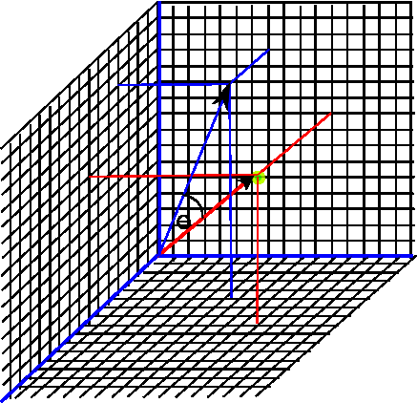
Angle Calculation
Z distance provides X and Y positional data relative to bottom controller
Angle of Roll, Yaw, and Pitch computed between starting position and current position
Fundamental Matrix compiled
Z-distance error: ± 0.711 cm
Angular error: To Be Determined

Slide 16
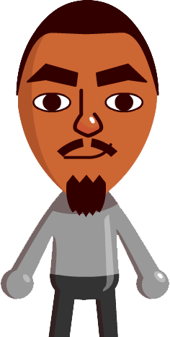
Trenton johnson
Our product
(software)

Slide 17
Software: Compatibility
The software should run on any PC that has Java Runtime 1.5 or higher installed. The most recent Java update is recommended.
Recommended system requirements:
  1 GB RAM
  1.2 GHz processor

Slide 18
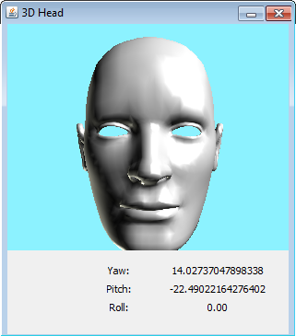
Software: Graphical User Interface
The software has a virtual 3D head that responds to the patient’s head movement.

Slide 19
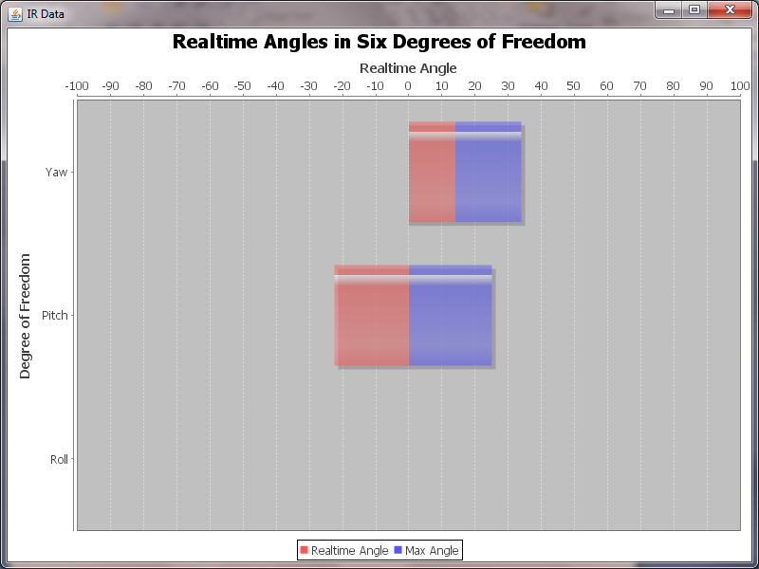
Software: Graphical User Interface
Graphing
  Horizontal bar graphs change in real-time as the patient’s head moves.
  Measures three rotational degrees of freedom
  Graphs can, and will be,
  saved, and will serve as
  primary means of saving
  records.

Slide 20
Software: Usability
The interface is very easy for patients and professionals to use.
Prompting
  The application lets the user know which exercise to perform at a certain time.
  Allows the software to “know” what to measure at a time
  Patients never have to guess which exercise to do.

Slide 21
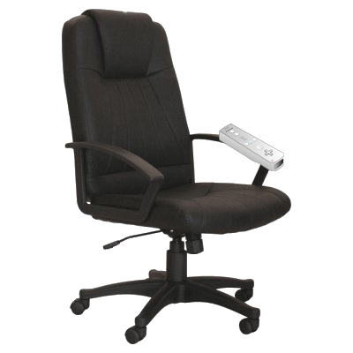
Software: Usability
Navigation
  Patients can have partial control of the interface using a third Wiimote attached to the chair.

Slide 22
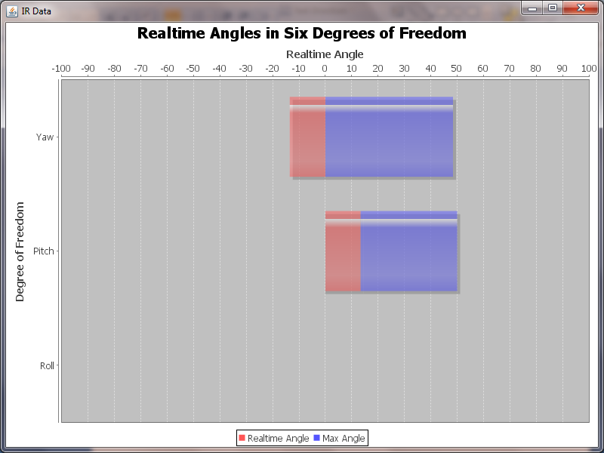
Software: Recording
As stated earlier, the primary means of record-keeping is by reviewing and comparing graphs.
You may be able to notice that the blue bar shows definite improvement.

Slide 23
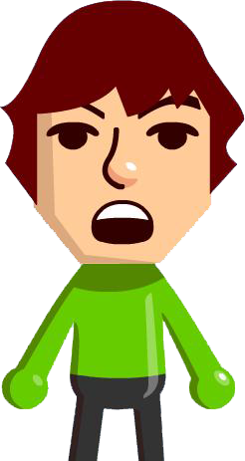
Group
Demonstration

Slide 24
Daniel Hammer
Conclusion

Slide 25
Results
Interactive display
Progress visibility
Desired error
  Linear: 0.25”
  Angular: 5°
Linear error: about 1% = 0.28” = 7.1mm
Angular error: in process (ppi needed)
Potential for industry standard

Slide 26
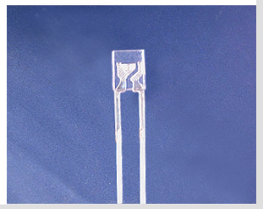
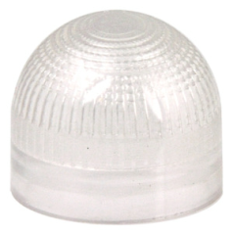
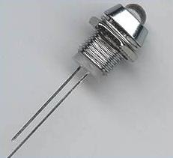
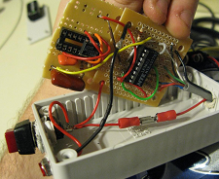
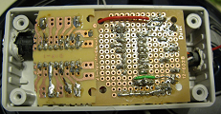
Improvements
Square LEDs or Diffusers
More LEDs = higher accuracy
  5-5-5 timer with decade counter
  30 Hz = 5 points per LED per second
140 Degrees
180 Degrees
Fully constrained and mirrored housing

Slide 27
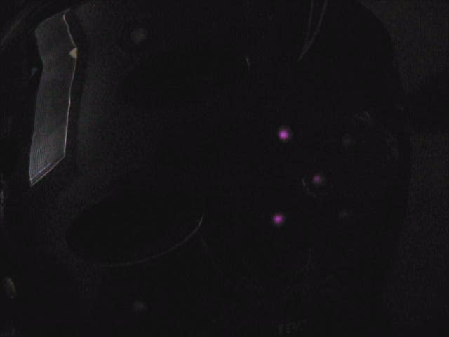

Slide 28
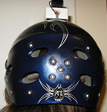
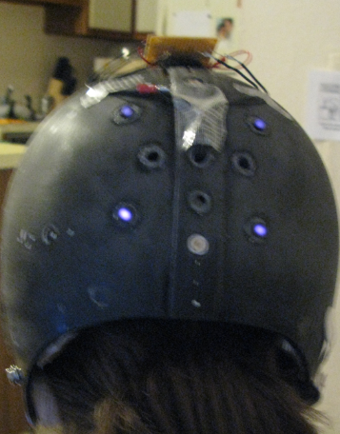
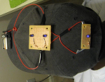
Helmet Considerations
Custom mold would be ideal
Soft cap
Hard cap
Hinged hard cap

Slide 29
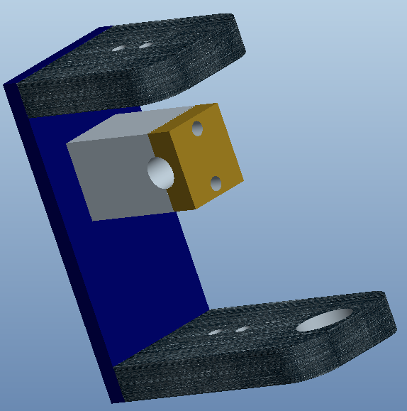
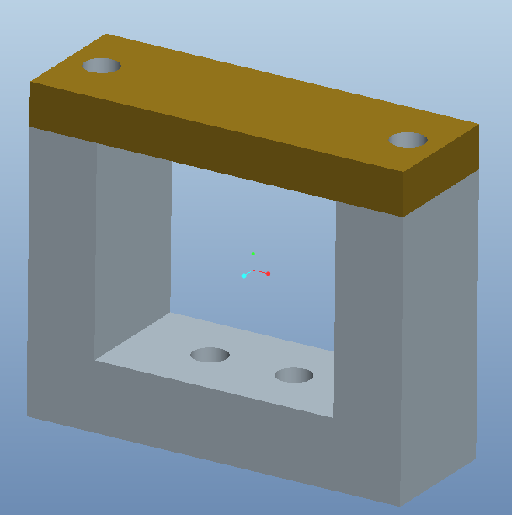
Improvements
Over/Under Bracket w/ Laser and Mounting Hardware
Dual Axis Wii-mote
Clamping Mounts

Slide 30
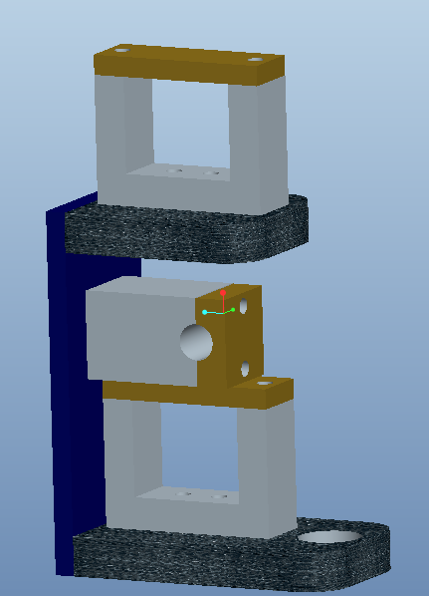
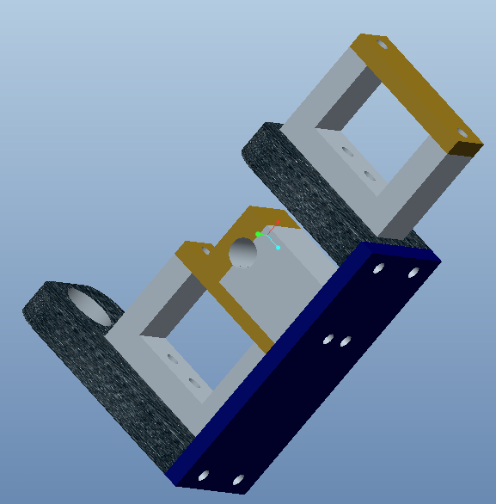
Improvements

Slide 31
Evolution of Design
Healthcare
  Implementation on other body parts
  Rehabilitation
  Therapy
  Fully documented, full body capture
  Robotics
  Multimedia 3-D Viewer Perception
  Animation

Slide 32
Conclusion
Needs established
Low Cost
Portable
Safe
Easy to Use and Maintain
Accurate
Expansion Possibilities

Slide 33
Questions?

