Slide 1
Wii CARE
James Augustin
Benjamin Cole
Daniel Hammer
Trenton J. Johnson
Ricardo Martinez

Slide 2
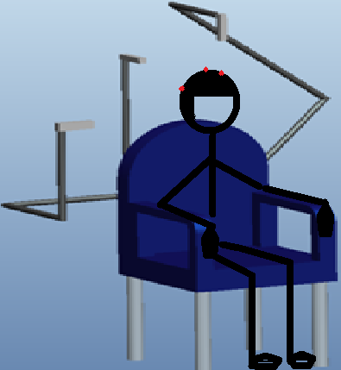
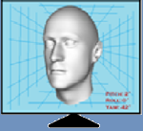
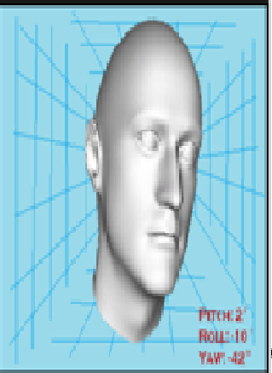
Introduction
Head Tracking Device for Rehabilitation services | Economical tool with more accuracy in quantifying range of motion during rehabilitating cervical exercises for physical therapists Operational Capability Low cost, light-weight, transportable, wireless, storable measurement of cervical range of motion Records patient’s progress and deficiencies 2 degree angular & 2 mm horizontal/vertical error Use in any location with computer system; patient’s home
Technical Approach 3 Wiimote Sensors; 3 - 8 Infrared LED “transmitters” Stabilizing station Bluetooth Data transmission Java coded display 1st Generation Cap with IR LEDs Triangulation 2nd Generation Helmet with sequencing lights 555 timer circuit Stereoscopic Vision | MILESTONE LENGTH DATE COST Generation 1 1.5 months 2/11 $240 Generation 2 1.5 months 4/11 $400 Total available: $2500 Deliverables Operation Manual, Web Page, Final Report (Hard Copy & CD) Sponsor Information HARRIS Corporation, 1025 West NASA Blvd. Melbourne, Florida 32919-0001 Email: jrust@harris.com

Slide 3
Original Scope
Construct easily adaptable LED housing device
Use 2 Wii controllers and luminosity
Portable Wii-controller stands
Low Cost
Ease of use for both patient and physician for rehabilitation exercise

Slide 4
Meeting With Harris
Meeting with John Rust on November 19th
Key Issues brought up:
Sensitivity of Wii controller’s IR camera
How accurate can it determine depth?
How to differentiate the LEDs
More testing with the Wii controllers

Slide 5
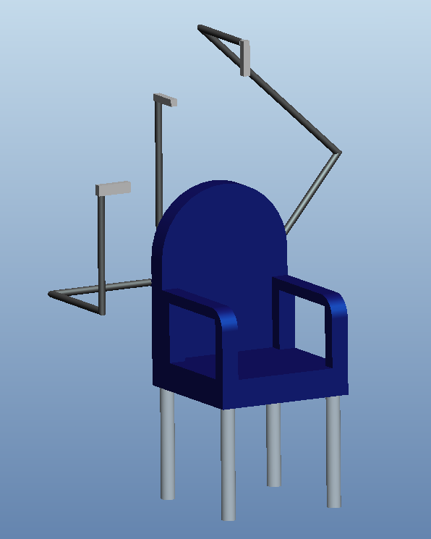
Phase 2 Changes
3 Wii controllers; controller for each axis of motion
Luminosity deemed unsuitable
Wii controllers to be attached to chair

Slide 6
Second Meeting With Harris
Meeting with John Rust and vision expert on December 16th
Design Possibilities:
Stereoscopic Vision
Use epipolar geometry and Least Mean Squares
Hard Surface for LED placement
Blinking LEDs with 5-5-5 timers for higher accuracy

Slide 7
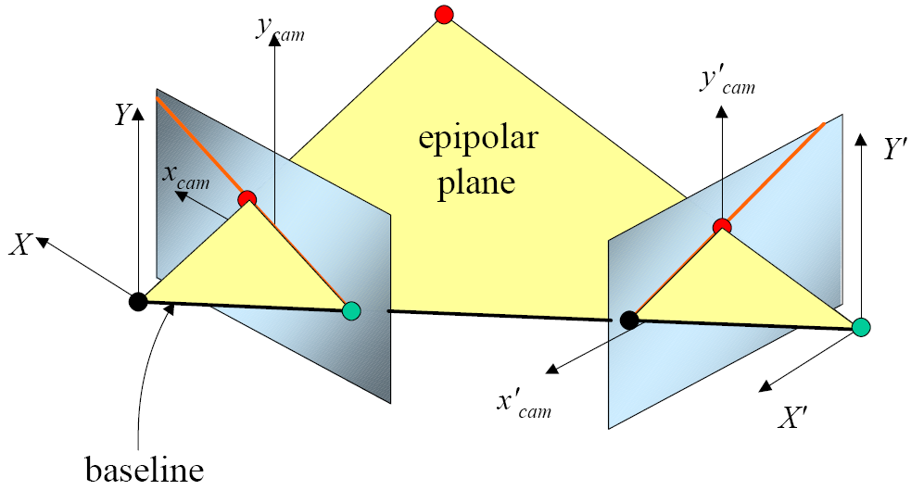
Meeting with Computer Vision Expert
Dr. Xiuwen Liu: Faculty member of Computer Vision Lab at FSU
“An Introduction to 3D Vision”
Epipolar Geometry Algorithms

Slide 8
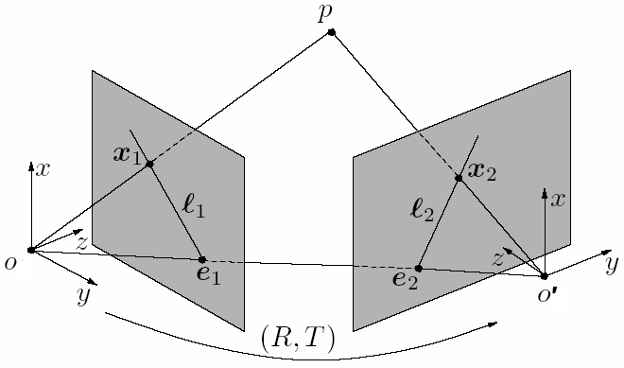
Phase 3 Changes
Specific use for cervical treatment and diagnosis
2 Wii controllers
Stereoscopic vision with epipolar geometry
Helmet with 10 blinking LEDs for accuracy

Slide 9
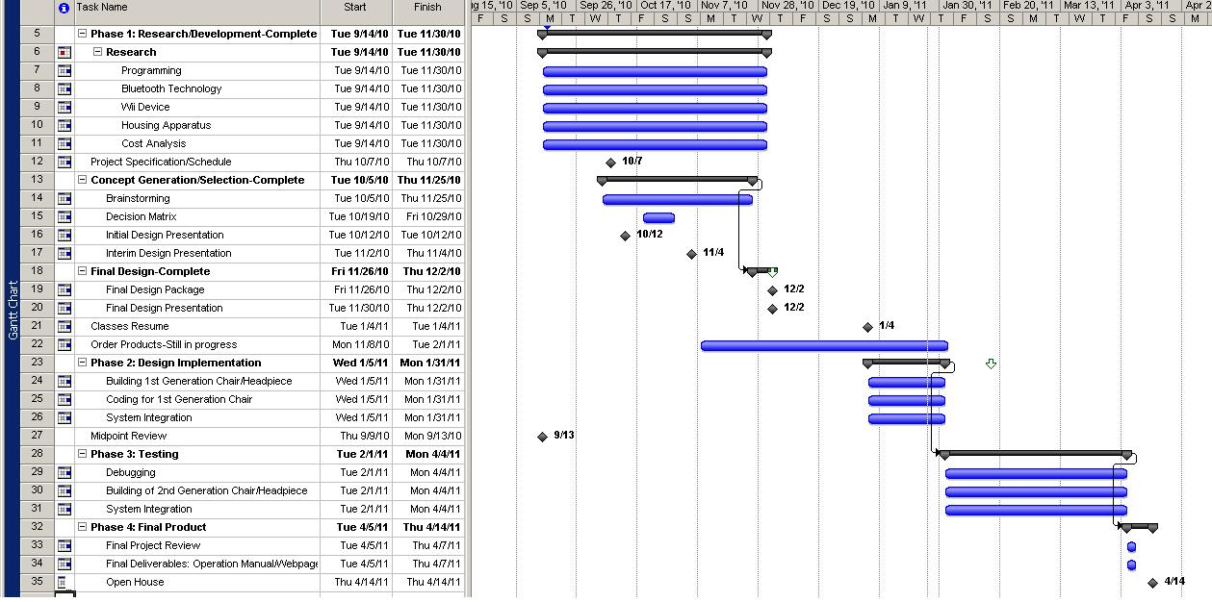
Updated Schedule

Slide 10
Risks
Compatibility issues with the Bluetooth device and drivers
Wii remote controllers interacting with the infrared LEDs in an unexpected manner
Mishaps during the development process
No fully functional code as of yet.

Slide 11
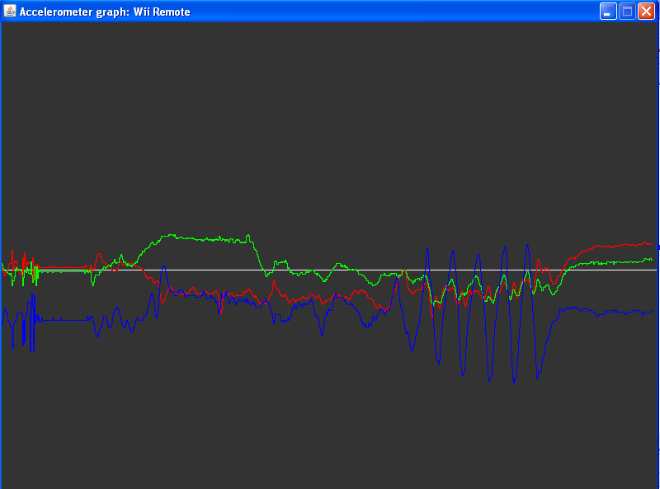
Programming
Java and Bluetooth finally work together.
A test program was used to graphically record the changes in accelerometer data from the Wiimote.

Slide 12
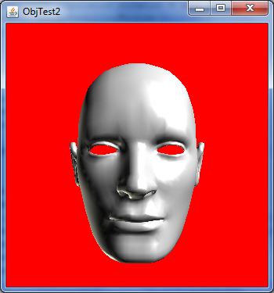
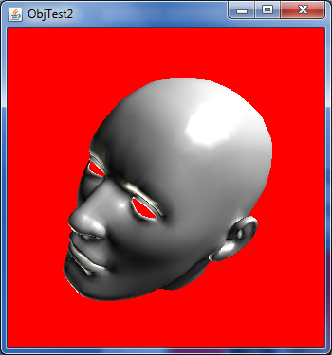
Modeling
The Java 3D library has allowed a virtual head to be manipulated in Java code.

Slide 13
Modeling
The three-dimensional head will respond to changes in the IR data instead of dragging the mouse.

Slide 15
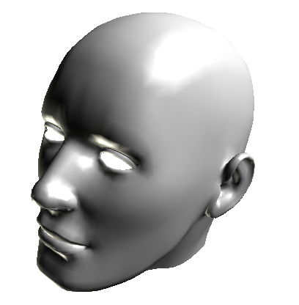
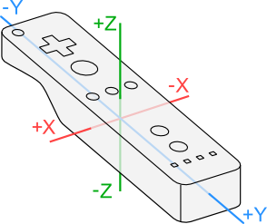
Modeling: Next Step
Develop the code to let the Wiimotes speak to the virtual head.

Slide 16
Meetings
Tyressa Judge: Physical Therapist
Prescription/Determination Angles
John Rust: Design Engineer
Follow-up/Patent
Harris: Vision Team
Follow-up/Debugging
Faculty: Advisors
Follow-up/Submission

Slide 17
Prototype
Headpiece X completed
Chair / in progress
Mounts / in progress
Data Recording X completed
3D Visual X completed
Communication / in progress
Testing - starts Feb 1st
Re-analysis - starts Feb 1st

Slide 18
2nd Generation
Headpiece / in progress
Timer / in progress
Vision Housing - starts Feb 7th
Data Recording - starts Feb 7th
Testing - starts March 1st
Final Modifications - starts March 1st
Patent Discussions - starts March 1st
Submission - April 1st

